Slide 1

Predicting Student Success and Financial
Outcomes in Higher Education
Yiting Wang | Chutian Gong | Aneesh Ojha | Kuntal | Zheng
ECE143 Programming for Data Analysis | December 5, 2025

Slide 2
Contents
Introduction: Motivation, Dataset
Methodology: Pre-Processing, Modeling Approach
Results
Visualizations
Insights
References

Slide 3
Introduction

Slide 4
Motivation
The Investment Gap:
  Higher education is one of the largest lifetime financial investments, yet students often lack data-driven insights on ROI.
Key Questions:
  Which institutional factors actually predict completion rates?
  How do specific university characteristics affect post-grad earnings and debt?
Our Goal:
  To analyze the U.S. Dept. of Education College Scorecard dataset to uncover the hidden drivers of student success.

Slide 5
Dataset: College Scorecard
Source: U.S. Department of Education
Coverage: Over 6,000 U.S. postsecondary institutions, spanning 1996–present
Purpose: Improve transparency around college costs, outcomes, & institutional performance.
Key Features:
Institutional characteristics (location, size, type, admission rates)
Cost and financial aid information
Student demographics
Completion and retention rates
Post-graduation outcomes (median earnings, employment rates)
Student debt levels
Widely used for education analytics, economic mobility research, and data-driven college comparison tools.

Slide 6
Methodology

Slide 7




Data Preprocessing Pipeline
Data Integration
28 annual CSV files loaded
Year extraction from filenames
Merged dataset: 196,163 records
Data Cleaning
21 columns type conversion
Net price consolidation
Removed 6 high-missing columns
Quality validation
Data Filtering
Removed institutions <100 students
Filtered for outcome data completeness
Final: 133,642 × 19 columns
Feature Engineering
5 derived features (ROI, ratios)
Log transformation (earnings, cost, debt)
One-hot encoding
Final: 67 features

Slide 8
Modeling Approach
Random Forest Regression (Prediction)
Goal: Predict 10-year ROI with
Key Methods: GroupKFold CV + RandomizedSearchCV (40 iterations)
Multiple Linear Regression (Interpretation)
Goal: Understand directional relationships between features and outcomes
Key Methods: Standard scaling, Log-transformations, Group-aware train-test split
Subgroup Models (Comparative Analysis)
Goal: Compare predictability: Public vs Private, Large vs Small, Regional differences
Key Methods: Group-aware splitting, median imputation, log-transformation
Metrics Applied: R², MAE, RMSE, subgroup performance comparisons

Slide 9
Results

Slide 10
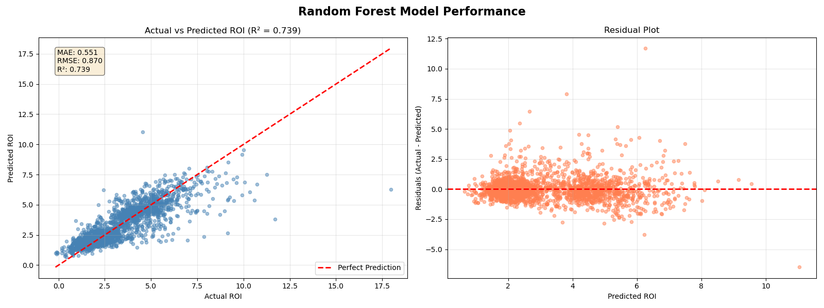
Random Forest Performance

Slide 11
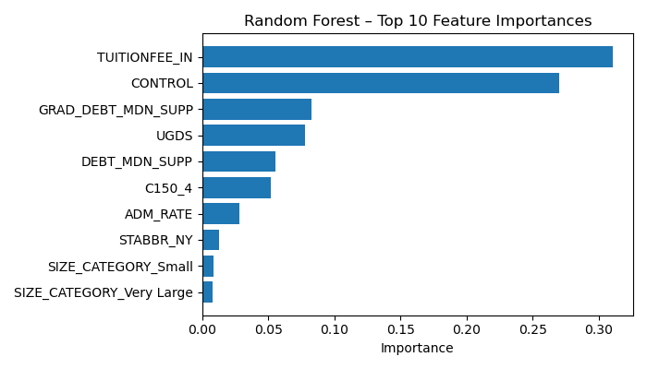
Feature Importances

Slide 12
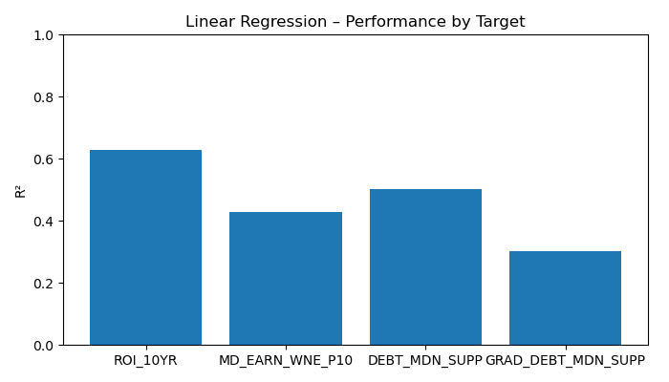
Multiple Linear Regression

Slide 13
Visualizations

Slide 14
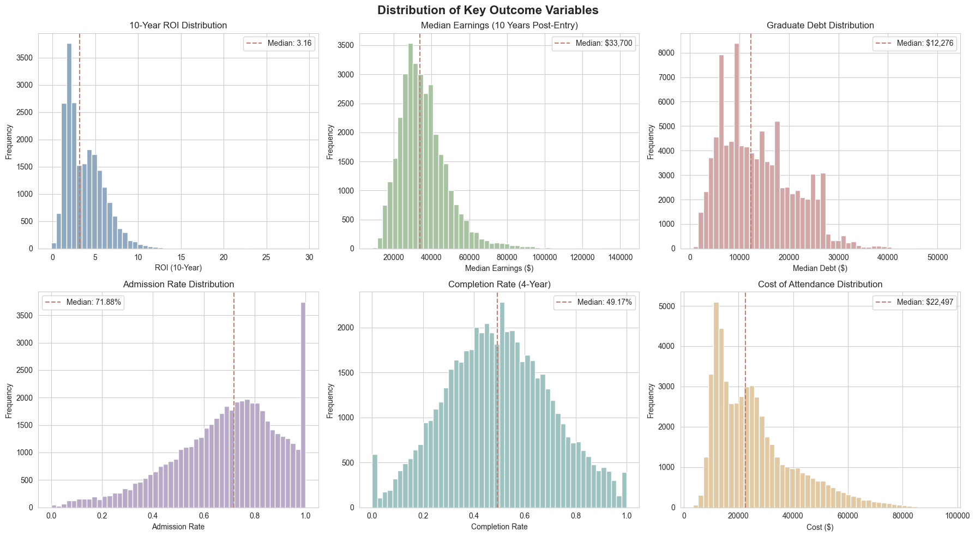
Key Variables Distribution

Slide 15
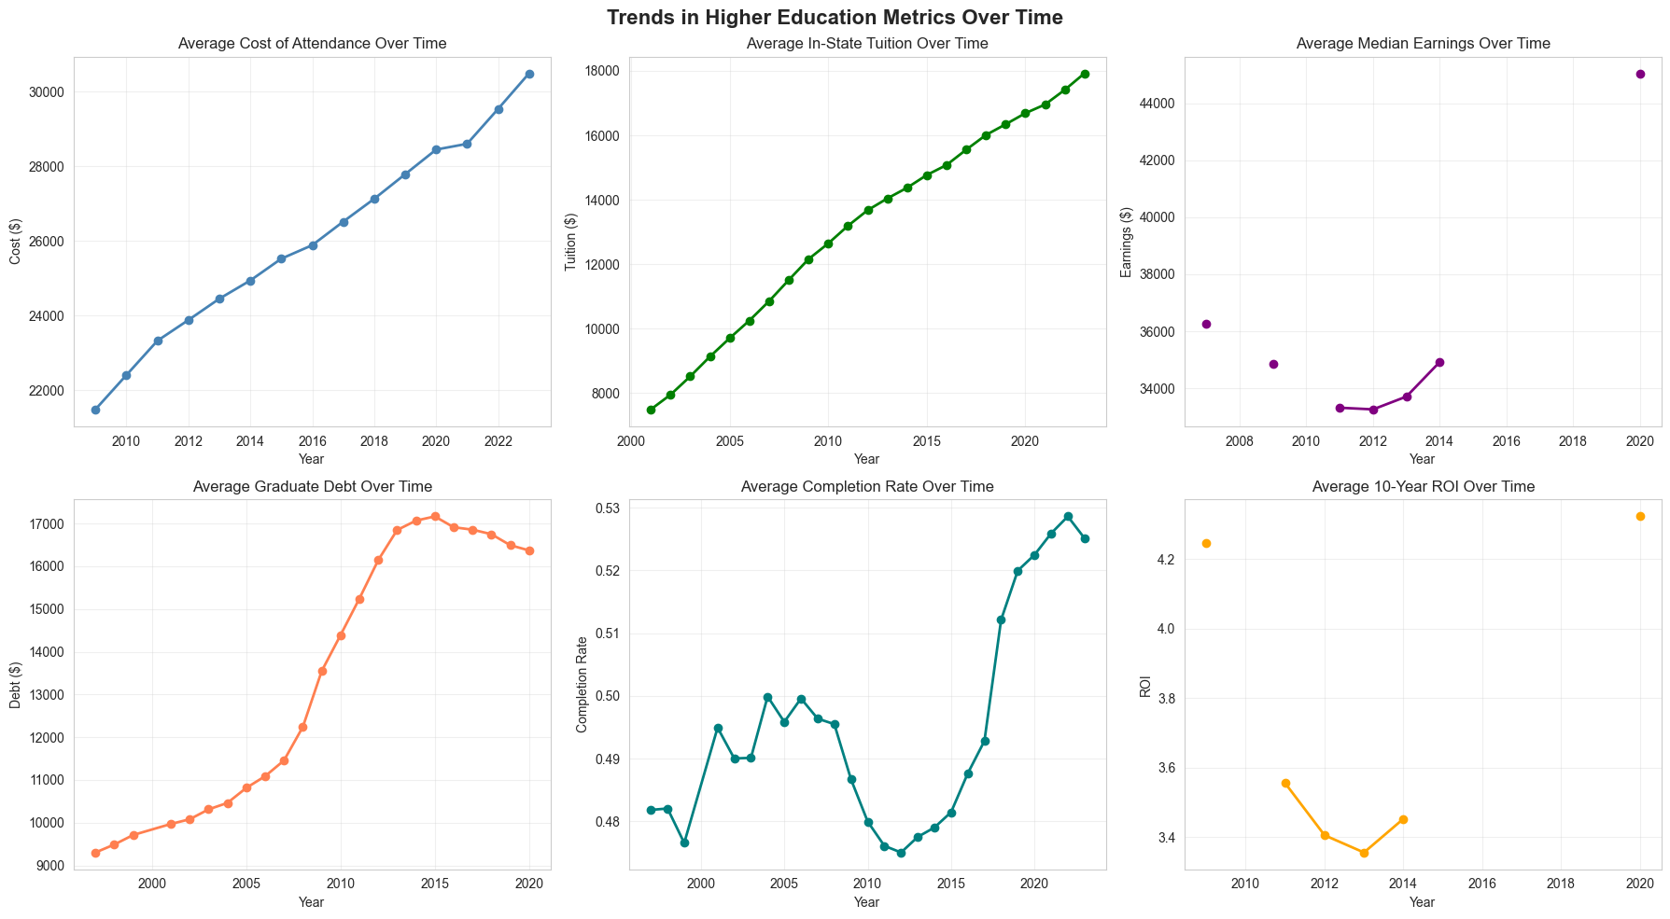
Trends Over Time

Slide 16
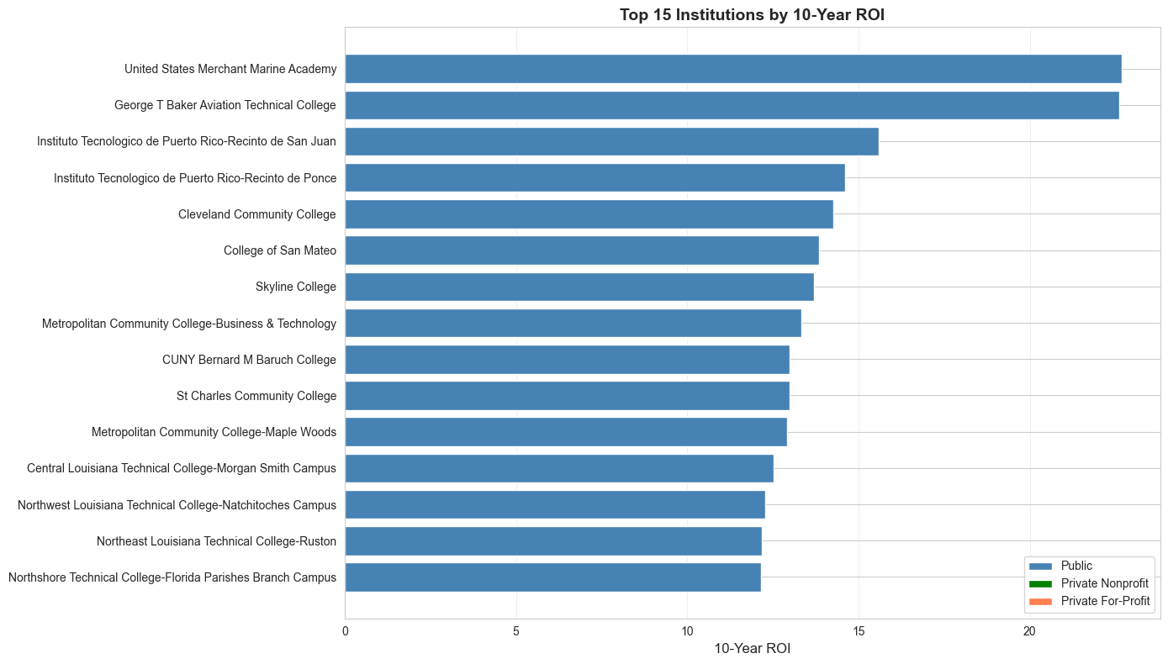
Top Performers

Slide 17
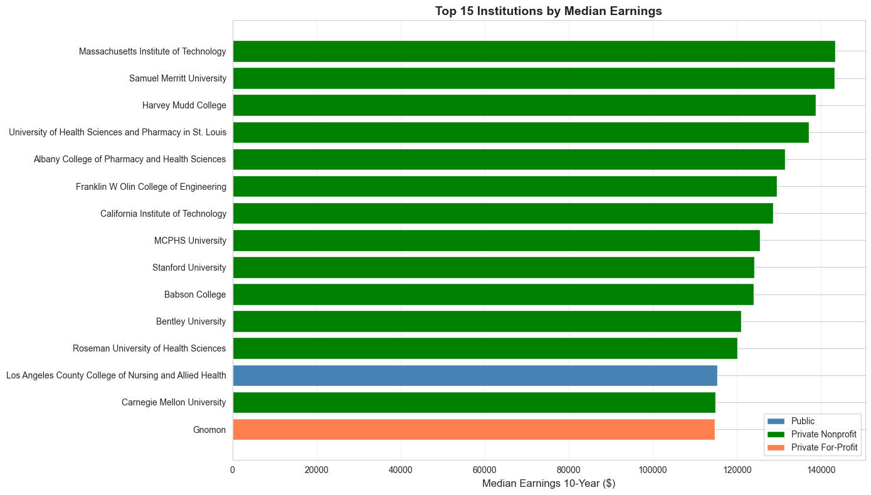
Top Performers

Slide 18
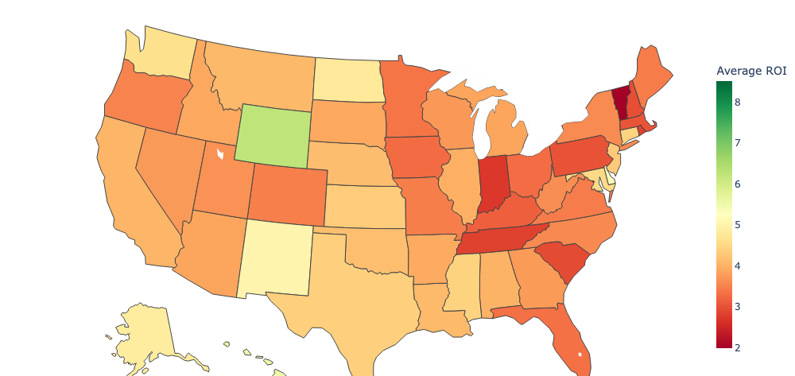
Geographic analysis

Slide 19
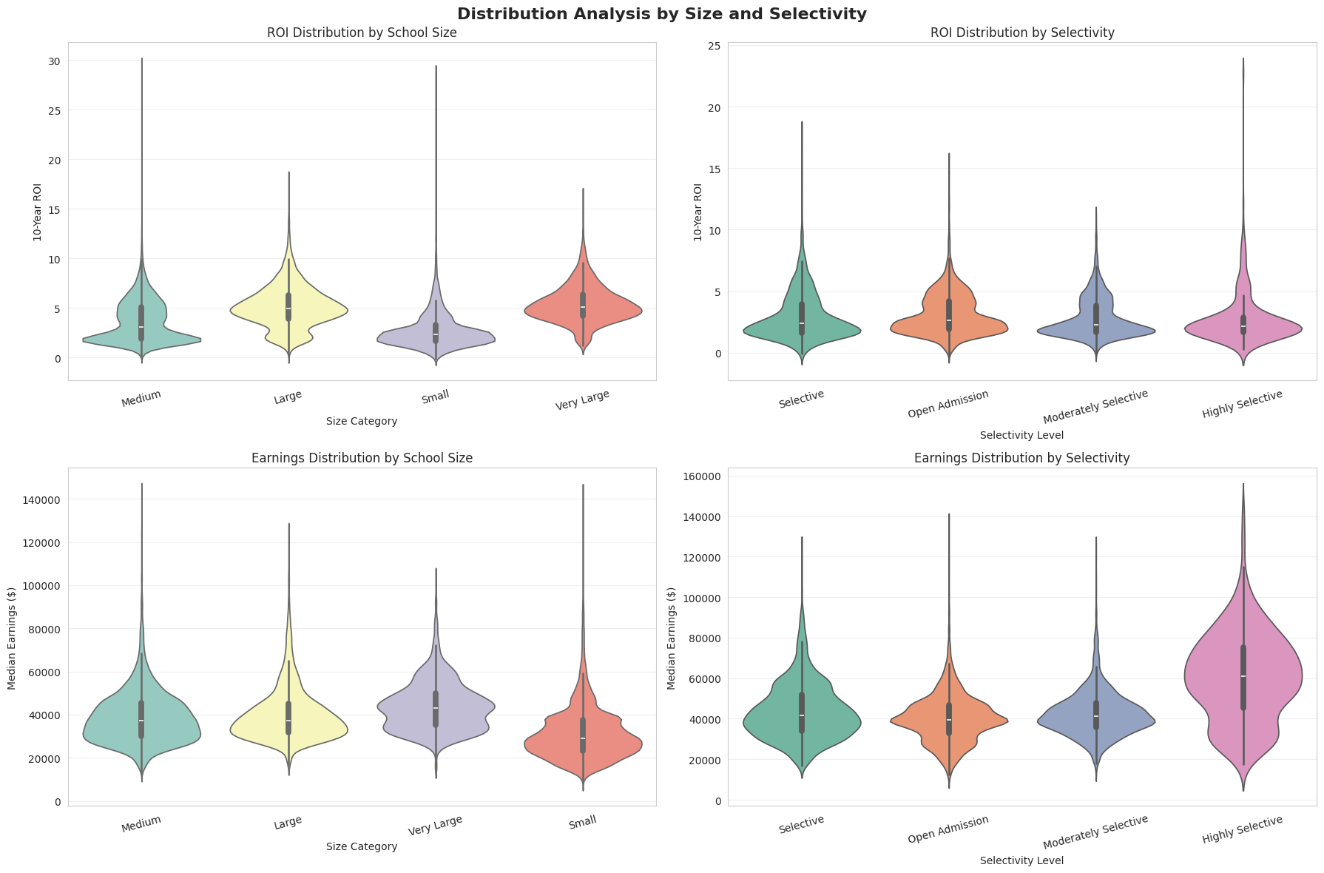
Institution size & selectivity

Slide 20
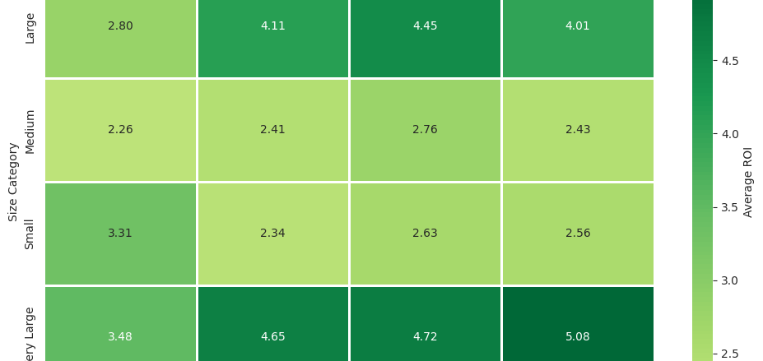
Institution size and selectivity

Slide 21
Insights

Slide 22
Key Findings
Tuition is the Dominant Driver of ROI
Tuition + institution type explain 58% of predictive power
Strong negative correlation: Higher cost ⇒ Lower ROI
ROI drops sharply across tuition quartiles despite higher earnings at expensive schools
2. Public Institutions Deliver the Highest ROI
Public schools have highest ROI, lowest tuition, and lower debt
All Top 20 ROI institutions are public
Private nonprofit and for-profit schools show significantly lower ROI
3. Geography Strongly Influences Earnings
State is the #1 predictor of future earnings (Linear Regression)
Highest-ROI states: NY, CA, NJ
Lowest-ROI regions: PR, VI, MS, AL
4. Selectivity Does Not Predict ROI
Highly selective schools have higher earnings but much higher costs
Moderately selective institutions provide the best ROI balance

Slide 23
References
U.S. Department of Education. (2024). College Scorecard Data Documentation. Retrieved from https://collegescorecard.ed.gov/data/
Bastedo, M. N., & Jaquette, O. (2011). Running in place: Low-income students and the dynamics of higher education stratification. Educational Evaluation and Policy Analysis, 33(3), 318-339.
Chetty, R., Friedman, J. N., Saez, E., Turner, N., & Yagan, D. (2020). Income segregation and intergenerational mobility across colleges in the United States.
The Quarterly Journal of Economics, 135(3), 1567-1633.
Dale, S. B., & Krueger, A. B. (2014). Estimating the effects of college characteristics over the career using administrative earnings data. Journal of Human Resources, 49(2), 323-358.
Scikit-learn Documentation. (2024). Machine Learning in Python.
Retrieved from https://scikit-learn.org/

Slide 24
THANK YOU

