Slide 1
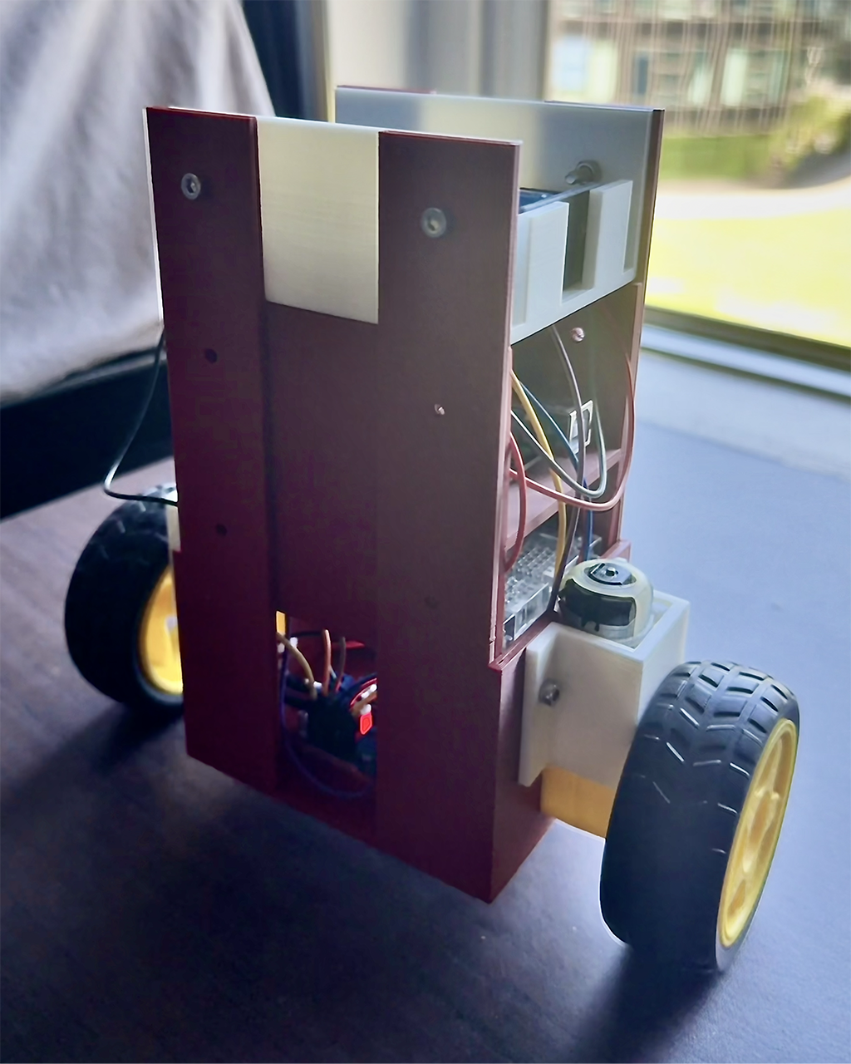
Design a Robot with Balancing Ability and Self-controllability
Team:
Members:
Box3
Zhihao Lin (u8175491@anu.edu.au)
Zongjun Yang (u8463895@anu.edu.au)

Slide 2
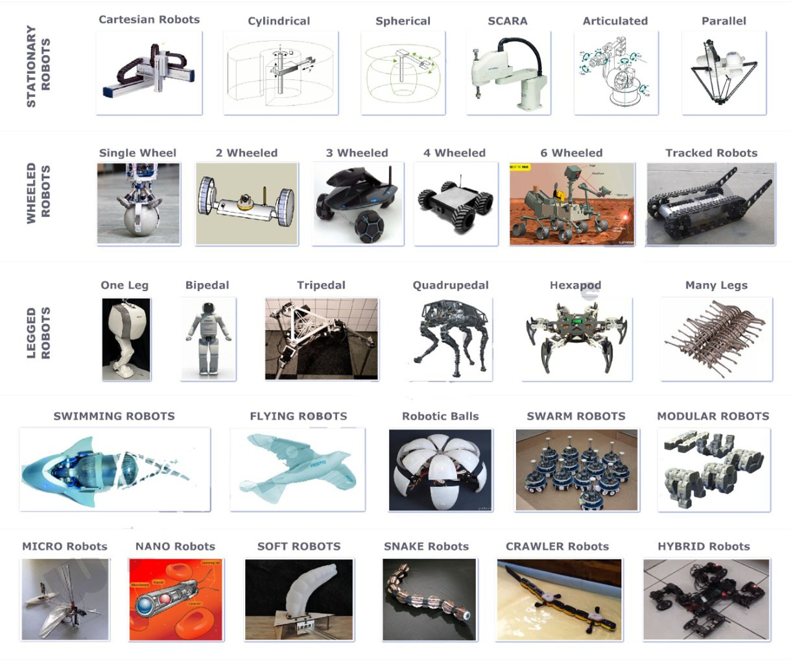
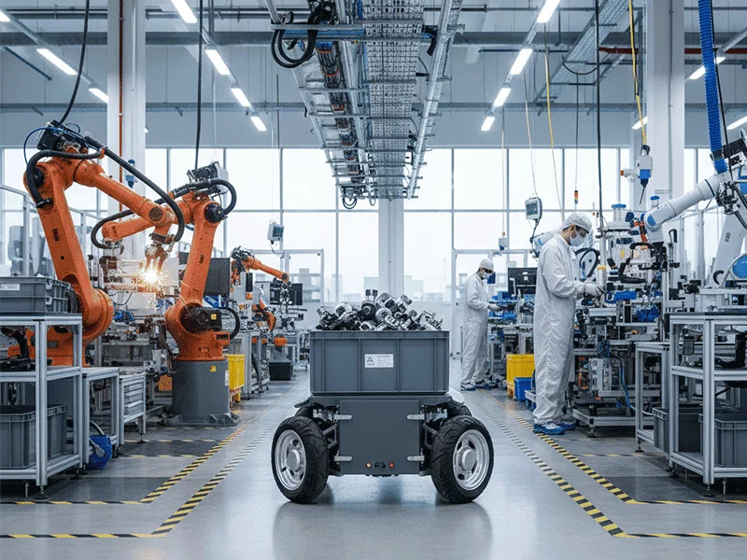
Background
Industry robots [1]
Types of robots [2]
Requirements Review
Top-level requirements
Maintain its balanced state
Drift less than 0.5m in 1s
Recover from 15° perturbation within 2s
Advanced requirements
Fully control its state
Follow a designated path
Dynamically adapt to varying environments

Slide 3
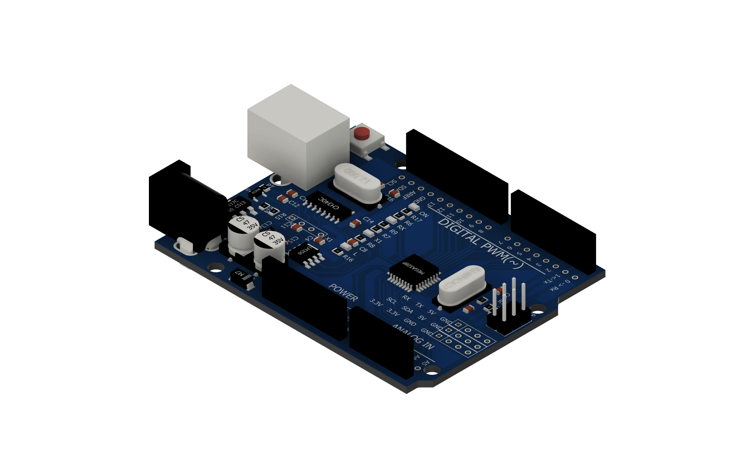
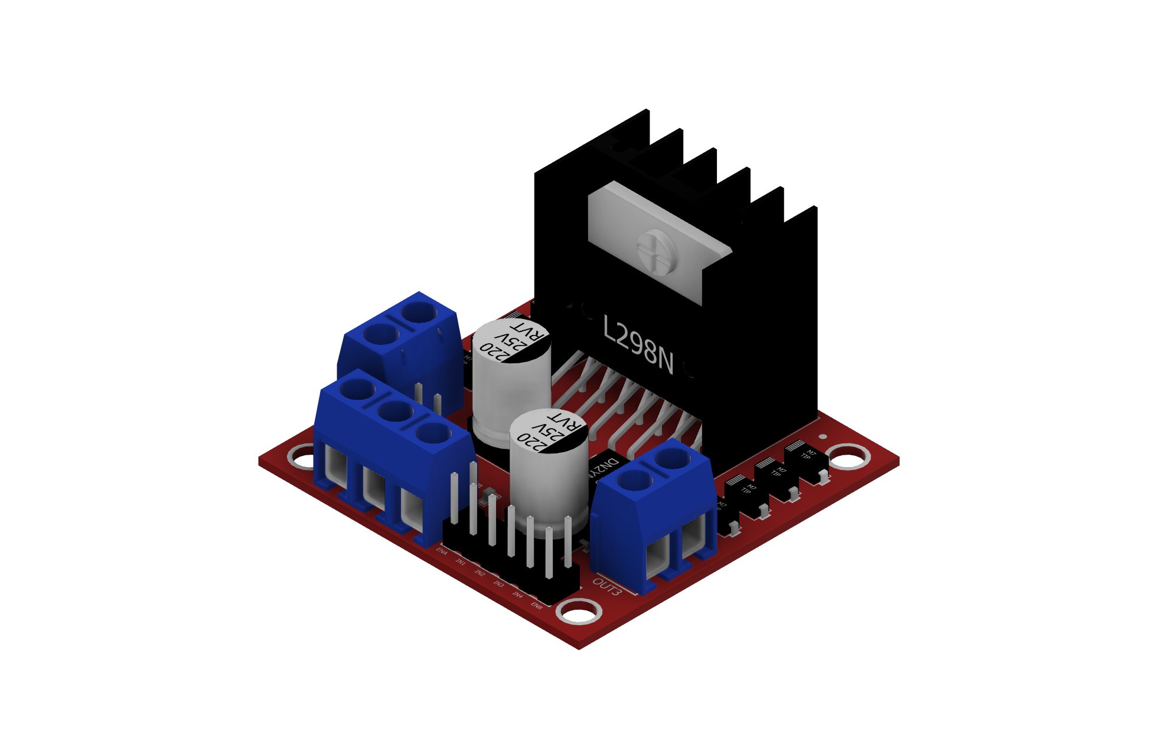
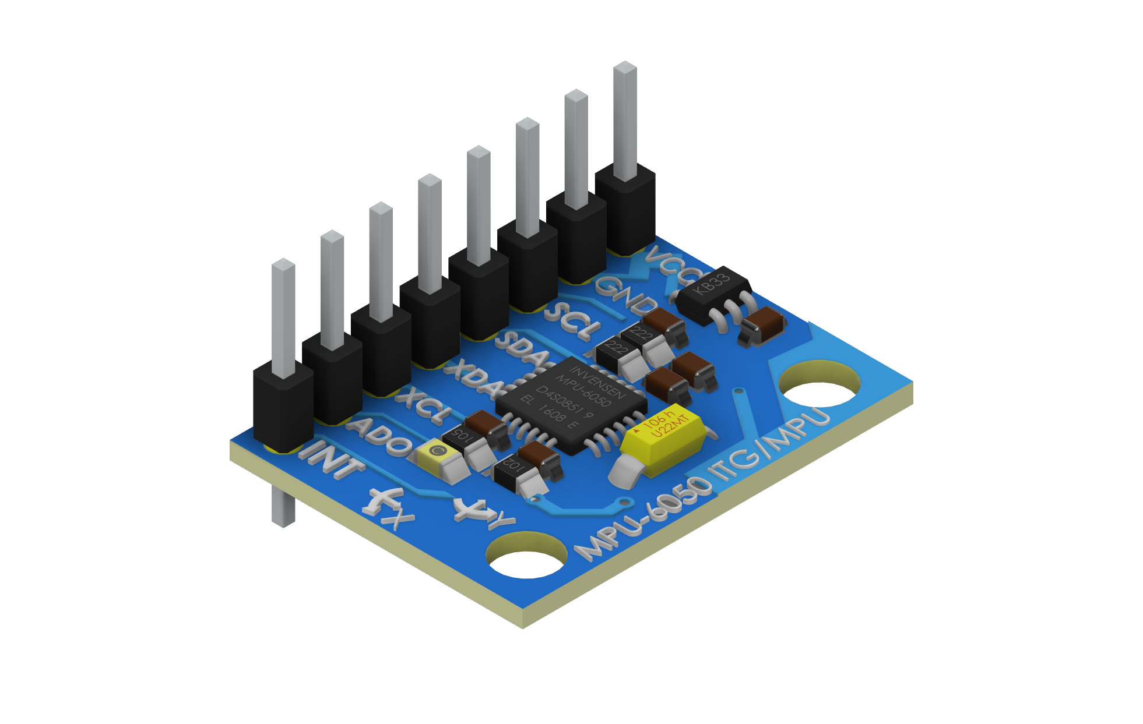
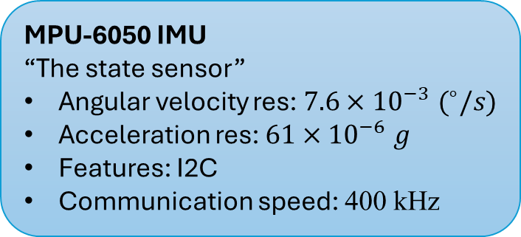
System Architecture
Electronic Components
MPU-6050 IMU
“The state sensor”
Angular velocity res: $7.6×{10}^{−3} (^{∘}/s)$
Acceleration res: $61×{10}^{−6} g$
Features: I2C
Communication speed: 400 kHz
Arduino UNO
“The central processor”
Clocking speed: 16 MHz
Features: I2C, PWM
L298N motor driver
“The action driver”
Power output: 3.2 - 40 V
Features: PWM
Li-ion cell
“The power supply”
Capacity: 800 mAh
Nominal voltage: 3.7 V

Slide 4

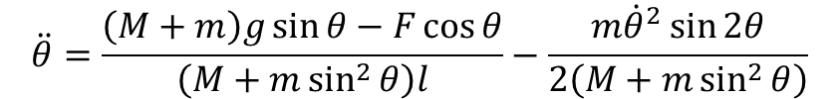
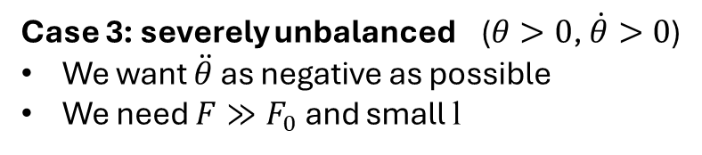
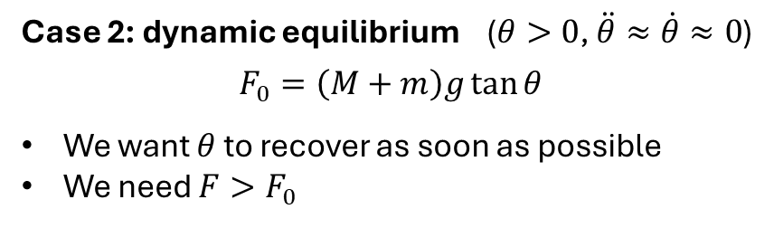
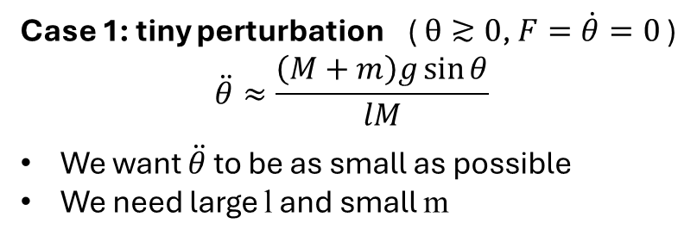

Mechanical Design: Physical Model
Case 1: tiny perturbation ( $θ≳0$, $F=\dot{θ}=0$ )
$$\ddot{θ}≈\frac{\left(M+m\right)g\sin{θ}}{lM}$$
We want $\ddot{θ}$ to be as small as possible
We need large l and small m
Case 2: dynamic equilibrium ($θ>0$, $\ddot{θ}≈\dot{θ}≈0$)
$$F_{0}=\left(M+m\right)g\tan{θ}$$
We want $θ$ to recover as soon as possible
We need $F>F_{0}$
Use Lagrangian mechanics:
$$L=\frac{1}{2}M{\dot{x}}^{2}+\frac{1}{2}m\left[{\left(\dot{x}+l\dot{θ}\cos{θ}\right)}^{2}+{\left(l\dot{θ}\sin{θ}\right)}^{2}\right]−mgl\cos{θ}$$
$$\frac{d}{dt}\frac{∂L}{∂\dot{x}}−\frac{∂L}{∂x}=F$$
$$\frac{d}{dt}\frac{∂L}{∂\dot{θ}}−\frac{∂L}{∂θ}=0$$
Case 3: severely unbalanced ($θ>0$, $\dot{θ}>0$)
We want $\ddot{θ}$ as negative as possible
We need $F≫F_{0}$ and small l
$$\ddot{θ}=\frac{\left(M+m\right)g\sin{θ}−F\cos{θ}}{\left(M+m\sin^{2}{θ}\right)l}−\frac{m{\dot{θ}}^{2}\sin{2θ}}{2\left(M+m\sin^{2}{θ}\right)}$$

Slide 5


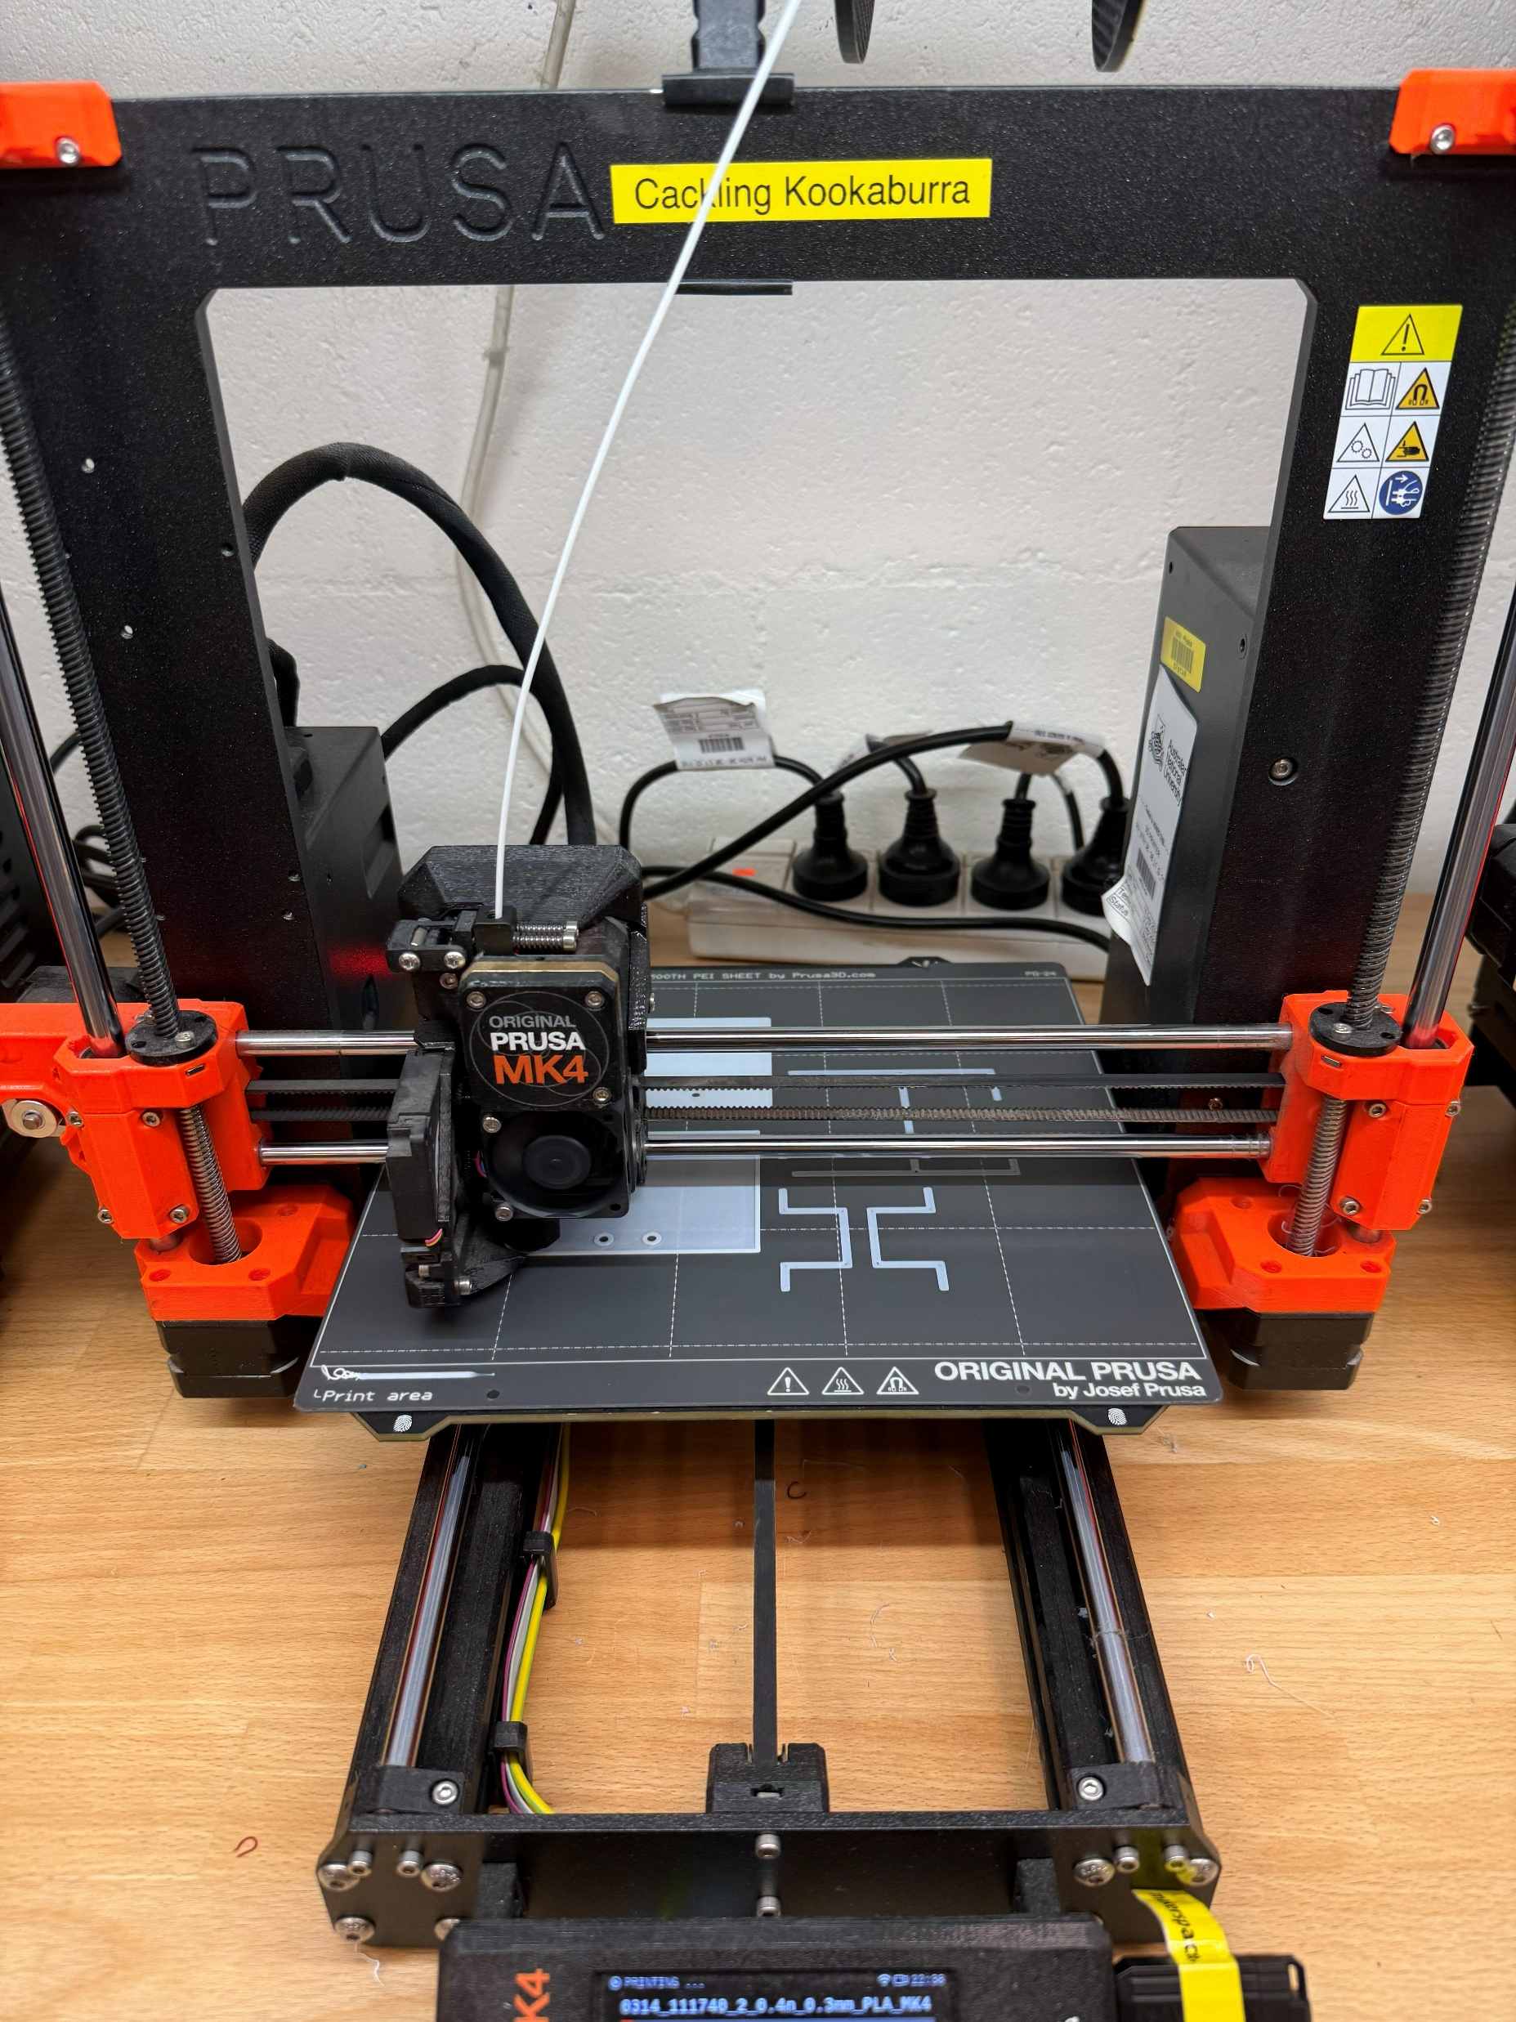
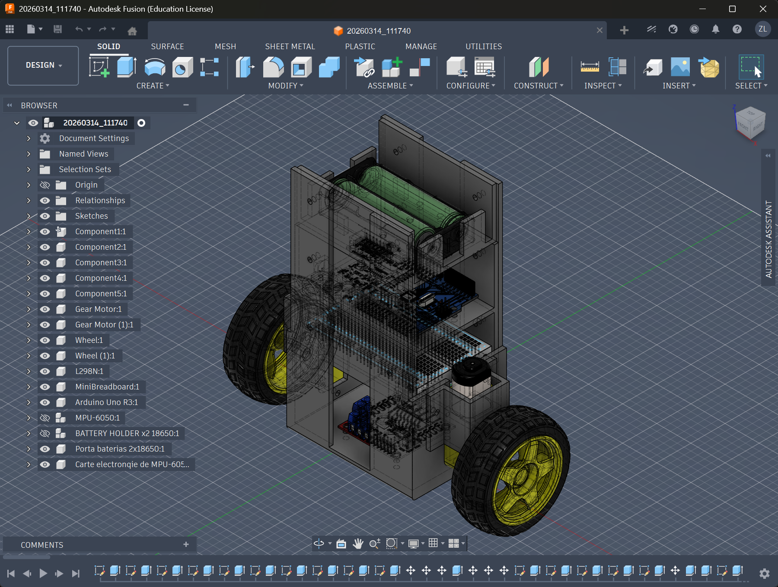
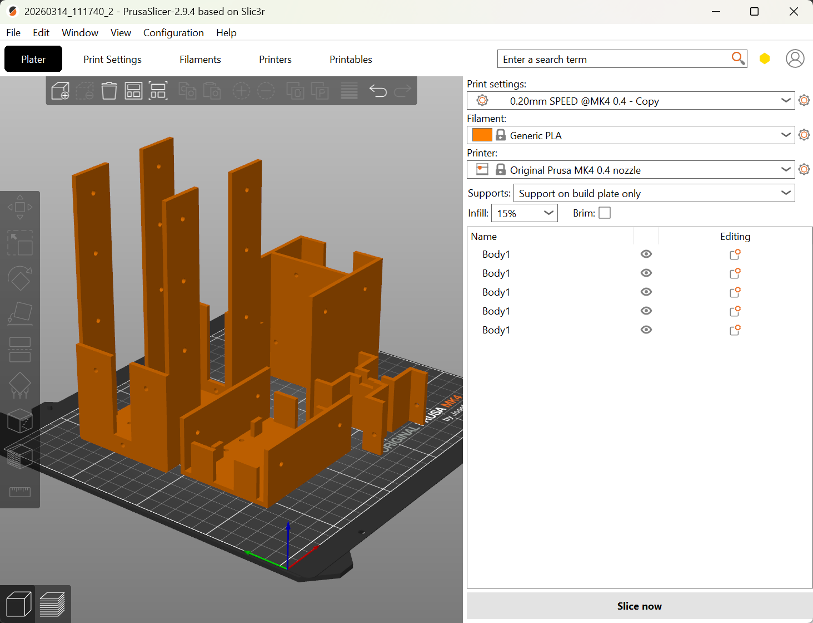
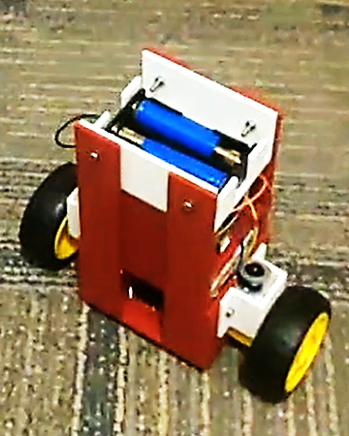
Mechanical Design: Chassis and Assemble

Slide 6
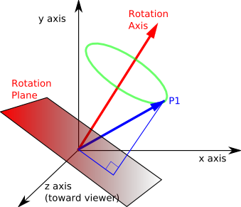
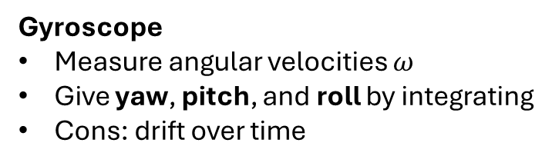

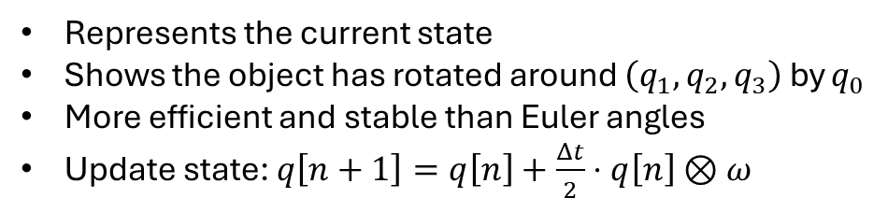
Signal Processing: IMU
Sensor Fusion
Quaternion
Gyroscope
Measure angular velocities $ω$
Give yaw, pitch, and roll by integrating
Cons: drift over time
$$q=\left[q_{0},q_{1},q_{2},q_{3}\right]$$
Represents the current state
Shows the object has rotated around $\left(q_{1},q_{2},q_{3}\right)$ by $q_{0}$
More efficient and stable than Euler angles
Update state: $q\left[n+1\right]=q\left[n\right]+\frac{Δt}{2}⋅q\left[n\right]⊗ω$
Accelerometer
Measure accelerations
Determine pitch and roll from gravity direction
Cons: noisy
Magnetometer
Measure magnetic field
Determine yaw from Earth’s magnetic field
Cons: easily disturbed
Fusion
Complementary Filter
Mahony Filter
…
Quaternions [3]

Slide 7

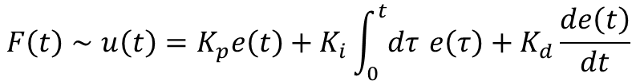
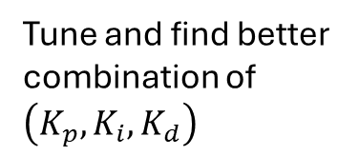

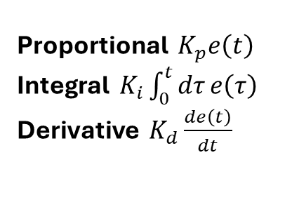

Signal Processing: PID Controller
Error term e(t): difference between the current state S(t) and the desired state $s_{0}$
Output u(t): used to drive the current state toward the desired state
$$F\left(t\right)∼u\left(t\right)=K_{p}e\left(t\right)+K_{i}\int_{0}^{t}{dτ} e\left(τ\right)+K_{d}\frac{de\left(t\right)}{dt}$$
Proportional $K_{p}e\left(t\right)$
Integral $K_{i}\int_{0}^{t}{dτ}e\left(τ\right)$
Derivative $K_{d}\frac{de\left(t\right)}{dt}$
the larger the error is, the large the output is to restore the state
the longer the error persists, the large the output is to further restore the state
the faster the error decreases, the smaller the output is to reduce oscillation
Tune and find better combination of $\left(K_{p},K_{i},K_{d}\right)$
Tune $s_{0}$ and $K_{p}$
Tune $K_{d}$
Tune $K_{i}$

Slide 8
Control Logic
Read States
Calculate pitch, yaw, …
Calculate acceleration in the world frame
…
Feedback Control
Calculate the output of PID controller
Use other feedback logics
…
Check States
Determine whether the pitch is recoverable
Estimate the perturbation
…
Take Action
Further adjust the controller output
Control the motors
…

Slide 9
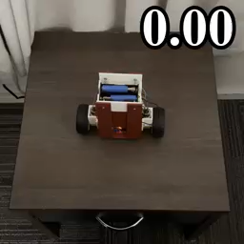
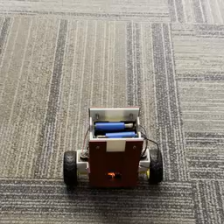
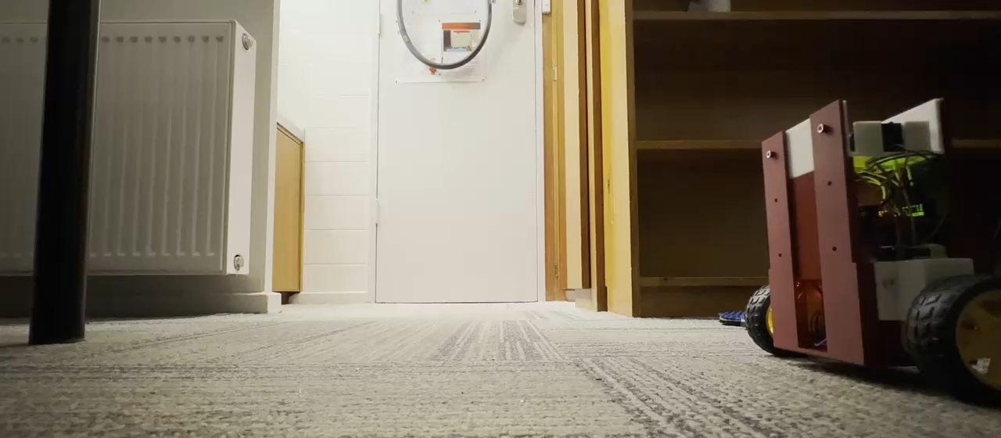
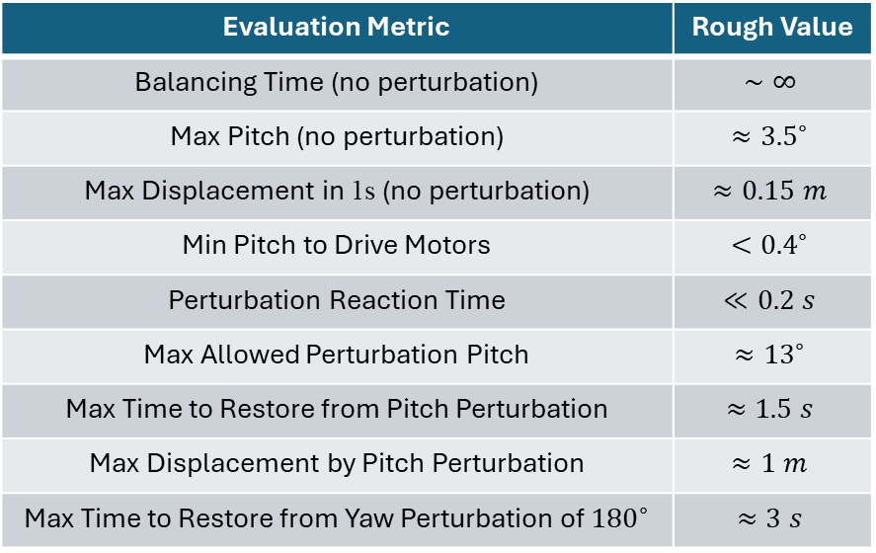
Current Progress
Evaluation Metric | Rough Value
Balancing Time (no perturbation) | $$∼∞$$
Max Pitch (no perturbation) | $$≈{3.5}^{∘}$$
Max Displacement in 1s (no perturbation) | $$≈0.15 m$$
Min Pitch to Drive Motors | $$<{0.4}^{∘}$$
Perturbation Reaction Time | $$≪0.2 s$$
Max Allowed Perturbation Pitch | $$≈{13}^{∘}$$
Max Time to Restore from Pitch Perturbation | $$≈1.5 s$$
Max Displacement by Pitch Perturbation | $$≈1 m$$
Max Time to Restore from Yaw Perturbation of ${180}^{∘}$ | $$≈3 s$$

Slide 10
Project Management
Phase 1 (Week 7-8):
Phase 2 (Week 9-11):
Phase 3 (Week 12):
Improve the locking skill and motion skill
Develop the adaption skill and resurrection skill
Do the final improvements based on the tests

Slide 11
Thank you for listening!
References
[1] Wang, A., & Wang, A. (2026, January 27). Autonomous Mobile Robot (AMR) applications by industry. Fdata Robot. https://www.fdatabot.com/autonomous-mobile-robot-amr-applications-by-industry/
[2] Arvindpdmn, J. R. C. (2022, May 23). Mobile robot. Devopedia. https://devopedia.org/mobile-robot
[3] Quaternions. (n.d.). https://ece.montana.edu/seniordesign/archive/SP14/UnderwaterNavigation/Quaternions.html

