Slide 1
Project: Advanced Computer Architecture
Klaas Meersman – Daan Vercammen

Slide 2
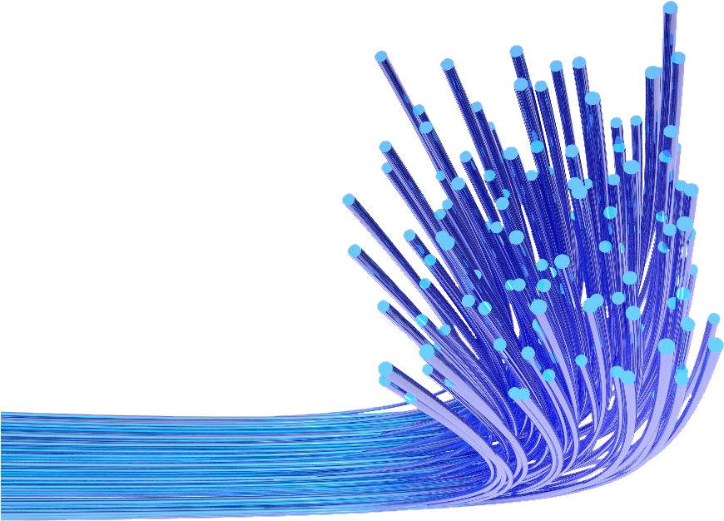
The problem
Simulating light propagation in optical fibers is computationally expensive, especially with realistic sources like LEDs emitting millions of rays
Each ray must be traced as it reflects multiple times inside the fiber
Our goal: Efficiently simulate and analyze the distribution of rays at the fiber exit

Slide 3
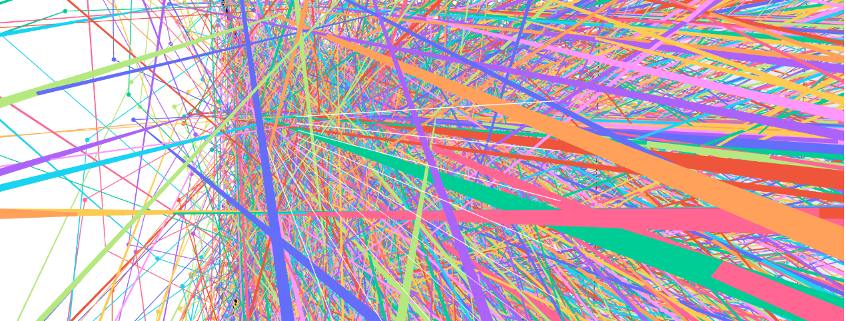
Why Use a GPU
Each ray is independent
CPUs have limited cores; GPUs can run thousands of threads simultaneously
This parallelism enables us to simulate millions of rays in a fraction of the time

Slide 4
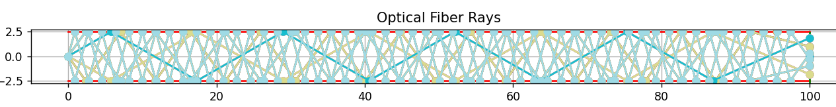
Implementation: 2D
First started with a 2D implementation
Simple triangular geometry
Scalable up to millions of rays

Slide 5
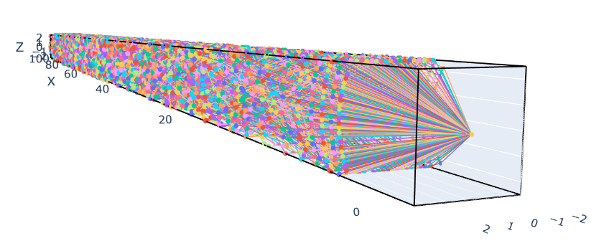
Implementation: 3D
Transferred to 3D to add complexity
Length, width and height of fibre is scalable
Simulations for verification

Slide 6
Implementation: port to GPU
Each GPU thread traces a single ray
Rays initialized with directions matching a Lambertian profile
At each wall collision, direction is updated using geometric optics
Simulation ends when the ray exits the fiber; only exit positions are stored

Slide 7
Optimizations
Both ray initialization and propagation is done on the GPU
Only end points are copied back
Binning rays by initial angle to reduce divergence within GPU warps
Tuned parameters: block size and bin counts
Notes:
Initilaziaton on the GPU, minimizes data transfer, and is also very paralizable
End points copied back: we don’t need the paths, only the endpoint
Binning rays by initial angle: 40% increase (from about 2700 ms to 1700ms)
Used cuRAND for fast, robust random number generation on GPU
Tuned block size and bin count, gave about another 20%

Slide 8
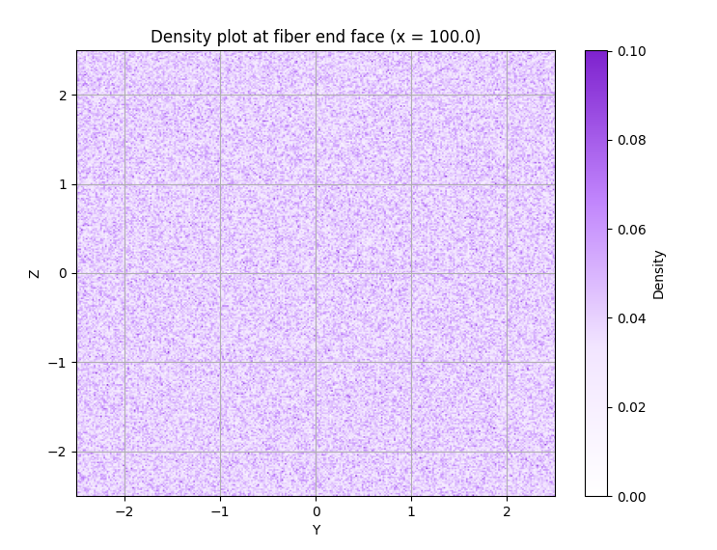
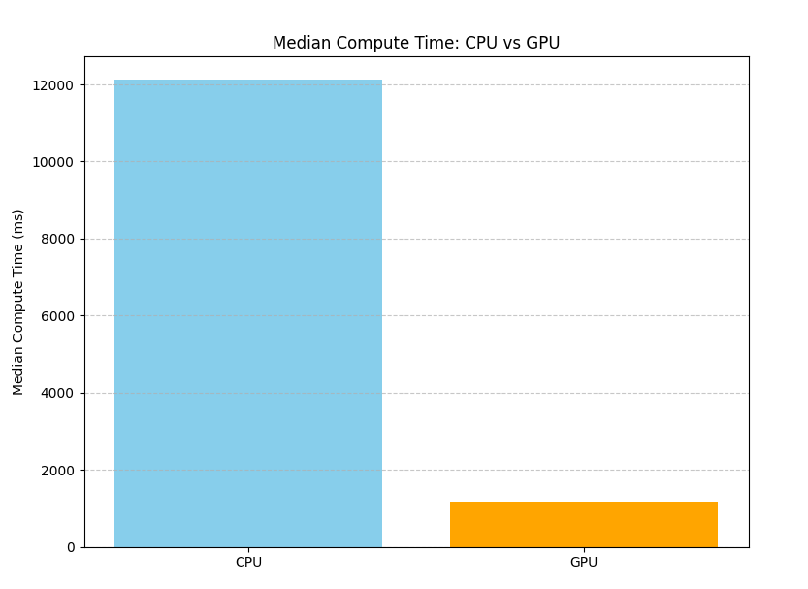
Results
Notes:
Output density is uniform
GPU implementation is about 10 times faster

Slide 9
Possible improvements
Performance
Divergence remains
Use structure-of-arrays
Features
More complex physical phenomena
Dispersion graphs
Notes:
Divergence within bins remains
Each ray is a full object; could optimize with structure-of-arrays.
Currently only geometric optics; could add polarization, wavelength effects, or simulate bent fibers.
Could add dispersion graphs to study signal spread.

Slide 10
Conclusion
GPU acceleration makes large-scale fiber raytracing practical
Achieved major speedup without sacrificing accuracy
There’s room for further optimization and feature expansion

Slide 11
Q&A

Slide 12
Optimizations that didn't work
Implementing streams
Copying only endpoints vs. whole ray object
Striding
Notes:
Streams: overlap data transfer and computation didn’t work.
We expect the ray object to be within minimal object size as the object is quite small.
Striding did not improve performance

