Slide 1
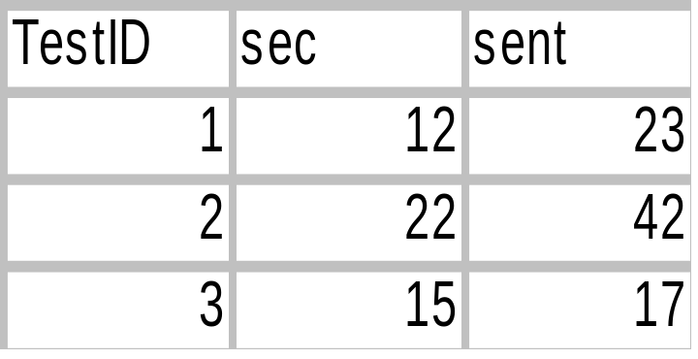
Separate by ;
then cut into
pieces: lead,
middle,
var_name,
end
Create SQL regex
execute and return
TestID,
message
Create SQL regex
execute and return
TestID,
message
Test Duration: {INT sec};
published {INT sent} mios
Merge Tables
final datatable
and temp
datatable
(add col named
var_name)‏
Create regex to
get actual data
out of
'message'
column
Populate temp
DataTable
with returned
Does TestID of temp exist
in final table?
Final Product DataTable
– ready for evaluation
Yes
No
Create new
row with
TestID
Use regex to
get actual data,
put into
final table

