Slide 1



The Component Workload Emulator (CoWorkEr) Utilization Test Suite (CUTS) Overview
James H. Hill
j.hill@vanderbilt.edu
Vanderbilt University
Nashville, TN USA
www.dre.vanderbilt.edu
www.dre.vanderbilt.edu/CUTS
Institute for Software Integrated Systems
Vanderbilt University Nashville, Tennessee

Slide 2
Motivation: Service-Oriented Architectures
Historically, distributed real-time & embedded (DRE) systems were built directly atop OS & protocols
Applications
Operating System & Communication Protocols
Hardware Devices

Slide 3
Motivation: Service-Oriented Architectures
Historically, distributed real-time & embedded (DRE) systems were built directly atop OS & protocols
Applications
Domain-Specific Services
Traditional methods of development have been replaced by middleware layers to reuse architectures & code
  Viewed externally as Service-Oriented Architecture (SOA) Middleware
Service-Oriented Architecture Middleware
Common Services
Distribution Middleware
Infrastructure Middleware
Operating System & Communication Protocols
Hardware Devices

Slide 4
Motivation: Service-Oriented Architectures
Historically, distributed real-time & embedded (DRE) systems were built directly atop OS & protocols
Applications
Domain-Specific Services
Traditional methods of development have been replaced by middleware layers to reuse architectures & code
  Viewed externally as Service-Oriented Architecture (SOA) Middleware
Multi-layer Resource Manager (MLRM)
Common Services
Distribution Middleware
e.g., Multi-layer Resource Manager (MLRM)
  MLRM leverages standards-based SOA middleware to manage computing & communication resources for shipboard computing environments
Infrastructure Middleware
Operating System & Communication Protocols
Hardware Devices

Slide 5
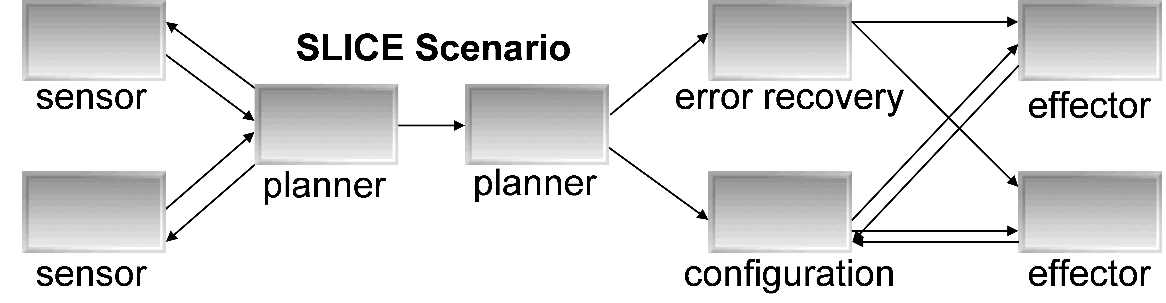
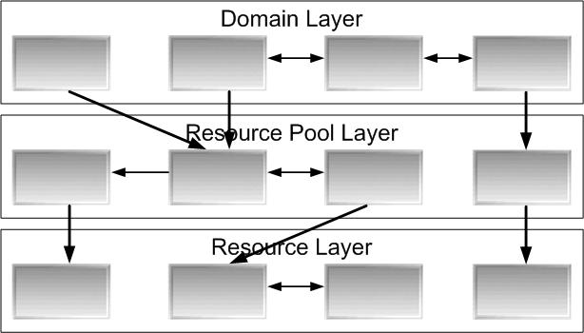
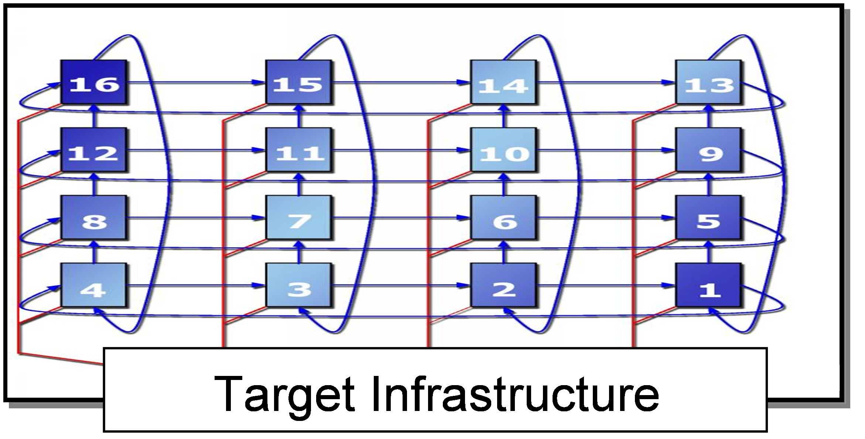
Serialized Phasing in Large-scale Systems (1/2)
System infrastructure components developed first
Application components developed after infrastructure is mature
Level of Abstraction
Development Timeline

Slide 6
Serialized Phasing in Large-scale Systems (2/2)
Finished development
System integration & testing
Integration Surprises!!!
Level of Abstraction
Development Timeline

Slide 7
Complexities of Serialized Phasing
Still in development
Ready for testing
Complexities
System infrastructure cannot be tested adequately until applications are done
Level of Abstraction
Development Timeline

Slide 8
Complexities of Serialized Phasing
Overall performance?
Complexities
System infrastructure cannot be tested adequately until applications are done
Entire system must be deployed & configured properly to meet QoS requirements
Existing evaluation tools do not support “what if” evaluation
Level of Abstraction
Development Timeline
It is hard to address these concerns in processes that use serialized phasing

Slide 9
QoS Concerns with Serialized Phasing
Meet QoS requirements?
Key QoS concerns
Which D&C’s meet the QoS requirements?
Level of Abstraction
Development Timeline

Slide 10
QoS Concerns with Serialized Phasing
Performance metrics?
Key QoS concerns
Which D&C’s meet the QoS requirements?
What is the worse/average/best time for various workloads?
Level of Abstraction
Development Timeline

Slide 11
QoS Concerns with Serialized Phasing
System overload?
Key QoS concerns
Which D&C’s meet the QoS requirements?
What is the worse/average/best time for various workloads?
How much workload can the system handle until its QoS requirements are compromised?
Level of Abstraction
Development Timeline
It is hard to address these concerns in processes that use serialized phasing

Slide 12

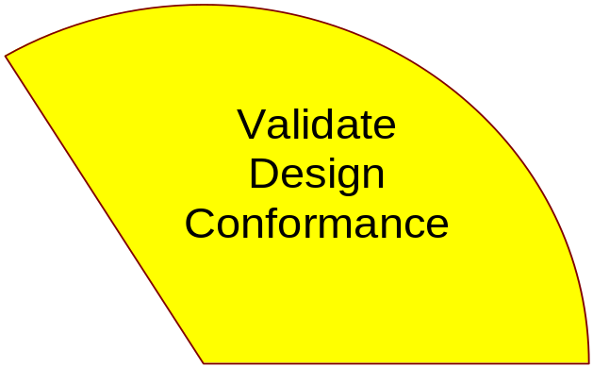


Next Generation System Execution Modeling Tools
Component Workload Emulator (CoWorkEr) Utilization Test Suite (CUTS) Workflow
While target system under development:
  Use a domain-specific modeling language (DSML) to define & validate infrastructure specifications & requirements
  Use DSML to define & validate application specifications & requirements
  Use middleware & MDD tools generate D&C metadata so system conforms to its specifications & requirements
  Use analysis tools to evaluate & verify QoS performance
  Redefine system D&C & repeat
Enables testing on target infrastructure throughout the development lifecycle
http://www.dre.vanderbilt.edu/~hillj/docs/publications/CUTS-RTCSA06.pdf

Slide 13
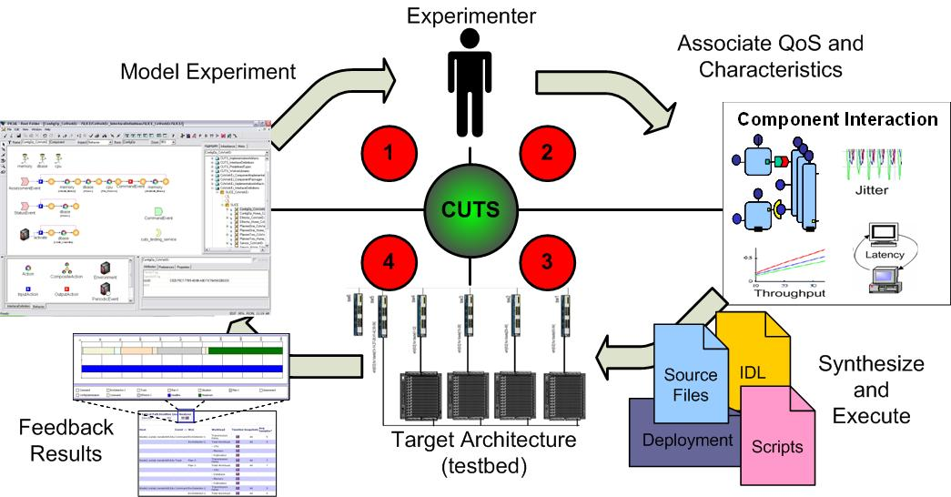
CUTS Workflow & Architecture
Software architects, developers, & systems engineers specify the structure of an enterprise DRE system
They associate the necessary QoS characteristics with individual components (e.g., CPU utilization) or the system as a whole
Tools synthesize emulation code & configuration metadata to deploy the system in the target environment
Metrics are collected & analyzed to explore how design alternatives from multiple computational & valuation perspectives affect system QoS

Slide 14
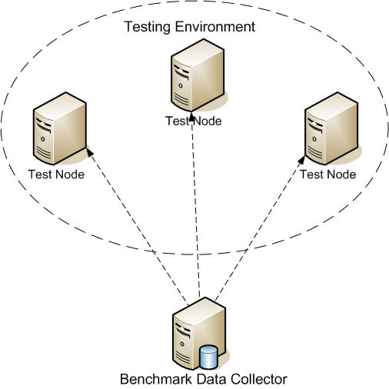
Typical Layout of CUTS
Multiple Test Nodes are isolated inside a Testing Environment
The Test Nodes represent real nodes in the target environment
  i.e., have the same hardware/software configuration
Emulated/real are executed in the Testing Environment
Benchmark Data Collector (BDC) is the test moderator (and a service component) that monitors the emulated/real components in real-time

Slide 15
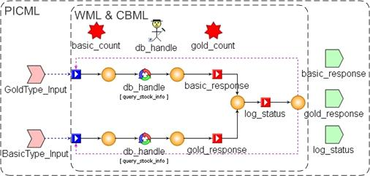
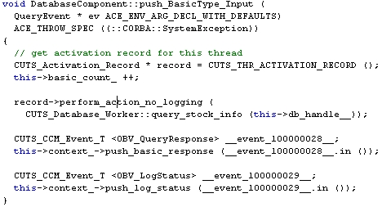
Designing Components for Emulation
Component Behavior Modeling Language (CBML) & Workload Modeling Language (WML) are used to define the behavior & workload, respectively
CBML & WML are stand-alone languages that have been combined with PICML
CBML & WML enhances PICML by enabling structural & behavior specification from a single model
Emulation code for components is generated directly from the enhanced PICML model that conforms to CCM standards

Slide 16

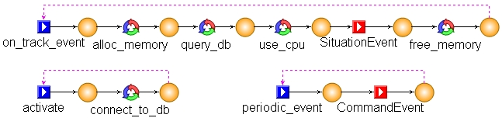
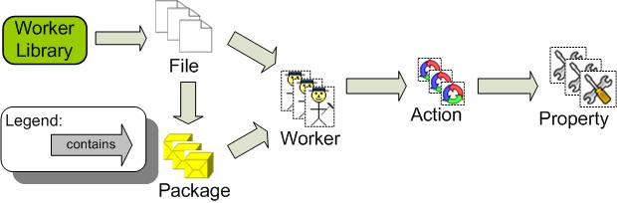
Details of CBML & WML
CBML is an domain-specific modeling language (DSML) based on I/O automata semantics
CBML captures the behavior of components using abstract elements
  i.e., their actions and logical execution using modeling elements
WML is an DSML for capturing workload of realistic operations
WML is extensible and can capture user-defined workloads
Main Modeling Elements of CBML
Example of Defining Behavior in CBML
High-level Overview of WML’s
Modeling Structure

Slide 17
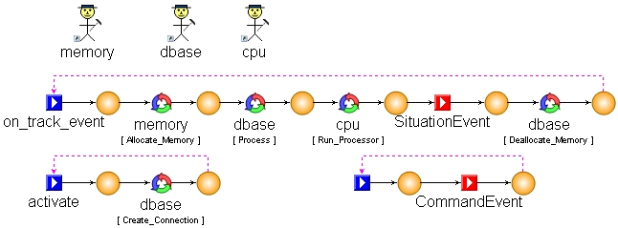
Details of CBML & WML
CBML is an domain-specific modeling language (DSML) based on I/O automata semantics
CBML captures the behavior of components using abstract elements
  i.e., their actions and logical execution using modeling elements
WML is an DSML for capturing workload of realistic operations
WML is extensible and can capture user-defined workloads
WML compliments CBML by allowing modelers to assign realistic (or predefined) workloads to generic CBML operations
Predefined database operation
Worker responsible for doing database operation
Combined CBML & WML model

Slide 18
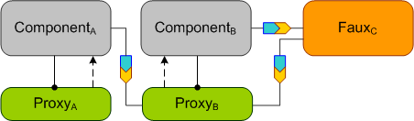
Monitoring Components in CUTS
CUTS provides both intrusive & non-intrusive monitoring capabilities
Non-intrusive monitoring is handled using (auto-generated) proxies that have the same interface & attributes as their hosted component
Intrusive monitoring is handled by augmenting the source code to associate user-defined data with the current event
By default, non-intrusive proxies capture the arrival rate, throughput, and service rate of each event port of a component
Proxies can monitor both emulated & real components
Proxy can support emulated, or real, components
Proxies forward data to instrumented component

Slide 19
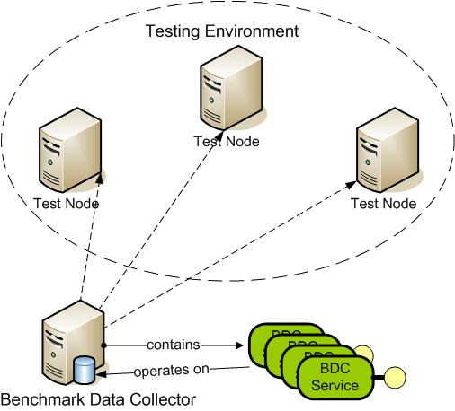
Monitoring Tests in CUTS
The Benchmark Data Collector (BDC) is responsible for monitoring the overall system while a test is active
The BDC collects metrics from each component (or proxy) at a user-defined intervals & caches the latest metrics in-memory
The BDC is also a service component that can load user-defined services that operate on/analyze the collected metrics in real-time
  e.g., historian, logging metrics to a database or providing real-time analysis for decision making
Each service also exposes an optional remote interface for online collaboration with external tools
services
Optional remote interface
In-memory database

Slide 20
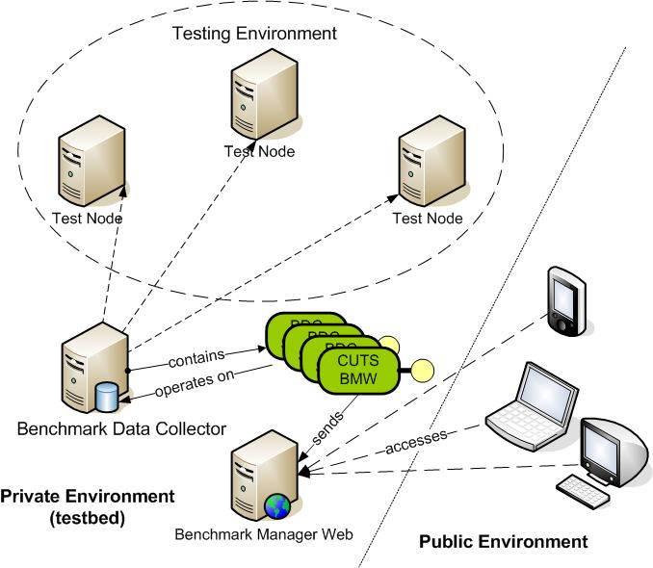
Analysis of Performance Metrics
Performance metrics can be analyzed online (while the test is active) or offline (while the test is inactive)
Out of the box, CUTS offers a BDC service (if loaded) called CUTS_BMW that logs metrics to a database for viewing by the Benchmark Manager Web (BMW) Utility
The BMW is a Microsoft .NET 2.0 web application that presents metrics in a friendly manner
Other services, similar to CUTS_BMW, can be defined to provided other analysis capabilities
  e.g., such as real-time path analysis

Slide 21
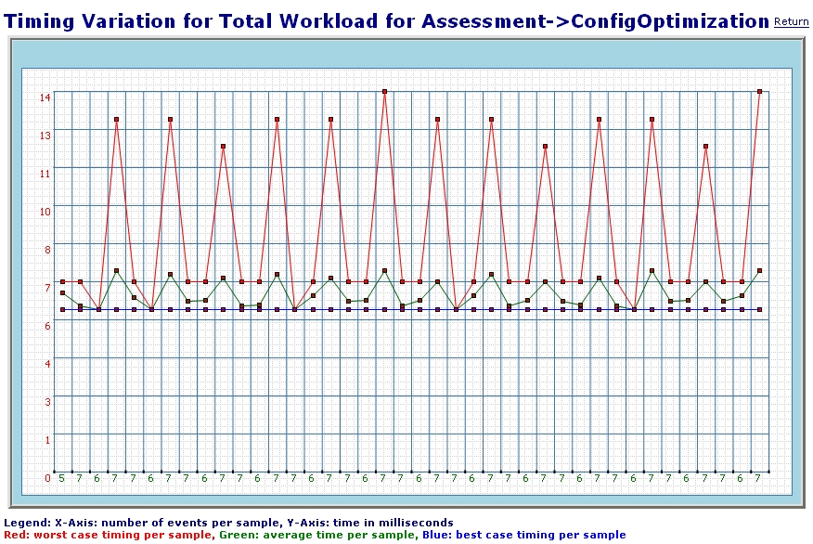
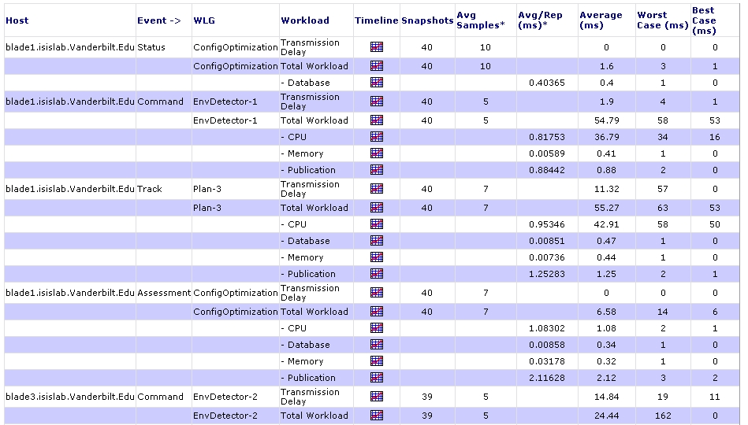
Benchmark Manager Web Utility
Benchmark Manager Web (BMW) Utility analyzes & graphically displays performance metrics stored in a local/remote database
General analysis shows users overall performance of each component hosted by a proxy
  e.g., event count, service rate, & queuing time
Detailed analysis shows users the performance of an action in the respective component
  e.g., memory & CPU actions, event handling & etc.

Slide 22
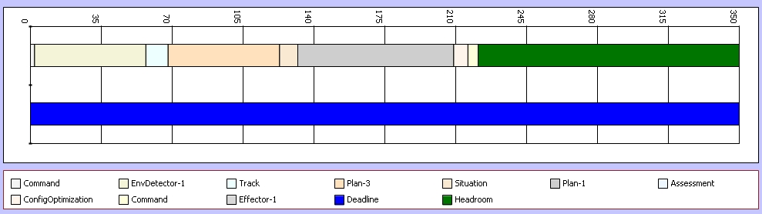
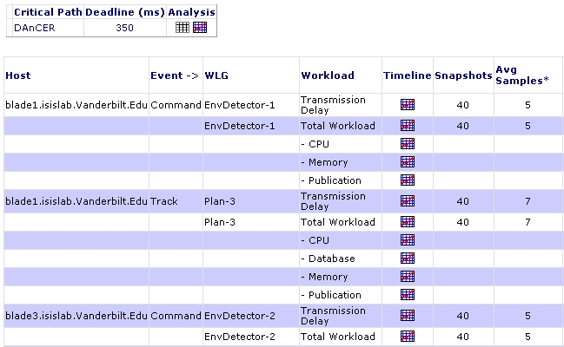
Benchmark Manager Web Utility
Benchmark Manager Web (BMW) Utility analyzes & graphically displays performance metrics stored in a local/remote database
General analysis shows users overall performance of each component hosted by a proxy
  e.g., event count, service rate, & queuing time
Detailed analysis shows users the performance of an action in the respective component
  e.g., memory & CPU actions, event handling & etc.
Critical paths show users end-to-end performance of execution paths (or event traces) through the system

Slide 23

MLRM Case Study: SLICE Scenario (1/2)
sensor 1
(main)
error recovery
effector 1
(main)
planner 1
planner 2
sensor 2
configuration
effector 2
Component Interaction for SLICE Scenario
D&C & Performance Requirements
Critical path deadline is 350 ms
  main sensor to main effector through configuration
Components in the critical paths must be deployed across all 3 hosts
Main sensor & effector must be deployed on separate hosts
Three hosts
One database is shared between all hosts

Slide 24
MLRM Case Study: SLICE Scenario (2/2)
350ms deadline
sensor 1
(main)
error recovery
effector 1
(main)
planner 1
planner 2
sensor 2
configuration
effector 2
Questions we would like to answer
Can we meet the D&C & performance requirements?

Slide 25
MLRM Case Study: SLICE Scenario (2/2)
sensor 1
(main)
error recovery
effector 1
(main)
planner 1
planner 2
sensor 2
configuration
effector 2
Questions we would like to answer
Can we meet the D&C & performance requirements?
Are there multiple deployments that meet the 350ms critical path deadline?
  Which yields the most headroom

Slide 26
MLRM Case Study: SLICE Scenario (2/2)
sensor 1
(main)
error recovery
effector 1
(main)
planner 1
planner 2
sensor 2
configuration
effector 2
Questions we would like to answer
Can we meet the D&C & performance requirements?
Are there multiple deployments that meet the 350ms critical path deadline?
  Which yields the most headroom
Can we meet the 350ms critical path deadline with all component deployed on a single host?

Slide 27
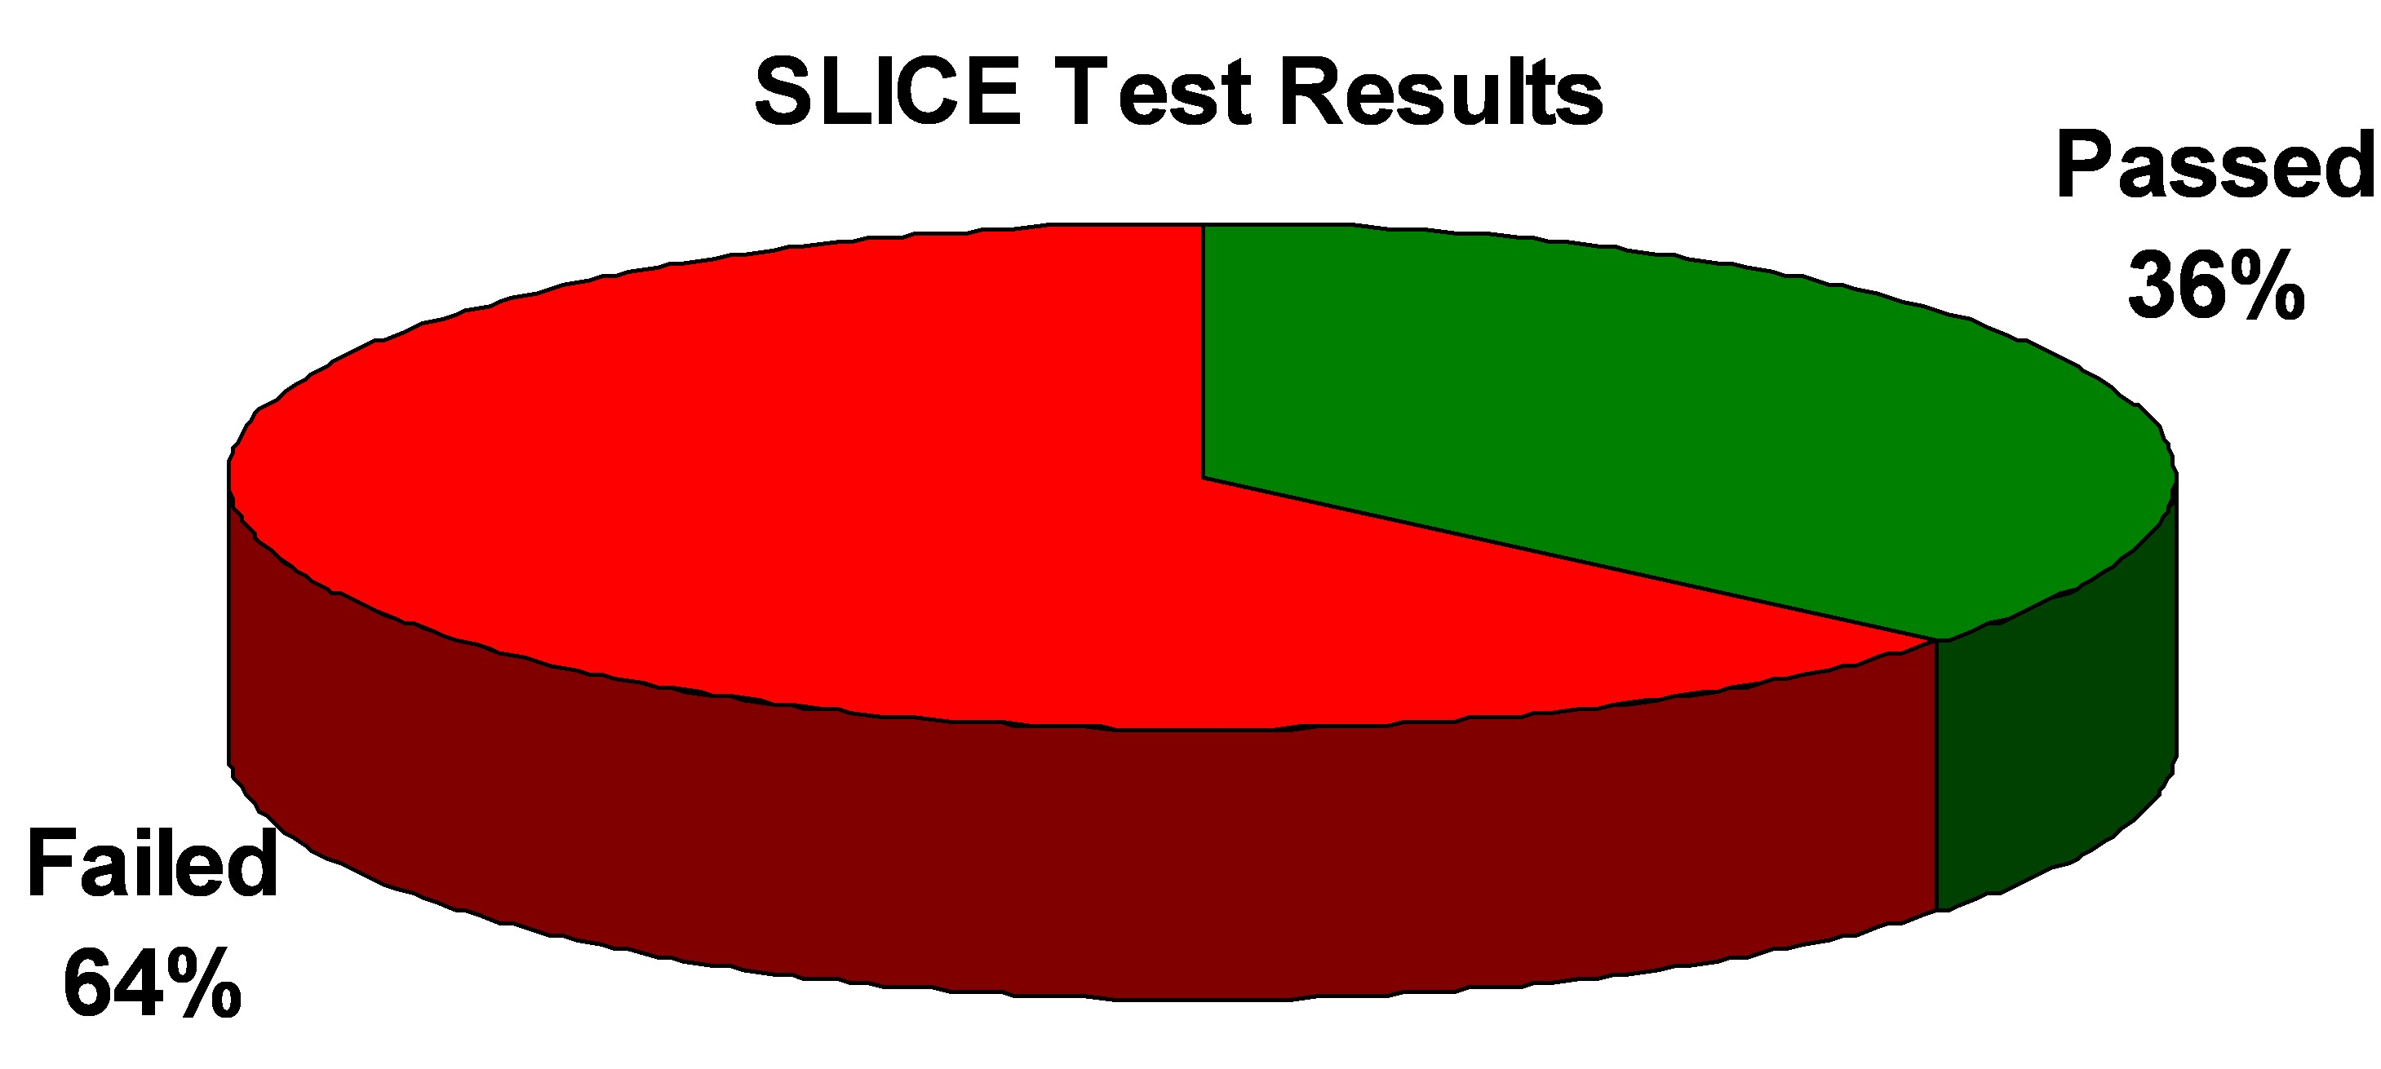
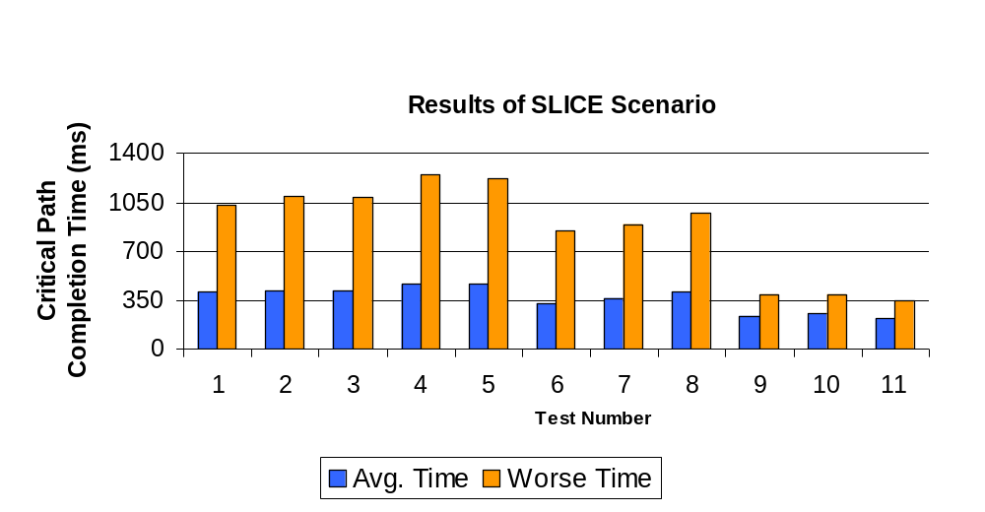
Overall Results of SLICE Scenario
Test 11 produced the best results
Average case: 221 ms
Worse case: 343 ms
Population size of 11 tests
Only 4 of 11 deployments met the 350 ms critical path deadline for average time
Test 11 only test to meet critical path deadline for worse time

Slide 28
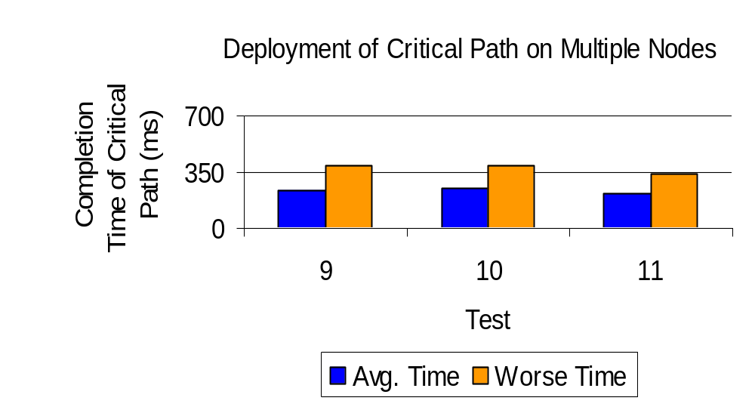
SLICE Results: D&C & QoS Requirements
Deployment Table
Test | Node 1 | Node 2 | Node 3
9 | sensor 1 & planner 1 | planner 2, configuration, & effector 1 | Sensor 2, error re recovery & effector 2
10 | sensor 1 & planner 1 | configuration & effector 1 | planner 2, sensor 2, error recovery & effector 2
11 | sensor 1, planner 1 & configuration | planner 2 & effector 1 | sensor 2, error recovery & effector 2
Test 9 meet the critical path QoS requirement, but did not meet the deployment requirement
Tests 10 & 11 meet both the critical path QoS & deployment requirements
We were able to answer the critical path & deployment questions

Slide 29
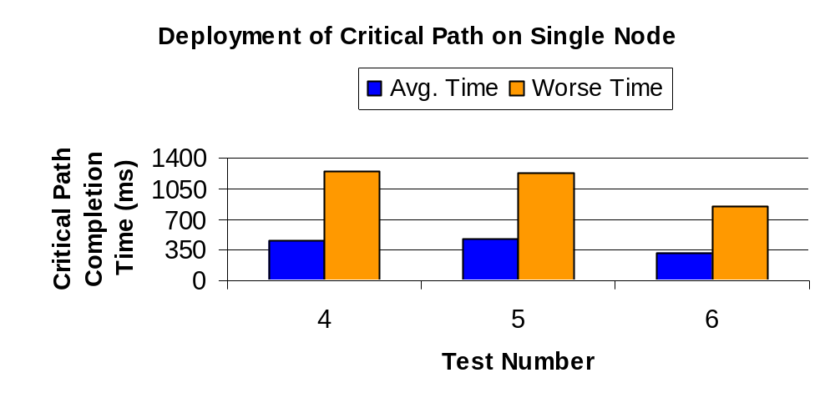
SLICE Results: Single Host Deployment
Deployment Table
Test | Node 1 | Node 2 | Node 3
4 | All components | (nothing) | (nothing)
5 | All components, excluding error recovery | Error recovery | (nothing)
6 | All component in the critical path | All components not in the critical path | (nothing)
Test 6 had a average time of 323 ms
We were able to answer the question about deploying on a single node

