Slide 1

Optimization of Spiking Neural Network

Slide 2
Agenda
General information
TODO

Slide 3

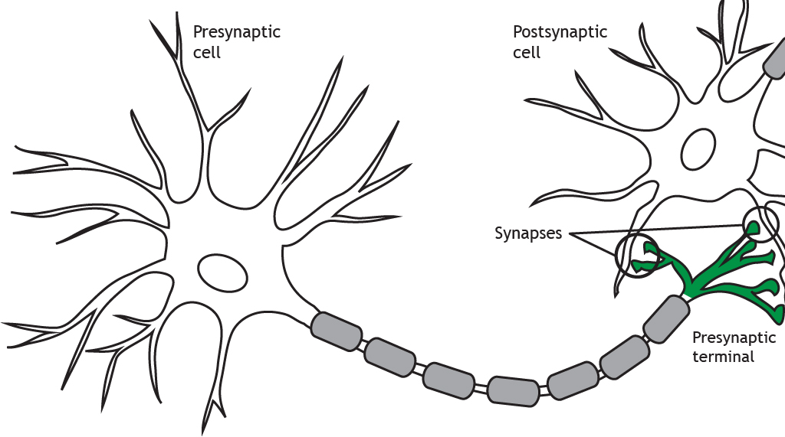


Biology
$$action potential$$
Source: [1]19.06.23 https://openbooks.lib.msu.edu/neuroscience/chapter/synapse-structure/
$$dendrites$$

Slide 4

Spiking neural network (SNN)
Modelled on neurons of brain
Biologically plausible
Little power consumption
$$Motivation:$$

Slide 5




Model biology
Presynaptic neuron
Postsynaptic neuron
$$w_{ij}$$
i
j
$$action potential$$
$$w_{kj}$$
k
5
$$dendrites$$
Source: [1]19.06.23 https://openbooks.lib.msu.edu/neuroscience/chapter/synapse-structure/

Slide 6
ANN
Input:
32- or 64-bit messages
Singular presentation
Backpropagation
SNN
Input:
1-bit spike
Stream of events
Different learning rules

Slide 7






$\underline{w} ≅ w_{ij}$
$σ ≅$ threshold
$$ANN$$
$$SNN$$
$$\underline{x}$$
$$\underline{w}$$
Source: [cf. KI WiSE22 10-Einführung Hanika]

Slide 8
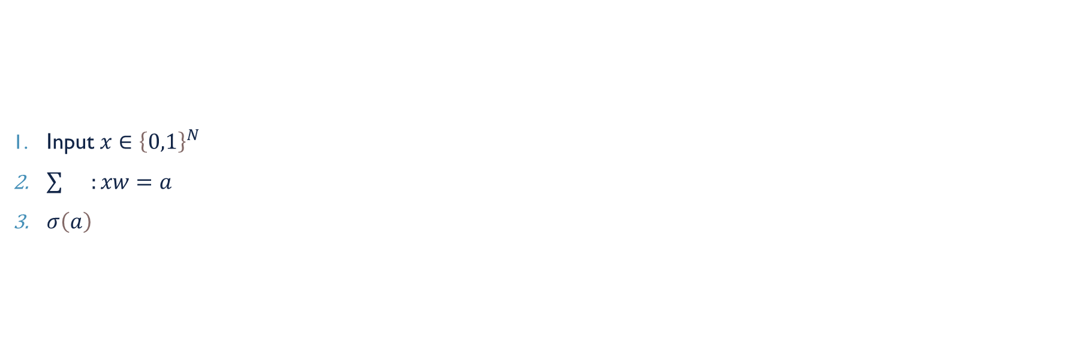







Input $x∈{\left\{0,1\right\}}^{N}$
$\sum{}:xw=a$
$σ\left(a\right)$
$$Spike$$
$$Decay$$

Slide 9
Problem
Input values
Temporal dependencies
Biologically plausible

Slide 10
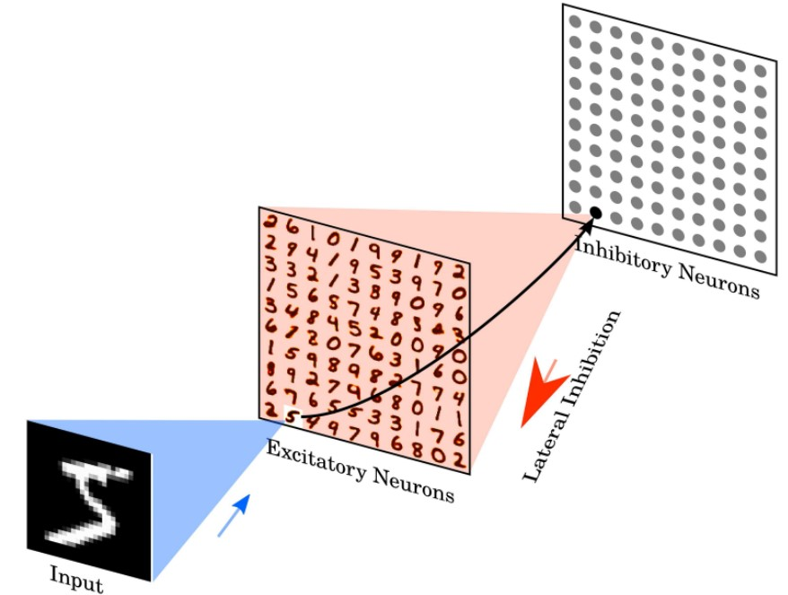

Architecture of snn
Input layer: 28x28 neurons
Preprocessing layer
Excitatory neuros
Inhibitory neurons
$$inhibition \& competition$$
Source: [TODO]

Slide 11
Synaptic plasticity
Mathematic formulae
Activity-dependent modification of synaptic weights
Abstract: timing of spikes
Detailed: state variables

Slide 12


STDp
Synaptic learning rule
Synapse weight $\sim$ degree of causality
$∆w=(x_{pre}−x_{tar}){(w_{max}−w)}^{μ}$

Slide 13

Neuron model
Membrane voltage/ potential V
Decay
Influence excitatory/ inhibitory synapses
$τ \frac{dV}{dt}=\left(E_{rest}−V\right)+g_{e}\left(E_{exc}−V\right)+g_{i}(E_{inh}−V)$
-> LIF

Slide 14

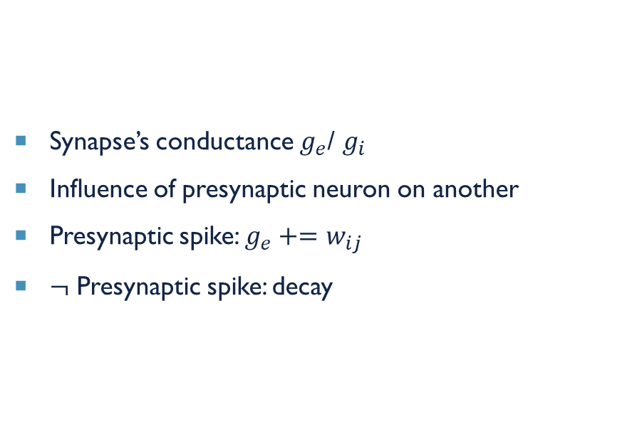
Synapse model
Synapse’s conductance $g_{e}$/ $g_{i}$
Influence of presynaptic neuron on another
Presynaptic spike: $g_{e}+=w_{ij}$
$¬$ Presynaptic spike: decay
$τ_{ge} \frac{dg_{e}}{dt}=−g_{e}$

Slide 15
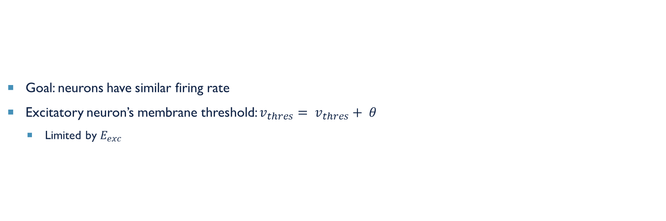
homoeostasis
Goal: neurons have similar firing rate
Excitatory neuron’s membrane threshold: $v_{thres}= v_{thres}+ θ$
Limited by $E_{exc}$

Slide 16
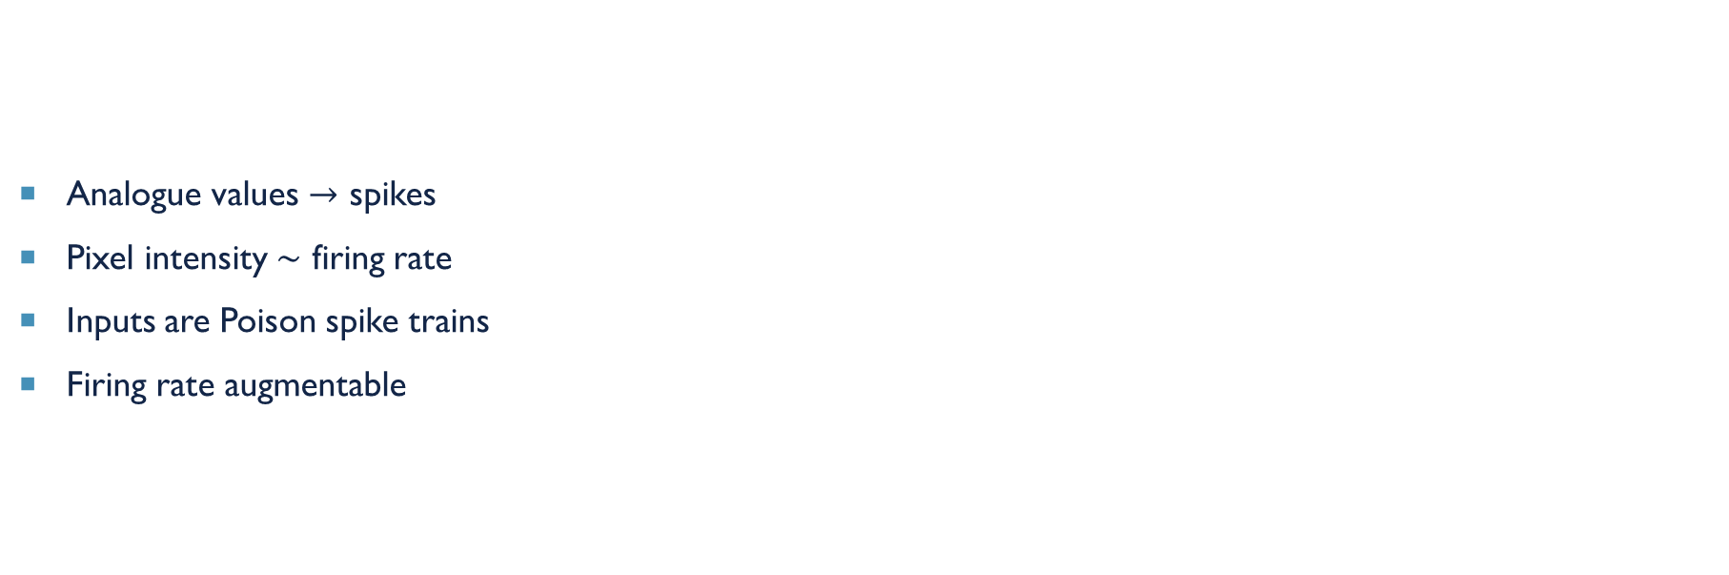
Input encoding
Analogue values $→$ spikes
Pixel intensity $\sim$ firing rate
Inputs are Poison spike trains
Firing rate augmentable

Slide 17

Training & testing
Training
150 ms phases without input between images
Testing
$η →$ 0
Class assignment to neuron
Highest response to training set
Labels
Predictions
Highest average firing rate

Slide 18
Kolmogorov–Smirnov test (K-S test)
Comparison to other statistical tests
Anderson-Darling test
Cramer Von-Mises test
Sign test
Chi-square Goodness-of-Fit test
refinements

