Slide 1

Optimization of Spiking Neural Network

Slide 2
Agenda
Biology
Biology to SNN
ANN vs. SNN
Input encoding
Spikes
Problem
Architecture
Synaptic plasticity
STDP
Neuron model
Synapse model
Homoeostasis
Training & testing

Slide 3
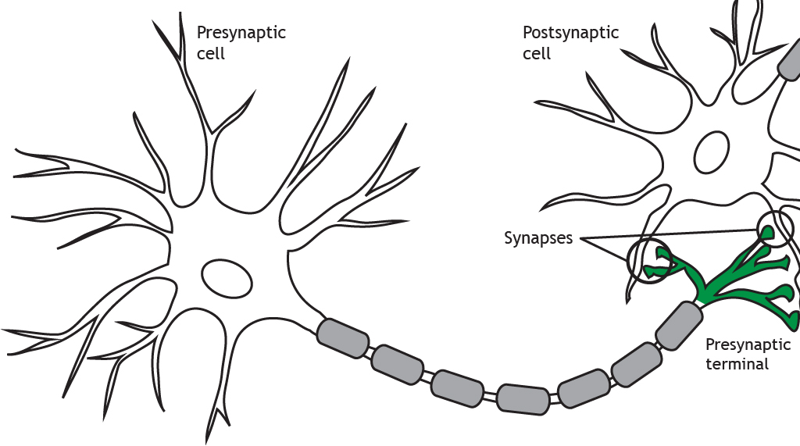

Biology
$$action potential$$
Source: [23]

Slide 4



Spiking neural network (SNN)
Modelled on neurons of brain
Biologically plausible
Little power consumption
$$Motivation:$$

Slide 5



Model biology
Presynaptic neuron
Postsynaptic neuron
$$w_{ij}$$
i
j
$$action potential$$
$$w_{kj}$$
k
5
Source: [23]

Slide 6






ANN
Input $\underline{x}$
$\sum{:}\underline{x} \text{∗} \underline{w}=a$
$σ\left(a\right)$
$$ANN$$
$$\underline{x}$$
$$\underline{w}$$
$$σ$$
Source: [cf. KI WiSE22 10-Einführung Hanika]
Notes:
$\sum{:}$ Netzeingabe : $\underline{x}$ * $\underline{w}$ = a
$σ$(a): Aktivierungsfunktion

Slide 7


ANN vs. SNN
$\underline{w} ≅ w_{ij}$
$σ ≅$ threshold
$$ANN$$
$$SNN$$
$$\underline{x}$$
$$\underline{w}$$
$$σ$$
Source: [cf. KI WiSE22 10-Einführung Hanika]
Notes:
$\sum{:}$ Netzeingabe : $\underline{x}$ * $\underline{w}$ = a
$σ$(a): Aktivierungsfunktion

Slide 8
ANN vs. SNN
ANN
Input:
32- or 64-bit messages
Singular presentation
Backpropagation
SNN
Input:
1-bit spike
Stream of events
Different learning rules

Slide 9

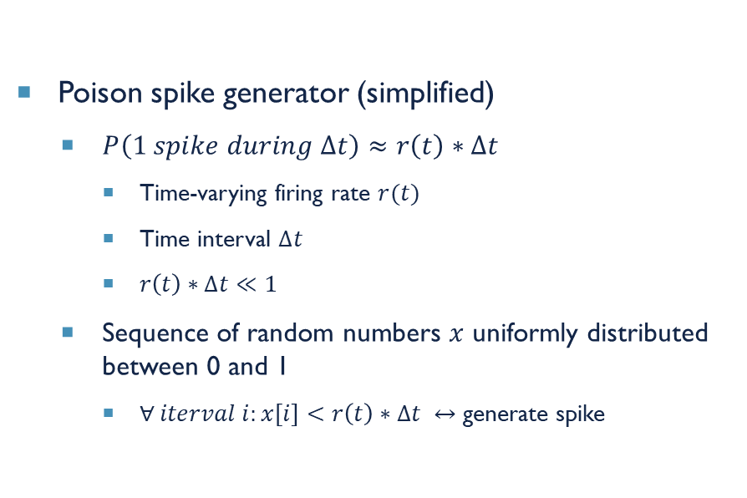
Input encoding
Analogue values $→$ spikes
Pixel intensity $\sim$ firing rate
Firing rate augmentable
Poison spike generator (simplified)
$P\left(1 spike during ∆t\right)≈r\left(t\right)∗∆t$
Time-varying firing rate $r(t)$
Time interval $∆t$
$r\left(t\right)∗∆t≪1$
Sequence of random numbers $x$ uniformly distributed between 0 and 1
$∀ iterval i:x\left[i\right]<r\left(t\right)∗∆t ↔$ generate spike
Notes:
0 to 255 proportional to 0 to 65.75Hz
independent spike hypothesis (generation)
Firing rate: spikes/second
Problem: spike assigned to discrete bin != continuous time value

Slide 10
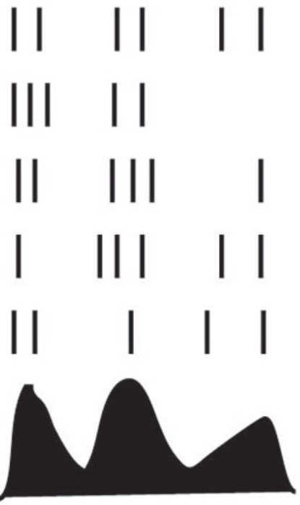
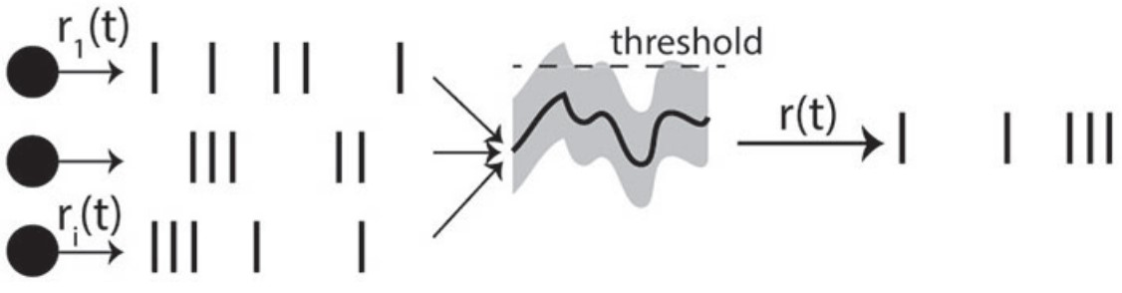

SNN: spikes
Input $\underline{x}∈{\left\{0,1\right\}}^{N}$
$\sum{:}\underline{x} \text{∗} \underline{w}=a$
$σ\left(a\right)$
t
Source: [TODO]
Notes:
$\sum{:}$ Netzeingabe : $\underline{x}$ * $\underline{w}$ = a
$σ$(a): Aktivierungsfunktion

Slide 11
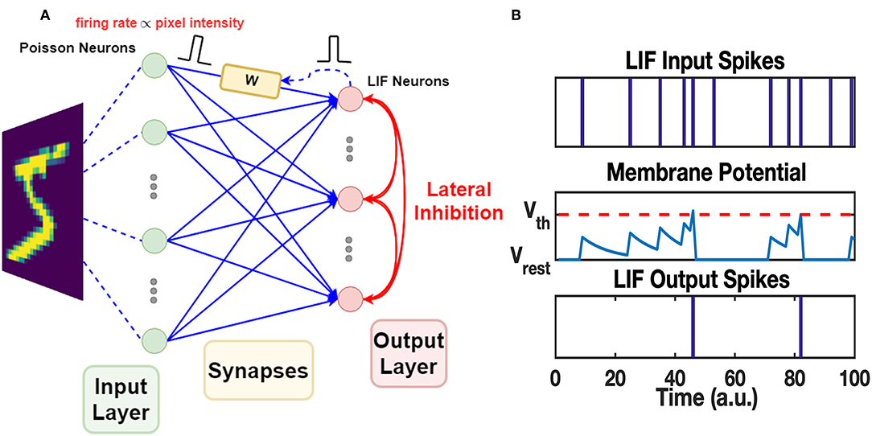

SNN: spikes
Input $\underline{x}∈{\left\{0,1\right\}}^{N}$
$\sum{:}\underline{x} \text{∗} \underline{w}=a$
$σ\left(a\right)$
Source: [10]
Notes:
$\sum{:}$ Netzeingabe : $\underline{x}$ * $\underline{w}$ = a
$σ$(a): Aktivierungsfunktion

Slide 12
SNN Problem
Biologically plausible
Input values
Temporal dependencies
Optimizing parameters
Source: [10]

Slide 13
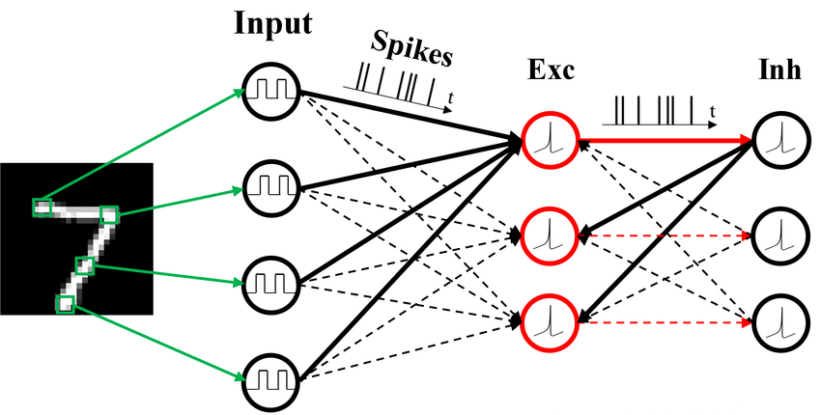

Architecture of snn
Input layer: 28x28 neurons
Preprocessing layer
Excitatory neuros
Inhibitory neurons
$$inhibition \& competition$$
Source: [25]
Notes:
Neuron per input pixel
Input-preprocessing: all-to-all
Exc:inh = 1:1 vs. bio 4:1
Exc-inh: one-to-one
Inh-exc: almost all-to-all

Slide 14
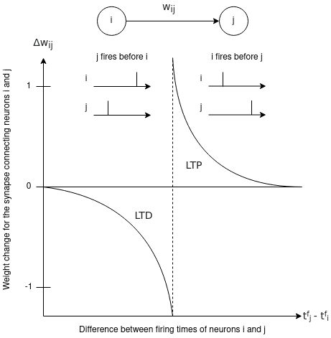

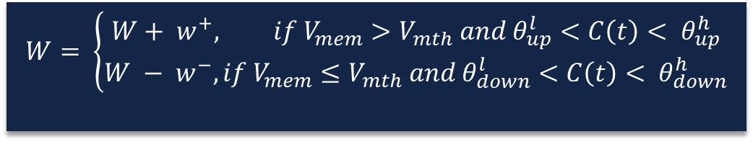
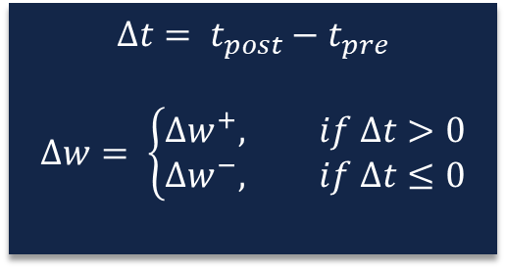
Synaptic plasticity
Mathematic formulae
Activity-dependent modification of synaptic weights
Abstract: timing of spikes
Detailed: state variables
Presynaptic neuron
Postsynaptic neuron
$$w_{ij}$$
i
j
$$∆t= t_{post}−t_{pre}$$
$$∆w= \left\{\begin{aligned}∆w^{+}, if ∆t>0 \\ ∆w^{−}, if ∆t≤0\end{aligned}\right.$$
$$W= \left\{\begin{aligned}W+ w^{+}, if V_{mem}>V_{mth} and θ_{up}^{l}<C\left(t\right)< θ_{up}^{h} \\ W − w^{−},if V_{mem}≤V_{mth} and θ_{down}^{l}<C\left(t\right)< θ_{down}^{h}\end{aligned}\right.$$
Source: [21]
Notes:
Calcium concentration C(t) (bounds)
Membrane potential $V_{mem}$
Membrane threshold $V_{mth}$
Potentiation $w^{+}$
Depression $w^{−}$
Teaching signals

Slide 15







Spike-timing-dependent plasticity (STDp)
Synaptic learning rule
Synapse weight $\sim$ degree of causality
$∆w=η(x_{pre}−x_{tar}){(w_{max}−w)}^{μ}$
$$dependence on previous weight$$
$$learning rate$$
$$presynaptic trace$$
$$target value$$
$$weight limit$$
Notes:
Strengthen pre-postsynaptic pairs <-> postsyn. Neuron reacts directly after presyn. Neuron fires
(disconnect/weaken else)
$presynaptic trace$: #recent presynaptic spikes (decaying or +=1)
$target value$: of presyn. Trace at moment of postsyn. Spike, #postsyn. Spikes
$x_{pre}$ < $x_{tar} →$no weight increase
Multiple spikes close in time: (1) sum up, (2) certain pairs (nearest)

Slide 16
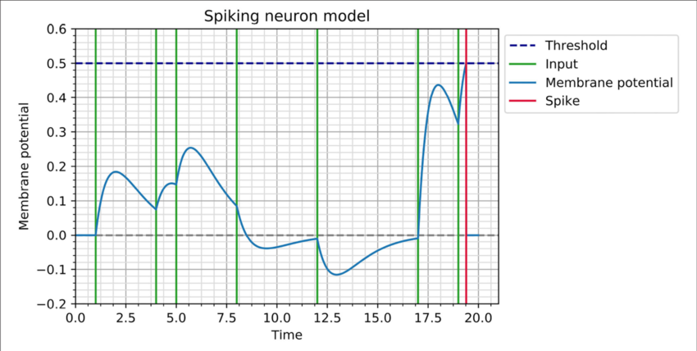
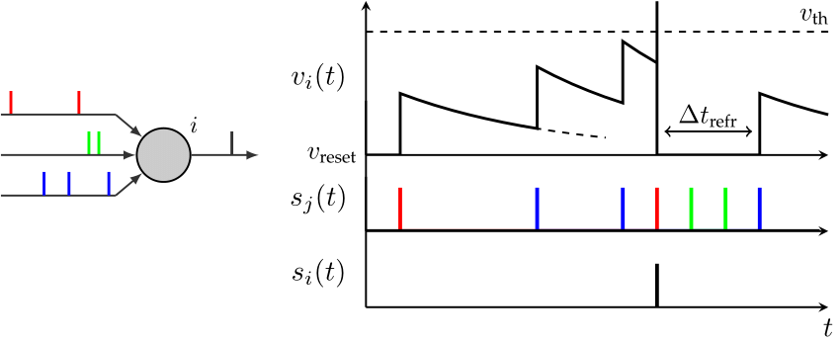



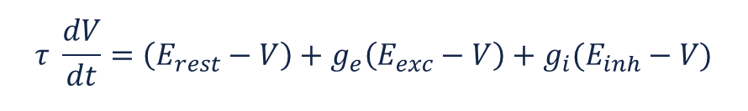
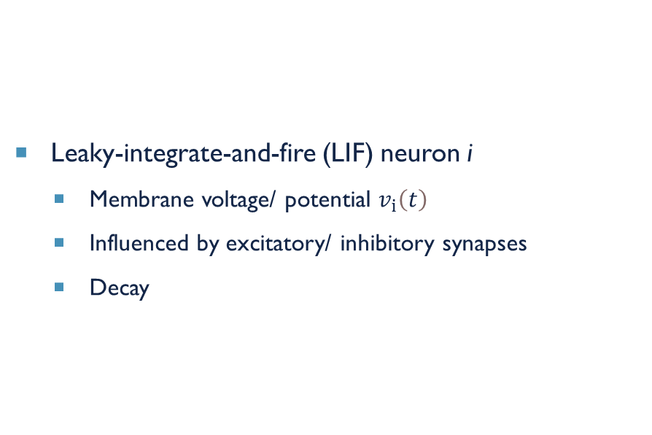
Neuron model
Leaky-integrate-and-fire (LIF) neuron i
Membrane voltage/ potential $v_{i}\left(t\right)$
Influenced by excitatory/ inhibitory synapses
Decay
$$τ \frac{dV}{dt}=\left(E_{rest}−V\right)+g_{e}\left(E_{exc}−V\right)+g_{i}(E_{inh}−V)$$
$$equilibrium potentials of synapses$$
$$resting membrane potential$$
$$conductances of synapses$$
Source: [26]
Source: [24]
Notes:
$\left(E_{rest}−V\right)≠0 ↔$ decay

Slide 17



Synapse model
Synapse’s conductance $g_{e}$/ $g_{i}$
Influence of presynaptic neuron on another
Presynaptic spike: $g_{e}+=w_{ij}$
$¬$ Presynaptic spike: decay
$$τ_{ge} \frac{dg_{e}}{dt}=−g_{e}$$
Presynaptic neuron
Postsynaptic neuron
$$w_{ij}$$
i
j
Notes:
$τ_{ge}$: time constant

Slide 18
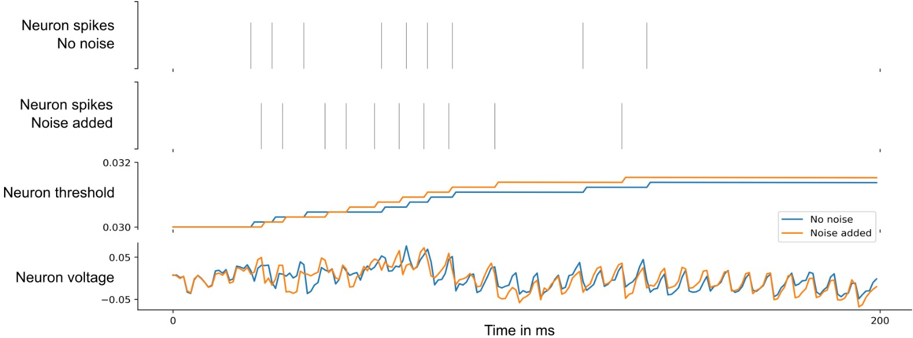
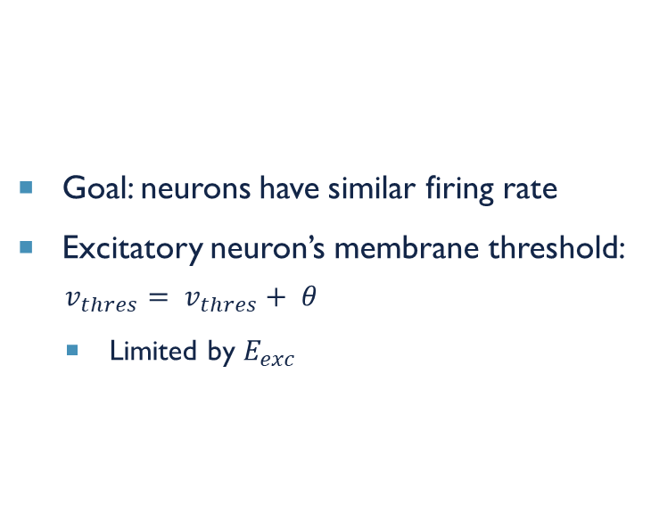
homoeostasis
Goal: neurons have similar firing rate
Excitatory neuron’s membrane threshold:
$$v_{thres}= v_{thres}+ θ$$
Limited by $E_{exc}$
Source: [27]

Slide 19

Training & testing
Training
150 ms phases without input between images
Testing
$η →$ 0
Class assignment to neuron
Highest response to training set
Labels
Predictions
Highest average firing rate

Slide 20
References
1. Azghadi, M.R., Iannella, N., Al-Sarawi, S.F., Indiveri, G., Abbott, D.: Spike-based synaptic plasticity in silicon: Design, implementation, application, and challenges.vIEEE 102, 717-737 (2014)
2. Beyel, M., Dutt, N.D., Krichmar, J.L.: Categorization and decision-making in a neurobiologically plausible spiking network using a stdp-like learning rule. Elsevier 48, 109-124 (2013)
3. Bi, G., Poo, M.: Synaptic modifications in cultured hippocampal neurons: dependence on spike timing, synaptic strength, and postsynaptic cell type. The journal of Neuroscience pp. 10464-10472 (1998)
4. Brette, R.: Philosophy of the spike: Rate-based vs. spike-based theories of the brain. Frontiers in Systems Neuroscience 9, 1-14 (2015)
5. Caporale, N., Dan, Y.: Spike timing-dependent plasticity: A hebbian learning rule. Annual Review of Neuroscience 31, 25-46 (2008)
6. Cook, M., Diehl, P.U.: Unsupervised learning of digit recognition using spike-timing-dependent plasticity. Frontiers in Computational Neuroscience 9, 1-8 (2015)
7. Diehl, P.U., Neil, D., Binas, J., Cook, M., Liu, S.C., Pfeiffer, M.: Fast-classifying, high-accuracy spiking deep networks through weight and threshold balancing. International joint conference on neural networks (IJCNN). IEEE pp. 1-8 (2015)
8. Goodman, D., Brette, R.: Brian: a simulator for spiking neural networks in python. Frontiers in Neuroscience 2, 1-10 (2008)
9. Guo, W., Fouda, M.E., Eltawil, A.M., Salama, K.N.: Neural coding in spiking neural networks: A comparative study for robust neuromorphic systems. Frontiers in Neuroscience 15, 1-21 (2021)
10. Guo, Y., Wu, H., Gao, B., Qian, H.: Unsupervised learning on resistive memory array based spiking neural networks. Frontiers in Neuroscience 13, 1-16 (2019)
11. Heeger, D.: Poisson model of spike generation. New York University 1, 1-13 (2000)
12. Indiveri, G., Chicca, E., Douglas, R.: A vlsi array of low-power spiking neurons and bistable synapses with spike-timing dependent plasticity. IEEE Transactions on Neural Networks 17, 211221 (2006)
13. Kheradpisheh, S.R., Ganjtabesh, M., Masquelier, T.: Bio-inspired unsupervised learning of visual features leads to robust invariant object recognition. Neurocomputing 205, 383392 (2016)
14. Kim, J., Kim, S.P., Hwang, H., Park, D., Jeong, U.: Object shape recognition using tactile sensor arrays by a spiking neural network with unsupervised learning. IEEE pp. 178183 (2020)
15. Lopes, P.H.C., Reid, I., Hobson, P.R.: The two-dimensional Kolmogorov-Smirnov test. XI International Workshop on Advanced Computing and Analysis Techniques in Physics Research pp. 112 (2007)
16. Masquelier, T., Thorpe, S.J.: Unsupervised learning of visual features through spike timing-dependent plasticity. PLoS Computational Biology 3, 247257 (2007)
17. Morrison, A., Aertsen, A., Diesmann, M.: Spike-timing-dependent plasticity in balanced random networks. Neural Computation 19, 14371467 (2007)
18. O'Connor, P., Neil, D., Liu, S., Delbruck, T., Pfeiffer, M.: Real-time classification and sensor fusion with a spiking deep belief network. frontiers in neuroscience 7, pp. 1-13 (2013)
19. Poster, J.P., Gerstner, W.: Triplets of spikes in a model of spike timing-dependent plasticity. The Journal of Neuroscience pp. 9673-9682 (2006)
20. Rathi, N., Roy, K.: Diet-snn: A low-latency spiking neural network with direct input encoding and threshold optimization. IEEE Transactions on Neural Networks and Learning Systems pp. 1-19 (2021)
21. Shears, O., Yazdani, A.H.: Spiking neural networks for image classification, https://oshears.github.io/adv-ml-2020-snn-project/pages/motivation.html
22. amd X. Lagorce, F.G., Stromatias, R., Pfeiffer, M., Plana, L.A., Furber, S.B., Benosman, R.B.: A framework for plasticity implementation on the spinnaker neural architecture. Frontiers in Neuroscience 8, 1-20 (2015)
23. https://openbooks.lib.msu.edu/neuroscience/chapter/synapse-structure/ (19.06.23)
24. https://www.researchgate.net/figure/A-model-of-a-LIF-neuron-The-graphic-right-shows-the-temporal-course-of-the-membrane_fig6_326696777 (03.07.23)
25. https://www.researchgate.net/figure/The-architecture-of-a-spiking-neural-network-SNN-The-network-consists-of-an-input_fig1_342529143 (03.07.2023)
26. https://www.researchgate.net/figure/Illustration-of-membrane-potential-dynamics-for-a-neuron-with-th-05-and-t-1-The_fig1_353893118 (04.07.23)
27. Darjan Salaj, Anand Subramoney, Ceca Kraisnikovic, Guillaume Bellec, Robert Legenstein, Wolfgang Maass (2021) Spike frequency adaptation supports network computations on temporally dispersed information eLife 10:e65459https://doi.org/10.7554/eLife.65459

Slide 21
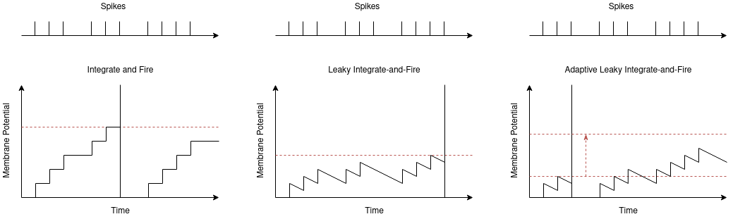
Neuron models
Source: [TODO] 04.07.2023 https://oshears.github.io/adv-ml-2020-snn-project/pages/motivation.html

