Slide 1

Optimization of Spiking Neural Network

Slide 2
Agenda
General information
Problem
Terms
Performance
Methods
Comparison
Outlook

Slide 3
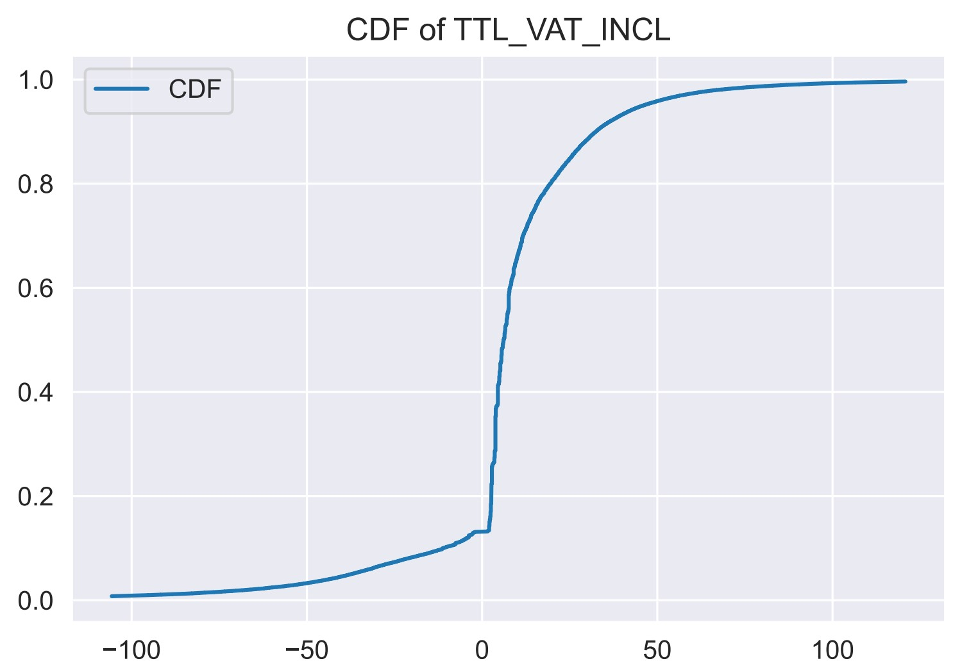

Kolmogorov–Smirnov test (K-S test)
Cumulative distribution function (CDF)
${CDF}_{N}=\frac{n(i)}{N}$
$n(i)$ $=\# \text{points} < Y_{i}$
N ordered data points $Y_{1}$, …, $Y_{N}$

Slide 4
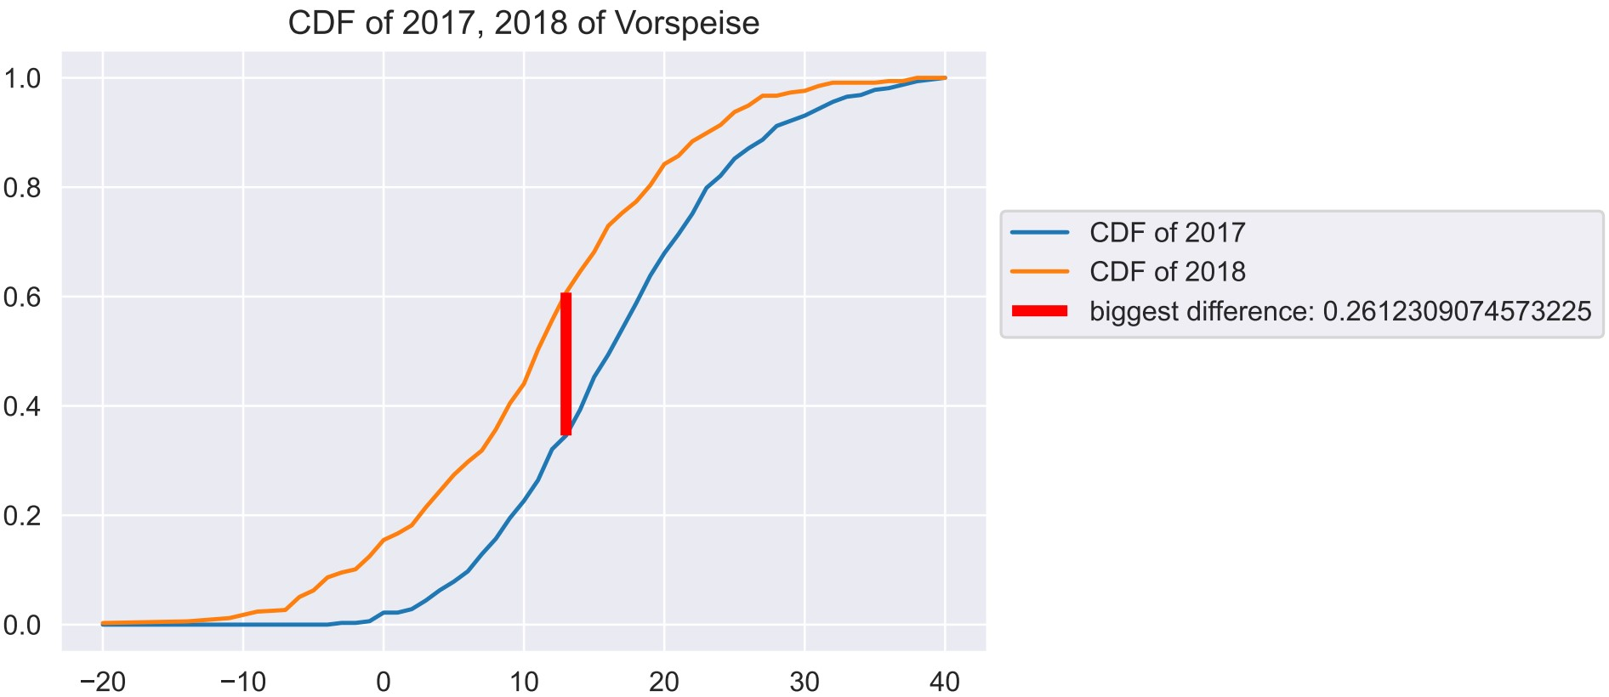
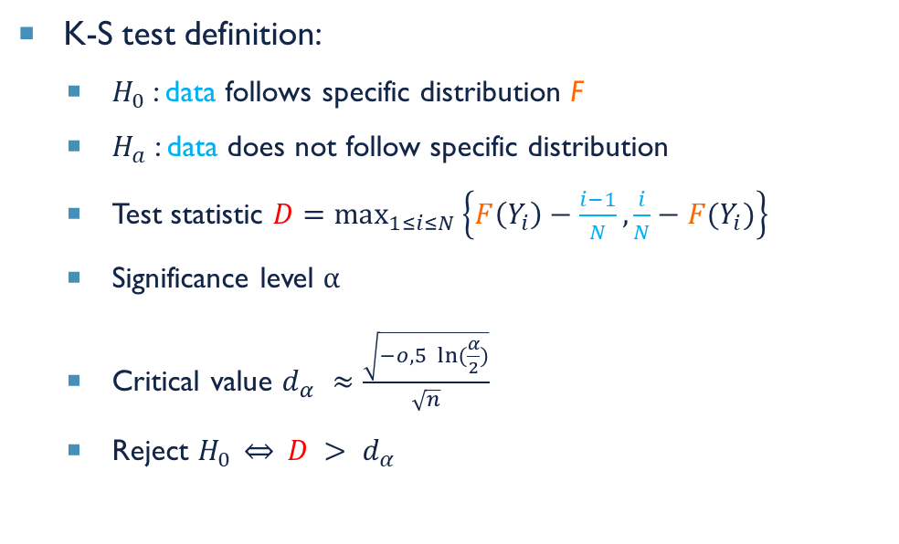
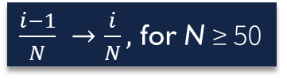
Kolmogorov–Smirnov test (K-S test)
K-S test definition:
$H_{0}$: data follows specific distribution F
$H_{a}$: data does not follow specific distribution
Test statistic $D=\max_{1≤i≤N}\left\{F\left(Y_{i}\right)−\frac{i−1}{N},\right.\left.\frac{i}{N}−F(Y_{i})\right\}$
Significance level α
Critical value $d_{α}$ $≈\frac{\sqrt{−o,5 \ln{(\frac{α}{2})}}}{\sqrt{n}}$
Reject $H_{0} \overset{⇔}{} D > d_{α}$
K-S test definition:
Theoretical distribution F
Empirical CDF
$\frac{i−1}{N} →\frac{i}{N},$ for N ≥ 50

Slide 5
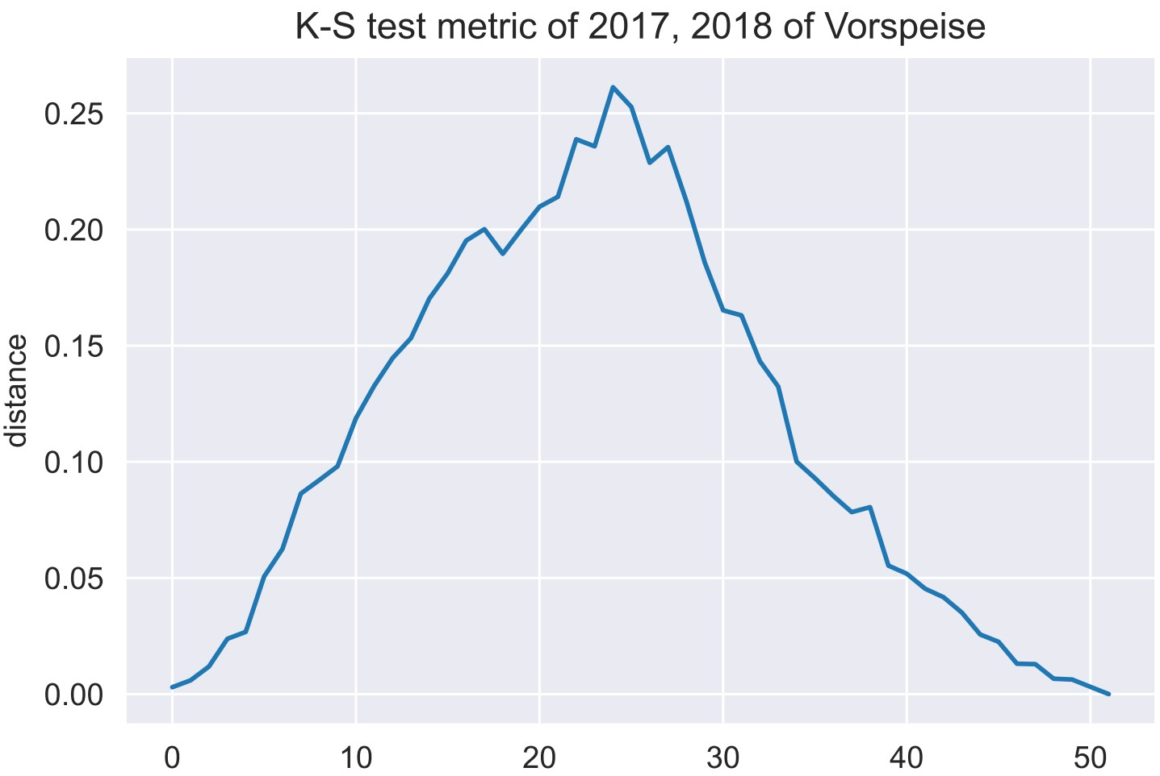

Kolmogorov–Smirnov test (K-S test)
K-S test distance is a metric and ≤ 1
K$\left(F,G\right)={sup \atop x ∈ℝ}\left|F\left(x\right)−G\left(x\right)\right|$

Slide 6
Kolmogorov–Smirnov test (K-S test)
Comparison to other statistical tests
Anderson-Darling test
Cramer Von-Mises test
Sign test
Chi-square Goodness-of-Fit test
refinements

Slide 7
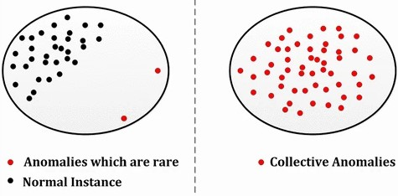
Collective Anomalies/Novelties
Source: [1]
Notes:
Group of anomalies!!!!
Data instances: occurrence as a group anomalous with respect to whole data set
Relationship between data instances necessary!
Mehrere anomalies (räumlich/zeitlich);
meist zeitlich begrenzt;
representation of UNknown process;
in HDR: change in underlying distribution of known process
Jeder Punkt in novelity is anomaly (andersrum nicht)

