Slide 1

Optimization of Spiking Neural Networks
Notes:
Pattern/object shape recognition

Slide 2
Agenda
Biology
Biology to SNN
ANN vs. SNN
Input encoding
Spikes
Problem
Architecture
Synaptic plasticity
STDP
Neuron model
Synapse model
Homoeostasis
Training & testing

Slide 3
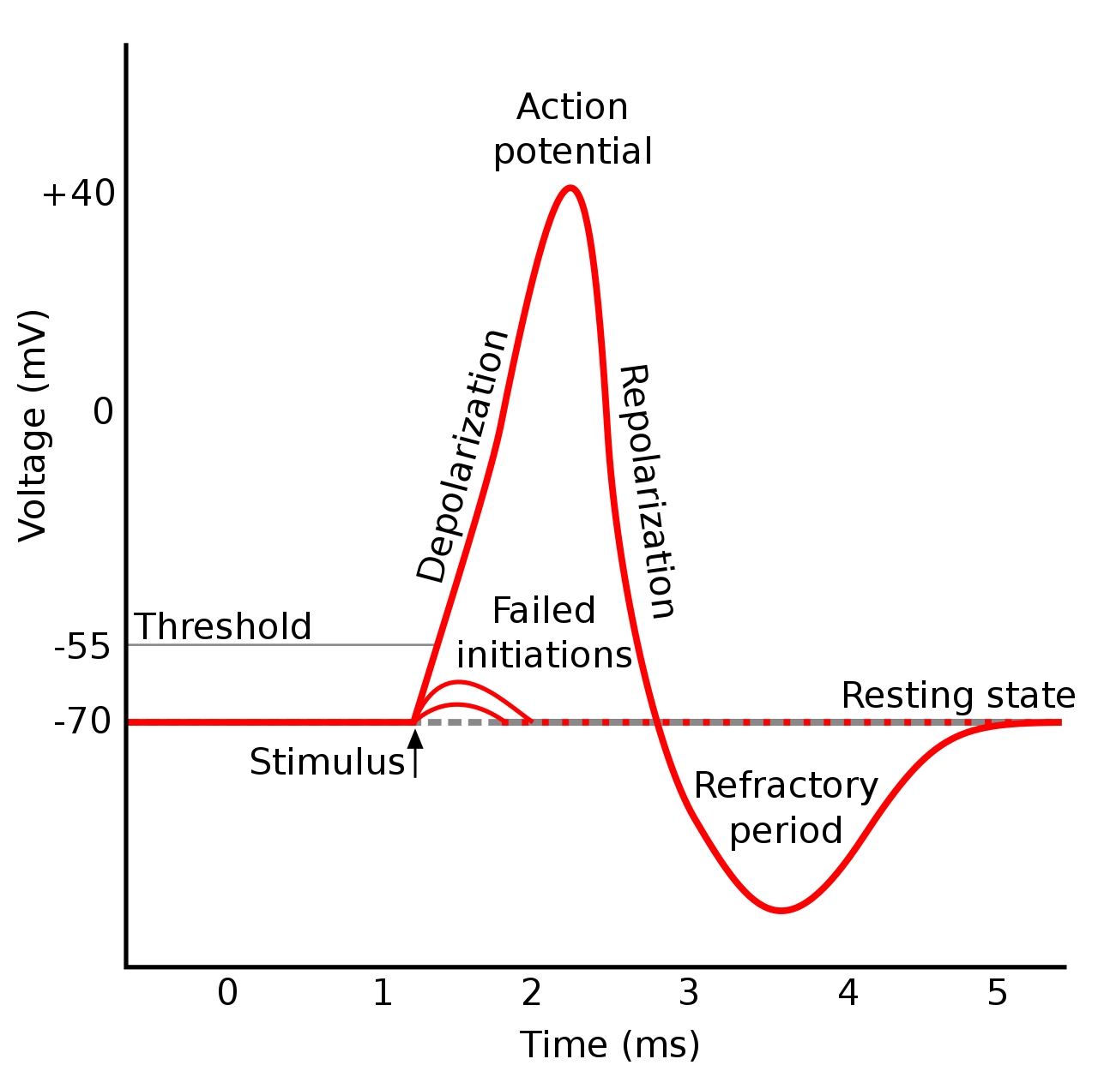

Biology
$$≅spike$$
Membrane potential
Source: https://en.wikipedia.org/wiki/Action_potential#/media/File:Action_potential.svg (11.07.2023)
Notes:
neuron
Action pot.: membrane pot. Rapidly rises & falls
Depolarization Ausbreitung

Slide 4
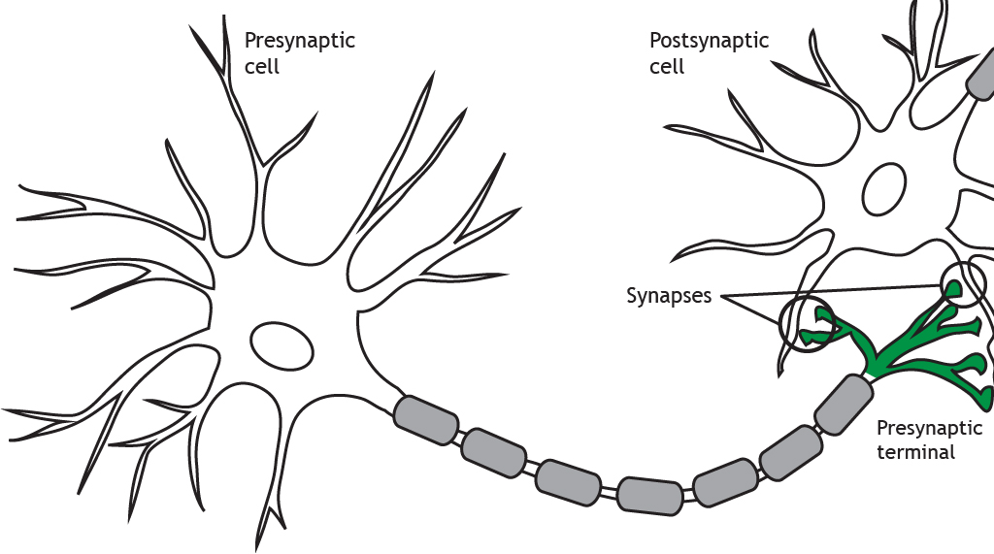

Biology
$$action potential$$
Source: [23]

Slide 5



Spiking neural network (SNN)
Modelled on neurons of brain
Biologically plausible
Little power consumption
$$Motivation:$$

Slide 6



Model biology
Presynaptic neuron
Postsynaptic neuron
$$w_{ij}$$
i
j
$$action potential$$
$$w_{kj}$$
k
6
Source: [23]

Slide 7

Communication of neurons
Rate-based model
Firing rate $≔ ∅ \#$ spikes/unit
$¬$ timing of spikes
Stronger assumption
Spike-based model
Firing rate
Spike timing
Better power consumption during training
Better for dynamically adaptable systems
Neural activity
Notes:
Firing rate: abstract
Unit: duration, neuron, trial

Slide 8
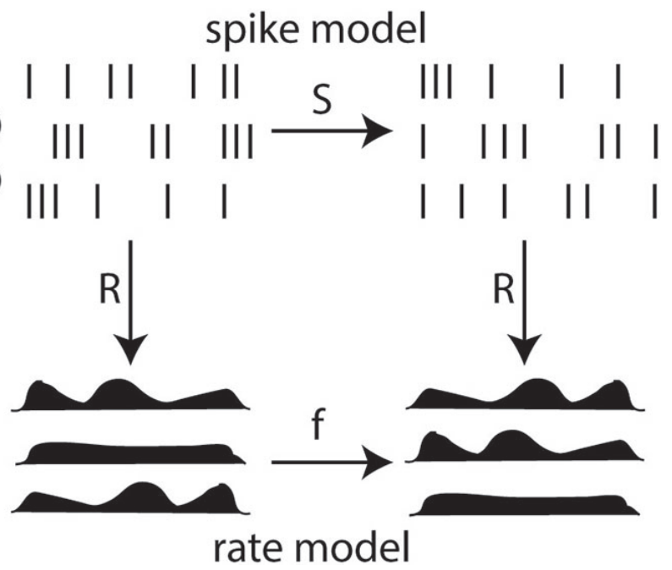
Communication of neurons
Source: [4]
Notes:
Spike model: function S describe relationship between pre- and postsynaptic spike trains
Rate model: function f
Reduction possible

Slide 9






ANN
Input $\underline{x}$
$\sum{:}\underline{x} \text{∗} \underline{w}=a$
$σ\left(a\right)$
$$ANN$$
$$\underline{x}$$
$$\underline{w}$$
$$σ$$
Source: [cf. KI WiSE22 10-Einführung Hanika]
Notes:
$\sum{:}$ Netzeingabe : $\underline{x}$ * $\underline{w}$ = a
$σ$(a): Aktivierungsfunktion

Slide 10



ANN vs. SNN
$\underline{w} ≅ w_{ij}$
$σ ≅$ threshold
$$ANN$$
$$SNN$$
Presynaptic neuron
Postsynaptic neuron
$$w_{ij}$$
$$\underline{x}$$
$$\underline{w}$$
$$σ$$
i
j
Source: [cf. KI WiSE22 10-Einführung Hanika]
Notes:
$\sum{:}$ Netzeingabe : $\underline{x}$ * $\underline{w}$ = a
$σ$(a): Aktivierungsfunktion

Slide 11
ANN vs. SNN
ANN
Input:
32- or 64-bit messages
Singular presentation
Backpropagation
SNN
Input:
1-bit spike
Stream of events
Different learning rules

Slide 12
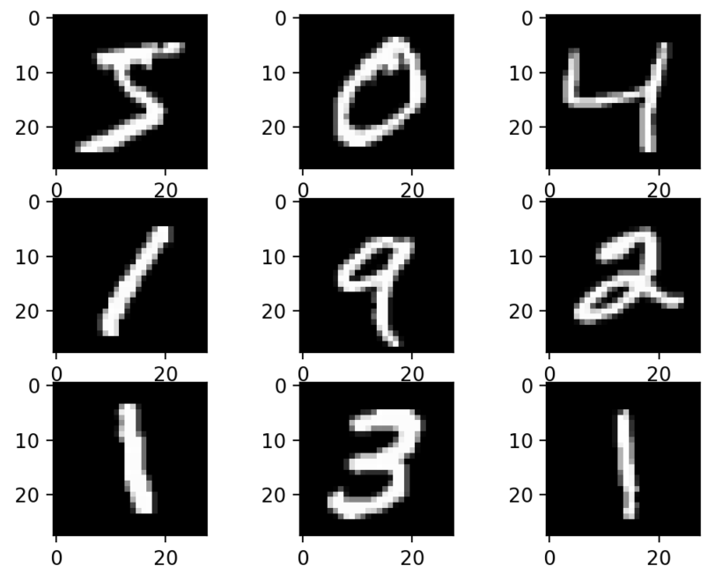

Input encoding
Analogue values $→$ spikes
Pixel intensity $\sim$ firing rate
Firing rate augmentable
Poisson model
Source: https://machinelearningmastery.com/how-to-develop-a-convolutional-neural-network-from-scratch-for-mnist-handwritten-digit-classification/ (11.07.2023)
Notes:
0 to 255 proportional to 0 to 65.75Hz (:4)
If exc. Neurons fire < 5 spikes in 250ms:
max. input firing rate += 32Hz
Present example again for 350ms
repeat

Slide 13
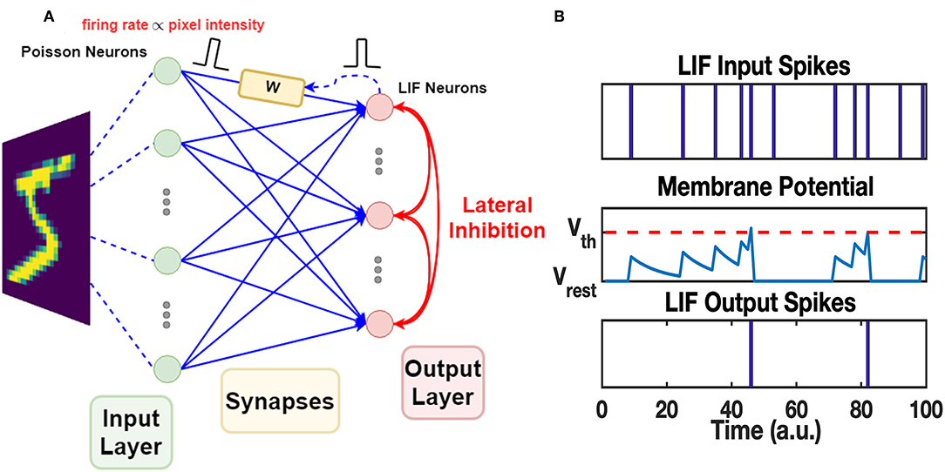
Poisson model of spike generation
Irregular interspike intervals reflect random process
Hypothesis:
Generation of each spike is independent of all the other spikes.
Spike train: completely described by Poisson process
Source: [10]
interspike interval
Hypothesis:
Generation of each spike is independent of all the other spikes.
Notes:
Poisson Process: rare, random events in time/space, e.g. action potentials
Next: PROBLEM

Slide 14
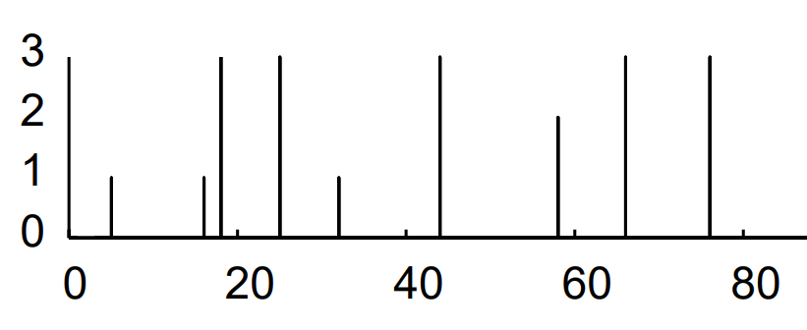
Poisson model of spike generation
Problematic features of neuronal firing
Refractory period
Bursting
Extension of Poisson model
Source: [10]
Non- Poisson features
Source: [11]

Slide 15

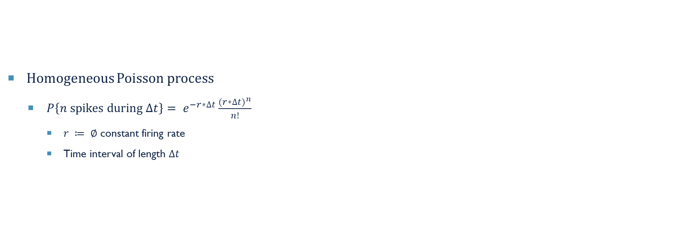
Poisson model of spike generation
Homogeneous Poisson process
$P\left\{n \text{spikes} \text{during} ∆t\right\}= e^{−r∗∆t}\frac{{(r∗∆t)}^{n}}{n!}$
$r ≔ ∅$ constant firing rate
Time interval of length $∆t$
Prerequisite:
Spikes are independent of each other.
Notes:
Poisson probability density function P
Prob of n spike in time interval

Slide 16

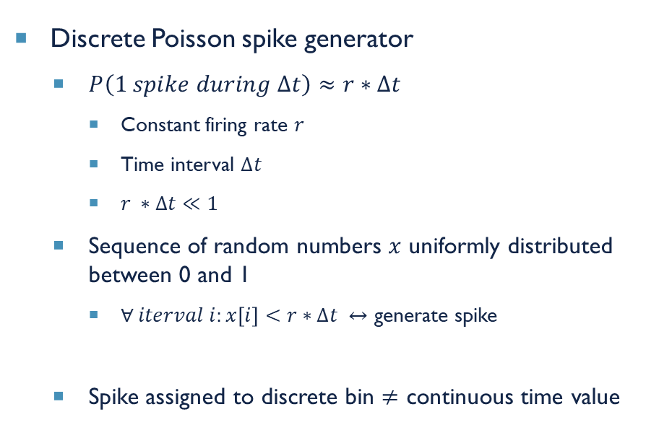

Poisson model of spike generation
Discrete Poisson spike generator
$P\left(1 spike during ∆t\right)≈r∗∆t$
Constant firing rate $r$
Time interval $∆t$
$r ∗∆t≪1$
Sequence of random numbers $x$ uniformly distributed between 0 and 1
$∀ iterval i:x\left[i\right]<r∗∆t ↔$ generate spike
Spike assigned to discrete bin $≠$ continuous time value
Continuous Poisson spike generator
Interspike intervals $i \sim$ exponential distribution
$t_{n+1}= t_{n}+i$
$t_{n}$, $t_{n+1}$ spike times
foundation
∆𝑡 very small
Source: [10]
interspike interval 𝑖
Notes:
Both HOMOGENEOUS poisson process
(1)
Divide time into short intervals
Generate random numbers x
independent spike hypothesis (generation)
Firing rate: spikes/second

Slide 17
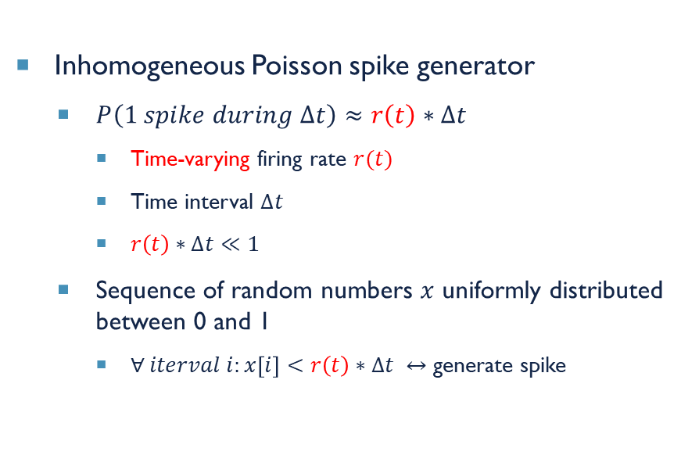
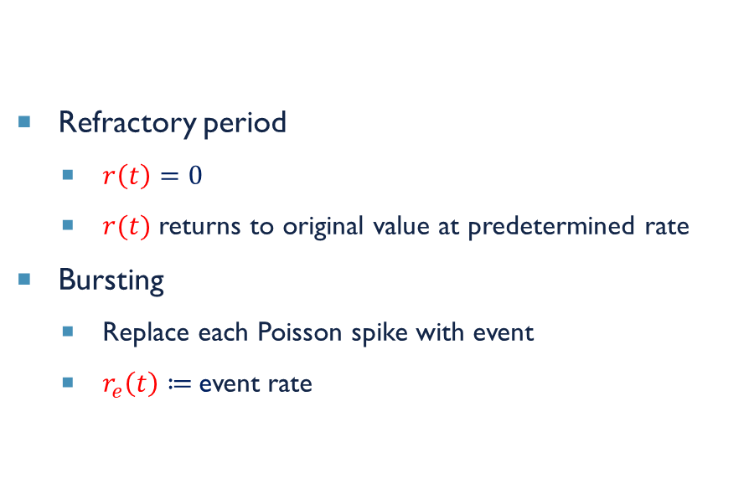
Poisson model of spike generation
Inhomogeneous Poisson spike generator
$P\left(1 spike during ∆t\right)≈r\left(t\right)∗∆t$
Time-varying firing rate $r(t)$
Time interval $∆t$
$r\left(t\right)∗∆t≪1$
Sequence of random numbers $x$ uniformly distributed between 0 and 1
$∀ iterval i:x\left[i\right]<r\left(t\right)∗∆t ↔$ generate spike
Refractory period
$r\left(t\right)=0$
$r(t)$ returns to original value at predetermined rate
Bursting
Replace each Poisson spike with event
$r_{e}\left(t\right)≔$event rate
∆𝑡 very small
Notes:
predetermined rate: e.g. exponential time course
Event = [0, x] spikes
Event rate in paper:
- PDF for #spikes/event
- For each event: draw random #spikes from PDF

Slide 18
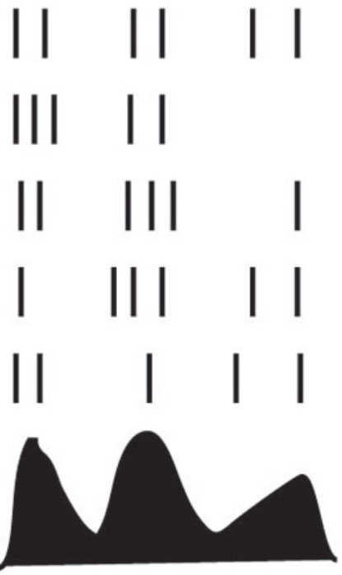
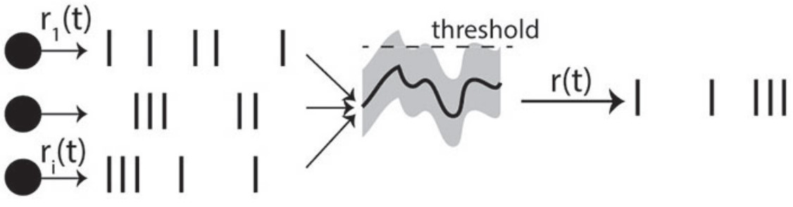

SNN: spikes
Input $\underline{x}∈{\left\{0,1\right\}}^{N}$
$\sum{:}\underline{x} \text{∗} \underline{w}=a$
$σ\left(a\right)$
t
Source: [4]
Notes:
$\sum{:}$ Netzeingabe : $\underline{x}$ * $\underline{w}$ = a
$σ$(a): Aktivierungsfunktion

Slide 19

SNN: spikes
Input $\underline{x}∈{\left\{0,1\right\}}^{N}$
$\sum{:}\underline{x} \text{∗} \underline{w}=a$
$σ\left(a\right)$
Source: [10]
Notes:
$\sum{:}$ Netzeingabe : $\underline{x}$ * $\underline{w}$ = a
$σ$(a): Aktivierungsfunktion
Spike trains

Slide 20
SNN Problem
Biologically plausible
Input values
Temporal dependencies
Optimizing parameters
Source: [10]

Slide 21
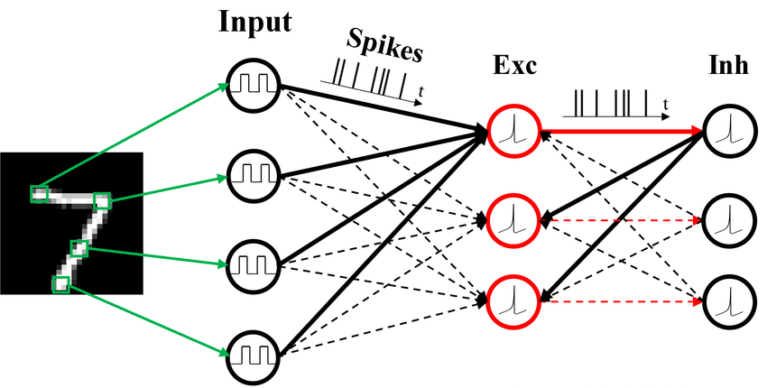

Architecture of snn
Input layer: 28x28 neurons
Preprocessing layer
Excitatory neuros
Inhibitory neurons
$$inhibition \& competition$$
Source: [25]
Notes:
Neuron per input pixel
Input-preprocessing: all-to-all
Exc:inh = 1:1 vs. bio 4:1
Exc-inh: one-to-one
Inh-exc: almost all-to-all

Slide 22
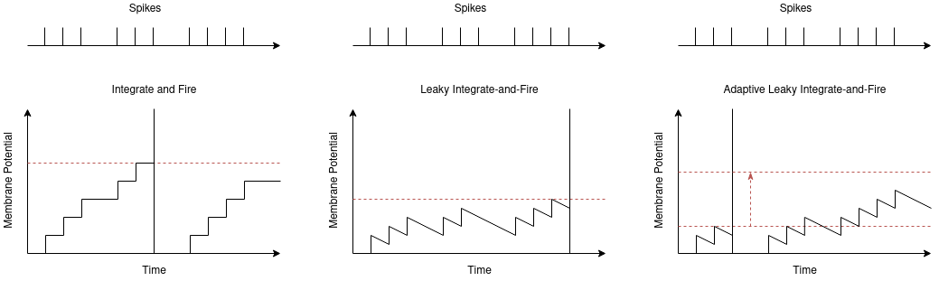

Rate-based learning
Approach:
Train ANN
Backpropagation
Initialize SNN
Weights of ANN
IF neurons
Biologically unrealistic
Source: https://oshears.github.io/adv-ml-2020-snn-project/pages/motivation.html (04.07.2023)

Slide 23
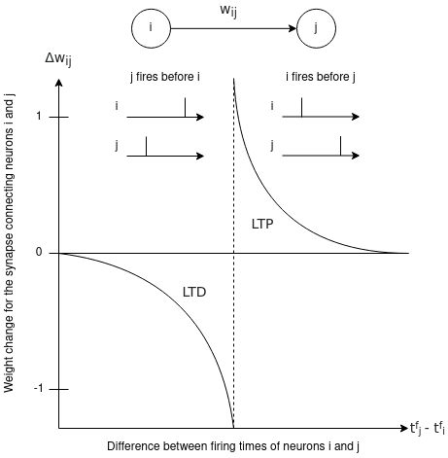


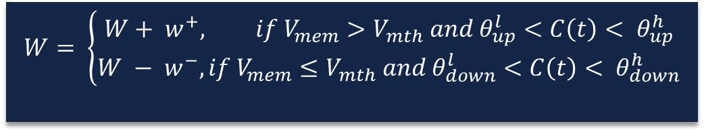
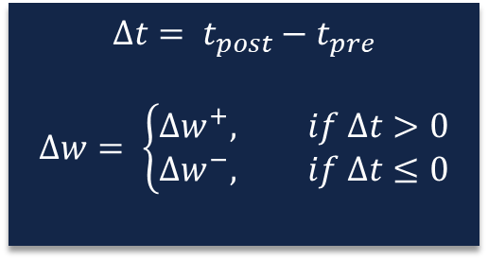
Synaptic plasticity
Mathematic formulae
Activity-dependent modification of synaptic weights
Abstract: timing of spikes
Detailed: state variables
Presynaptic neuron
Postsynaptic neuron
$$w_{ij}$$
i
j
$$∆t= t_{post}−t_{pre}$$
$$∆w= \left\{\begin{aligned}∆w^{+}, if ∆t>0 \\ ∆w^{−}, if ∆t≤0\end{aligned}\right.$$
$$W= \left\{\begin{aligned}W+ w^{+}, if V_{mem}>V_{mth} and θ_{up}^{l}<C\left(t\right)< θ_{up}^{h} \\ W − w^{−},if V_{mem}≤V_{mth} and θ_{down}^{l}<C\left(t\right)< θ_{down}^{h}\end{aligned}\right.$$
=$∆t$
Source: [21]
Notes:
Calcium concentration C(t) (bounds)
Membrane potential $V_{mem}$
Membrane threshold $V_{mth}$
Potentiation $w^{+}$
Depression $w^{−}$
Teaching signals

Slide 24







Spike-timing-dependent plasticity (STDp)
Synaptic learning rule
Synapse weight $\sim$ degree of causality
$∆w=η(x_{pre}−x_{tar}){(w_{max}−w)}^{μ}$
$$dependence on previous weight$$
$$learning rate$$
$$presynaptic trace$$
$$target value$$
$$weight limit$$
Notes:
Strengthen pre-postsynaptic pairs <-> postsyn. Neuron reacts directly after presyn. Neuron fires
(disconnect/weaken else)
$presynaptic trace$: #recent presynaptic spikes (decaying or +=1)
$target value$: of presyn. Trace at moment of postsyn. Spike, #postsyn. Spikes
$x_{pre}$ < $x_{tar} →$no weight increase
Multiple spikes close in time: (1) sum up, (2) certain pairs (nearest)

Slide 25
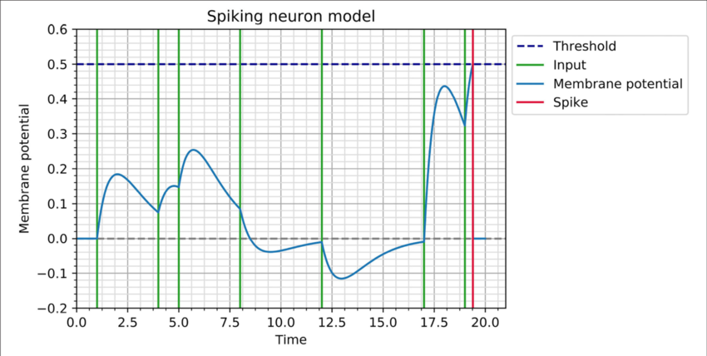
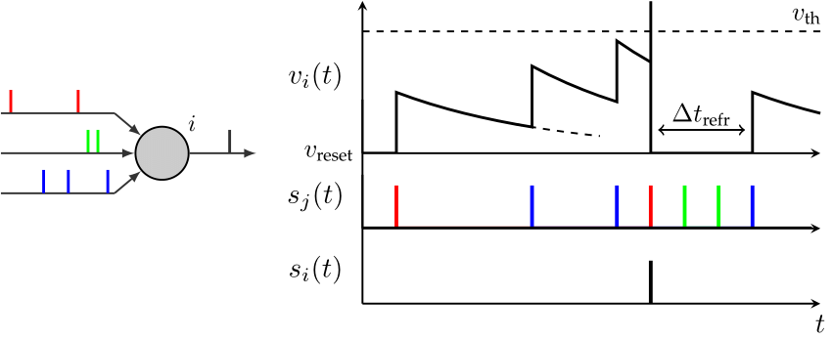



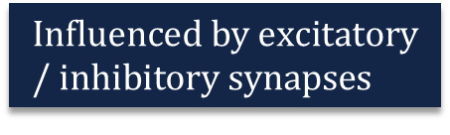
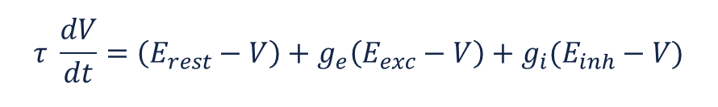


Neuron model
Leaky-integrate-and-fire (LIF) neuron i
Membrane potential $v_{i}\left(t\right)$
Influenced by excitatory/ inhibitory synapses
Decay
$$τ \frac{dV}{dt}=\left(E_{rest}−V\right)+g_{e}\left(E_{exc}−V\right)+g_{i}(E_{inh}−V)$$
$$equilibrium potentials of synapses$$
$$resting membrane potential$$
$$decay$$
$$conductances of synapses$$
$$Influenced by excitatory/ inhibitory synapses$$
Source: [26]
Source: [24]
Notes:
$\left(E_{rest}−V\right)≠0 ↔$ decay
$E_{exc}:$ limits maximum membrane potential
FORMEL nach Bildern

Slide 26



Synapse model
Synapse’s conductance $g_{e}$/ $g_{i}$
Influence of presynaptic neuron on another
Presynaptic spike: $g_{e}+=w_{ij}$
$¬$ Presynaptic spike: decay
$$τ_{ge} \frac{dg_{e}}{dt}=−g_{e}$$
Presynaptic neuron
Postsynaptic neuron
$$w_{ij}$$
i
j
Notes:
$τ_{ge}$: time constant

Slide 27
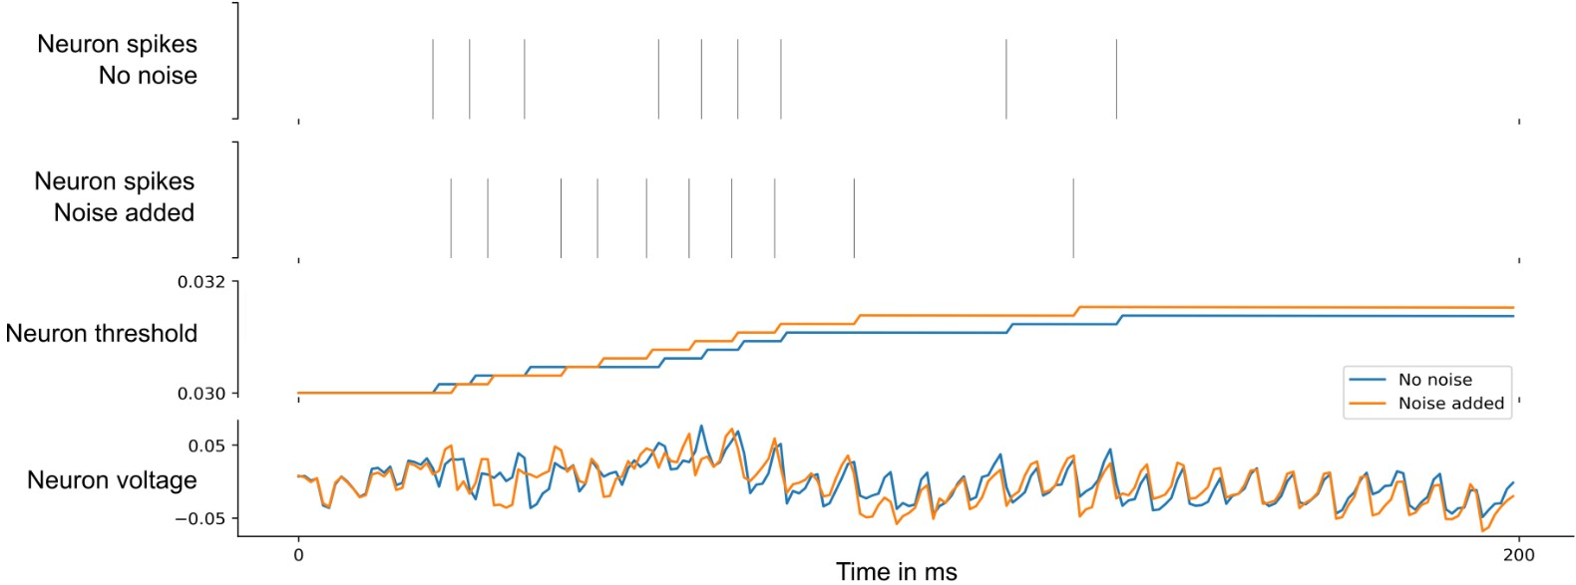
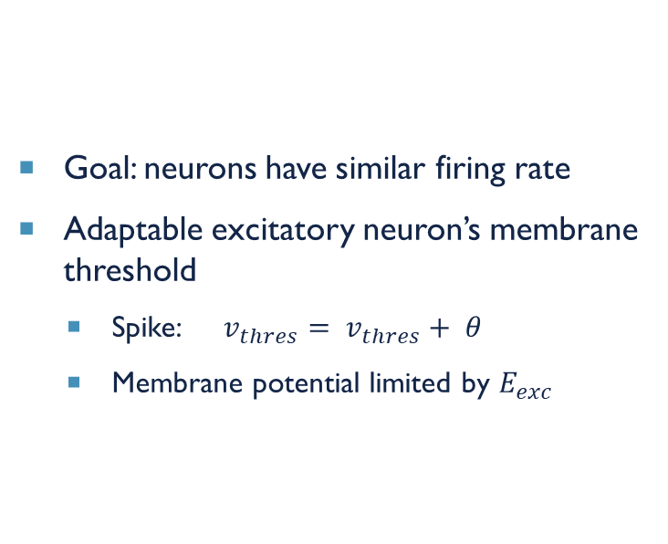
homoeostasis
Goal: neurons have similar firing rate
Adaptable excitatory neuron’s membrane threshold
Spike: $v_{thres}= v_{thres}+ θ$
Membrane potential limited by $E_{exc}$
Source: [27]

Slide 28
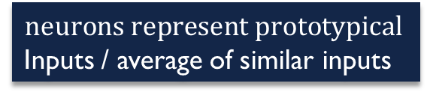
Competitive learning
Lateral inhibition
Prevents too many neurons from becoming too similar
Receptive fields explore input space
Homoeostasis
Similar firing rates
Constant # neuron’s receptive fields similar to input
$$neurons represent prototypical$$
Inputs / average of similar inputs

Slide 29
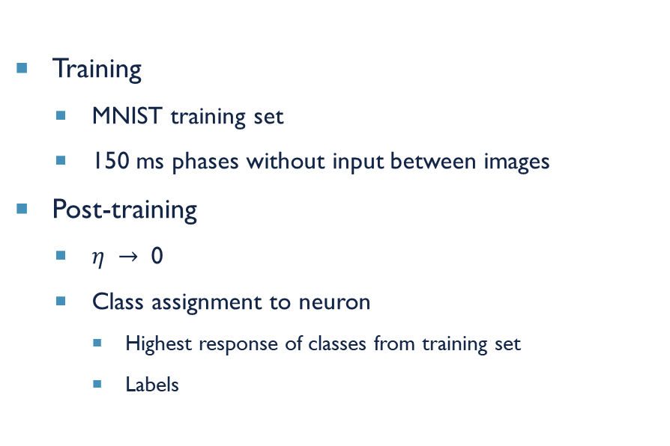
Training & testing
Training
MNIST training set
150 ms phases without input between images
Post-training
$η →$ 0
Class assignment to neuron
Highest response of classes from training set
Labels
Testing
MNIST test set
Predictions
Excitatory neurons
Highest average firing rate
Notes:
Training:
- 60.000 MNIST training set examples
- Neurons decay to resting values (except adaptive threshold)
Post-training:
$η →$ 0 => fix membrane spiking thresholds
Assign class to EXC. Neuron
Acc./Testing:
10.000 MNIST test set examples
Class firing rate: average of neuron firing rates
Max. class firing rate == class

Slide 30
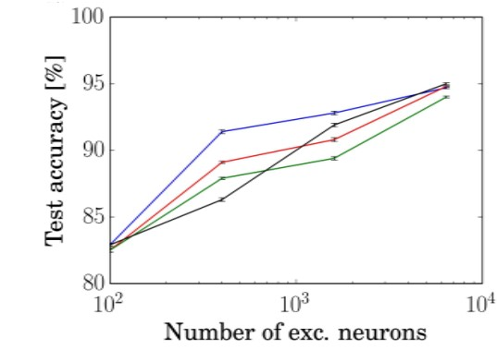
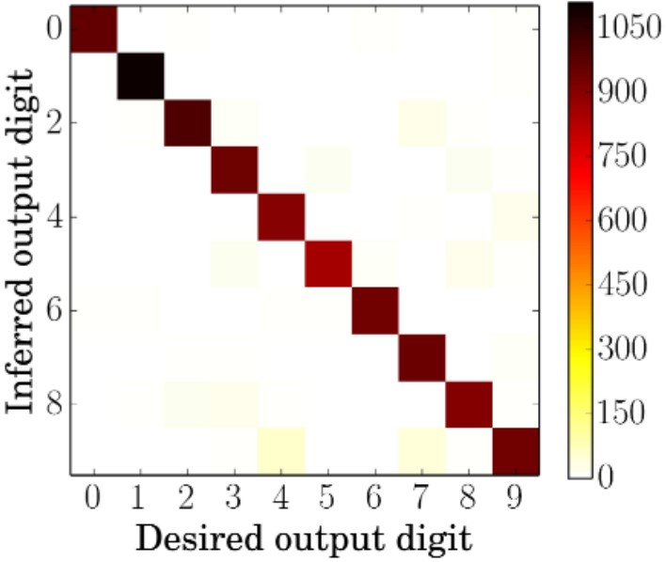
performance
Source: [8]
Source: [8]
Notes:
Colours: learning rules (red: our exponential weight dependence STDP)
6400 EXC. neurons best
4 as 9 most common misclassified digit

Slide 31
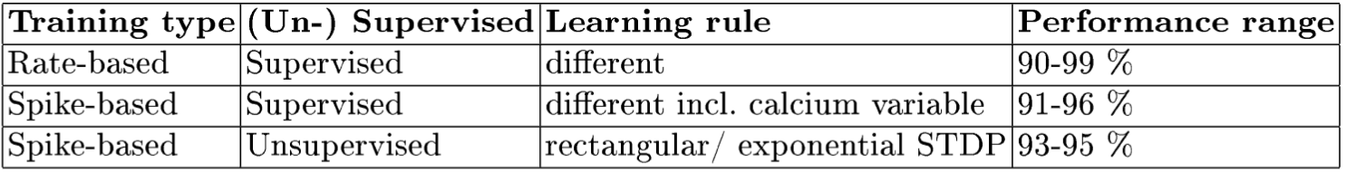
performance
Source: [8]

Slide 32

shortcomings
Difficulties to find equally powerful SNN equivalent to ANN model in reality
Uncertainty whether single model explains STDP at different synapses
Uncertainty with regards to factors, e.g. calcium signals, in certain cell types
Model’s robustness to noisy input sensor signals unclear for some models
Representation of input patterns
Hardware
$$future research$$
Notes:
Neuromorphic hardware:
bilden direkt in Hardware Funktionsweise von Neuronen nach
zwischen Neuronen gibt es physisches Verbindungsnetz (Bus-System)
Von Neumann architecture (!= processing many small messages)

Slide 33
References
1. Azghadi, M.R., Iannella, N., Al-Sarawi, S.F., Indiveri, G., Abbott, D.: Spike-based synaptic plasticity in silicon: Design, implementation, application, and challenges.vIEEE 102, 717-737 (2014)
2. Beyel, M., Dutt, N.D., Krichmar, J.L.: Categorization and decision-making in a neurobiologically plausible spiking network using a stdp-like learning rule. Elsevier 48, 109-124 (2013)
3. Bi, G., Poo, M.: Synaptic modifications in cultured hippocampal neurons: dependence on spike timing, synaptic strength, and postsynaptic cell type. The journal of Neuroscience pp. 10464-10472 (1998)
4. Brette, R.: Philosophy of the spike: Rate-based vs. spike-based theories of the brain. Frontiers in Systems Neuroscience 9, 1-14 (2015)
5. Caporale, N., Dan, Y.: Spike timing-dependent plasticity: A hebbian learning rule. Annual Review of Neuroscience 31, 25-46 (2008)
6. Cook, M., Diehl, P.U.: Unsupervised learning of digit recognition using spike-timing-dependent plasticity. Frontiers in Computational Neuroscience 9, 1-8 (2015)
7. Diehl, P.U., Neil, D., Binas, J., Cook, M., Liu, S.C., Pfeiffer, M.: Fast-classifying, high-accuracy spiking deep networks through weight and threshold balancing. International joint conference on neural networks (IJCNN). IEEE pp. 1-8 (2015)
8. Goodman, D., Brette, R.: Brian: a simulator for spiking neural networks in python. Frontiers in Neuroscience 2, 1-10 (2008)
9. Guo, W., Fouda, M.E., Eltawil, A.M., Salama, K.N.: Neural coding in spiking neural networks: A comparative study for robust neuromorphic systems. Frontiers in Neuroscience 15, 1-21 (2021)
10. Guo, Y., Wu, H., Gao, B., Qian, H.: Unsupervised learning on resistive memory array based spiking neural networks. Frontiers in Neuroscience 13, 1-16 (2019)
11. Heeger, D.: Poisson model of spike generation. New York University 1, 1-13 (2000)
12. Indiveri, G., Chicca, E., Douglas, R.: A vlsi array of low-power spiking neurons and bistable synapses with spike-timing dependent plasticity. IEEE Transactions on Neural Networks 17, 211221 (2006)
13. Kheradpisheh, S.R., Ganjtabesh, M., Masquelier, T.: Bio-inspired unsupervised learning of visual features leads to robust invariant object recognition. Neurocomputing 205, 383392 (2016)
14. Kim, J., Kim, S.P., Hwang, H., Park, D., Jeong, U.: Object shape recognition using tactile sensor arrays by a spiking neural network with unsupervised learning. IEEE pp. 178183 (2020)
15. Lopes, P.H.C., Reid, I., Hobson, P.R.: The two-dimensional Kolmogorov-Smirnov test. XI International Workshop on Advanced Computing and Analysis Techniques in Physics Research pp. 112 (2007)
16. Masquelier, T., Thorpe, S.J.: Unsupervised learning of visual features through spike timing-dependent plasticity. PLoS Computational Biology 3, 247257 (2007)
17. Morrison, A., Aertsen, A., Diesmann, M.: Spike-timing-dependent plasticity in balanced random networks. Neural Computation 19, 14371467 (2007)
18. O'Connor, P., Neil, D., Liu, S., Delbruck, T., Pfeiffer, M.: Real-time classification and sensor fusion with a spiking deep belief network. frontiers in neuroscience 7, pp. 1-13 (2013)
19. Poster, J.P., Gerstner, W.: Triplets of spikes in a model of spike timing-dependent plasticity. The Journal of Neuroscience pp. 9673-9682 (2006)
20. Rathi, N., Roy, K.: Diet-snn: A low-latency spiking neural network with direct input encoding and threshold optimization. IEEE Transactions on Neural Networks and Learning Systems pp. 1-19 (2021)
21. Shears, O., Yazdani, A.H.: Spiking neural networks for image classification, https://oshears.github.io/adv-ml-2020-snn-project/pages/motivation.html
22. amd X. Lagorce, F.G., Stromatias, R., Pfeiffer, M., Plana, L.A., Furber, S.B., Benosman, R.B.: A framework for plasticity implementation on the spinnaker neural architecture. Frontiers in Neuroscience 8, 1-20 (2015)
23. https://openbooks.lib.msu.edu/neuroscience/chapter/synapse-structure/ (19.06.23)
24. https://www.researchgate.net/figure/A-model-of-a-LIF-neuron-The-graphic-right-shows-the-temporal-course-of-the-membrane_fig6_326696777 (03.07.23)
25. https://www.researchgate.net/figure/The-architecture-of-a-spiking-neural-network-SNN-The-network-consists-of-an-input_fig1_342529143 (03.07.2023)
26. https://www.researchgate.net/figure/Illustration-of-membrane-potential-dynamics-for-a-neuron-with-th-05-and-t-1-The_fig1_353893118 (04.07.23)
27. Darjan Salaj, Anand Subramoney, Ceca Kraisnikovic, Guillaume Bellec, Robert Legenstein, Wolfgang Maass (2021) Spike frequency adaptation supports network computations on temporally dispersed information eLife 10:e65459https://doi.org/10.7554/eLife.65459

Slide 34
Neuron models
Source: [TODO] 04.07.2023 https://oshears.github.io/adv-ml-2020-snn-project/pages/motivation.html

Slide 35
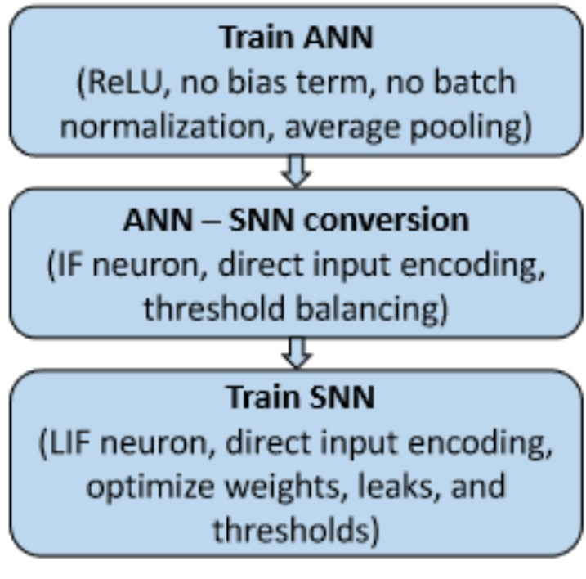
ANN-SNN-Transformation
Source: [20]

