Slide 1

Collectivity
Collective + Connecting

Slide 2
What is it?
A platform that tries to promote a collective lifestyle that alienates us from Capitalism.
“Sharing is Caring”

Slide 3
How does it do that?
Freebies
Objects you can donate. Why? So people don’t acquire new ones. That way, we minimize consumption, waste and we fight programmed obsolescence.
TimeBanks
It is a feature to share your skills. Your know how. For example, if you are a plumber, you can offer to fix pipes two hrs a week.

Slide 4
Why?
It is based on the idea that us, as human beings, always have something to contribute and we always have a value we can add to this society. This value, has nothing to do with our bank account statements. We are all worth something.

Slide 5
What makes US different?
There are other pages that allow you to share items..
We implemented a rating system
Geolocation
You don’t just share THINGS

Slide 6
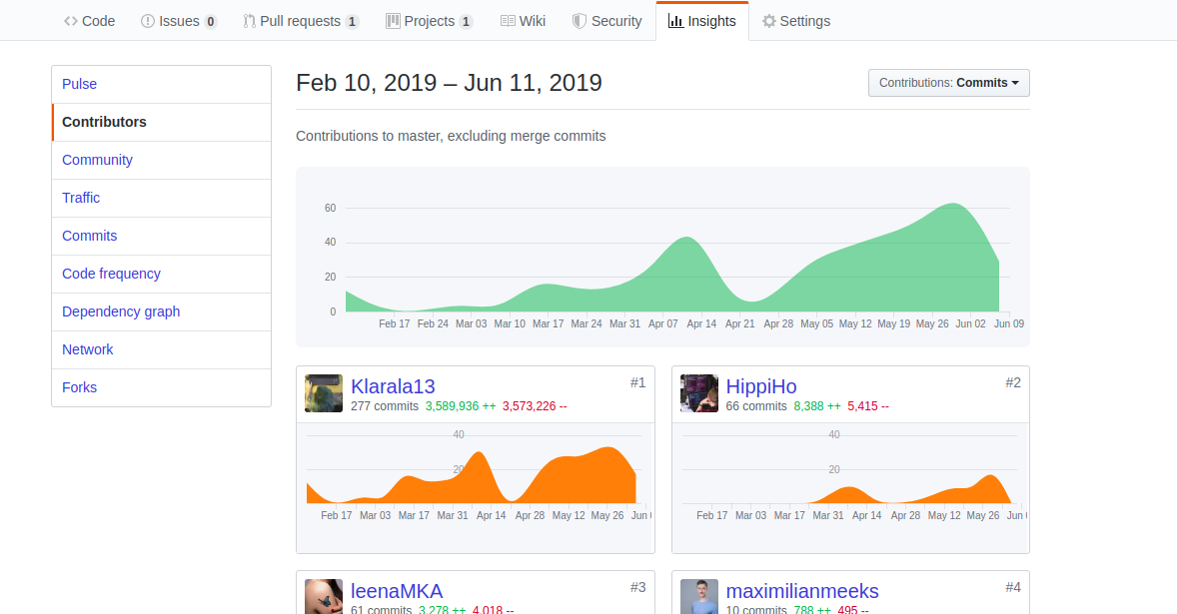
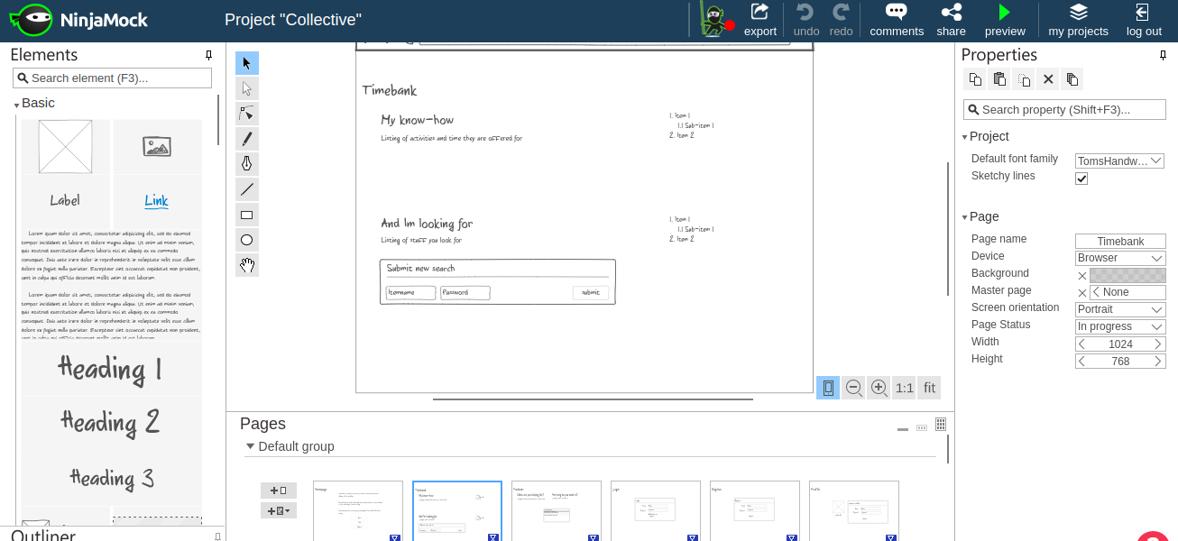
The project
So, on February 2019, I started to build this huge idea by myself… until we made it our group project and it became, the amazing product we will now show u…

Slide 7
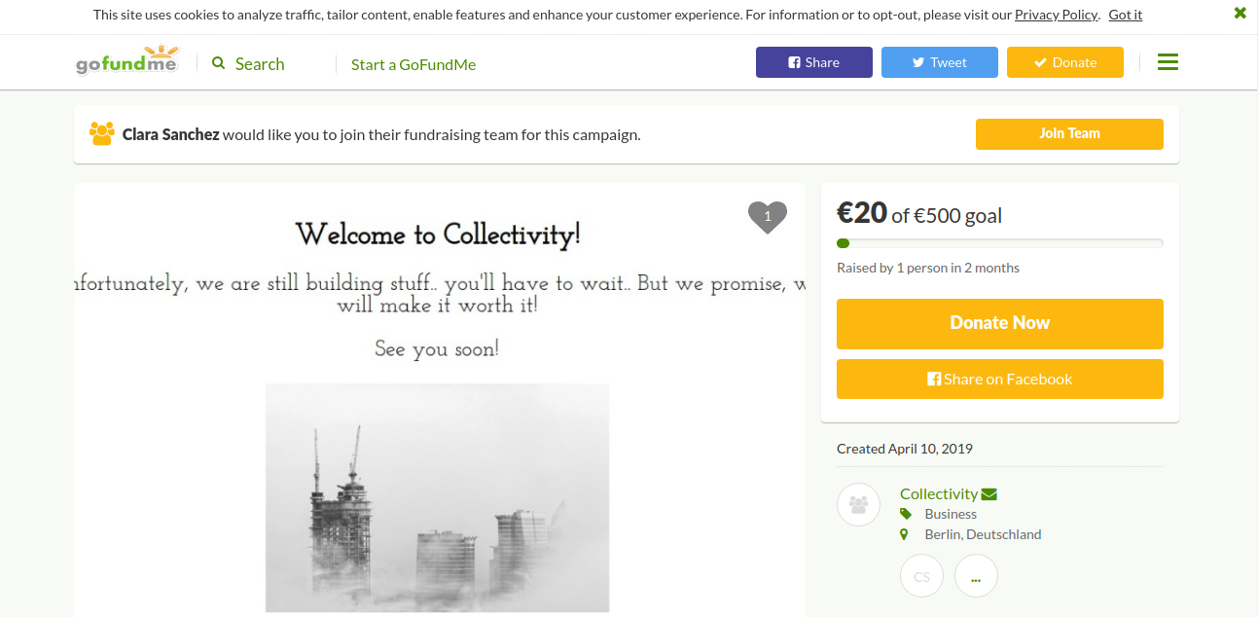
Crowdfunding and call for coworkers from all over the world

Slide 8
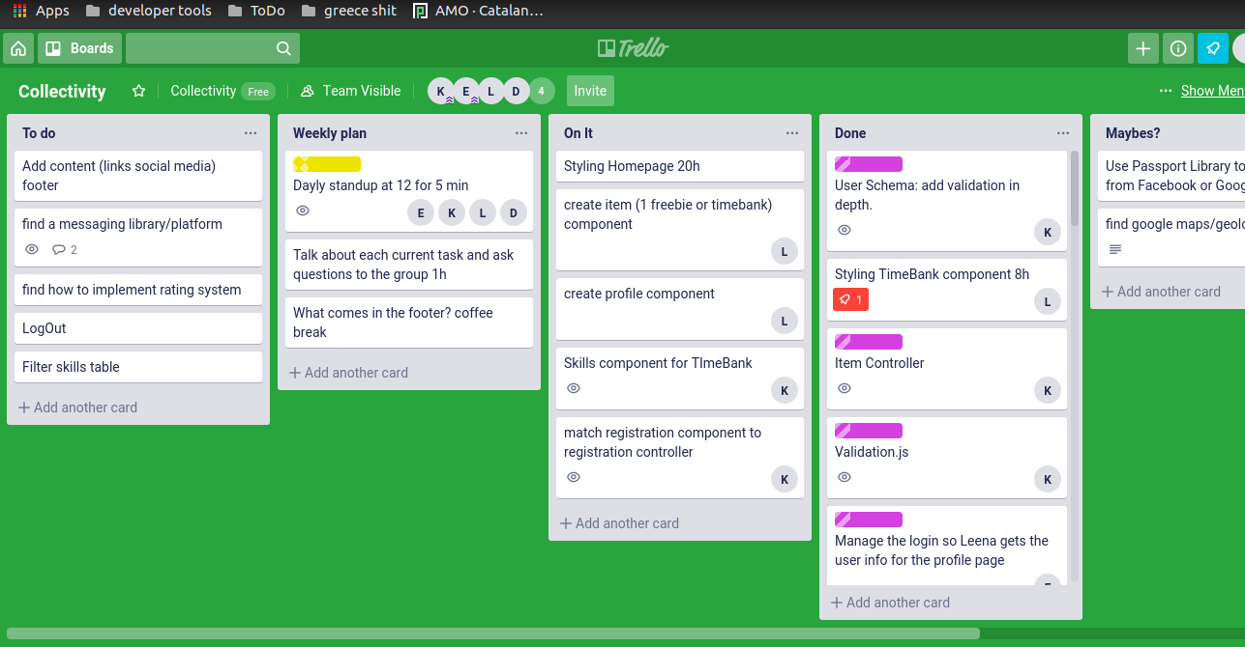
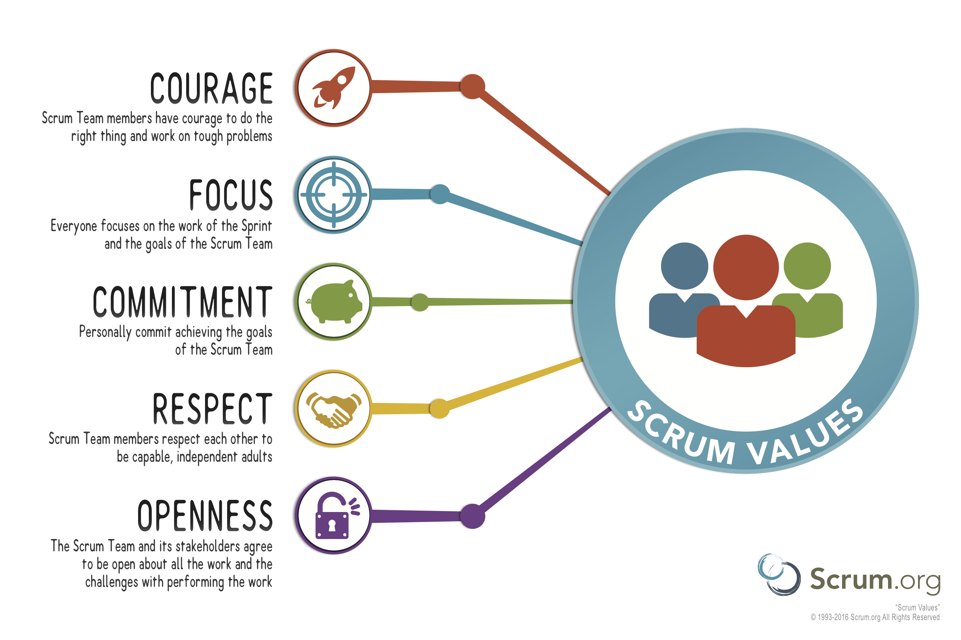
Becoming a team

Slide 9
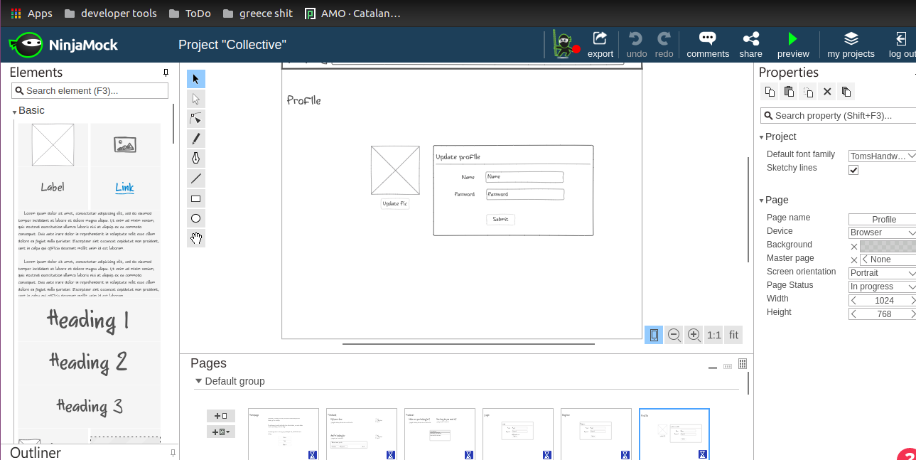
Start of design

Slide 10
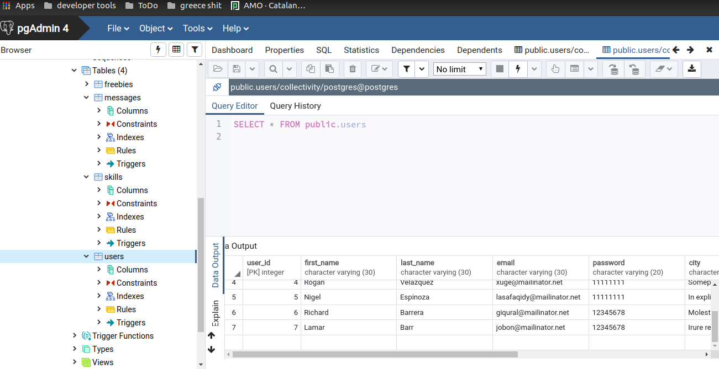
PostgreSQL & pgAdmin4

Slide 11
Techstack
Linux / Ubuntu & IOS
Javascript / ES6
React.js & HTML5
Bootstrap & CSS3
Node.js
PostgreSQL & pgAdmin4
Docker
Trello (Agile method)

