Slide 1
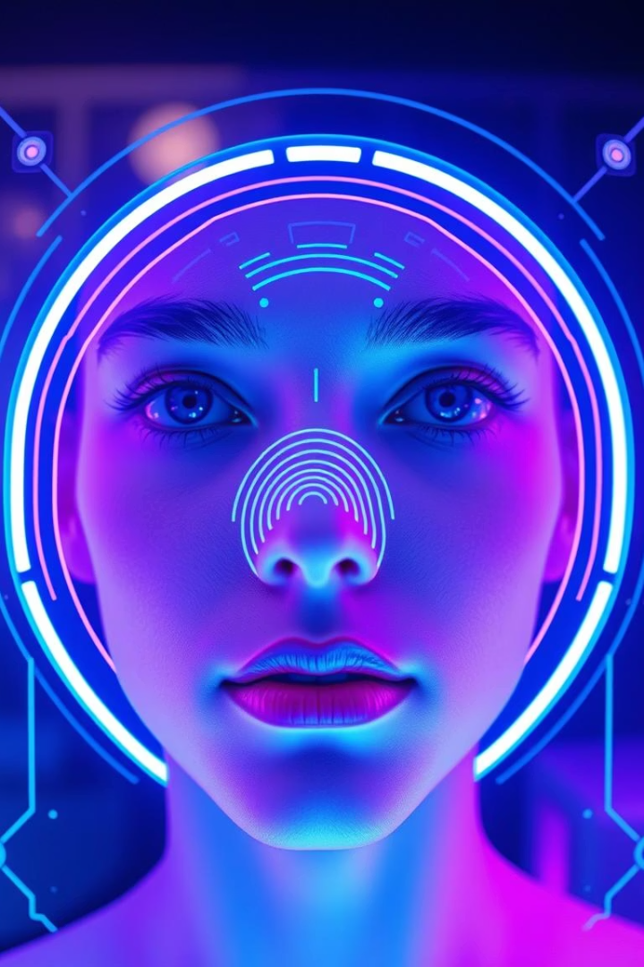

The Future of IT in Biometrics: Beyond Recognition
Explore the transformative trends shaping biometrics. From AI to privacy, discover how IT drives innovation in identity verification.
by Лев Кузнецов

Slide 2
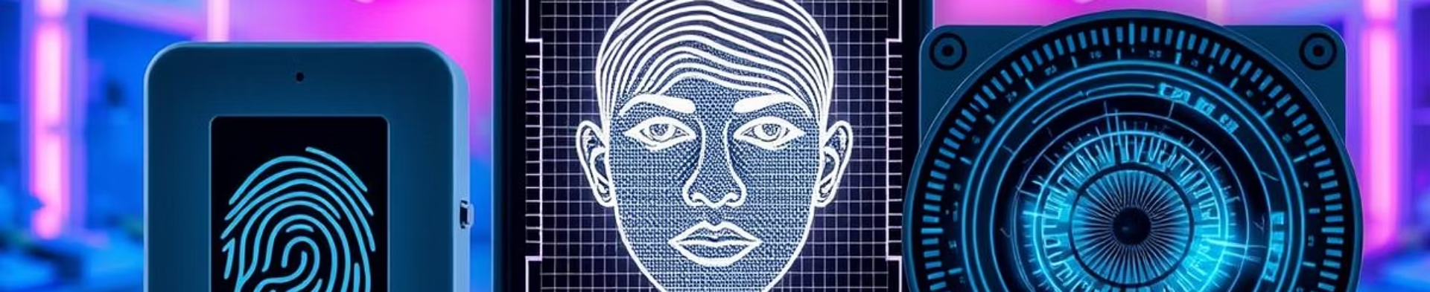
Current State of Biometrics: A Quick Review
Market Growth
Core Technologies
Adoption
From $36.6B in 2023 to $86.1B by 2029 (15.4% CAGR)
Fingerprint (28%)
86% of smartphones use biometrics for authentication
Facial Recognition (22%)
Iris Scanning (15%)

Slide 3
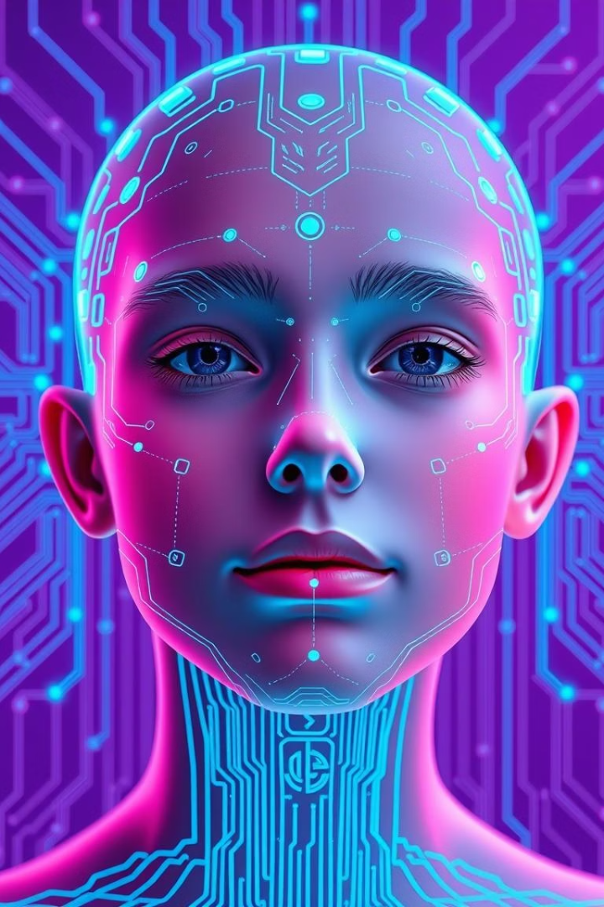



Trend 1: AI and Deep Learning Integration
Accuracy Boost
Faster Matching
Innovative Uses
Facial recognition hits 99.97% accuracy in tests
Deep learning speeds biometric matching by 40%
AI analyses gait for early Parkinson's detection

Slide 4
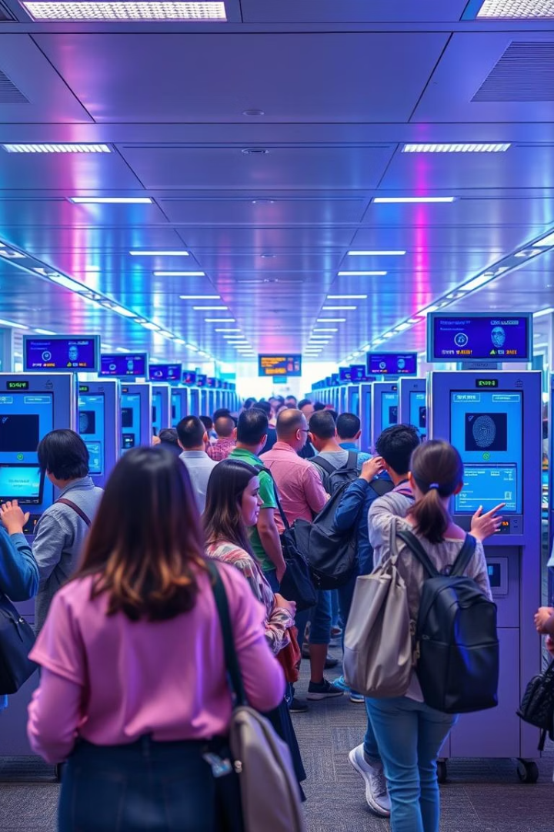
Trend 2: Multi-Modal Biometrics for Enhanced Security
Error Reduction
Spoofing Protection
Combining face, voice, and fingerprint cuts errors by 60%
Liveness detection with multiple sensors prevents fraud
Seamless Travel
Airports use iris and facial scans for fast passenger flow

Slide 5
Trend 3: Biometric IoT and Edge Computing
Smart Integration
Edge Computing
In-Car Monitoring
Biometric authentication in home devices and assistants
Real-time data processing reduces latency and boosts privacy
Driver’s face and heartbeat detect health and enable ignition

Slide 6




Trend 4: Blockchain and Biometric Identity
Decentralised Security
Blockchain protects biometric data from tampering
Privacy Enhancement
Secure, transparent biometric identity management systems
Real-World Example
Estonia's e-Residency uses blockchain to verify identity

Slide 7




Ethical and Privacy Considerations
Data Security
Privacy Compliance
Strong encryption like AES-256 and SHA-3 prevents breaches
GDPR mandates transparent data collection and usage
1
2
Regulatory Oversight
4
3
Bias Mitigation
UK Biometrics Commissioner ensures ethical use
AI models trained on diverse data reduce discrimination

Slide 8
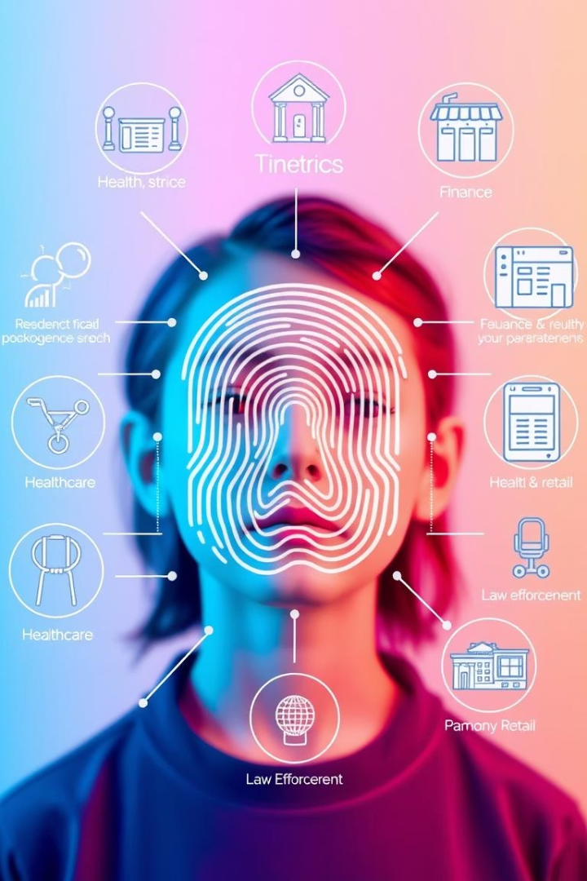
The Future is Here: Applications and Opportunities
Healthcare
Wearables for remote monitoring and drug adherence
Finance
Behavioural biometrics detect fraud using keystrokes
Retail
Emotion and facial recognition personalise shopping
Law Enforcement
Real-time facial recognition speeds suspect ID
Biometrics will soon be invisible and integrated everywhere.

