Slide 1
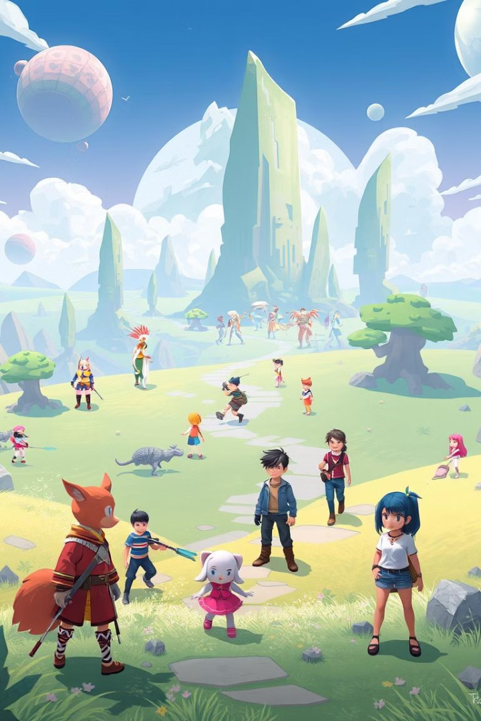

The World of Video Game Development
Explore the exciting profession of a game developer. The global video game market exceeded $200 billion in 2023. Over 3 billion gamers worldwide enjoy immersive experiences.
by Лев Кузнецов

Slide 2





Roles in Game Development
Programmers
Designers
Artists
Develop core logic and engine using C++ and C#.
Shape gameplay, levels, and systems with Unity and Unreal Engine.
Create visual assets, characters, and environments using Maya, Blender, and Photoshop.
Audio Engineers
Producers
Produce sound effects, music, and voiceovers with FMOD and Wwise.
Manage projects, schedules, and team coordination.

Slide 3

Essential Skills and Qualifications
$70K
Avg. Salary
Annual income range for game developers in the US.
$120K
Top-End Salary
Potential annual earnings for experienced professionals.
Technical skills include programming languages, game engines, and software proficiency. Creative skills involve design thinking and visual storytelling. Soft skills are teamwork, communication, problem-solving, and adaptability. Key tools are Unity, Unreal Engine, Git, Jira, and Perforce.

Slide 4
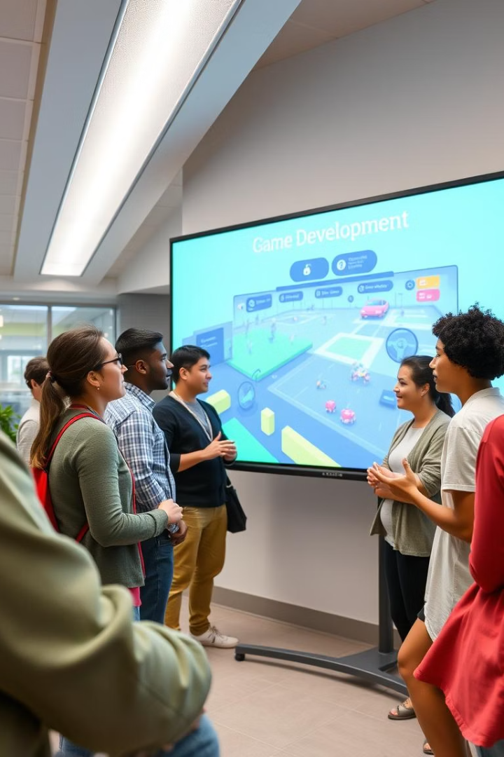
Education and Training Pathways
Bachelor'H4> Degrees in Computer Science or Game Design.
Specialized Programs
Game development bootcamps and vocational courses.
Online Resources
Tutorials, courses, and community forums from Coursera and Udemy.
Portfolio
Showcase personal projects and contributions.
Major companies include Electronic Arts (EA), Activision Blizzard, Ubisoft, Nintendo, and Sony.

Slide 5





Day-to-Day Responsibilities
Coding & Debugging
Writing clean, efficient code and resolving issues.
Design & Implementation
Crafting and integrating gameplay mechanics.
Asset Integration
Creating and adding visual components.
Team Collaboration
Working with cross-functional teams.
Testing & Refinement
Ensuring game features work flawlessly.
Meetings include daily stand-ups, sprint planning, and design reviews. Common workflows are Agile, Scrum, and Waterfall.

Slide 6
Industry Trends and Technologies
VR/AR Gaming
Blockchain & NFTs
Immersive experiences through Virtual and Augmented Reality.
Integration of digital assets and decentralized ownership.
AI & Machine Learning
Cloud Gaming
Enhancing gameplay and player experiences.
Streaming games on demand from remote servers.
Market Growth
Mobile Gaming
Expected 9% CAGR through 2028.
Development for iOS and Android platforms.

Slide 7
Career Paths and Opportunities
Entry-Level
1
Junior Programmer, Associate Designer, Assistant Artist.
Mid-Level
2
Game Programmer, Game Designer, 3D Artist.
Senior-Level
3
Lead Programmer, Lead Designer, Art Director.
Opportunities also exist in Indie Game Development and Contract Work as a freelancer.

Slide 8








Conclusion: Is Game Development for You?
Creativity
Passion
Innovation in design and storytelling.
Love for games drives dedication.
Continuous Learning
Technical Skills
Staying updated with new technologies.
Proficiency in coding and software.
Game development is an exciting and rewarding career. Promotion typically takes 2-3 years. Adaptability and continuous learning are essential for success.

