Slide 1
AI for work and productivity
Final project presentation
Lassané Kaboré
29 June 2025

Slide 2
Outline
Problem addressed
Proposed solution and workflow
Key features and limitations of AI tools used
Opportunity for improvement

Slide 3
Problem addressed
Develop an E-book with AI assistance, titled: Public Health, Epidemiology, and Clinical Research: 100 Essential Concepts Made Easy.
Convert E-book to flashcards
Develop a website to host and promote E-book
Distribute E-book free, but require email before download

Slide 4
Proposed solution and workflow
Used various GPTs (o3, o4 mini, o4 mini high) to brainstorm and cocreate content
Developed a Word doc containing the 100 concepts, consistently expanded with a) Definition, b) Example, c) Significance
Some struggle from Word doc to flashcards in PDF. No success with ChatGPT or Claude or Canva. Cursor worked!
Cursor critical in coding the website, deployed in GitHub
Another AI tool (https://formspree.io/) used to collect visitors' emails
ChatGPT used to create a visual (flyer) to promote the eBook.

Slide 5
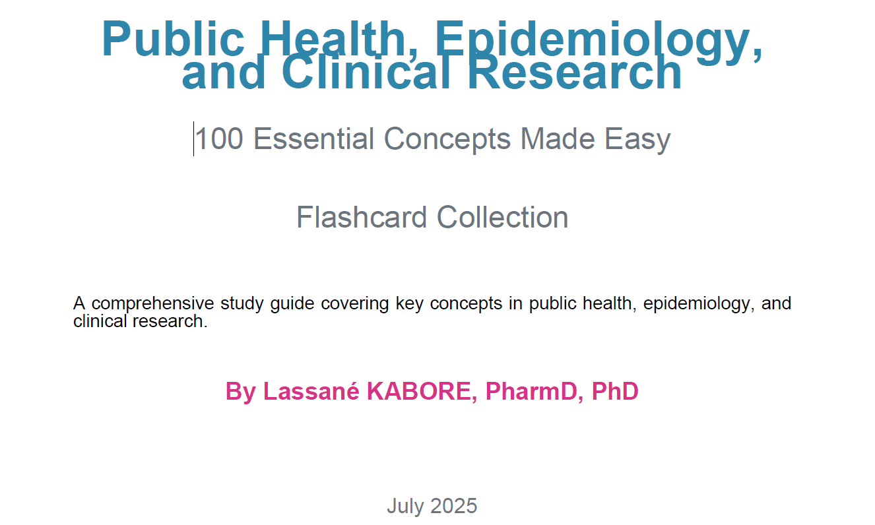
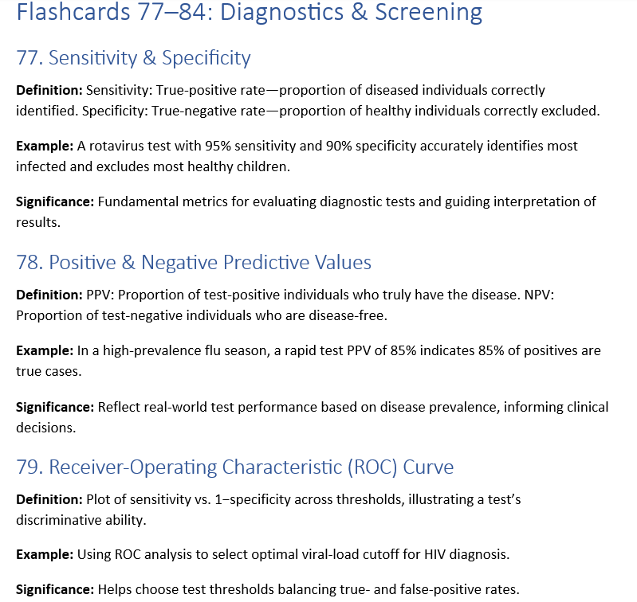
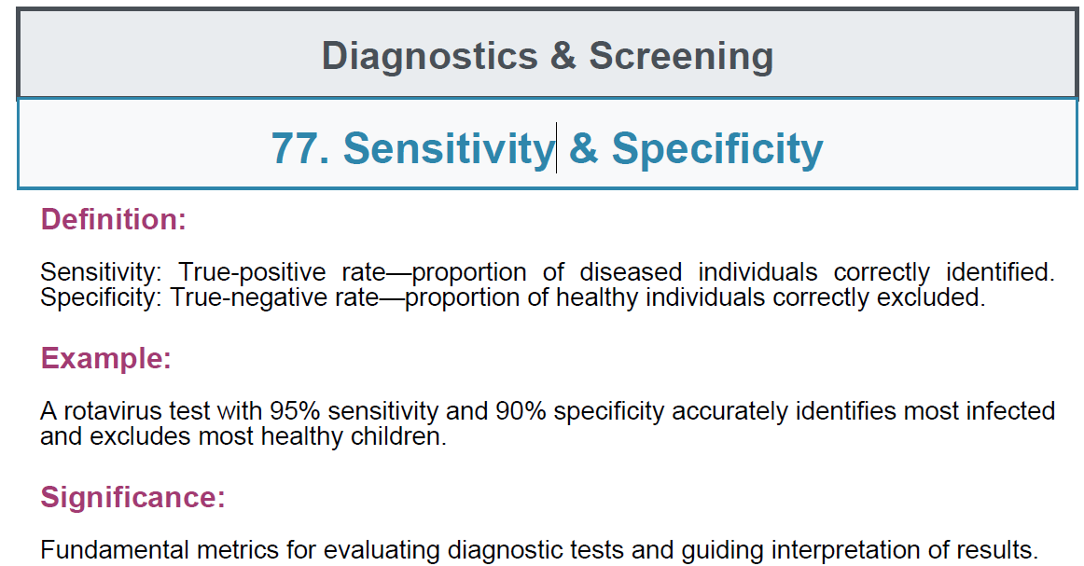
Proposed solution and workflow

Slide 6
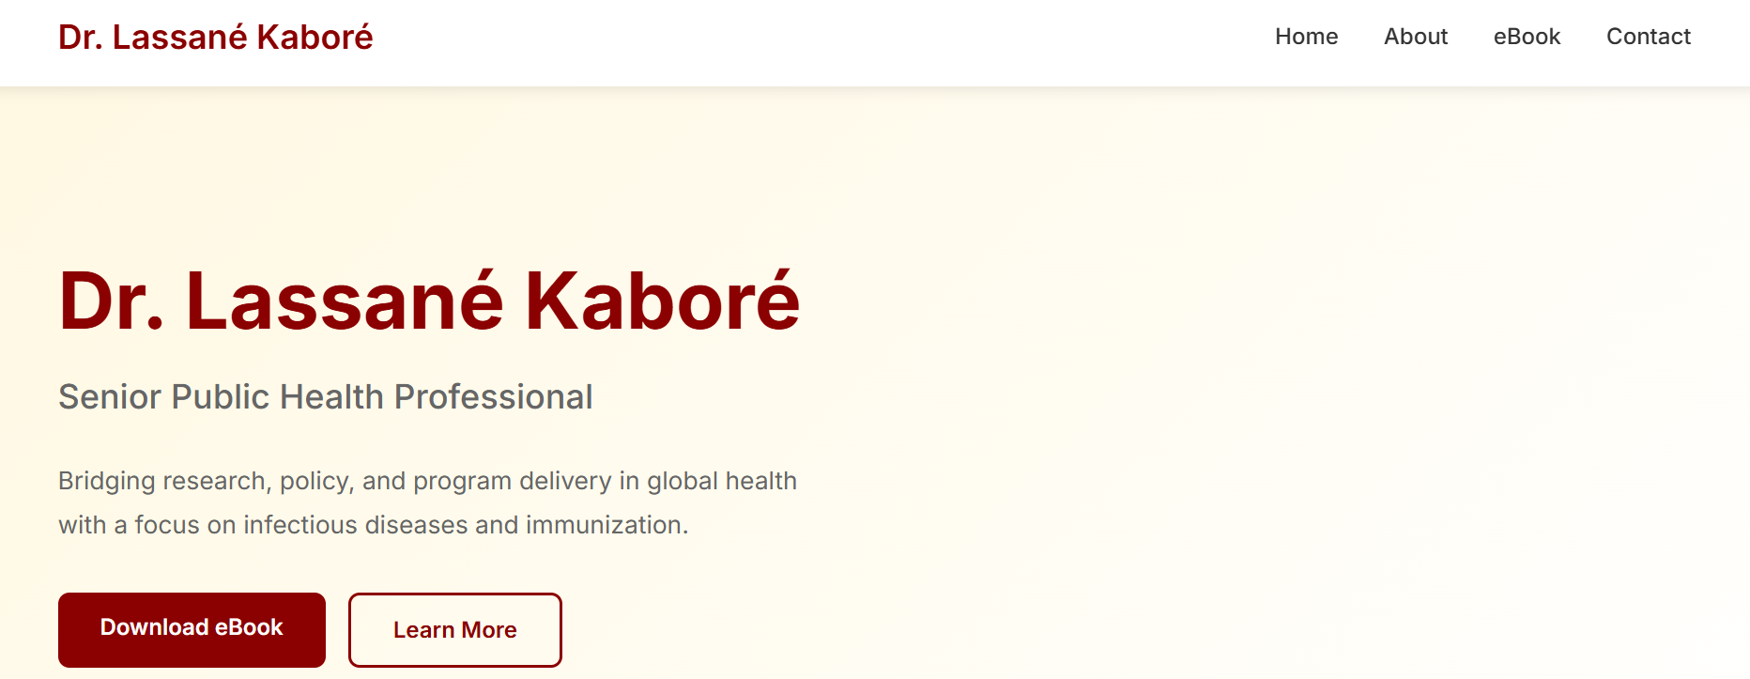
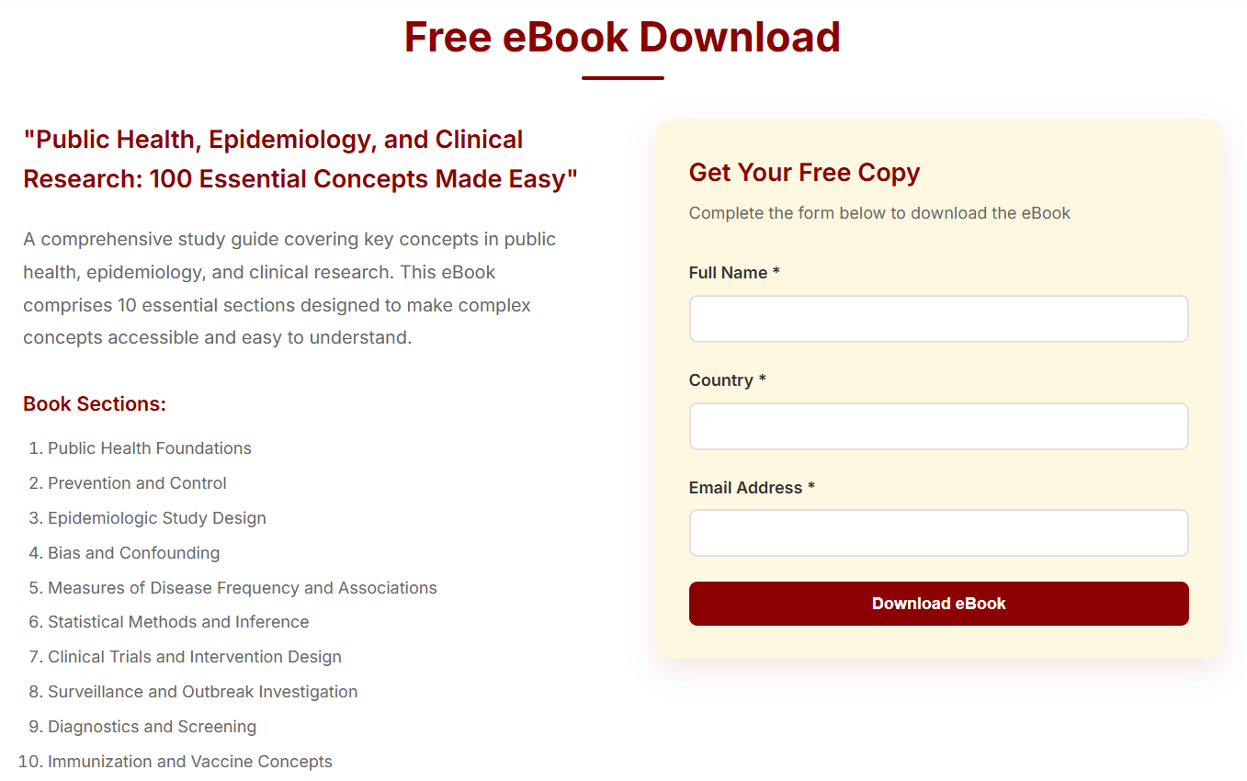
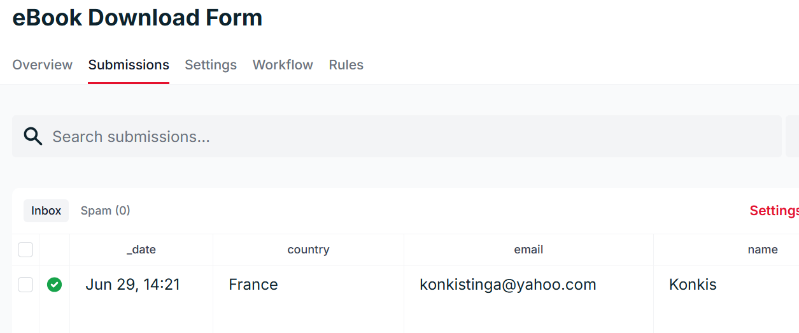
https://klass2024.github.io/final_project_ebook2025/
https://formspree.io/forms/manjarak/submissions

Slide 7
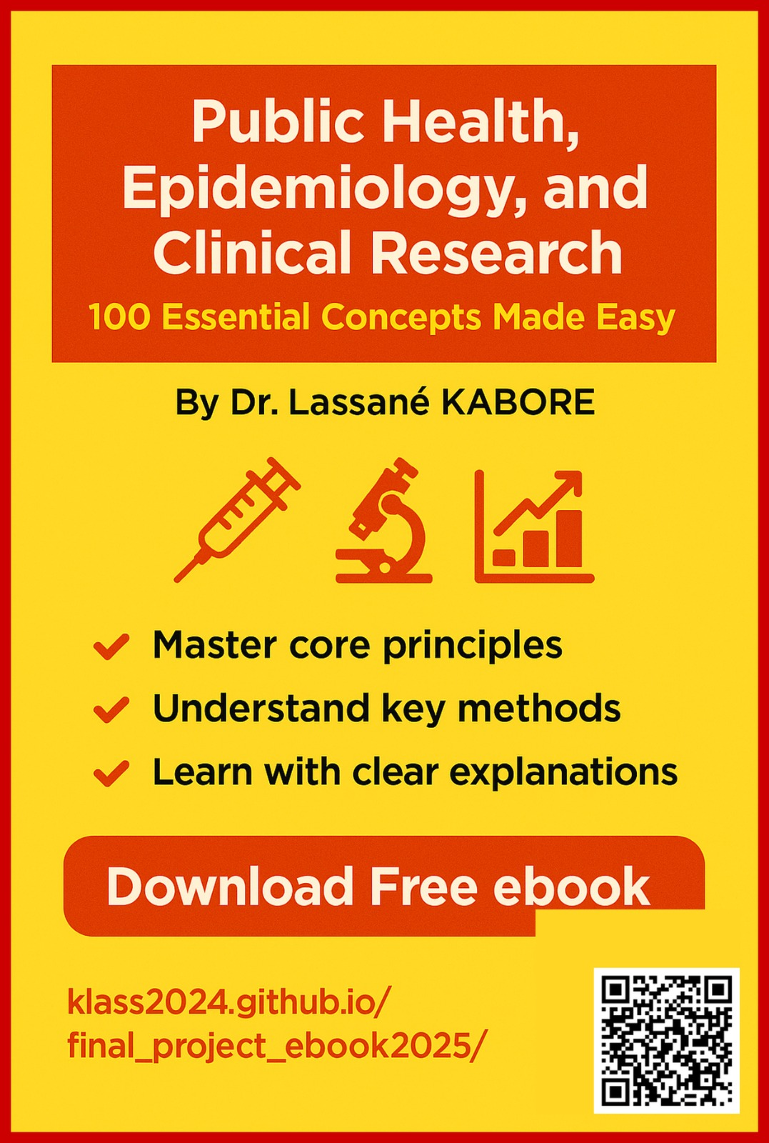
E-book campaign flyer

Slide 8
Key features and limitations of AI tools used
ChatGPT: Good for brainstorming and generation of textual material. Ok for visuals such as flyers. Wasn’t so good at coding.
Claude (free version): Good at coding but quickly reaches free plan limits.
Canva: you need some practice.
Cursor: best tool in this project, for flashcard production, and for website coding.

Slide 9
Opportunity for improvement
Improve the design of flashcards to professional printing standards
Further leverage AI to promote the book, manage “clients”, and potentially sell

