Slide 1
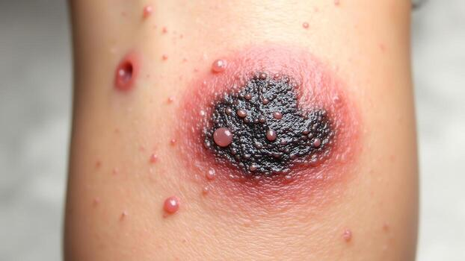
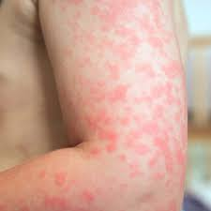
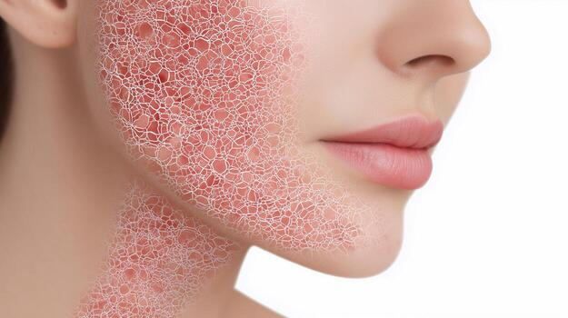
EPIDEXA
AI-powered app for early skin condition detection.

Slide 2

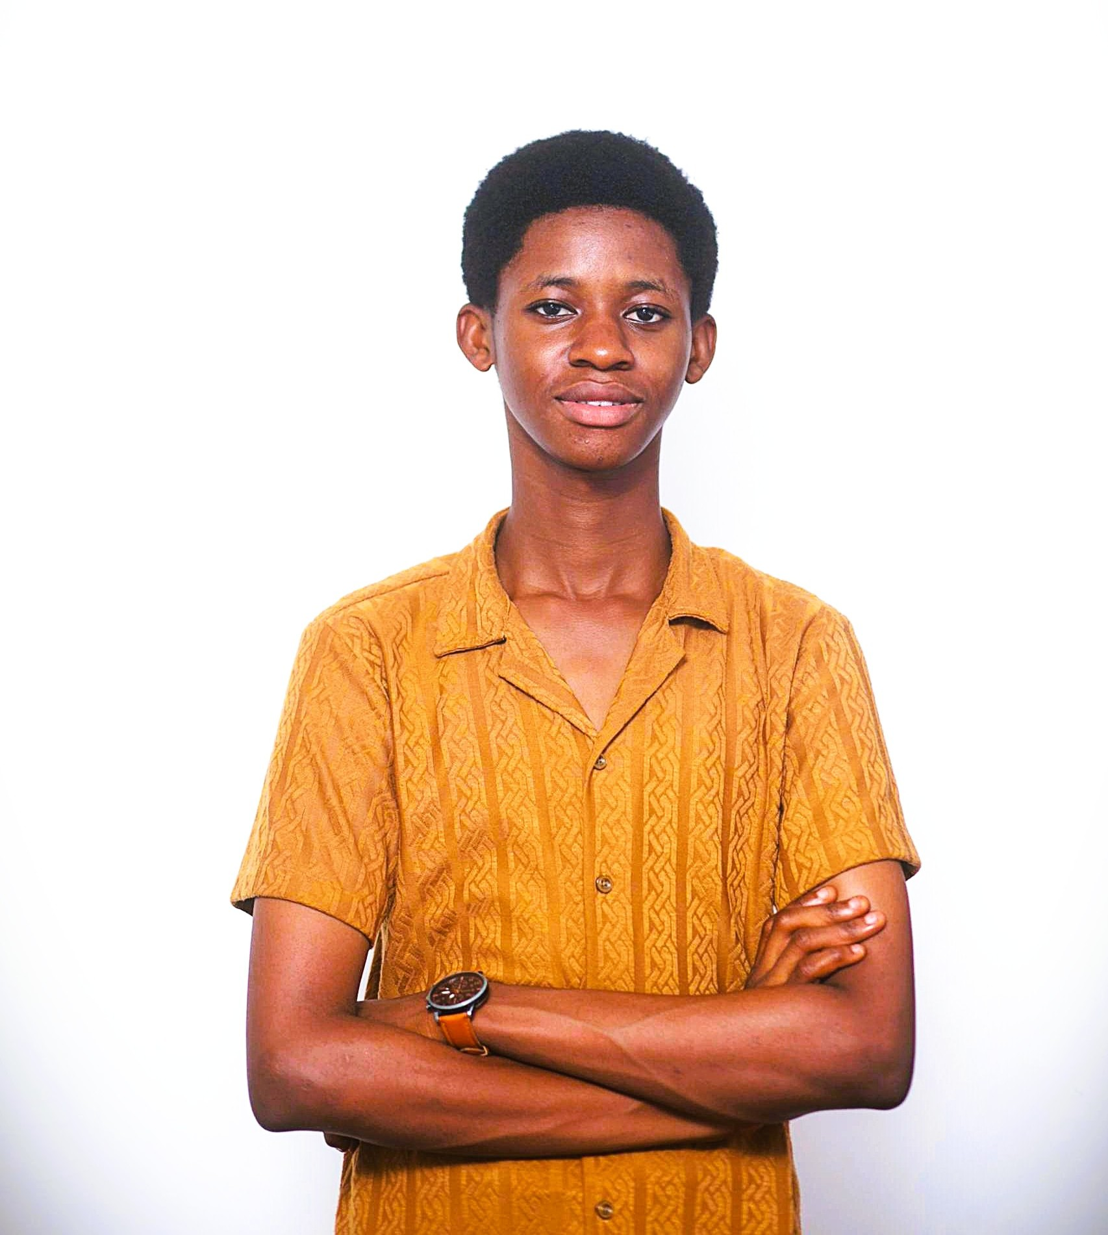



MEET THE TEAM
HOANG
Fullstack
Developer
JOSIAH
Fullstack Developer
ZAIN
AI Engineer
DANISH
AI Engineer
NOOR
Frontend Developer

Slide 3
PROBLEM STATEMENT
Skin issues like acne, eczema, and dryness affect many people, but understanding causes and tracking progress is difficult. Dermatologist consultations are often expensive and time-consuming, leaving many without proper guidance. There is a need for an affordable, accessible way to monitor and manage skin health effectively.

Slide 4
Target Users
Epidexa is designed for individuals, clinicians, and healthcare providers seeking early skin condition detection.
People that cannot afford dermatologist
Students
Working professionals
People in rural areas

Slide 5
KEY FEATURES
AI Skin
Detection
Personlized Care Tips
User Friendly App
Powered by AI to support accurate, fast, and intelligent skin condition detection.
Epidexa delivers tailored skin insights and recommendations based on individual analysis.
Designed with a simple, intuitive interface for easy and seamless use.

Slide 6
MARKET SIZE
TAM
Global market for digital skincare and AI-driven skin health solutions.
SAM
Smartphone users seeking mobile apps for skin analysis, skincare guidance, and dermatology support.
SOM
Early adopters and young users using affordable AI-based skin diagnosis and personalized care apps, especially in emerging markets.

Slide 7
COMPARISON WITH COMPETITORS
Feature/App | Epidexa | Symphony | EczemaWise | Rash-ID
Track Skin Symptoms
Personalized Recommendations
AI Photo / Sympton Analysis
Doctor In The Loop

Slide 8






DART & FLUTTER
SERVERPOD
POSTGRES
TENSORFLOW
CLOUDINARY
DOCKER

Slide 9
SERVERPOD USE CASES
ServerPod User
Authentication
API Client Endpoints
A
B
Session & Roles Control
User Password Hashing
C
D
SERVERPOD
FRAMEWORK
Audit Logging & Tracking
ServerPod Health Check
E
F
Database Management
Account Management
G
H

Slide 10
