Slide 1

EPIDEXA
Know Your Skin, Take Better Care”

Slide 2




TEAM MEMBERS
HAOANG
ABABIO
ZAIN
DANISH
NOOR

Slide 3
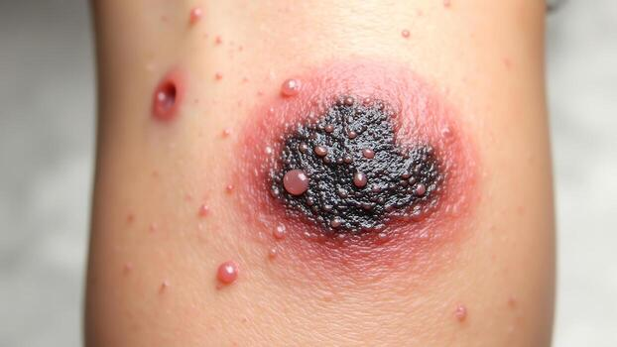
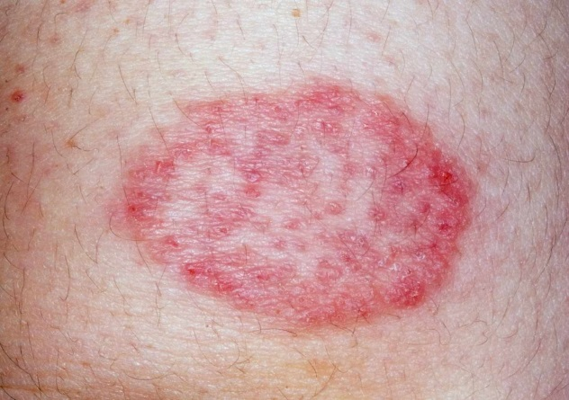
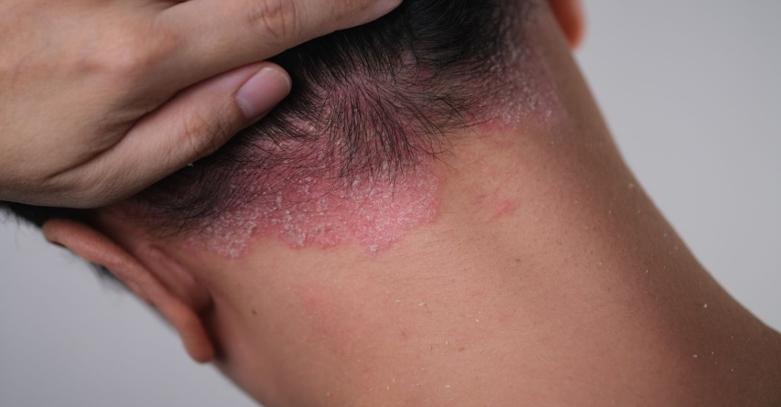
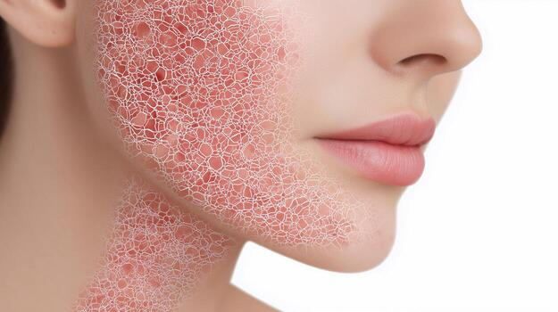
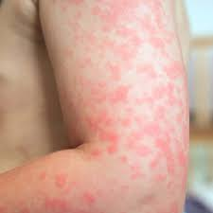
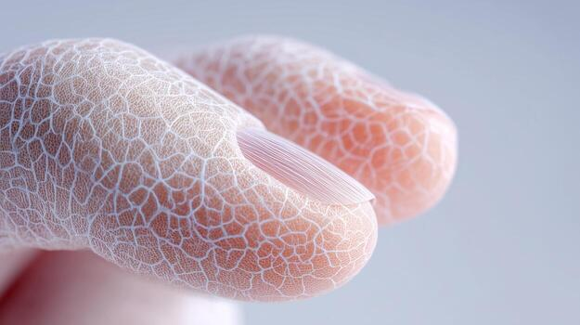
PROBLEM STATEMENT
Skin issues like acne, eczema, and dryness affect many people, but understanding causes and tracking progress is difficult. Dermatologist consultations are often expensive and time-consuming, leaving many without proper guidance. There is a need for an affordable, accessible way to monitor and manage skin health effectively.

Slide 4
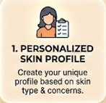
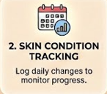
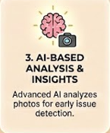




SOLUTION:
EPIDEXA

Slide 5
Target Users
People that cannot afford dermatologist
Working professionals
Students
People in rural areas

Slide 6
How EPIDEXA Works
Skin Condition Insights
Personalized Recommendation
AI analysis

Slide 7
Key Features
AI skin detection
User friendly mobile app
Personalized care tips
Affordable and fast

Slide 8
Growth Trends in Skin Issues & Mobile Health App Usage

Slide 9
Market Size
TAM
SAM
SOM
Global market for digital skincare and AI-driven skin health solutions.
Smartphone users seeking mobile apps for skin analysis, skincare guidance, and dermatology support.
Early adopters and young users using affordable AI-based skin diagnosis and personalized care apps, especially in emerging markets.

Slide 10
COMPARISON WITH COMPETITORS
Feature / App | Epidexa | Symphony | EczemaWise | Rash‑ID | Other AI Apps
Tracks skin symptoms | ✔ | ✔ | ✔ | ✔ | ✔
Personalized recommendations | ✔ | ✔ | ❌ | ❌ | ✔
AI photo / symptom analysis | ✔ | ✔ | ❌ | ✔ | ✔
Doctor in the loop | ✔ | ❌ | ✔ | ❌ | Limited
Progress reports / charts | ✔ | ✔ | ✔ | ✔ | Sometimes
Affordable alternative | ✔ | ✔ | ✔ | Subscription | Varies
Multiple skin conditions | ✔ | ✔ | ❌ | ✔ | Limited

Slide 11
Use case and impact
Early skin issue detection
Preventive Skin care
Reduced clinical meeting
Why EPIDEXA
Affordable Mobile accessibility
Instant analysis AI-driven insights

Slide 12








TECHNOLOGY
Flutter
Serverpod
PostgreSQL
Redis
Docker
TensorflowLite
LLaVA-Med
OpenBioLLM
Cloudinary
Firebase
GITHUB LINK
https://github.com/Klassic-Mak/skinAware/blob/main

Slide 13
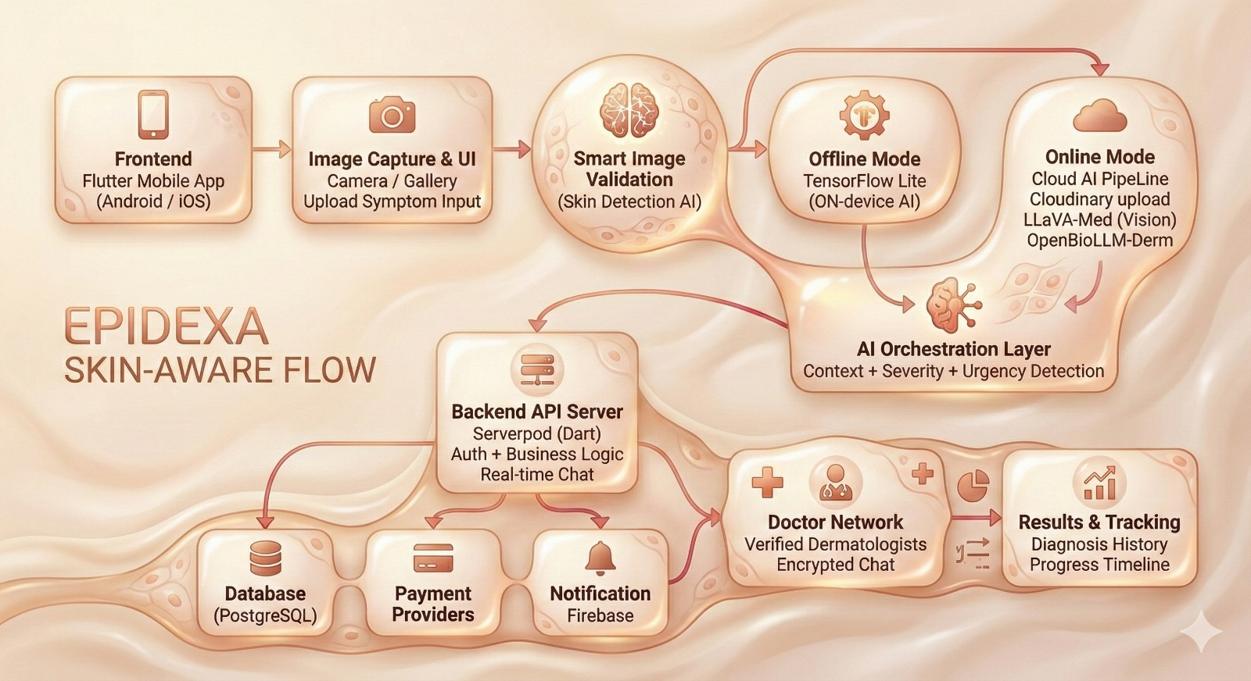
Flow of EPIDEXA

Slide 14
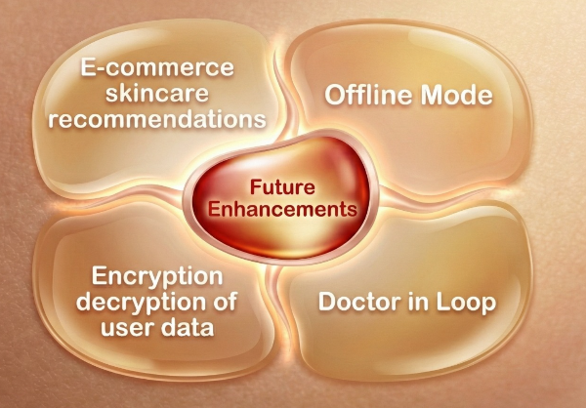
Future Scope

Slide 15
Conclusion
Epidexa is designed to make skincare simple and effective by offering personalized tips , product suggestions and ways to track progress. With future updates and new features, the app will continue to help users take better care of their skin everyday

