Slide 1

Session 3:
Advanced SQL Concepts
1.Database Joins
2. Subqueries
3. CTE(Common Table Expression)

Slide 2

Recap – Session 2
Basic Database Concepts:
  Database Keys
  Sequence
  Database Control Statement
  → Till now we have completed.
    Prepared Stage schema and Loaded Source Data.
    Prepared Target Schema.
    Created Fact and Dim(As Star Schema).
    Defiled Primary and Foreign Keys.

Slide 3


Slide 4
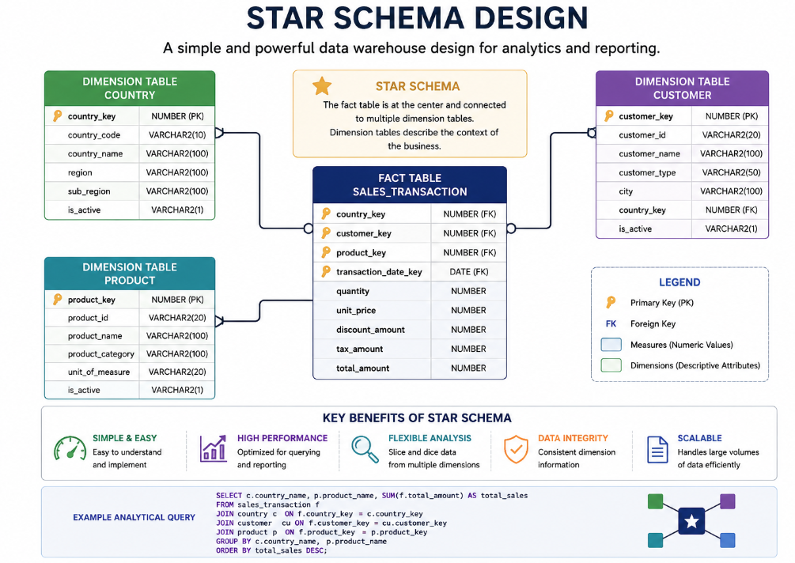

Slide 5
What is a JOIN?
A JOIN is used to combine data from two or more tables based on a related column between them.
Helps retrieve meaningful combined data
Based on Primary Key and Foreign Key relationships

Slide 6

Types of JOINs
INNER JOIN – matching records only
LEFT JOIN – all left table records
RIGHT JOIN – all right table records
FULL OUTER JOIN – all records from both tables
CROSS JOIN – Cartesian product

Slide 7

INNER JOIN vs LEFT JOIN
INNER JOIN returns only matched rows
LEFT JOIN returns all left rows + matched right rows
Unmatched right rows appear as NULL
Choice depends on business requirement

Slide 8
EMP Table
Employee Information
EMP_ID | EMP_NAME | DEPT_ID | SALARY
1 | John | 10 | 50000
2 | Smith | 20 | 60000
3 | David | 10 | 55000
4 | Chris | 30 | 45000
5 | Alex | NULL | 40000

Slide 9
DEPT Table
Department Details
DEPT_ID | DEPT_NAME
10 | HR
20 | IT
30 | Finance
40 | Marketing

Slide 10
Join Comparison Slide
OUTPUT REPORT
Join Type | Records Returned
INNER JOIN | 4
LEFT JOIN | 5
RIGHT JOIN | 5
FULL OUTER JOIN | 6
CROSS JOIN | 20

Slide 11

Subquery
A query inside another query that returns intermediate results.
It is also called:
Inner query OR Nested query
Subqueries help when:
You need intermediate results. You want to filter dynamically. You want to avoid temporary tables. You want readable SQL logic.

Slide 12
Type of Subquery
1. Single Row Subquery: Returns only one value
SELECT employee_name
FROM employees
WHERE salary > (SELECT AVG(salary) FROM employees);
2. Multiple Row Subquery: Returns multiple values
SELECT employee_name FROM employees
WHERE department_id IN (SELECT department_id
FROM departments WHERE location = 'Dubai’);
3. Multiple Column Subquery: Returns multiple columns
SELECT * FROM employees
WHERE (department_id, job_id) IN (
SELECT department_id, job_id FROM job_rules);
4. Correlated Subquery (VERY IMPORTANT)
Inner query depends on outer query
SELECT e1.employee_name, e1.salary
FROM employees e1 WHERE e1.salary > (
SELECT AVG(e2.salary) FROM employees e2
WHERE e2.department_id = e1.department_id);
Runs once per row
Slower but powerful

Slide 13
Type of Subquery
5. Nested Subquery (Subquery inside subquery):
SELECT employee_name FROM employees WHERE department_id IN (
SELECT department_id FROM departments WHERE manager_id IN (
SELECT employee_id FROM employees WHERE salary > 10000));
6. Subquery in SELECT clause:
SELECT employee_name, salary,
(SELECT AVG(salary) FROM employees) AS avg_salary
FROM employees;
7. Subquery in FROM clause (Derived Table):
SELECT dept_id, avg_salary FROM (
SELECT department_id AS dept_id,AVG(salary) AS avg_salary
FROM employees GROUP BY department_id);
8. Subquery in UPDATE & DELETE:
UPDATE employees SET salary = salary * 1.1
WHERE department_id IN (SELECT department_id FROM departments
WHERE location = 'Dubai');

Slide 14
Common Table Expression (CTE)
A Common Table Expression (CTE) is a temporary named result set that exists only for the duration of a single SQL statement.
Temporary result set defined using WITH clause
  Improves readability and maintainability
  Can replace complex subqueries
  Avoids repeating the same query
  Supports recursive queries

Slide 15
CTE Syntax and Example
WITH cte_name AS (
SELECT ... )
SELECT * FROM cte_name;
Basic CTE Example: Calculate average salary per department.
WITH dept_avg AS (
SELECT department_id, AVG(salary) avg_salary FROM employees GROUP BY department_id)
SELECT * FROM dept_avg;
CTE with JOIN: Find employees earning more than department average.
WITH dept_avg AS (
SELECT department_id, AVG(salary) avg_salary FROM employees GROUP BY department_id )
SELECT e.employee_name, e.salary, d.avg_salary FROM employees e JOIN dept_avg d
ON e.department_id = d.department_id WHERE e.salary > d.avg_salary;
Multiple CTEs: We can define multiple temporary result sets.
WITH dept_avg AS (
SELECT department_id, AVG(salary) avg_salary FROM employees GROUP BY department_id),
dept_max AS (
SELECT department_id, MAX(salary) max_salary FROM employees GROUP BY department_id)
SELECT * FROM dept_avg a JOIN dept_max m ON a.department_id = m.department_id;

Slide 16
CTE vs Subquery
Feature | Subquery | CTE
Readability | Lower | Higher
Reusability | Difficult | Easy
Debugging | Harder | Easier
Complex SQL | Messy | Cleane

Slide 17
Difference between CTE and Temporary Table
CTE | Temporary Table
Exists for query only | Exists for session
No storage | Physical storage
Faster for simple logic | Better for large reusable datasets

Slide 18
Key Takeaways
  Understand JOIN and differences between JOIN types.
  Sub Queries and their Types.
  CTE improves structure and readability.

Slide 19
QUIZ
JOINS:
1. Which JOIN returns only the matching records from both tables?
A. LEFT JOIN
B. RIGHT JOIN
C. INNER JOIN
D. FULL OUTER JOIN
2. What is returned by a LEFT JOIN?
A. Only matching records
B. All records from the left table and matching records from the right table.
C. All records from the right table only
D. Only unmatched records
Sub Query:
3. A subquery is:
A. A temporary table
B. A query written inside another SQL query
C. A database view
D. A query Join with another SQL query
4. Which operator is commonly used with a single-row subquery?
A. IN
B. EXISTS
C. =
D. ANY
5. What is unique about a correlated subquery?
A. It executes only once.
B. It references columns from the outer query and executes for each row.
C. It cannot use WHERE clause.
D. It always returns one row.

Slide 20
QUIZ
Common Table Expression (CTE)
6. Which of the following is NOT a benefit of using a CTE?
A. Improves query readability
B. Breaks complex queries into logical parts
C. Can be referenced multiple times in the same query.
D. Permanently stores data in the database.
7. Which option is generally best for improving the readability of a complex SQL query with multiple transformations?
A. Nested Subqueries
B. Multiple Temporary Tables
C. Common Table Expression (CTE)
D. CROSS JOIN
8. Which keyword is used to define a CTE?
A. TEMP
B. VIEW
C. WITH
D. CREATE

Slide 21
Assignment
Assignment 1: Customers with Above Average Sales.
Details: Find customers whose total sales amount is greater than the average sales amount of all customers. Expected Output:
Assignment 2: Top-Selling Product
Detail: Find the product with the highest total sales amount.
Assignment 3: Country-wise Sales Summary Using CTE
Detail: Display total sales for each country.
Hint: Create a CTE to join customer and sales data, then aggregate by country.
Assignment 4: Customers Who Bought More Than 5 Products
Detail: Find customers who purchased more than 5 products (transactions).
Customer Name | Total Sales
Expected Output :
ProductName | Total Sales
Expected Output :
CountryName | Total Sales
Expected Output :
Customer Name | Number Of Purchase

Slide 22

Next Session
Database Stored Procedure
Merge Statement with example

Slide 23
Thank you
Questions ?

