Slide 1
Session 8: Performance Tuning
Query Execution Order.
Performance Tuning Best Practice .
Real-word Example.
Quiz.
Project.

Slide 2
Session 7- Recap
What is performance tuning.
Detail about Indexing
Type of Index
Details about Execution Plan

Slide 3
Query Execution Order:
SELECT c.country, SUM(s.amount) AS total_sales
FROM customers c
INNER JOIN sales_transactions s ON c.customer_id = s.customer_id
WHERE s.amount > 1000
GROUP BY c.country
HAVING SUM(s.amount) > 5000
ORDER BY total_sales DESC
FETCH FIRST 5 ROWS ONLY;

Slide 4
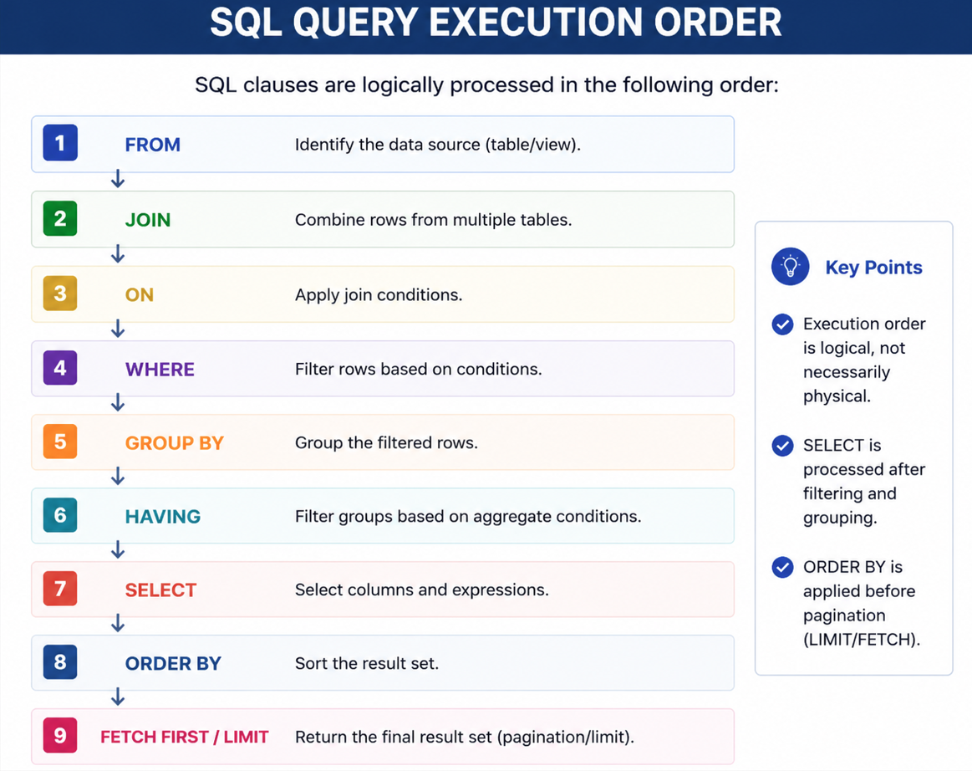

Slide 5
Performance Tuning Best Practices:
SQL Best Practices
✔ Avoid SELECT *
✔ Use proper joins
✔ Filter data early
✔ Review execution plans
Database Best Practices
✔ Maintain statistics
✔ Create appropriate indexes
✔ Partition large tables
✔ Archive historical data
ETL Best Practices
✔ Use incremental loads
✔ Implement parallel processing
✔ Monitor ETL execution time

Slide 6

Real-World Example (Telecom Data Platform)
Scenario
Telecom operator has:
5 Million Subscribers
Daily Usage:
500 Million Records
Problem:
Monthly usage report takes: 1 Hours
Investigation
Found:
Full table scan
Missing index
No partitioning
Solution
Implemented: Index Created and table partitioned by monthly
Before 1 hours . Now: 5 minutes

Slide 7
Quiz
SQL Query Execution Order Quiz
1. In the logical execution of a SQL query, which clause is processed first?
A. SELECT
B. WHERE
C. FROM
D. ORDER BY
2. Given FROM customers c JOIN sales_transactions s ON c.customer_id = s.customer_id, what is the purpose of the ON condition?
A. Define how rows from the tables are matched
B. Sort the joined rows
C. Choose the final output columns
D. Filter the final grouped result
3. Why is GROUP BY logically processed before HAVING?
A. HAVING creates the groups
B. HAVING sorts the groups
C. HAVING filters groups created by GROUP BY
D. HAVING selects individual rows before grouping
4. Consider GROUP BY c.country HAVING SUM(s.amount) > 5000. What does HAVING evaluate?
A. The customer table before the join
B. Each country group based on its aggregate amount
C. Each transaction before grouping
D. The final rows after ORDER BY

Slide 8
Quiz
5. Which clause is logically processed after HAVING in the simplified execution order discussed in the session?
A. WHERE
B. SELECT
C. FROM
D. JOIN
6. Why does ORDER BY logically occur before FETCH FIRST or LIMIT?
A. LIMIT creates the sort order
B. FETCH FIRST creates the SELECT list
C. ORDER BY filters groups
D. Rows must be sorted before selecting the requested top rows
7. What is the logical execution order of these clauses: WHERE, FROM, SELECT, ORDER BY?
A. FROM → WHERE → SELECT → ORDER BY
B. WHERE → FROM → ORDER BY → SELECT
C. SELECT → FROM → WHERE → ORDER BY
D. FROM → SELECT → WHERE → ORDER BY
8. Which condition is best placed in WHERE rather than HAVING when the condition is s.amount > 1000 for individual transactions?
A. WHERE s.amount > 1000
B. GROUP BY s.amount > 1000
C. ORDER BY s.amount > 1000
D. HAVING s.amount > 1000

Slide 9
End-to-End Oracle Database & ETL Project Assignment
Project Overview
Complete an end-to-end Oracle database and ETL project using a publicly available dataset.
Apply concepts covered in the training sessions: database fundamentals, keys, joins, subqueries, CTEs, MERGE, procedures, packages, exception handling, analytical functions, transactions, and performance tuning.
Build the solution as a realistic data integration/data warehouse project.

Slide 10
Project Objective
Select and analyze a dataset.
Load raw data into a staging layer.
Identify and handle data-quality issues.
Perform data cleansing and transformation.
Use SQL and PL/SQL to implement the ETL process.
Create Dimension and Fact tables where appropriate.
Implement stored procedures and an Oracle package.
Implement exception handling and error logging.
Use MERGE for appropriate target loading.
Use analytical functions for data processing or validation.
Apply performance-tuning techniques.
Validate and reconcile the final target data.

Slide 11
Question
Thanks

