Slide 1
DIVINE PURPOSE INVESTMENTS (DPI) SCHOOLS
Strategic plan for 2025-2031 (7-year)

Slide 2
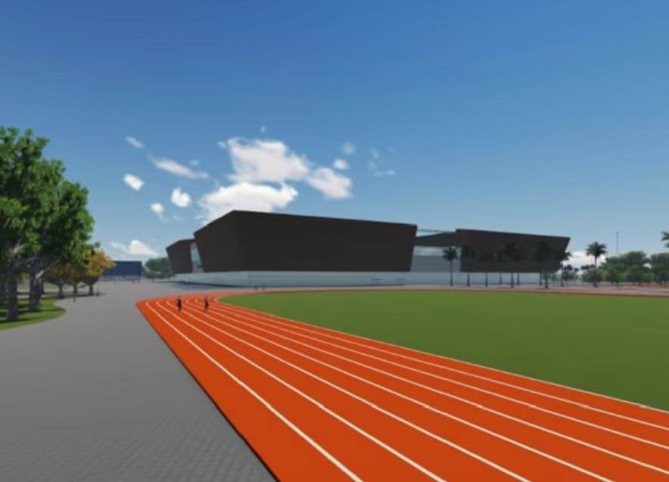
An Education, & Community digital hub Built on Kingdom principles of: 1. Godliness 2. Dominion, 3. Education 4. Technology 5. Sustainable community transformation
Transforning the port

Slide 3

About DPI Schools: Overview
Divine Purpose Investments Ltd is a company involved in the education sector. We run schools at different levels – nursery, Primary, and Secondary using both the national and an international (Accelerated Christian Education) curricula.
Our mandate is to disciple young people; shepherd them to be the much-sought-after agents for transformation in a land that badly needs restoration. They, like Isaiah says in 58:12, “will rebuild the ancient ruins, and raise up the foundations of many generations. They will be called repairers of broken walls, restorers of streets to dwell in.”
DPI Schools started way back in 2007 with Divine Kids Nursery School; in 2010, we added a primary section (Divine Purpose Junior School P.1-p7); and in 2017 was added the International section ( Shekinah Christian International School K-12). Our current population is approximately 500 students,

Slide 4


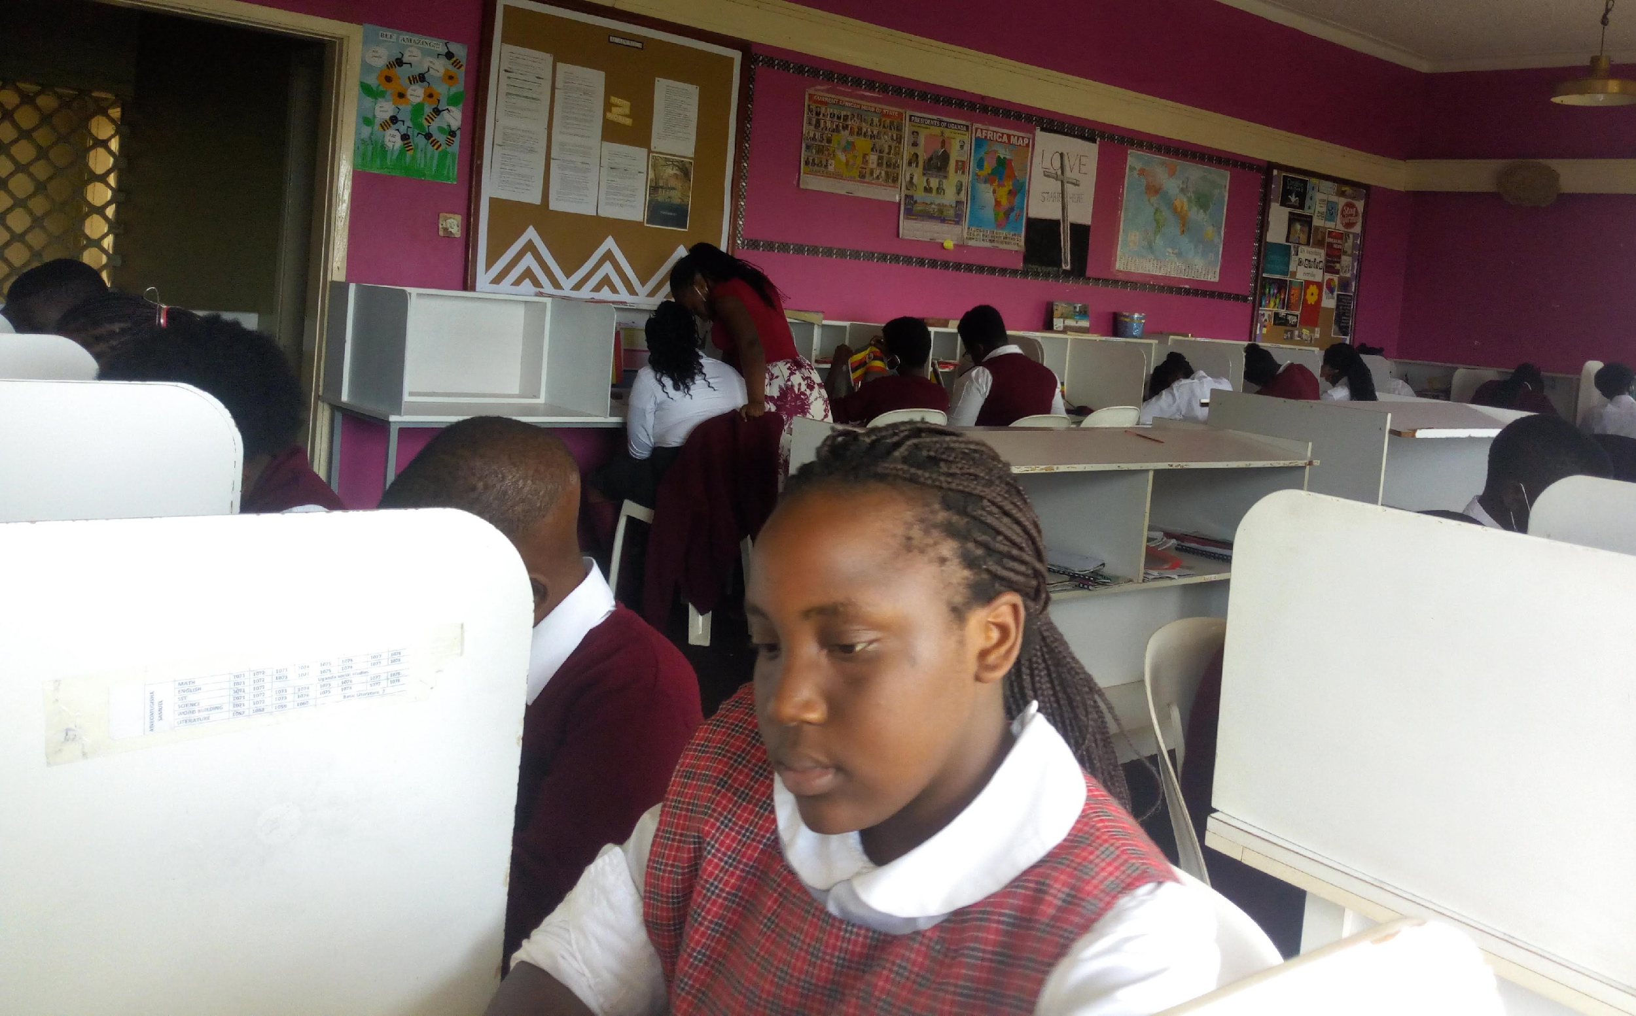
Our Vision
Christ-like, Servant Leaders transforming Nations.
Our Mission
To bring up godly and responsible individuals through impartation of biblical values, excellent and professional Learning, in a friendly and stimulating environment so that they are able to discover their life’s purpose and develop their creative, intellectual and spiritual capacities needed for their pivotal role in transforming nations, now and in the future.

Slide 5
About ACE curriculum
Biblically based programme infused with Godly character
A.C.E. curriculum helps students learn the academics required to enter college. It also builds in students a lifelong burning passion to learn and grow spiritually.
Character Development
Godly character training prepares students to welcome and accept challenges and future opportunities. Sixty character traits, such as kindness, loyalty, and honesty, are taught within the curriculum. Students can observe character development in the true-to-life character strips and then apply the Godly character lessons to their own lives.
Scriptural Foundation
The curriculum conveys Biblical values and concepts considered foundational to meaningful interpersonal relationships and productive learning in such a way as to become life-shaping influences. With A.C.E.’s concept of individualized learning, students don’t just get by—they get ahead!
Individualized approach
A.C.E. addresses structural concerns of the conventional educational system in which students fail to perform to their grade levels. A biblically based educational program geared to meet the learning needs of individual children consists of a mastery-based curriculum and self-instructional materials, character-building, and is individually prescribed.

Slide 6
