Slide 1
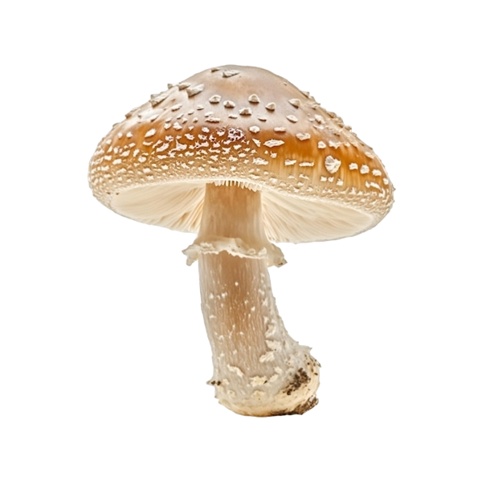
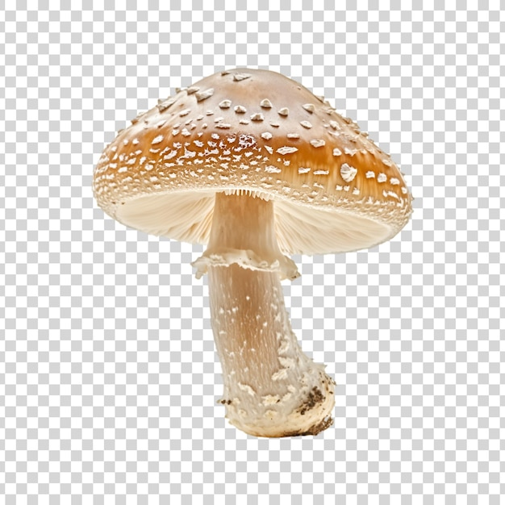

Slide 2
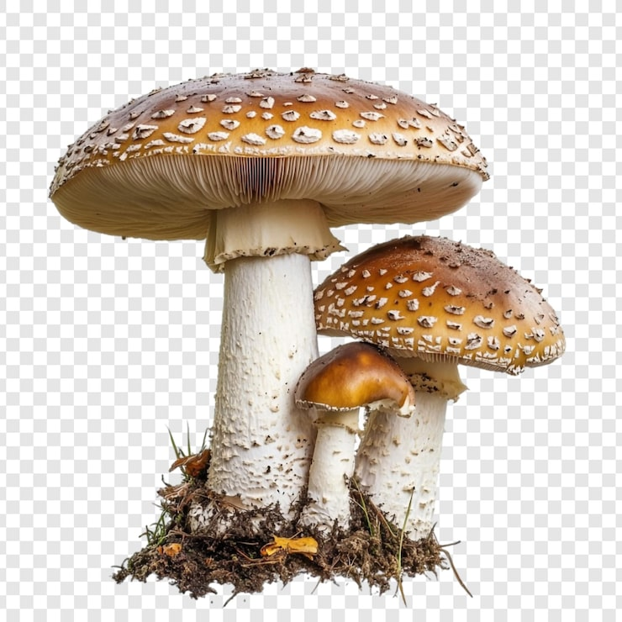
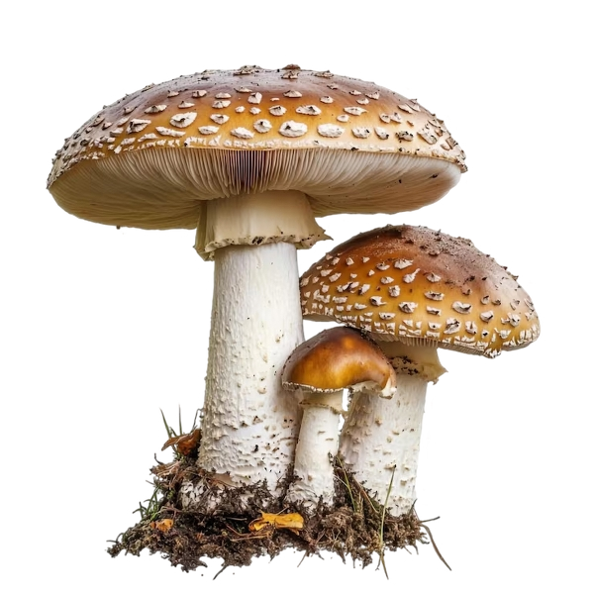

Slide 3
https://www.rawpixel.com/search/mushroom%20transparent?page=1&path=1522&sort=curated
Php nyelv
Magyar erdők képek pl: https://femina.hu/utazas/erdo-kirandulas-magyarorszag/
Google: magyarország erdejei
https://www.google.com/search?client=firefox-b-d&hs=c3L&sca_esv=d0a1e93f4488cb4c&sxsrf=ANbL-n5qTrz3iwwgmNPFPNx_VXRQolWBaQ:1775902793360&udm=2&fbs=ADc_l-akmJ9clyHhwEynr9YRwEo_tYQUWp-_aNxOcHgKpLE-YUy1rF_kA3bn_mrSgXcgNhn0lG9RN80gRMxP-A2NGIg7J5gdlXV5DDIdWAtC8_mhva8zYLtVfqyd-IgMRVeOawD0mDfTZp0QXWmBbv-AQP8pYxzUETQr4Pb0gjC49FdHpzao1Q19QqjTNUOuC8lKuFy9_2JwEUzz6P3K_yUg6WVRxQugSg&q=magyarorsz%C3%A1g+erdejei&sa=X&ved=2ahUKEwiMpJ25yeWTAxXBHBAIHd7UKLkQtKgLegQIFhAB&biw=1600&bih=721&dpr=1#sv=CAMSVhoyKhBlLV82c19KOWVIRGtZWVRNMg5fNnNfSjllSERrWVlUTToORWVaWnZTYnZkS2tiSE0gBCocCgZtb3NhaWMSEGUtXzZzX0o5ZUhEa1lZVE0YADABGAcgy4vgrQ5KCBABGAEgASgB

Slide 4
őzök
https://www.google.com/search?client=firefox-b-d&hs=c3L&sca_esv=d0a1e93f4488cb4c&sxsrf=ANbL-n5qTrz3iwwgmNPFPNx_VXRQolWBaQ:1775902793360&udm=2&fbs=ADc_l-akmJ9clyHhwEynr9YRwEo_tYQUWp-_aNxOcHgKpLE-YUy1rF_kA3bn_mrSgXcgNhn0lG9RN80gRMxP-A2NGIg7J5gdlXV5DDIdWAtC8_mhva8zYLtVfqyd-IgMRVeOawD0mDfTZp0QXWmBbv-AQP8pYxzUETQr4Pb0gjC49FdHpzao1Q19QqjTNUOuC8lKuFy9_2JwEUzz6P3K_yUg6WVRxQugSg&q=magyarorsz%C3%A1g+erdejei&sa=X&ved=2ahUKEwiMpJ25yeWTAxXBHBAIHd7UKLkQtKgLegQIFhAB&biw=1600&bih=721&dpr=1#sv=CAMSVhoyKhBlLUl0Ui16WEN6SWJrTUVNMg5JdFItelhDeklia01FTToOWVRLc1lZUHllY1EyWk0gBCocCgZtb3NhaWMSEGUtSXRSLXpYQ3pJYmtNRU0YADABGAcgsL_0pAxKCBABGAEgASgB

