Slide 1
What‘s new in C#
The not-so-comprehending-List

Slide 2
Language vs Runtime vs API
Short recap:
The language determines which C# code be used
The runtime determines which IL code can be used
The APIs determine ... which APIs can be used

Slide 3
Language vs Runtime vs API
You have .NET 4.5 installed – which C# features can you use?
The one that your Visual Studio supports.

Slide 4
Language vs Runtime vs API
As long as a language feature does not require a specific API or runtime feature it can be used on many frameworks.
Within those limits you can compile f.e. C#7 features to .NET Framework 2.

Slide 5
Language vs Runtime vs API
Lowering: Transforming a complex statement into several simpler statements
Lock (try, TryEnter, Finally)
Using (try, finally, Dispose)
While (goto, break)
ForEach (different depending on target framework)
Further samples: http://mattwarren.org/2017/05/25/Lowering-in-the-C-Compiler/

Slide 6
Oldies but goldies
https://docs.microsoft.com/en-us/dotnet/csharp/whats-new/csharp-version-history
Short recap on rarely used useful features...

Slide 7
Oldies but goldies
Missing:
C#3 - Anon types
C#4 - Covariant / contravariant

Slide 8
C#2 Iterators - yield return
public IEnumerable<int> GetFromTo(int start, int end) { if (start > end) throw new ArgumentOutOfRangeException(); for (int i = start; i < end; i++) yield return i; } public void UseIterator() { var enumerable = GetFromTo(15, 20); foreach (var i in enumerable) Console.WriteLine(i); }

Slide 9
C#4 Named/Optional args
public void Drive(int persons = 1, bool fast = true, bool safe = false) { //Do stuff } public void Use() { Drive(); Drive(safe:true); }

Slide 10
C#5 Caller Info
public void Log([CallerMemberName] string caller = null) { Console.WriteLine($"Called by {caller}");
//Called by DoStuff } public void DoStuff() { Log(); }

Slide 11
C#5 Caller Info
public void LogDetailed([CallerMemberName] string caller = null, [CallerFilePath] string file= null, [CallerLineNumber] int line = 0) { Console.WriteLine($"Called by {caller} ({file} line {line})"); //Called by DoDetailedStuff (C:\Github\CSTrainings\CsTrainings\CS5\CallerInfo.cs line 30) }
public void DoDetailedStuff() { LogDetailed(); }

Slide 12
C#5 Caller Info with using
public void New() { using (Utils.LogMethod()) { //DoStuff } }
public void Old() { Console.WriteLine("-->Old"); //DoStuff Console.WriteLine("<--Old"); }

Slide 13

C#6
https://docs.microsoft.com/en-us/dotnet/csharp/whats-new/csharp-6
Tons of new but small stuff
New compiler platform Roslyn (CAAS)
Visual Studio 2013

Slide 14
C#6 ReadOnly & Initializer
public Guid ReadOnly { get; } public string WithInitializer { get; } = "Value"; public int InitializerFromMethod { get; } = GetDefault(); public string Property { get; set; } = "DefaultValue";

Slide 15
C#6 Null conditional operations
public override string ToString() { return o?.ToString() ?? string.Empty; } public void DoStuff() { nested?.NestedMember?.NestedMember?.DoStuff(); }

Slide 16
C#6 Expression bodies
public string Id => "NoIdea"; public string GetId() => Id; public override string ToString() => o?.ToString() ?? string.Empty; public void DoStuff() => nested?.NestedMember?.NestedMember?.DoStuff(); public string WithCs7() => nested?.ToString() ?? throw new NotSupportedException();

Slide 17
C#6 String interpolation / nameof
private string a; public void DoStuff() { var x = $"Current value of {nameof(a)} is {a}"; }

Slide 18
C#6 String interpolation / nameof
var x = $"Field is called {nameof(a)}"; var y = "Field is called " + nameof(a);

Slide 19
C#... String concatenation
var a = "A"; var b = "B"; var c = "C"; var d = a + b + c; var e = $"{a}{b}{c}"; var sb = new StringBuilder(); sb.Append(a); sb.Append(b); sb.Append(c); var f = sb.ToString();

Slide 20
C#6 Exception filters
try { DoStuff(); } catch (NotSupportedException nex) when (nex.Message == "It's OK after all") { } try { DoStuff(); } catch (NotSupportedException nex) { if (nex.Message != "It's OK after all") throw; }

Slide 21
C#7
https://docs.microsoft.com/en-us/dotnet/csharp/whats-new/csharp-7
out tuples
Tuples
Pattern matching
Local functions
Numerical literals

Slide 22
C#7 Tuples
public (string firstname, string lastname) GetName() { return ("Klaus", "Linzner"); } public void Caller() { var x = GetName(); Console.WriteLine($"{x.firstname} {x.lastname}"); }

Slide 23
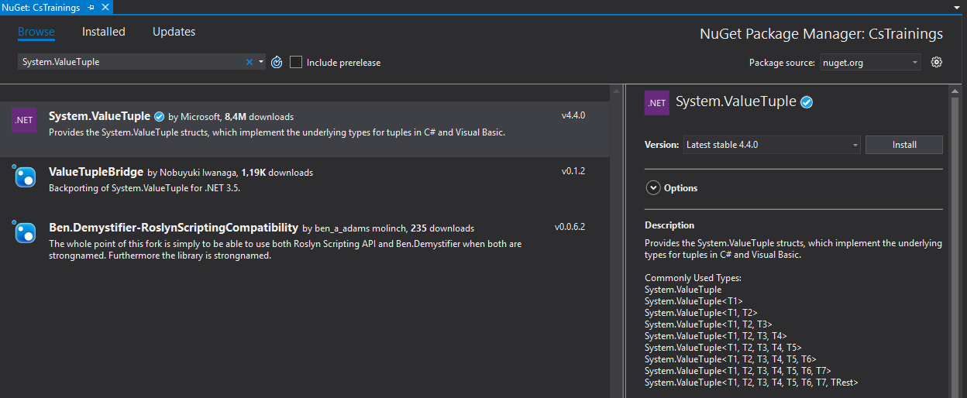
C#7 Tuples

Slide 24
C#7 Tuples
[return: System.Runtime.CompilerServices.TupleElementNames(new string[] { "firstname", "lastname" })] public System.ValueTuple<string, string> GetName() { return new System.ValueTuple<string, string>("Klaus", "Linzner"); } public void Caller() { System.ValueTuple<string, string> name = this.GetName(); Console.WriteLine(string.Format("{0} {1}", name.Item1, name.Item2)); }

Slide 25
C#7 Tuples
var users = db.Query<(int id, string name)>("select Id, Name from Users").AsList();
Major feature of C#7
Rule of thumb: Not in public interfaces
https://blog.marcgravell.com/2017/04/exploring-tuples-as-library-author.html
Fun nevertheless: var users = db.Query<(int id, string name)>("select Id, Name from Users").AsList();

Slide 26
C#7 Out variables
if (int.TryParse(input, out var i)) { Console.WriteLine(i); } if (int.TryParse(input, out int j)) { Console.WriteLine(i); Console.WriteLine(j); }

Slide 27
C#7 pattern matching
if (o is A a) { Console.WriteLine(a.AMember); }else if (o is B b) { Console.WriteLine(b.BMember); }
switch (o) { case A a:
Console.WriteLine(a.AMember); break; case B b:
Console.WriteLine(b.BMember); break; }

Slide 28
C#7 Local functions
public void DoStuff(Dictionary<string, string> dict) { foreach (var kvp in dict) { Console.WriteLine(Format(kvp)); } string Format(KeyValuePair<string, string> kvp) { return string.IsNullOrEmpty(kvp.Value) ? $"Kvp: {kvp.Key}" : $"Kvp : {kvp.Key} == {kvp.Value}"; } }

Slide 29
C#7 Local functions
public void DoStuff(Dictionary<string, string> dict) { foreach (var kvp in dict) { Console.WriteLine(Format(kvp)); } string Format(KeyValuePair<string, string> kvp) { return string.IsNullOrEmpty(kvp.Value) ? $"Kvp: {kvp.Key}" : $"Kvp : {kvp.Key} == {kvp.Value}"; } }

Slide 30
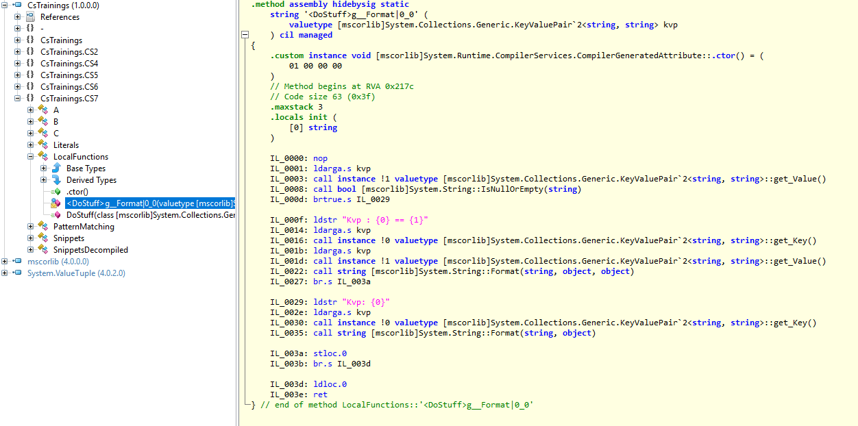
C#7 Local functions
public void DoStuff(Dictionary<string, string> dict) { foreach (KeyValuePair<string, string> current in dict) { Console.WriteLine(LocalFunctions.< DoStuff > g__Format | 0_0(current)); } }

Slide 31
C#7 Numerical Literals
private int i = 1000000; private int j = 1_000_000; private int b = 0b01_10_11_00;

Slide 32
C#7.1
https://docs.microsoft.com/en-us/dotnet/csharp/whats-new/csharp-7-1
Async Main Method
Default literals

Slide 33
C# 7.2
https://docs.microsoft.com/en-us/dotnet/csharp/whats-new/csharp-7-2
Reference semantics on value types
private protected access modifier

Slide 34
Current State
Last runtime update was VERY long ago .NET 4 ~ 2010
Point updates to ship newer JIT,...
AFAIK no .NET 5 planned

Slide 35
Current State
Modular .NET - .NET core
Goal: Don‘t target a framework –target a core API set (net standard)
https://gist.github.com/davidfowl/8939f305567e1755412d6dc0b8baf1b7
Use NuGet for everything else
Even some compiler features (tuple return type)

