Slide 1

Docker
Workshop
Rainer Stropek
software architects gmbh
Web
Mail
Twitter
http://www.timecockpit.com
rainer@timecockpit.com
@rstropek
For Software Developers

Slide 2
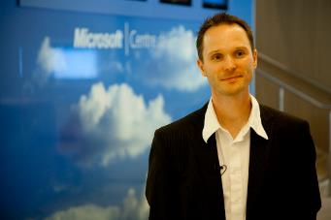
Your Host
Rainer Stropek
Developer, Entrepreneur
Azure MVP, MS Regional Director
IT-Visions
Contact
software architects gmbh rainer@timecockpit.com Twitter: @rstropek

Slide 3
What is Docker?
Introduction

Slide 4
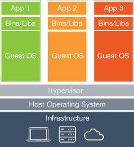
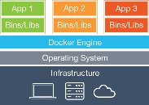
What is Docker?
Virtual Machines
Virtual machines vs. Docker
Each VM runs its own guest operating system
Container reuse the host operating system
Container run in user space
Not a total replacement of classical hypervisors or config management tools
Docker Container
Image Source: https://www.docker.com/whatisdocker/

Slide 5
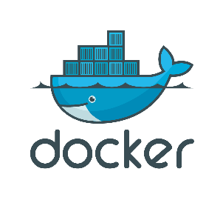
What’s Docker?
Container virtualization
Container run in user space and use kernel of host
Has been existing in Linux for quite a while
Docker builds on Linux Containers (LXC) and makes it easy to use and consume
Advantages?
Fast (boot time), small, and agile (e.g. Docker in Docker)
Portable
Immutable
Disadvantages?
Linux on Linux and Windows on Windows, no mix
Security (less isolated)

Slide 6
Strengths and Limits
Quotas, Limits
Added Isolation
Windows Server vs. Hyper-V Containers
Managed almost identically (Docker and PowerShell)
Difference: Isolation level
More details in MSDN
Process
Linux Container
Virtual Machines
Linux
Kernel
Process
Windows Server Container
Hyper-V Container
Hyper-V VMs
Windows
Kernel
Faster, more efficient
More isolated, more secure
Source: Mark Fussel (Microsoft), Azure Service Fabric - Build always-on, hyper-scalable, microservice-based cloud applications

Slide 7
Docker‘s Technical Components
Linux container format (libcontainer)
Isolation layers
Filesystem – each container has its own filesystem (layered, copy-on-write)
Processes – each container has its own process environment
Network – separate virtual network interfaces
Resources – individually allocated CPUs, memory
Logging
STDOUT, STDERR, STDIN are logged for analysis purposes
Interactive shell
Pseudo-tty attached to STDIN

Slide 8
What’s Docker?
Command line tool, REST services
Docker client can manage remote Docker daemon
Container packaging format
Dockerfiles for image creation from source code
Version management for images
Images can be based on images
Docker Hub: Platform to exchange images and Dockerfiles
Publishing on Docker Hub is not in scope of this talk

Slide 9
What to Use Docker For?
Make dev/test/prod-cycle more productive
Developers build containers, not apps
Containerize build-, test- and CI-tools
Segregation of duties
Dev cares for app running in container, ops cares for managing containers
Microservices
Isolate services
Consistency across stages (dev/test/prod)
Test even complex environments locally
Containers are lightweight → run on rather small dev boxes

Slide 10
Docker Tools
Introduction

Slide 11
Docker and Microsoft
Docker Toolbox
Docker environment for Windows and Mac incl. VirtualBox
Docker Machine: Support for Hyper-V and Microsoft Azure
Container virtualization in Windows
Announced for next version of Windows Server
Windows Containers Quick Start
Use Azure to play with Docker
Existing VM image (Docker on Ubuntu server) in Azure marketplace
Use Docker container to run Azure tools (e.g. https://hub.docker.com/r/microsoft/azure-cli/)

Slide 12
Visual Studio DevOps Tooling
Docker Extension for Visual Studio Code
https://code.visualstudio.com/Docs/languages/dockerfile
Visual Studio 2015 Tools for Docker
https://visualstudiogallery.msdn.microsoft.com/0f5b2caa-ea00-41c8-b8a2-058c7da0b3e4
Step-by-step description for deploying an ASP.NET Web App

Slide 13
Docker in Azure
Ubuntu server with Docker in Microsoft Azure
Azure Docker Extension
ARM Template
https://github.com/rstropek/DockerVS2015Intro/tree/master/dockerDemos/00-AzureARM

Slide 14
Docker Machine
Documentation
https://docs.docker.com/machine/overview/
Important Commands for Docker Machine
docker-machine create – Create a machine
docker-machine ls – Lists machines
docker-machine config – Print the connection config
docker-machine start/stop – Restarts/stops a machine
docker-machine rm – Removes a machine
docker-machine ssh – Log into or run a command on a machine using SSH
docker-machine scp – Copy files using scp
docker-machine env – Set environment variables to make Docker use a machine

Slide 15
Docker in Azure
List Docker Machines
Create machines
Hyper-V
Azure
Create containers on machine
Remove machines

Slide 16
Docker Machine
docker-machine ls
docker-machine create --driver hyperv newMachine
// Look at created Hyper-V Server
docker-machine env newMachine
// Play with Docker
// SSH into newMachine (for details see blog article)
docker-machine rm newMachine
// Get publishsettings-file using
// https://manage.windowsazure.com/publishsettings/index
docker-machine create --driver azure --azure-subscription-id 26400a43-0000-0000-0000-000000000000 --azure-publish-settings-file my.publishsettings dockerMachineTest
// Look at created Azure VM in http://portal.azure.com
docker-machine env dockerMachineTest
// Play with Docker
docker-machine rm dockerMachineTest

Slide 17
Docker Cluster Solutions
Docker Swarm
https://docs.docker.com/swarm/overview/
Native clustering for Docker, turns a pool of Docker hosts into a single, virtual Docker host
Apache Mesos and Docker
http://mesos.apache.org/documentation/latest/docker-containerizer/
Azure Container Service
https://azure.microsoft.com/en-us/services/container-service/
Set of templates to deploy Apache Mesos or Docker Swarm into Azure

Slide 18
Access Docker Remotely
Default: Docker runs on non-networked Unix socket
unix:///var/run/docker.sock
TCP socket can be enabled (see Docker docs) → Docker Remote Web API
Docker available on the network → enable TLS
Docker docs

Slide 19
Remote Docker
// Connect to Docker client in Azure
// (see also https://github.com/rstropek/DockerVS2015Intro)
// Set environment variable (secure by default)
export DOCKER_HOST=tcp://dockertraining .northeurope.cloudapp.azure.com:2376 DOCKER_TLS_VERIFY=1
docker info
docker ps

Slide 20
Container
Working with containers

Slide 21
Containers
Launched from images
Layered, copy-on-write
Will be covered in details later
Contain one or more processes
Can be short-lived
Sometimes even to run jus a single command
Shared via registries
Docker Hub (private and public repositories)
Run your own private registry (registry image on Docker Hub)

Slide 22
Docker CLI
Documentation
http://docs.docker.com/reference/commandline/cli
Important Commands for Containers
docker run – Run a command in a new container
docker ps – List containers
docker start/stop – Restarts/stops a container
docker rm – Removes container(s)
docker attach – Attach to running container
docker top – Display processes running in container
docker exec – Run a command in a container

Slide 23
Docker CLI
docker run
--name helloDocker -i -t ubuntu /bin/bash
Starting Containers
Command to execute
Interactive container
Daemonized container
Running in the background
--rm removes container when it exits
Image name
Allocate pseudo-tty
Keep STDIN open
Name of the container
docker run --name …
-d ubuntu /bin/bash -c "while true; do echo hi; done"
Command to execute (with arguments)
Detach the container to the background (daemonized)

Slide 24
Demo
# Check if docker is running
docker info
# Start interactive container
docker run -it ubuntu /bin/bash
echo Hello > hello.txt
exit
# List containers
docker ps
docker ps –a
docker ps --no-trunc -aq
# Restart container
docker start …
# Attach to container
docker attach …
# Remove container
docker rm …
# Remove all containers
docker rm `docker ps --no-trunc -aq`
Interactive Container

Slide 25
Demo
# Start demonized container and get logs
docker run -d ubuntu /bin/bash \
-c "while true; do echo hello world; sleep 1; done"
# Get the logs (-f for continuous monitoring)
docker logs …
# Check the processes in docker container
docker top …
# Open interactive shell in running container
docker exec -it … /bin/bash
# Inspect the details of a running container
docker inspect …
# WINDOWS
docker run -it windowsservercore cmd
docker build –t myweb .
docker run
Daemonized Container

Slide 26
Docker Events
Docker reports real time events from the server
docker events
Usages
Admin and monitoring purposes
Triggering auto-configurations (e.g. load balancer configuration with Interlock and Nginx)

Slide 27
Networking
Docker Networking

Slide 28
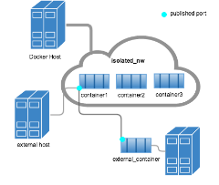
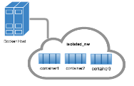
Networks
By default, three networks
none, host, bridge (default)
Additional networks can be created
Bridge network = single host
Overlay network (advanced topic, see Docker docs) can include multiple hosts
Network isolation
For details see https://docs.docker.com/engine/userguide/networking/dockernetworks/

Slide 29
Networks
# List all networks
docker network ls
# Inspect network details
docker network inspect bridge
# Disconnect a container from network
docker network disconnect bridge mycontainer
# Connect a container to a network
docker network connect mynetwork mycontainer
# Create own network
docker network create -d bridge mynetwork
# Start container in a specific network
docker run -it --net=mynetwork ubuntu
For details about network security, see Docker docs
Container name
Network name
Network name
Driver name

Slide 30
DNS
# Start nginx web server on a custom network
docker run -d --net mynetwork --name web nginx
# Start Ubuntu client in same network
docker run -it --net mynetwork --name client ubuntu
# Ping web server
ping web
# Install curl and access web server
apt-get install curl
curl web
# Start Ubuntu container and link it using alias
docker run -it --net mynetwork --link=server3:nginx ubuntu
Container name in DNS
Docker daemon contains embedded DNS server
Container-specific link
For details see https://docs.docker.com/engine/userguide/networking/configure-dns/

Slide 31
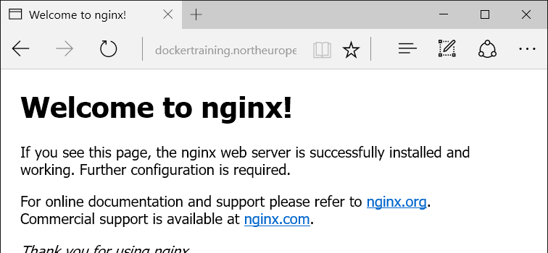
Binding container ports to host
docker run -d --net bridge -p 8080:80 nginx
# Start nginx web server on host network
docker run -d --net host nginx
# Nginx is now available on the public internet:
Host port
Container port
Port mapping
EXPOSE in Dockerfiles
See Docker docs
Use host network
Assign container to host network

Slide 32
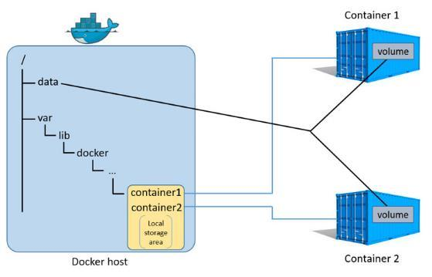
Data Volumes
Directory or file in the Docker host’s filesystem that is mounted directly into a container
Details see Docker docs
Source: https://docs.docker.com/engine/userguide/storagedriver/imagesandcontainers/

Slide 33
Mount Host
# Run postgres in a new container
docker run --name mydb -e POSTGRES_PASSWORD=P@ssw0rd!
-d postgres
# Run client and execute some SQL
docker run -it --link mydb --rm postgres /bin/bash
psql -h mydb -p 5432 -U postgres
# Execute some SQL (e.g. create and fill a table)
CREATE TABLE Test (ID INT PRIMARY KEY);
INSERT INTO Test VALUES (1);
SELECT * FROM Test;
\q
# Delete container --> data is gone
docker rm –f mydb
-------------------
# Create data directory on host
mkdir dbdata
# Repeat the same example but this time with volume mapping
docker run --name mydb -e POSTGRES_PASSWORD=P@ssw0rd!
-v ~/dbdata:/var/lib/postgresql/data -d postgres

Slide 34
Data Volume Container
# Create data volume container
docker create -v /dbdata --name dbstore postgres /bin/true
docker ps –a
# Create postgres container and mount data volume container
docker run --name mydb -e POSTGRES_PASSWORD=P@ssw0rd!
-e PGDATA=/dbdata --volumes-from dbstore -d postgres
# Run client and execute some SQL (see previous example)
# Remove postgres container, recreate it --> data still there
# Start container to backup data
mkdir backup
docker run --rm --volumes-from dbstore
-v ~/backup:/backup ubuntu tar cvf /backup/backup.tar /dbdata
ls –la backup/

Slide 35
Docker Volumes on Azure Files
Azure Files-Driver for Docker Volumes available
https://github.com/Azure/azurefile-dockervolumedriver
Store persistent data outside of Docker Containers
Docker containers/hosts can be moved, recreated, etc. without loosing data
High availability, replication for data
Multiple containers/hosts can access the same volume

Slide 36
Azure Files Volume
// Create volume
docker volume create
-d azurefile --name dbdatavol -o share=dbdatavol
// Create postgres DB with data on Azure Files
docker run –d --name mydb -e POSTGRES_PASSWORD=P@ssw0rd!
-e PGDATA=/dbdata -v dbdatavol:/dbdata -p 5432:5432 postgres
Volume name
Share name
Driver name
Map Azure Files-based volume
Put data into volume-mapped folder

Slide 37
Images
Working with images

Slide 38
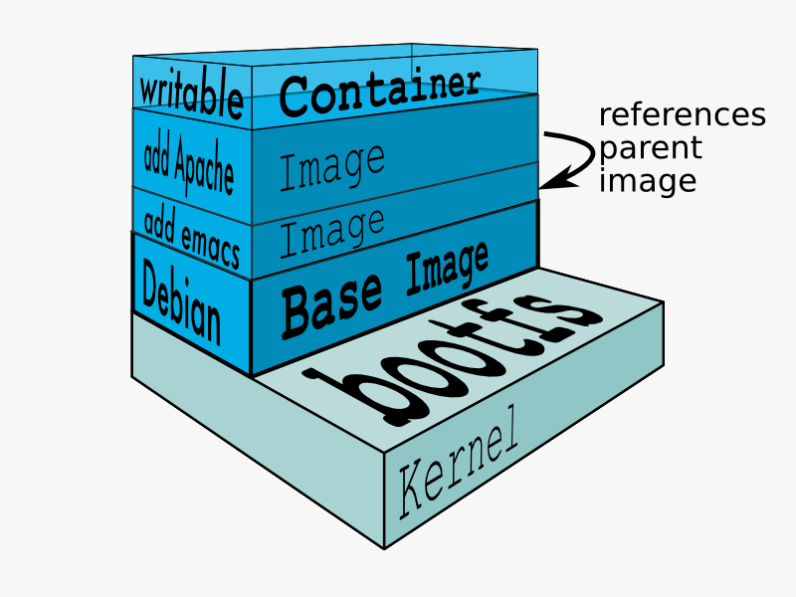
File System Layers
Rootfs stays read-only
Union-mount file system over the read-only file system
Multiple file systems stacked on top of each other
Only top-most file system is writable
Copy-on-write
Image Source: https://docs.docker.com/terms/layer

Slide 39
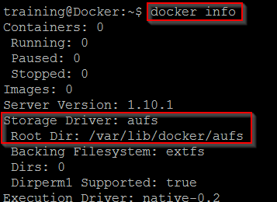
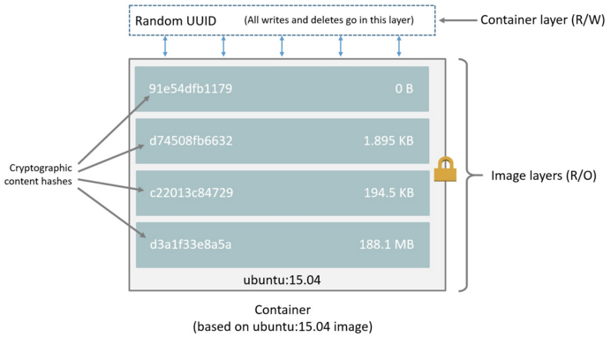
Images
# Pull image from docker hub
docker pull ubuntu
# Look for image directories on disk
ls /var/lib/docker/aufs/layers
Docker data directory
More about storage drivers see Docker docs
Source: https://docs.docker.com/engine/userguide/storagedriver/imagesandcontainers/

Slide 40
Docker CLI
Important Commands for Images
docker images – List all images
docker search – Search for image on Docker Hub
docker pull – Pulls an image from the registry (Docker Hub)
docker commit – Create image from container
docker inspect – Get low-level information on container or image

Slide 41
Docker CLI
docker commit
-m="Demo image" --author="Rainer Stropek"
Building Images from Containers
Message
Author of the image
templateContainer rstropek/ubuntu:withFile
Target repository:tag
Name of the container

Slide 42
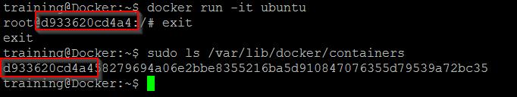
Demo
# Start interactive container
docker run -it ubuntu /bin/bash
echo "Hello Docker" > helloWorld.txt
exit
# Build image from container
docker commit … rainer:withFile
# Remove container
docker rm -f …
# Create new container from new image
docker run -it rainer:withFile /bin/bash
# View history of image
Docker history rainer:withFile
# Remove image
docker rmi rainer:withfile
# Run DockerUI in container
# https://github.com/crosbymichael/dockerui
docker run -d -p 9000:9000 --privileged \
-v /var/run/docker.sock:/var/run/docker.sock \
dockerui/dockerui
Create Image

Slide 43
Dockerfiles
Creating images from source

Slide 44
Dockerfiles
# Version 0.0.1
FROM nginx
MAINTAINER Rainer Stropek "rainer@timecockpit.com"
ENV REFRESHED_AT 2014-02-22
RUN apt-get -qq update
COPY *.html /usr/share/nginx/html/
Execute command in new layer on top of the image and commit the result
Documentation
https://docs.docker.com/reference/builder/
https://registry.hub.docker.com/_/nginx/
Copy files to the filesystem of the container
docker build –t staticweb .
Dockerfile location
Tag for the image

Slide 45
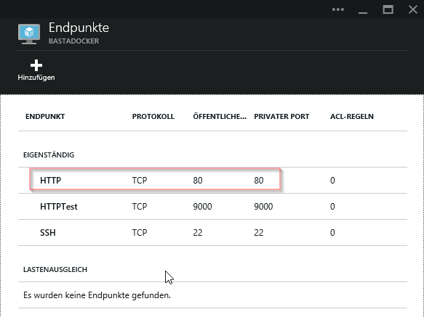
Docker CLI
docker run --name staticwebcontainer \
-d -p 80:80 staticweb
Exposing ports
Expose port 80
Run daemonized

Slide 46
Demo
# Get sample code from GitHub
git clone https://github.com/rstropek/DockerVS2015Intro.git
# Build website
cd dockerDemos/01-staticWeb/app
npm install
grunt
cd ..
# Build image from Dockerfile
docker build -t staticweb .
docker run -d -p 80:80 staticweb
# Change website content and rebuild container
# Run a second container, run a third container (linked)
docker run -i -t --link <cont1>:sweb1 --link <cont2>:sweb2 ubuntu /bin/bash
apt-get install curl
curl http://sweb1
Dockerfile
Sample files see https://github.com/rstropek/DockerVS2015Intro/tree/master/dockerDemos/01-staticWeb

Slide 47
Demo
# Run grunt inside a docker container
docker run --rm -v ~/DockerVS2015Intro/dockerDemos/01-staticWeb/app:/data digitallyseamless/nodejs-bower-grunt grunt
# Run daemonized grunt inside a docker container
docker run -d -v ~/DockerVS2015Intro/dockerDemos/01-staticWeb/app:/data digitallyseamless/nodejs-bower-grunt grunt watch
# Run nginx webserver inside daemonized container
docker run -d -p 80:80 -v ~/DockerVS2015Intro/dockerDemos/01-staticWeb/app:/usr/share/nginx/html nginx
Automated build

Slide 48
Demo
# Run grunt inside a docker container
docker run --rm
-v ~/DockerVS2015Intro/dockerDemos/01-staticWeb/app:/data
dockerfile/nodejs-bower-grunt
grunt
Remove the container when it exists
Run Grunt (build) in Container
Mount host volume (host:container)
Use existing image
Run grunt

Slide 49
Docker Compose
Tool for running multi-container applications

Slide 50
Demo
printer:
build: .
links:
- dependent-service
dependent-service:
image: dependent-service
Build local Dockerfile
For more info visit https://docs.docker.com/compose/
Link to other containers (e.g. Redis, MongoDB)
Run service container depends on based on an existing image

Slide 51
Demo
# Build dependent service
# directory: ~/DockerVS2015Intro/dockerDemos/02-compose/dependentService
npm install
docker build –t dependent-service .
# Run container using dependent service
# directory: ~/DockerVS2015Intro/dockerDemos/02-compose
npm install
docker-compose run printer
Automated build
Sample files see https://github.com/rstropek/DockerVS2015Intro/tree/master/dockerDemos/02-compose

Slide 52
ASP.NET in Docker
Running ASP.NET in Docker

Slide 53
Simple ASP.NET
FROM microsoft/aspnet
RUN apt-get install -y curl
RUN curl -sL https://deb.nodesource.com/setup_5.x | bash -
RUN apt-get install -y nodejs
COPY ./my-web /src
RUN cd /src && dnu restore
EXPOSE 5000
WORKDIR /src
CMD ["dnx", "web"]
Dockerfile
Sample files see https://github.com/rstropek/DockerVS2015Intro/tree/master/dockerDemos/04-aspnet

Slide 54
Simple ASP.NET
# Generate an ASP.NET web app
yo aspnet webbasic "my-web"
# Add “--server.urls=http://*:5000/“ to project.json so
# that ASP.NET listens not only on localhost
# Build image with sample app
docker build -t rainer:myweb .
# Run ASP.NET container
docker run -d -p 80:5000 rainer:myweb
Sample files see https://github.com/rstropek/DockerVS2015Intro/tree/master/dockerDemos/04-aspnet

Slide 55
Dockerfile
FROM microsoft/aspnet
MAINTAINER Rainer Stropek "rainer@timecockpit.com"
ENV REFRESHED_AT 2015-01-02
ENV SOURCE_DIR /app/src
RUN mkdir -p $SOURCE_DIR
WORKDIR $SOURCE_DIR
COPY refreshAndRunSample.sh $SOURCE_DIR/
RUN chmod a+x $SOURCE_DIR/refreshAndRunSample.sh
RUN apt-get -qqy install git
RUN git init \
&& git pull https://github.com/aspnet/Home.git \
&& cd samples/HelloMvc/ \
&& kpm restore
ENTRYPOINT ["/app/src/refreshAndRunSample.sh"]
Base image: https://registry.hub.docker.com/u/microsoft/aspnet/
Run container
docker run -d -t -p 80:5004 aspnet-beta8

Slide 56
Application Scenarios
Running continuous integration in containers
Rebuild complex runtime environment on my laptop
Identical environment for dev, test, and prod
Cost reduction in the cloud
High density hosting (e.g. multiple versions)
Split software into multiple, independent services
Micro-services, see Manfred’s session tomorrow

Slide 57
Q&A
Workshop
Rainer Stropek
software architects gmbh
Web
Mail
Twitter
http://www.timecockpit.com
rainer@timecockpit.com
@rstropek
Thank you for attending!

