Slide 1

Nano Server
Nano Server Workshop
Rainer Stropek
software architects gmbh
Web
Mail
Twitter
http://www.timecockpit.com
rainer@timecockpit.com
@rstropek
and Windows Containers

Slide 2

Your Host
Rainer Stropek
Developer, Entrepreneur
MVP Microsoft Azure
MVP Development Technologies
MS Regional Director
Senior Consultant IT-Visions
Contact
software architects gmbh rainer@timecockpit.com Twitter: @rstropek

Slide 3
Windows OS for the Cloud
Optimized for the cloud (private/public)
Smaller footprint, faster startup, less update, etc.
How can it be smaller and faster?
Headless (=no GUI)
Limited functionality (e.g. only 64bit, no AD domain controller, no group policy, …; details)
Current Branch for Business (CBB)
2-3 feature update/year for Nano Server
Not more than two Nano Server CBB releases behind for support (details)

Slide 4
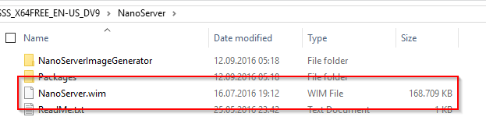
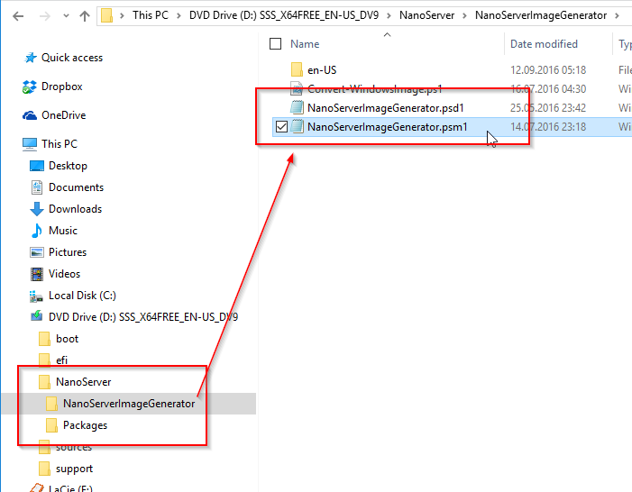
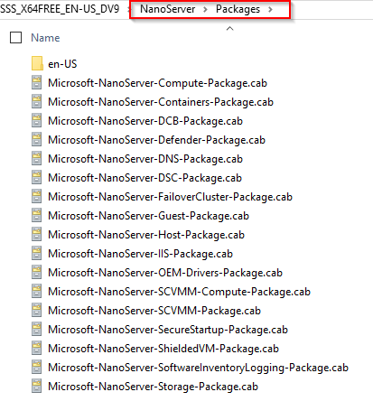
Installation
Tip: You can create custom Windows images to be used as a baseline

Slide 5
Install Nano Server
Create VHD
Add virtual Machine
Connect
Remote PowerShell

Slide 6
Installation
# Location where the Windows Server 2016 ISO is mounted.
# We will copy the Nano Server Image Generator from there.
$winServerInstallRoot = "d:\"
$temp = "c:\temp"
$nanoServerImageGeneratorFolder = "$temp\NanoServerImageGenerator"
$targetPath = $temp + "\demo\NanoServerVM.vhd"
$computerName = "mynanoserver"
$secure_string_pwd = convertto-securestring "pass" -asplaintext -force
[Environment]::SetEnvironmentVariable("TEMP", "c:\temp\tempFolder",`
"Process")
# Copy Nano Server Image Generator to local disk
if (!(Test-Path -Path "$nanoServerImageGeneratorFolder")) {
Copy-Item "$winServerInstallRoot\NanoServer\NanoServerImageGenerator" `
"$nanoServerImageGeneratorFolder" -Recurse -Force
}
# Import Nano Generator module
cd $nanoServerImageGeneratorFolder
Import-Module .\NanoServerImageGenerator -Verbose
# Create Nano Server ISO VHD
New-NanoServerImage -Edition Standard -DeploymentType Guest `
-MediaPath $winServerInstallRoot `
-BasePath .\Base -TargetPath $targetPath -ComputerName $computerName `
-AdministratorPassword $secure_string_pwd `
-Package Microsoft-NanoServer-Guest-Package -MaxSize 100GB `
-EnableRemoteManagementPort -Verbose
Create VHD
https://github.com/rstropek/DockerVS2015Intro/blob/master/dockerDemos/07-win-container-nano-server/setup-simple-nano-server.ps1

Slide 7
Installation
Import-Module Hyper-V
net start WinRM
$computerName = "Simple Nano Server"
$vm = Get-VM -Name $computerName
$vmIP = (Get-VMNetworkAdapter $vm)[0].IPAddresses[0]
Set-Item WSMan:\localhost\Client\TrustedHosts $vmIP -Force
$cred = Get-Credential
$session = New-PSSession -ComputerName $vmIP -Credential $cred
Enter-PSSession -Session $session
Connect and create session
https://github.com/rstropek/DockerVS2015Intro/blob/master/dockerDemos/07-win-container-nano-server/connect-nano-server.ps1

Slide 8
Deployment
Virtual machine from ISO
Physical machine
Dual boot VHD/VHDX
PxE-boot and install Nano Server from WDS (details)
Booting into WinPE and deploying Nano Server using a .wim file (details)
Tip: Consider Nano Server Image Builder GUI

Slide 9
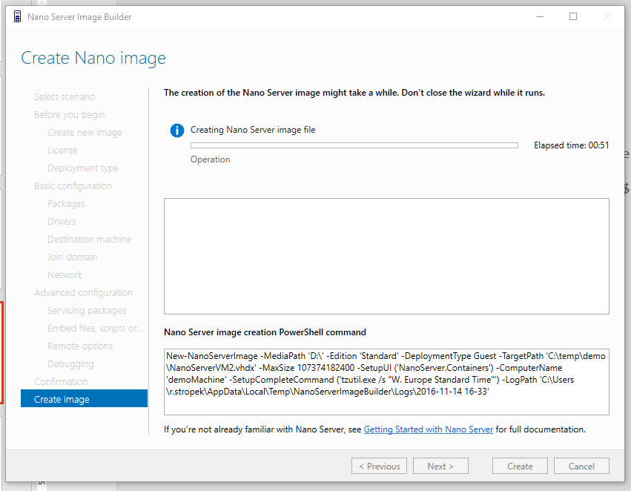
Install Nano Server
Nano Server Image Builder
https://blogs.technet.microsoft.com/nanoserver/2016/10/15/introducing-the-nano-server-image-builder/

Slide 10
Updates
Use -ServicingPackagePath option
New-NanoServerImage and Edit-NanoServerImage
Apply update to an existing VHD or VHDX
Offline or running
Add-WindowsPackage or dism
Manage updates using CIM/WMI
https://technet.microsoft.com/en-us/windows-server-docs/get-started/update-nano-server

Slide 11
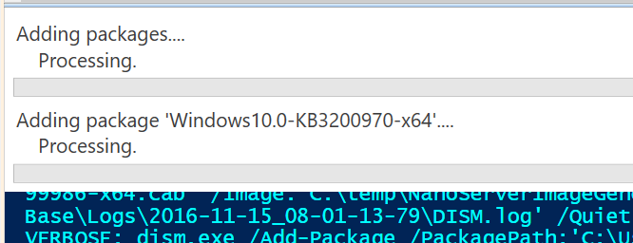
Demo
$sess = New-CimInstance `
-Namespace root/Microsoft/Windows/WindowsUpdate `
-ClassName MSFT_WUOperationsSession
$scanResults = Invoke-CimMethod -InputObject $sess `
-MethodName ScanForUpdates `
-Arguments @{SearchCriteria="IsInstalled=0";OnlineScan=$true}
$scanResults.Updates | Select Title
# SAMPLE RESULT:
# Title
# -----
# Cumulative Update for Windows Server 2016 for x64-based Systems (KB3197954)
# Update for Windows Server 2016 for x64-based Systems (KB3199986)
# Cumulative Update for Windows Server 2016 for x64-based Systems (KB3200970)
# DOWNLOAD AND EXPAND UPDATES
Expand kb3200970.msu -F:* kb3200970
# COPY CAB FILES
New-NanoServerImage … `
-ServicingPackagePath `
"c:\temp\Windows10.0-KB3197954-x64.cab", `
"c:\temp\Windows10.0-KB3199986-x64.cab", `
"c:\temp\Windows10.0-KB3200970-x64.cab" …
Install Updates during VHD building

Slide 12
PowerShell
PowerShell Core Edition
Limited functionality
Details in TechNet
Guidelines for porting to PowerShell Core available
Details in TechNet

Slide 13
Container
Container Host
Installation details
Container Base Image
microsoft/nanoserver on Docker Hub

Slide 14
Docker and Nano
Start Nano Server as Docker Container
Dockerfile
Nano Server with IIS
Nano Server as Docker Host
Setup
Connect from Docker client

Slide 15
Summary
Higher hosting density → lower costs
Less updates and reboots → higher availability
Frequent update → faster innovation
Nano Server: Windows OS for the private and public cloud

Slide 16
Q&A
Nano Server Workshop
Rainer Stropek
software architects gmbh
Mail Web Twitter
rainer@timecockpit.com http://www.timecockpit.com @rstropek
Thank your for coming!

