Slide 1
BUSCO: Assessment of Transcriptome Completeness
Azra Kapetanovic

Slide 2
OVERVIEW
Overview of Transcriptome Analysis
What is BUSCO?
How Does BUSCO Work?
Interpreting BUSCO Results
References

Slide 3
Overview of Transcriptome Analysis
Understanding gene expression and functional genomics
Examination of the transcriptome at a particular time and condition

Slide 4
What is BUSCO?
Acronym for Benchmarking Universal Single-Copy Orthologs
Bioinformatics tool for assessing the completeness and quality of genome or transcriptome assemblies

Slide 5
How Does BUSCO Work?
Comparison of the input transcriptome sequences with a predefined set of orthologs
Conserved orthologs are universally present in most genomes
Single-copy control
Assessment of presence, absence, and fragmentation of each ortholog

Slide 6
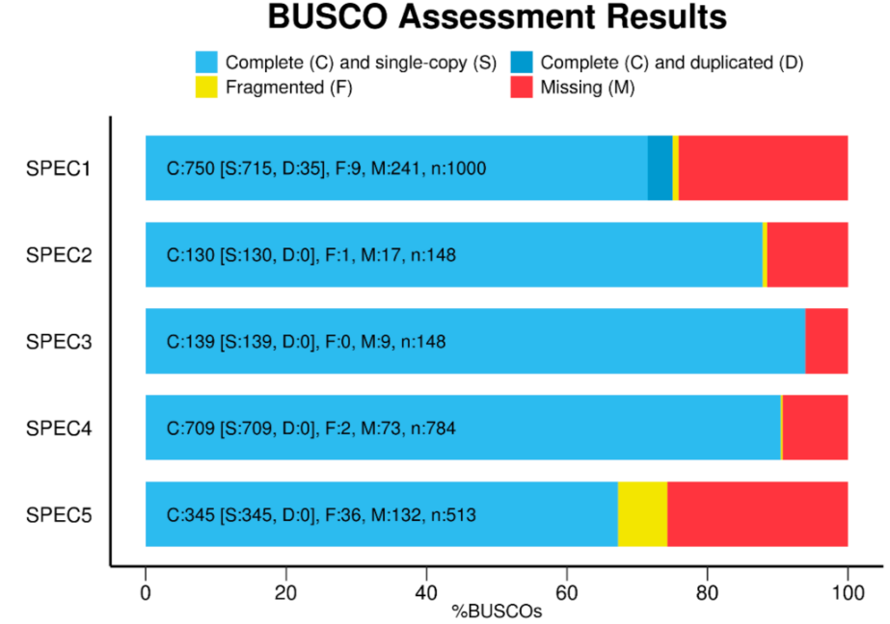
Interpretation OF Results
Complete (C) orthologs: present as a single (S) or duplicated (D), full-length copy
Fragmented (F) orthologs: partially present
Missing (M) orthologs: not detected
Higher percentages indicate a more complete assembly

Slide 7
Interpretation OF Results: TROUBLESHOOTING
Duplicated orthologs: gene duplication, alternative splicing
Fragmented orthologs: sequencing errors, incomplete transcriptome assembly, limitations of the assembly algorithm, highly divergent orthologs
Missing orthologs: low/no gene expression, incomplete sequencing coverage, highly fragmented transcripts

Slide 8
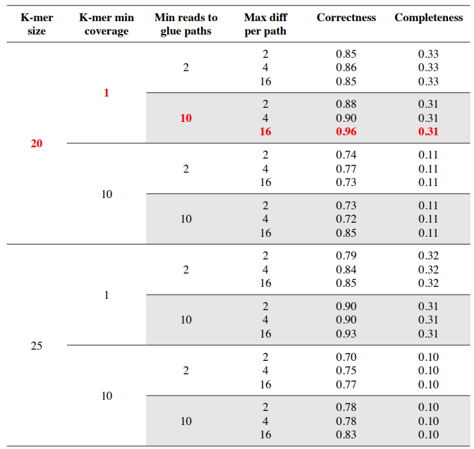

Slide 9
REFERENCES
Mosè Manni, Matthew R Berkeley, Mathieu Seppey, Felipe A Simão, Evgeny M Zdobnov, BUSCO Update: Novel and Streamlined Workflows along with Broader and Deeper Phylogenetic Coverage for Scoring of Eukaryotic, Prokaryotic, and Viral Genomes. Molecular Biology and Evolution, Volume 38, Issue 10, October 2021, Pages 4647–4654, https://doi.org/10.1093/molbev/msab199
Manuel Mendoza and others, Transcriptomic landscape of the kleptoplastic sea slug Elysia viridis, Journal of Molluscan Studies, Volume 89, Issue 1, March 2023, eyad001, https://doi.org/10.1093/mollus/eyad001

Slide 10
THANK YOU FOR YOUR ATTENTION!

