Slide 1
TransDecoder
Find Coding Regions Within Transcripts

Slide 2
TransDecoder identifies coding regions within transcript sequences
Sequences generated by
de novo RNA-Seq transcript assembly using Trinity
Sequences generated based on
RNA-Seq alignments to the genome using Cufflinks
Fasta output file
GTF output file
GTF/GFF files define genomic regions covered by different types of genomic features, e.g. genes, transcripts, exons, or UTRs.

Slide 3
TransDecoder is run on fasta files
Having a GTF/GFF file
Construct the transcript fasta file from the annotation coordinates in the GTF/GFF file
Recompute a genome-based coding region annotation file (GFF)
Execute TransDecoder

Slide 4
How does TransDecoder work?
Based on probabilistic models
Takes nucleotide composition as well as length of open reading frames (ORFs) into account
ab initio predictor -> the prediction model is based on self-training methods
Why are CDS predictions performed?
Sequence comparisons are more sensitive with protein sequences
Notes:
Includes identifying a certain number of long ORFs from within the assembly, which serve as test set for predicting CDS from the remaining contigs afterwards

Slide 5
Criteria used for the identification
a minimum length open reading frame (ORF) is found in a transcript sequence
a log-likelihood score similar to what is computed by the GeneID software is > 0.
The coding score is greatest when the ORF is scored in the 1st reading frame
If a candidate ORF is found fully encapsulated by the coordinates of another candidate ORF, the longer one is reported
Notes:
Scores for both exon-defining signals and protein-coding potential are computed as log-likelihood ratios, which for a given predicted exon are summed up into the exon score, in consequence also a log-likelihood ratio.

Slide 6
A PSSM is built/trained/used to refine the start codon prediction
A position-specific scoring matrix is a commonly used representation of motifs in biological sequences
The ATG PSSM context score is calculated based on a 3 step algorithm
Using PSSM a twice higher correlation with ribosomal density and protein levels can be obtained
(in comparison to the previous translation initiation efficiency rule)
Zur H, Tuller T. New universal rules of eukaryotic translation initiation fidelity. PLoS Comput Biol.

Slide 7
Predicting coding regions from a transcript fasta file
Step 1: extract the long open reading frames
TransDecoder.LongOrfs will identify ORFs that are at least 100 amino acids long – Can be lowered via the '-m' parameter
include the -S flag to examine only the top strand.
Include --complete_orfs_only if you want to exclude partials
TransDecoder.LongOrfs -t target_transcripts.fasta
Notes:
If the transcripts are oriented according to the sense strand,

Slide 8
Predicting coding regions from a transcript fasta file
Step 2: predict the likely coding regions
A working directory (ex. transcripts.transdecoder_dir/) is created to run and store intermediate parts of the pipeline
TransDecoder.Predict -t target_transcripts.fasta

Slide 9
Output files
.pep file : peptide sequences for the final candidate ORFs; all shorter candidates within longer ORFs were removed.
.cds file : nucleotide sequences for coding regions of the final candidate ORFs
.gff3 file : positions within the target transcripts of the final selected ORFs
.bed file : bed-formatted file describing ORF positions, best for viewing using GenomeView or IGV.

Slide 10
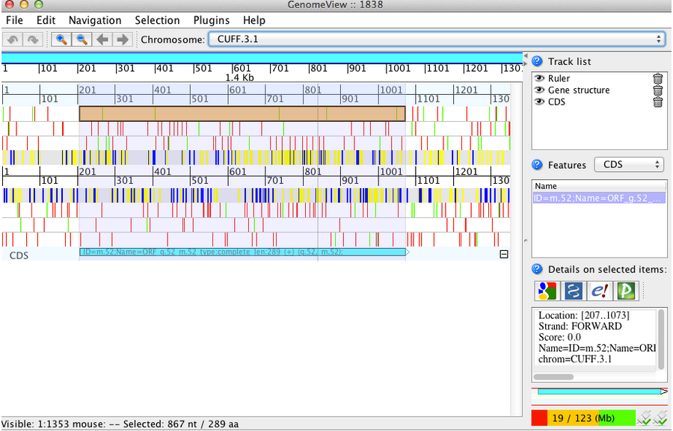
Viewing ORFs on target transcripts
Loading the transcript fasta file and the ORF predictions (bed file) into GenomeView

