Slide 1



MAFFT - Alignment
Presenter
Tahmina Begum
Carolina Ruiz Valdez

Slide 2
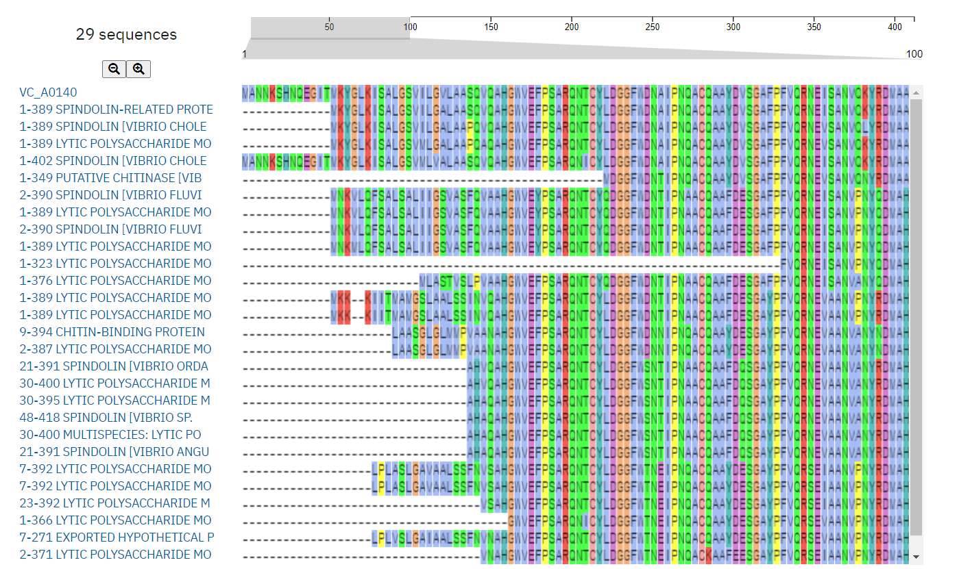
Multiple sequence alignment(MSA)
The alignment of three or more biological sequences (protein or nucleic acid) of similar length
They share a lineage and are descendent from common ancestor
Residues in same row are same sequences
Residues in same column share some similarities
Different column contains different pattern of residue distribution

Slide 3
Application of MSA
Identifying similarities between sequences
Detecting conserved regions and structural homologies
Assists improved prediction of secondary and tertiary structure of proteins
Making patterns or profiles that can be further used to predict new sequences falling in a given family
Inferring evolutionary trees or linkages

Slide 4
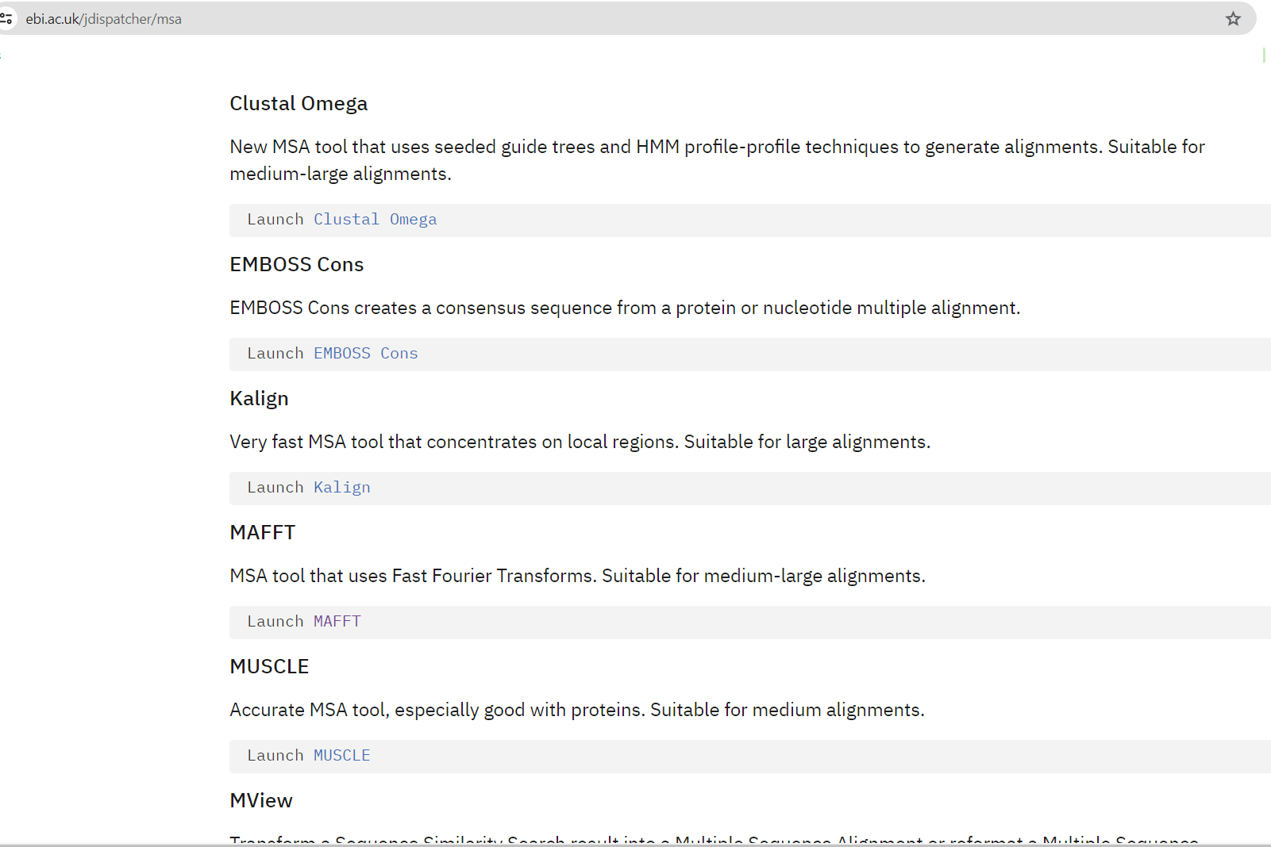
Tools used for MSA
Clustal Omega
EMBOSS Cons
Kalign
MAFFT
MUSCLE
Mview
T-Coffee
WebPRANK
MSA online https://www.ebi.ac.uk/jdispatcher/msa

Slide 5
MAFFT
Multiple Alignment using Fast Fourier Transform
Developed by Kazutaka Katoh
High speed multiple sequence alignment program
Command-line program with no graphical user interface
Accepts a set of unaligned sequences in FASTA format and returns an alignment of the sequences in FASTA, CLUSTAL or Phylip format
Runs on a UNIX-like environment, such as Linux, Terminal on Mac OS X, and Cygwin on Windows
This tool can align up to 500 sequences or a maximum file size of 1 MB

Slide 6
Strategies for Alignment with MAFFT
The progressive method (FFT-NS-1, FFT-NS-2)
The iterative refinement method with the WSP score (FFT-NS-i, NW-NS-i )
The iterative refinement method using both the WSP and consistency scores (L-INS-i, E-INS-i, G-INS-i)
The order of speed : A > B > C
The order of accuracy: A < B < C

Slide 7
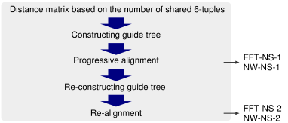
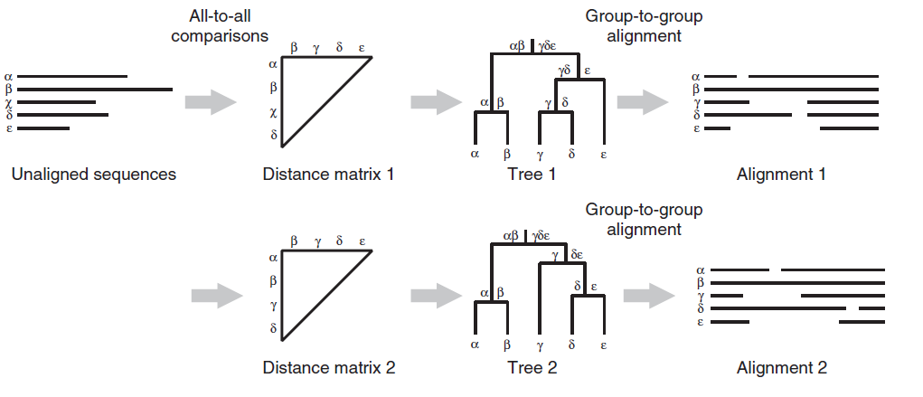
The progressive method
FFT-NS-1
(mafft --retree 1 input_file > output_file or fftns --retree 1 input_file > output_file)
Make a rough distance matrix by counting the number of shared 6-tuples between every sequence pair
Build a guide tree
Align the sequences according to the branching order
2. FFT-NS-2
(mafft --retree 2 input_file > output_file or fftns input_file > output_file)
The guide tree is re-computed from the FFT-NS-1
Alignment the second progressive alignment is carried out.

Slide 8
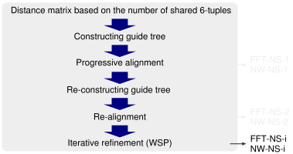
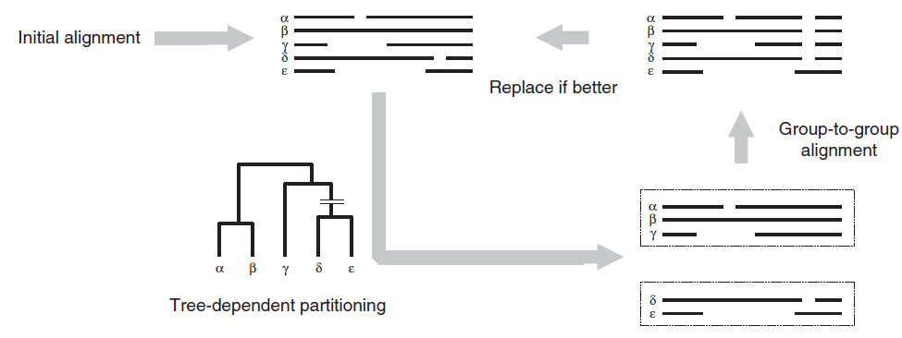
The iterative refinement method with the WSP score
FFT-NS-i (max. 1,000 cycles):
mafft --maxiterate 1000 input_file > output_file or
fftnsi --maxiterate 1000 input_file > output_file
The iterative refinement is repeated until no more improvement in the WSP score is made or the number of cycles reaches 1,000.

Slide 9
Advantages of MAFFT
L-INS-i is one of the most accurate multiple sequence alignment methods currently available.
FFT-NS-2 and other progressive methods can align many and/or long DNA/protein sequences.
The scoring system was designed to allow large gaps.
MAFFT is suitable for LSU rRNA and SSU rRNA alignments that sometimes have variable loop regions.
It takes less CPU runtime than other algorithms that have the same or similar accuracies especially T-Coffee, ClustalW, and Needleman-Wunsch.
https://mafft.cbrc.jp/alignment/software/about.html

Slide 10
MAFFT Limitations
Accuracy: Library extension is not performed unlike TCoffee, because iterative refinement is more efficient than library extension.
Scalability: If two unrelated and long genomic DNA sequences are given, FFT-NS-2 tries to make a full-length alignment using rigorous DP.
The order of alignable blocks or domains are assumed to be conserved for all input sequences.
https://mafft.cbrc.jp/alignment/software/about.html

Slide 11
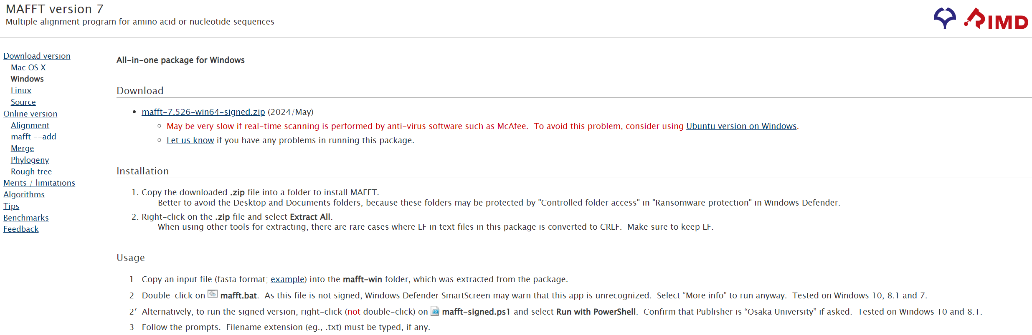
How to install MAFFT
https://mafft.cbrc.jp/alignment/software/
Or use an online service, for example: https://www.ebi.ac.uk/jdispatcher/msa/mafft

Slide 12
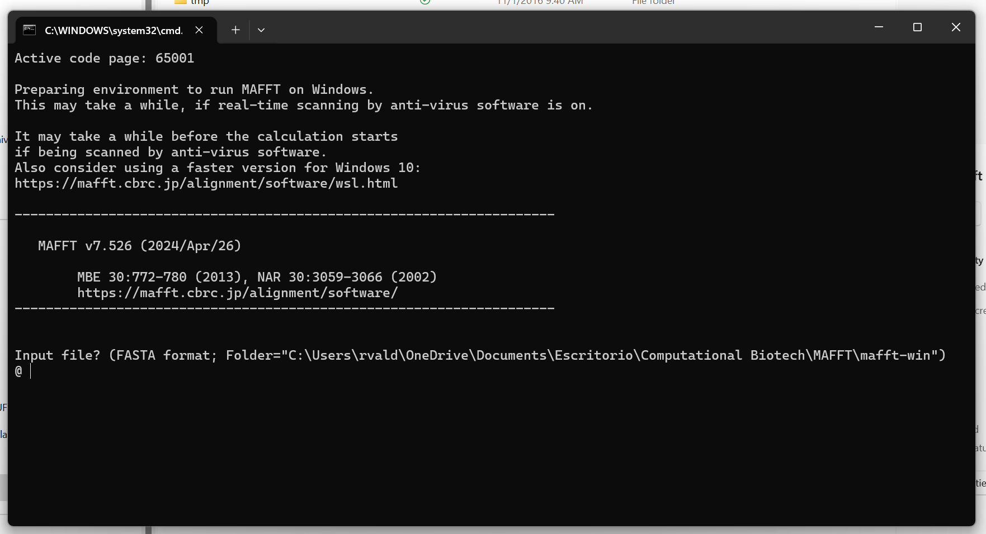

Using MAFFT
Using file provided:
The sequences can be protein- or RNA-coding sequences or non-coding nucleotide sequences, such as introns or spacers.
When a sequence has no corresponding residue because of an insertion or deletion event, the position is displayed as ‘‘-’’ which is called a ‘‘gap.’’
Notes:
MAFFT is a command-line program with no graphical user interface. It runs on a UNIX-like environment, such as Linux, Terminal on Mac OS X, and Cygwin on Windows. For users who prefer a graphical interface, web-based interfaces are available at several MAFFT servers.

Slide 13
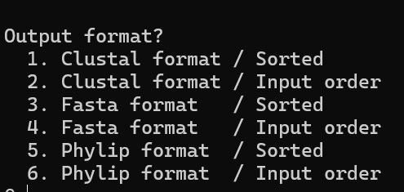
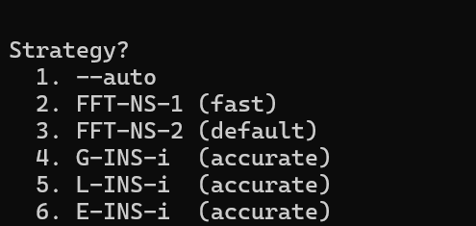
Using MAFFT
Notes:
2,3 Progressive methods
4, 5, 6 Iterative refinement methods

Slide 14
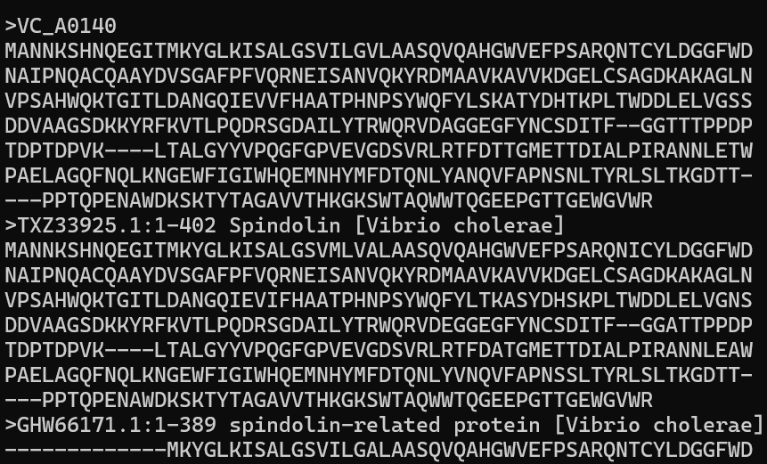
Using MAFFT

Slide 15
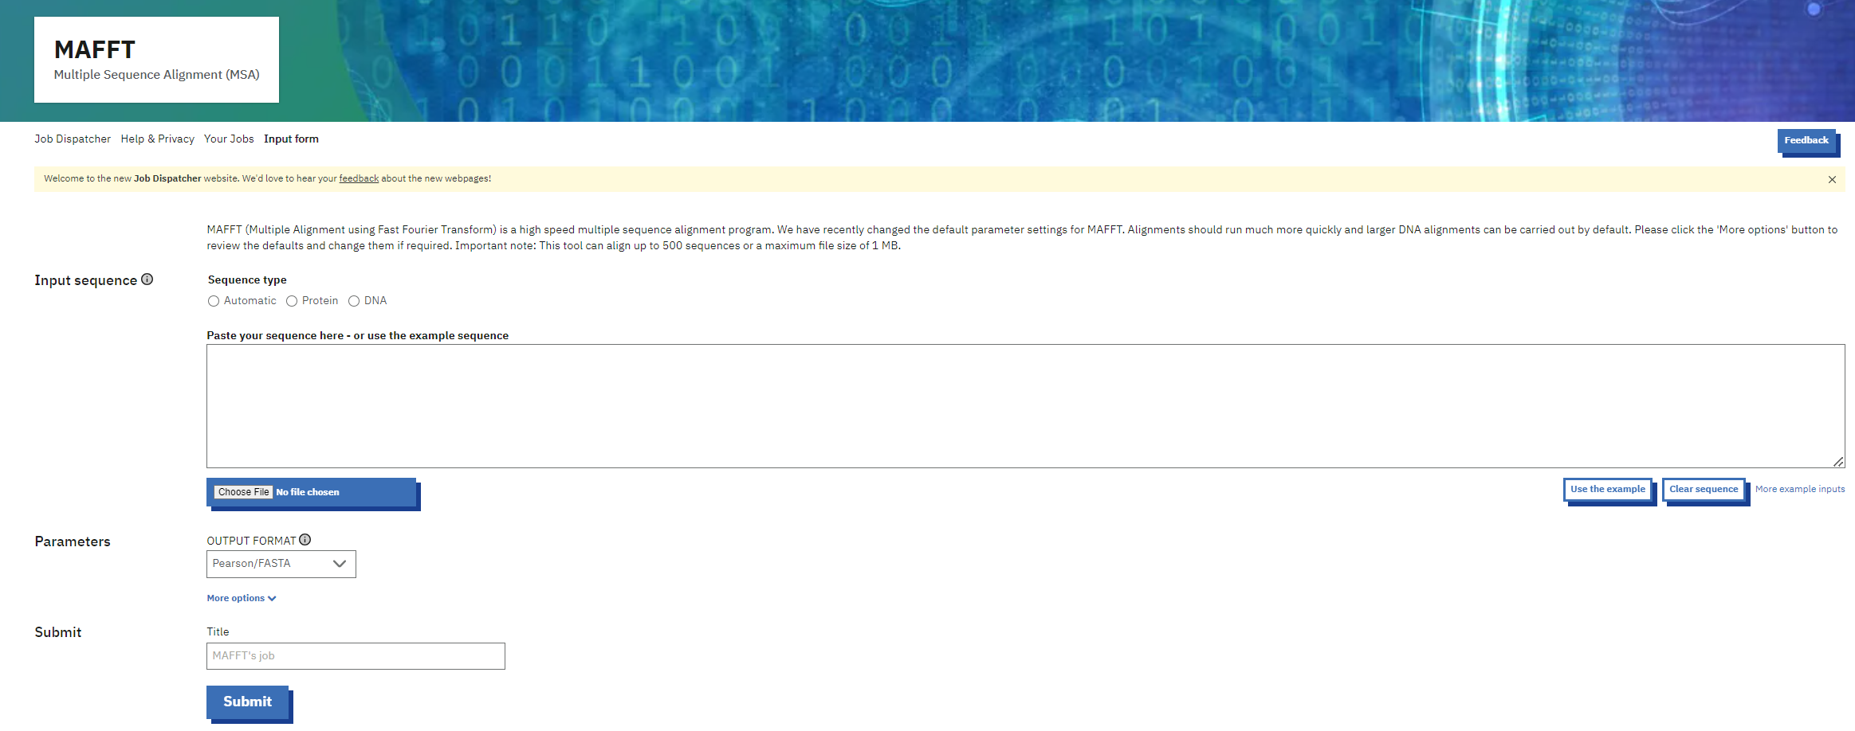
Using MAFFT online
https://www.ebi.ac.uk/jdispatcher/msa/mafft

Slide 16
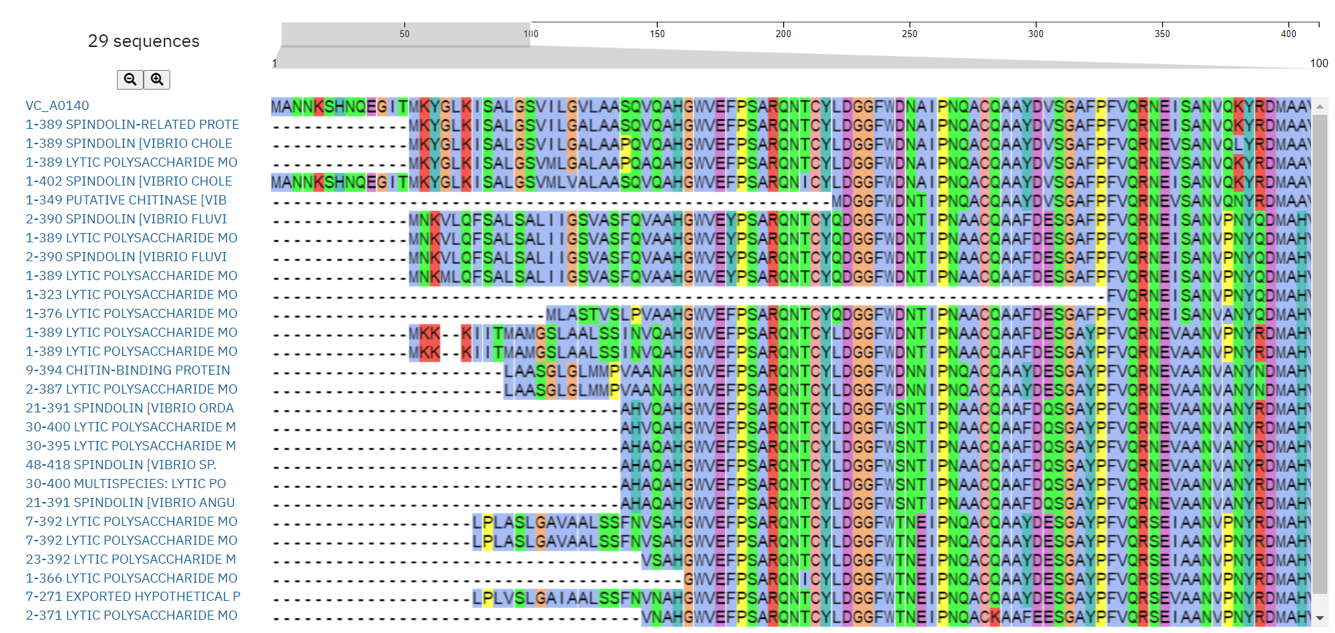
Using MAFFT online

Slide 17
MAFFT 0nline Servers
Kyushu University http://align.bmr.kyushu-u.ac.jp/mafft/online/server
EBI http://www.ebi.ac.uk/mafft/
GenomeNet http://align.genome.jp/mafft/
Max PlanckInstitute http://toolkit.tuebingen.mpg.de/mafft

Slide 18
Comparison online vs. installed
Online:
Installed:
Commands: https://mafft.cbrc.jp/alignment/software/manual/manual.html

Slide 19
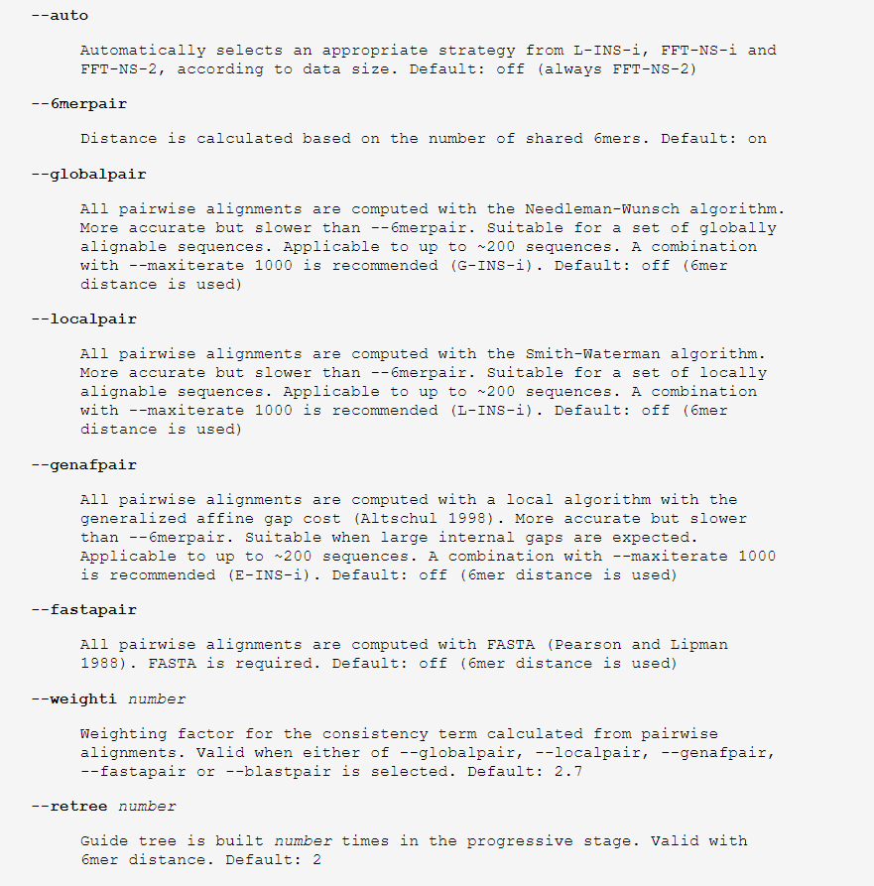
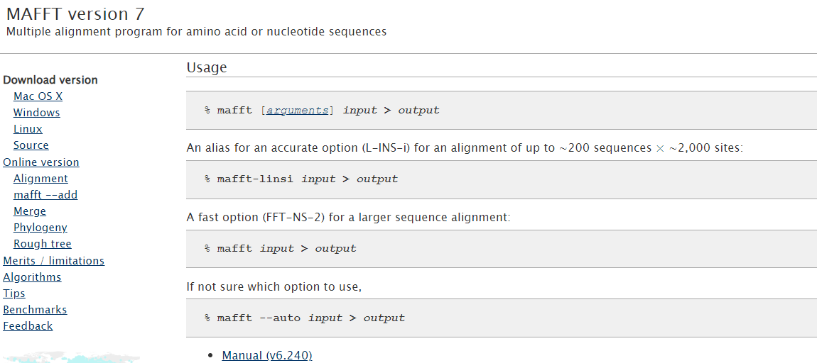
Command line argument
https://mafft.cbrc.jp/alignment/software/manual/manual.html#lbAI
https://mafft.cbrc.jp/alignment/software/

Slide 20
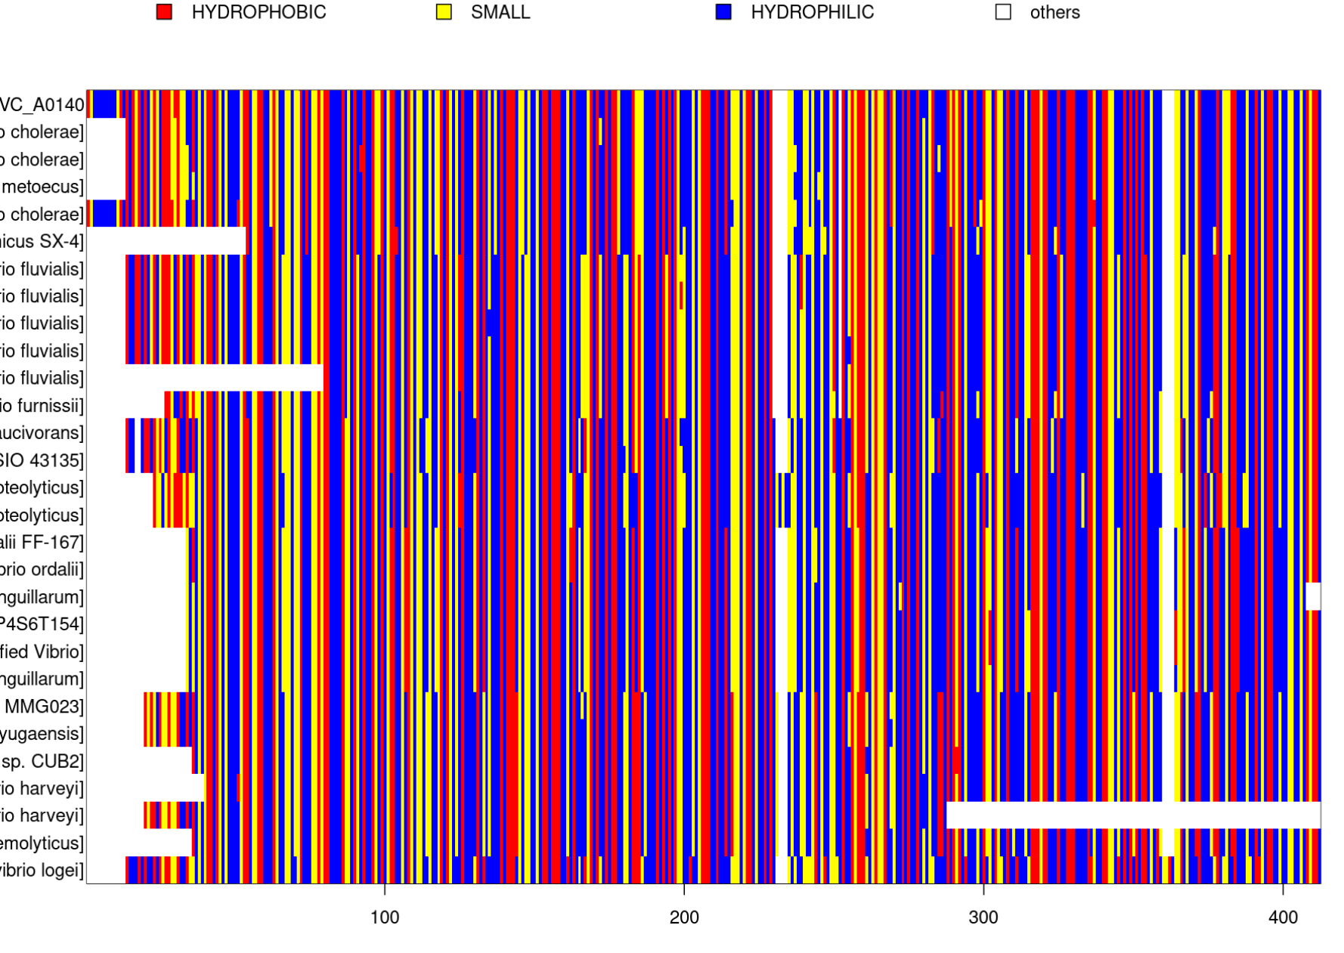
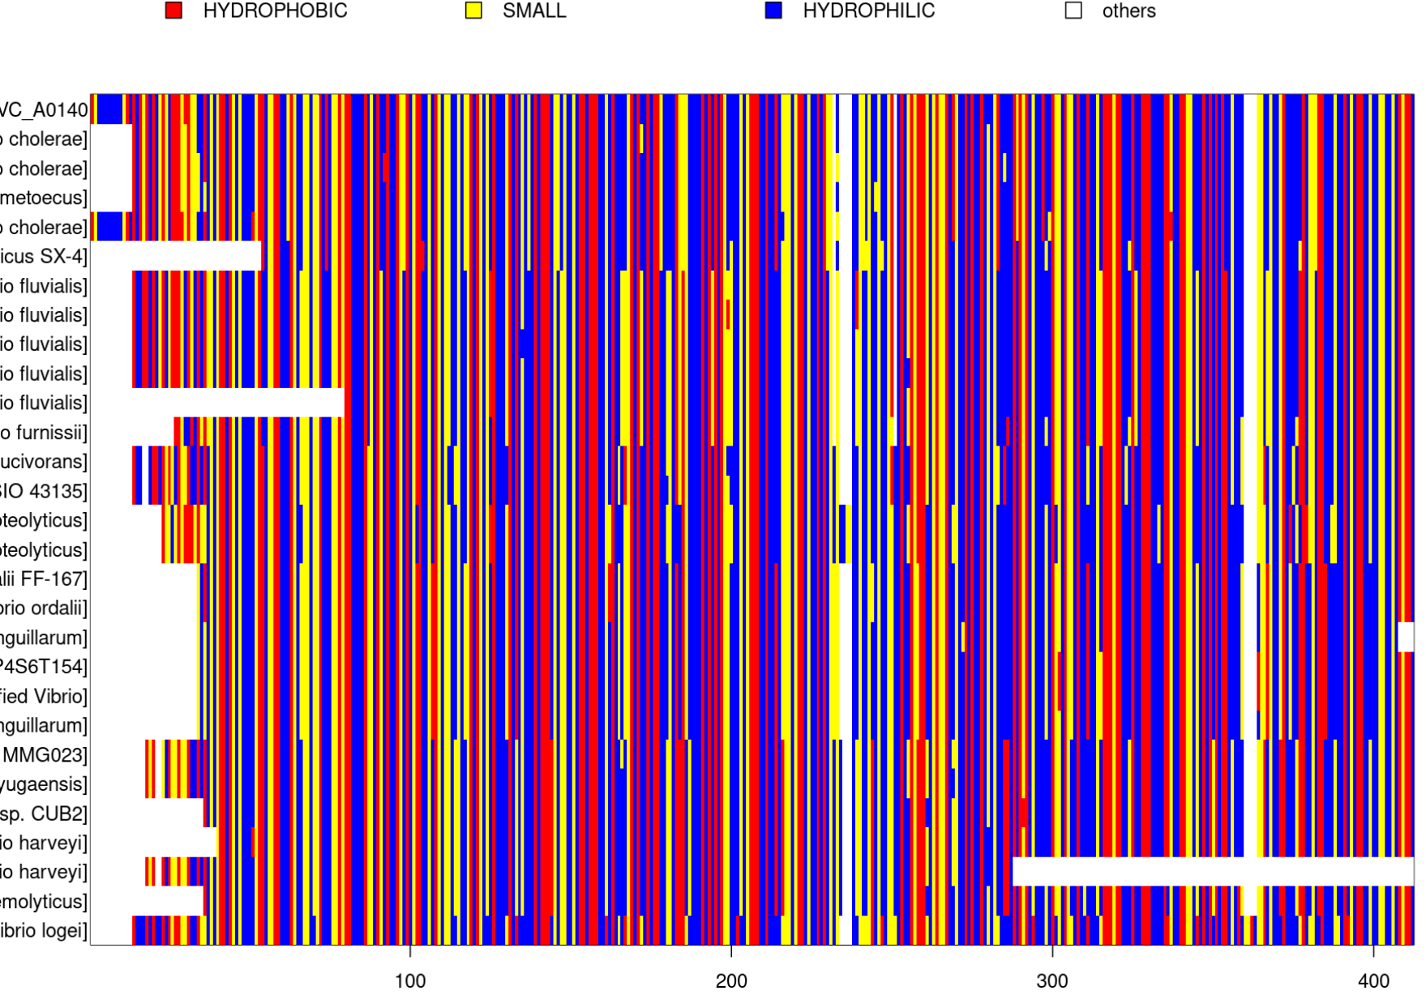
Comparison online vs. installed
Results:

Slide 21
Example
Align sequences from provided file using MAFFT:

Slide 22
Thanks for you attention!

