Slide 1
Adult Census Income Prediction
By-kuldeep sharma

Slide 2
Objective:
Development of a predictive model to classify whether a person earns more than 50K dollars per annum or not.. The model will determine the same using some parameters like age, work class, educational qualifications, country, etc.
Benefits:
Can be used by Governmental / Non-Governmental / Private agencies where people needed to be classified on the basis of their annual income
For e.g. : in granting scholarships or waivers to needy students, for different schemes by government for poor ones, etc.

Slide 3
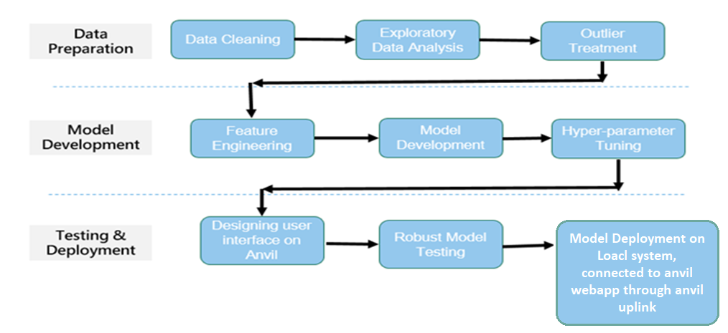
Architecture

Slide 4
Data Validation and Data Transformation :
Missing Values – All the missing values were replaced with the value being repeated the most number of times.
Numerical Columns - All the numerical features were standardized, preventing any data leakage by using data pipelines.
Categorical Columns - Either label encoding or one hot encoding was done to treat the categorical features

Slide 5
Data Insertion in Database:
Cassandra Database - The dataset was imported to Cassandra database from where we can access it with the help of python
Insertion of files in the table - All the data is uploaded into a table named “kuldeep” into which is present inside a database named “adult census”.

Slide 6
Model Training:
Data Export from Db :
The accumulated data from DB is exported to python and read using pandas
Performing EDA to get insight of data like identifying distribution , outliers ,trend
among data etc.
Check for null values in the columns. If present impute the null values.
Encode the categorical values with numeric values.
Perform Standard Scalar to scale down the values.

Slide 7
Model Selection
Different classification models were compared and hyperparamater tuning was done via gridsearchcv on the best performing one that is CatBoost Classifier
Prediction
The model is made in such a way to maximize the accuracy and also other performance metrics so that the predictions are as accurate as possible
The average accuracy after cross validation was observed to be 89.6 percent.

Slide 8
Q & A:
Q1) What’s the source of data?
The data for training is provided by the client in the form answers to certain questions asked which the user has to input.
Q 2) What was the type of data?
The data was the combination of numerical and Categorical values.
Q 3) What’s the complete flow you followed in this Project?
Refer slide 3 for better Understanding

Slide 9
Q 5) How logs are managed?
Following are the logs that we are using :
modeling like, Data Insertion log, Model Fitting log, prediction log, etc.
Q 6) What techniques were you using for data pre-processing?
Removing unwanted attributes
Visualizing relation of independent variables with each other and output variables
Checking and changing Distribution of continuous values
Removing outliers
Cleaning data and imputing if null values are present.
Converting categorical data into numeric values.
Scaling the data

Slide 10
Q 7) How training was done or what models were used?
First, we started with data cleaning, EDA and feature engineering
Then, outliers and ambiguities were removed from the data and categorical features data transformation was applied for categorical columns like one hot encoding, label encoding, etc
Various categorization ML models are trained on test data and their accuracy on test data and training data is compared.
Catboost model was used as the best estimator which was then used for production followed by hyperparameter tuning.
Q 8) How Prediction was done?
Some questions were asked to the client like his age, qualifications, etc and his responses are taken as inputs which are then feeded to the model as a single test case and the predictions are then returned on the clients screen after a interval of one second in which the data pipeline processes the input data to get the output

Slide 11
Q 9) What are the different stages of deployment?
When the pipeline is ready, we connected the front-end made on Anvil with the backend code having the pipeline on the local machine via anvil uplink.
A server is created in a separate Jupyter notebook, on the local system where the trained model is loaded.
The anvil webapp passes inputs from user to callable function in Jupyter notebook where required data transformation takes place and prediction is done on the entered data.
The prediction is then returned to anvil server which displays results based on model prediction to the user.

