Slide 1
WG1 Eindhoven 2017-09-26 FTS token auto-suggest using neural networks (Formerly „Deep-Spell“)

Slide 2
Auto-Suggest FTS token
Background
Currently token completion suggestion can only be done using the FTS5 vocab table
All tokens are stored with their number of occurence there
No relations
No classification of tokens
Doing an auto-suggest for tokens based on more than the available information takes a lot of time consuming algorithm and data crunching
Idea: Let the Artificial Intelligence find out what the best suggestion is

Slide 3
Auto Suggest FTS token
Background
FTS5 vocab table example
Even if we would add priorities or other „importance factors“ to tokens we still would need to come up with a certain idea „how“
Still the tokens are/would not be related to each other → context has no influence on suggestion
Term | Occurences
10th | 10.000
new | 1000
york | 50
main | 800
st | 100.000
… | …
St L[ouis] | vs | St Loui[siana] | ➞ Subtoken violation
California Los A[ngeles] | vs | California Los A[lamos] | ➞ Hierarchy violation
Virginia V[ictoria] | vs | Virginia V[irginia] | ➞ Redundancy violation

Slide 4
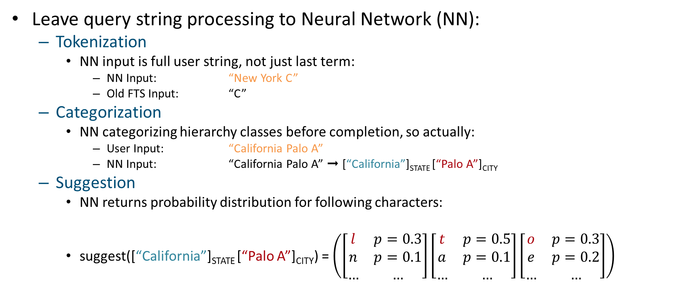
Neural Networks
Solution approach
Leave query string processing to Neural Network (NN):
Tokenization
NN input is full user string, not just last term:
NN Input: “New York C”
Old FTS Input: “C”
Categorization
NN categorizing hierarchy classes before completion, so actually:
User Input: “California Palo A”
NN Input: “California Palo A” ➞ [“California”]_{STATE} [“Palo A”]_{CITY}
Suggestion
NN returns probability distribution for following characters:
suggest([“California”]_{STATE} [“Palo A”]_{CITY}) = $\left(\left[\begin{matrix}l & p=0.3 \\ n & p=0.1 \\ … & …\end{matrix}\right]\left[\begin{matrix}t & p=0.5 \\ a & p=0.1 \\ … & …\end{matrix}\right]\left[\begin{matrix}o & p=0.3 \\ e & p=0.2 \\ … & …\end{matrix}\right]\right)$

Slide 5




Architecture
Solution approach
User
Query String
“California Palo A”
Step 1: Categorization Network (Discriminator)
Step 2: Prediction Network (Extrapolator)
[“California”]_{STATE} [“Palo A”]_{CITY}
C
a
l
i
f
o
r
n
i
a
P
a
l
o
A
First, read prefix characters and their categories….
…then predict completion!
l
t
o
…
Ranked character/class predictions per timestep

Slide 6
Technology stack of demonstrator
Demonstrator
Road FTS North America database with full road coverage
Using classification of COUNTRY, STATE, CITY, ROAD
About 44,000 cities and total of 9,448,382 roads
Tensorflow in Python to train neural network models
Classifier: 2-way LSTM-RNN (forward, backward), ~ 400K neurons
Completer/Suggester: 1 LSTM-RNN, ~600K neurons
Trained model size: ~ 10 MB
Python Webservice to showcase prediction

Slide 7
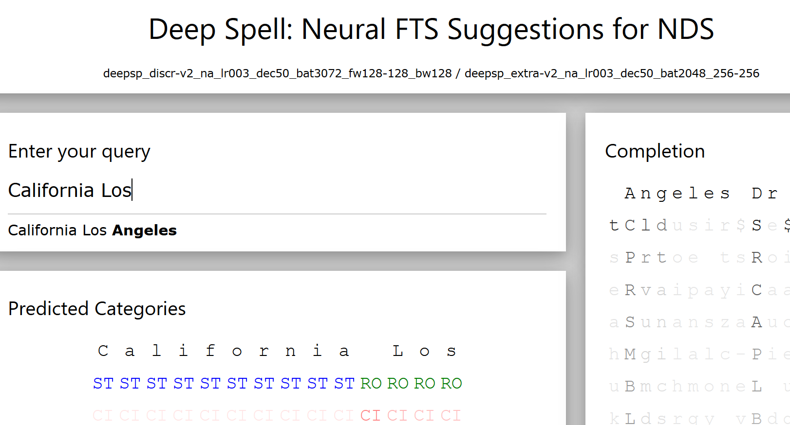
Demo
Demonstrator

Slide 8
Demonstrator Performance
Next Steps
Running Demonstrator Server on Raspberry Pi 3
Category prediction and completion wall-time measurement
100-500 ms, depending on prefix length
Lots of optimization potential
1.2 GHz*4 CPU only, no GPU/TPU acceleration
No Neural Network State/Result Caching
Python

Slide 9
Demonstrator Performance
Next Steps
Per-category assessment of completion performance
Samples generated by randomly (at least 2 characters prefix) truncating last token postfix from sequence of North American address tokens.
Greedy completion precision is measured as percentage of correctly completed characters of last token. Only respects first completion result -> Greedy!
Category | Identification-Recall | Identification-Precision | Identification-F1 | Greedy Completion Precision
CITY | 82% | 78% | 80% | 36%
ROAD | 94% | 23% | 37% | 31%
COUNTRY | 20% | 19% | 19% | 100%
STATE | 84% | 65% | 73% | 97%
ZIP | 65% | 65% | 65% | 12%

Slide 10
Demonstrator Performance
Next Steps
Category | Identification-Recall | Identification-Precision | Identification-F1 | Greedy Completion Precision
CITY | 82% | 78% | 80% | 36%
ROAD | 94% | 23% | 37% | 31%
COUNTRY | 20% | 19% | 19% | 100%
STATE | 84% | 65% | 73% | 97%
ZIP | 65% | 65% | 65% | 12%
Remarks
Low Identification of (truncated) country names reflects low presence of countries in randomized addresses -> Network does not expect people to enter countries
Low Completion precision of ZIP Codes is not bad (we want the network to generalize address language model)
Precision-Recall tradeoff for ROAD class means Network over-expects roads

Slide 11
Open Questions & Possible next steps
Next Steps
Combine with database content to improve suggestions?
How to implement an interface for this in NDS?
Virtual Table in SQLite?
Support different frameworks for DeepLearning?

