Slide 1
Deep Spell
Next Generation Query Auto-Suggestion in NDS

Slide 2
FTS Suggestion now
Suggestion based on Inverted Token Index
Problem: Context has no influence on suggestion
Term | Occurences | Prio
10th | 10.000 | ?
new | 1000 | 1
york | 50 | 1
main | 800 | 10
st | 100.000 | ?
… | … | …
St L[ouis] | vs | St Loui[siana] | ➞ Subtoken violation
California Los A[ngeles] | vs | California Los A[lamos] | ➞ Hierarchy violation
Virginia V[ictoria] | vs | Virginia V[irginia] | ➞ Redundancy violation

Slide 3
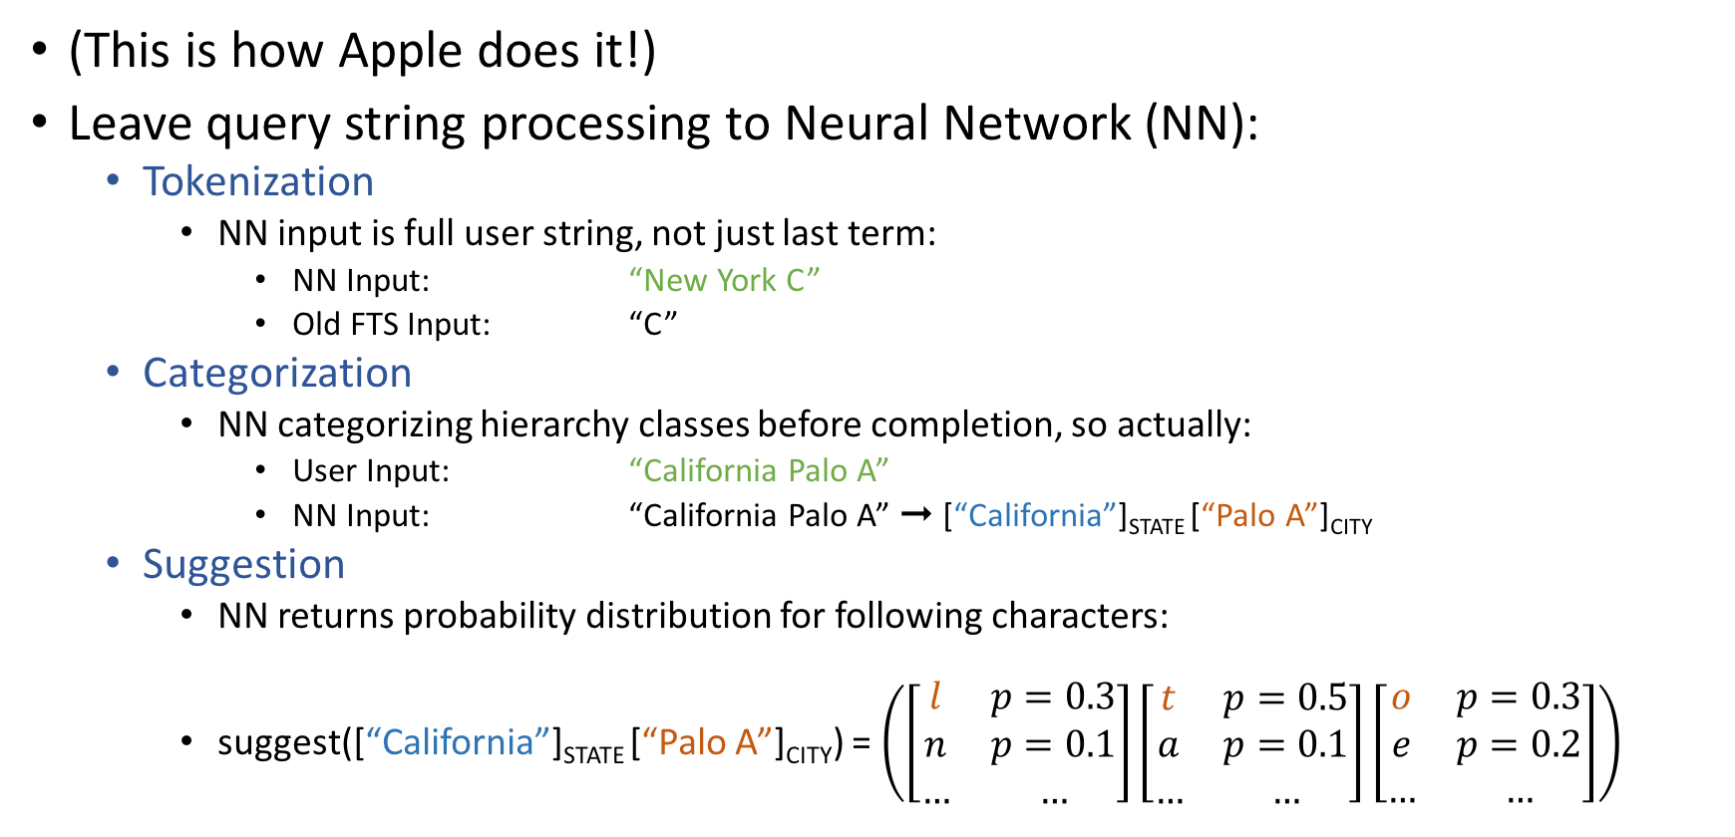
Solution
(This is how Apple does it!)
Leave query string processing to Neural Network (NN):
Tokenization
NN input is full user string, not just last term:
NN Input: “New York C”
Old FTS Input: “C”
Categorization
NN categorizing hierarchy classes before completion, so actually:
User Input: “California Palo A”
NN Input: “California Palo A” ➞ [“California”]_{STATE} [“Palo A”]_{CITY}
Suggestion
NN returns probability distribution for following characters:
suggest([“California”]_{STATE} [“Palo A”]_{CITY}) = $\left(\left[\begin{matrix}l & p=0.3 \\ n & p=0.1 \\ … & …\end{matrix}\right]\left[\begin{matrix}t & p=0.5 \\ a & p=0.1 \\ … & …\end{matrix}\right]\left[\begin{matrix}o & p=0.3 \\ e & p=0.2 \\ … & …\end{matrix}\right]\right)$

Slide 4




Architecture
User
Query String
“California Palo A”
Step 1: Categorization Network (Discriminator)
Step 2: Prediction Network (Extrapolator)
[“California”]_{STATE} [“Palo A”]_{CITY}
C
a
l
i
f
o
r
n
i
a
P
a
l
o
A
First, read prefix characters and their categories….
…then predict completion!
l
t
o
…
Ranked character/class predictions per timestep

