Slide 1
WG1 Wuhan 2017-10-20 FTS token auto-suggest using neural networks (Formerly „Deep-Spell“)

Slide 2
Auto-Suggest FTS token
Background
Currently token completion suggestion can only be done using the FTS5 vocab table
All tokens are stored with their number of occurence there
No relations
No classification of tokens
Doing an auto-suggest for tokens based on more than the available information takes a lot of time consuming algorithm and data crunching
Idea: Let the Artificial Intelligence find out what the best suggestion is

Slide 3
Auto Suggest FTS token
Background
FTS5 vocab table example
Even if we would add priorities or other „importance factors“ to tokens we still would need to come up with a certain idea „how“
Still the tokens are/would not be related to each other → context has no influence on suggestion
Term | Occurences
10th | 10.000
new | 1000
york | 50
main | 800
st | 100.000
… | …
St L[ouis] | vs | St Loui[siana] | ➞ Subtoken violation
California Los A[ngeles] | vs | California Los A[lamos] | ➞ Hierarchy violation
Virginia V[ictoria] | vs | Virginia V[irginia] | ➞ Redundancy violation

Slide 4
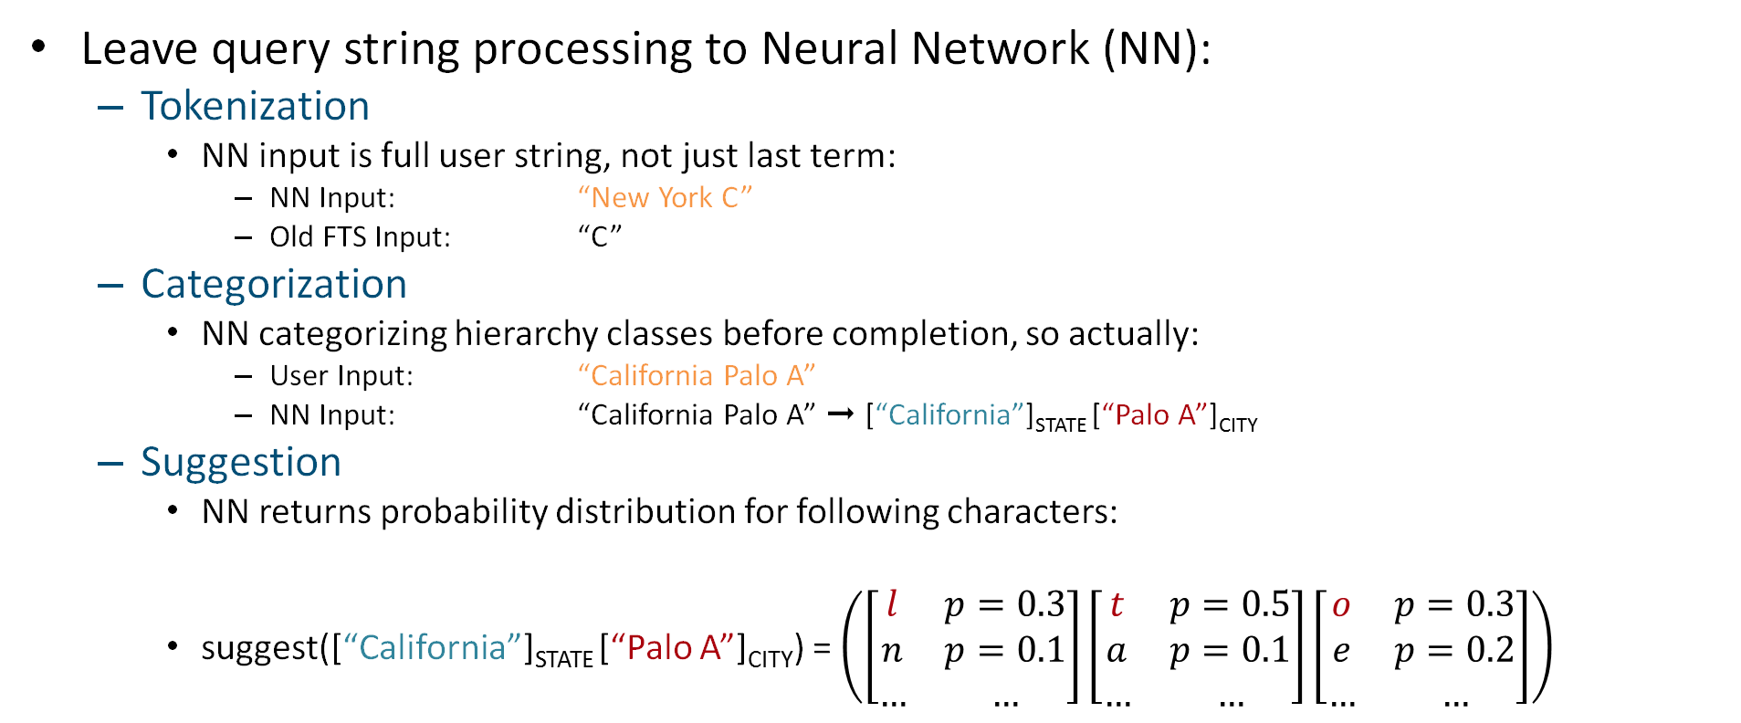
Neural Networks
Solution approach
Leave query string processing to Neural Network (NN):
Tokenization
NN input is full user string, not just last term:
NN Input: “New York C”
Old FTS Input: “C”
Categorization
NN categorizing hierarchy classes before completion, so actually:
User Input: “California Palo A”
NN Input: “California Palo A” ➞ [“California”]_{STATE} [“Palo A”]_{CITY}
Suggestion
NN returns probability distribution for following characters:
suggest([“California”]_{STATE} [“Palo A”]_{CITY}) = $\left(\left[\begin{matrix}l & p=0.3 \\ n & p=0.1 \\ … & …\end{matrix}\right]\left[\begin{matrix}t & p=0.5 \\ a & p=0.1 \\ … & …\end{matrix}\right]\left[\begin{matrix}o & p=0.3 \\ e & p=0.2 \\ … & …\end{matrix}\right]\right)$

Slide 5




Architecture
Solution approach
User
Query String
“California Palo A”
Step 1: Categorization Network (Discriminator)
Step 2: Prediction Network (Extrapolator)
[“California”]_{STATE} [“Palo A”]_{CITY}
C
a
l
i
f
o
r
n
i
a
P
a
l
o
A
First, read prefix characters and their categories….
…then predict completion!
l
t
o
…
Ranked character/class predictions per timestep

Slide 6
Technology stack of demonstrator
Demonstrator
Road FTS North America database with full road coverage
Using classification of COUNTRY, STATE, CITY, ROAD
About 44,000 cities and total of 9,448,382 roads
Tensorflow in Python to train neural network models
Classifier: 2-way LSTM-RNN (forward, backward), ~ 400K neurons
Completer/Suggester: 1 LSTM-RNN, ~600K neurons
Trained model size: ~ 10 MB
Python Webservice to showcase prediction

Slide 7
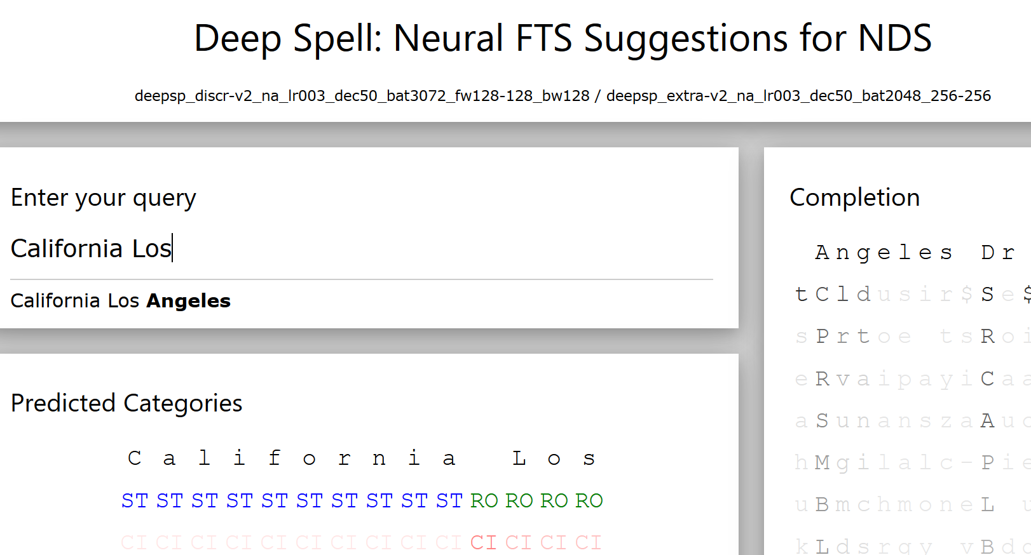
Demo
Demonstrator

Slide 8
Demonstrator Performance
Demonstrator
Running Demonstrator Server on Raspberry Pi 3
Category prediction and completion wall-time measurement
100-500 ms, depending on prefix length
Lots of optimization potential
1.2 GHz*4 CPU only, no GPU/TPU acceleration
No Neural Network State/Result Caching
Python

Slide 9
What’s new since Eindhoven
What’s new
Classifier
Improved recognition score above 95% in all classes
Reason: More training, Moved to all-lowercase, removed ZIP category
Still plan on adding POI category
Completer
Added reliable neural multi-suggestion
Added detailed quality comparisons with
New Component: Neural Spellchecker/Matcher
More on that later in the presentation

Slide 10
What’s new since Eindhoven
What’s new
Correctness of top three suggestions for NN/FTS5 per prefix length:

Slide 11
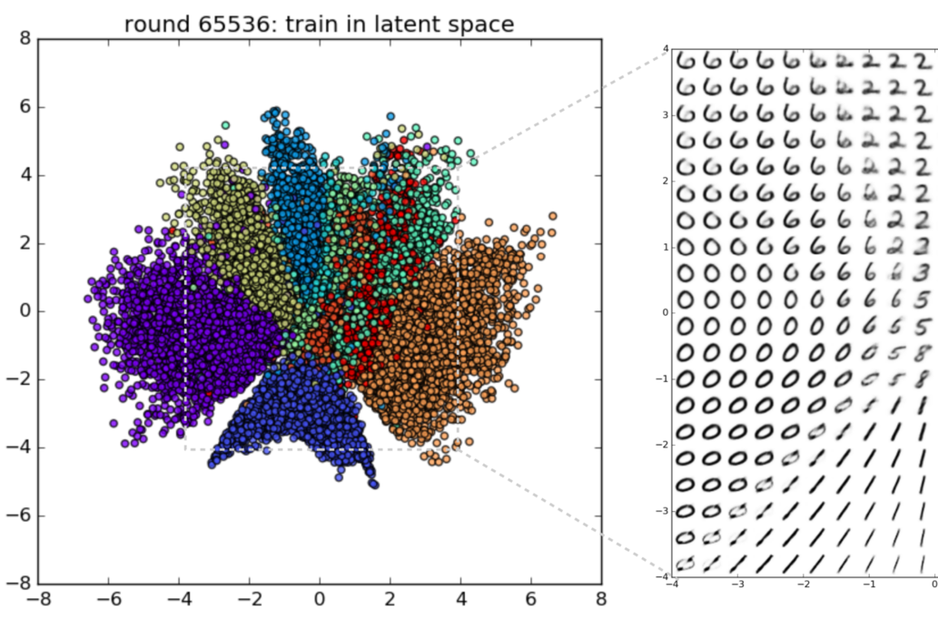
What’s new since Eindhoven
What’s new
FAQ: How would a Neural Network match incorrect user input?
NNs (“Autoencoders”) are really good at creating low-dimensional hashes of objects (images, text).
Idea: Let NN encode (hash) user input, find match-suggestions from nearest neighbors.
We have implemented this! (mostly)
Neural Network generated (x,y) hashes of images of hand-written numbers.
http://blog.fastforwardlabs.com/2016/08/12/introducing-variational-autoencoders-in-prose-and.html

Slide 12
Open Questions & Possible next steps
Next Steps
How to implement an interface for this in NDS?
Virtual Table in SQLite?
Support different frameworks for Deep Learning?
Which parts do you wish to invesigate further?
What would you like to have explained most in Gröbenzell?

