Slide 1
Mapviewer Extensions Workshop
An introduction to interactive NDS MapViewer Extensions
Joseph Birkner (j.birkner@klebert-engineering.de)

Slide 2
Structure of this workshop
10 mins.: Trick Sharing (Setup, Docs …)
5 mins.: MapViewer/Extension System Architecture
10 mins.: IMapDataProxy (The Swiss Army Knife)
5 mins.: Project For Today
15 mins.: Implement a Bookmark Icon
15-30 mins.: Implement Attribute Inspection With New Field
15-30 mins.: Implement Search Interface
Total: ~1.5-2h

Slide 3
Trick Sharing: Setup
Workshop Sources:
git clone https://github.com/Klebert-Engineering/td-2019-mapviewer-ext
Building things: Either …
… Have DBI 2019.4.0 with SDK Dev Setup for your platform
set –DAFW_SDK_DIR, NDS_PLUGIN_PATH …
… Or just use the Docker Dev container!
wget ke-dev-jb-4.local:8080/mvo-ext-dev-docker.tgz

Slide 4
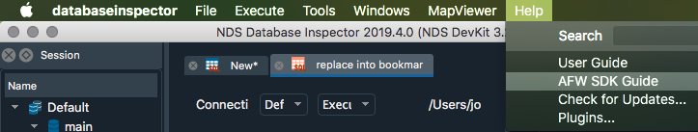
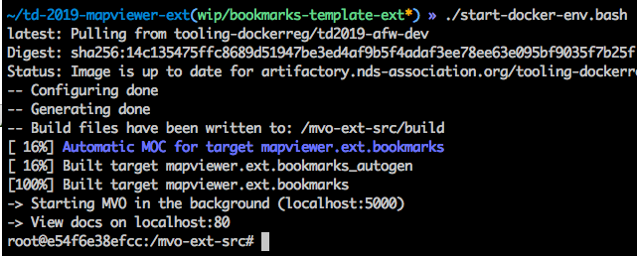
Trick Sharing: Documentation
View through DBI
View through container

Slide 5
Trick Sharing: View your own map in the container
Adjust mvo-cfg/mapviewerserver.json:
{
"__comment": "Just modify/add/remove entries to configure available maps:",
"maps":
{
"map1":"/maps/ROOT.NDS"
}, …
Path must be mapped into container
Map Label in MapViewer

Slide 6
MapViewer Architecture
MapViewer-Online
DatabaseInspector / mapviewerserver
start
Application Framework (AFW)
Plugin System
IMapViewerExtensionFactory
mapviewer.backend
IMapViewerExtensionInstance
Browser
IMapViewerExtensionRegistry
my.extension
Session Server
own
MyExtensionFactory
IMapViewerUserOptions
ViewerMapDataProxy
http.server
IMapElementBatch
message loop
SvgMapDataProxy
create
IMapDataProxy
IMapViewerStyle
IAttributePanel
GET, POST
use
MyExtensionInstance
own

Slide 7

MapViewer Extension Interface
Plugin System
IMapViewerExtension
mapviewer.backend
IMapViewerExtensionInstance
my.extension
IMapViewerExtensionRegistry
MyExtension
own, use
IMapDataProxy
IMapElementBatch
create, own
IMapViewerStyle
create
use
MyExtensionInstance
own

Slide 8

The Swiss Army Knife
addAreaElement()
onSearchActionRequested()
addSearchAction()
onRequestAttributes()
setOptionValue()
addLineElement()
getString()
addLabelElement()
onViewportChanged()
getBool()
addPointElement()
onOptionsChanged()
addString()
add3dObject ()
onStyleForName()
onLeftClick()
addBool()
IMapElementBatch
IMapViewerExtensionUserOptions
newMapElementBatch()
IMapDataProxy
userOptions()
newAttributePanel()
(set)CameraPosition()
(set)CameraAltitude()
insertHeightmapTile()
highlightTiles()
(set)CameraOrientation()
IAttributePanel
removeMapElementBatch()
setStatusMessage()
(set)BackgroundColor()

Slide 9

Project for Today
Focus on Interactivity
We have implemented a bare-bone Bookmarks Extension!
We want to add Features to it:
Icons
Attribute Inspection
Filtering

Slide 10

Adding a bookmark icon
Change the newPointStyle() call for POINT_STYLE to use an image:
proxy.newPointStyle(QString(":/bookmark.png"), 1., 32.);

Slide 11
Attribute inspection
Add some info to Bookmark
E.g. QDateTime::currentDateTime().toString()
Persist it
Adjust attribsRequested() → Returns list of attrib. panel headings
Create a newAttributePanel()
Add some Info about the selected Bookmark to it
→ addAttrib(QString const& name, QVariant const& val)
Commit it (for panelIndex 0)
→ commit(VisualElementId elementId, int panelIndex)
Return a list with one entry (e.g. “More Info”)

Slide 12
Search interface
In initialize(), call userOptions.addSearchAction(…)
Will be displayed as a button in the MapViewer’s Search Tab
Once clicked, triggers callback in extension:
Create a callback for onSearchActionRequested()
Returns error, or empty string if search activated
Create a callback for onSearchActionTerminated()
Called to notify that user requested search to ceise

Slide 13

Questions

