Slide 1
Increased Costs Requests Per Site Breakdown
Site | Request | Amount Increase | % Increase from FY26 Budget
NAPCK | +1 Site Lead | $121,567.00 | 12%
NAPCK | OT reduced to 4% | -$16,150.35 | -5% OT overall
NAPCK | R&M Increase | $29,198.00 | 10%
TLS Georgetown | R&M Increase | $30,275.42 | 14%
Cincinnati | R&M increase | $19,620.00 | 18%
Cincinnati | +1 Technician | $77,717.06 | 28%
Kansas City | +1 Technician | $77,717.06 | 21%
Princeton | +1 Technician | $77,717.06 | 25%

Slide 2
Increased Costs Over Time and Additional Headcount
The following charts illustrate key cost drivers contributing to increased facility maintenance expenses across the region.
Rising material costs and expanded workload have significantly impacted operating budgets.
Man vs. machine demands, combined with aging infrastructure and critical equipment, continue to increase maintenance complexity and labor intensity.
To maintain safety, service continuity, and operational coverage, additional headcount is requested for:
NAPCK
This positions is critical to sustaining performance standards, ensuring timely response, and mitigating risk across multiple sites.

Slide 3
Increased R&M Costs Over Time
Analysis of R&M cost over the years
The trend of increased costs has impacted our repairs and maintenance expenses and budgets.
The top chart shows the number of CM/SR work orders over the years, which have remained within 300.
The bottom chart shows our repairs and maintenance expenses for those fiscal years, which Rapidly increased and has remained mostly flat at the higher level.
With our buildings and equipment continuing to get older, combined with the increased costs for repairs and materials, the charts show just how significant the changes have been over the last few years, which will continue to be a problem for our R&M budgets.
I am requesting additional $79,093.42 in funds for 3 properties in the region (NAPCK $ 29,198.00, TLS Georgetown $ 30,275.42, Cincinnati $ 19,620.00)
Year | Total CM/SR
2022 | 1919
2023 | 1649
2024 | 1671
2025 | 1729
2026 | 1838
FY | R&M Spend | Budget
2022 | $ 951,330 | $ 1,007,434
2023 | $ 1,221,434 | $ 1,007,434
2024 | $ 1,101,368 | $1,067,434
2025 | $ 1,093,150 | $ 1,091,593
2026 | $ 661,460

Slide 4
Increased R&M Costs Over Time at NAPCK
Analysis of R&M cost NAPCK
The number of CM and SR work orders has remained stable; however, R&M costs continue to rise due to escalating material and labor expenses.
NAPCK did not receive any additional R&M budget allocation in FY26, further tightening available resources amid increasing cost pressures.
I am requesting an additional $29,198.00 for the R&M budget at NAPCK
Year | Total CM/SR
2022 | 749
2023 | 542
2024 | 617
2025 | 609
2026 | 554
FY | R&M Spend | Budget
2022 | $ 330,814 | $ 288,318
2023 | $ 311,789 | $ 288,318
2024 | $ 388,137 | $ 288,318
2025 | $ 422,661 | $ 291,980
2026 | $ 388,176 | $ 291,980

Slide 5
Increased R&M Costs Over Time at Cincinnati
Analysis of R&M cost Cincinnati
Although CM and SR work orders have declined, R&M expenses have not followed suit—continuing to rise due to increased material, labor, and service costs.
Cincinnati did not receive any additional R&M budget allocation in FY26, limiting the ability to offset these ongoing cost escalations.
I am requesting an additional $19,620.00 for the R&M budget at Cincinnati.
Year | Total CM/SR
2022 | 309
2023 | 244
2024 | 215
2025 | 202
2026 | 186
FY | R&M Spend | Budget
2022 | $ 86,256 | $ 91,640
2023 | $ 177,611 | $ 91,640
2024 | $ 117421 | $ 91,640
2025 | $ 114,221 | $ 104,000
2026 | $ 144,221 | $ 109,000

Slide 6
Increased Costs Over Time at TLS Georgetown
Analysis of R&M cost TLS Georgetown
Repair and Maintenance (R&M) expenses have continued to outpace the growth in CM and SR work order volume, driven by rising material and labor costs.
TLS Georgetown did not receive any additional R&M budget allocations in FY26, further constraining the ability to absorb escalating expenses.
I am requesting an additional $30,275.42 for the R&M budget at TLS Georgetown
Year | Total CM/SR
2022 | 333
2023 | 286
2024 | 307
2025 | 341
2026 | 350
FY | R&M Spend | Budget
2022 | $ 235,267 | $ 216,253
2023 | $ 226,544 | $ 216,253
2024 | $ 252,594 | $ 216,253
2025 | $ 229,773 | $ 216,253
2026 | $ 322,114 | $ 216,253

Slide 7
Increased OT Rates and Additional Headcount – Midwest Region
Analysis of OT Rates over the years
Overtime rates have more than tripled over the past five years, driven by increased workload demands, aging infrastructure, and a growing reliance on manual intervention (“Man vs. Machine”).
Sustained overtime levels contribute to employee fatigue, reduced productivity, and heightened turnover risk.
Operating at elevated overtime rates places ongoing pressure on Professional Services budgets and impacts long-term workforce sustainability
Year | Total OT Rate
2021 | 2.6
2022 | 5.4
2023 | 5.5
2024 | 5.6
2025 | 7.9
2026 | 6.7

Slide 8
Additional Headcount at NAPCK
Analysis of work orders and OT rate over the years
In 2022, NAPCK transitioned to a 3-shift, 12-hour weekend schedule, significantly limiting the availability of standard work hours for project execution and maintenance activities.
The top chart reflects a substantial increase in CM/SR work orders over recent years, which has since stabilized at an elevated level.
The bottom chart illustrates the upward trend in overtime rates at NAPCK due to the amount of activities that can not be completed during production, underscoring sustained operational strain.
Aging infrastructure, expanded production schedules, and escalating repair costs have created continued upward pressure on Professional Services budgets. These factors highlight the need for additional support to maintain performance and service continuity.
A request is being made for one additional headcount at NAPCK ($121,567) to address growing workload demands.
This position would strengthen regional coverage across Cincinnati, PEMC, and TLS Georgetown, while mitigating operational impact and ensuring service reliability at NAPCK.
Year | Total CM/SR
2021 | 196
2022 | 749
2023 | 542
2024 | 617
2025 | 609
2026 | 554
Year | OT Rate %
2022 | 2.5
2023 | 5.5
2024 | 6.1
2025 | 12.7
2026 | 9.2

Slide 9
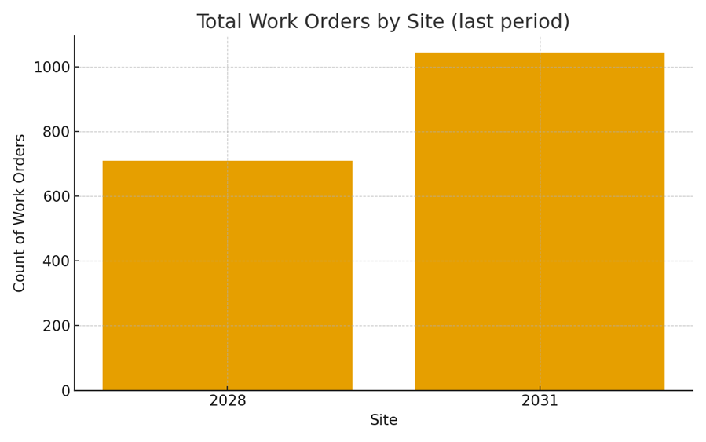
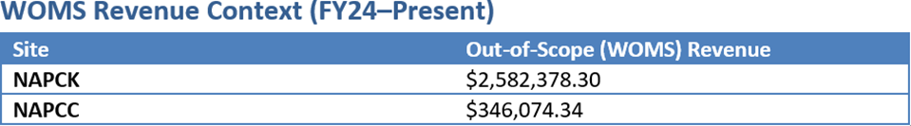
Additional Headcount at NAPCK
NAPCK Has been running operations 7 days a week since 2022.
NAPCC only runs 5 days a week and a half a day on 50% of Saturdays
NAPCK has had over $2.2 million more out of scope work since FY24 to present than NAPCC
NAPCK has 4 Technicians
NAPCC has 4.5 Technicians
Requesting and additional $121,567 in Professional Services for a Site Lead at NAPCK

