Slide 1


Based on Arduino Uno
IOT
刘闯

Slide 2




1 Arduino Uno
2 Sensor
catalogue
3 I2C
4 Bluetooth
5 APP IOT

Slide 3
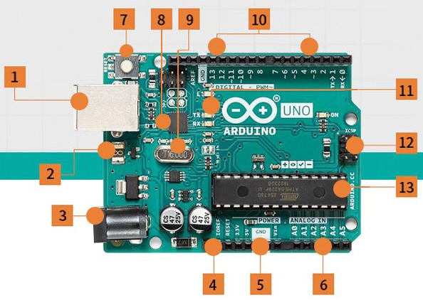
01
Uno

Slide 4
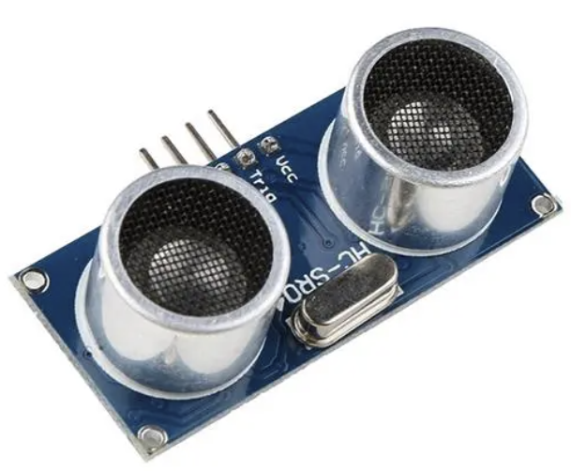
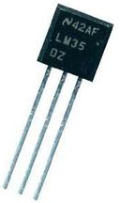
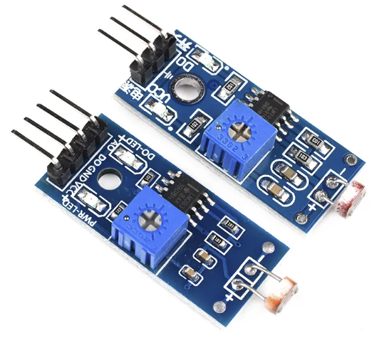
02
Sensor

Slide 5
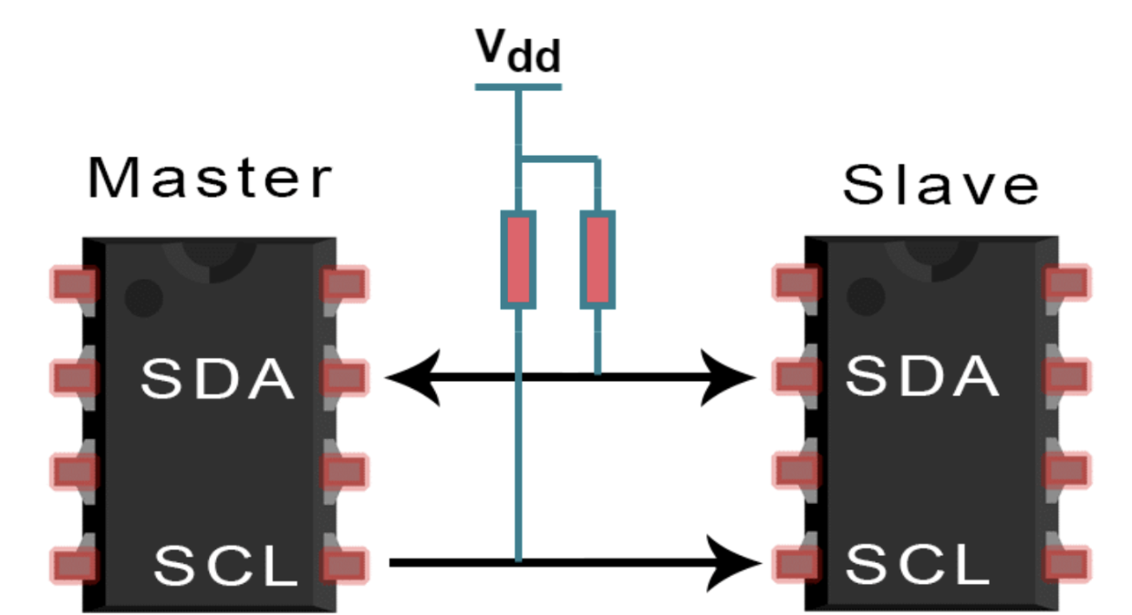
03
I2C

Slide 6
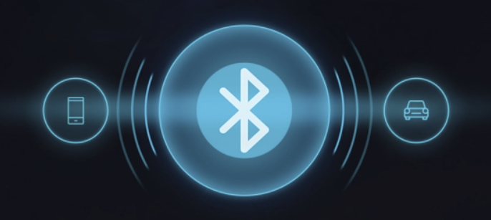
04
Bluetooth

Slide 7
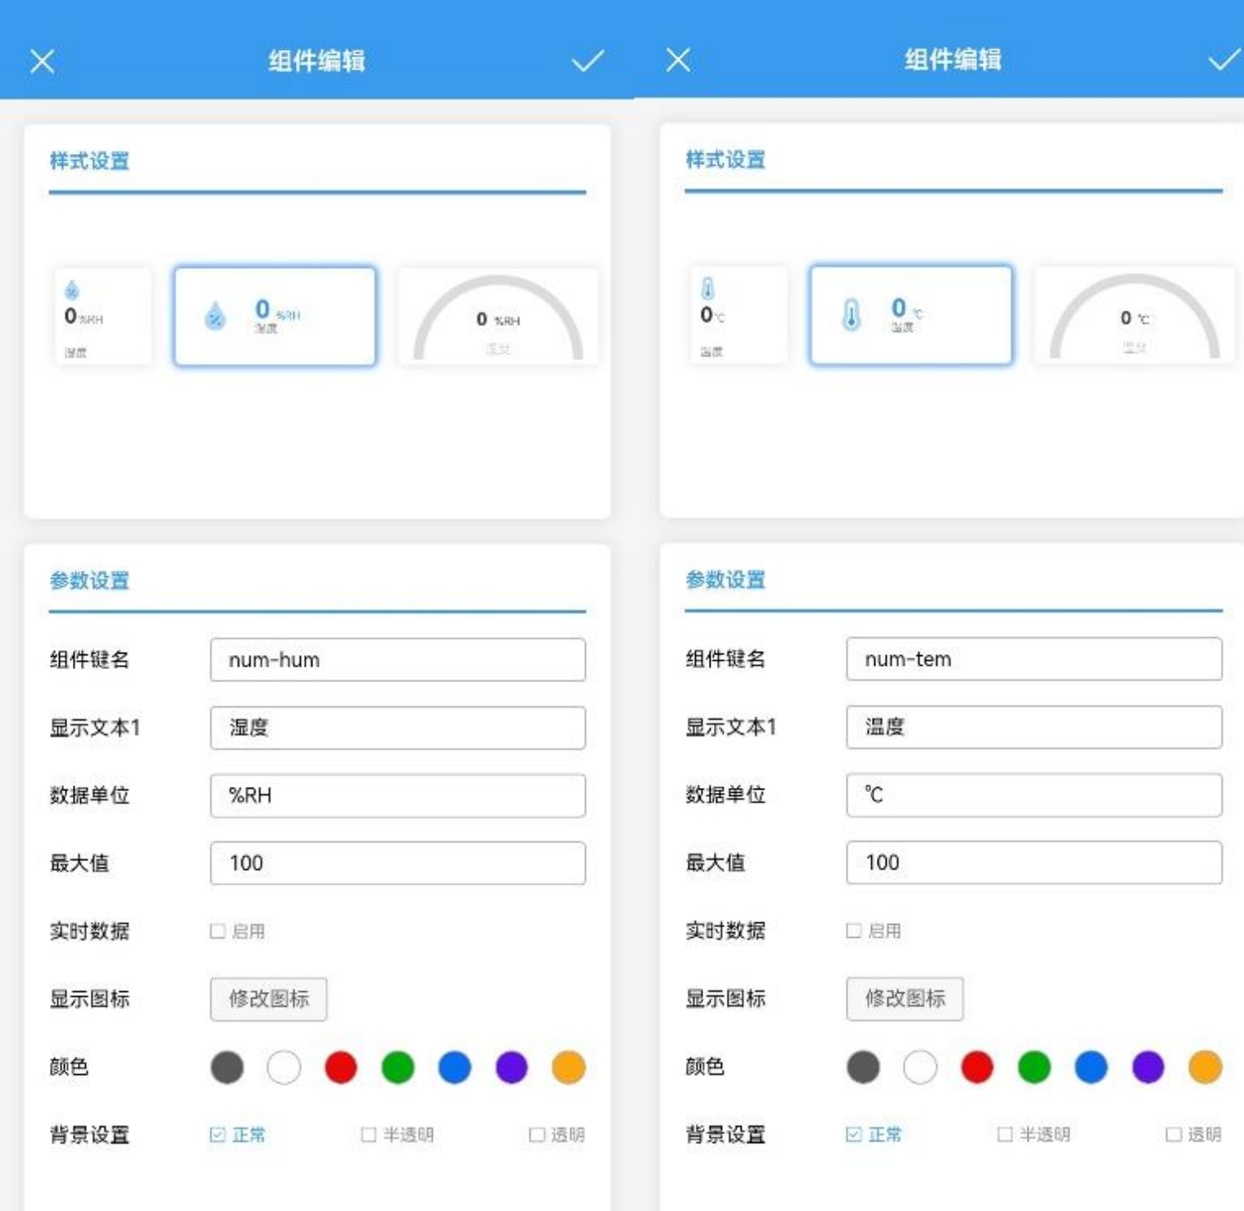
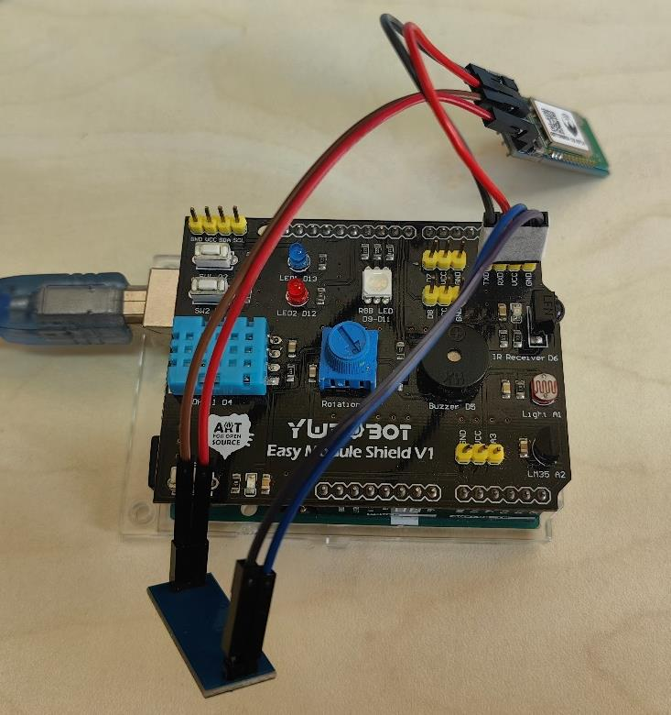
05
APP

Slide 8
06
Assessment
70%: 1-6 classroom inspection items
Step by step from the I/O ports of the controller to the use of various types of sensors. Students can earn scores by completing code writing and debugging.
30%: 7-8
Hardware device issuance, students are able to freely utilize the design of the IOT.

