Slide 1
CS101 Algorithms and Data Structures
Dynamic Programming
Textbook Ch 15
Notes:
Adapted from http://www.cs.princeton.edu/~wayne/kleinberg-tardos and https://ece.uwaterloo.ca/~dwharder/aads/Lecture_materials/

Slide 2
Fibonacci numbers
Consider this function:
    double F( int n ) {
    return ( n <= 1 ) ? 1.0 : F(n - 1) + F(n - 2);
    }
The run-time of this algorithm is

Slide 3
Fibonacci numbers
Consider this function:
    double F( int n ) {
    return ( n <= 1 ) ? 1.0 : F(n - 1) + F(n - 2);
    }
The runtime is similar to the actual definition of Fibonacci numbers:
T(n) = Ο(2^{n})

Slide 4
Fibonacci numbers
Problem:
  To calculate F(44), it is necessary to calculate F(43) and F(42)
  However, to calculate F(43), it is also necessary to calculate F(42)
  It gets worse, for example
    F(40) is called 5 times
    F(30) is called 620 times
    F(20) is called 75 025 times
    F(10) is called 9 227 465 times
    F(0) is called 433 494 437 times
Surely we don’t have to recalculate F(10) almost ten million times…

Slide 5
Fibonacci numbers
Here is a possible solution:
  To avoid calculating values multiple times, store intermediate calculations in a table
  When storing intermediate results, this process is called memoization
    The root is memo
  We save (memoize) computed answers for possible later reuse, rather than re-computing the answer multiple times

Slide 6
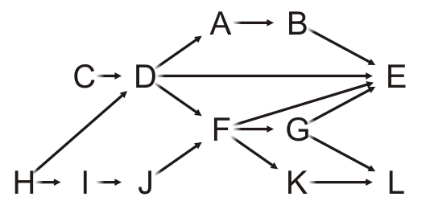
Connected
Determining if two vertices are connected in a DAG, we could implement the following:
    bool Weighted_graph::connected( int i, int j ) {
    if ( adjacent( i, j ) ) {
    return true;
    }
    for ( int v : neighbors( i ) ) {
    if ( connected( v, j ) ) {
    return true;
    }
    }
    return false;
    }
  What are the issues with this implementation?

Slide 7
Dynamic programming
In solving optimization problems, the top-down approach may require repeatedly obtaining optimal solutions for the same sub-problem
  Mathematician Richard Bellman initially formulated the concept of dynamic programming in 1953 to solve such problems
  This isn’t new, but Bellman formally defined this process

Slide 8
Dynamic programming
Dynamic programming is distinct from divide-and-conquer, as the divide-and-conquer approach works well if the sub-problems are essentially unique
  Storing intermediate results would only waste memory
If sub-problems re-occur, the problem is said to have overlapping sub-problems

Slide 9
Algorithmic paradigms
Greedy. Process the input in some order, myopically making irrevocable decisions.
Divide-and-conquer. Break up a problem into independent subproblems;
solve each subproblem; combine solutions to subproblems to form solution to original problem.
Dynamic programming. Break up a problem into a series of overlapping subproblems; combine solutions to smaller subproblems to form solution to large subproblem.
fancy name for
caching intermediate results
in a table for later reuse
Notes:
overlapping subproblem = subproblem whose results can be reused several times.
DP can improve running time from exponential to polynomial; from n^2 to n; or from n! to 2^n.

Slide 10
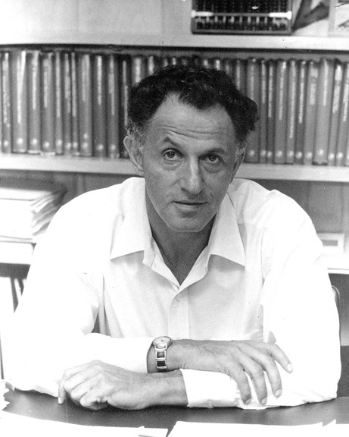
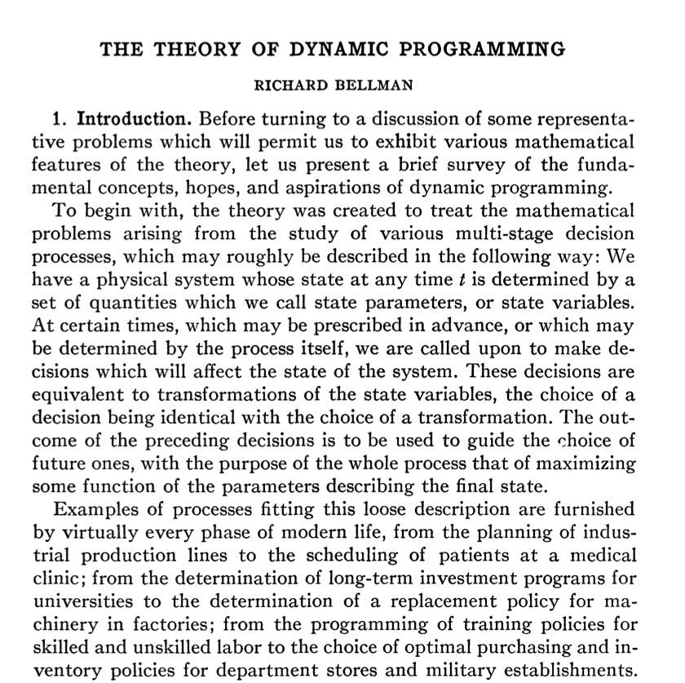
Dynamic programming history
Bellman. Pioneered the systematic study of dynamic programming in 1950s.
Etymology.
  Dynamic programming = planning over time.
  Secretary of Defense had pathological fear of mathematical research.
  Bellman sought a “dynamic” adjective to avoid conflict.
Notes:
[wayne s18] try to use it pejoratively, e.g., dynamic smell emanating from locker room. :)
It also has a very interesting property as an adjective, and that is its impossible to use the word, dynamic, in a pejorative sense. Try thinking of some combination that will possibly give it a pejorative meaning. Its impossible. Thus, I thought dynamic programming was a good name. It was something not even a Congressman could object to.
Secretary of Defense = Charles Wilson
Bellman was at RAND working for Air Force
The theory of dynamic programming. Bull. Amer. Math. Soc. Volume 60, Number 6 (1954), 503-515.

Slide 11

Dynamic programming applications
Application areas.
  Computer science: AI, compilers, systems, graphics, theory, ….
  Operations research.
  Information theory.
  Control theory.
  Bioinformatics.
Some famous dynamic programming algorithms.
  Avidan–Shamir for seam carving.
  Unix diff for comparing two files.
  Viterbi for hidden Markov models.
  De Boor for evaluating spline curves.
  Bellman–Ford–Moore for shortest path.
  Knuth–Plass for word wrapping text in .
  Cocke–Kasami–Younger for parsing context-free grammars.
  Needleman–Wunsch/Smith–Waterman for sequence alignment.

Slide 12
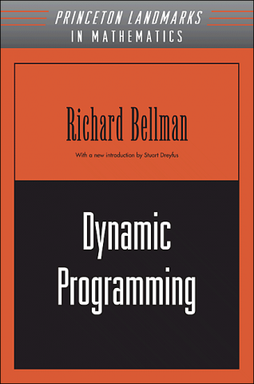

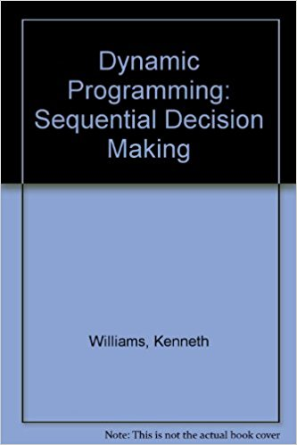
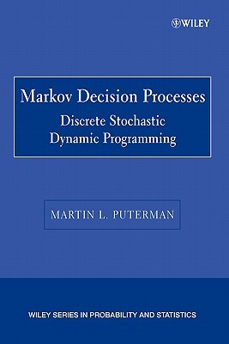
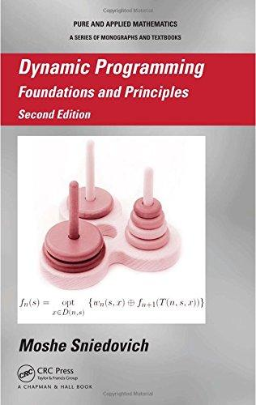
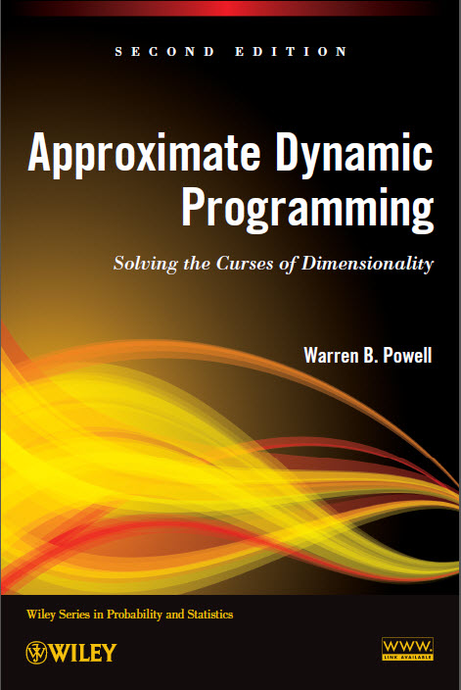
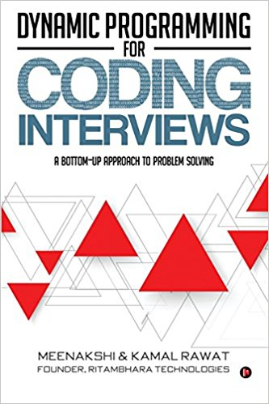
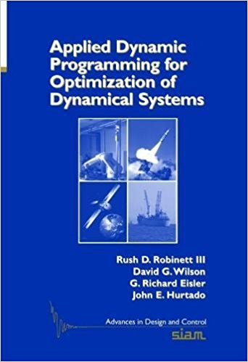
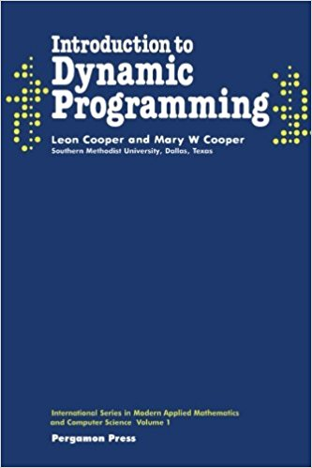
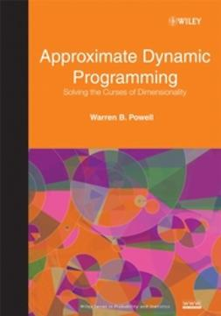
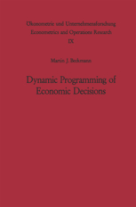
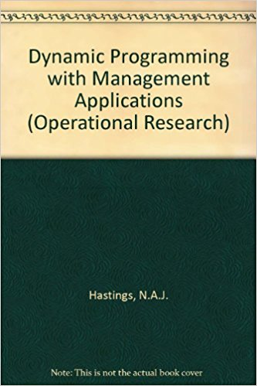
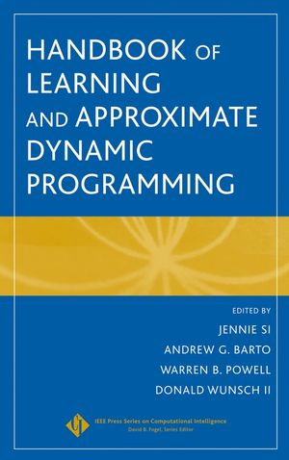
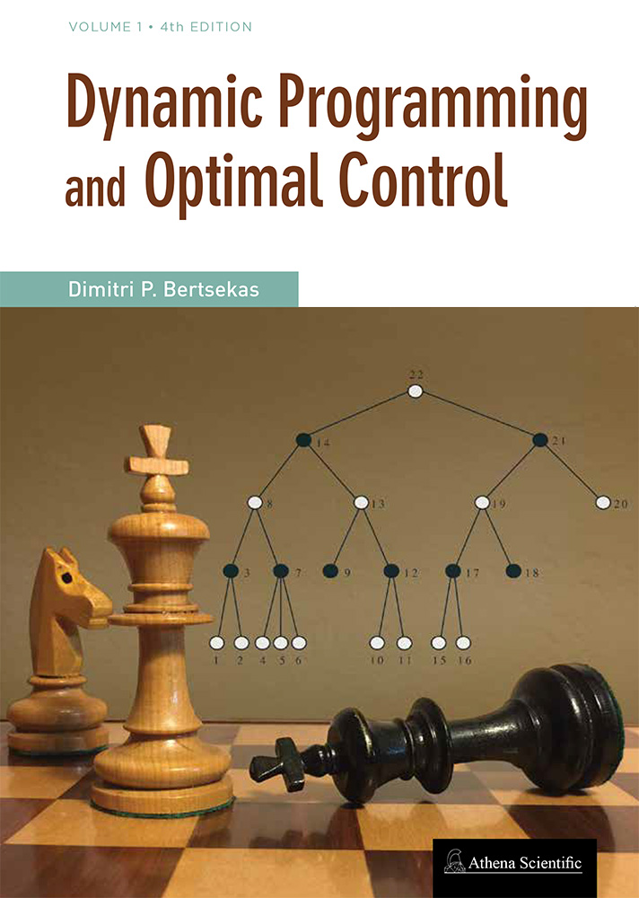
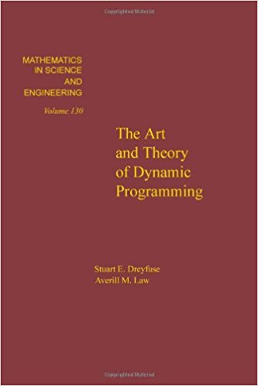
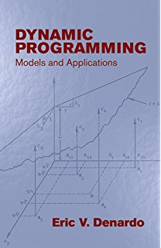
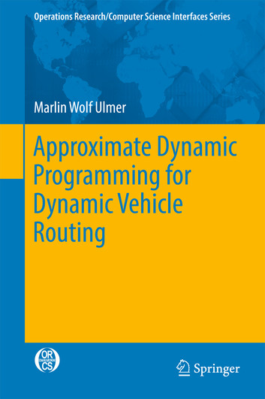



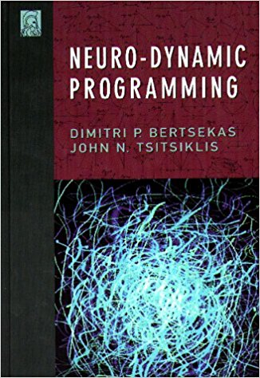
Dynamic programming books

Slide 13
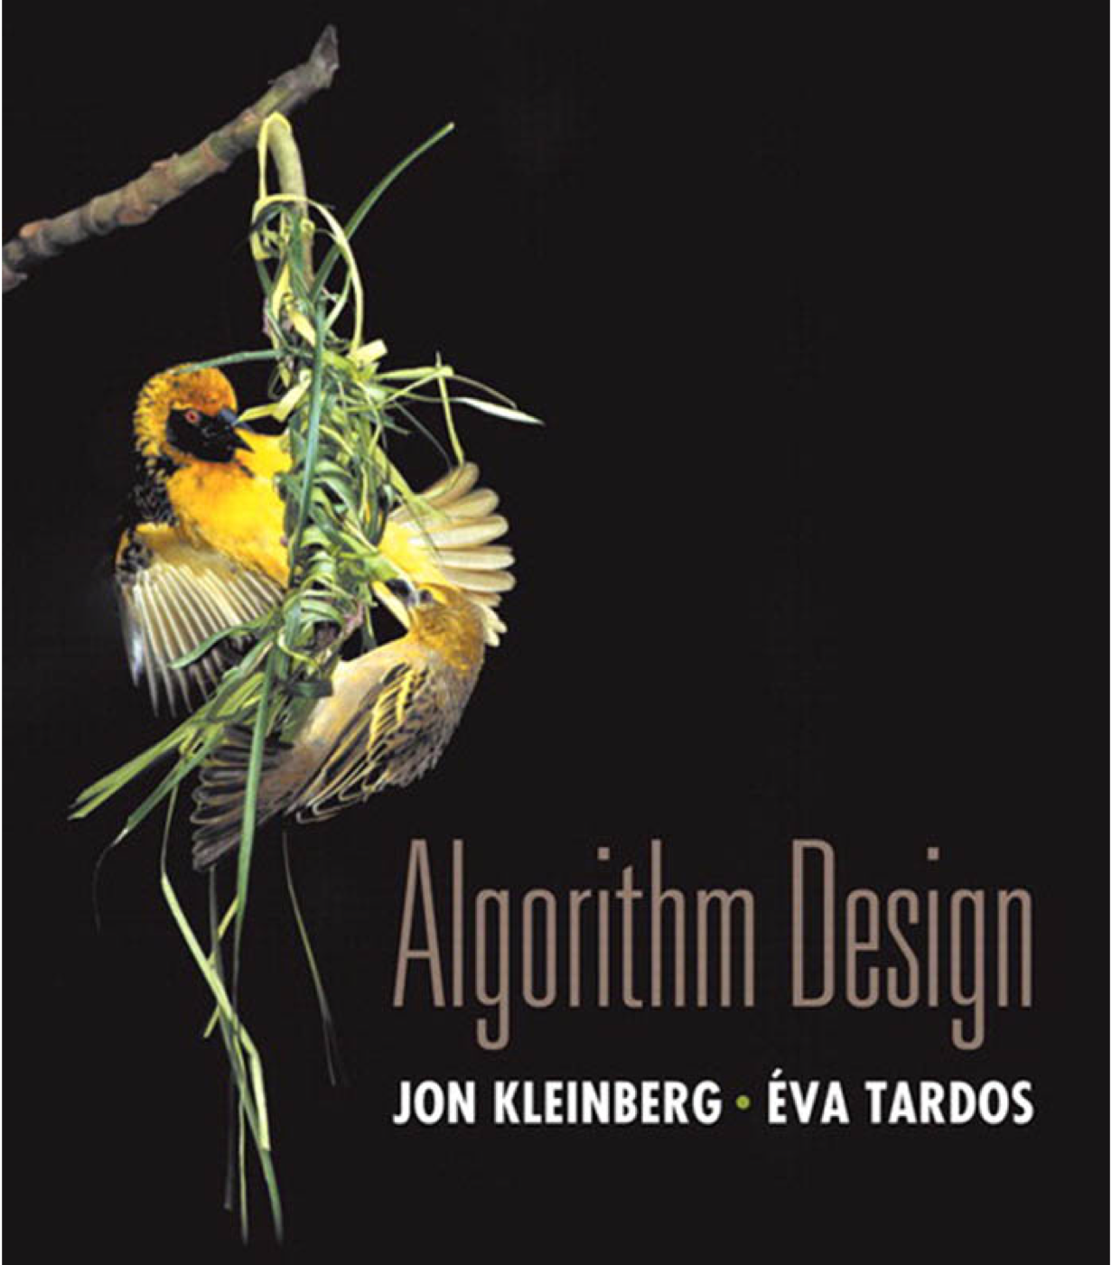

Dynamic Programming
weighted interval scheduling
  segmented least squares
  knapsack problem
Sections 6.1–6.2

Slide 14

Weighted interval scheduling
  Job j starts at sj, finishes at fj, and has weight wj > 0.
  Two jobs are compatible if they don’t overlap.
  Goal: find max-weight subset of mutually compatible jobs.
sj
wj
fj
a
b
c
d
e
f
g
h
time
0
1
2
3
4
5
6
7
8
9
10
11
Notes:
https://www.ciriscience.org/why-train-certify-CIRI-K-12.php

Slide 15
Earliest-finish-time first algorithm
Earliest finish-time first.
  Consider jobs in ascending order of finish time.
  Add job to subset if it is compatible with previously chosen jobs.
Recall. Greedy algorithm is correct if all weights are 1.
Observation. Greedy algorithm fails spectacularly for weighted version.
weight = 999
b
a
weight = 1
weight = 1
h
time
0
1
2
3
4
5
6
7
8
9
10
11

Slide 16
Weighted interval scheduling
Convention. Jobs are in ascending order of finish time: f₁ ≤ f₂ ≤ . . . ≤ f_{n} .
Def. p(j) = largest index i < j such that job i is compatible with j.
Ex. p(8) = 1, p(7) = 3, p(2) = 0.
i is leftmost interval
that ends before j begins
1
1
2
2
3
3
4
4
5
5
6
6
7
7
8
8
time
0
1
2
3
4
5
6
7
8
9
10
11

Slide 17
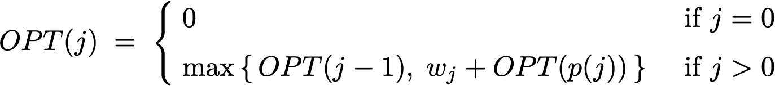
Dynamic programming: binary choice
Def. OPT(j) = max weight of any subset of mutually compatible jobs for subproblem consisting only of jobs 1, 2, ..., j.
Goal. OPT(n) = max weight of any subset of mutually compatible jobs.
Case 1. OPT(j) does not select job j.
  Must be an optimal solution to problem consisting of remaining
  jobs 1, 2, ..., j – 1.
Case 2. OPT(j) selects job j.
  Collect profit wj.
  Can’t use incompatible jobs { p(j) + 1, p(j) + 2, ..., j – 1 }.
  Must include optimal solution to problem consisting of remaining compatible jobs 1, 2, ..., p(j).
Bellman equation.
optimal substructure property
(proof via exchange argument)
Notes:
This is sometimes known as the “dynamic programming equation” or “Bellman equation.”

Slide 18
Weighted interval scheduling: brute force
Brute-Force (n, s1, …, sn, f1, …, fn, w1, …, wn)
_________________________________________________________________________________________________________________________________________________________________________________________________________________________________________________________________________________________________________________________________________________________________________________________________________________________________________________________________________________________________________________________________________________________________________________________________________________________________________________________________________________________________________________________________________________________________________________________________________________________________________________________________________________________________________________________________________________________________________________________________________________________________________________________________________________
Sort jobs by finish time and renumber so that f1 ≤ f2 ≤ … ≤ fn.
Compute p[1], p[2], …, p[n] via binary search.
Return Compute-Opt(n).
Compute-Opt( j )
_________________________________________________________________________________________________________________________________________________________________________________________________________________________________________________________________________________________________________________________________________________________________________________________________________________________________________________________________________________________________________________________________________________________________________________________________________________________________________________________________________________________________________________________________________________________________________________________________________________________________________________________________________________________________________________________________________________________________________________________________________________________________________________________________________________
If (j = 0)
  return 0.
Else
  Return max {Compute-Opt( j – 1), wj + Compute-Opt(p[ j ]) }.

Slide 19
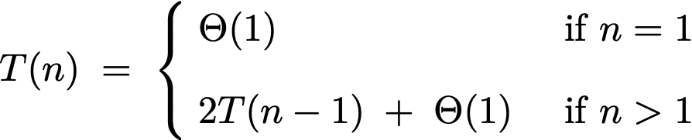
Dynamic programming: quiz 1
What is running time of Compute-Opt(n) in the worst case?
  Θ(n log n)
  Θ(n²)
  Θ(1.618^{n})
  Θ(2^{n})
Compute-Opt( j )
_________________________________________________________________________________________________________________________________________________________________________________________________________________________________________________________________________________________________________________________________________________________________________________________________________________________________________________________________________________________________________________________________________________________________________________________________________________________________________________________________________________________________________________________________________________________________________________________________________________________________________________________________________________________________________________________________________________________________________________________________________________________________________________________________________________
If (j = 0)
  return 0.
Else
  Return max {Compute-Opt( j – 1), wj + Compute-Opt(p[ j ]) }.
Notes:
Worst case occurs when p[j] = j - 1 for each j

Slide 20
Weighted interval scheduling: brute force
Observation. Recursive algorithm is spectacularly slow because of overlapping subproblems ⇒ exponential-time algorithm.
Ex. Number of recursive calls for family of “layered” instances grows like Fibonacci sequence.
5
1
1
4
3
2
2
3
3
3
2
2
1
4
4
2
1
1
0
1
0
5
5
p(1) = 0, p(j) = j-2
1
0
recursion tree

Slide 21
Weighted interval scheduling: memoization
Top-down dynamic programming (memoization).
  Cache result of subproblem j in M[j].
  Use M[j] to avoid solving subproblem j more than once.
Top-Down(n, s1, …, sn, f1, …, fn, w1, …, wn)
_________________________________________________________________________________________________________________________________________________________________________________________________________________________________________________________________________________________________________________________________________________________________________________________________________________________________________________________________________________________________________________________________________________________________________________________________________________________________________________________________________________________________________________________________________________________________________________________________________________________________________________________________________________________________________________________________________________________________________________________________________________________________________________________________________________
Sort jobs by finish time and renumber so that f1 ≤ f2 ≤ … ≤ fn.
Compute p[1], p[2], …, p[n] via binary search.
M[0] ← 0.
Return M-Compute-Opt(n).
global array
M-Compute-Opt( j )
_________________________________________________________________________________________________________________________________________________________________________________________________________________________________________________________________________________________________________________________________________________________________________________________________________________________________________________________________________________________________________________________________________________________________________________________________________________________________________________________________________________________________________________________________________________________________________________________________________________________________________________________________________________________________________________________________________________________________________________________________________________________________________________________________________________
If (M[j] is uninitialized)
  M[j] ← max { M-Compute-Opt (j – 1), wj + M-Compute-Opt(p[j]) }.
return M[j].

Slide 22
Weighted interval scheduling: running time
Claim. Memoized version of algorithm takes O(n log n) time.
Pf.
  Sort by finish time: 𝚹(n log n) via merge sort.
  Compute p[j] for each j : O(n log n) via binary search.
  M-Compute-Opt(j): each invocation takes O(1) time and either
    (1) returns an initialized value M[j]
    (2) initializes M[j] and makes two recursive calls
  Progress measure Φ = # initialized entries among M[1..n].
    initially Φ = 0; throughout Φ ≤ n.
    increases Φ by 1 ⇒ ≤ 2n recursive calls.
  Overall running time of M-Compute-Opt(n) is O(n). ▪

Slide 23
Weighted interval scheduling: finding a solution
Q. DP algorithm computes optimal value. How to find optimal solution?
A. Make a second pass by calling Find-Solution(n).
Analysis. # of recursive calls ≤ n ⇒ O(n).
Find-Solution(j)
_________________________________________________________________________________________________________________________________________________________________________________________________________________________________________________________________________________________________________________________________________________________________________________________________________________________________________________________________________________________________________________________________________________________________________________________________________________________________________________________________________________________________________________________________________________________________________________________________________________________________________________________________________________________________________________________________________________________________________________________________________________________________________________________________________________
If (j = 0)
  Return ∅.
Else if (wj + M[p[j]] > M[ j – 1])
  Return { j } ∪ Find-Solution(p[j]).
Else
  Return Find-Solution( j – 1).
M[j] = max { M[j – 1], wj + M[p[j]] }.
Notes:
[wayne s18] implicit assumption that can do union operation in constant time on the set of jobs.
[wayne s13] could use a proof
.
Note: maintaining predecessor indices doesn’t work that well here because if pred[j] = j-1, it may be that OPT does not take j but it also may be that OPT takes job and job j-1 is compatible ith job j.

Slide 24
Weighted interval scheduling: bottom-up dynamic programming
Bottom-up dynamic programming. Unwind recursion.
Running time. The bottom-up version takes O(n log n) time.
Bottom-Up(n, s1, …, sn, f1, …, fn, w1, …, wn)
_________________________________________________________________________________________________________________________________________________________________________________________________________________________________________________________________________________________________________________________________________________________________________________________________________________________________________________________________________________________________________________________________________________________________________________________________________________________________________________________________________________________________________________________________________________________________________________________________________________________________________________________________________________________________________________________________________________________________________________________________________________________________________________________________________________
Sort jobs by finish time and renumber so that f1 ≤ f2 ≤ … ≤ fn.
Compute p[1], p[2], …, p[n].
M[0] ← 0.
For j = 1 to n
  M[j] ← max { M[ j – 1], wj + M[p[j]] }.
_________________________________________________________________________________________________________________________________________________________________________________________________________________________________________________________________________________________________________________________________________________________________________________________________________________________________________________________________________________________________________________________________________________________________________________________________________________________________________________________________________________________________________________________________________________________________________________________________________________________________________________________________________________________________________________________________________________________________________________________________________________________________________________________________________________
previously computed values
Notes:
[wayne s18] should we make connection to solving longest path problem in a DAG? In this case, DAG = interval graph, weight of edge v->w = value of job v and topological order = order of nodes in increasing order of finish time or start time. Could reduce number of edges in DAG by adding 0-weight edges from v to v+1 (corresponding to not doing job j).

Slide 25




House coloring problem
Goal. Paint a row of n houses red, green, or blue so that
  No two adjacent houses have the same color.
  Minimize total cost, where cost(i, color) is cost to paint i given color.
 | A | B | C | D | E | F
 | 7 | 6 | 7 | 8 | 9 | 20
 | 3 | 8 | 9 | 22 | 12 | 8
 | 16 | 10 | 4 | 2 | 5 | 7
cost to paint house i the given color
Notes:
Note: shouldn’t paint house D blue even though blue paint is cheapest.

Slide 26
House coloring problem
Subproblems.
  R[i] = min cost to paint houses 1, …, i with i red.
  G[i] = min cost to paint houses 1, …, i with i green.
  B[i] = min cost to paint houses 1, …, i with i blue.
  Optimal cost = min { R[n], G[n], B[n] }.
Dynamic programming equation.
  R[i + 1] = cost(i+1, red) + min { B[i], G[i] }
  G[i + 1] = cost(i+1, green) + min { R[i], B[i] }
  B[i + 1] = cost(i+1, blue) + min { R[i], G[i] }
Running time. O(n).
overlapping
subproblems
Notes:
assumes houses are indexed 1 to n

Slide 27
Maximum subarray problem
Goal. Given an array x of n integer (positive or negative), find a contiguous subarray whose sum is maximum.
Applications. Computer vision, data mining,
genomic sequence analysis, technical job interviews, ….
12 | 5 | −1 | 31 | −61 | 59 | 26 | −53 | 58 | 97 | −93 | −23 | 84 | −15 | 6
187

Slide 28

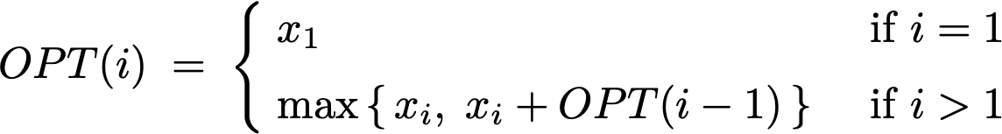
Kadane’s algorithm
Def. OPT(i) = max sum of any subarray of x whose rightmost
index is i.
Goal.
Bellman equation.
Running time. O(n).
take only
element i
take element i
together with best subarray
ending at index i − 1
Notes:
A professor at Brown wanted to solve the 2D version for a pattern matching problem in digital images. Maximum sum subarray was a maximum likelihood estimator of a certain kind of pattern. Algorithm for 2D version of problem too slow, so simplified to 1D. O(n^3) algorithm still too slow, so asked Michael Shamos, who overnight designed O(n log n) algorithm. Bentley and Shamos thought it was optimal until they described problem to CMU statistician, who designed O(n) algorithm within a minute.

Slide 29
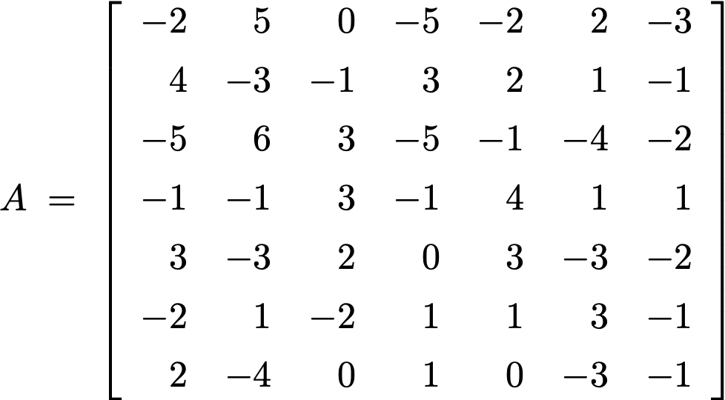
Maximum rectangle problem
Goal. Given an n-by-n matrix A, find a rectangle whose sum is maximum.
Applications. Databases, image processing, maximum likelihood estimation, technical job interviews, …
13
Notes:
Example: the values might be normalized brightnesses in a digital image.

Slide 30
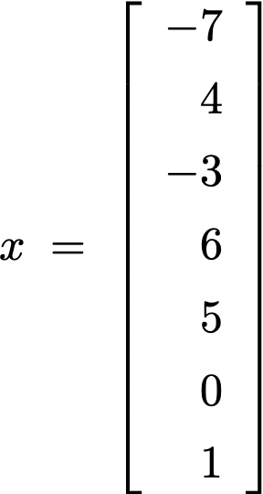
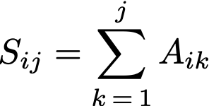

Bentley’s algorithm
Assumption. Suppose you knew the left and right column indices j and j′.
An O(n³) algorithm.
  Precompute cumulative row sums .
  For each j < j′ :
    define array x using row-sum differences:
    run Kadane’s algorithm in array x
Open problem. O(n^{3−ε}) for any constant ε > 0.
j
j′
0 − 5 − 2
solve maximum
subarray problem
in this array
Notes:
Easy lower bound of Omega(n^2).

Slide 31
Dynamic Programming
  weighted interval scheduling
segmented least squares
  knapsack problem
Section 6.3

Slide 32
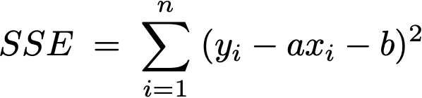
Least squares
Least squares. Foundational problem in statistics.
  Given n points in the plane: (x1, y1), (x2, y2) , …, (xn, yn).
  Find a line y = ax + b that minimizes the sum of the squared error:
Solution. Calculus ⇒ min error is achieved when
y
x
Notes:
the term "regression" stems from the work of Sir Francis Galton (1822-1911), a famous geneticist, who studied the heights of fathers and their sons. He found that offspring of a parent of larger than average height tended to be smaller than their parents, and offspring of parents of smaller than average size tended to be larger than their parents. "regression toward mediocrity".
Gauss (1809-1811) used Gaussian elimination to solve multiple linear regression
Gauss-Markov theorem (least squares estimates are uniformly minimum variance estimates (UMVUE) among all linear unbiased estimates)

Slide 33
Segmented least squares
Segmented least squares.
  Points lie roughly on a sequence of several line segments.
  Given n points in the plane: (x1, y1), (x2, y2) , …, (xn, yn) with
  x1 < x2 < ... < xn, find a sequence of lines that minimizes f (x).
Q. What is a reasonable choice for f (x) to balance accuracy and parsimony?
goodness of fit
number of lines
y
x

Slide 34
Segmented least squares
Segmented least squares.
  Points lie roughly on a sequence of several line segments.
  Given n points in the plane: (x1, y1), (x2, y2) , …, (xn, yn) with
  x1 < x2 < ... < xn, find a sequence of lines that minimizes f (x).
Goal. Minimize f (x) = E + c L for some constant c > 0, where
  E = sum of the sums of the squared errors in each segment.
  L = number of lines.
y
x

Slide 35
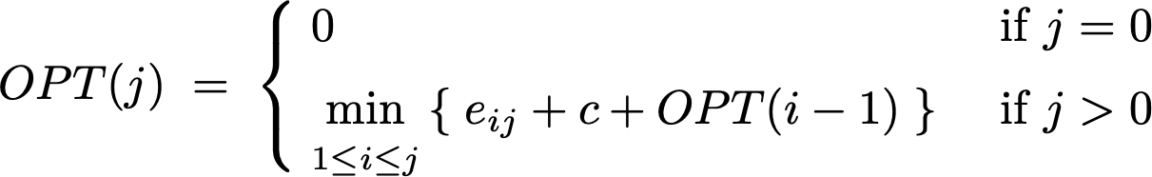
Dynamic programming: multiway choice
Notation.
  OPT(j) = minimum cost for points p1, p2, …, pj.
  eij = SSE for for points pi, pi+1, …, pj.
To compute OPT(j):
  Last segment uses points pi, pi+1, …, pj for some i ≤ j.
  Cost = eij + c + OPT(i – 1).
Bellman equation.
optimal substructure property
(proof via exchange argument)

Slide 36
Segmented least squares algorithm
Segmented-Least-Squares(n, p1, …, pn, c)
__________________________________________________________________________________________________________________________________________________________________________________________________________________________________________________________________________________________________________________________________________________________________________________________________________________________________________________________________________________________________________________________________________________________________________________________________________________________________________________________________________________________________________________________________________________________________________________________________________________________________________________________________________________________________________________________________________________________________________________________________________________________________________________________________________________________________________________________________________________________________________________________________________________________________________________________________________________________________________________________________________________________________________________________________________________
For j = 1 to n
  For i = 1 to j
    Compute the SSE eij for the points pi, pi+1, …, pj.
M[0] ← 0.
For j = 1 to n
  M[j] ← min 1 ≤ i ≤ j { eij + c + M[i – 1] }.
Return M[n].
__________________________________________________________________________________________________________________________________________________________________________________________________________________________________________________________________________________________________________________________________________________________________________________________________________________________________________________________________________________________________________________________________________________________________________________________________________________________________________________________________________________________________________________________________________________________________________________________________________________________________________________________________________________________________________________________________________________________________________________________________________________________________________________________________________________________________________________________________________________________________________________________________________________________________________________________________________________________________________________________________________________________________________________________________________________
previously computed value

Slide 37
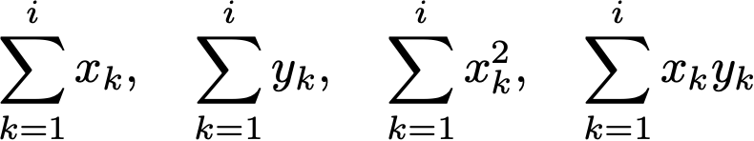
Segmented least squares analysis
Theorem. [Bellman 1961] DP algorithm solves the segmented least squares problem in O(n³) time and O(n²) space.
Pf.
  Bottleneck = computing SSE eij for each i and j.
  O(n) to compute eij. ▪
Remark. Can be improved to O(n²) time.
  For each i : precompute cumulative sums .
  Using cumulative sums, can compute eij in O(1) time.
Notes:
Compute cumulative sums, as in maximum rectangle problem.
a_{ij} \; = \; \frac{n \sum_k x_ky_k - (\sum_k x_k)(\sum_k y_k)}{n \sum_k x_k^2 - (\sum_k x_k)^2}, \quad b_{ij} \; = \; \frac{\sum_k y_k - a_{ij} \sum_k x_k}{n}
\sum_{k=1}^i x_k, \quad \sum_{k=1}^i y_k, \quad
\sum_{k=1}^i x_k^2, \quad \sum_{k=1}^i x_k y_k

Slide 38
Dynamic Programming
  weighted interval scheduling
  segmented least squares
knapsack problem
Section 6.4

Slide 39
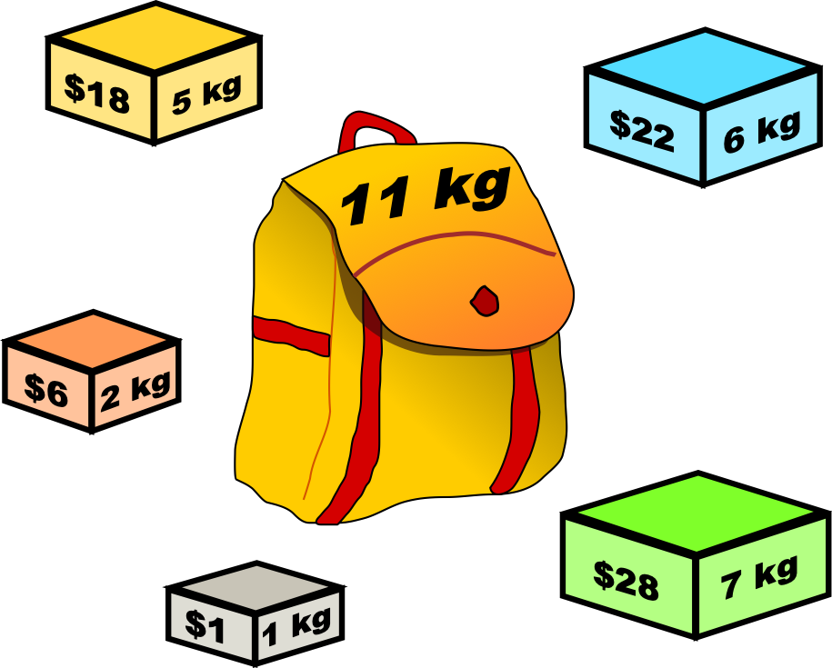
Knapsack problem
Goal. Pack knapsack so as to maximize total value.
  There are n items: item i provides value vi > 0 and weighs wi > 0.
  Knapsack has weight capacity of W.
Assumption. All input values are integral.
Ex. { 1, 2, 5 } has value $35 (and weight 10).
Ex. { 3, 4 } has value $40 (and weight 11).
i | vi | wi
1 | US$1 | 1 kg
2 | US$6 | 2 kg
3 | US$18 | 5 kg
4 | US$22 | 6 kg
5 | US$28 | 7 kg
knapsack instance
(weight limit W = 11)
Creative Commons Attribution-Share Alike 2.5
by Dake
Notes:
We really just need the wi values to be integral.
https://commons.wikimedia.org/wiki/File:Knapsack.svg

Slide 40
Dynamic programming: quiz 2
Which algorithm solves knapsack problem?
  Greedy by value: repeatedly add item with maximum vi.
  Greedy by weight: repeatedly add item with minimum wi.
  Greedy by ratio: repeatedly add item with maximum ratio vi / wi.
  Dynamic programming.
i | vi | wi
1 | US$1 | 1 kg
2 | US$6 | 2 kg
3 | US$18 | 5 kg
4 | US$22 | 6 kg
5 | US$28 | 7 kg
knapsack instance
(weight limit W = 11)
Creative Commons Attribution-Share Alike 2.5
by Dake
Notes:
greedy by value would take { 5, 2, 1}
greedy by weight would take { 1, 2, 3}
greedy by ratio would take { 5, 2, 1}

Slide 41
Dynamic programming: quiz 3
Which subproblems?
  OPT(w) = max-profit with weight limit w.
  OPT(i) = max-profit subset of items 1, …, i.
  OPT(i, w) = max-profit subset of items 1, …, i with weight limit w.
  Any of the above.
Notes:
OPT(i, v) = min weight of a knapsack for which we can obtain a solution of value ≥ v using a subset of items 1,..., i.

Slide 42
Dynamic programming: false start
Def. OPT(i) = max-profit subset of items 1, …, i.
Goal. OPT(n).
Case 1. OPT(i) does not select item i.
  OPT selects best of { 1, 2, …, i – 1 }.
Case 2. OPT(i) selects item i.
  Selecting item i does not immediately imply that we will have
  to reject other items.
  Without knowing which other items were selected before i,
  we don’t even know if we have enough room for i.
Conclusion. Need more subproblems!
optimal substructure property
(proof via exchange argument)
Notes:
Hu’chi

Slide 43
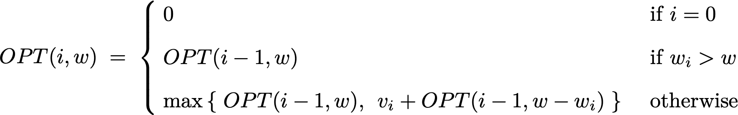
Dynamic programming: adding a new variable
Def. OPT(i, w) = max-profit subset of items 1, …, i with weight limit w.
Goal. OPT(n, W).
Case 1. OPT(i, w) does not select item i.
  OPT(i, w) selects best of { 1, 2, …, i – 1 } using weight limit w.
Case 2. OPT(i, w) selects item i.
  Collect value vi.
  New weight limit = w – wi.
  OPT(i, w) selects best of { 1, 2, …, i – 1 } using this new weight limit.
Bellman equation.
possibly because wi > w
optimal substructure property
(proof via exchange argument)

Slide 44
Knapsack problem: bottom-up dynamic programming
Knapsack(n, W, w1, …, wn, v1, …, vn )
__________________________________________________________________________________________________________________________________________________________________________________________________________________________________________________________________________________________________________________________________________________________________________________________________________________________________________________________________________________________________________________________________________________________________________________________________________________________________________________________________________________________________________________________________________________________________________________________________________________________________________________________________________________________________________________________________________________________________________________________________________________________________________________________________________________________________________________________________________________________________________________________________________________________________________________________________________________________________________________________________________________________________________________________________________________________________________________________________________________________________________________________________________
For w = 0 to W
  M[0, w] ← 0.
For i = 1 to n
  For w = 0 to W
    If (wi > w) M[i, w] ← M[i – 1, w].
    Else M[i, w] ← max { M[i – 1, w], vi + M[i – 1, w – wi] }.
Return M[n, W].
__________________________________________________________________________________________________________________________________________________________________________________________________________________________________________________________________________________________________________________________________________________________________________________________________________________________________________________________________________________________________________________________________________________________________________________________________________________________________________________________________________________________________________________________________________________________________________________________________________________________________________________________________________________________________________________________________________________________________________________________________________________________________________________________________________________________________________________________________________________________________________________________________________________________________________________________________________________________________________________________________________________________________________________________________________________________________________________________________________________________________________________________________________
previously computed values

Slide 45
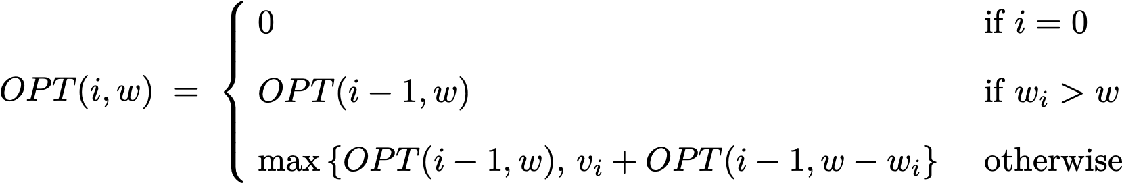
Knapsack problem: bottom-up dynamic programming demo
i | vi | wi
1 | US$1 | 1 kg
2 | US$6 | 2 kg
3 | US$18 | 5 kg
4 | US$22 | 6 kg
5 | US$28 | 7 kg
weight limit w
 | 0 | 1 | 2 | 3 | 4 | 5 | 6 | 7 | 8 | 9 | 10 | 11
{ } | 0 | 0 | 0 | 0 | 0 | 0 | 0 | 0 | 0 | 0 | 0 | 0
{ 1 } | 0 | 1 | 1 | 1 | 1 | 1 | 1 | 1 | 1 | 1 | 1 | 1
{ 1, 2 } | 0 | 1 | 6 | 7 | 7 | 7 | 7 | 7 | 7 | 7 | 7 | 7
{ 1, 2, 3 } | 0 | 1 | 6 | 7 | 7 | 18 | 19 | 24 | 25 | 25 | 25 | 25
{ 1, 2, 3, 4 } | 0 | 1 | 6 | 7 | 7 | 18 | 22 | 24 | 28 | 29 | 29 | 40
{ 1, 2, 3, 4, 5 } | 0 | 1 | 6 | 7 | 7 | 18 | 22 | 28 | 29 | 34 | 35 | 40
subset
of items
1, …, i
OPT(i, w) = max-profit subset of items 1, …, i with weight limit w.
Notes:
OPT: { 4, 3 }
value = 22 + 18 = 40

Slide 46
Knapsack problem: running time
Theorem. The DP algorithm solves the knapsack problem with n items
and maximum weight W in Θ(n W) time and Θ(n W) space.
Pf.
  Takes O(1) time per table entry.
  There are Θ(n W) table entries.
  After computing optimal values, can trace back to find solution:
  OPT(i, w) takes item i iff M [i, w] > M [i – 1, w]. ▪
weights are integers
between 1 and W

Slide 47
Dynamic programming: quiz 4
Does there exist a poly-time algorithm for the knapsack problem?
  Yes, because the DP algorithm takes Θ(n W) time.
  No, because Θ(n W) is not a polynomial function of the input size.
  No, because the problem is NP-hard.
  Unknown.
“pseudo-polynomial”
equivalent to P ≠ NP conjecture
because knapsack problem is NP-hard
Notes:
pseudo-polynomial time: running time is polynomial in the running time if the numeric values are encoded in unary.
There exists a poly-time algorithm that produces a feasible solution that has value within 1% of optimum. [ Section 11.8 ]

Slide 48

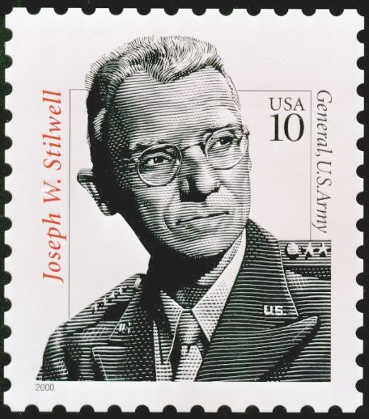






Coin changing
Problem. Given n coin denominations { c1, c2, …, cn } and a target value V, find the fewest coins needed to make change for V (or report impossible).
Recall. Greedy cashier’s algorithm is optimal for U.S. coin denominations,
but not for arbitrary coin denominations.
Ex. { 1, 10, 21, 34, 70, 100, 350, 1295, 1500 }.
Optimal. 140¢ = 70 + 70.

Slide 49
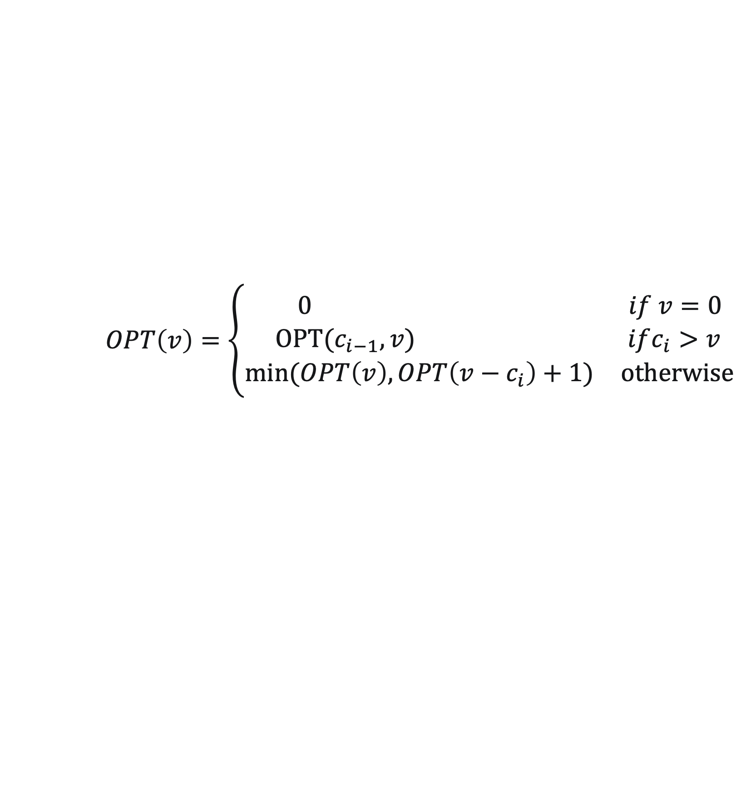
Coin changing
Def. OPT(v) = min number of coins to make change for v.
Goal. OPT(V).
Multiway choice. To compute OPT(v),
  Select a coin of denomination ci for some i.
  Select fewest coins to make change for v – ci.
Bellman equation.
Running time. O(n V).
optimal substructure property
(proof via exchange argument)
$$OPT\left(v\right)=\left\{\begin{aligned}\begin{matrix} 0 & if v=0\end{matrix} \\ \begin{matrix} OPT(c_{i−1},v) & ifc_{i}>v\end{matrix} \\ \begin{matrix}min⁡(OPT\left(v\right), OPT\left(v−c_{i}\right)+1) & otherwise\end{matrix}\end{aligned}\right.$$
Notes:
[wayne s18] simplify by making c_1 = 1 so solution always exists?
Note: problem is (weakly) NP-hard.

Slide 50
Dynamic programming summary
Outline.
  Define a collection of subproblems.
  Solution to original problem can be computed from subproblems.
  Natural ordering of subproblems from “smallest” to “largest” that enables determining a solution to a subproblem from solutions to smaller subproblems.
Techniques.
  Binary choice: weighted interval scheduling.
  Multiway choice: segmented least squares.
  Adding a new variable: knapsack problem.
Top-down vs. bottom-up dynamic programming. Opinions differ.
typically, only a polynomial
number of subproblems
Notes:
Solution to original problem can be computed from subproblems (e.g., original problem is a subproblem!)
Typically, only a polynomial number of subproblems (but not the case for knapsack problem or TSP)

