Slide 1
Chapter 0:
Introduction to Protein Design
Protein Diversity
Computational Protein Design

Slide 2
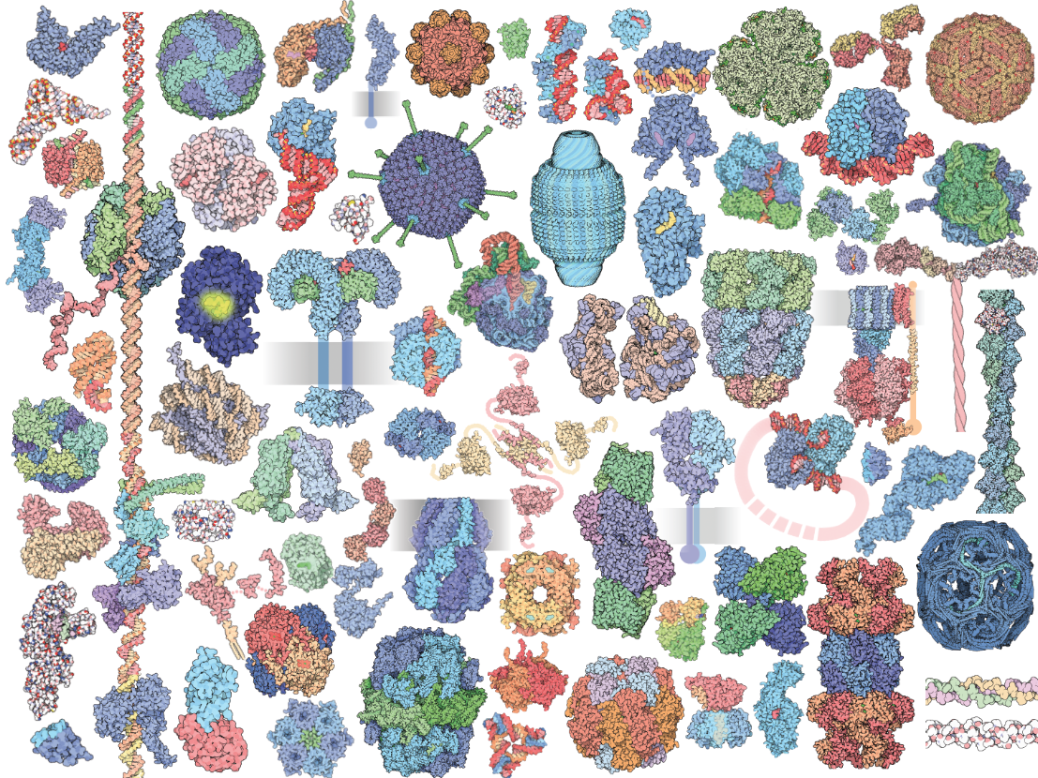
An Immense World of Proteins
Sequence
Structure
Function
Illustration by David S. Goodsell

Slide 3
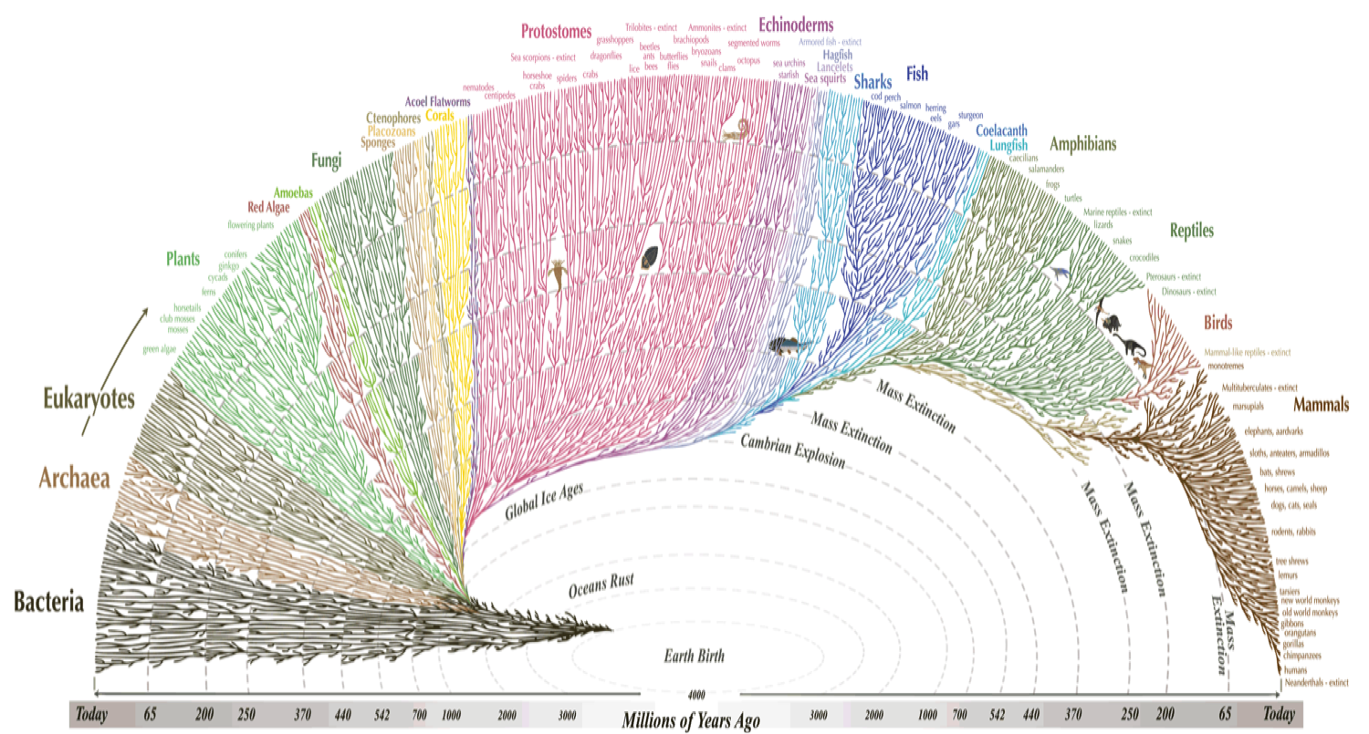
Protein Diversity through the Lens of Evolution

Slide 4
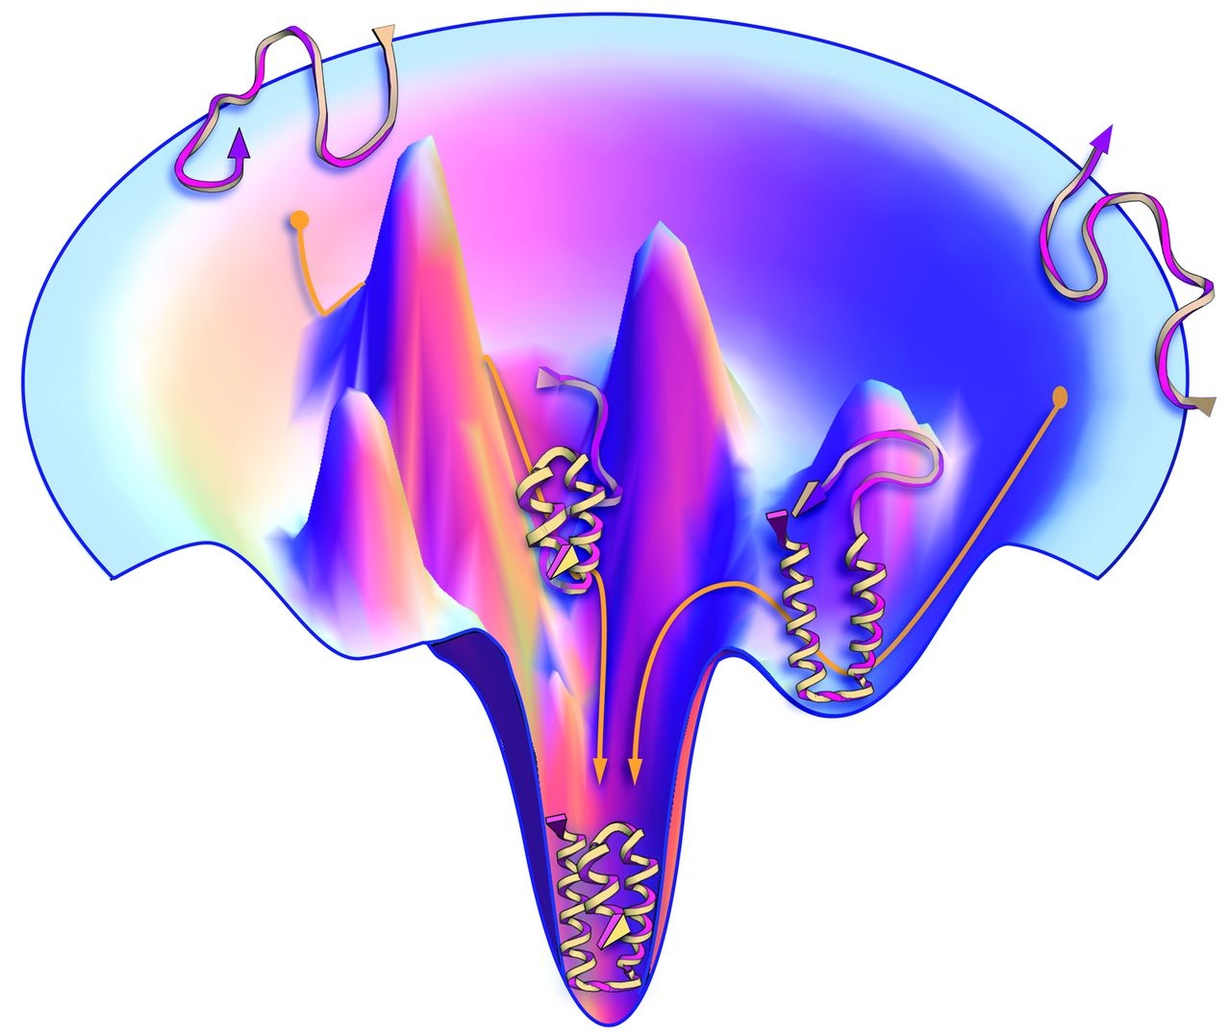
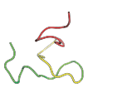
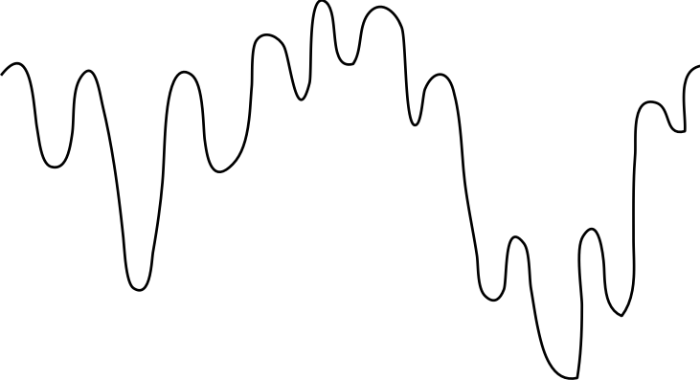
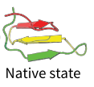
Protein Diversity through the Lens of Physics
Unfolded
Energy
Native state
(Folded)
Conformational space
Sequence space
A protein with N amino acids can have 20^{N} sequences.

Slide 5
Protein Conformational Space
Torsion angles in proteins are flexible
Levinthal’s paradox
F(phi, psi, chi)

Slide 6
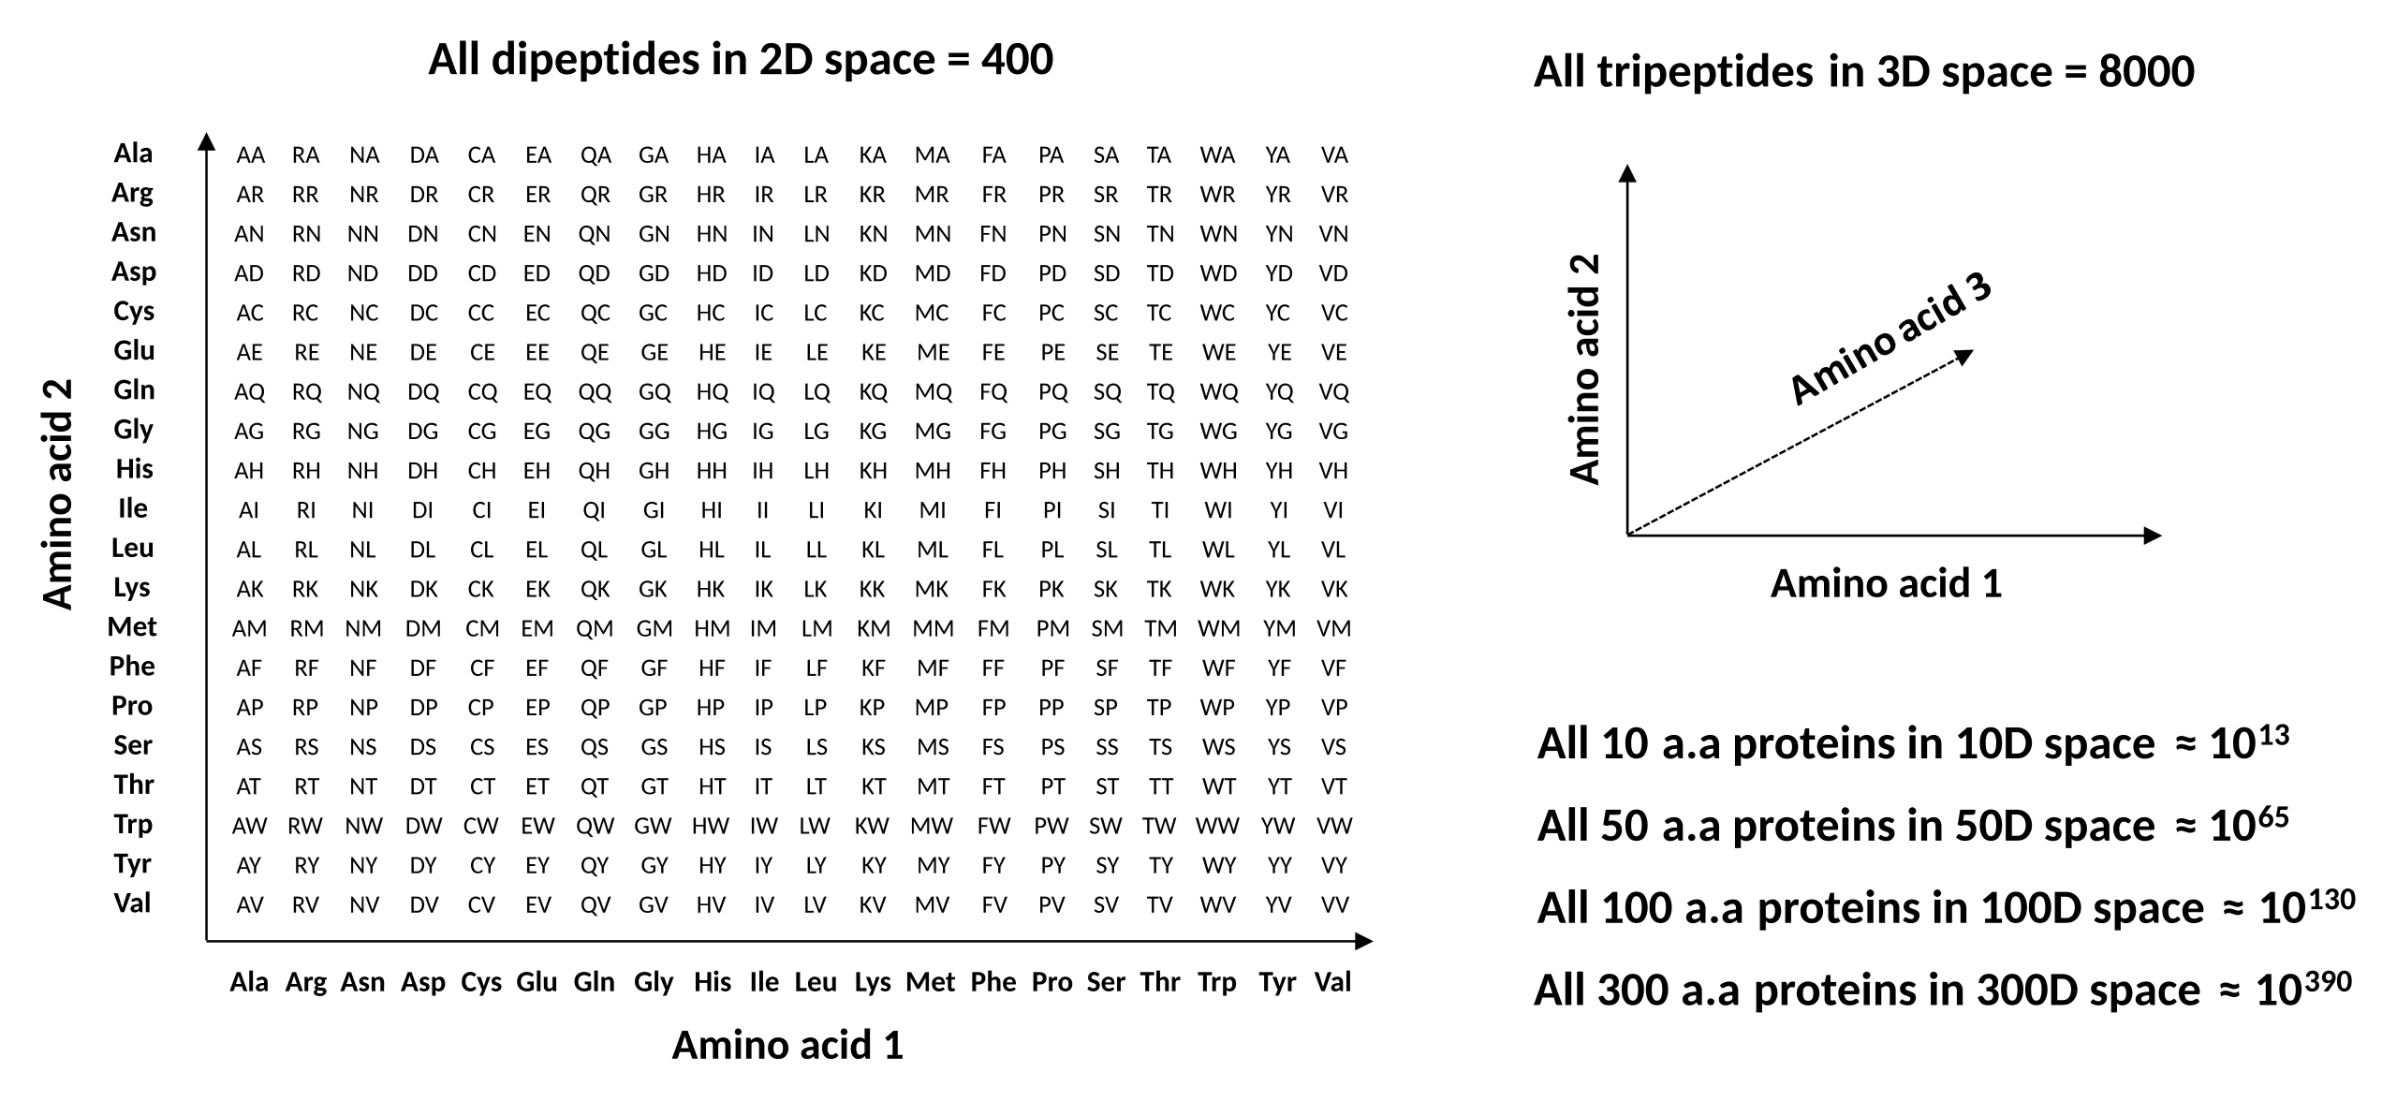
Protein Sequence Space
A protein with N amino acids can have 20^{N} sequences.
By Thomas Shafee - Thomas, Shafee, (2014). "Evolvability of a viral protease: experimental evolution of catalysis, robustness and specificity". PhD Thesis. University of Cambridge., CC BY 4.0, https://commons.wikimedia.org/w/index.php?curid=94447984

Slide 7
Sequence, Structure, Function
F(phi, psi, chi)
A protein with N amino acids can have 20^{N} sequences.
~10^{2N} possible backbone conformations
An Immense World of Proteins

Slide 8
Computational Protein Design
Multiple levels of protein design
Two schools of thoughts
Computational models

Slide 9
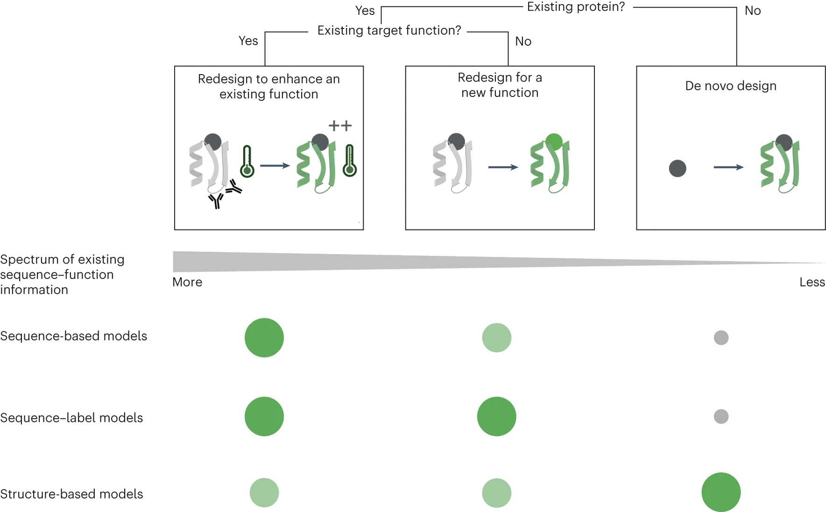
Multiple levels of designing protein function
We design proteins:
to tune the function of an existing protein
to make new structural variations of an existing function
to create a new way of doing something
thermal stability
faster turnover
smaller/bigger size
combination of functions
electromagnetic sensing?
protein computase?
your imagination!

Slide 10
Computational Protein Design
Multiple levels of protein design
to tune the function of an existing protein
to make new structural variations of an existing function
to create a new way of doing something
Two schools of thoughts
Computational models

Slide 11
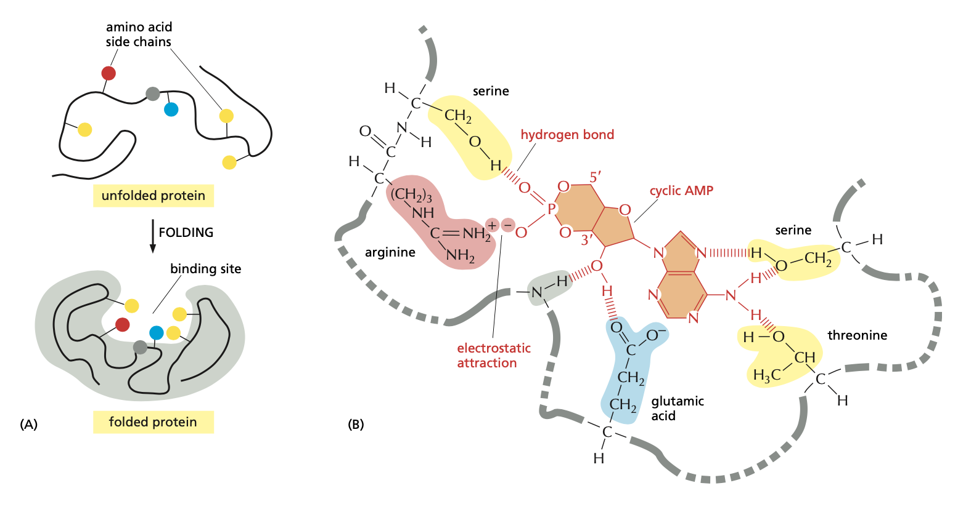
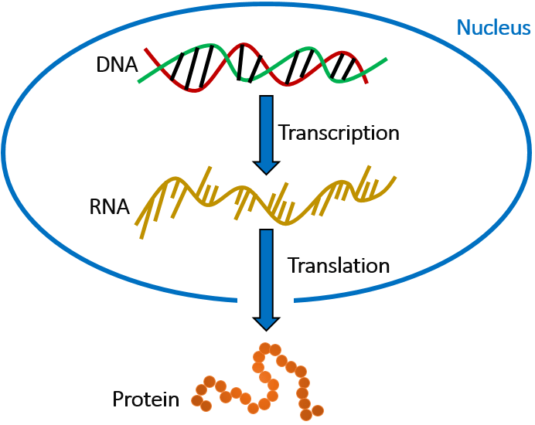
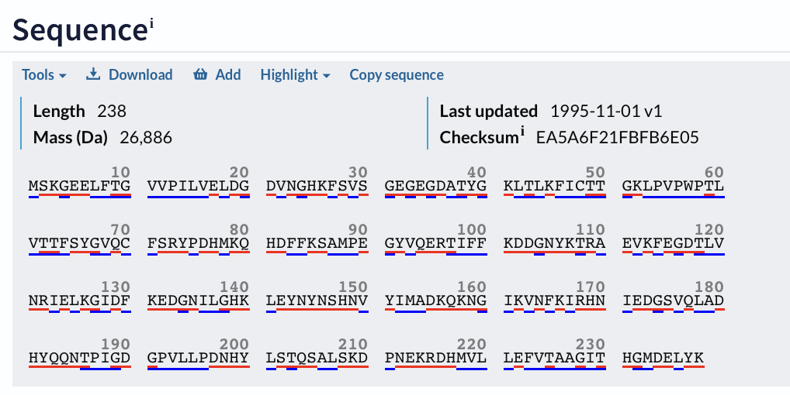
Two Approaches to Protein Design
Sequence-centric
Structure-centric

Slide 12
Sequence-Centric Approaches to Protein Design
Natural Evolution
Function
“Protein Engineering”

Slide 13
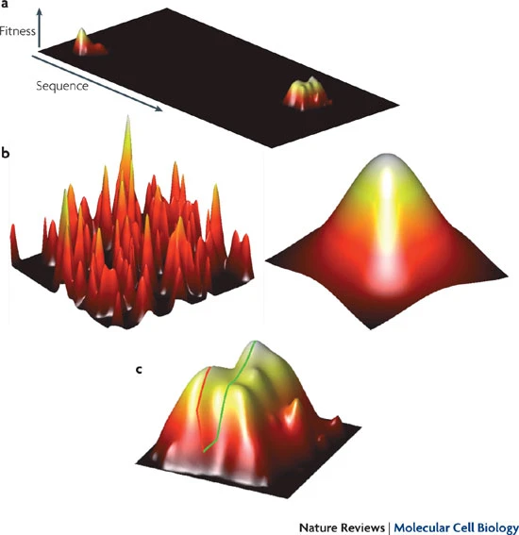
Fitness Landscape: the map from protein sequences to their functions
Natural Evolution: sequence -> function
“Badland”
“Fujiyama”
Romero, P., Arnold, F. Exploring protein fitness landscapes by directed evolution. Nat Rev Mol Cell Biol10, 866–876 (2009). https://doi.org/10.1038/nrm2805

Slide 14
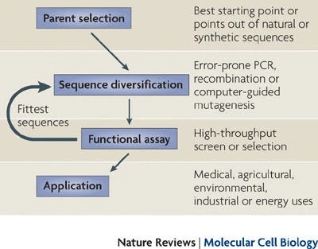
Exploring the Fitness Landscape by Directed Evolution
Romero, P., Arnold, F. Exploring protein fitness landscapes by directed evolution. Nat Rev Mol Cell Biol10, 866–876 (2009). https://doi.org/10.1038/nrm2805

Slide 15

‘Revolution by Evolution’: Chemistry Nobel Prize 2018

Slide 16
Two Approaches to Protein Design
Sequence-centric
Structure-centric
Sequence Diversity
Function Selection
Experimental design
Data-driven computational modeling

Slide 17
Structure-Centric Protein Design
Protein Science
sequence –> structure -> function
Protein Function Design
function –> structure -> sequence

Slide 18
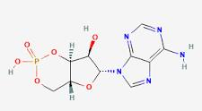
Structure-Centric Protein Design
Target Function
Structural Basis
Sequence Design
Recognize cAMP
Design amino acid sequences that can fold and form the desired 3D functional motifs supported by the scaffold structure.
Functional Motifs
all the possible binding configurations holding cAMP
Scaffolds
all the possible protein backbones holding the functional motif

Slide 19
De Novo Fluorescence-Activating Proteins
Target Function
Structural Basis
Sequence Design
Fluorescence
Functional motif
all the possible binding configurations holding the chromophore in planer conformation
amino acid sequences that can fold and form the desired 3D functional motifs supported by the scaffold structure.
Physics and chemistry of fluorescence
Applications in biology
Choice of chromophore
Scaffold
polypeptide backbone structures that can possibly hold the functional motif

Slide 20
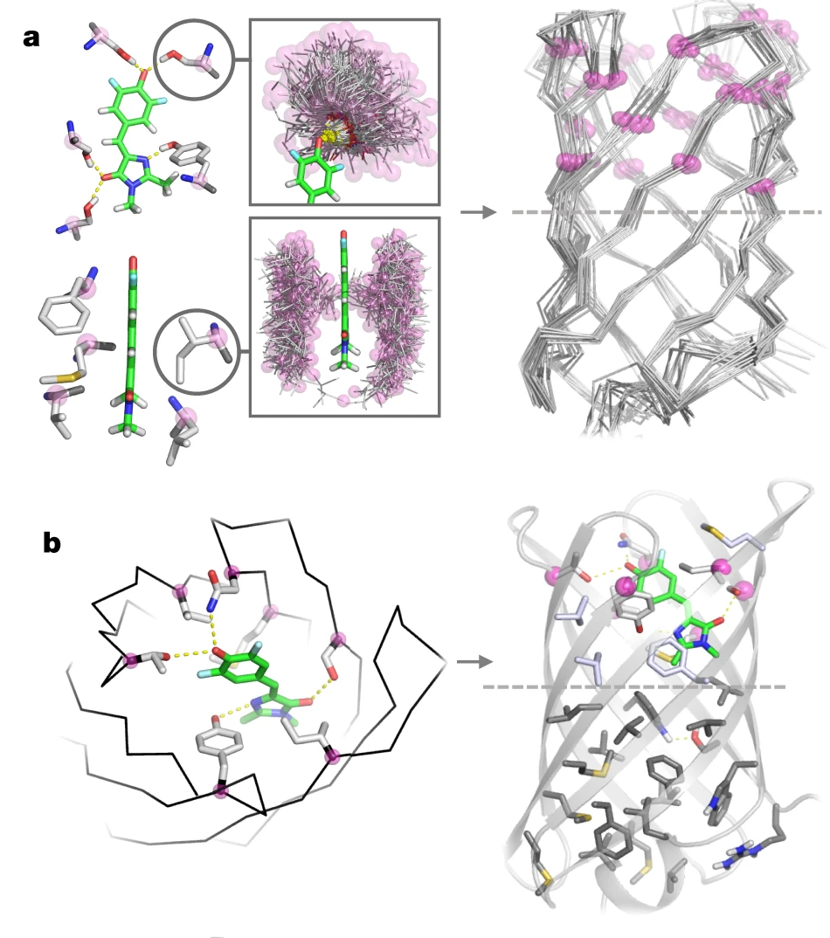
De Novo Fluorescence-Activating beta Barrel
Target Function
Structural Basis
Functional motif
Scaffold
Sequence Design
Dou et al, 2018 Nature

Slide 21
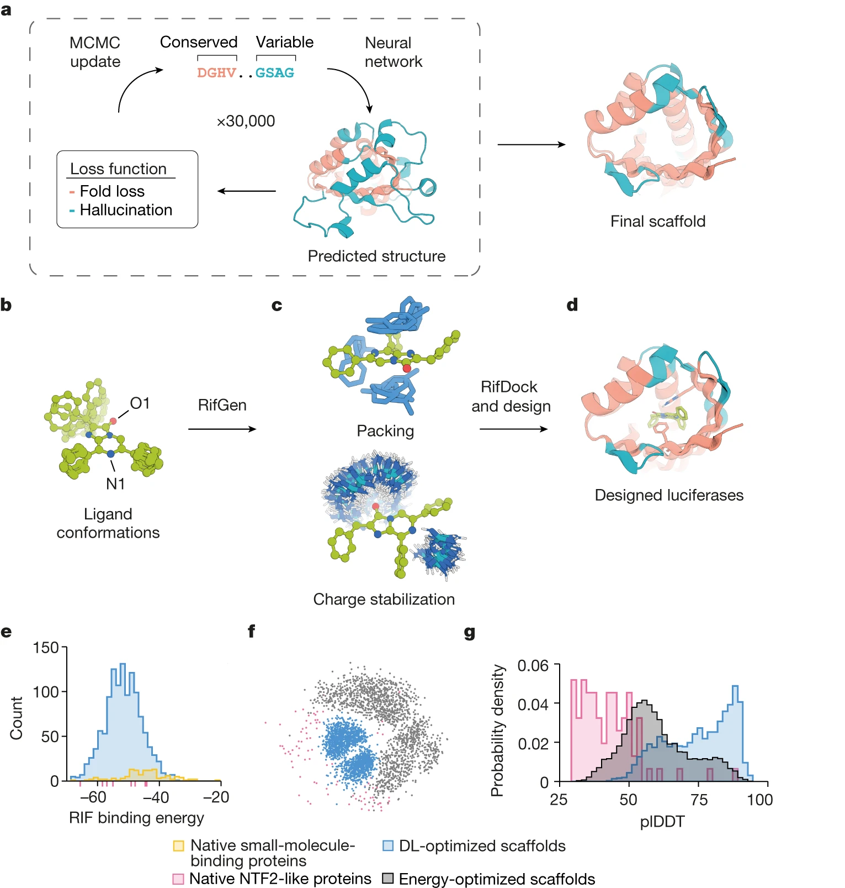
De novo design of a luciferase by deep learning
Deep network hallucination helps generating highly possible scaffolds
Yeh et al, 2023 Nature

Slide 22
Two Approaches to Protein Function Design
Sequence-centric
Structure-centric
Target Function
Sequence Diversity
Structural Basis
Functional motif
Function Selection
Scaffold
Experimental design
Data-driven computational modeling
Sequence Design

Slide 23
Computational Protein Design
Multiple levels of protein design
to tune the function of an existing protein
to make new structural variations of an existing function
to create a new way of doing something
Two schools of thoughts
sequence-centric approach
structure-centric approach
Computational models

Slide 24



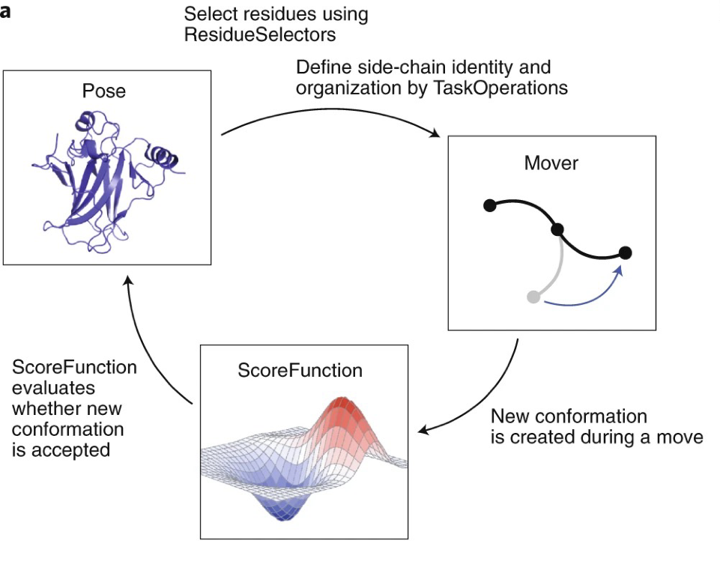
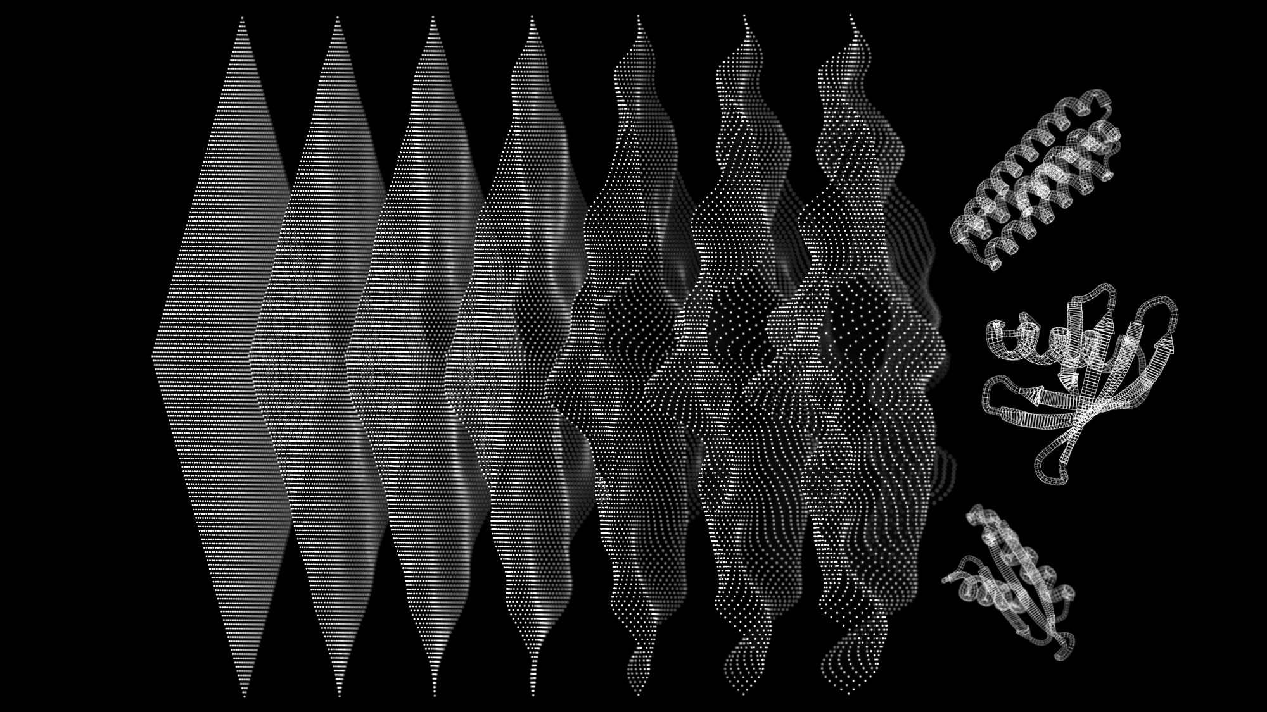
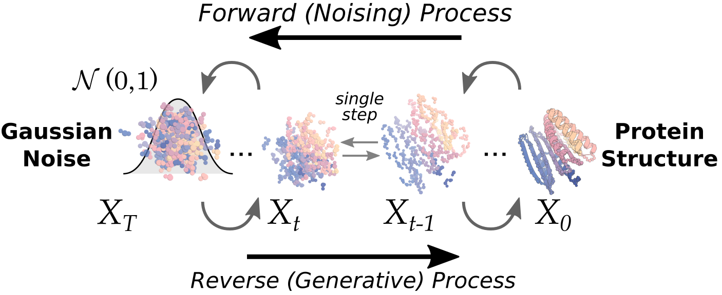
Computational Models for Designing Proteins
Physics-Based Models
2. Deep Learning Models

Slide 25
Protein Design
Multiple levels of protein design
to tune the function of an existing protein
to make new structural variations of an existing function
to create a new way of doing something
Two schools of thoughts
sequence-centric approach
structure-centric approach
Computational Models
physics-based models
deep learning models

Slide 26
Why do we want to design proteins?
To deepen our understanding of protein science
-- Protein physics: how can physical laws explain proteins?
-- Protein biology: molecular design principle, evolution ...
-- Basic rules about protein structure and sequences
To enable functions not yet seen in nature
Most of the protein sequence-structure space is not explored by natural proteins!

