Slide 1
Chapter 1:
Molecular Driving Forces
Principles of Probability
Entropy
Boltzmann Distribution

Slide 2
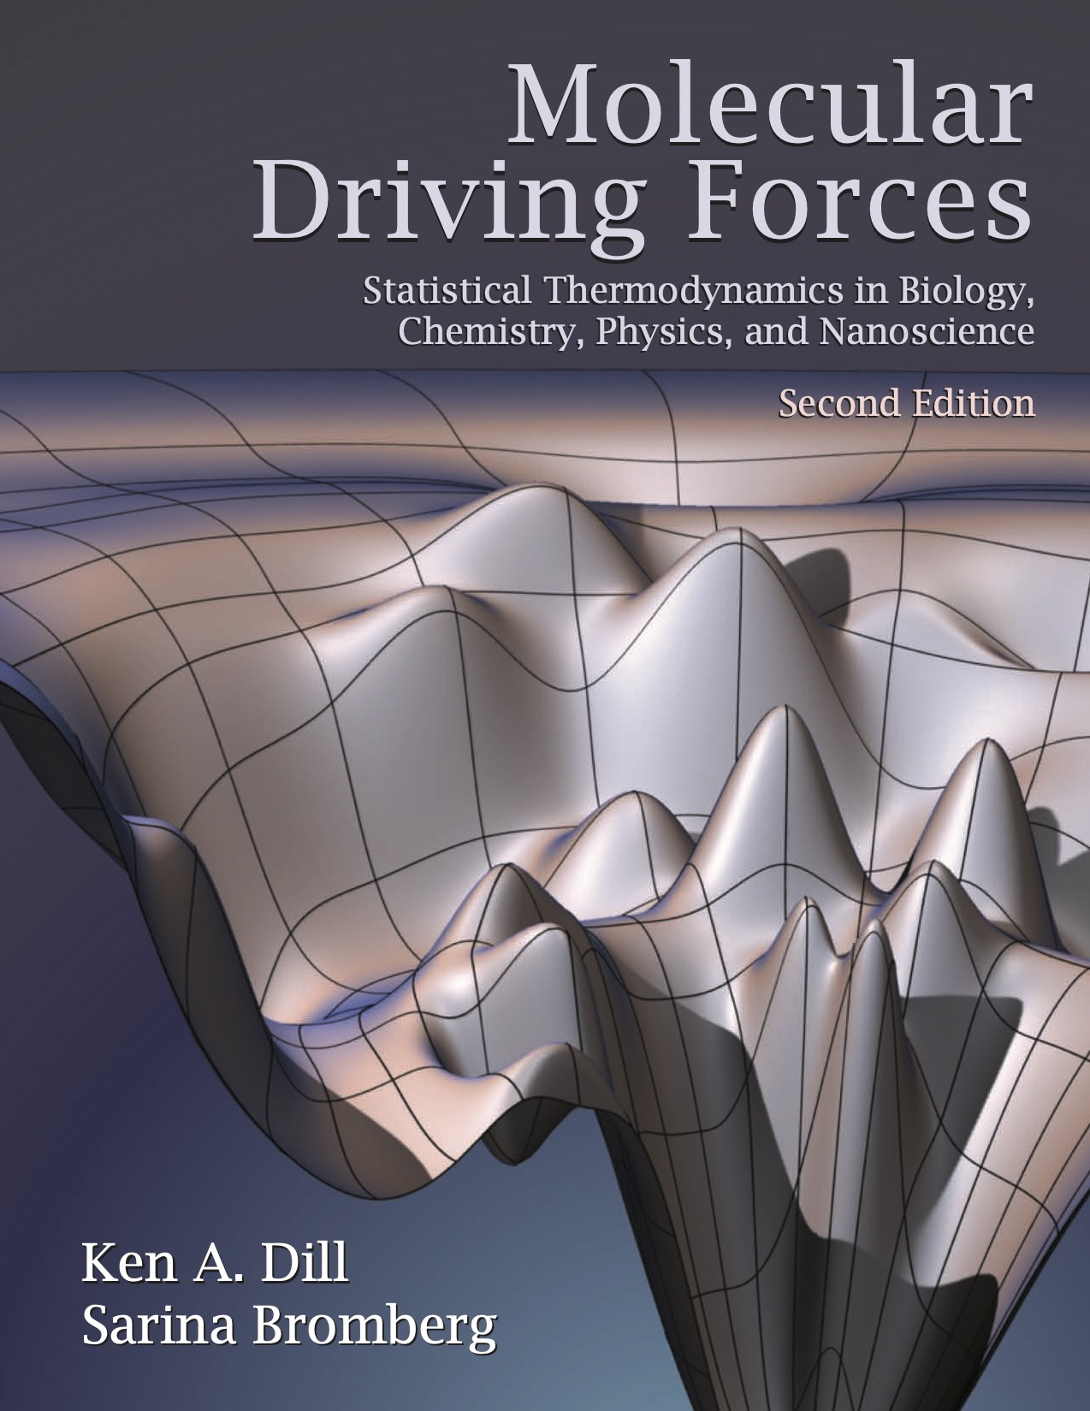
Molecular Driving Forces
“The reason that a system will evolve to a Boltzmann distribution is that a Boltzmann distribution is so very much more highly probable that any other distribution.
....Actually, a Boltzmann distribution is so much more highly probable than any other distribution that evolution to a Boltzmann distribution is inevitable.
This evolution is the molecular driving force. ”
-- Addison Ault, Journal of Chemical Education

Slide 3
Probability Theory
Probabilities describe frequencies or incomplete knowledge.
The addition and multiplication rules allow you to draw consistent inferences about probabilities of multiple events.
Distribution functions describe collections of probabilities: discrete v.s. continuous
Combinatorics is the counting of arrangements of systems.

Slide 4
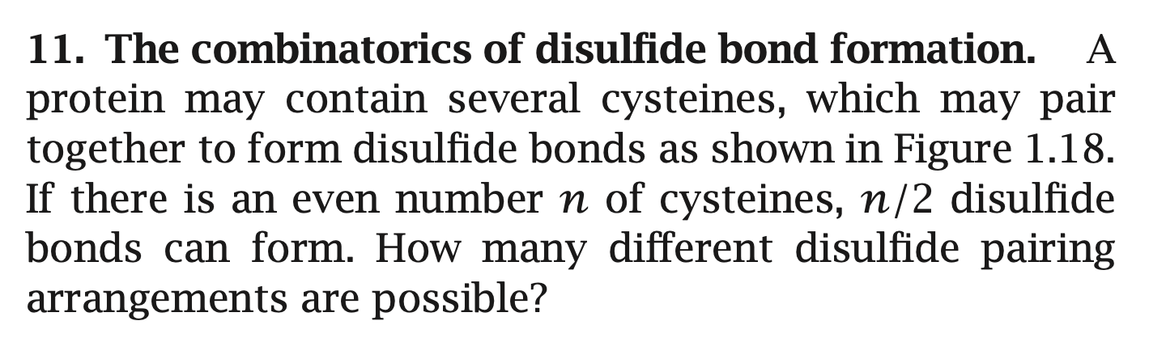
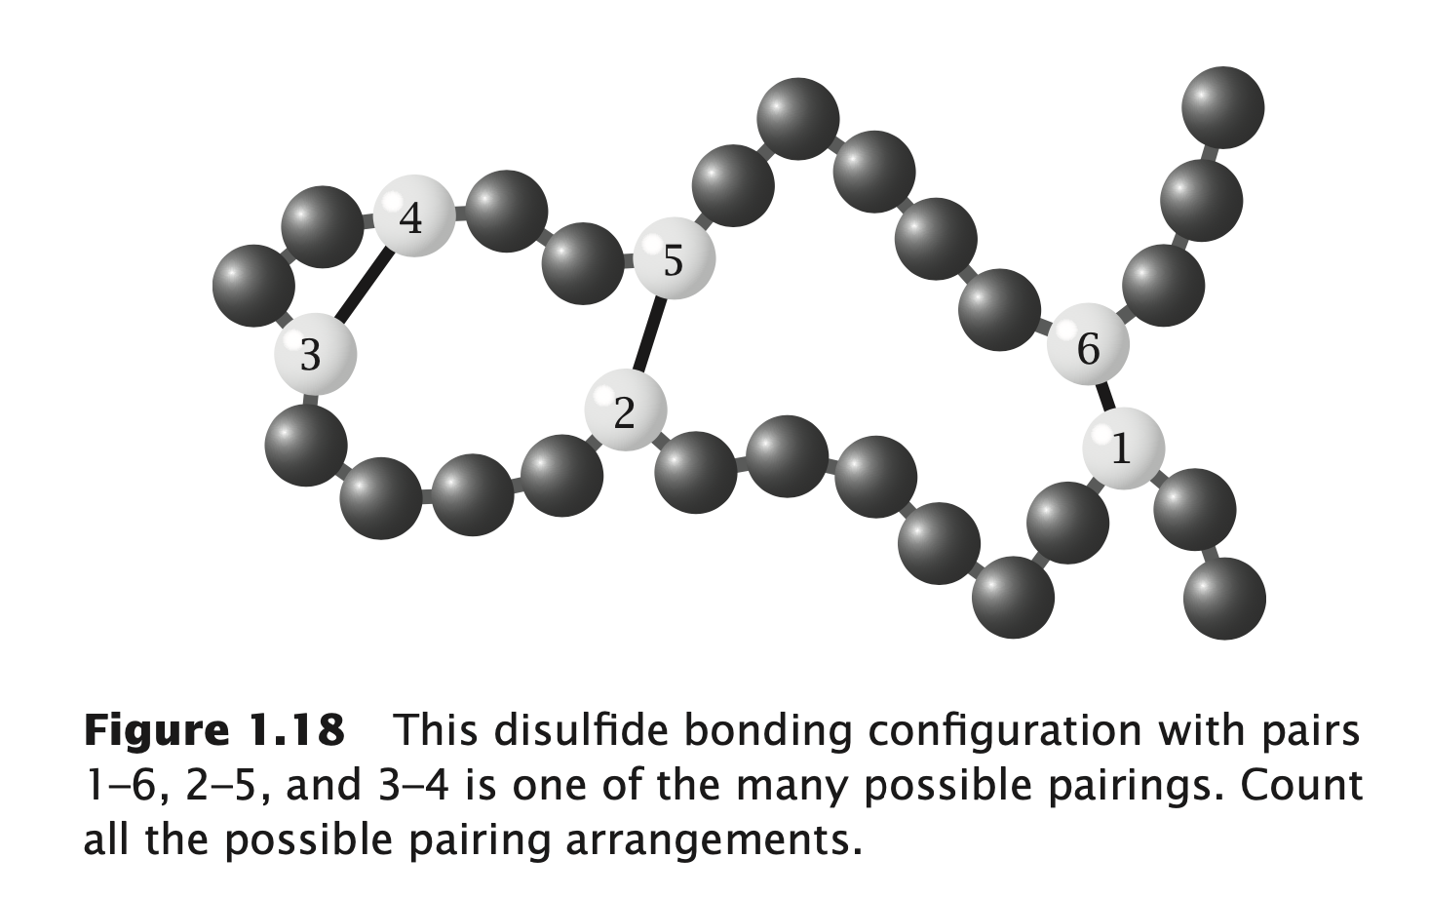
Quiz

Slide 5
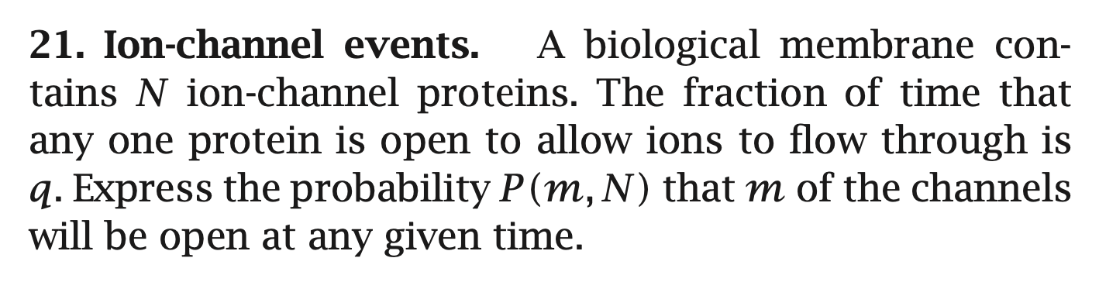

Slide 6
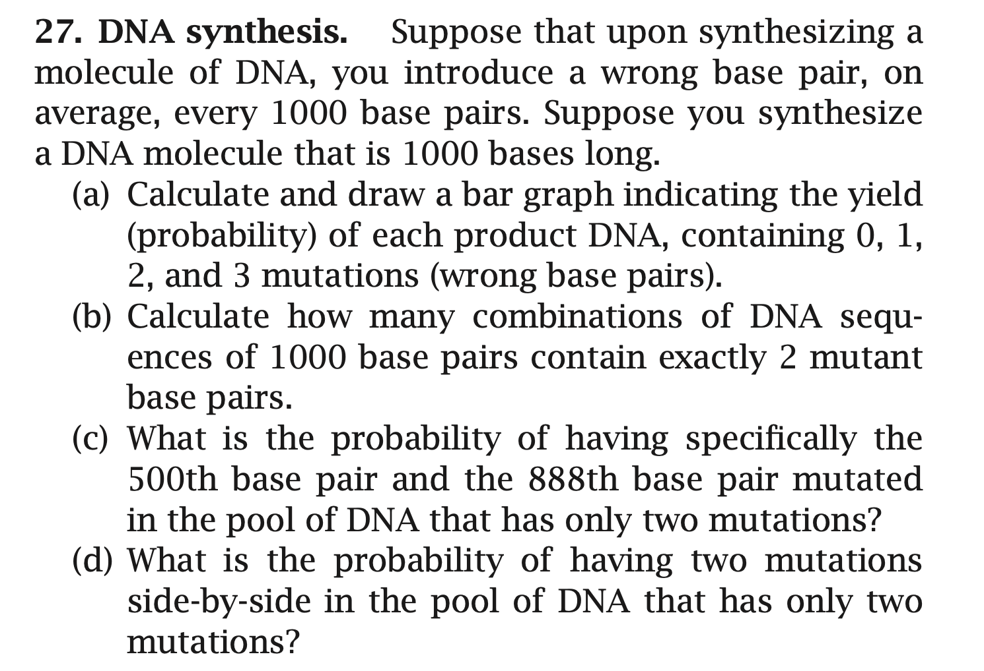

Slide 7
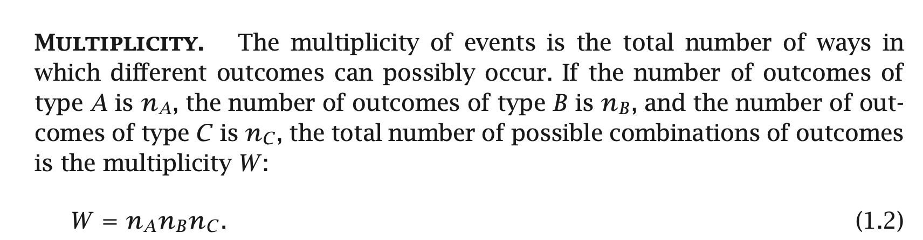
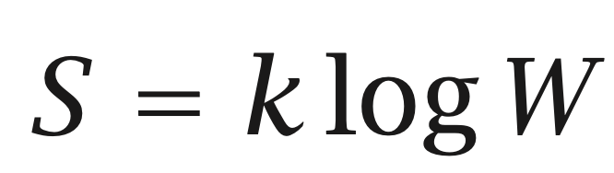
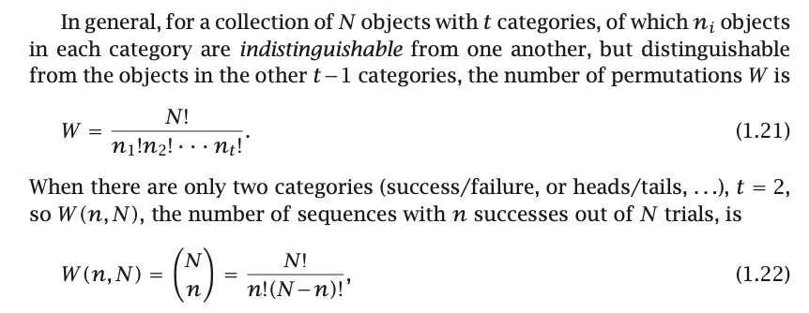
Entropy
Probabilities, together with combinatorics, provide the basis for reasoning about entropy.
Notes:
W: 微观状态数

Slide 8
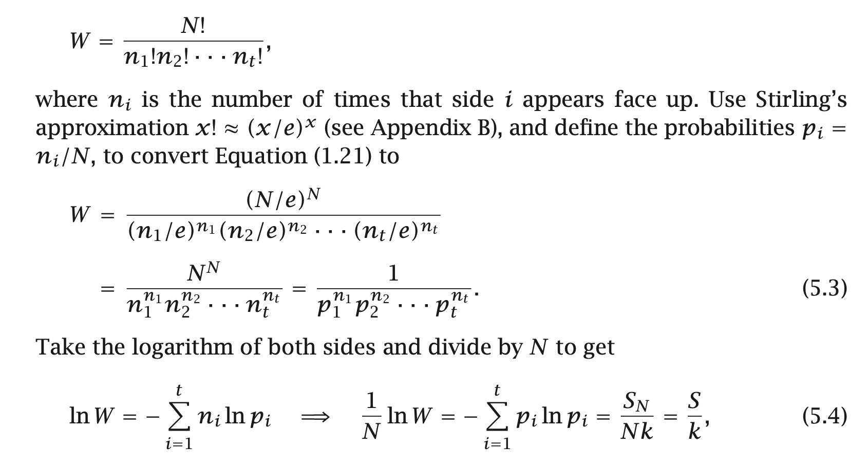
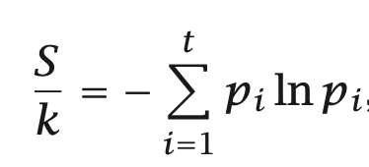

Slide 9
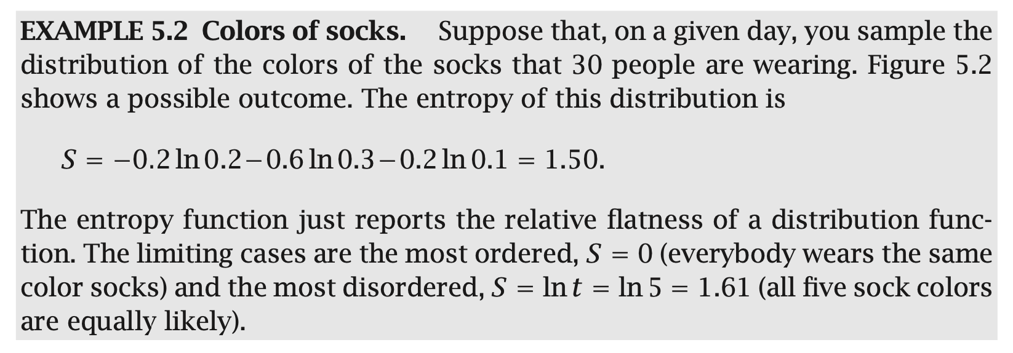
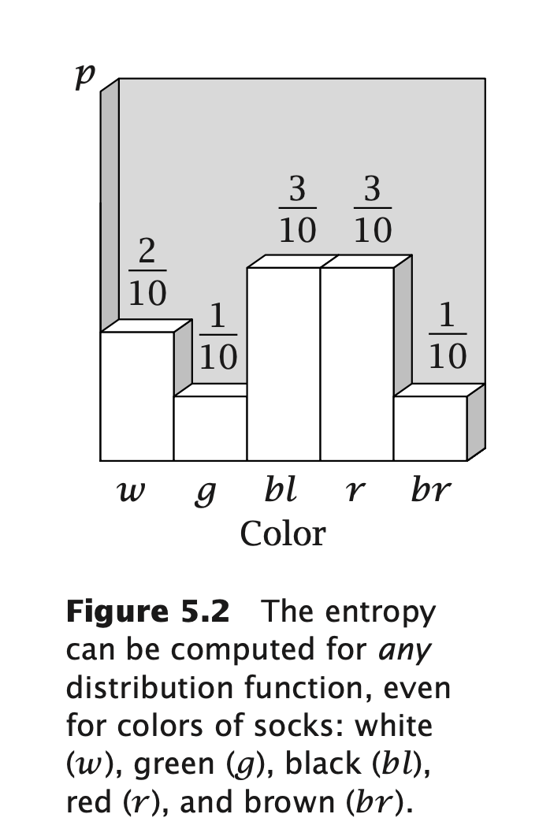

Slide 10
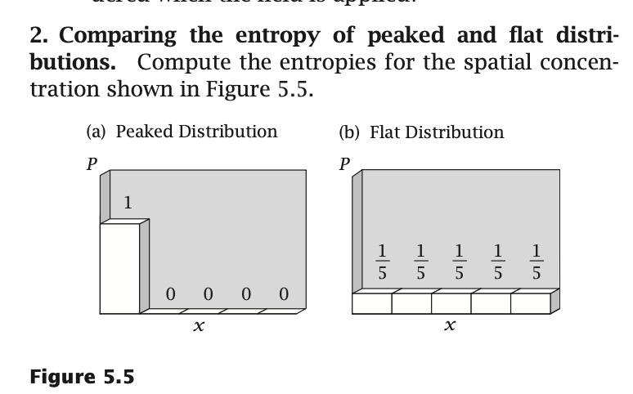
Quiz

Slide 11
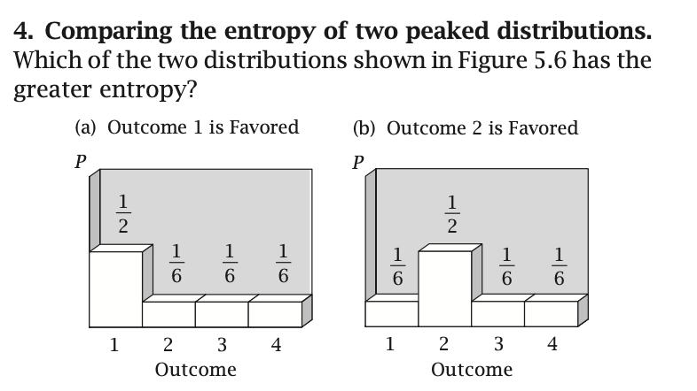

Slide 12
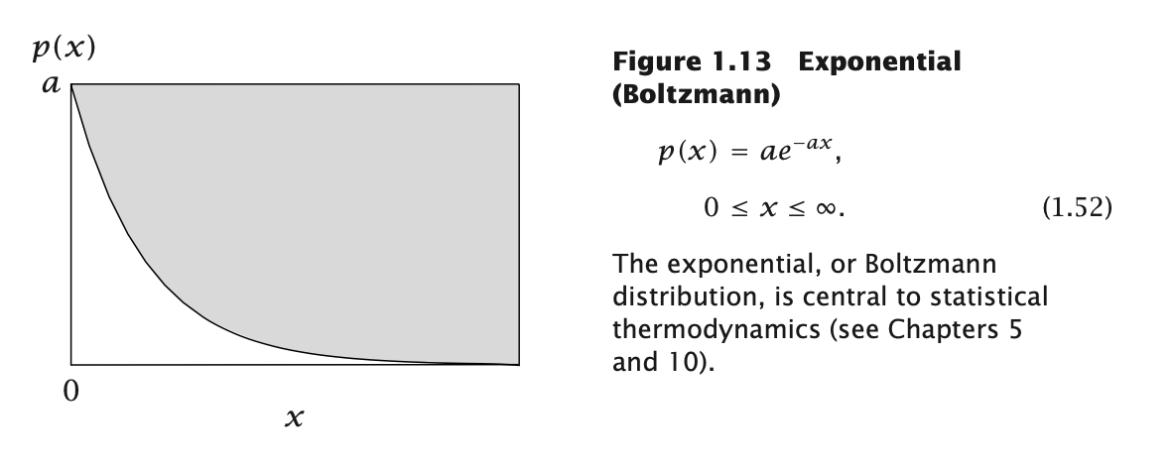
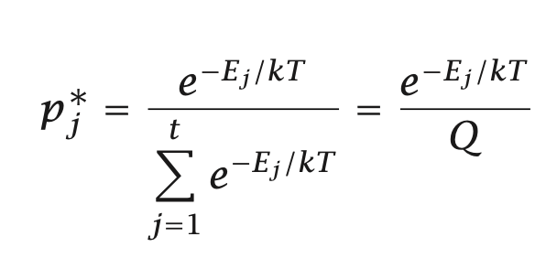
Boltzmann Distribution

Slide 13
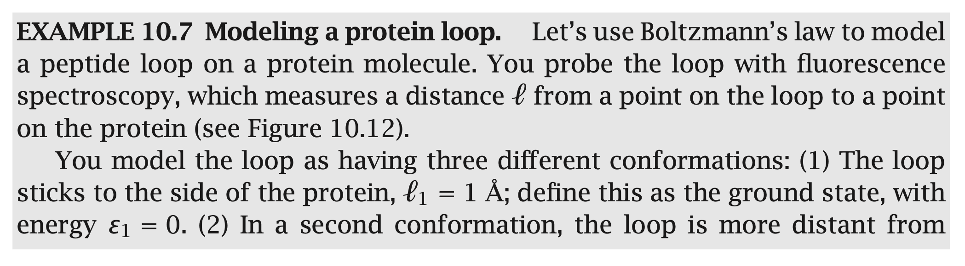
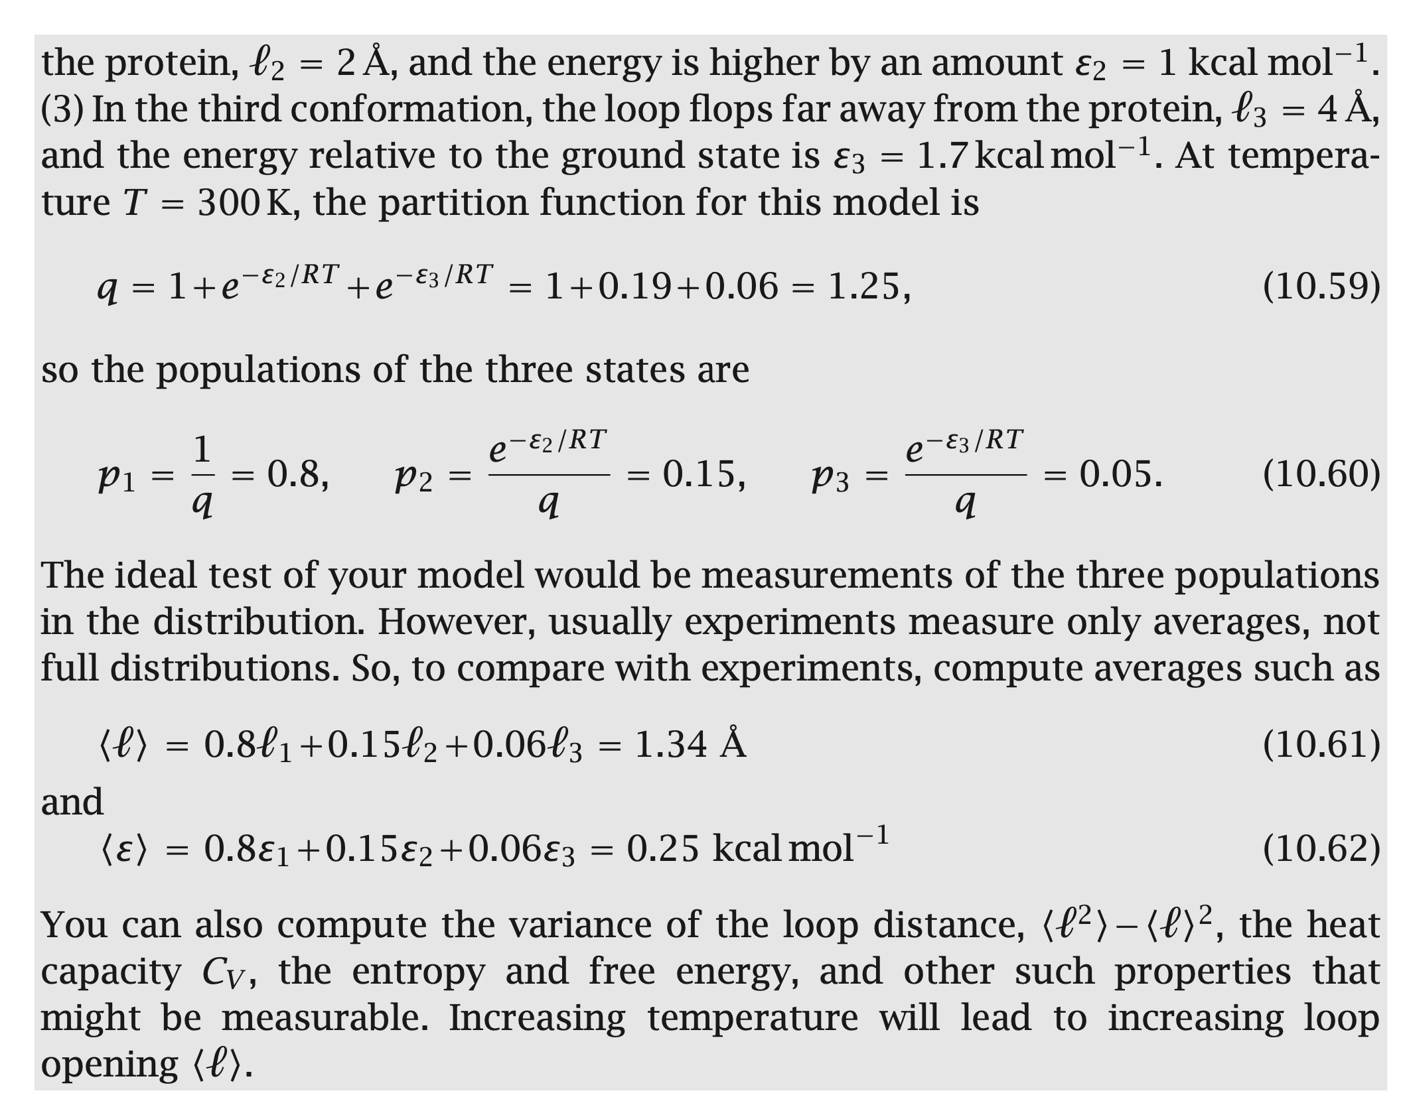
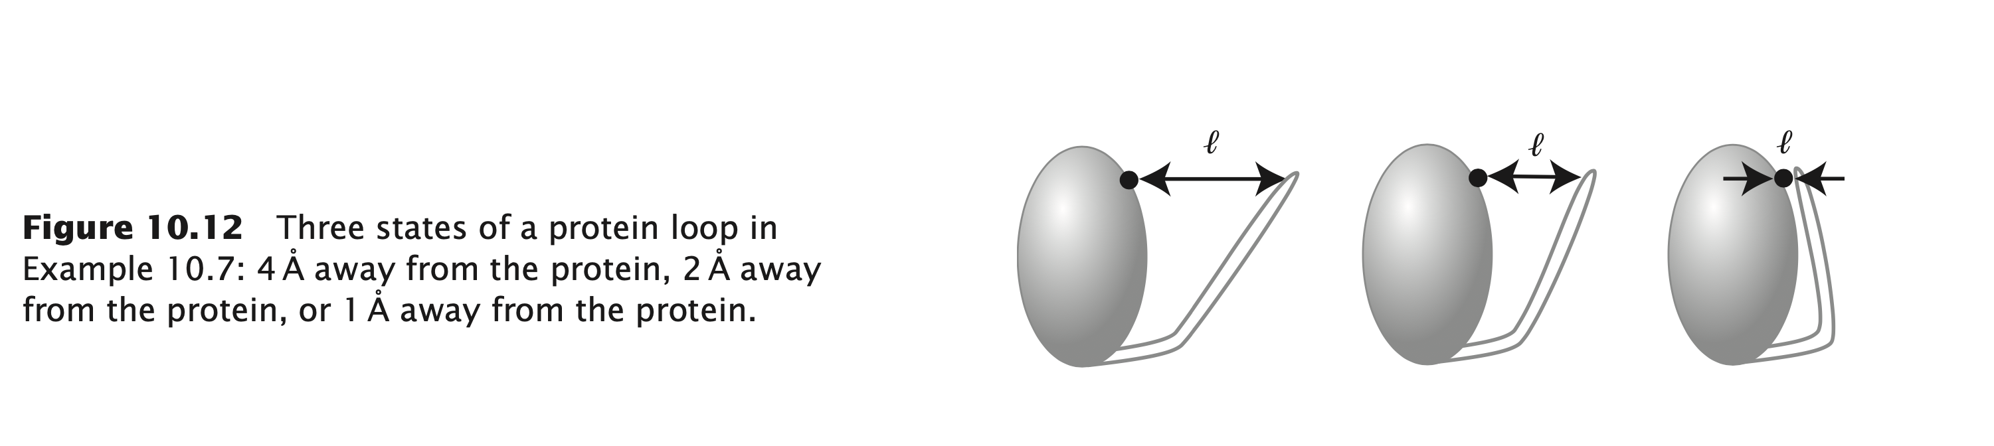

Slide 14
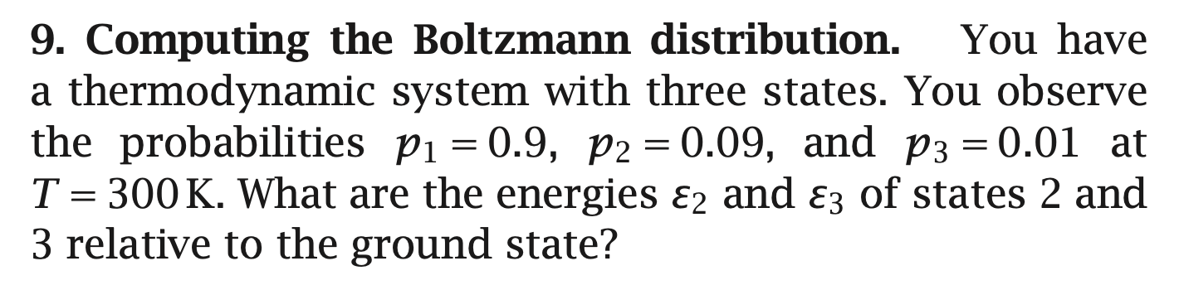
Quiz

Slide 15
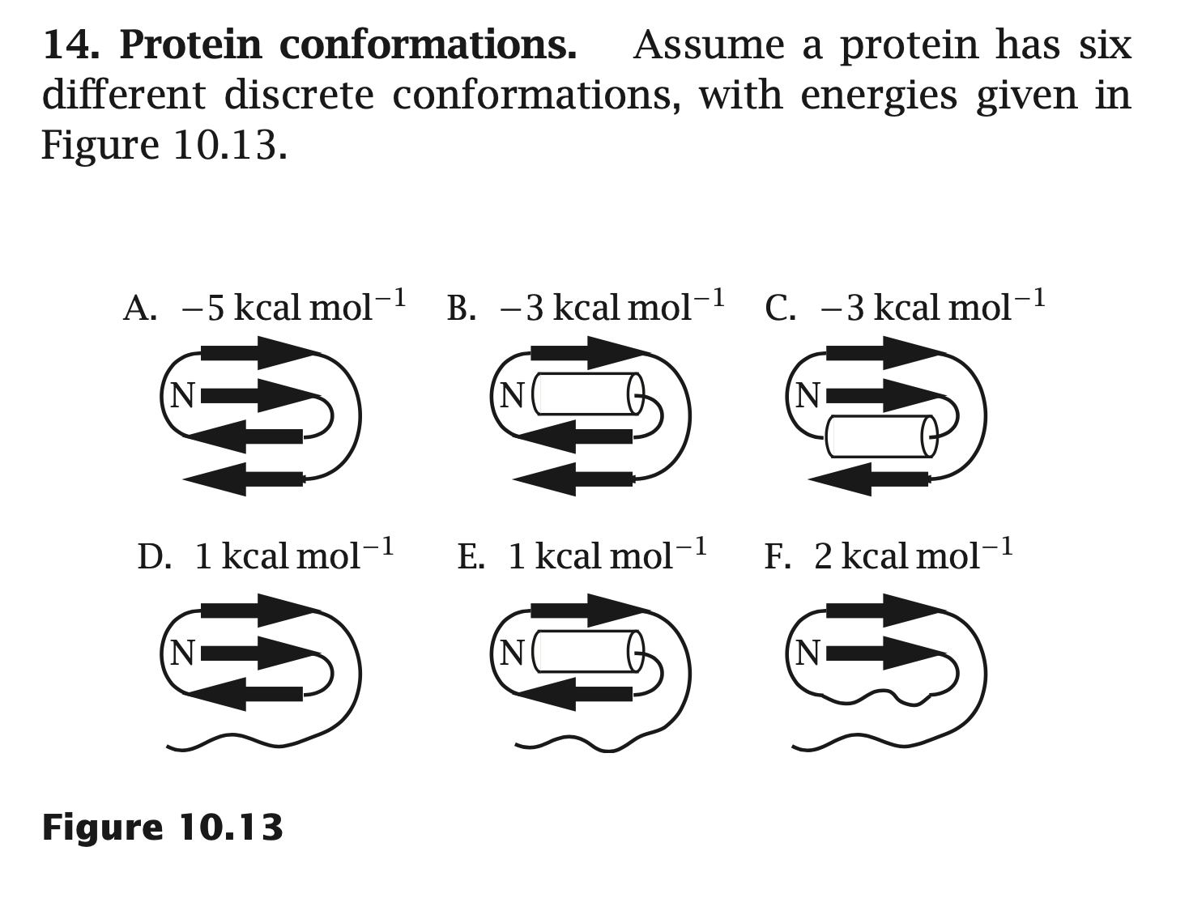
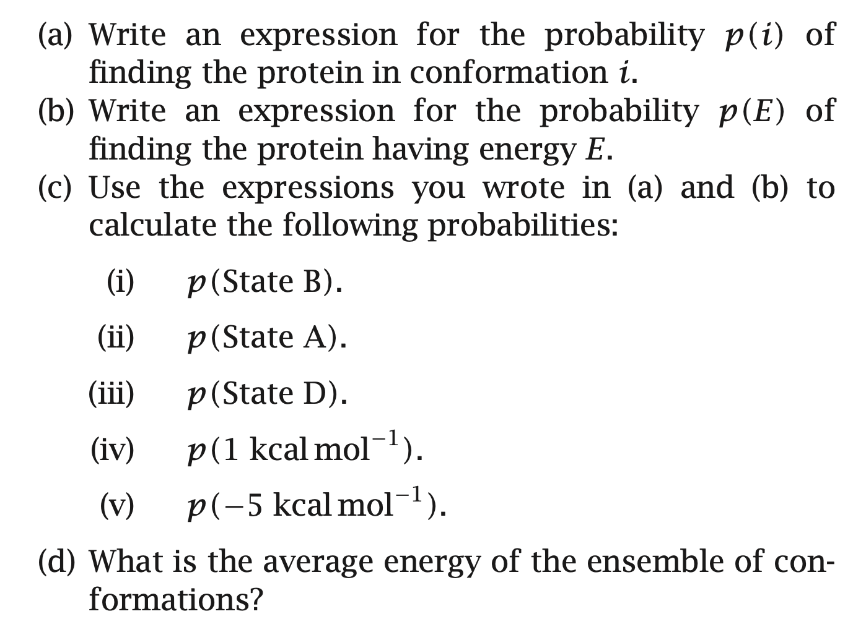

Slide 16
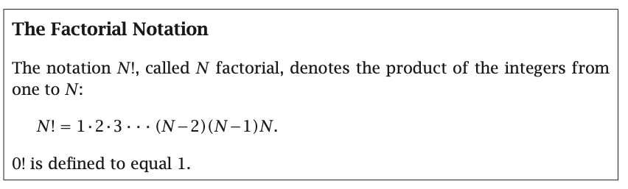
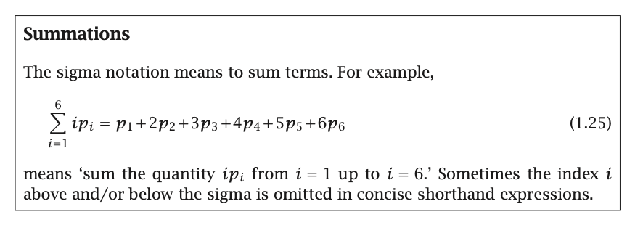

Slide 17
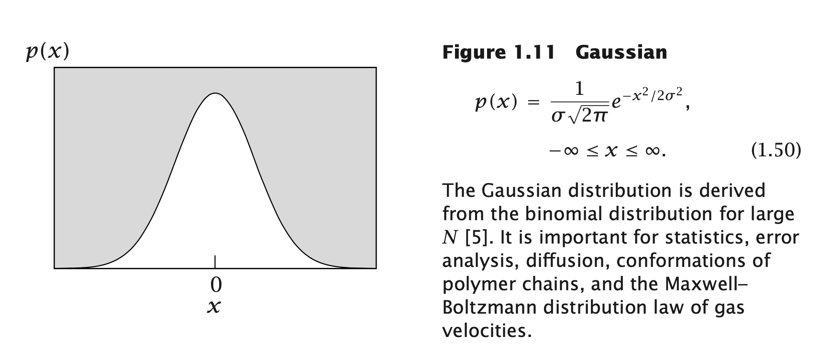

Slide 18
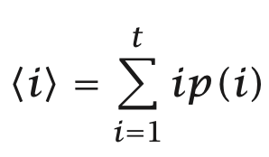
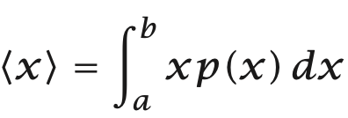
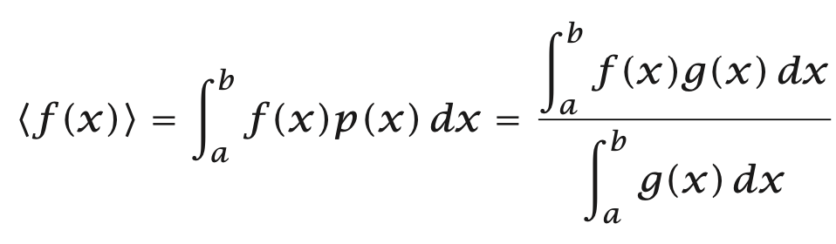
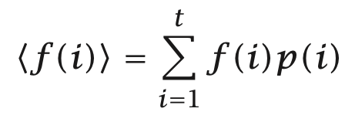
the mean, average, or expected value

Slide 19
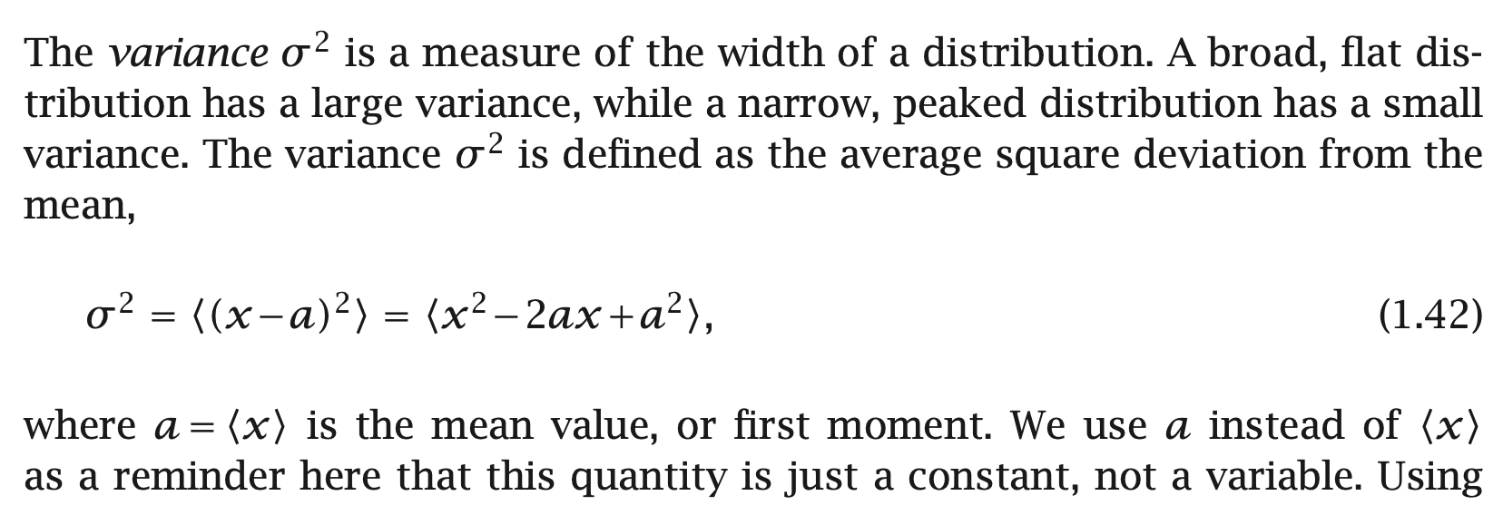

variance

