Slide 1
Chapter 2: Protein Folding

Slide 2
References
Book chapters:
Protein Physics, Chapter 17, 18, 19, 20, 21
Papers:
Anfinsen, C.B., Haber, E., Sela, M., White, F.H., 1961. Kinetics of formation of native ribonuclease during oxidation of the reduced polypeptide chain. Proc. Natl. Acad. Sci. U. S. A.
Anfinsen, C.B., 1973. Principles that govern the folding of protein chains. Science 181, 223–230.
Levinthal, C., 1968. Are there pathways for protein folding? J. Chim. Phys. Chim. Biol. 65, 44–45.
Levinthal, C., 1969. How to fold graciously. In: Debrunner, P., Tsibris, J.C.M., Munck, E. (Eds.),

Slide 3
Outline
Protein Basics
Thermodynamics of protein folding
Kinetics of protein folding

Slide 4
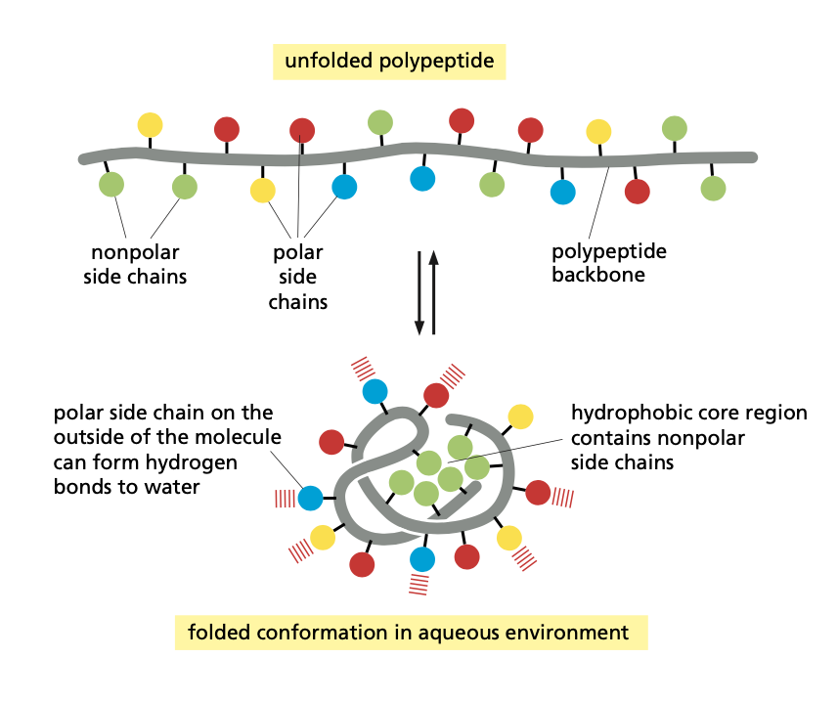
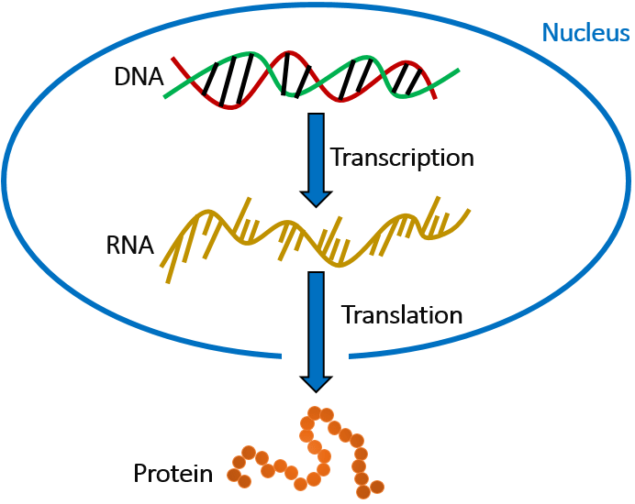
Protein Basics: What is a protein?
Protein biology
Protein physics

Slide 5
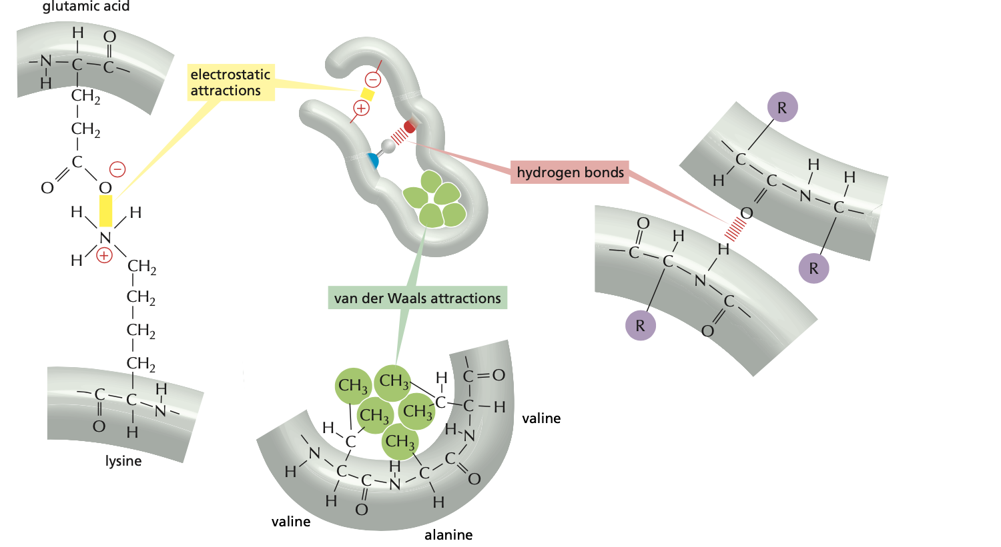
Protein Basics: What is a protein?
Protein physics
Forces
hydrogen bonds
van der Waals attractions
electrostatic attractions

Slide 6
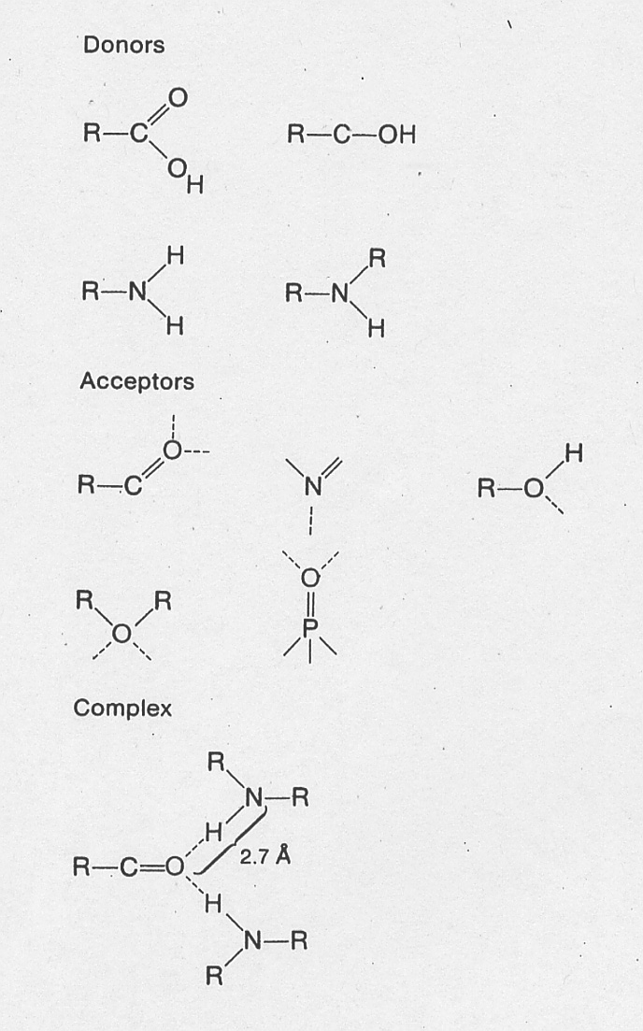
Forces: Hydrogen Bonds
Covalent bonds between hydrogen atoms and electronegative atoms can be quite polarized, with the hydrogen atom effectively having a significant positive partial charge. Because of their relatively small size, these positively polarized hydrogen atoms can interact strongly with electronegative atoms such as O and N.
  -D-H … A-
While thought to be primarily electrostatic in origin, this “Hydrogen bond” has some partial covalent properties, for example the distance between a hydrogen atom and an oxygen expected given the van der Waals radii of the atoms is ~2.6Å, while in a hydrogen bond the distance is usually ~1.8Å.
The angular dependence of the interaction is also quite strong: the angle between the three atoms involved in the hydrogen bond is usually close to 180 degrees.

Slide 7
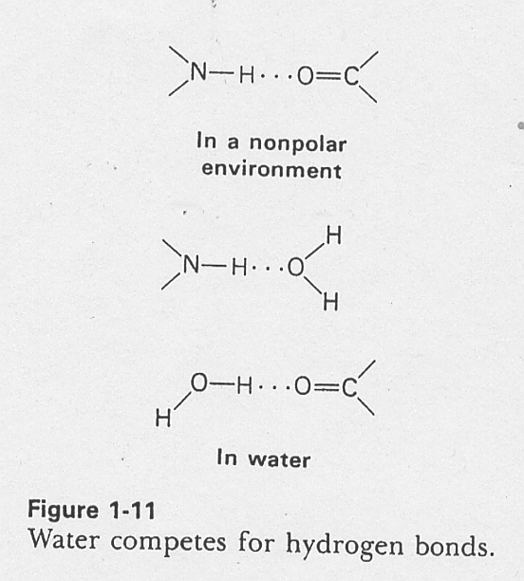
Hydrogen bonding is a critical feature of the structure of liquid water. Water molecules are extensively hydrogen bonded to one another, and these strong interactions account for the unusually high boiling point of water compared to other simple liquids and many of the other anomalous features of water.
The strengths of most hydrogen bonds are ~2-10kcal/mol. However, in most of the applications we will be interested, there is little net change in the number of hydrogen bonds since solvent exposed polar atoms in proteins generally make hydrogen bonds with water, and formation of hydrogen bonds within a protein molecule requires breaking these interactions with water. The free energies associated with these exchanges of hydrogen bonding partners are considerably smaller than the cost of burying a hydrogen bonding donor or acceptor such that it cannot make intra-molecular hydrogen bonds.
Forces: Hydrogen Bonds

Slide 8
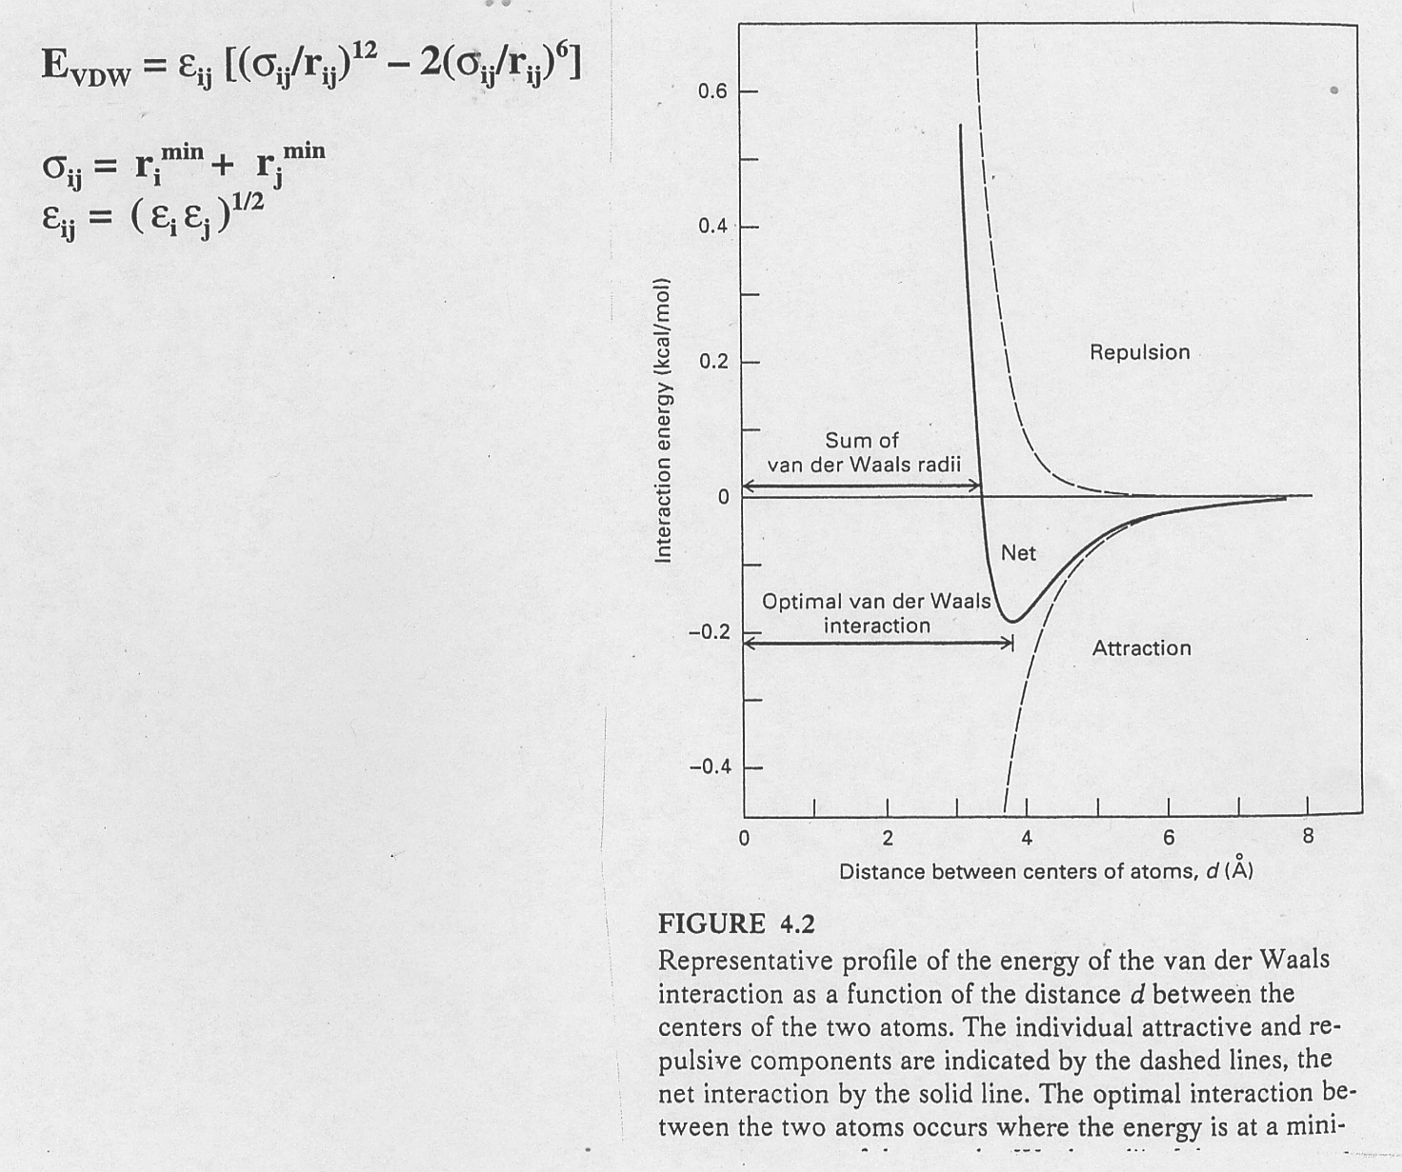
Forces: van der Waals attractions
Although individually weak (order of 0.2kcal/mol) a given atom may interact with many other atoms in a molecule.
Lennard Jones potential (The 6-12 potential)

Slide 9
Here is a typical set of parameters for the atoms in proteins; the values needed in the 6-12 potential are obtained from these parameters using the formulas on the previous page.
Forces: van der Waals attractions
Atom symbol | ε_{i} in kcal/mol | r_{i} in A | Group represented
C | 0.12 | 2.1 | carbonyl carbon
H | 0.05 | 0.8 | polar hydrogen
N | 0.24 | 1.6 | nitrogen
O | 0.16 | 1.6 | carbonyl oxygen

Slide 10
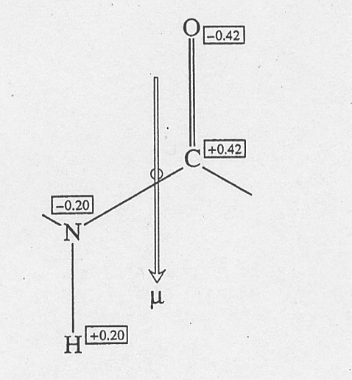
Forces: electrostatic attractions
  Coulomb’s law (1785): E = k *q1* q2/ (ε r)
    The charges q1 and q2 are in units in which the electron has a charge of –1, r is in Angstroms and E in kcal/mol. With these units, the conversion factor k is 332 (kcal/mol) Å/e2. ε is the dielectric constant of the medium.
  For example, the interaction energy between an Na+ and Cl- separated by 3Å is ~110kcal/mol.
  Note that the interaction energy falls off like 1/r (much less rapidly than vdW interactions) and hence there can be quite long range effects: in a vacuum, interaction energy between two ions separated by 50nm is still greater than RT. May influence rate of protein-protein association (electrostatic steering) and catalysis.
  In proteins, have many polar groups which are overall neutral but have significant dipole moments due to differences in the electro-negativities of their constituent atoms (carboxyl groups, amide groups, aromatic rings). Charge-dipole interactions fall off like 1/r2, dipole-dipole interactions, like 1/r3.

Slide 11
Protein Basics: What is a protein?
Protein physics
Forces
Force field potential (energy)
“Interactions”
hydrogen bonds
van der Waals attractions
electrostatic attractions

Slide 12
Outline
Protein Basics
Thermodynamics of protein folding
Kinetics of protein folding

Slide 13
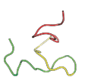
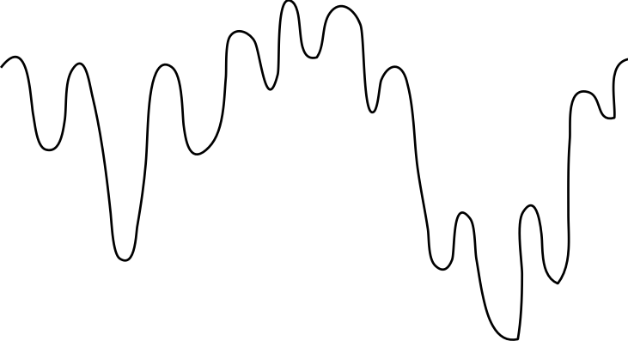
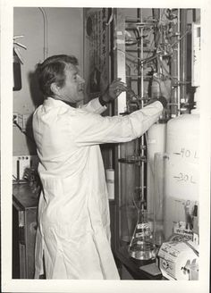
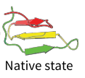
The thermodynamic hypothesis for protein folding
Anfinsen’s Dogma
Reversible protein folding/unfolding in a test tube
For a given protein sequence:
"The native conformation is determined by the totality of interatomic interactions and hence by the amino acid sequence, in a given environment."
Unfolded
Energy
Anfinsen, C. (1973). Science
Principles that govern the folding of protein chains.
Christian B. Anfinsen
(1916-1995)
Nobel Prize in Chemistry
1972
Native state
(Folded)
Conformational space

Slide 14
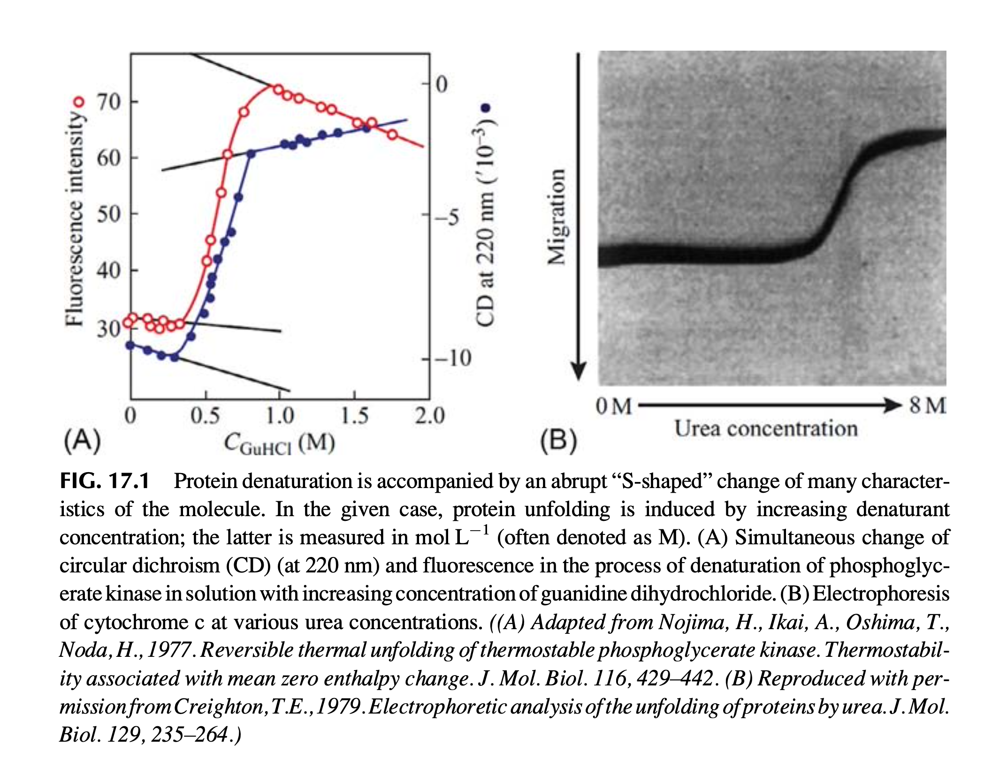
Protein unfolding is a cooperative process with an “S-shaped” transition.

Slide 15
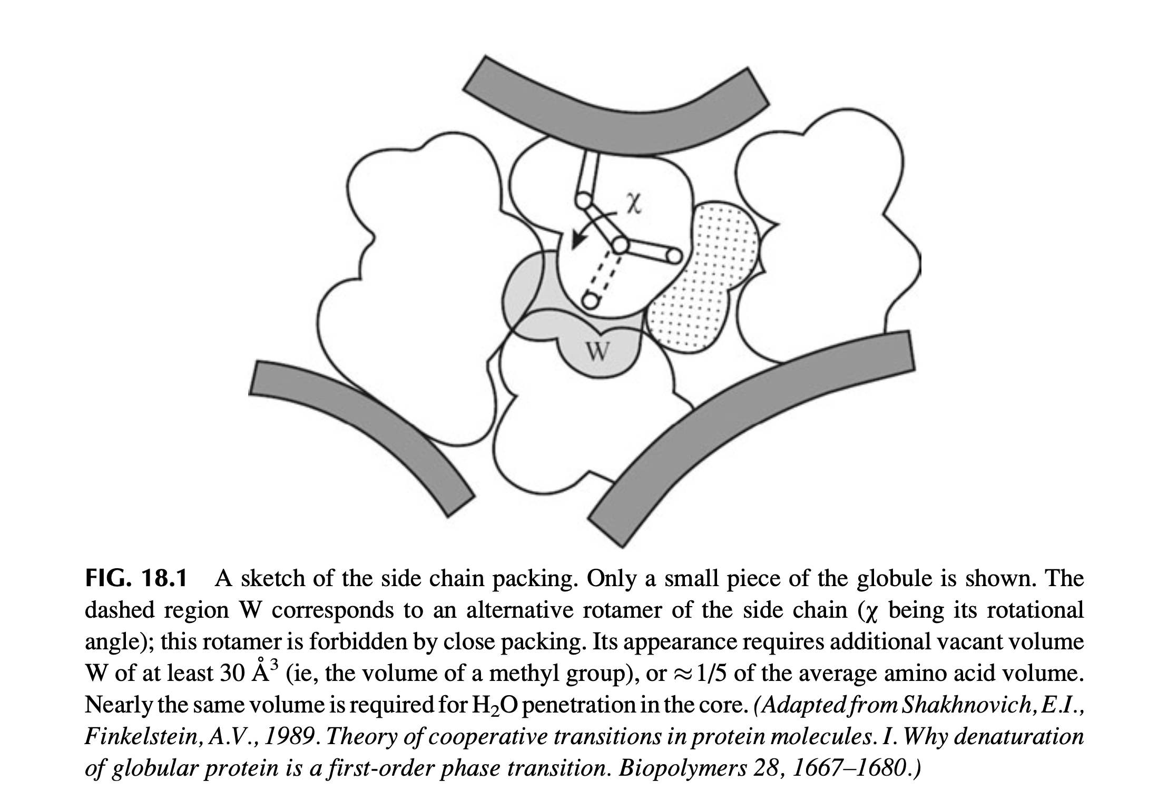
Protein core is tightly packed like a solid crystal

Slide 16
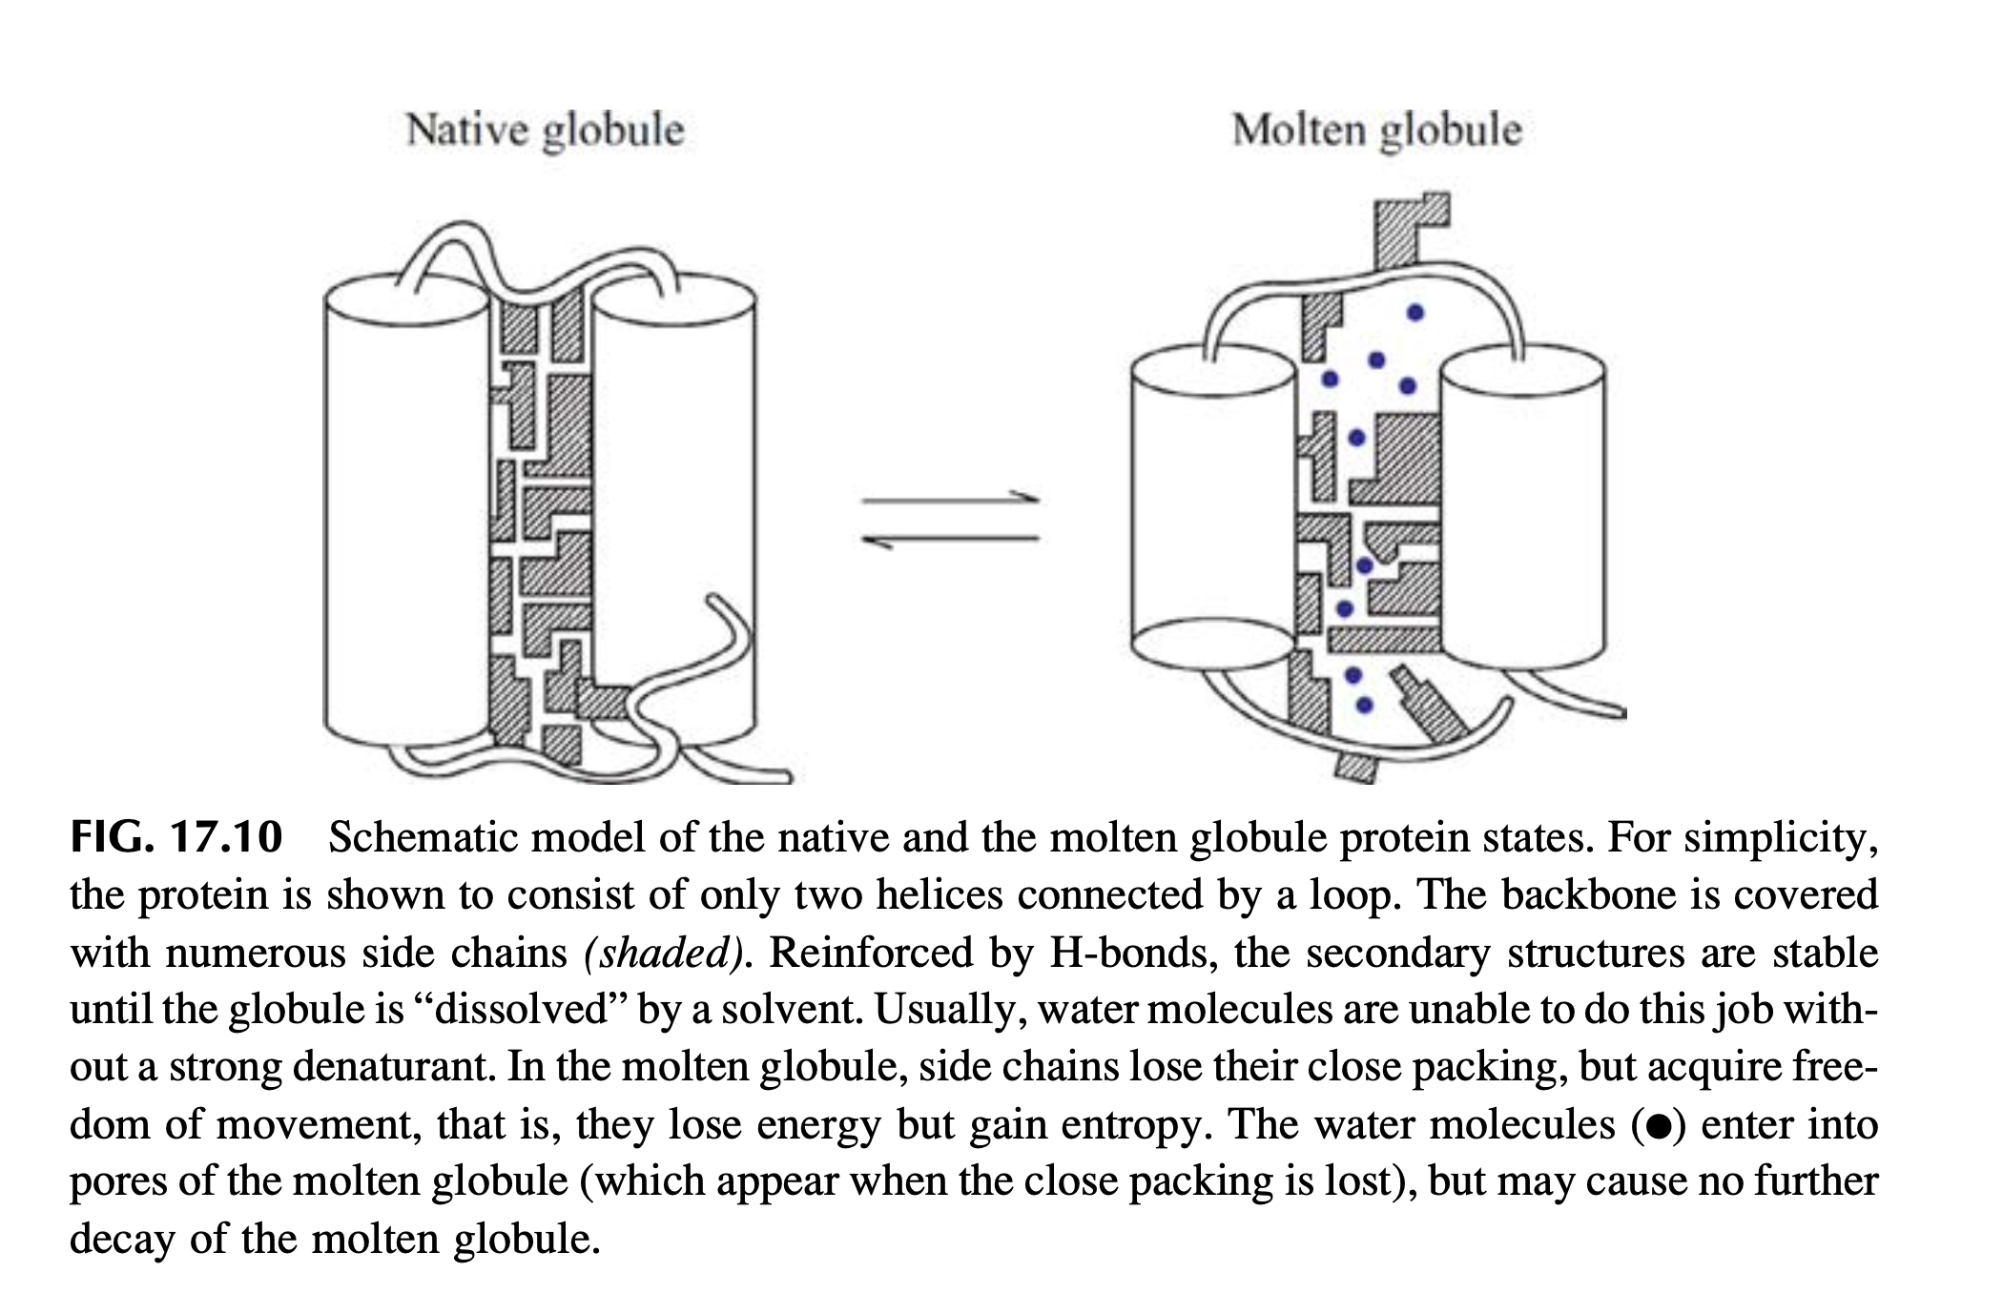
Protein becomes molten globule when its core becomes fluid

Slide 17
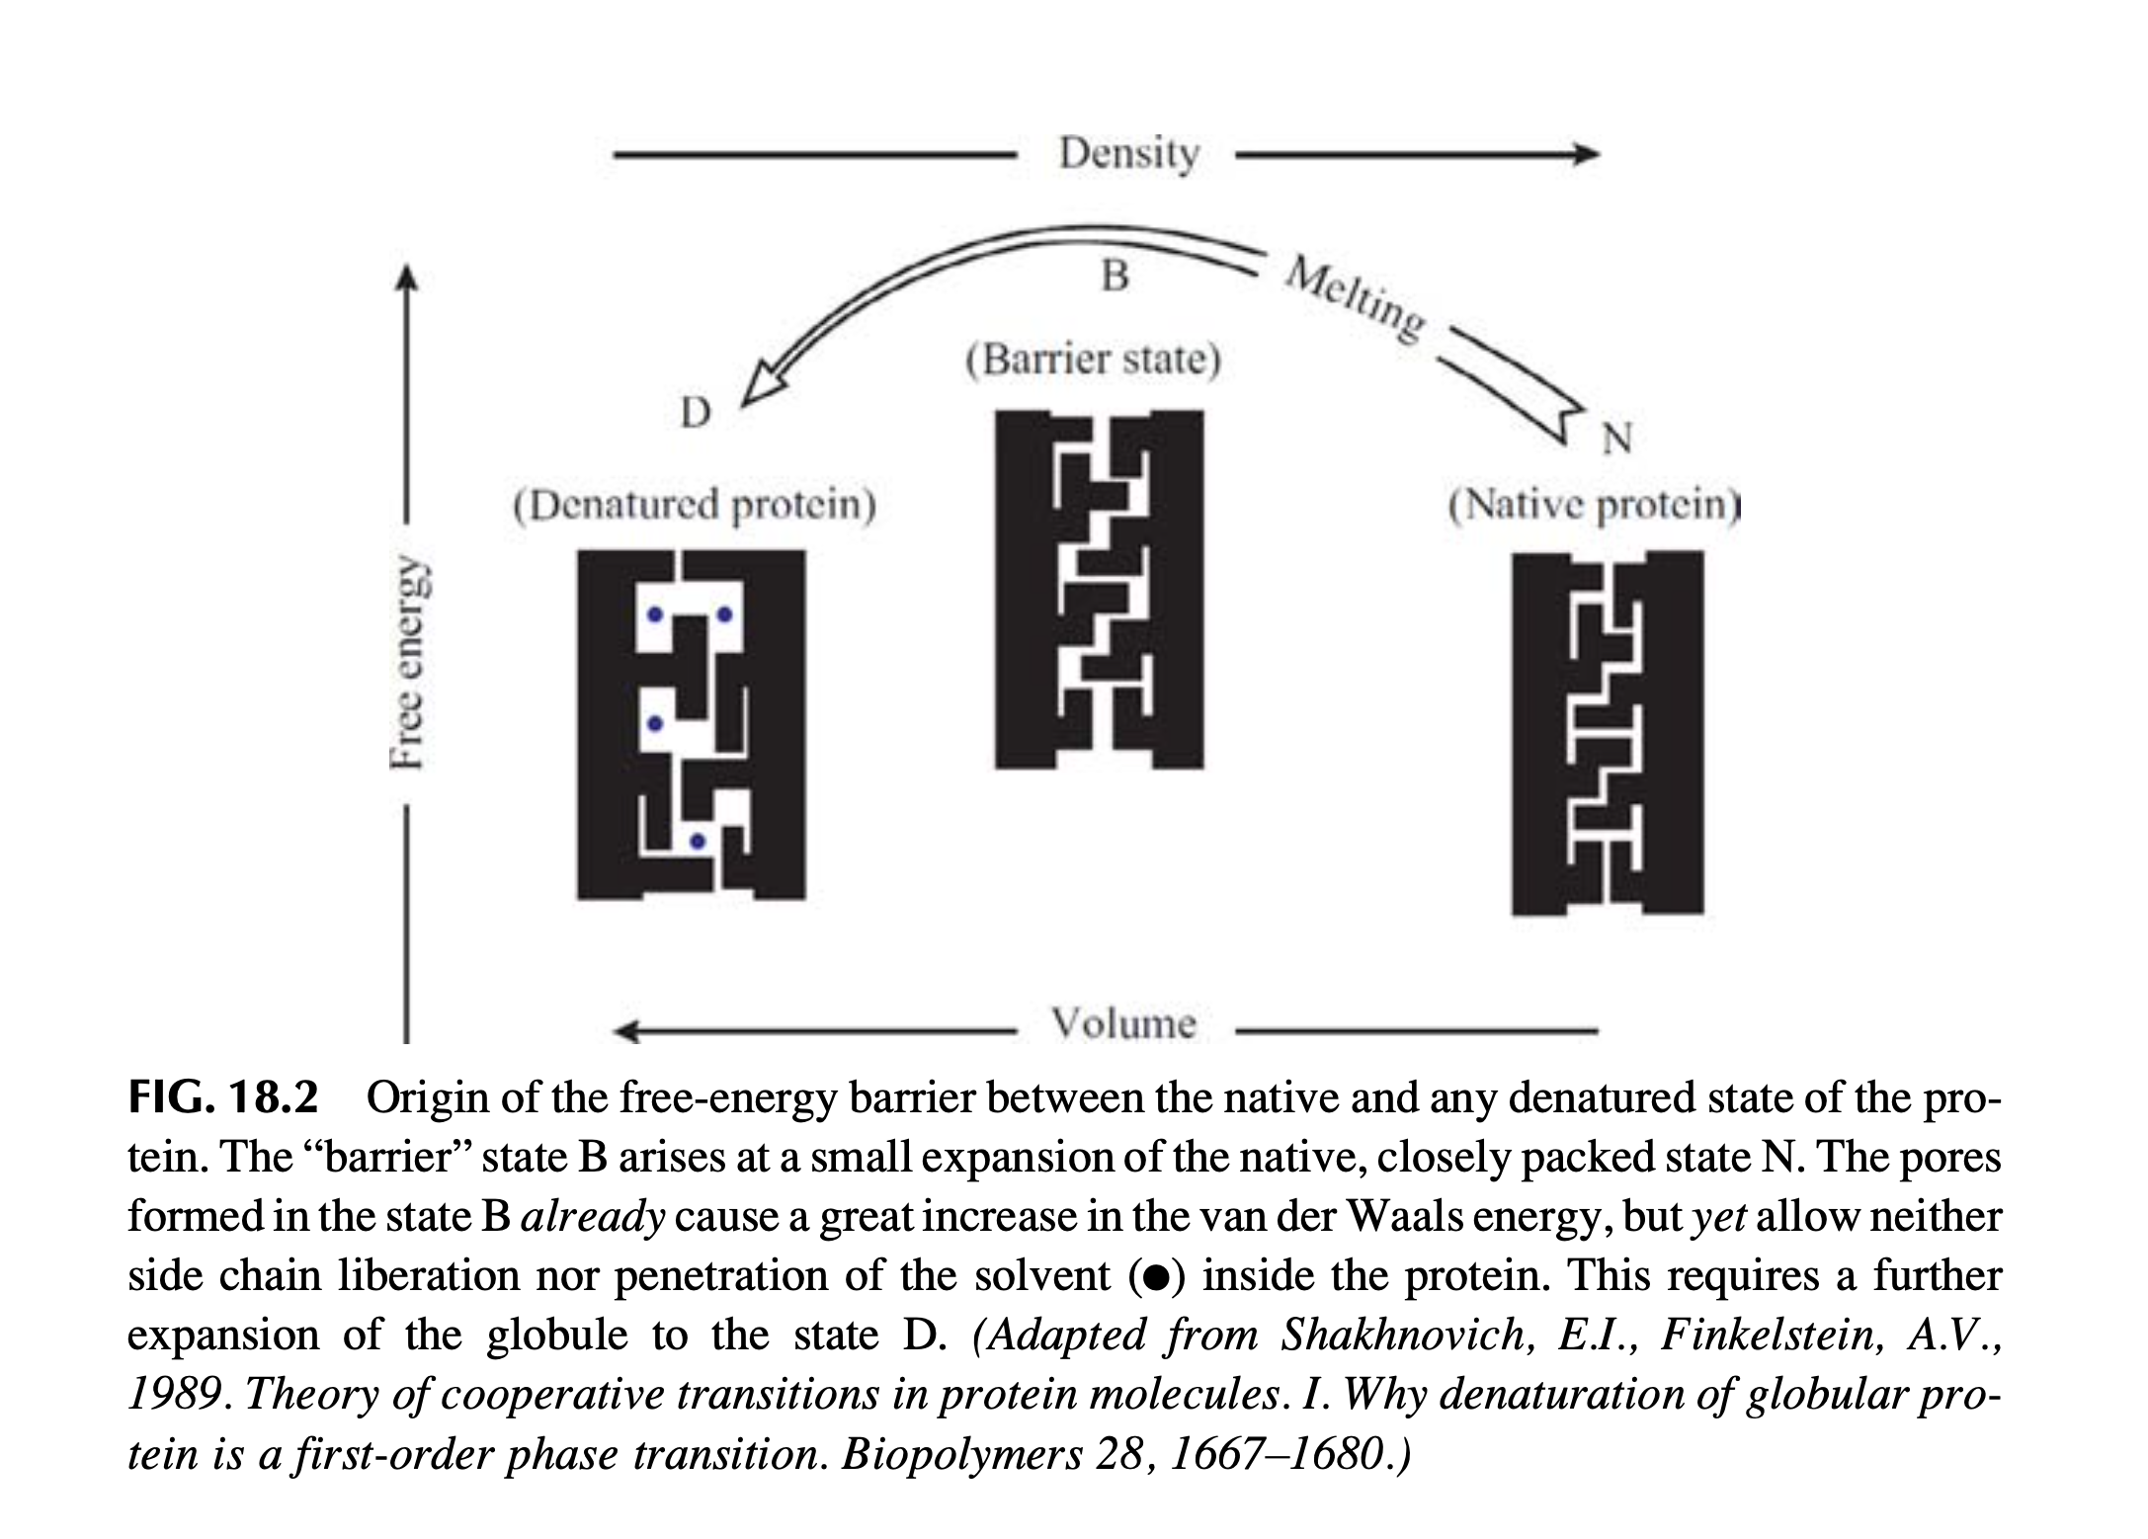
Protein unfolding approximates first-order phase transition

Slide 18
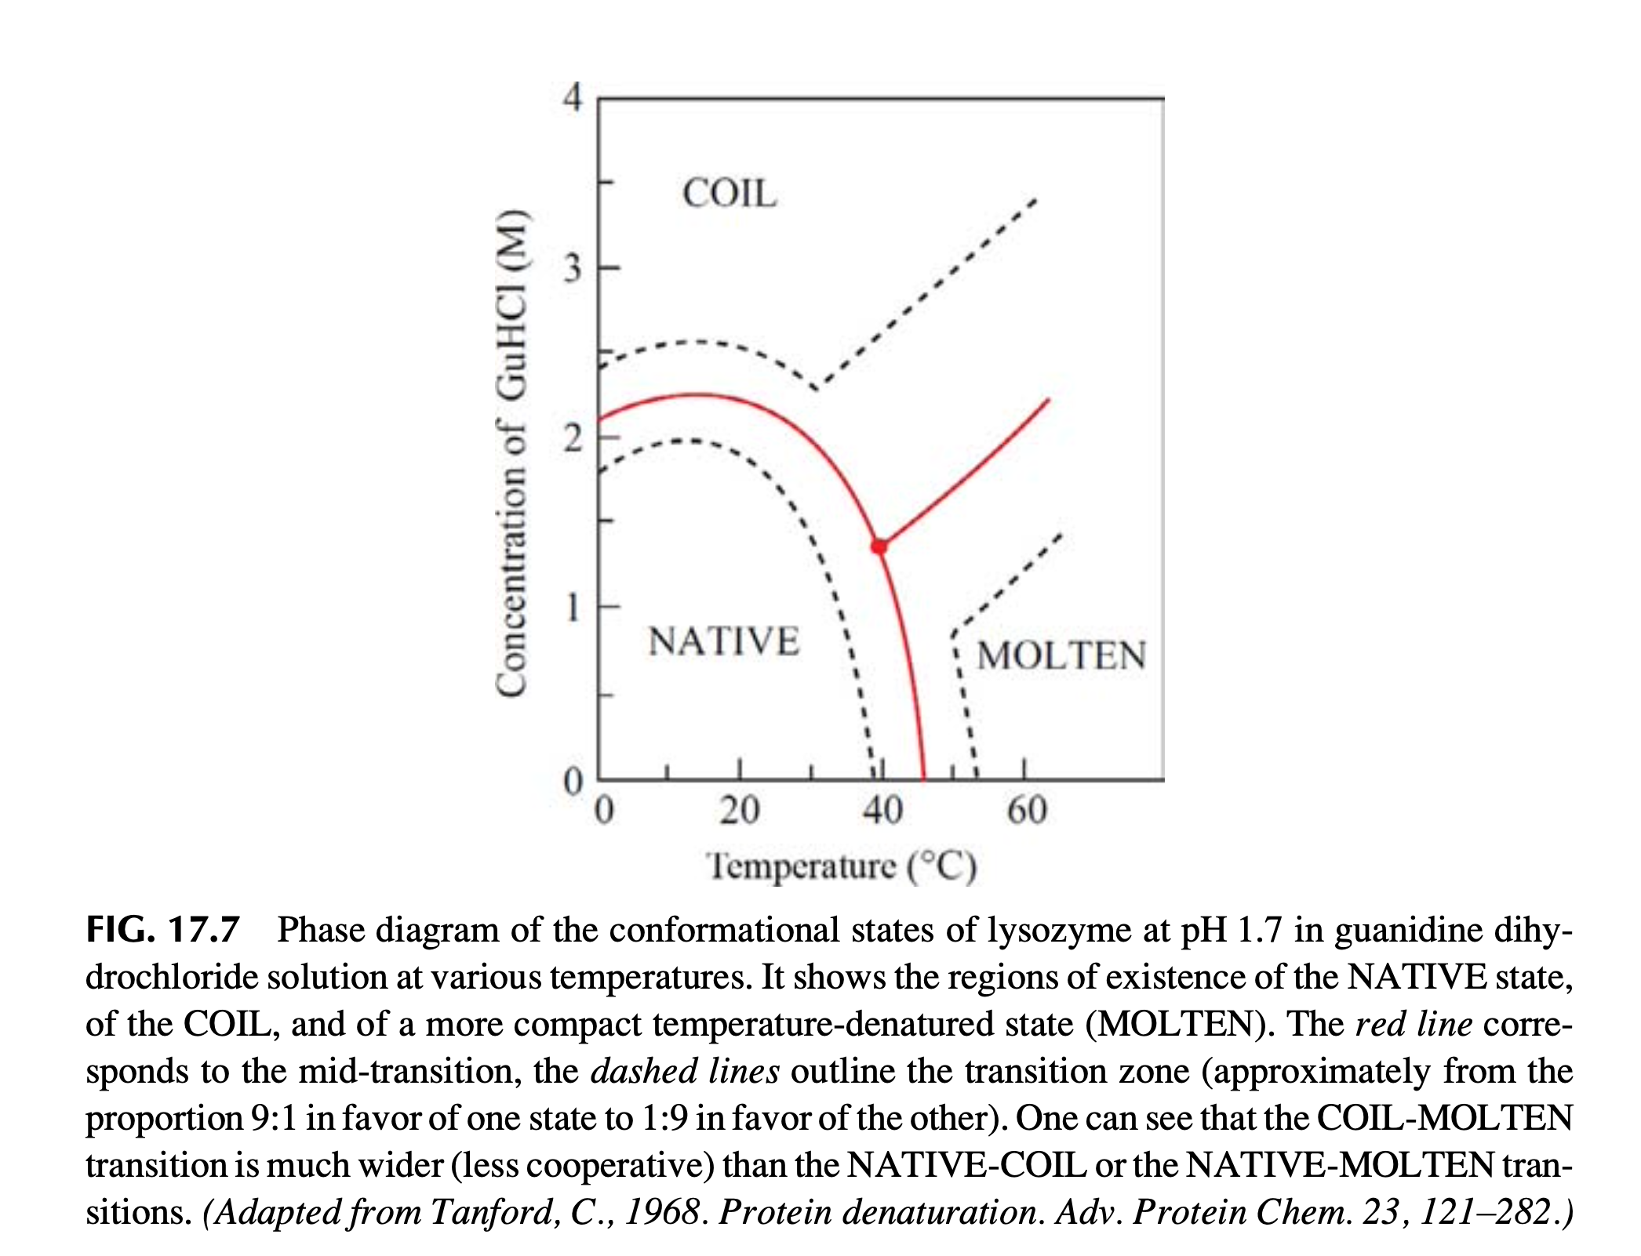
Protein unfolding approximates first-order phase transition
Phase diagram

Slide 19
Protein unfolding is a cooperative process with an “S-shaped” transition.
Protein unfolding does not occur gradually but as a jump over the free energy barrier.
Therefore, the protein tolerates the modification of ambient conditions up to a certain limits, and then melts altogether, like a macroscopic solid body.
This “all-or-none” transition between the native and denatured state is explained by a sudden jump in entropy which occurs only when the globule’s expansion crosses a certain threshold.

Slide 20
Protein conformational space: conformations and energy states
For a given heteropolymer, there are N physically possible conformations (3D structure/configuration).
Each conformation has a measurable E (the forces).
We catalog all the conformations according to their values of E. Those conformations with the same E form an energy state.
Each energy state can have multiple possible conformations, characterized by the conformational entropy S.
We describe a molecule’s conformational space by its energy states.
In statistical mechanics, energy states are macrostates, and those conformations in the same energy state are microstates.

Slide 21
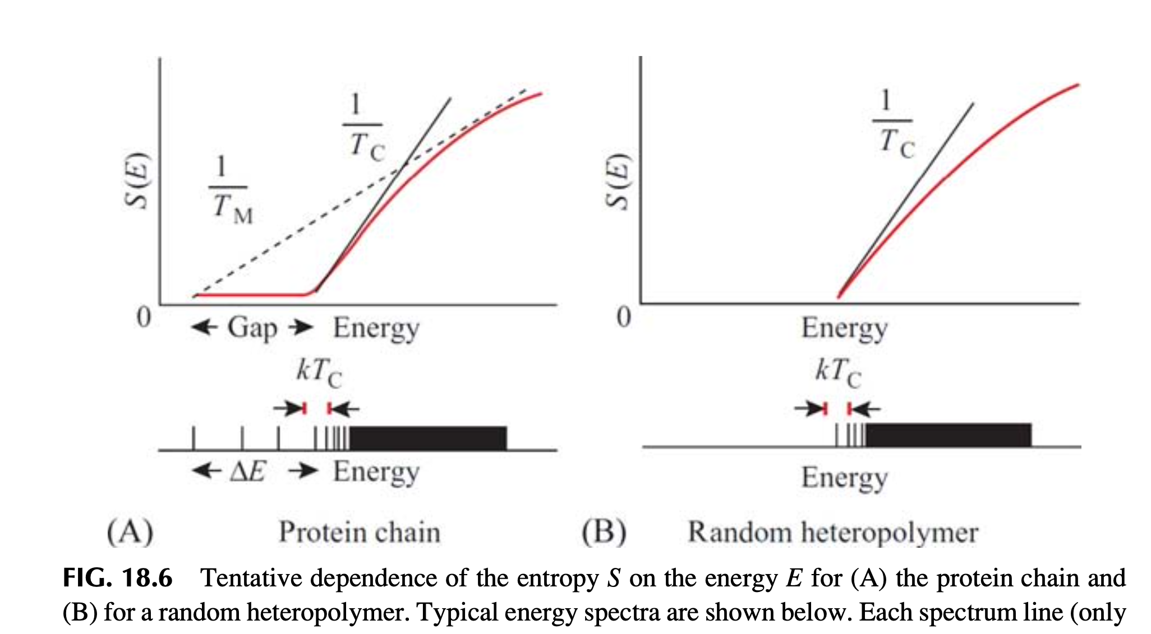
... A sudden jump in entropy?
dS(E)/dE = 1/T(E)
protein energy spectrum
low
high

Slide 22
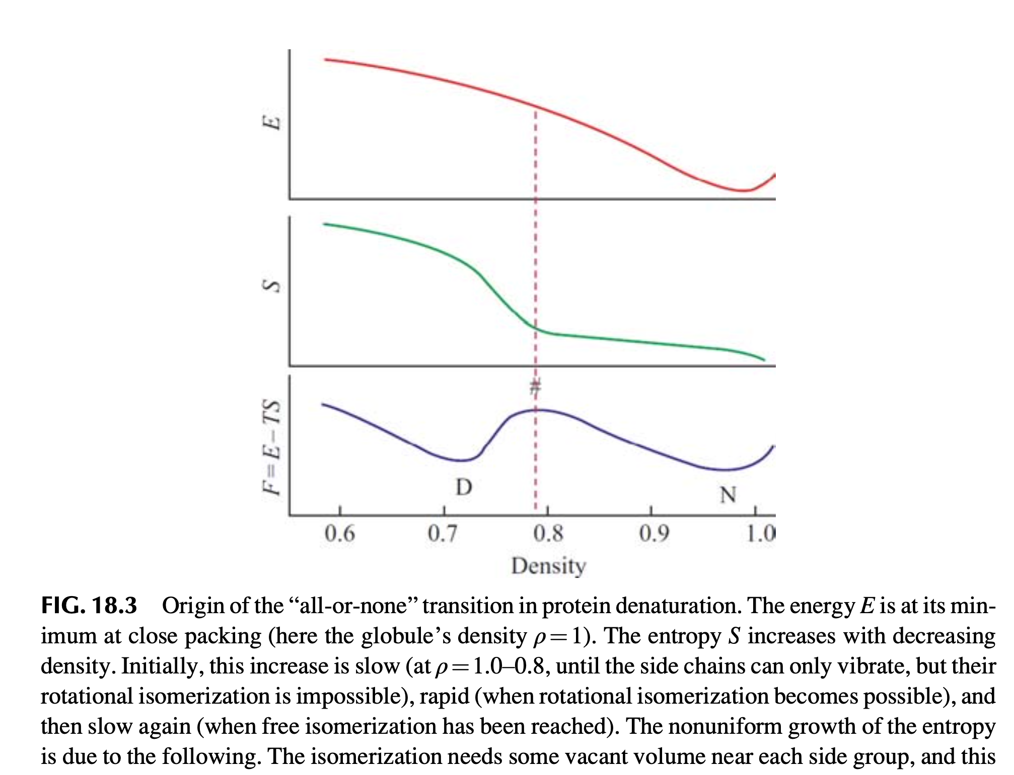
... A sudden jump in entropy?
E: force field potential
~ interacting energy
~ enthalpy
S: conformational entropy
Notes:
Molten globule: the intrachain interactions are much weaker and the chain motility if much higher.
The liberation of these fluctuations that make the MG thermodynamically advantageous.

Slide 23
Which physical property distinguishes the protein from a random heteropolymer?

Slide 24
Which physical property distinguishes the protein from a random heteropolymer?
The “all-or-none” protein melting needs a sufficiently broad energy gap between the lowest-energy fold and the bulk of “misfolded” structure.
The distinctive feature of a protein energy spectrum is the large energy gap between the energy of the most stable and the region where the energies of many other “denatured” structures.
The energy gap is fundamental for protein physics. Without it, a heteropolymer won’t be able to tolerate any change of ambient conditions.

Slide 25
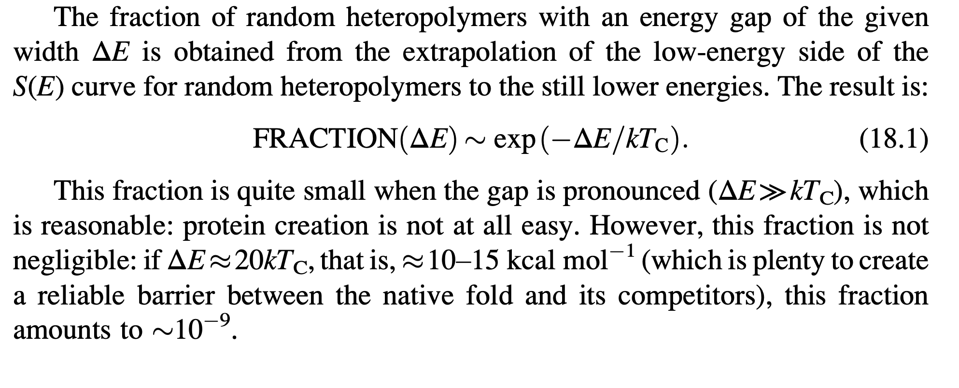
The fraction of random heteropolymers with an energy gap ΔE
T_{c}= 37 Celsius, 310.15 Kelvin
k = 1.38 X 10⁻²³ m²kg s⁻² K⁻¹
Natural or laboratory evolution works according to physics !
Notes:
Recall Boltzmann Distribution

Slide 26
Outline
Protein Basics
Thermodynamics of protein folding
Kinetics of protein folding
Notes:
What does it mean to solve the protein folding problem? A comprehensive solution should not only predict the most stable protein structure, it should also describe energy landscape to some degree that can further explains the protein function. But nevertheless, it’s already super hard to just figure out the most stable structure regardless of the local or global landscape. Structure prediction is focused on solving this first step.
The first stru was solved in 1960

Slide 27
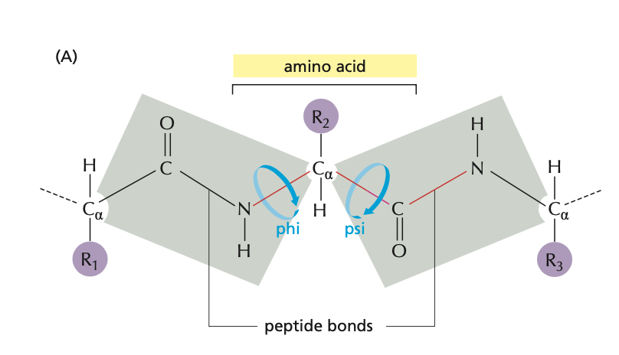

Protein folding kinetics: How to fold graciously?
Levinthal’s Paradox
“….in a protein structure containing 150 amino acids, for example…… Even if we knew these angles to better than a tenth of a radian, there would be 10³⁰⁰ possible configurations in our theoretical protein. “
Cyrus Levinthal: How to fold graciously
Each amino acid takes 10 possible phi angles and 10 possible psi angles
Total number of possible combinations of different phi and psi for 150-aa peptide: 10³⁰⁰
Dihedral angles: angles between two planes
Notes:
What does it mean to solve the protein folding problem? A comprehensive solution should not only predict the most stable protein structure, it should also describe energy landscape to some degree that can further explains the protein function. But nevertheless, it’s already super hard to just figure out the most stable structure regardless of the local or global landscape. Structure prediction is focused on solving this first step.
The first stru was solved in 1960

Slide 28
Protein folding kinetics: How to fold graciously?
Levinthal’s Paradox
“….in a protein structure containing 150 amino acids, for example…… Even if we knew these angles to better than a tenth of a radian, there would be 10³⁰⁰ possible configurations in our theoretical protein. “
Cyrus Levinthal: How to fold graciously
Levinthal’s answer:
It seems that the protein folding follows some specific pathway, and the native fold is simply the end of this pathway, no matter if it is the most stable chain fold or not.
In other words, Levinthal suggested that the native protein structure is determined by kinetics and corresponds to the easily accessible local rather than the global free energy minimum.

Slide 29
Is a protein’s folded structure controlled by kinetics or thermodynamics?
In predicting a protein’s structure from its sequence, what should we look for? the lowest-energy structure or the most rapidly folding structure?
In designing a protein, should we maximize the ΔE of the structure or create a rapid pathway to the final structure?
Maybe, the “lowest-energy” structure automatically forms a focus for the “most rapidly” folding pathways, and therefore it is automatically capable of fast folding?

Slide 30
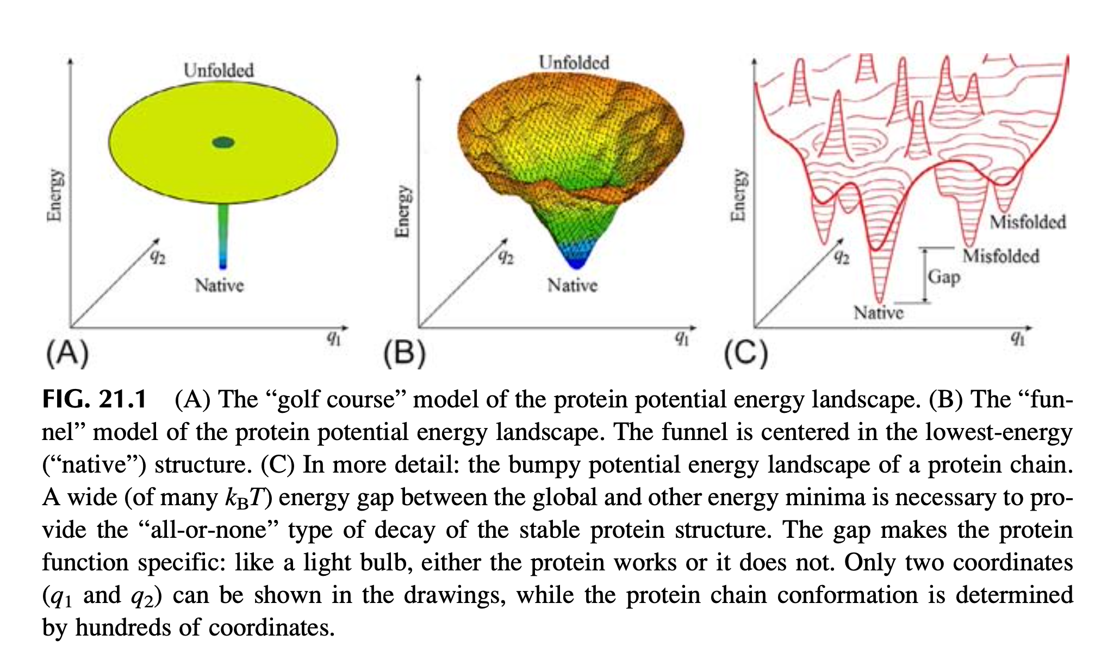
Thermodynamics suggested a funnel-like energy landscape
Conformational space
Notes:
The concept of energy landscape
to fit into the thermodynamic observations

Slide 31
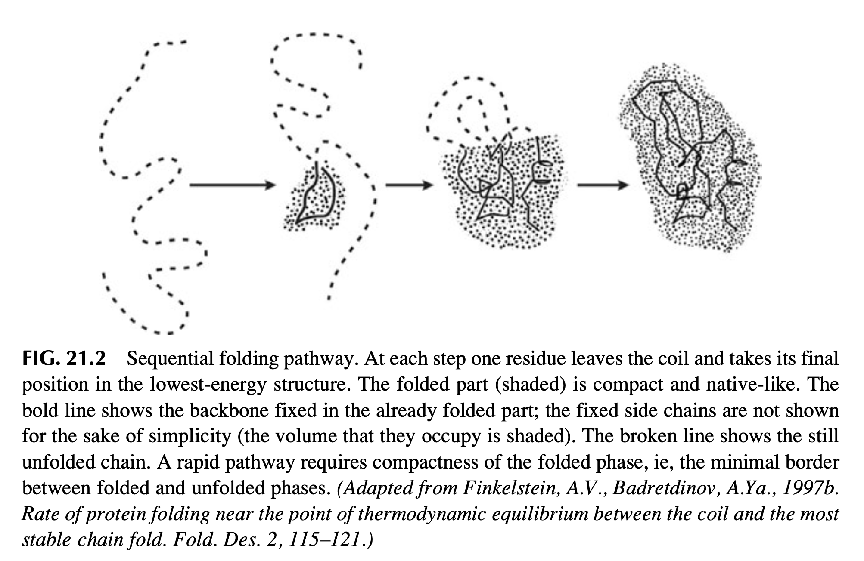
Can a protein find its lowest-energy structure within a reasonable time?
Notes:
Phase diagram is a graphical representation of the physical states of a substance under different conditions of temperature and pressure.

Slide 32
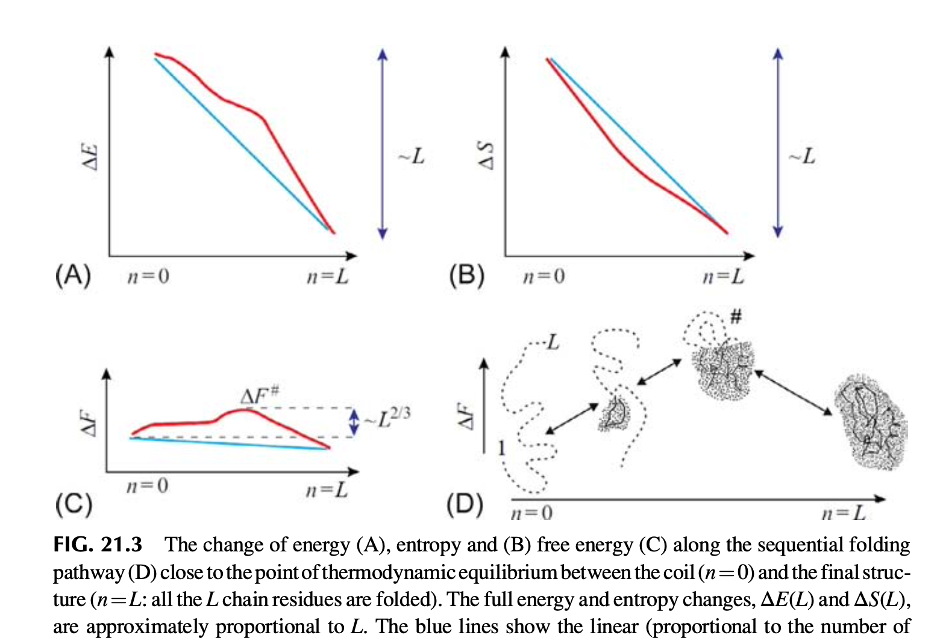
Can a protein find its lowest-energy structure within a reasonable time?
ΔF = ΔE - T *ΔS
Notes:
Phase diagram is a graphical representation of the physical states of a substance under different conditions of temperature and pressure.

Slide 33
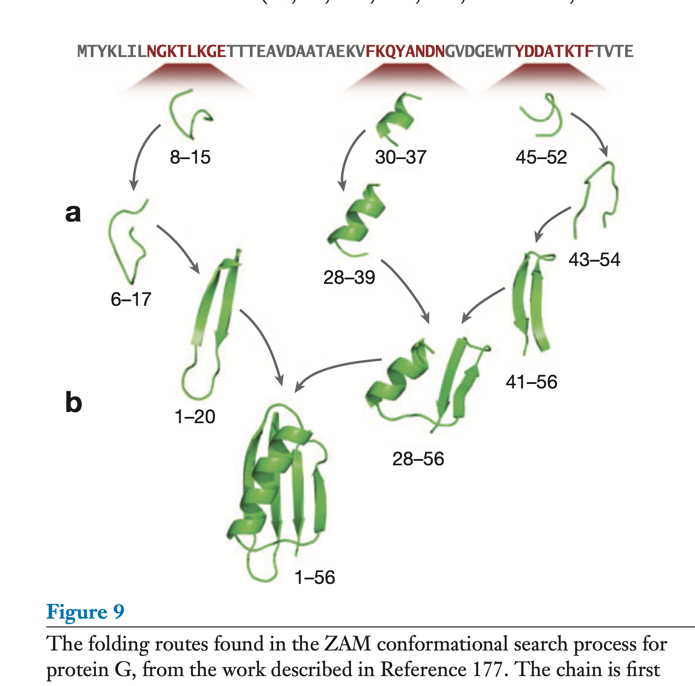
Can a protein find its lowest-energy structure within a reasonable time?

Slide 34
Can a protein find its lowest-energy structure within a reasonable time?
When moving along these pathways to the energy minimum, the protein gains energy but loses entropy. Its structure become more compact and more fixed.
The deeper the energy minimum, the greater the energy gain and the easier to overcome the “entropic resistance”.
Levinthal’s paradox can be avoided if there is a folding pathway where the entropy decrease is immediately or nearly immediately compensated for by the energy decrease.
Notes:
Phase diagram is a graphical representation of the physical states of a substance under different conditions of temperature and pressure.

Slide 35
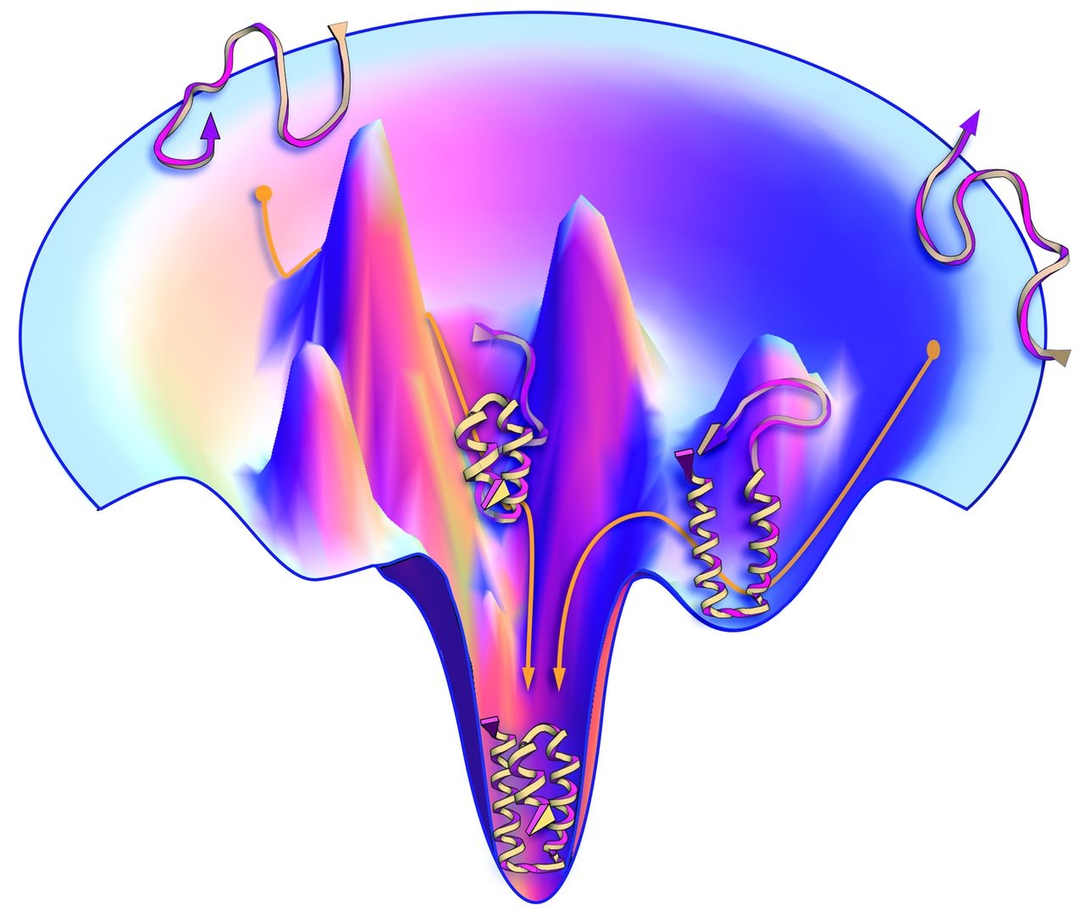
Summary
Protein Basics
Thermodynamics of protein folding
Kinetics of protein folding
hydrogen bonds
van der Waals attractions
electrostatic attractions
Notes:
What does it mean to solve the protein folding problem? A comprehensive solution should not only predict the most stable protein structure, it should also describe energy landscape to some degree that can further explains the protein function. But nevertheless, it’s already super hard to just figure out the most stable structure regardless of the local or global landscape. Structure prediction is focused on solving this first step.
The first stru was solved in 1960

Slide 36
The defining feature of “protein-like” heteropolymers
The existence of a large energy gap between the folded and the unfolded conformations.
Protein folding has the typical physical characteristics associated with a complex process obeying the laws of statistical physics.

Slide 37

Protein folding simulation in a computer

Slide 39
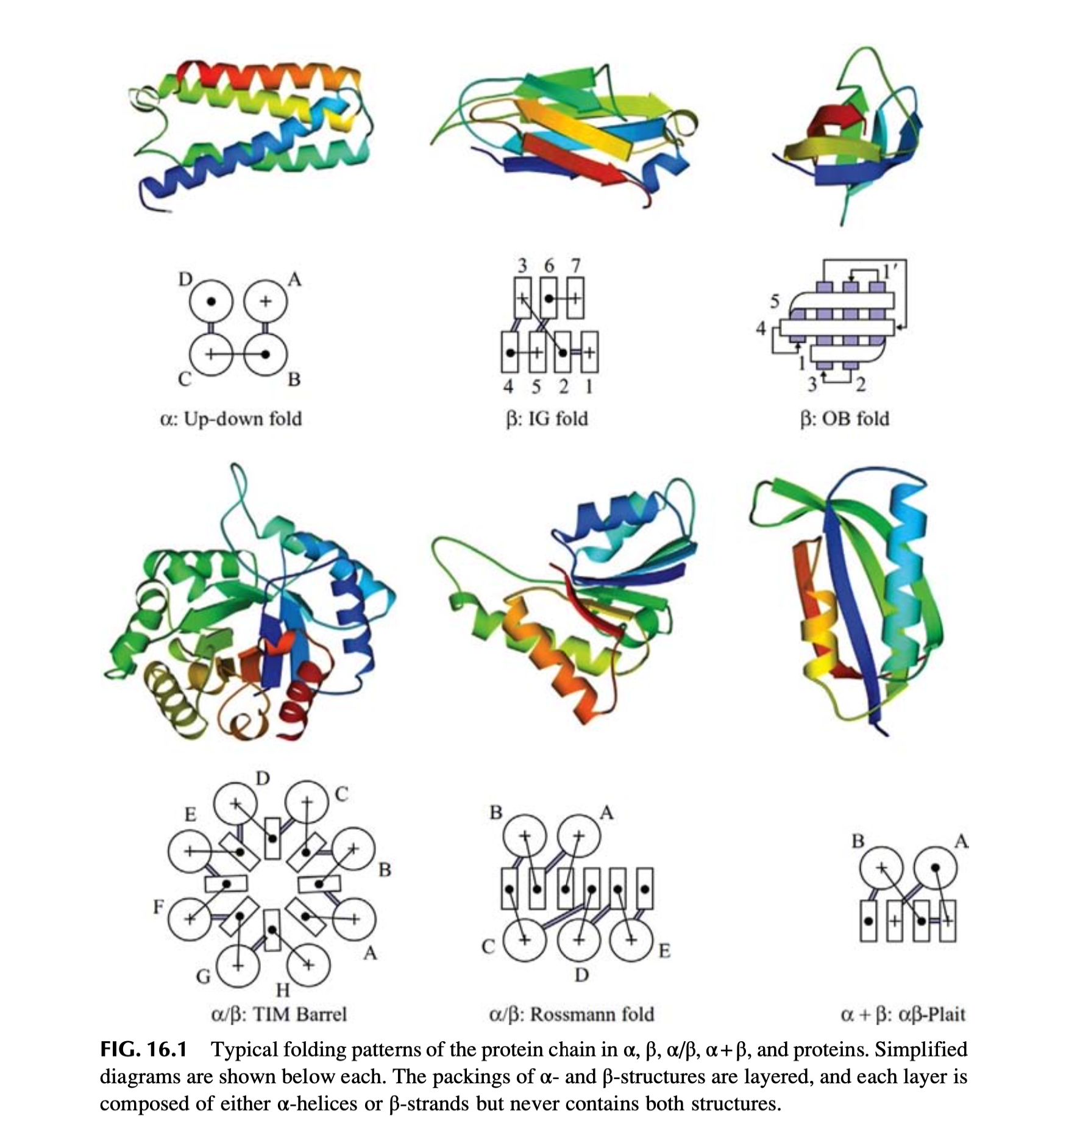
Protein Basics: What is a protein?
Notes:
What does it mean to solve the protein folding problem? A comprehensive solution should not only predict the most stable protein structure, it should also describe energy landscape to some degree that can further explains the protein function. But nevertheless, it’s already super hard to just figure out the most stable structure regardless of the local or global landscape. Structure prediction is focused on solving this first step.
The first stru was solved in 1960

