Slide 1
Chapter 5: Protein Dynamics

Slide 2
References
Book chapters:
Brooks, C. L., III; Karplus, M.; Pettitt, B. M. Proteins: A theoretical perspective of dynamics, structure, and thermodynamics; Wiley: New York, 1988
Papers:
Ringe, D.; Petsko, G. A. Study of protein dynamics by X-ray diffraction. Methods Enzymology 1986, 131, 389-433

Slide 3
Proteins are not static
Motion is an incontrovertible consequence of existing at room temperature (thermal fluctuation). Theoretically energy per atom is ~ 1kcal/mol at 25C (289K), which leads to a movement at the level of Å /ps.
Protein motion was recognized to be important: ever since the first protein structure was solved by Perutz and Kendrew.
By Valerie Daggett

Slide 4
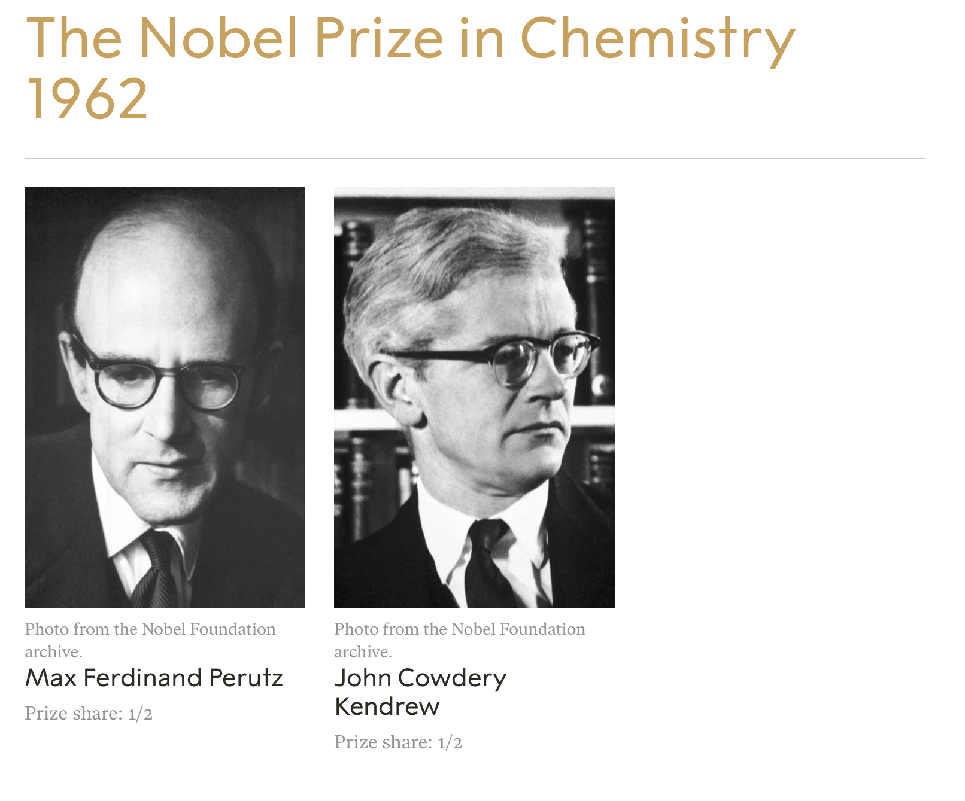
.. for their major achievement of successfully using X-rays to determine the structures of complex proteins.
...Perutz determined the molecular structure of the protein haemoglobin that transports oxygen in the blood, and Kendrew, his colleague at Cambridge University, determined the molecular structure of the smaller, related protein myoglobin.
This was no straightforward task. Finding the structure of myoglobin required the measurement of around 250,000 X-ray reflections on 110 crystals – a real feat of perseverance and patience.

Slide 5
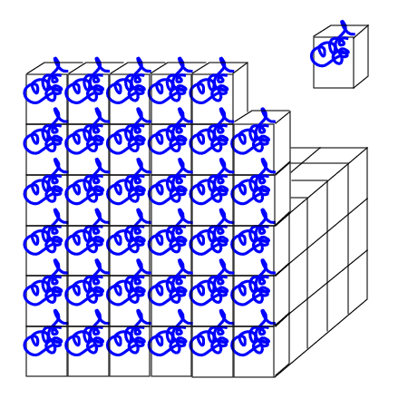
Structure Determination by X-ray Crystallography
A crystal is a regular array (2D or 3D) of identical unit cells.
a crystal within a 3D lattice
a unit cell
The net X-ray diffraction is a convolution of that from the lattice and from the unit cell.

Slide 6
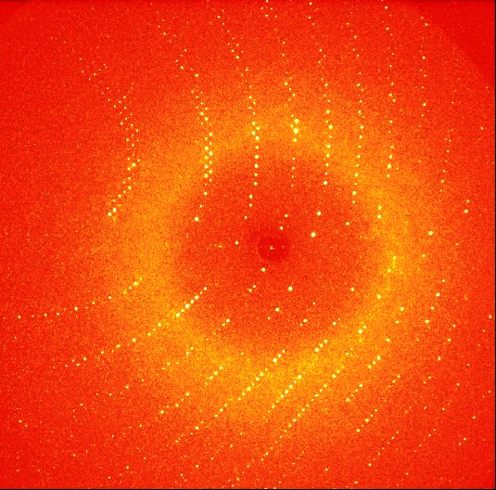

A material is a crystal if it has a sharp diffraction pattern...
X-rays
lysozyme crystal

Slide 7

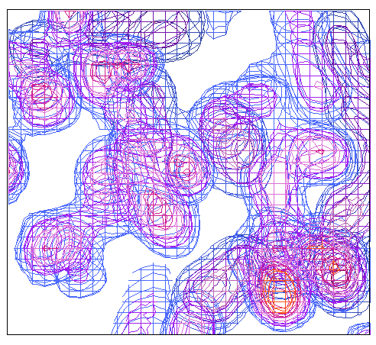
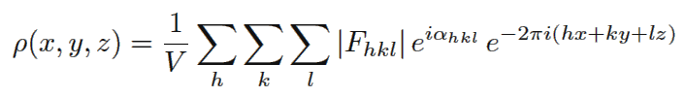
Structure Determination by X-ray Crystallography
Forward and Inverse Fourier Transforms
ρ(x,y,z)
Electron Density in Unit Cell
|F_{hkl}|
Observed Diffraction Amplitudes
Atom Coordinates

Slide 8
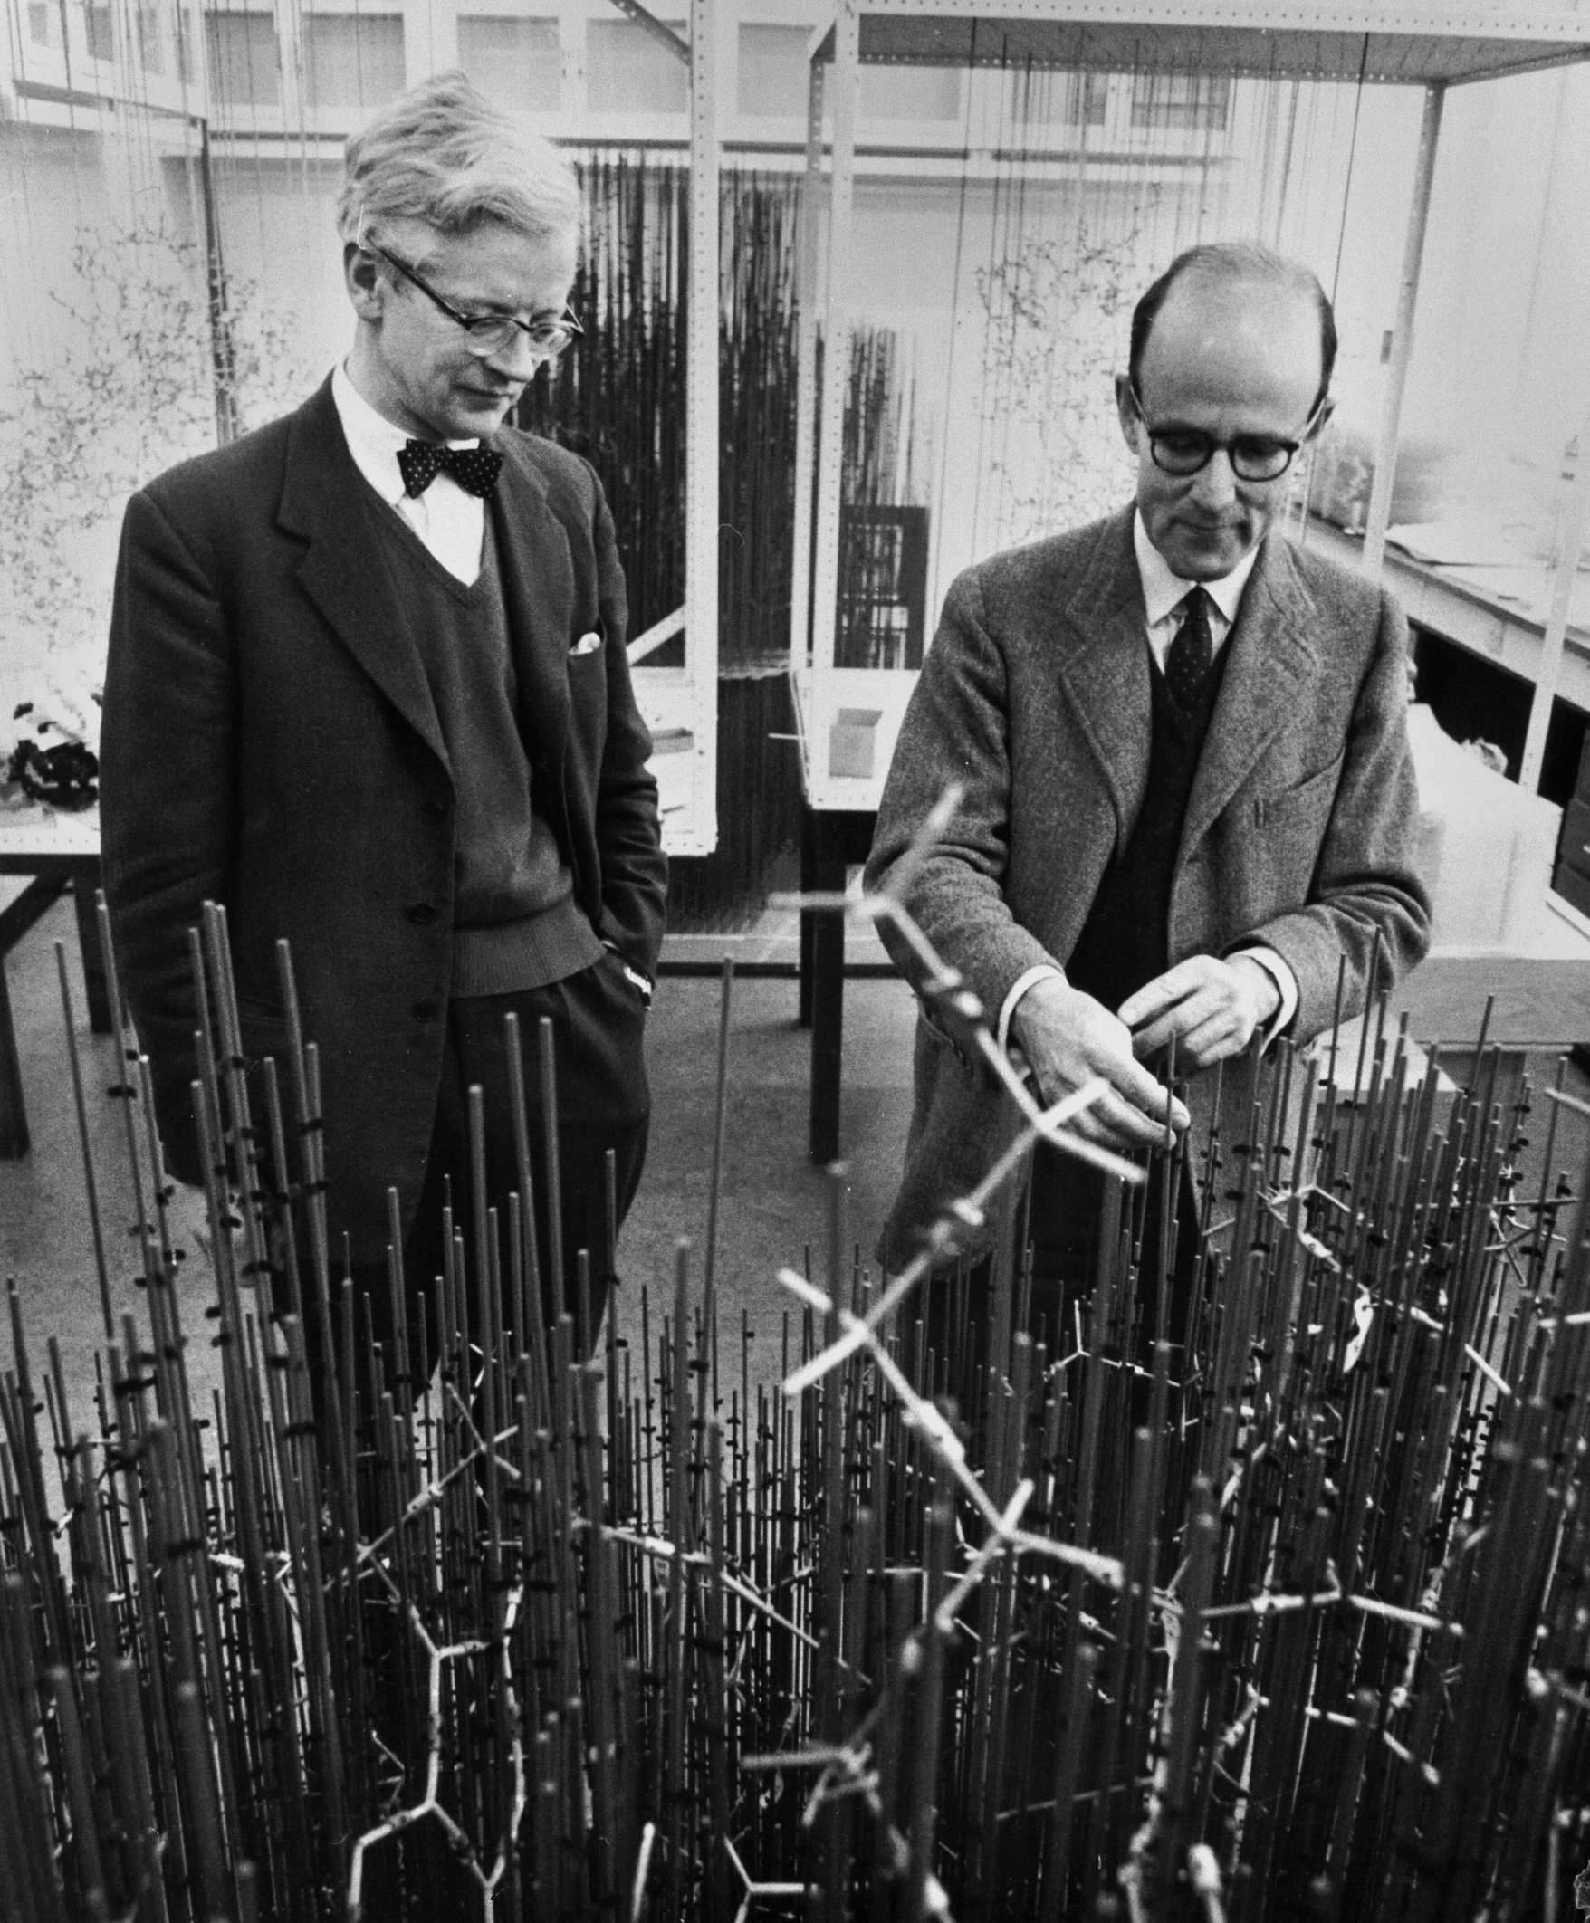
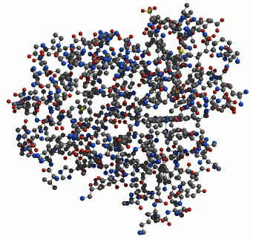
First proteins structures at atomic level: Hemoglobin and Myoglobin
ball: atoms
stick: bonds

Slide 9
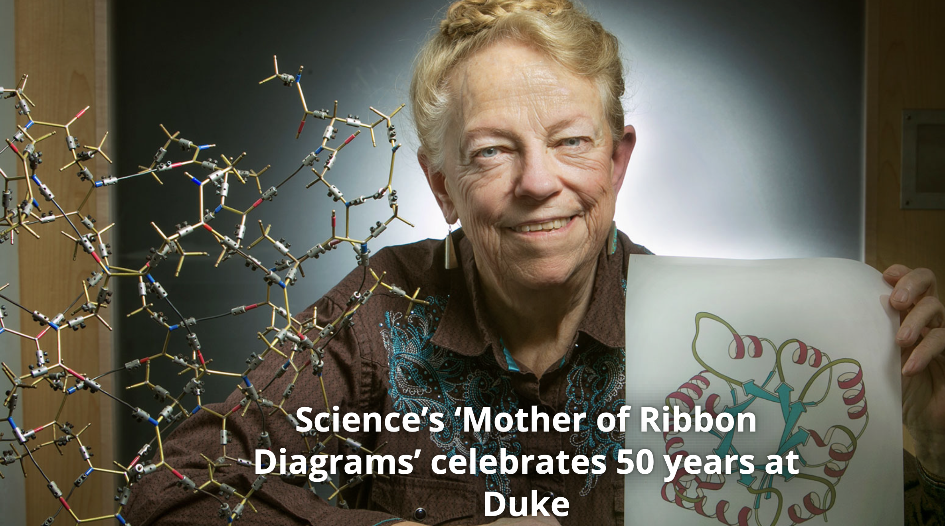
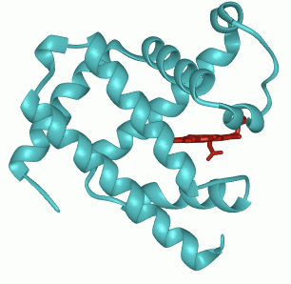
Jane Richardson invented an art format to highlight the secondary structure

Slide 10
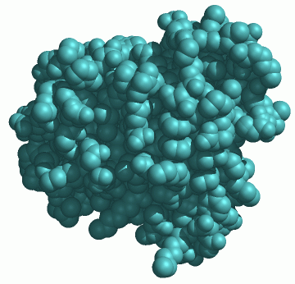
Myoglobin Crystal Structure in Three Representations
Stick-and-ball
Cartoon
Sphere

Slide 11
No pathway for O₂ to enter and release in Myoglobin!
When every atom is shown with realistic volume:
❓

Slide 12
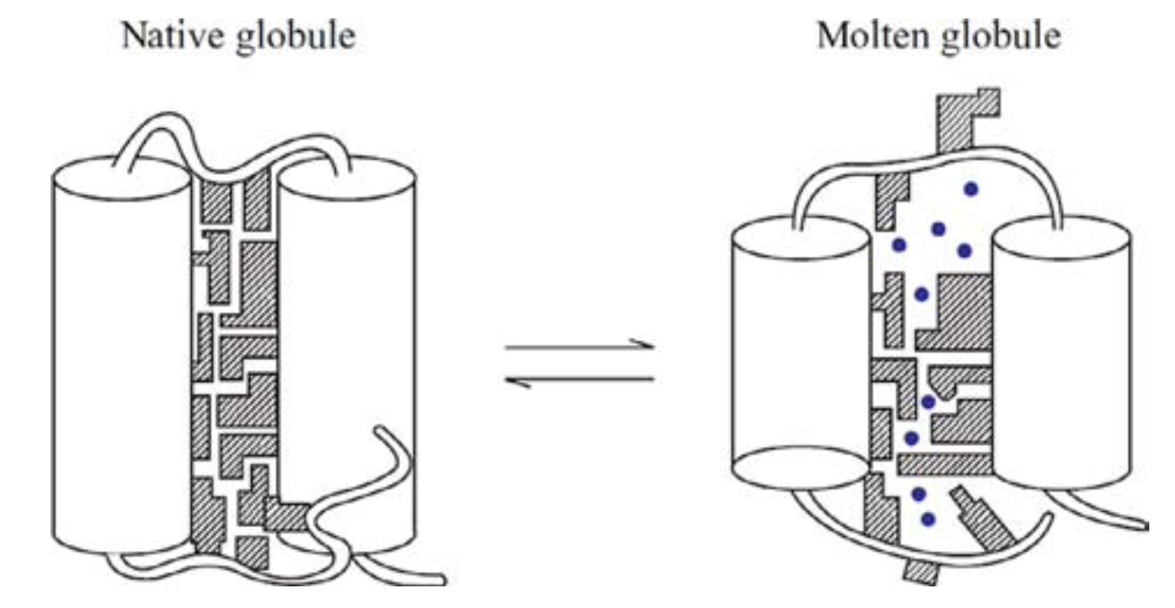
How does a protein achieve both?
Proteins need motions to function
Proteins are more like solid than glass
❓

Slide 13
Classification of Motions in Proteins
Spatial scale:
1 Å = 0.1 nanometer
C-N peptide bond: ~1.33 Å
Time:
Protein folding: ~5 milliseconds
Protein translation: 20 seconds to several minutes
Energy:
Protein folding: -5~-15 kcal/mol
Thermal energy(kT): -1 kcal/mol

Slide 14
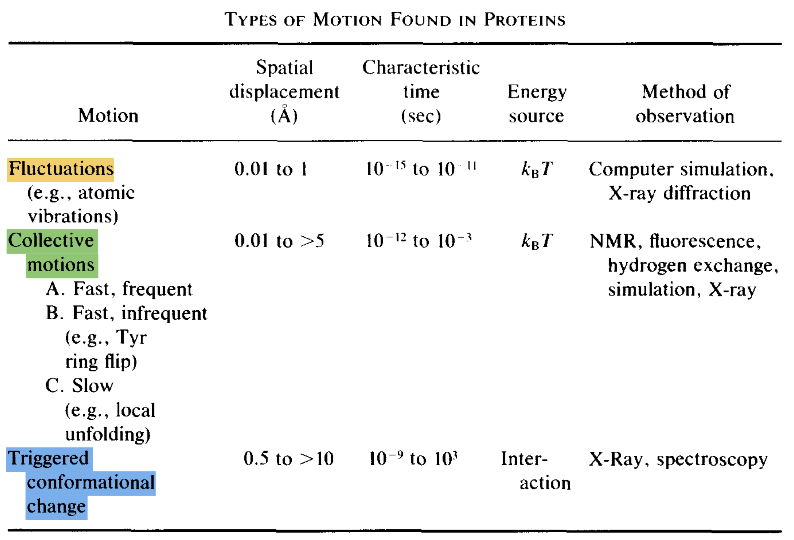
Classification of Motions in Proteins
2.
1.

Slide 15
Outline
Evidence of protein dynamics by X-ray Crystallography
Computational simulation of protein dynamics
The role of protein dynamics in protein function
Relevance to protein function design

Slide 16
Outline
Evidence of protein dynamics by X-ray Crystallography
Computational simulation of protein dynamics
The role of protein dynamics in protein function
Relevance to protein function design

Slide 17
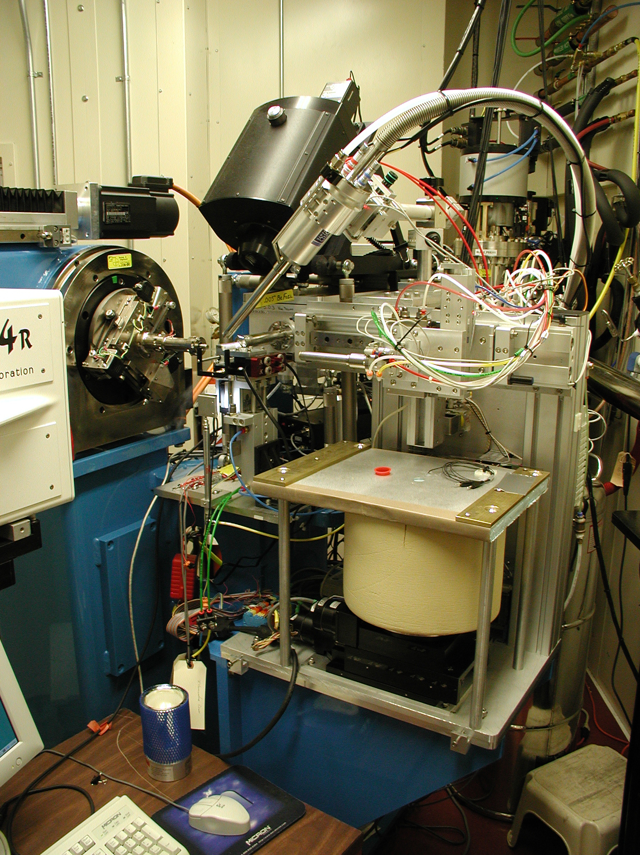
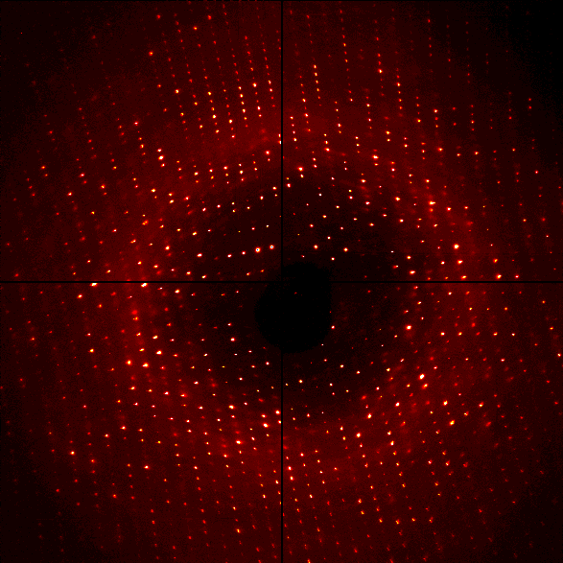


Protein Motions Revealed by X-ray Diffraction
The Crystal
X-Ray crystallography is similar to photography using a camera with a very fast frame rate, but whose shutter remains open for a long time.
X-rays come
from here
X-ray
detector
a shutter allows light to pass and reach the detector to capture a permanent image.

Slide 18
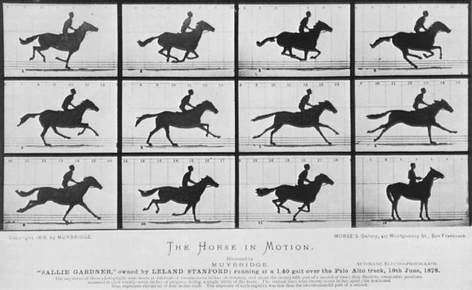
Protein Motions Revealed by X-ray Diffraction
Such a camera gets a superposition of many pictures of the galloping horse in different poses.

Slide 19
Protein Motions Revealed by X-ray Diffraction
When we speak of “the crystal structure of a protein” we really mean the average structure of over 10¹⁷ molecules.
The average structure is merely the best single model that can be fit to the superposition of many slightly different structures.
The dynamic information obtainable from X-ray crystallography is simply an estimate of how far each atom deviates from its average position, and in what direction.

Slide 20
Atomic Structures from X-ray Diffraction
Observed Diffraction Amplitudes
Electron Density in Unit Cell
Atom Coordinates
Atom Coordinates with Standard Deviation

Slide 21
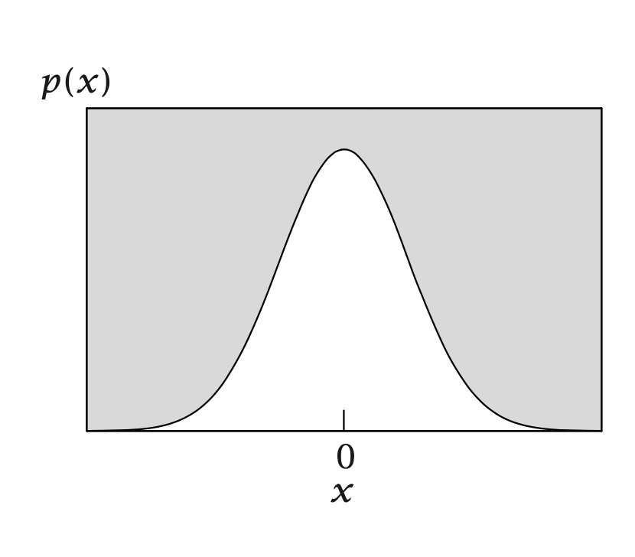
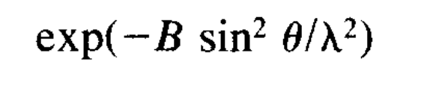
B Factor in Crystal Structure Determination
In the Debye-Waller treatment of atomic motion, the probability of finding an atom at a given distance from its average position is considered to be Gaussian.
constant
Motion was quantified by the mean-square displacement from the average position
B = 8π² <x²>
x : deviation from the average position

Slide 22
Protein Motions Revealed by X-ray Diffraction
B = 8π² <x²>
<x²> = <x²>_{v} + <x²>_{c} + <x²>_{ld}
<x²>_{v} ：individual atomic fluctuations
<x²>_{c} ：collective motions (discrete conformations)
<x²>_{ld} ：lattice disorder
~10¹⁷ protein molecules

Slide 23
Protein Motions Revealed by X-ray Diffraction
B = 8π² <x²>
<x²> = <x²>_{v} + <x²>_{c} + <x²>_{ld}
irrelevant to protein motions
It is safe to assume that lattice disorder does not dominate the relative <x²> values if the crystal gives high resolution diffraction pattern (< 2 Å).
Comparison between different crystal structures is not valid.
Residue-to-residue comparison in the same crystal structure is relative safe.

Slide 24
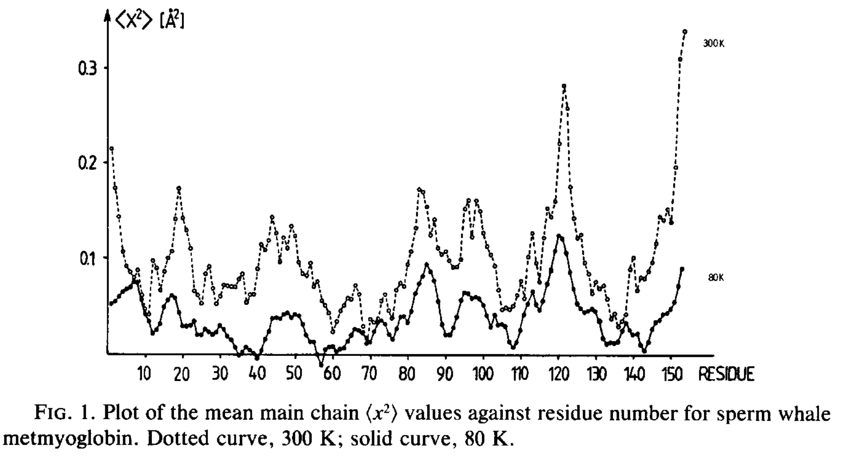
Overall Protein Motions
Myoglobin crystal structure at 1.6 Å

Slide 25
Overall Protein Motions
Buried residues have lower values.
Notes:
The striking drop in B with cooling observed in this study is the most convincing evidence that proteins are flexible in the crystalline state and that lattice disorder does not dominate the observed B factors.
Residues with large displacements tend to have large temperature dependence, while residues with small B factors show little change on cooling.

Slide 26
Overall Protein Motions
Striking drop in <x²> with cooling from 300K to 80K
Residues with large <x²> tend to have large temperature dependence
Notes:
The striking drop in B with cooling observed in this study is the most convincing evidence that proteins are flexible in the crystalline state and that lattice disorder does not dominate the observed B factors.
Residues with large displacements tend to have large temperature dependence, while residues with small B factors show little change on cooling.

Slide 27
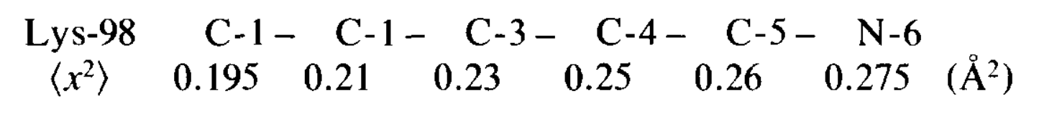
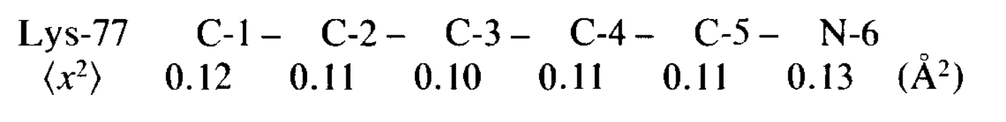
Per Residue Protein Motions
Surface Lysine-98 in myoglobin:
Surface Lysine-77 in myoglobin:
(making salt bridge with Arg)
Pre-residue movements reflect local interactions

Slide 28
Summary: Evidence of protein dynamics by X-ray Crystallography
An X-ray structure is an average structure of ~10¹⁷ molecules over a long time (days or weeks.)
Dynamic information revealed by X-ray diffraction is quantified by B factor, which reflects the atomic deviation from the average position.
B factor comes from three sources, including lattice disorder. Only high-resolution structures yield meaningful dynamic information.
X-Ray diffraction provides information about the atomic-level spatial distribution of protein dynamics, but not about time scales.

Slide 29
Outline
Evidence of protein dynamics by X-ray Crystallography
Computational simulation of protein dynamics
The role of protein dynamics in protein function
Relevance to protein function design

Slide 30
Computational Simulation of Proteins with High Spatial and Temporal Resolutions
Experiment clearly demonstrates that proteins are mobile, but no single experiment or combination of experiments can provide an all-inclusive view of the dynamic behavior of all atoms in a proteins.
Computer simulations can!
--- the promise of molecular dynamics simulation
Notes:
复习

Slide 31

... for the development of multiscale models for complex chemical systems.
Chemists used to create models of molecules using plastic balls and sticks. Today, the modelling is carried out in computers. Computer models mirroring real life have become crucial for most advances made in chemistry today.

Slide 32
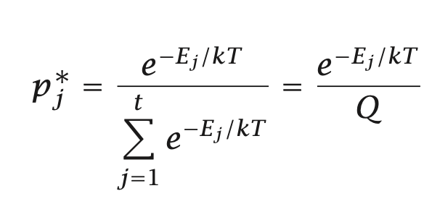
Force Field or Potential Energy Function
Force field or energy function provides a computational method to calculate the energy of the system as a function of the atomic coordinates.
The potential energy can be used directly to determine the relative stabilities of the different possible structures of the system.
The relative populations of such structures under conditions of thermal equilibrium are given in terms of the potential energy by the familiar Boltzmann distribution law.
Although quantum mechanical calculations can provide potential surfaces for small molecules, empirical energy functions of the molecular mechanics type are the only possible source of such information for proteins and their solvent surroundings.

Slide 33
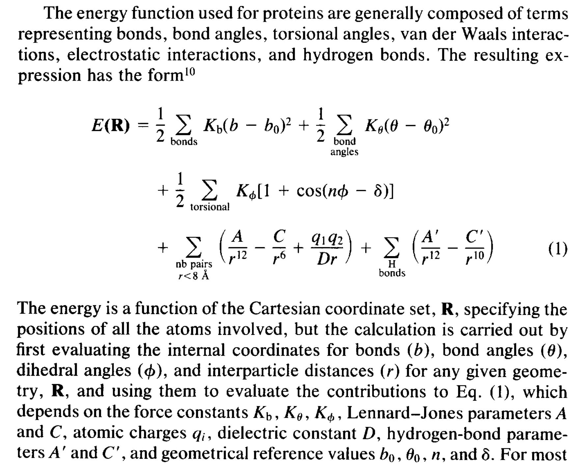
Energy Functions in Molecular Dynamics
Hard variables:
bond lengths and bond angles
Soft variables:
torsion angles, nonbonded interactions

Slide 34
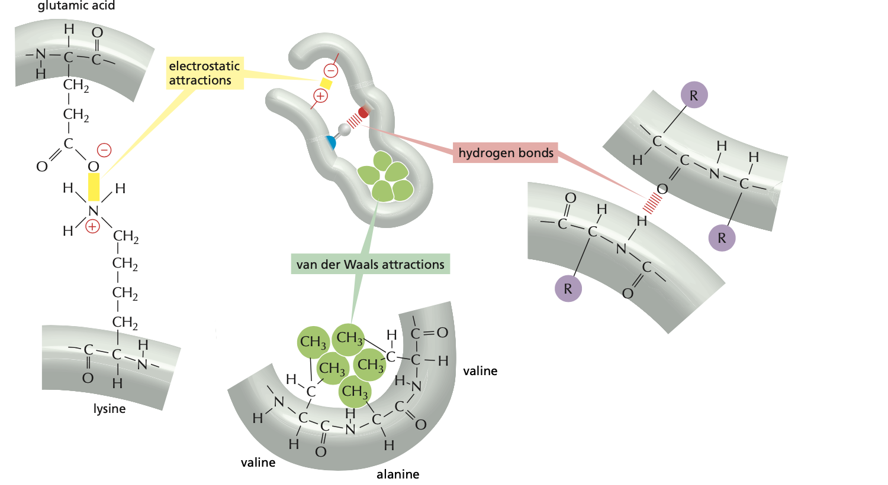
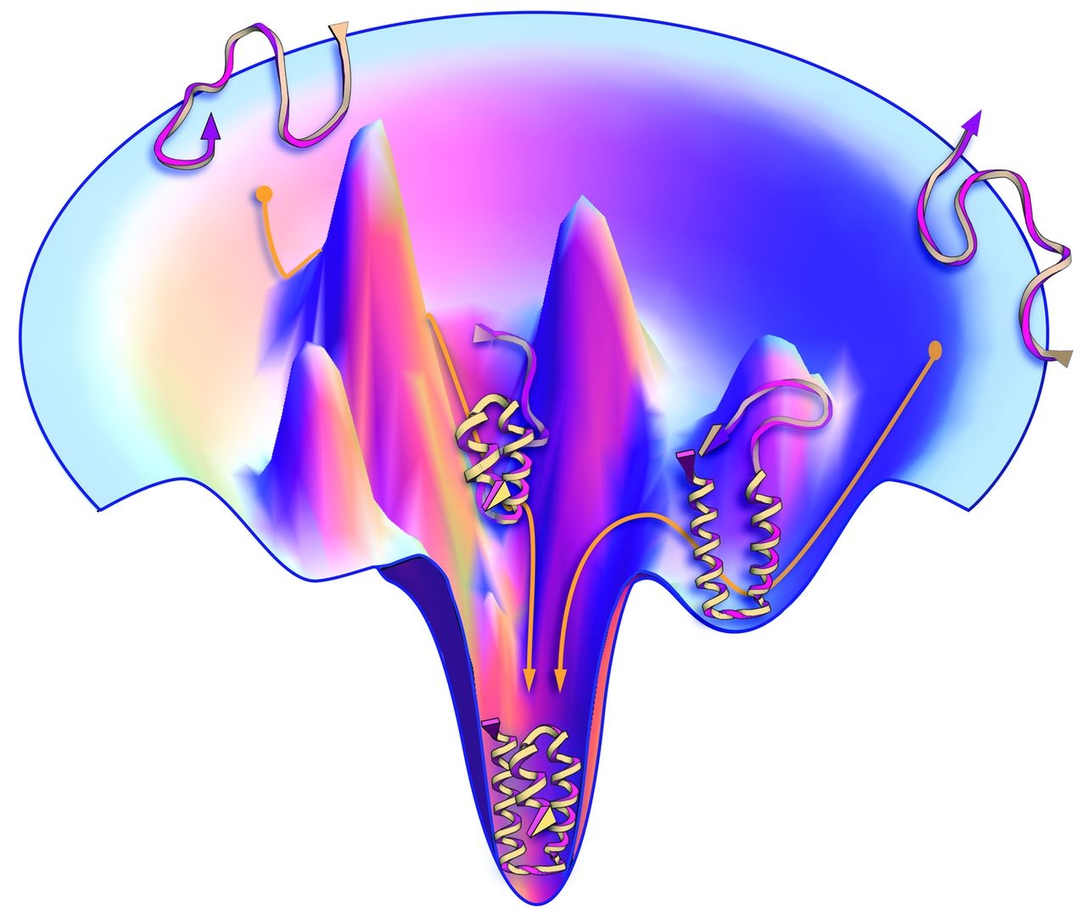
Previously in protein folding...
Martin Karplus: “Where globular proteins differ from small molecules is that the contacts among nonbonded atoms play an essential role in the potential energy of the folded or native structure.”
Basic forces
Energy Landscape
hydrogen bonds
van der Waals attractions
electrostatic attractions
Notes:
What does it mean to solve the protein folding problem? A comprehensive solution should not only predict the most stable protein structure, it should also describe energy landscape to some degree that can further explains the protein function. But nevertheless, it’s already super hard to just figure out the most stable structure regardless of the local or global landscape. Structure prediction is focused on solving this first step.
The first stru was solved in 1960

Slide 35
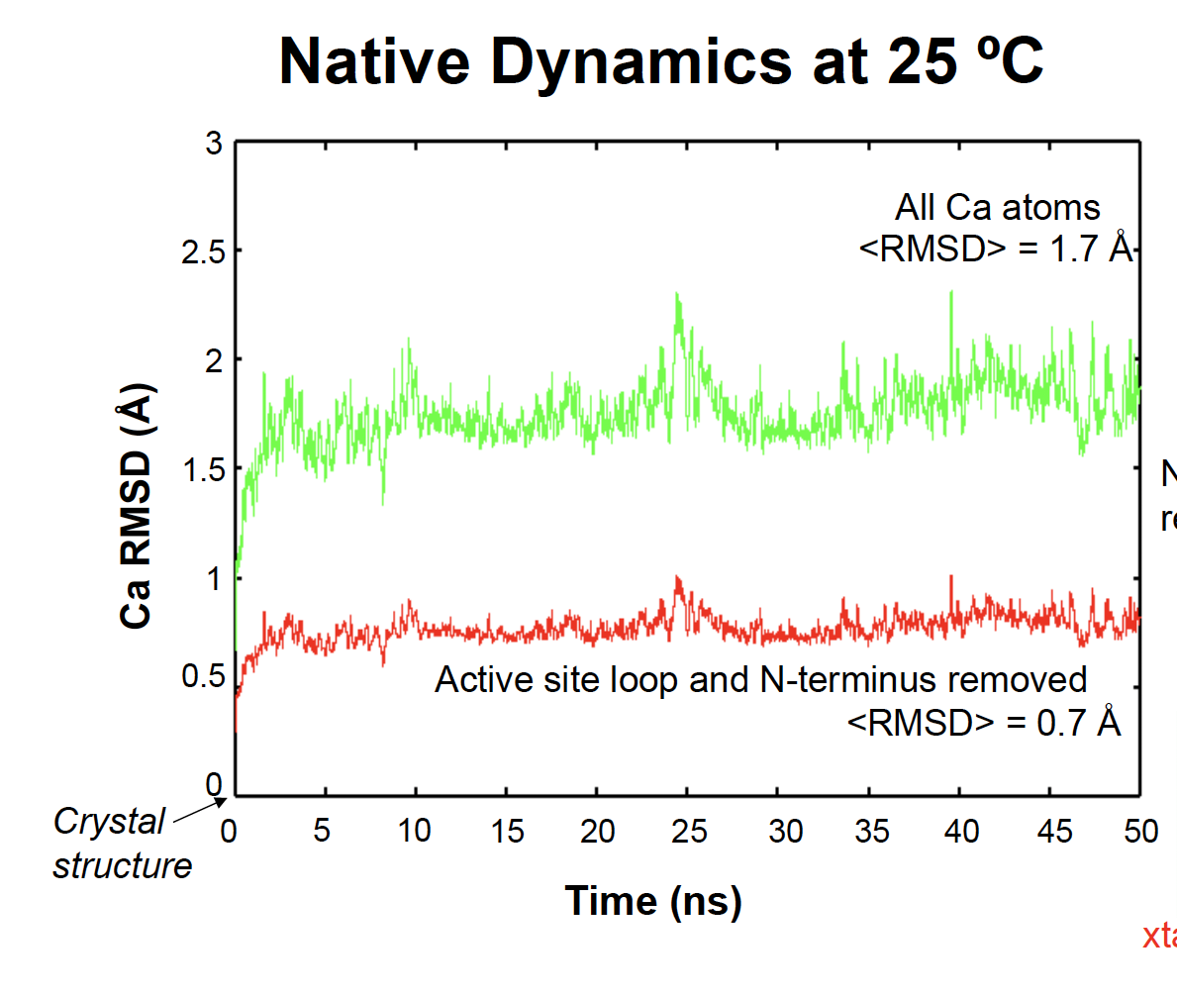
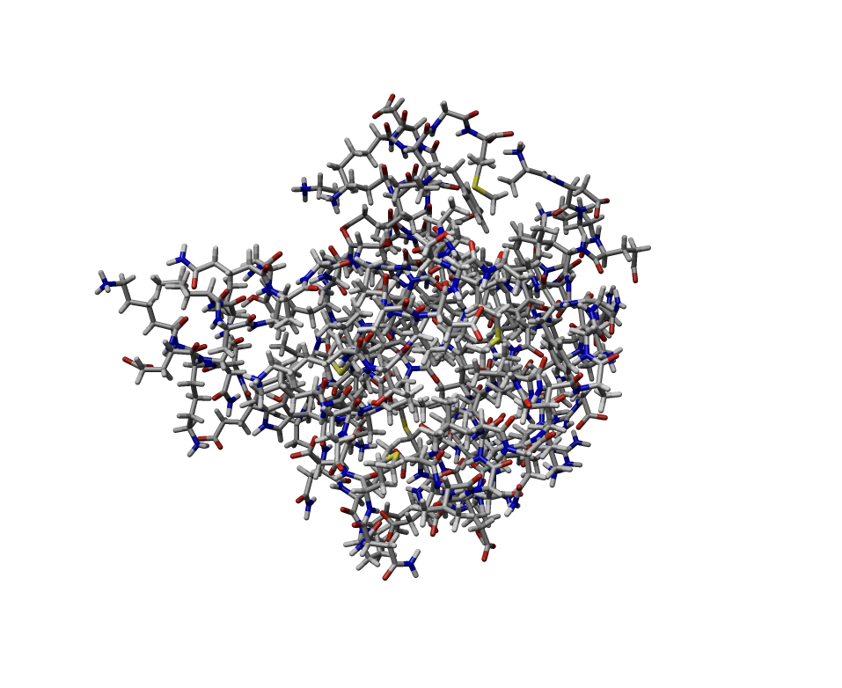
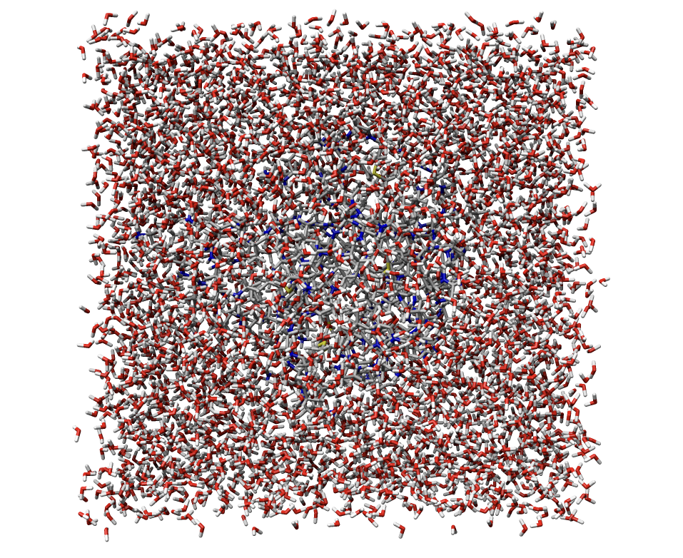
A Typical Trajectory from MD Simulation
3chy
3chy with waters
now we have protein motions simulated in real time!

Slide 36
Summary: Computational simulation of protein dynamics
Molecular dynamic simulation complements the experimental methods on studying the protein motions.
Molecular dynamic simulation relies on the accuracy of its force field.
Molecular dynamic simulation adds time dimension to the study of protein motions
Another course specialized on MD

Slide 37
Outline
Evidence of protein dynamics by X-ray Crystallography
Computational simulation of protein dynamics
The role of protein dynamics in protein function
Relevance to protein function design

Slide 38
Protein motions are necessary for substrate access
No pathway for O₂ to enter and release in Myoglobin
What are the motions ?
Are those motions necessary for the function?
❓
Notes:
复习

Slide 39
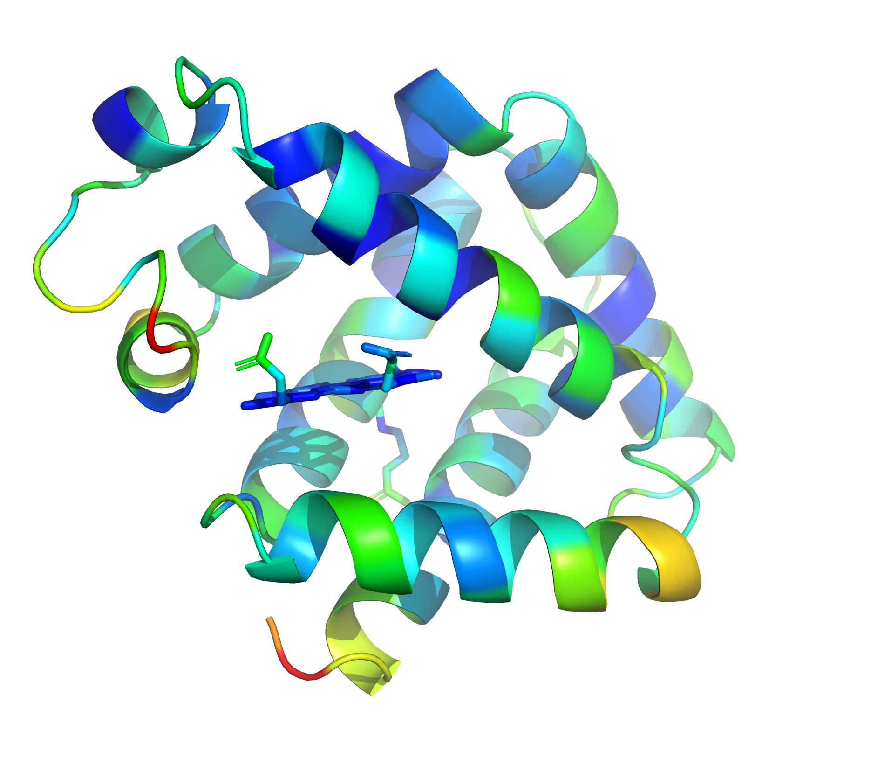
Protein motions are necessary for substrate access
What are the motions ?
B factor analyses indicate there is a region of relative high <x²> that leads to the binding site.
❓
Pymol Session
Notes:
复习

Slide 40
Protein motions are necessary for substrate access
What are the motions ?
2. Direct evidence for the existence of a channel and its location has come from crystallographic studies of the binding of a large ligand, the phenyl group, to capture the “opening ” of the myoglobin.
❓
Notes:
复习

Slide 41
Protein motions are necessary for substrate access
Are those motions necessary for the function?
Does this protein have to hide the substrate entrance?
Protection of a buried reactive group while permitting rapid binding of the desired ligands is one important functional role for enzyme flexibility.
❓
Notes:
复习

Slide 42
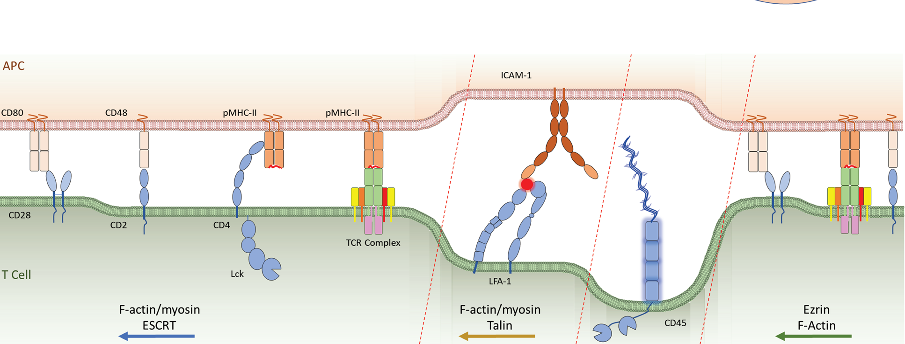
Other Examples
Recognition function uses flexible long loops to reach a bigger volume.
Notes:
复习

Slide 43
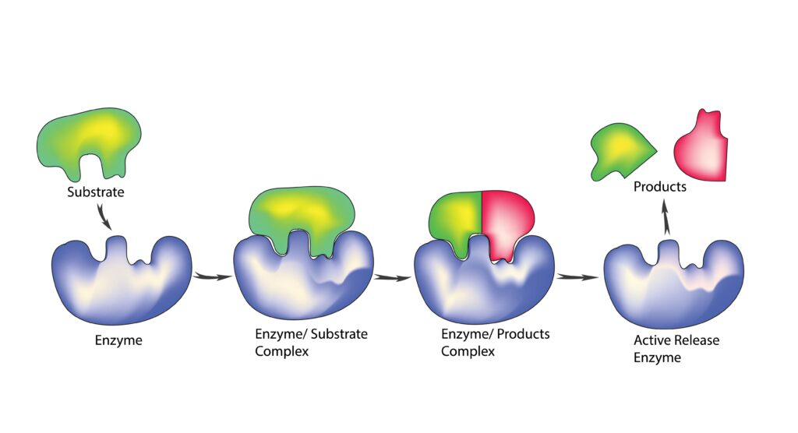
Other Examples
Enzymatic function uses flexible substrate binding to achieve weak but specific interactions.
ΔG = ΔH - TΔS
Notes:
复习

Slide 44
Summary: The role of protein dynamics in protein function
Protein motions are necessary for certain functions: substrate access in enzymes, molecular recognition on cell surface, small molecule binding with high specificity but low affinity...
Quantitative studies (such as X-ray B factor analysis and MD simulations) provide convincing evidence for protein motions.
Still, protein dynamics are hard to study both experimentally and computationally.

Slide 45
Outline
Evidence of protein dynamics by X-ray Crystallography
Computational simulation of protein dynamics
The role of protein dynamics in protein function
Relevance to protein function design

Slide 46
Most of the designed proteins are rock solid!

Slide 47
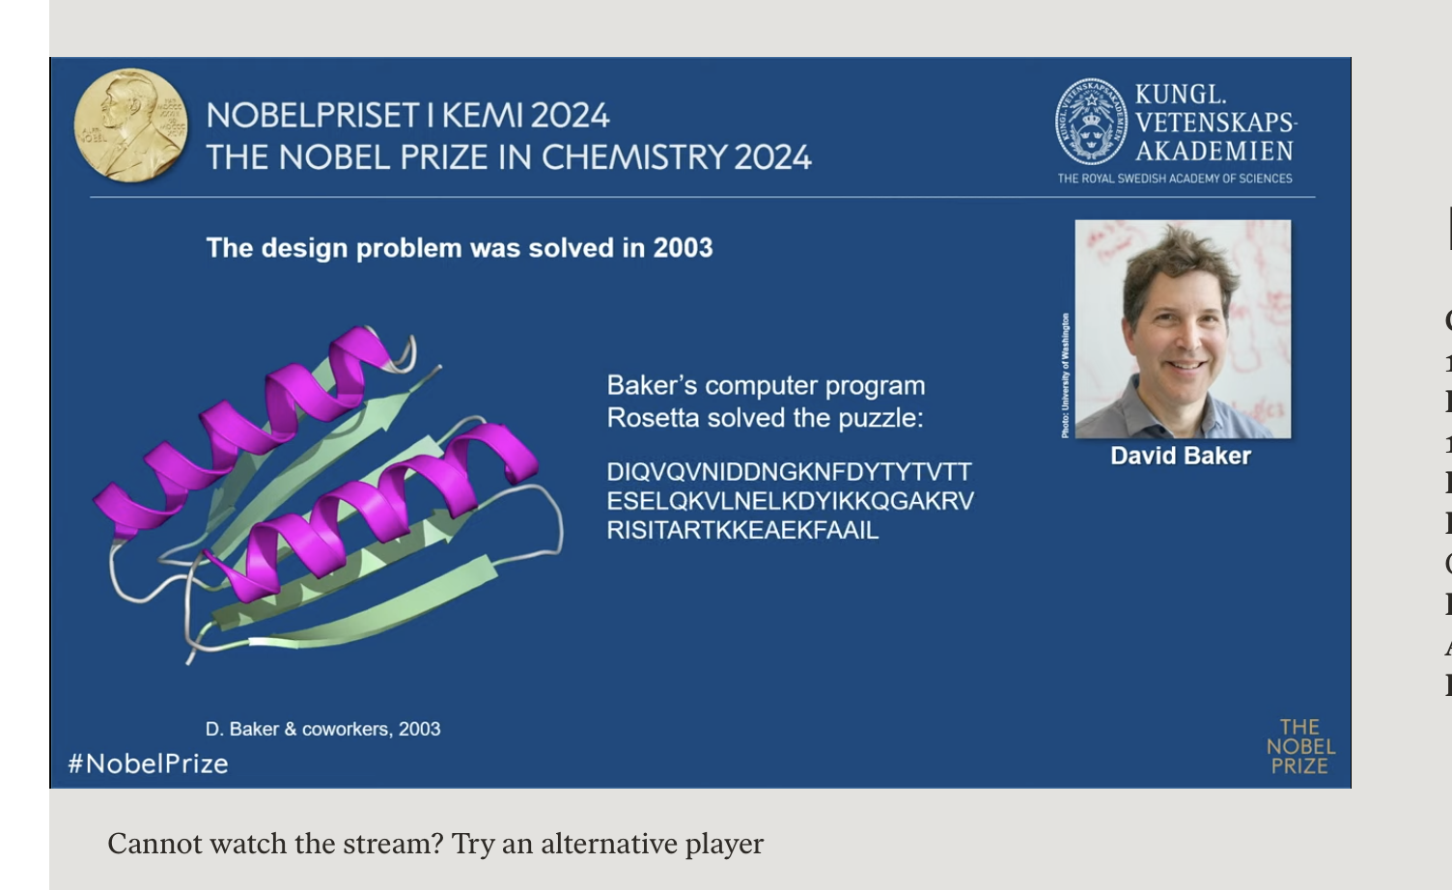
Top7 is a rock-like protein

Slide 48
How does a protein achieve both?
Proteins need motions to function
Proteins are more like solid than glass
❓

Slide 49
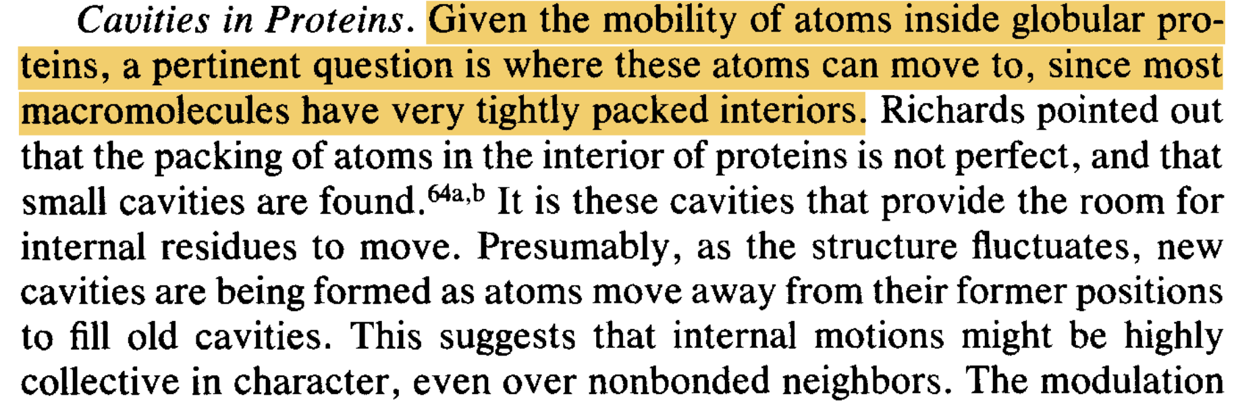

Slide 50
An open question:
How to design a dynamically functional protein?
Notes:
复习

Slide 51
Summary
Evidence of protein dynamics by X-ray Crystallography
Computational simulation of protein dynamics
The role of protein dynamics in protein function
Relevance to protein function design

