Slide 1

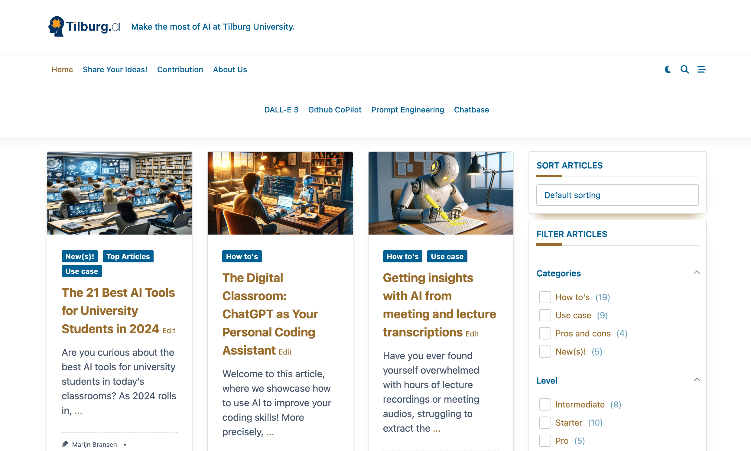


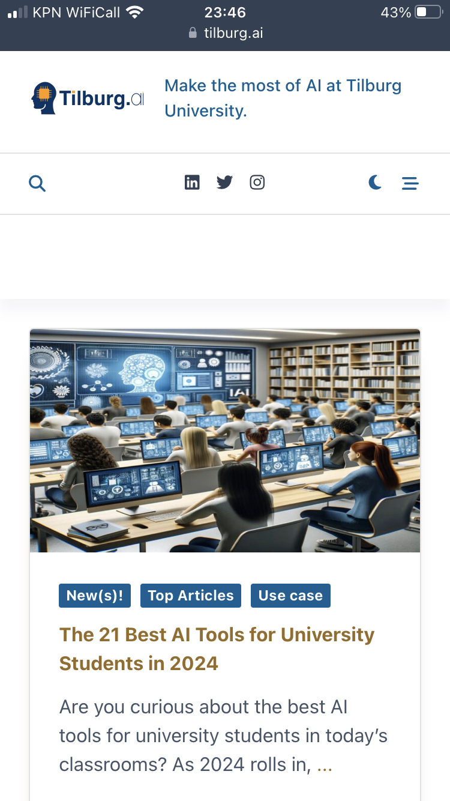
How Can AI Transform Your Research and Learning Experience?
Find out at…

Slide 2
How Can AI Transform Your Research and Learning Experience?
Find out at…

Slide 3
How Can AI Transform Your Research and Learning Experience?
Find out at…

