Slide 1



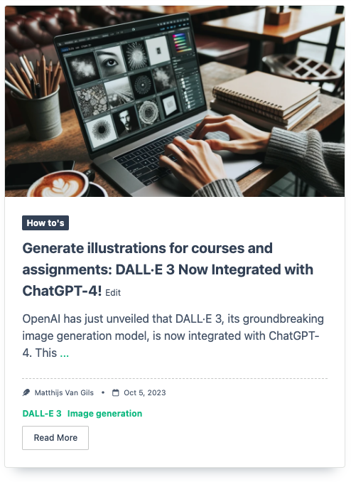
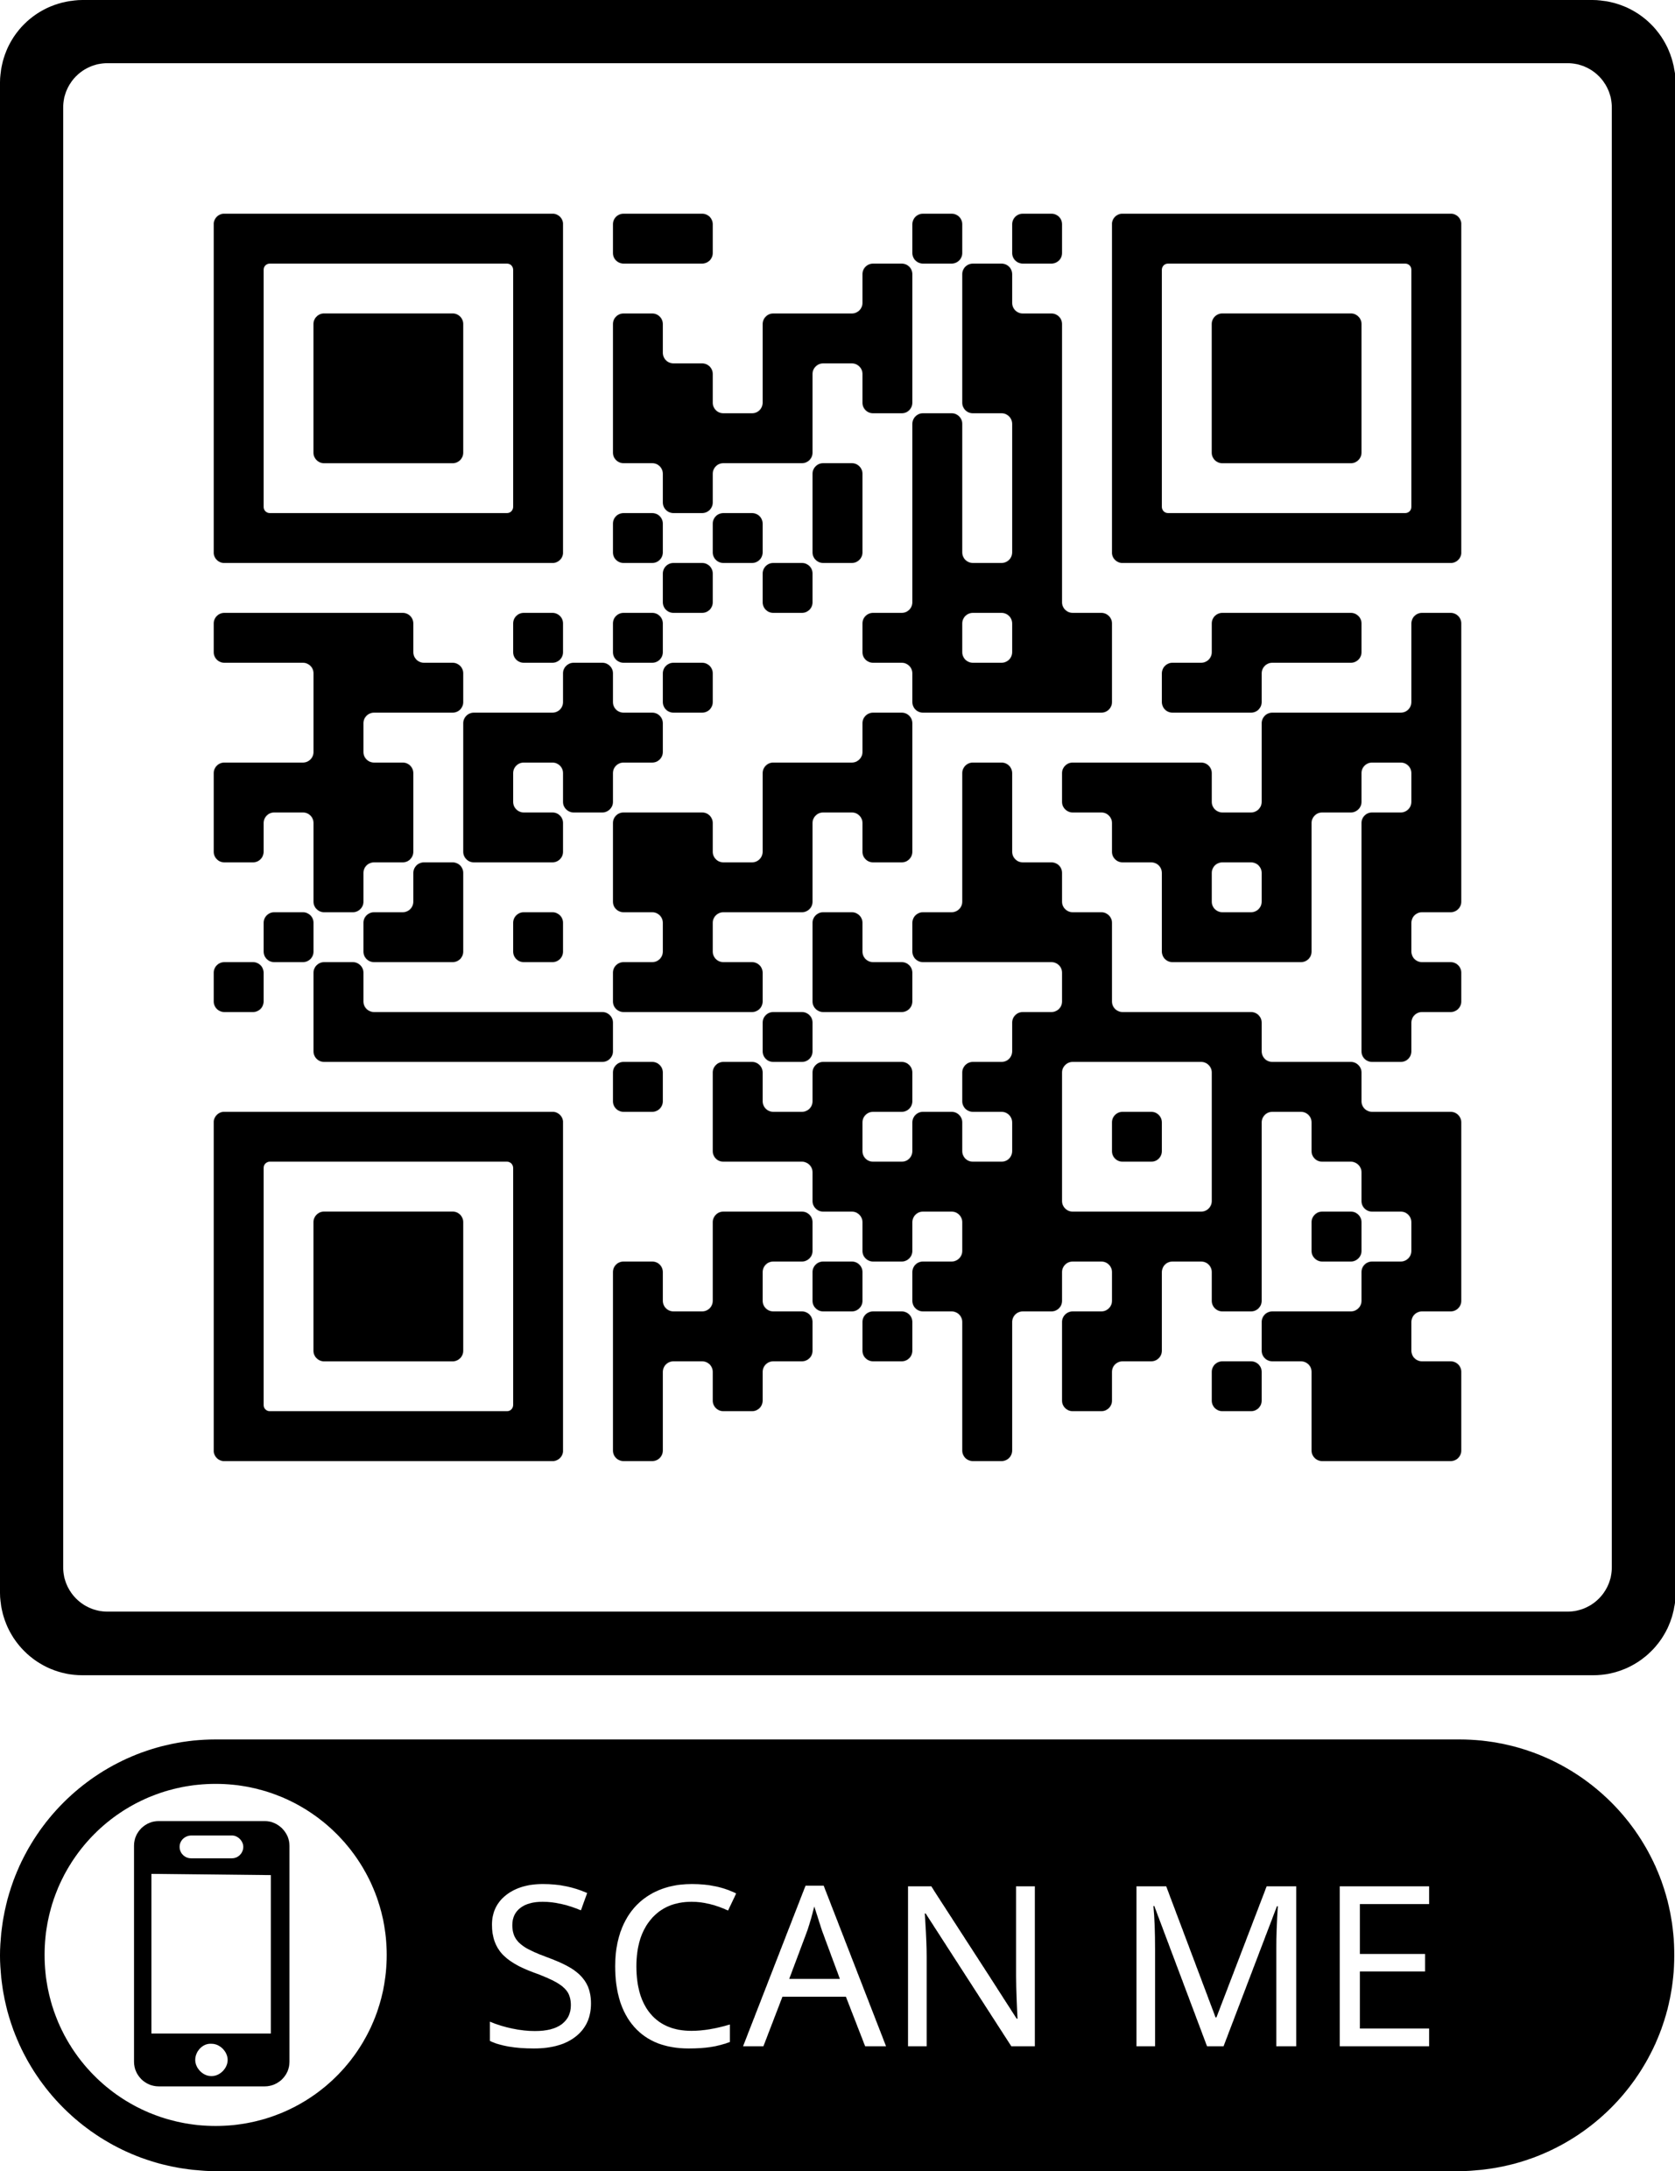

Read our latest post on Tilburg.ai!
Add image here
How to’s
Use case
Add the title of the article here
Add QR-code here
Add the thumbnail text of the article in this block of text...

