Slide 1

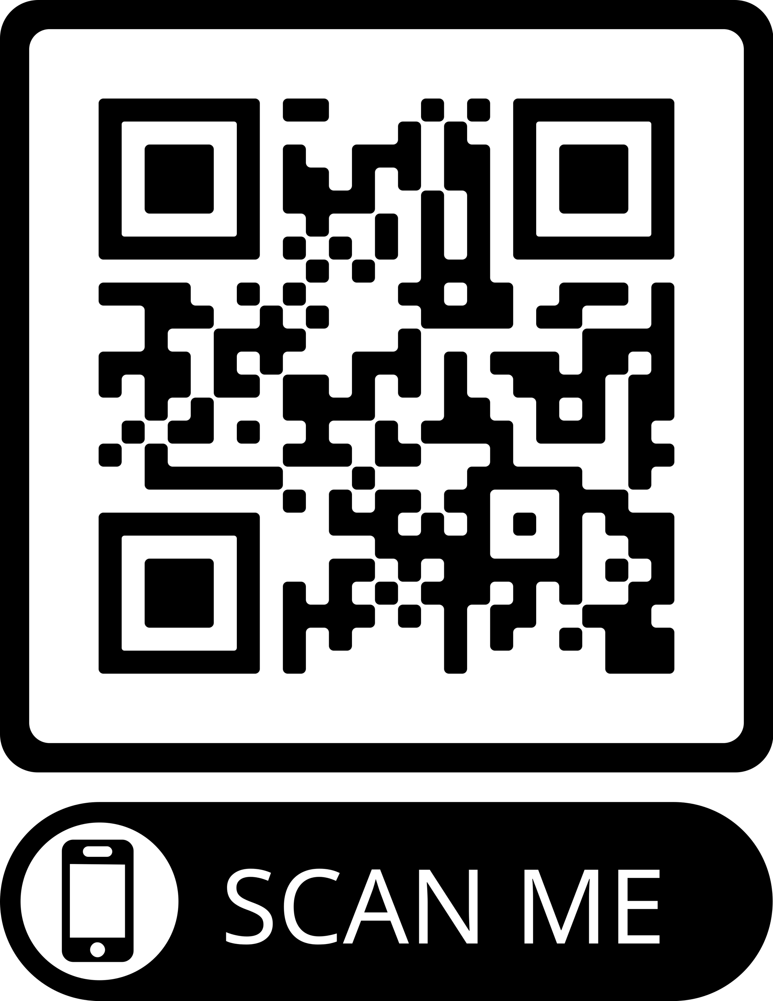

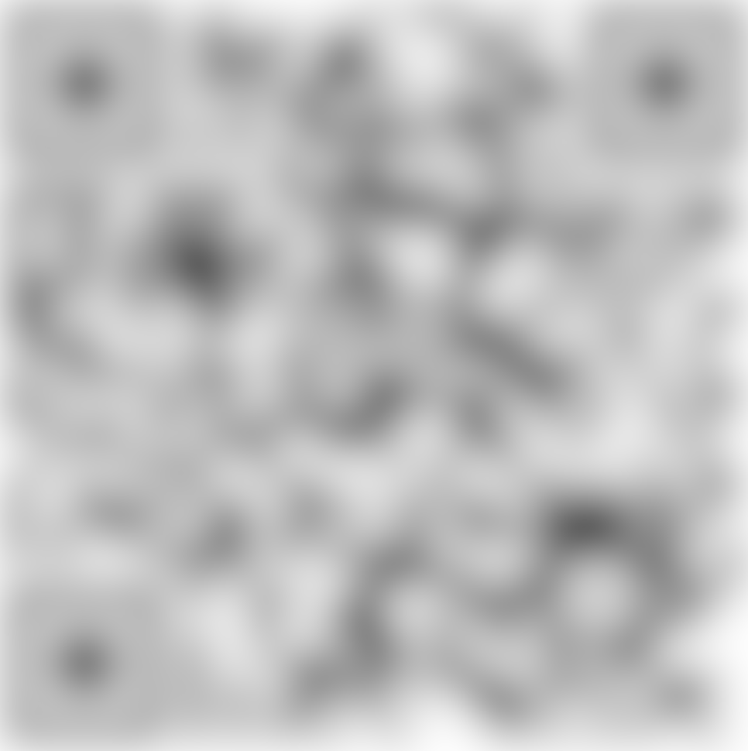
Read our recent posts on Tilburg.ai!
How to’s
Use case
Add the title of the article here
Add QR-code here
Add the thumbnail text of the article in this block of text...
Add image here
How to’s
Use case
Add the title of the article here
Add QR-code here
Add image here
Add the thumbnail text of the article in this block of text...
How to’s
Use case
Add the title of the article here
Add QR-code here
Add image here
Add the thumbnail text of the article in this block of text...

Slide 2
Read our recent posts on Tilburg.ai!
Add QR-code here
Add QR-code here
How to’s
Use case
How to’s
Use case
Add the title of the article here
Add the title of the article here
Add the thumbnail text of the article in this block of text...
Add the thumbnail text of the article in this block of text...

