Slide 1


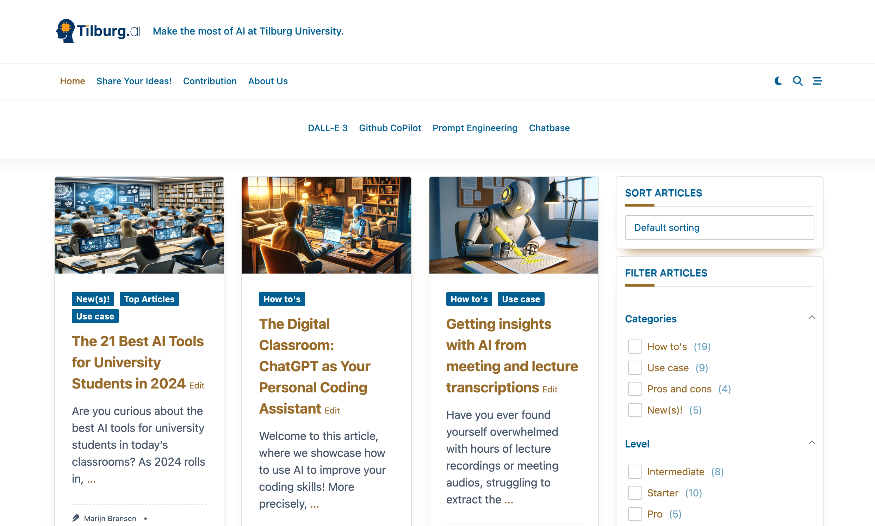

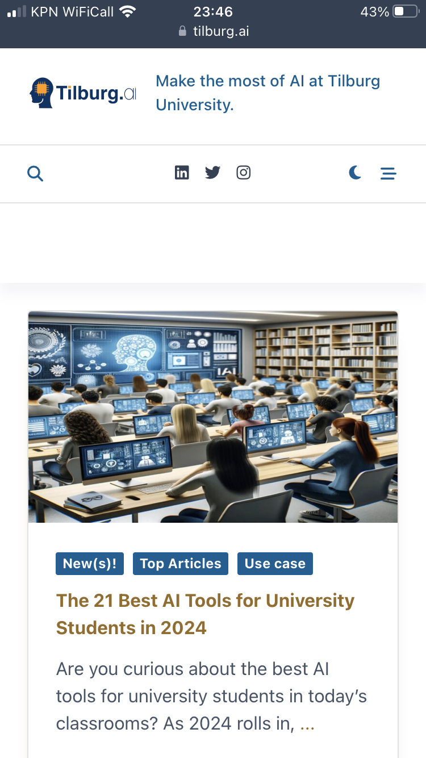
How Can AI Transform Your Research and Learning Experience?
Find out at…

