Slide 1




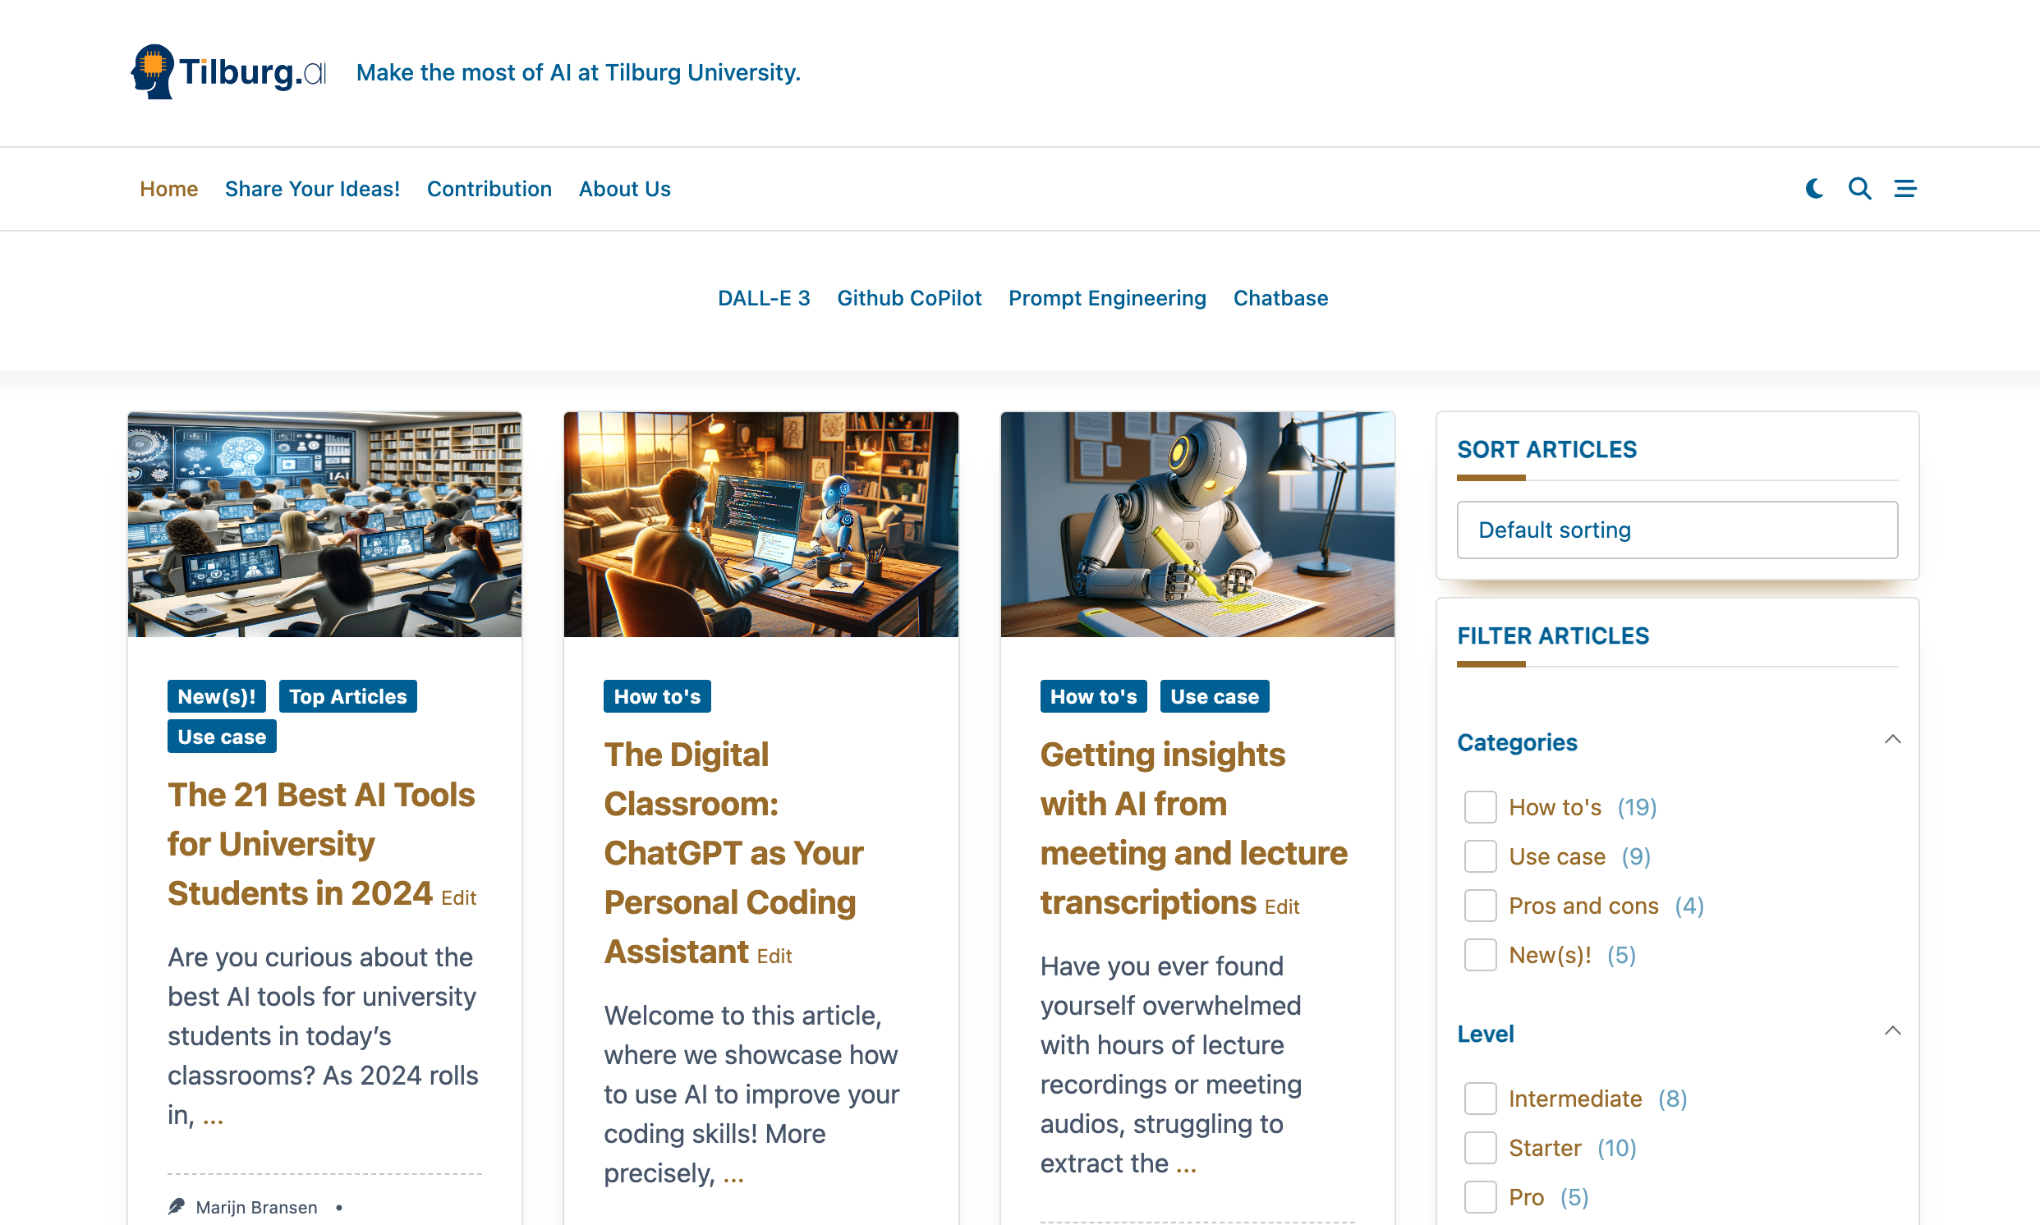

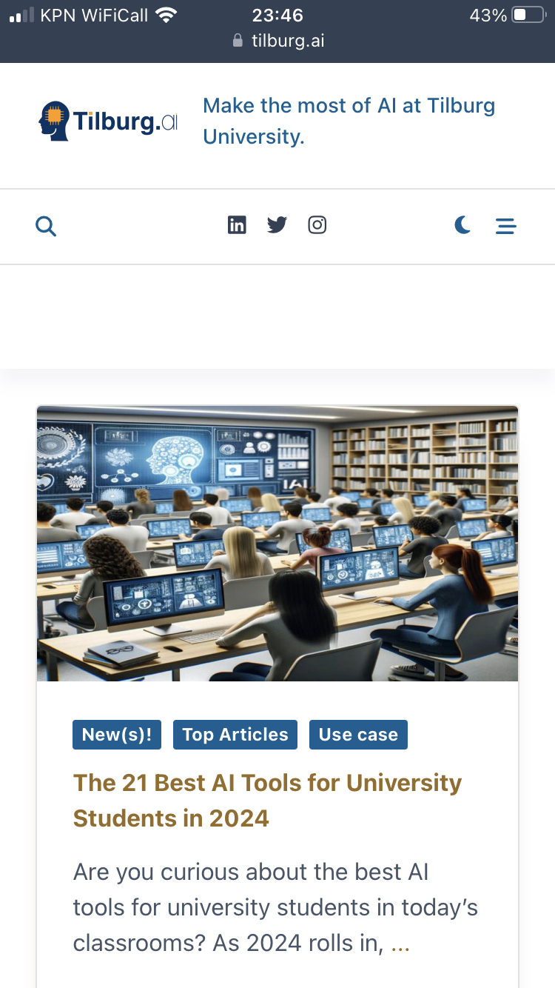
How Can AI Transform Your Research and Learning Experience?
Find out at…

