Slide 1

Multi-Agent Court-Act Assistant
Student:
Anastasia Senichenkova, 01.04.02 Applied Mathematics and Informatics
Scientific supervisor:
to be specified
Scientific consultant:
to be specified

Slide 2
Problem statement
Open corpora of Russian courts of general jurisdiction (SOY) are large, mixed, and hard to search for analogous cases.
A case card stores metadata and sometimes HTML; a parallel corpus splits the act into header, facts (fabula), and operative part. There is no gold outcome label.
Legal LLMs often invent citations. Predicting a judgment from this data would be scientifically weak and practically misleading.
Scientific track: normalize the card into a Case Graph, retrieve comparable practice from an index, and draft a position that may cite only indexed case IDs.

Slide 3
Goal and tasks
Goal: build a working multi-agent prototype that analyzes a SOY case card, retrieves analogous practice, and drafts a grounded legal position.
Tasks:
Analyze the JSONL cards and parquet act-splits; define the Case Graph schema.
Implement ETL into SQLite so agents never scan raw gigabytes.
Implement a LangGraph pipeline with playbooks (dossier / analogs / risk / appeal / draft / full).
Evaluate routing, analog precision@5, and a citation Guard; ship CLI and Streamlit UI.

Slide 4
Related work
Zhong et al.; Chalkidis et al., LexGLUE / LEGAL-BERT: classification and judgment prediction. Gap: our corpus has no reliable outcome label; a “win probability” would overclaim.
COLIEE; Shao et al., BERT-PLI: learned case retrieval. Gap: we need an explainable ranker on Russian SOY acts, not an English encoder.
Lewis et al., RAG; Cui et al., ChatLaw: generate from retrieved text. Gap: generation must not invent case IDs.
Wu et al., AutoGen; LangGraph: LLM multi-agent stacks. We use an explicit linear graph: nodes outside the plan skip.
Magesh et al.: leading legal AI tools hallucinate citations. This motivates Guard against the SQLite index.
Takeaway: the gap is grounded retrieval and drafting — not another outcome classifier.

Slide 5
Methods and tools
Methods: rule-based legal NLP, Case Graph normalization, lexical information retrieval, multi-agent orchestration with playbooks.
Analog score (explainable): 5·same article + 3·same judge + 2·same region + 1.5·same instance + Jaccard overlap of fabula tokens.
Tools: Python 3.11+, LangGraph, Pydantic, PyArrow, SQLite (WAL, batch upsert), Streamlit; optional Ollama (OpenAI-compatible API).
Data: docs.json SOY cards; correct_df_splitted_text.parquet (200 parts, text_1 / text_2 / text_3).

Slide 6
Scientific novelty
The task is restated as Case Graph construction and analog retrieval, not judgment prediction.
A linear LangGraph with six playbooks: unused nodes skip, so one graph serves dossier, practice search, risk, appeal, and drafting.
Hybrid analog score is transparent (article / judge / region / instance / Jaccard) and runs without embeddings.
Guard accepts a draft only if cited case IDs exist in the index — a direct response to citation hallucination.
The pipeline is usable without an LLM key (rules + index statistics); the model is optional wording, not the source of facts.

Slide 7
Solution: data and index
JSONL cards and parquet rows are normalized into one Case Graph (id, court, judge, region, charges, timeline, fabula, operative part).
ingest writes SQLite: sources parquet / docs / both, limit, reset; existing parquet IDs are skipped; batch insert + WAL.
Full load: 1,862,811 cases from 200 parquet parts. Agents query case_store.sqlite only.
Corpus mix: civil 1,609,786; administrative 161,766; unknown 91,121; criminal 138 — so the system is not a criminal-outcome predictor.

Slide 8
Solution: agents and playbooks
Linear graph: Orchestrator → Parser → Timeline → Act Reader → Qualification → Retriever → Risk → Appeal → Draft → Guard → Respond.
  Playbooks: dossier (card only); analogs; risk; appeal; draft; full. Orchestrator picks by query rules; an explicit --playbook is never overridden.
  Retriever ranks by the hybrid score; Respond prints markdown only from AgentState; Guard checks cited IDs.
  Interfaces share the same functions: CLI (ingest / status / ask) and Streamlit UI.

Slide 9
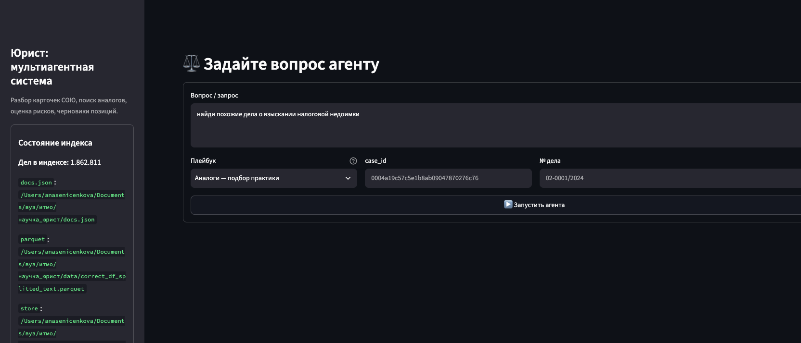
Demo: Streamlit query
Index of 1,862,811 cases. Query: tax-arrears analog search. Playbook: analogs.

Slide 10
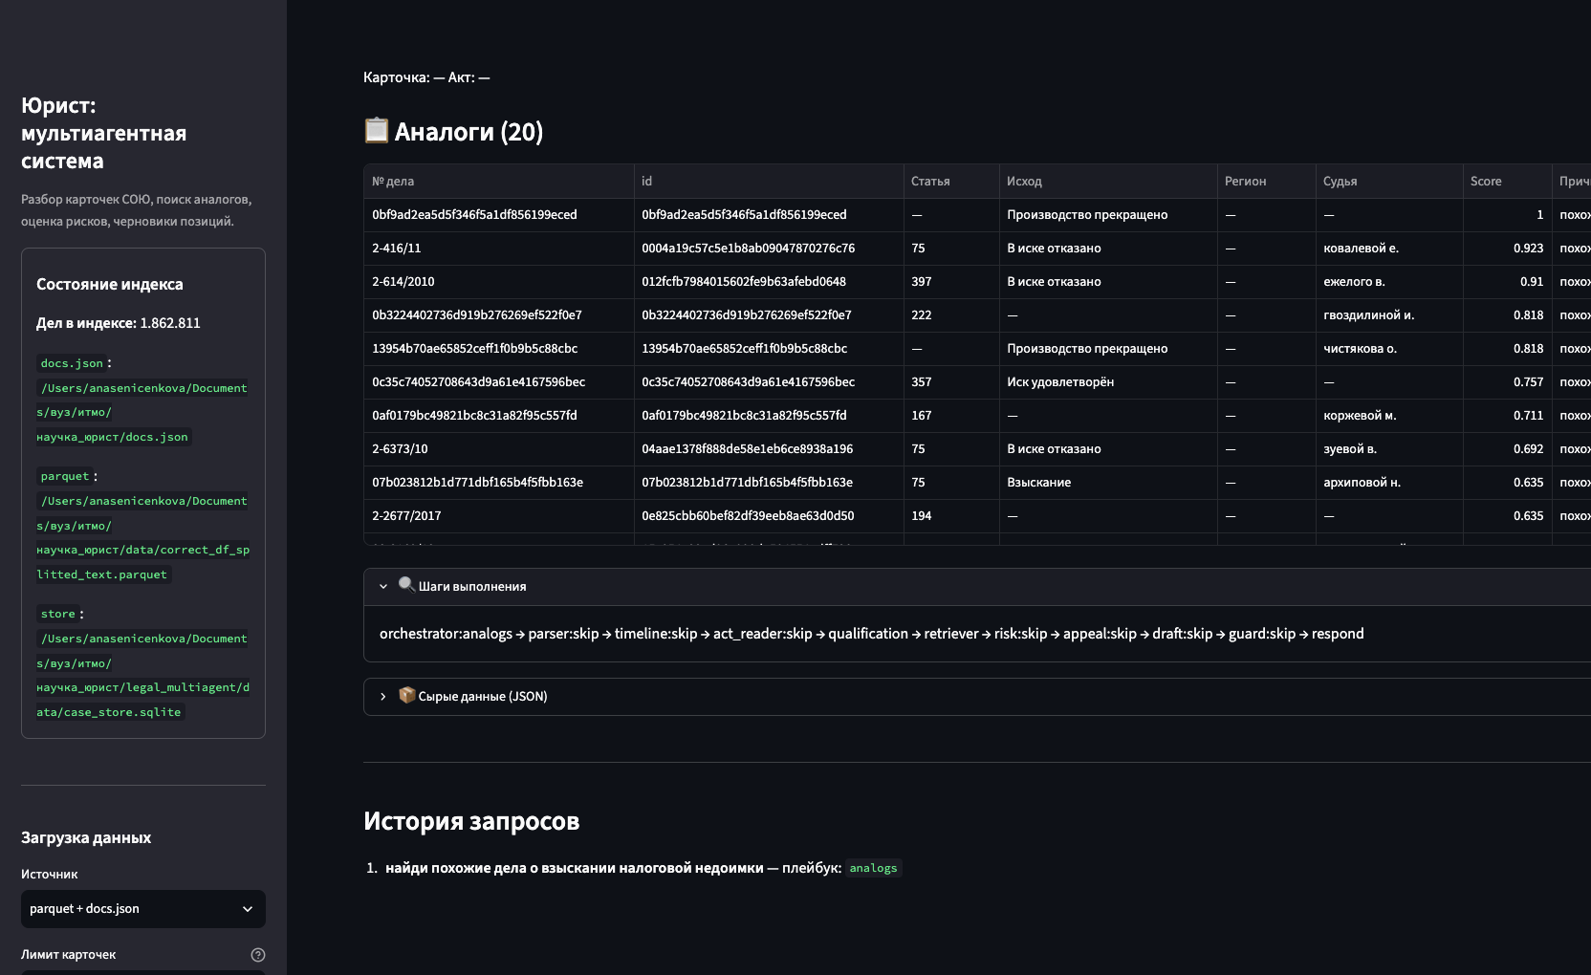
Demo: analog table and graph steps
20 ranked analogs. Unused LangGraph nodes skip (parser → … → Guard).

Slide 11
Main results
Working artifact: legal_multiagent (CLI, Streamlit, README). Full index: 1.86M cases (~69 GB SQLite).
30 automated tests passed (normalization, retrieval, routing, Guard, Risk). No invented facts in Respond.
Retriever: ≥ 60% of top-5 analogs share article and region. Guard rejects unknown case IDs.
Code and README: repository root (cognitive-funnel README; not a public license).
Kind | Records | Share | Role in system
Civil | 1,609,786 | 86.4% | main analog pool
Administrative / other / criminal | 253,025 | 13.6% | sparse; 138 criminal

Slide 12
Main results
Qualitative checks
Routing: five query types map to the intended playbook.
Respond: final answer contains only numbers and IDs present in state.
Risk: wording states this is not a court forecast; warns when analogs are few.
Limits of the current evaluation
No lawyer-labeled “this analog is useful” set on the full corpus (precision@5 is a proxy).
LLM branches (act reader / drafting) were not run e2e without an API key.
Lexical Jaccard can promote a different article if token overlap is high.

Slide 13
Expected next results
Fabula embeddings for analog search, compared with the current hybrid score.
A small lawyer-labeled relevance slice and precision/recall on that slice.
Mocks for Ollama so the full LangGraph path runs in CI.
Submit the Elsevier-format draft (paper/main.tex) to a student / legal-IR workshop.

Slide 14
Conclusion
The goal is met: a prototype that builds a Case Graph, retrieves analogs from SQLite, and drafts a position without citing missing IDs.
Task 1–2: schema + ETL for 1.86M parquet acts. Task 3: LangGraph playbooks, CLI, UI. Task 4: 30 tests; routing and Guard hold.
The system is an assistant for practice search, not a judgment classifier and not legal advice.
Next: embeddings, human relevance labels, and a workshop submission.

Slide 15
Publication readiness
A full manuscript is prepared in Elsevier elsarticle (paper/main.tex + references.bib).
Status: draft / preprint in the repository — not submitted, no acceptance yet.
Venue: to be selected (legal IR, multi-agent systems, or an ITMO student track) within three months.
No reviewer reports yet. The Overleaf-ready source can be compiled as pdfLaTeX.

