Slide 1
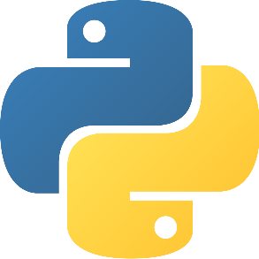
Introduction
Software Engineering for Data Scientists
February 2020

Slide 2
Agenda
Training Requirements
Training Overview
Python Basics refresher (Pre-read)
Expressions
Control structures
Functions
Modules
Advanced Python
Iterables
Functional traits
Generator
Decorator
Annexes

Slide 3
Agenda
Training Requirements
Training Overview
Python Basics refresher (Pre-read)
Expressions
Control structures
Functions
Modules
Advanced Python
Iterables
Functional traits
Generator
Decorator
Annexes

Slide 4



Training requirements
git clone git@github.gamma.bcg.com:swe-training/training-se.git
Set up the training environment with the Prerequisites and the Getting started steps from the README.md
Docker installed
PyCharm set up
Git basic knowledge
Instructions available here:
Ressources available here:
Fundamental training available
here:
https://confluence.gamma.bcg.com/display/TRAIN/Docker
https://confluence.gamma.bcg.com/display/TRAIN/Pycharm+IDE
https://github.gamma.bcg.com/pages/Gamma-GitHub-Training/BCG-Gamma/#/

Slide 5
Agenda
Training Requirements
Training Overview
Python Basics refresher (Pre-read)
Expressions
Control structures
Functions
Modules
Advanced Python
Iterables
Functional traits
Generator
Decorator
Annexes

Slide 6
Software Engineering Training for Data Scientists Agenda
Thursday, June 25th | Friday, June 26th |  | Monday, June 29th | Tuesday, June 30th
8:30-10:00 Use Case 2: Code Architecture
Design Pattern
9:00–10:00 Introduction: Advanced Python*
9:00-10:30 Use Case 1: From notebooks to scripts
Test (part 2)
9:00-10:30 Use Case 2: Code Architecture
Code Improvement
10:00-11:00 OOP Fundamentals
10:00-10:20 Break
10:30-10:45: Break
10:20-12:00 Use Case 2: Code Architecture
Design Pattern
10:30-10:45 Break
10:45–1:00pm Use Case 2: Code Architecture
Environment & Docker setup*
Design Pattern
10:45-12:45 Use Case 2: Code Architecture
Context Manager and Decorator
11:00-11:15: Break
11:15-12:15 Use Case 1: From notebooks to scripts
Characteristics of production-ready code
12:00-12:10 Break
12:15-1:00pm Use Case 1: From notebooks to scripts
Test (part 1)
12:10-1:10pm Use Case 2: Code Architecture
Code Improvement
12:45-1:00pm Q&A
Lectures
Breaks
Hands on session
*this part is rather hands-on

Slide 7
Detailed agenda
Introduction
Use case 1
Use case 2
Pre-Read - Python Basics refresher
Expressions
Control structures
Functions
Modules
Advanced Python
Iterables
Functional traits
Generator
Decorator
Annexes
Application exercices
Use Cases Exercises (Reminder)
OOP Fundamentals
Class, Objects and Methods
Property
Data Encapsulation, Inheritance & Polymorphism
Built-in functions
Tests
Unit test
Integration test
End to end test
Design Pattern
Singleton
Factory
Abstract Classes
Code Improvement
Organize your code
Data ingestion
Errors
Logging
Documenting
Formatting
Debugging
Package Design
Context Manager & Decorator
(Not covered by the session, optional)
Deployment
Docker
CI

Slide 8
Python environment
Introduction
Use case 1
Use case 2
Conda environment with Python 3.6 (Recommended)
Or Python 3.6 virtual env
Docker environment with Python interpreter from the model service. See getting started of the README.md (Recommended)
Or Conda environment with Python 3.6
Docker environment with Python interpreter from the model service. See getting started of the README.md (Recommended)
Or Conda environment with Python 3.6 (& requirements.txt)
>>> conda create -n training-se pip python==3.6.9
>>> conda activate training-se

Slide 9

Use Cases Exercises
All the exercises are available here https://github.gamma.bcg.com/swe-training/training-se
The goal of those exercises is to reproduce what happens on a real case.
From a first draft of the code on a Jupyter Notebook, you will implement:
A first and basic python module (UC1)
A production python module (UC2)
Each exercise focuses on a specific subject from the lectures.
The instructions and documentation are in the training-se branch. Make sure you have set up the training environment with the Prerequisites and the Getting started from the README.md
For each exercise pull the associated branch.
Follow the instructions in EXERCISES.md
Ask for help if needed.

Slide 10
Agenda
Training Requirements
Training Overview
Python Basics refresher (Pre-read)
Expressions
Control structures
Functions
Modules
Advanced Python
Iterables
Functional traits
Generator
Decorator
Annexes

Slide 11
Agenda
Training Requirements
Training Overview
Python Basics refresher (Pre-read)
Expressions
Control structures
Functions
Modules
Advanced Python
Iterables
Functional traits
Generator
Decorator
Annexes

Slide 12
Expressions – Main types
Scalar types
Collection types
 |  | Constructors
Integer | 2 | int
Float | 2.2 | float
String | 'hello' | str
Boolean | True | Bool
 |  | Constructors
List | [1, 2, 3] | list
Tuple | (1, 2, 3) | tuple
Dictionary | {'a':1, 'b':2, 'c':3} | dict
Set | {'a', 'b', 'c'} | set

Slide 13
Agenda
Training Requirements
Training Overview
Python Basics refresher (Pre-read)
Expressions
Control structures
Functions
Modules
Advanced Python
Iterables
Functional traits
Generator
Decorator
Annexes

Slide 14
Control structures – If, For and While
If statements
For statements
While statements
Allows to express conditional statements
Allows to iterate through all collections types
Allows repeated execution as long as statement is true
if x < 0:
print('Negative')
elif x == 0:
print('Zero')
else:
print('Positive')
dic = {'a': 1, 'b': 2, 'c': 3}
for k, v in dic.items():
print("key: ", k)
print("value: ", v)
x = 0
while x < 5:
x += 1
print(x)
Output for x = 0
Output
key: a
value: 1
key: b
value: 2
key: c
value: 3
Output
1
2
3
4
5
Zero
Output for x = 10
Positive

Slide 15
Control structures – Break, Continue and Pass
Break
Continue
Pass
Breaks out of the innermost enclosing for or while loop
Continues to the next iteration of the loop
Does nothing
for letter in "PYTHON":
if letter == "H":
break
print('letter', letter)
for letter in "PYTHON":
if letter == "H":
continue
print('letter', letter)
for letter in "PYTHON":
if letter == "H":
pass
print('letter', letter)
Output
Output
Output
letter P
letter Y
letter T
letter P
letter Y
letter T
letter O
letter N
letter P
letter Y
letter T
letter H
letter O
letter N

Slide 16
Agenda
Training Requirements
Training Overview
Python Basics refresher (Pre-read)
Expressions
Control structures
Functions
Modules
Advanced Python
Iterables
Functional traits
Generator
Decorator
Annexes

Slide 17
Define functions and arguments
Defining functions
Optional arguments
Classic definition
Allow function to accept optional arguments :
*args for optional positional arguments
**kwargs for optional keyword arguments
def my_func(a, b, c):
#...
return True
def my_func(required, *args, **kwargs):
print(required)
if args:
print(args)
if kwargs:
print(kwargs)
Collected as tuple
Lambda definition
Collected as dictionary
x = lambda a, b, c: a + b + c
>>> my_func("Hello", 1, 2, a="value1", b="value2")
Hello
(1, 2)
{'a': 'value1', 'b': 'value2'}
>>> my_func("Hello", 1, 2, {"a":"value"})
Hello
(1, 2, {'a': 'value'})
>>> my_func(*["Hello", 1, 2], **{"a":"value"})
Hello
(1, 2)
{'a': 'value'}
required
*args
**kwargs
A lambda function is a small, anonymous function
It can take any number of arguments but can only have on expression
Useful when a function is required for a short period of time, for example nested inside another function
Unpacking of arguments: positional (*) vs keyword (**)

Slide 18
Agenda
Training Requirements
Training Overview
Python Basics refresher (Pre-read)
Expressions
Control structures
Functions
Modules
Advanced Python
Iterables
Functional traits
Generator
Decorator
Annexes

Slide 19
Modules and PYTHONPATH
Absolute and relative import
PYTHONPATH
Absolute imports specifies the object to be imported using its full path from the root of the folder
Python can use the environment variable PYTHONPATH to find the modules
It includes which directory that should be taken into account when looking for modules
from module1 import function1
from module.module2 import function2
import sys
sys.path
['','C:\\Users\\user\\AppData\\Local\\Programs\\Python\\Python37\\python37.zip', 'C:\\Users\\user\\AppData\\Local\\Programs\\Python\\Python37\\lib', …]
Relative imports specifies the object to be imported related to the location were the statement is
from .module1 import function1
from ..module1 import function1
Modules can be added to the PYTHONPATH
Use .module1 (resp ..module1) to look for module1 in a directory one (resp two) level above the __file___ where the import statement is

Slide 20
os and sys
os
sys
To get current directory:
To get the list of command line arguments passed to a python script
os.getcwd()
'C:\\Users\\user\\Documents\\Project'
sys.argv
To change current directory
['script.py', 'param1', 'param2']
os and sys modules provide numerous tools to deal with filenames, path and directories
os provides tools for directories
os.sys or sys for the system
os.chdir(path)
To get search paths for python modules
sys.path
To list all files in a directory
['','C:\\Users\\user\\AppData\\Local\\Programs\\Python\\Python37\\python37.zip', …]
os.listdir(path)
['data', 'dir_1', 'main.py']
To create a directory
To get version number of current python interpreter
os.mkdir("new_dir")
sys.version
'3.8.0 (tags/v3.8.0:fa919fd, Oct 14 2019, 19:37:50) [MSC v.1916 64 bit (AMD64)]'
To access environment variables
os.environ.keys()
os.environ[NAME] = VALUE

Slide 21
Pathlib
Get current working directory
pathlib.Path.cwd()
WindowsPath¹ ('C:/Users/user/AppData/Local/Programs/Python/Python38')
Get home directory
pathlib.Path.home()
WindowsPath('C:/Users/user')
Create a custom path
Pathlib module offers a convenient way to manipulate paths objects
It is especially useful for compatibility of the paths across operating systems (e.g. Win/Mac)
1
pathlib.Path(r'C:\Users\Baptiste\test\test.py')
2
pathlib.Path.home() / 'python' / 'scripts' / 'test.py'
WindowsPath('C:/Users/user/python/scripts/test.py')
Resolve make the path absolute, resolving any symlink
3
pathlib.Path(__file__).resolve()
WindowsPath('C:/Users/user/python/scripts/test.py')
Pathlib objects have useful properties
path
# PosixPath('/home/user/project/test.md')
path.name
# 'test.md'
path.stem
# 'test'
path.suffix
# '.md'
path.parent
# PosixPath('/home/user/project')
path.parent.parent
# PosixPath('/home/user')
path.anchor
# '/'
1. WindowsPath is replaced By PosixPath for Mac and Linux

Slide 22
Agenda
Training Requirements
Training Overview
Python Basics refresher (Pre-read)
Expressions
Control structures
Functions
Modules
Advanced Python
Iterables
Functional traits
Generator
Decorator
Annexes

Slide 23
Agenda
Training Requirements
Training Overview
Python Basics refresher (Pre-read)
Expressions
Control structures
Functions
Modules
Advanced Python
Iterables
Functional traits
Generator
Decorator
Annexes

Slide 24
Iterators
It inherits from Iterable
iter()
Abstract method of Iterable
It enables to return an iterator from iterable objects (list, tuple, string…)
next()
Abstract method of Iterator
It enables to manually iterate through all the items of an iterator
Iterators are objects used to iterate over an iterable object (e.g. a collection)
It is a lazy evaluator, meaning it does evaluation when we need it

Slide 25
>>> l = [1, 2, 3, 4]
>>> it = iter(l)
>>> next(it)
>>> next(it)
>>> next(it)
>>> next(it)
>>> next(it)

Slide 26
>>> l = [1, 2, 3, 4]
>>> it = iter(l)
>>> next(it)
>>> next(it)
>>> next(it)
>>> next(it)
>>> next(it)
Output 1
2
3
4
Traceback (most recent call last):
File "<input>", line 1, in <module>
StopIteration

Slide 27
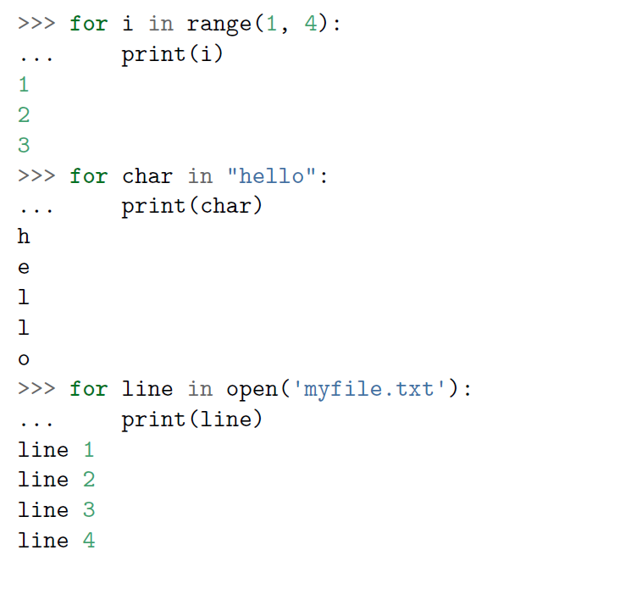
Everything is Iterable (1)

Slide 28
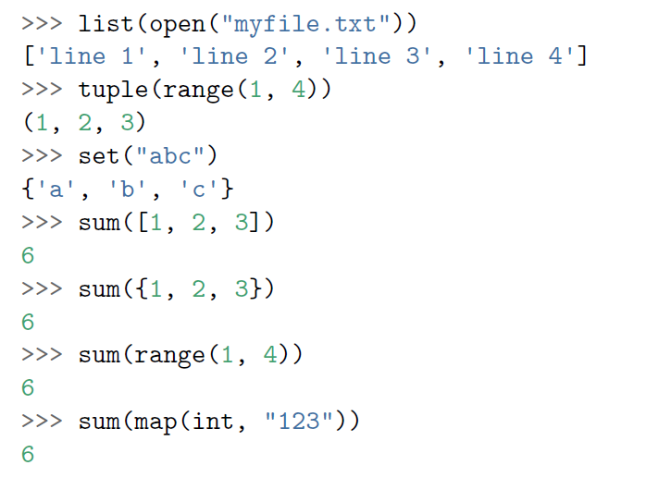
Everything is Iterable (2)

Slide 29
Unpacking works for all iterables
>>> a, b, c, d = open('myfile.txt')
>>> print(c)
line 3

Slide 30
>>> first, * all, last = range(100)
>>> print(first)
>>> print(sum(all))
>>> print(last)

Slide 31
>>> first, * all, last = range(100)
>>> print(first)
>>> print(sum(all))
>>> print(last)
Output 0
4851
99

Slide 32
Agenda
Training Requirements
Training Overview
Python Basics refresher (Pre-read)
Expressions
Control structures
Functions
Modules
Advanced Python
Iterables
Functional traits
Generator
Decorator
Annexes

Slide 33
Examples of lazy evaluated functions
map
Applies a function on all the elements of an iterable
Functional traits
my_add = lambda a, b :a + b
list(map(my_add, [1, 2, 3], [4, 5, 6]))
[5, 7, 9]
Generator functions allow to declare a function that behaves like an iterator, i.e. it can be used in a for loop
Generators are memory efficient as the results are calculated when needed (lazy)
filter
Allows to select items in an iterable
def my_check(a):
return a > 10 and a%2
list(filter(my_check, [1, 5, 10, 11, 12, 25]))
[11, 25]
zip
Makes an iterator that pairs elements from each iterables given as input
list(zip([1, 2, 3], [4, 5, 6]))
[(1, 4), (2, 5), (3, 6)]
reduce
Applies a function of two arguments cumulatively to the elements of an iterable, optionally starting with an initial argument
result = reduce(lambda a, b : a if a>b else b,
[3, 4, 6, 9, 34, 12])
34
Very useful to recursively merge data frames
Notes:
Notes view: 32

Slide 34
>>> l = ("madam", "freer", "kayak", "kiosk")
>>> pal = list(filter
(lambda word: word == word[::-1],
l))
>>> print(palindromes)

Slide 35
>>> l = ("madam", "freer", "kayak", "kiosk")
>>> pal = list(filter
(lambda word: word == word[::-1],
l))
>>> print(palindromes)
Output ["madam", "kayak"]

Slide 36
>>> items = ['Banana', 'Apple', 'Orange' ]
>>> qty = [1, 2, 3]
>>> l = list(zip(items, map(lambda x: x*10, qty))
>>> list(filter(lambda x: x[1] > 10, l)

Slide 37
>>> items = ['Banana', 'Apple', 'Orange' ]
>>> qty = [1, 2, 3]
>>> l = list(zip(items, map(lambda x: x*10, qty))
>>> list(filter(lambda x: x[1] > 10, l)
Output [('Apple'', 20), ('Orange', 30)]

Slide 38
Built-in functions, the basics
dir
Returns a list of valid attributes of the object passed in parameters
>>> l = list(map(lambda _: _%2 == 0, range(5)))
>>> l
[True, False, True, False, True]
>>> dir(l)
['__add__', '__class__', '__contains__', '__delattr__', ..., 'append', 'clear', 'copy', 'count', 'extend', 'index', 'insert', 'pop', 'remove', 'reverse', 'sort']
any
Evaluates if at least one is True
inspect
Helps you get information about live objects, such as modules, classes, methods, functions, tracebacks, frame objects and code objects
>>> any(l)
True
zip(*list)
Unpacks the list in a way that each element of your list becomes an argument to the function and then zip them
all
Evaluates if all are True
>>> all(l)
False
>>> l = [(1, 'a'), (2, 'b')]
>>> list(zip(*l)
[(1, 2), ('a', 'b')]

Slide 39
Built-in functions in Python 3
Built-in Functions
abs() | dict() | help() | min() | setattr()
all() | dir() | hex() | next() | slice()
any() | divmod() | id() | object() | sorted()
ascii() | enumerate() | input() | oct() | staticmethod()
bin() | eval() | int() | open() | str()
bool() | exec() | isinstance() | ord() | sum()
bytearray() | filter() | issubclass() | pow() | super()
bytes() | float() | iter() | print() | tuple()
callable() | format() | len() | property() | type()
chr() | frozenset() | list() | range() | vars()
classmethod() | getattr() | locals() | repr() | zip()
compile() | globals() | map() | reversed() | __import__()
complex() | hasattr() | max() | round()
delattr() | hash() | memoryview() | set()

Slide 40
Agenda
Training Requirements
Training Overview
Python Basics refresher (Pre-read)
Expressions
Control structures
Functions
Modules
Advanced Python
Iterables
Functional traits
Generator
Decorator
Annexes

Slide 41
Generator (I)
Using yield
yield is a keyword that is used liked return, except the function will return an iterator
>> def get_even(number):
for nb in range(number):
if nb % 2 == 0:
yield nb
>> c = get_even(20)
>> c
<generator object get_even at 0x10a63df68>
>> list(c)
[0, 2, 4, 6, 8, 10, 12, 14, 16, 18]
>> list(c)
[]
Generator functions allow you to declare a function that behaves like an iterator, i.e. it can be used in a for loop
Code writing is simplified
Values are generated on demand, enabling lower memory usage (as only one item is loaded at the time)
Generator is computed on demand (only once!)
Using generator expressions
Putting a for loop in brackets will create a generator
gen = (nb for nb in range(20) if nb % 2 == 0)
list(gen)
Very useful for most DS projects
[0, 2, 4, 6, 8, 10, 12, 14, 16, 18]

Slide 42
Generator (II)
Imagine you have a huge dataframe you can not load in memory entirely
You can use generators to go through it and load it one column at the time
Generator chaining
from itertools import islice
import pandas as pd
import numpy as np
a = islice(open("./tmp/stores.csv"), 1, None)
b = map(lambda _: _.split(','), a)
c = map(lambda _: np.median(_[1:25]), b)
df = pd.DataFrame(list(c))

Slide 43
How would you implement a generator of prime numbers ?
def take(n, gen):
res = []
for _ in range(n):
res.append(next(gen))
return res
def prime_gen() -> Generator[int, None, None]:
>>> take(15, prime_gen())
[2, 3, 5, 7, 11, 13, 17, 19, 23, 29, 31, 37, 41, 43, 47]

Slide 44
def prime_gen():
yield 2
yield 3
prime_set = {2, 3}
current_number = 5
while True:
if all(map(lambda _: current_number % _ != 0, prime_set)):
yield current_number
prime_set |= {current_number}
current_number += 2

Slide 45
328350
Comprehensions
List
[x**2 for x in range(50) if x % 2 == 0]
[0, 4, 16 …]
Set
{x ** 2 for x in range(50)}
Comprehension return a list, set or dictionary object using an iterable
Equivalent to writing a for loop
{ 0, 2, 4 … }
Dict
{idx: v**2 for idx, v in enumerate (range(50))}
{0 : 0, 1 : 2, 2 : 4 …}
Generator
sum(x**2 for x in range(100))
328350

Slide 46
Itertools offers a useful set of iterators
Chain
Product
Cycle
>>> import itertools
>>> for x in itertools.chain('abc',
range(3)):
print(x)
a
b
c
0
1
2
>>> list(itertools.product('abc', range(3)))
[('a', 0),
('a', 1),
('a', 2),
('b', 0),
('b', 1),
('b', 2),
('c', 0),
('c', 1),
('c', 2)]
>>> infinite = iter(itertools.cycle('abc'))
>>> print(next(infinite))
'a'
>>> print(next(infinite))
'b'
>>> print(next(infinite))
'c'
>>> print(next(infinite))
'a'
>>> print(next(infinite))
'b'
And many others!

Slide 47
Collections module(I)
Counter
Output
Initializing
from collections import Counter
Counter(['a', 'b', 'c', 'a', 'b', 'b'])
Counter({'a': 2, 'b': 3, 'c': 1})
Counter(a=2, b=3, c=1)
Counter({'b': 3, 'a': 2, 'c': 1})
Counter({'b': 3, 'a': 2, 'c': 1})
Counter({'b': 3, 'a': 2, 'c': 1})
Accessing Counts
c = Counter(['a', 'b', 'c', 'a', 'b', 'b'])
list(c.elements())
c.most_common()
['a', 'a', 'b', 'b', 'b', 'c']
Implements specialized datatypes as alternatives of general purpose collections (list, tuple etc…)
[('b', 3), ('a', 2), ('c', 1)]
Operations
C1: Counter({'b': 3, 'a': 2, 'c': 1}) C2: Counter({'a': 1, 'b': 1, 'c': 1, 'd': 1, 'e': 1, 'f': 1}) Combined counts: Counter({'b': 4, 'a': 3, 'c': 2, 'd': 1, 'e': 1, 'f': 1}) Subtraction: Counter({'b': 2, 'a': 1}) Intersection (taking positive minimums): Counter({'a': 1, 'b': 1, 'c': 1})
c1 = Counter(['a', 'b', 'c', 'a', 'b', 'b'])
c2 = Counter('abcdef')
print('c1:', c1)
print('c2:', c2)
print('\n Combined counts:')
print(c1 + c2)
print('\n Substraction:')
print(c1 - c2)
print('\n Intersection (taking positive minimums):')
print(c1 & c2)

Slide 48
Collections module(II)
Works as a python dictionary except it does not throw a KeyError when trying to access a non-existent key
Defaultdict
Dictionary where keys maintain the order in which they are inserted
OrderedDict
Returns a tuple with names for each position in the tuple
Namedtuple
Used to combine several dictionaries of mappings. Returns a list of dictionaries
Chainmap
List optimized for inserting and removing items
Deque

Slide 49
Agenda
Training Requirements
Training Overview
Python Basics refresher (Pre-read)
Expressions
Control structures
Functions
Modules
Advanced Python
Iterables
Functional traits
Generator
Decorator
Annexes

Slide 50
Decorator (I)
def check_path(function):
def wrapper(path, *args, **kwargs):
if not os.path.isfile(path):
raise ValueError(f"Path {path} does not exist")
else:
print(f"{path} checked ! ")
return function(path, *args, **kwargs)
return wrapper
@check_path
def load_data(path):
return pd.read_csv(path)
load_data('path_error.csv')
# ValueError(path_error.csv does not exist)
load_data('path_right.csv')
# pd.DataFrame
Decorators allow to add a new functionality to an existing function without modifying its structure
As objects, Python functions can be
passed as arguments
Returned from a function
Modified
Assigned to a variable
Core idea of decorators

Slide 51
Decorator (II)
Use functools.wraps to easily construct a decorator
from functools import wraps
def my_decorator(f):
@wraps(f)
def wrapper(*args, **kwargs):
print('Calling decorated functions')
return f(*args, **kwargs)
return wrapper
@my_decorator
def example():
"""Docstring"""
print('Called example function')

Slide 52
Decorator (III)
Decorators can take arguments
def check_type_args(type_):
def check_type(function):
def wrapper(*args, **kwargs):
data = args[0]
column = args[1]
if data[column].dtype!=type_:
raise ValueError(f"Column {column} does not have {type_} as type.")
else:
print("type checked !")
return function(*args, **kwargs)
return wrapper
return check_type
@check_type_args(float)
def average(data, column):
return data[column].mean()
average(data, "sales")
#type checked !
#43.233413

Slide 53
Main usage of decorators
For example, they can be used for :
Timing of a function
Profiling of a method
Enrichment of function parameters
Authentication
Validation of the inputs (type, path, args,…)
Decorators enable to add functionalities used in several functions without adding complexity into the functions
Data Science application:
Check if a file has not already been dumped, before processing it
Define a custom log function
Profiler

Slide 54
How would you implement a logging decorator ?
>>> @LogDecorator()
def test_function(a, b, c): -> int
return a ** b / c
>>> test_function(2, 4, 8)
[2020-02-01 18:30:12 [ INFO] test_function(2, 4, 8) = 2.0

Slide 55
def logdecorator(fn):
@functools.wraps(fn)
def decorated(*args, **kwargs):
try:
logger.info("{0} {1} {2}".format(fn.__name__,
args, kwargs))
result = fn(*args, **kwargs)
logger.info(result)
return result
except Exception as ex:
logger.info("Exception {0}".format(ex))
raise ex
return result
return decorated

Slide 56
Agenda
Training Requirements
Training Overview
Python Basics refresher (Pre-read)
Expressions
Control structures
Functions
Modules
Advanced Python
Iterables
Functional traits
Generator
Decorator
Annexes

Slide 57

PIP and Pypi
Install a package
pip install package_name
Install a specific version of a package
pip install package==1.1.0
PIP is an installer for python packages
Install all packages required
pip install –r requirement.txt
Pypi is a software repository for python where you can find many packages.
PIP uses it as the default source for packages and their dependencies
Another custom repository can be specified to PIP
(e.g. an internal repository)

Slide 58
Venv & Conda
VENV
$ cd my_project_folder
$ python3 –m venv env_name
$ source venv/bin/activate
$ pip install pandas
$ deactivate
Creates a directory containing python executables as well as 'pip' library
Once the virtual environment is activated, packages installed using pip will be placed in the venv folder
Virtualenv & conda env are a tool to keep dependencies of a project in a separated location
Conda env
$ cd my_project_folder
$ conda create –n env_name (python=x.x)
$ conda activate my_env
$ conda install pandas
$ deactivate
Creates a directory containing python executables as well as 'pip' library and conda executables
Always centralize dependencies in a 'requirements.txt' (pip) or 'environment.yml' (conda) file for faster set-up and reproducibility
Once the virtual environment is activated, packages installed using pip or conda will be placed in the venv folder

