Slide 1
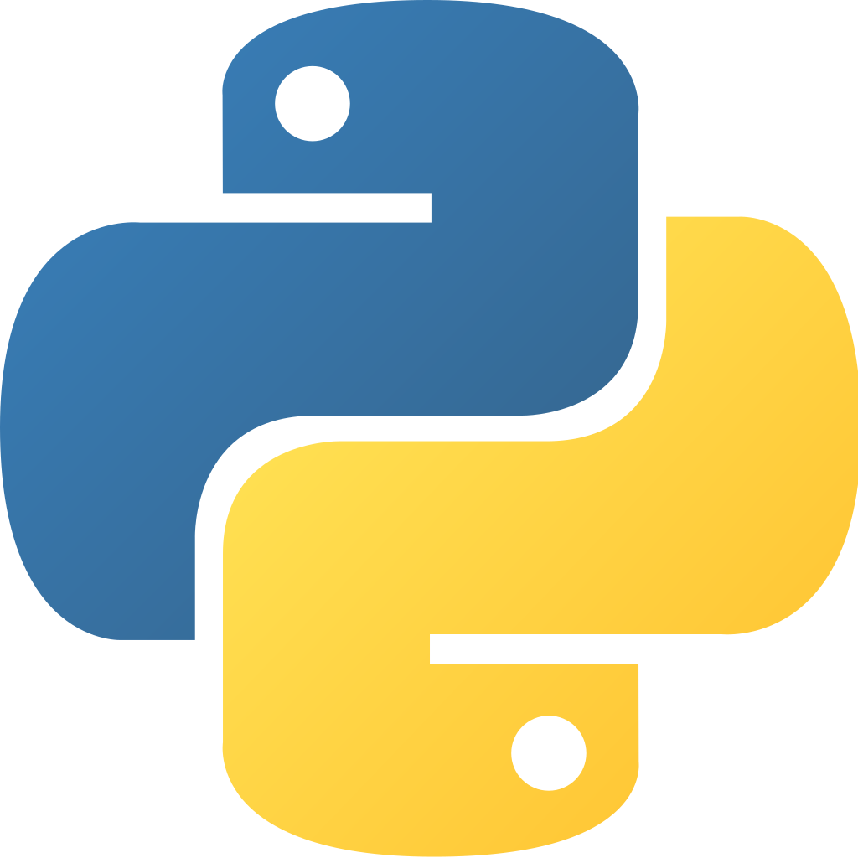
Use Case 2
Software Engineering for Data Scientists
February 2020

Slide 2
What have we done so far ?
Not structured
Oriented-Object Programming (OOP)
Pipeline – sequentiality & loose coupling
Model Factory – homogeneity between ML models
Not flexible
Not robust
Config – immutable parameters
ConfigHandler – unicity of key objects (singleton)
Tests
Continuous Integration (CI)
Not easily reproducible
Scenarios – code versioning (commit hash is kept…)
Decorators – reproducible actions all along the code
Context manager – guarantee enter() and exit() for specific objects
Not easily deployable
Docker, Sphinx documentation

Slide 3

Exercise 2.1 Which architecture should we adopt to reach our goal ?

Slide 4
Working framework for the next exercises
demand_forecast
Main repository
app
Web App module (e.g. visualization, user-friendly run interface)
configs
Model configuration module
doc
Sphinx documentation module
More details about the overall structure and the different classes implemented in the Sphinx documentation
(available after pulling the repo and calling docker-compose up)
http://localhost:8000/
src
Core module
backtest
Post-processing for Web App dashboard (e.g. accuracy KPI)
context
Scope of the prediction
data
SQL data extraction (incl. creation of mock data for training)
demand_forecast
Features engineering & ML modules
services
Standard object (e.g. handlers, logger, database manager)
tasks
Pipeline modules
utils
Auxiliary functions
tests
Tests functions for the different modules
tmp
Outputs, etc.
Often useful
Optional

Slide 5
Agenda
Design Pattern
Singleton
Factory
Abstract Classes
Code Improvement
Organize your code
Data Ingestion
Errors
Logging
Documenting
Formatting
Debugging
Package Design
Context Manager & Decorator (Reminder)
Deployment (Not covered along training sessions)
Docker
CI
Solution overview

Slide 6
Agenda
Design Pattern
Singleton
Factory
Abstract Classes
Code Improvement
Organize your code
Data Ingestion
Errors
Logging
Documenting
Formatting
Debugging
Package Design
Context Manager & Decorator (Reminder)
Deployment (Not covered along training sessions)
Docker
CI
Solution overview

Slide 7
Agenda
Design Pattern
Singleton
Factory
Abstract Classes
Code Improvement
Organize your code
Data Ingestion
Errors
Logging
Documenting
Formatting
Debugging
Package Design
Context Manager & Decorator (Reminder)
Deployment (Not covered along training sessions)
Docker
CI
Solution overview

Slide 8
Singleton
Steps to implement a Singleton
Use a module
Create a single instance and pass it every object that needs it
Alter the instantiation process of the class
A singleton pattern is a design pattern that restricts the instantiation of a class to a "single" instance
Useful for
Configurations
Connections to a database
Output
class Config:
def __init__(self):
pass
def __new__(cls):
if not hasattr(cls, '_config'):
cls._config = super(Config, cls).__new__(cls)
else:
print('class already instantiated')
return cls._config
config1 = Config()
config2 = Config()
# returns
# class already instantiated

Slide 9
Agenda
Design Pattern
Singleton
Factory
Abstract Classes
Code Improvement
Organize your code
Data Ingestion
Errors
Logging
Documenting
Formatting
Debugging
Package Design
Context Manager & Decorator (Reminder)
Deployment (Not covered along training sessions)
Docker
CI
Solution overview

Slide 10
Factory
class Loader():
def load(self, data, format):
if format == 'csv':
__loader = _load_csv
elif format == 'xlsx':
__loader = _load_xlsx
else:
raise ValueError(format)
return __loader(data)
def _load_csv(data):
return pd.read_csv(data)
def _load_xlsx(data):
return pd.read_excel(data)
loader = Loader()
loader.load(data,"csv")
# pd.DataFrame
loader.load(data,"xlsx")
#pd.DataFrame
The factory design pattern enables to create objects without having to specify the exact class of the object.
The created objects share a common interface
To implement the Factory pattern, we can define a class with methods to create objects
Useful to create different ML models

Slide 11
Abstract Factory
class AbstractData
@abstractmethod : load()
@abstractmethod : filter()
The abstract factory pattern is an extension of the factory pattern using an abstract class that allows the creation of families of related products
class Data_1(AbstractData)
class Data_n(AbstractData)
load()
filter()
load()
filter()
Useful if you have a complex data ingestion to design
All the Data objects now share the same interface, which is convenient when n takes high values

Slide 12
Agenda
Design Pattern
Singleton
Factory
Abstract Classes
Code Improvement
Organize your code
Data Ingestion
Errors
Logging
Documenting
Formatting
Debugging
Package Design
Context Manager & Decorator (Reminder)
Deployment (Not covered along training sessions)
Docker
CI
Solution overview

Slide 13
Abstract classes and @abstractmethod (I)
from abc import *
class Loader(ABC):
def __init__(self, path: str):
self.path = path
super().__init__()
@abstractmethod
def load(self, *args, **kwargs) -> pd.DataFrame:
#Load the dataframe.
raise RuntimeError("Not implemented")
@abstractmethod
def transform(self,*args, **kwargs) -> pd.DataFrame:
#Update the dataframe with this method
raise RuntimeError("Not implemented")
@property
def get_path(self):
return self.path
class Sales(Loader):
def load(self):
self.__data = pd.read_csv(self.path)
return self.__data
def transform(self, date) -> pd.DataFrame:
return self.__data.loc[self.__data['time']>=date]
sales = Sales('../test.csv')
sales.load()
# pd.DataFrame
sales.transform('2019-01-01')
# pd.DataFrame transformed
Abstract class
Abstract classes are classes that contain one or more abstract methods
An abstract method is a method that is declared, but contains no implementation
Python comes with a module which provides the infrastructure for defining Abstract Base Classes : abc
Sales can't be instantiated if the load & transform method are not defined
Example class inheriting from Abstract class

Slide 14
Abstract classes and @abstractmethod (II)
ABC | Abstract method | Basic examples
collections.Iterable | __iter__ | def __iter__(self): return iter(self.__data)
collections.Iterator | __next__ | def __next__(self): if self.current<self.__n: self.current+=1 return self.__data[self.current] else: raise StopIteration
collections.Generator | send, throw
collections.MutableMapping | __getitem__ __setiem__ __delitem__ __iter__ __len__ | def __getitem__(self, key): return self.__data[key] def __setitem__(self, key, item): self.__data[key] = item
collections.Mapping | __getitem__ __iter__ __len__ | def __len__(self): return len(self.__data)
Abstract classes are often used with the basic collections classes
For a ML project, an abstract class like Mapping can be useful to load and create a tailor-made dictionary class (e.g configuration,…)
Full collections objects and
Abstract methods:
https://docs.python.org/3.4/library/collections.abc.html

Slide 15
Exercise 2.2 Implement an immutable configuration Branch origin/training/ex-read-only-config

Slide 16
Exercise 2.3 Implement a singleton Branch origin/training/ex-config-handler
Exercise 2.4
Add a Scenario class Branch origin/training/ex-oop

Slide 17
Agenda
Design Pattern
Singleton
Factory
Abstract Classes
Code Improvement
Organize your code
Data Ingestion
Errors
Logging
Documenting
Formatting
Debugging
Package Design
Context Manager & Decorator (Reminder)
Deployment (Not covered along training sessions)
Docker
CI
Solution overview

Slide 18
Agenda
Design Pattern
Singleton
Factory
Abstract Classes
Code Improvement
Organize your code
Data Ingestion
Errors
Logging
Documenting
Formatting
Debugging
Package Design
Context Manager & Decorator (Reminder)
Deployment (Not covered along training sessions)
Docker
CI
Solution overview

Slide 19
Repository Structure
├── LICENSE
├── README.md
├── .gitignore
├── main.py
├── renquirements.txt
├── src
│ ├─ config
│ │ ├─ config.yml
│ │ └─ config.py
│ │
│ ├─ example_pkg
│ │ ├─ __init__.py
│ │ ├─ foo.py
│ │ ├─ bar.py
│ │ ├─ baz.py
│ │ └─ utils
│ │ └─ plot.py
│ ├─ test
│ │ ├─ foo_test.py
│ │ ├─ bar_test.py
│ │ └─ baz_test.py
│ │
│ ├─ data
│ │ ├─ inputs
│ │ │ └─ input01.csv
│ │ └─ outputs
│ │ └─ output0.csv
│ │
│ └─ doc
A repository should follow the following structure
In this lecture we will now go in the details of example_pkg
The test part has already been discussed and the configuration part will be treated in the next lecture

Slide 20
example_pkg
├─ example_pkg
│ ├─ __init__.py
│ ├─ foo.py
│ ├─ bar.py
│ ├─ baz.py
│ └─ utils
│ ├─ __init__.py
└─ plot.py
package
A package is a directory containing modules with an extra file __init__.py
Modules encapsulate classes, functions and global objects
modules
utility
functions

Slide 21
Package design
Packages are a way of structuring Python’s module namespace by using “dotted module names”
When importing the package, Python searches through the directories on sys.path looking for the package subdirectory
The __init__.py files are required to make Python treat directories containing the file as packages
In a first approach, you should include an empty __init__.py file at the root of each package/subpackage

Slide 22
Package design
In __init__.py
# in the __init__.py example_pkg
__all__ = ['bar', 'foo']
├─ example_pkg
│ ├─ __init__.py
│ ├─ bar/
│ ├─ foo/
│ └─ baz/
You can filter the imported modules encountered in the package using __all__
In the main script
from example_pkg import *
print(bar)
print(baz) # -> will raise and error

Slide 23
Importlib
Importlib is part of python standard library of modules
It provides and implementation of the import statement
Dynamic imports Gives the ability to import a module that is passed to it as a string
import importlib
importlib.import_module('foo')
Module import checking Checks if a package was imported
importlib.util.find_spec('foo')

Slide 24
Agenda
Design Pattern
Singleton
Factory
Abstract Classes
Code Improvement
Organize your code
Data Ingestion
Errors
Logging
Documenting
Formatting
Debugging
Package Design
Context Manager & Decorator (Reminder)
Deployment (Not covered along training sessions)
Docker
CI
Solution overview

Slide 25
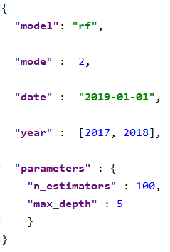
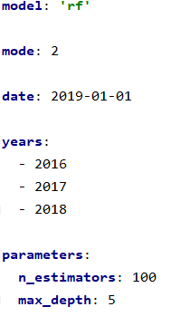
Configuration files
1. Create your configuration file
2. Validate its structure
JSON
Lightweight format for storing and transporting data in an easy to understand way
Create a json file in Python using json.dump(dict_file, file)
Import an exisiting json file in Python using json.load(open(file))
Schema
Module that allows you to validate ANY Python structure
Example of application in Python with the YAML file:
Configuration files include all the parameters that can be changed by a user to launch a run
They are kept in separate files from the code
They should be versioned with the code
from schema import *
import datetime
schema = Schema({
Optional(‘model’) : str,
Optional(‘mode’) : int,
Optional(‘date’) : datetime.date,
Optional(‘years’) : And(
list,
lambda _ : type(_) is int
),
Optional(‘parameters’) : {
‘n_estimators’ : int,
‘max_depth’ : int
}
})
schema.validate(
yaml.safe_load(open(‘config.yml’))
)
YAML
Serialization language to structure data in readable and concise way
Create a yaml file in Python using yaml.dump(dict_file, file)
Import an existing yaml file in Python using yaml.load(open(file))

Slide 26
ETL – Extract Transform Load
ETL should output only what is needed for the model
E.g. if Revenues are needed, compute quantity time price in the ETL and drop the quantity and price columns
A maximum of operations should be done with an ETL tool
E.g. in SQL
ETL should be properly logged and audited
Log start and stop of the events, errors and tests.
Log auditing information (number of rows, sum of revenues, etc..) for sanity check
Higher robustness and performance

Slide 27
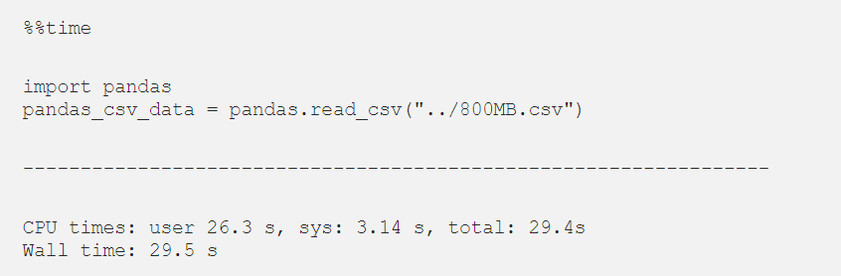
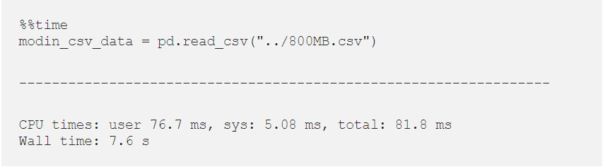
Reading large CSV files
Using traditional approaches
Specify the chunksize parameter when calling pd.read_csv(). It will iterate over subsets of the dataframe, each of them made up of #chunksize rows
Using additional frameworks
Dask enables large datasets manipulation, accelerating long computations via many cores and distribute computing on large datasets with standard Pandas operation
Modin is build on Pandas but in a distribute way, in order to scale it and increase computation speed
E.g.: Comparison¹ Pandas vs Modin
/4
1. Source: https://towardsdatascience.com/get-faster-pandas-with-modin-even-on-your-laptops-b527a2eeda74

Slide 28


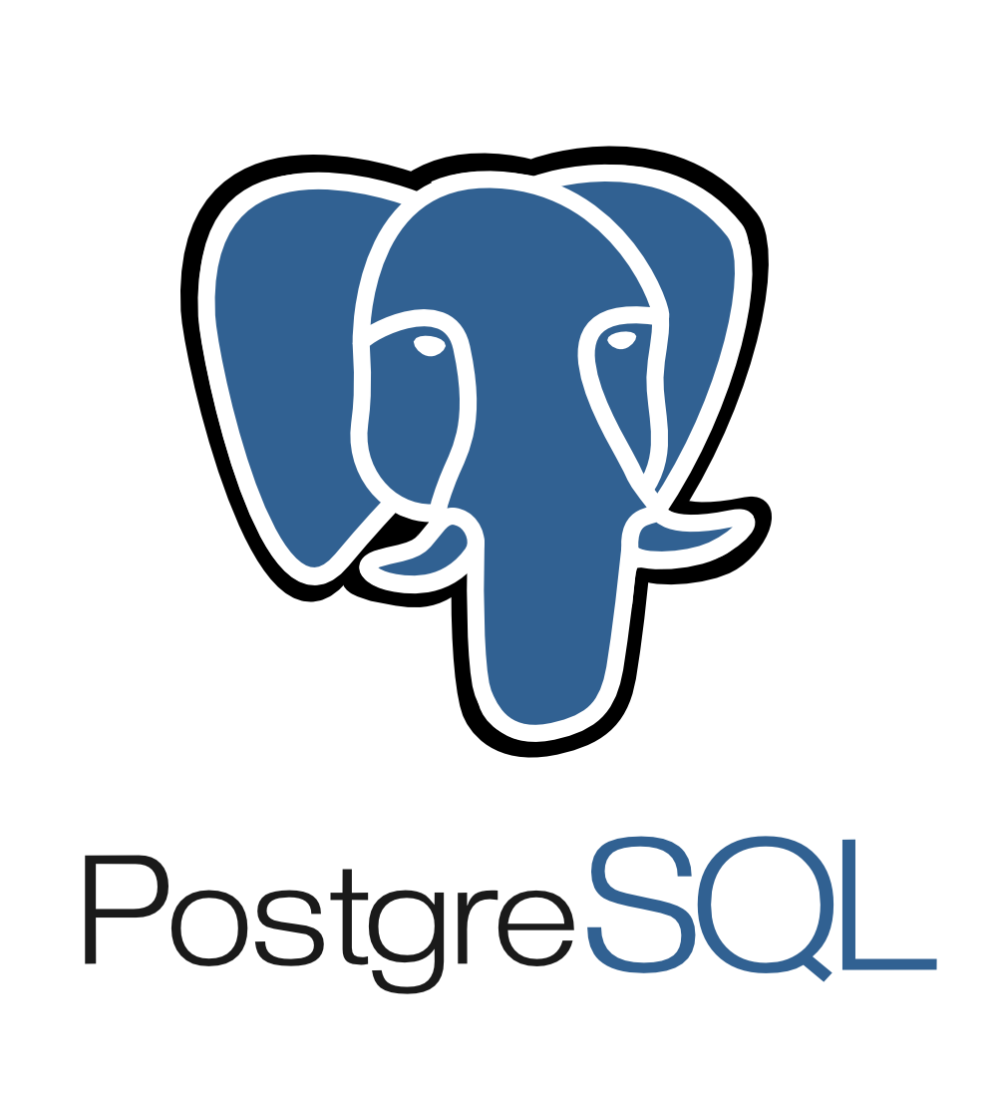
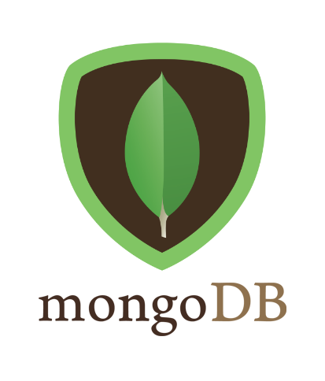

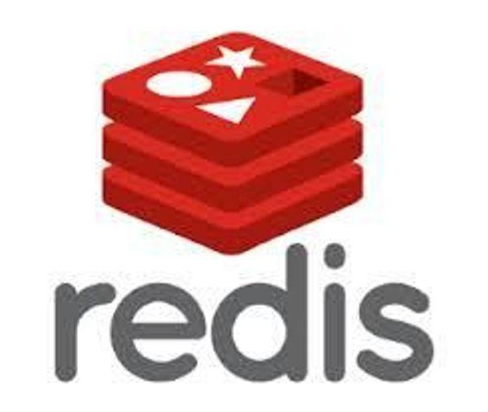
Relational vs. Non relational databases
Management Systems
Relational
Accessible with SQL
For data structured in rows and columns:
Each row/tuple contains a unique instance of data
Each data has a unique primary key
The relationship between tables can be set via foreign keys
Database
Non relational
For non-structured or semi-structured data.
It includes :
Flat files
Column store
Graph database
NoSQL

Slide 29
Best practices to connect to a relational DB¹ with Python
import sqlite3
class dbopen(object):
"""
Simple CM for sqlite3 databases. Commits everything at exit.
"""
def __init__(self, path):
self.path = path
self.conn = None
self.cursor = None
def __enter__(self):
self.conn = sqlite3.connect(self.path)
self.cursor = self.conn.cursor()
return self.cursor
def __exit__(self, exc_class, exc, traceback):
if traceback is None:
self.conn.commit()
else:
self.conn.rollback()
self.conn.close()
if __name__ == '__main__':
with dbopen('./sample.db') as c:
c.execute("CREATE TABLE seekmap (id text, offset int, length int)")
c.execute("INSERT INTO seekmap VALUES ('a', 0, 2000)")
c.execute("INSERT INTO seekmap VALUES ('b', 2000, 3000)")
c.execute("SELECT * FROM seekmap")
result = c.fetchall()
print(result)
print(result)
Ensure you close all the connections you open
Add a rollback in case something goes wrong²
Avoid redundancy by using a context manager
Do not save your connections credentials directly in the code
Apply all the changes to the DB
If something goes wrong, no change applied
Close the connection
Return all the requests results
This approach works for all packages used (SQLAlchemy, psycopg2…)
This enables to ensure consistency in the DB

Slide 30
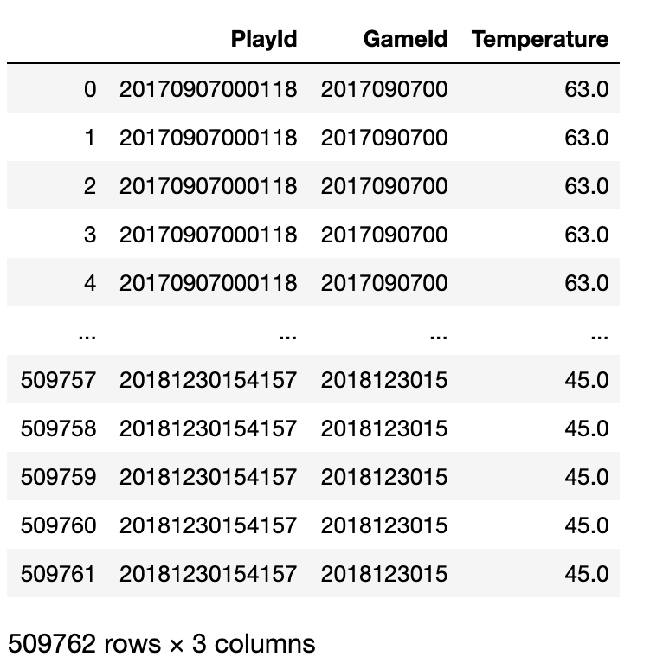
How to speed up your loop
Example dataframe
Using vectorized code is key to improve the performance of your code
Going from Pandas to Numpy would also improve your performance
 | Runtime comparison for column addition/multiplication
For loop | 1m37
Apply | 128 ms
Pandas | 2.5 ms
Numpy | 1.3 ms

Slide 31
Type your data objects
If you don't specify the type of array
Typing the data consists of assigning a type to a specific object
In Python, this is made possible through some libraries like Numpy
indices = np.arange(1, 230)
print("size of automatically typed array: %d bytes" %indices.nbytes)
# -> size of automatically typed array: 1832 bytes
Assuming you do not need to store integers greater than 2⁸, you can define your array as follows
indices_t = np.arrange(1, 230, dtype = 'int8') # example of typage
print("Size of manually typed array : %d bytes" % indices_t.nbytes)
# -> size of manually typed array: 229 bytes
For Python 3.5 and above, type hinting is possible: it enables to optionally annotate the types of Python functions, arguments, and variables in a way that can be used by various tools

Slide 32
Pandas Optimization (I)
Index Optimization
Set relevant columns as index to speed up your computation
%%timeit
listings.merge(reviews, on='listing_id')
# 439 ms ± 24.5 ms per loop (mean ± std. dev. of 7 runs, 1 loop each)
%%timeit
reviews_ = reviews.set_index('listing_id')
listings_ = listings.set_index('listing_id')
listings_.merge(reviews_, left_index=True, right_index=True)
# 393 ms ± 17.4 ms per loop (mean ± std. dev. of 7 runs, 1 loop each)
Vectorize Optimization
Never loop over a dataframe. Use at least .map() or .apply() and if possible vectorize your computation
from utils import haversine
%%timeit
# Timing apply on the Haversine function
df['distance'] = df.apply(lambda row: haversine(40.671, -73.985, row['latitude'], row['longitude']), axis=1)
# 90.6 ms ± 7.55 ms per loop (mean ± std. dev. of 7 runs, 10 loops each)
# Vectorized implementation of Haversine applied on Pandas series
df['distance'] = haversine(40.671, -73.985, df['latitude'], df['longitude'])
# 1.62 ms ± 41.5 µs per loop (mean ± std. dev. of 7 runs, 1000 loops each)
# Vectorized implementation of Haversine applied on NumPy arrays
df['distance'] = haversine(40.671, -73.985, df['latitude'].values, df['longitude'].values)
# 370 µs ± 18 µs per loop (mean ± std. dev. of 7 runs, 1000 loops each)

Slide 33
Pandas Optimization (II)
Memory Optimization
Load only necessary columns and downcast your columns to the smallest datatype possible without losing any information
def optimize_ints(df: pd.DataFrame) -> pd.DataFrame:
ints = df.select_dtypes(include=['int64']).columns.tolist()
df[ints] = df[ints].apply(pd.to_numeric, downcast='integer')
return df
def optimize_objects(df: pd.DataFrame, datetime_features: List[str]) -> pd.DataFrame:
for col in df.select_dtypes(include=['object']):
if col not in datetime_features:
num_unique_values = len(df[col].unique())
num_total_values = len(df[col])
if float(num_unique_values) / num_total_values < 0.5:
df[col] = df[col].astype('category')
else:
df[col] = pd.to_datetime(df[col])
return df
def optimize(df: pd.DataFrame, datetime_features: List[str] = []):
return optimize_ints(optimize_objects(df, datetime_features)))
Filter Optimization
Operate filters in the first steps when chaining multiple operations (even when merging)
listings = listings.sample(frac=0.2, random_state=1337)
def optimized_merge(df1, df2, merge_column):
df2 = df2[df2[merge_column].isin(df1[merge_column])]
return df1.merge(df2, on=merge_column)
%%timeit
listings.merge(reviews, on='listing_id')
# 106 ms ± 2.46 ms per loop (mean ± std. dev. of 7 runs, 10 loops each)
%%timeit
optimized_merge(listings, reviews, 'listing_id')
# 69.6 ms ± 761 µs per loop (mean ± std. dev. of 7 runs, 10 loops each)

Slide 34
Be careful while optimizing pandas operations; code quality and robustness are more important than speed-ups
Pandas objects are not copied by default
Information are stored only once to optimize memory usage
Explicitly copy critical pandas objects
Control their content at all times (e.g. columns, scope, type)
>> data_raw = pd.DataFrame(data={“a”: 1, “b”: 2}, index=[0])
>> data_raw["b"].values
array([2])
>> data_formatted = data_raw
>> id(data_formatted) == id(data_raw)
True # same address in memory (i.e. same object)
>> data_formatted["b"] *= 2
>> data_raw["b"].values # changes in `df_new` affect `df` too
array([4])
>> data_formatted["c"] = "new column"
>> data_raw["c"].values # column "c" is in `data_raw` too
array(['new column'])
>> def add_column(
data: pd.DataFrame,
column_name: str,
value: str
):
data[column_name] = value
return data
>> data_enriched = add_column(data_raw, "d", "inside fct")
>> data_raw["d"].values
array(["inside fct"])
>> id(data_enriched) == id(data) # again pointing to same object
True
>> data_raw = pd.DataFrame(data={“a”: 1, “b”: 2}, index=[0])
>> data_raw["b"].values
array([2])
>> data_formatted = data_raw.copy()
>> id(data_formatted) == id(data_raw)
False # new address in memory (i.e. new object)
>> data_formatted["b"] *= 2
>> data_raw["b"].values # `data_raw` has not changed
array([2])
>> data_formatted["c"] = "new column"
>> data_raw["c"].values # `data_raw` has not changed
KeyError: 'c'
>> def add_column(
data: pd.DataFrame,
column_name: str,
value: str
):
data_new = data.copy()
data_new[column_name] = value
return data_new
>> data_enriched = add_column(data_raw, "d", "inside fct")
>> data_raw["d"].values
KeyError: 'd'
>> id(data_enriched) == id(data) # pointing to a new object
True
You can manually optimize memory usage with the `del` command to let python's garbage collector know which objects can be freed from memory

Slide 35
Agenda
Design Pattern
Singleton
Factory
Abstract Classes
Code Improvement
Organize your code
Data Ingestion
Errors
Logging
Documenting
Formatting
Debugging
Package Design
Context Manager & Decorator (Reminder)
Deployment (Not covered along training sessions)
Docker
CI
Solution overview

Slide 36
The different types of error in Python
A Python program terminates as soon as it encounters an error, it will then raise an exception error
In Python, there are built-in exception errors in order to classify the type of error encountered
IOError A file can not be opened
ImportError A module can not be found by Python
ValueError A function receives an argument with right type but inappropriate value
KeyError A key is not found in a dictionary
NameError A variable is not found in a dictionary
ZeroDivisionError Second operand of division or modulo operation is zero
SyntaxError Syntax error is encountered (raised by parser)

Slide 37
Raising exceptions
You can raise custom exceptions when a particular condition is met, in order to prevent your code from crashing
Code
x = 10
if x > 5:
raise Exception('x should not exceed 5. The value of x was: {}'.format(x))
Output
Traceback (most recent call last):
File "<input>", line 2, in <module>
Exception: x should not exceed 5. The value of x was: 10

Slide 38
Handling exceptions : try and except block
The try & except syntax allows to effectively handle error and avoid the code to crash
The except clause determines how your program responds to exceptions
Code
try:
out = 1 / 0
except ZeroDivisionError:
print("Division by zero problem")
Output
Division by zero problem
By catching the error, we have prevented the code to crash

Slide 39
Agenda
Design Pattern
Singleton
Factory
Abstract Classes
Code Improvement
Organize your code
Data Ingestion
Errors
Logging
Documenting
Formatting
Debugging
Package Design
Context Manager & Decorator (Reminder)
Deployment (Not covered along training sessions)
Docker
CI
Solution overview

Slide 40
Logging
Loggers enable to meet security and auditability requirements
When you run a python script, you want to know which part is being executed
Loggers have 5 different hierarchical levels
DEBUG Detailed information, for diagnosing problems | Value=10
INFO Confirm things are working as expected | Value=20
WARNING Something unexpected happened, or indicative of some problem. But the software is still working as expected | Value=30
ERROR More serious problem, the software is not able to perform some function | Value=40
CRITICAL A serious error, the program itself may be unable to continue running | Value=50

Slide 41
Logging
Depending on the configuration of your logger, only the logs that have a higher level of importance will be displayed
Code
Level of logging
File where you store the logs
import logging
logging.basicConfig(level=logging.INFO, file='sample.log',
format='%(asctime)s :: %(levelname)s :: %(message)s')
logging.info('This is a test')
Message format
Output
2019-12-12 13:01:46,397 :: INFO :: This is a test

Slide 42
Logging
Code
You can log exceptions that will include any associated traceback information
import logging
# Create of get the logger
logger = logging.getLogger(__name__)
# set log level
logger.setLevel(logging.INFO)
def divide(x, y):
try:
out = x / y
except ZeroDivisionError:
logger.exception("Division by zero problem")
else:
return out
# Logs
logger.error("Divide {x} / {y} = {c}".format(x=10, y=0, c=divide(10, 0)))
Output
2019-12-12 13:15:46,945 :: ERROR :: Division by zero problem
Traceback (most recent call last):
File "<input>", line 3, in divide
ZeroDivisionError: division by zero
2019-12-12 13:15:46,945 :: ERROR :: Divide 10 / 0 = None

Slide 43
Agenda
Design Pattern
Singleton
Factory
Abstract Classes
Code Improvement
Organize your code
Data Ingestion
Errors
Logging
Documenting
Formatting
Debugging
Package Design
Context Manager & Decorator (Reminder)
Deployment (Not covered along training sessions)
Docker
CI
Solution overview

Slide 44
Documenting a module
""""
This module is the base structure for the ingestion and the datafile.
Each data file must inherit from this data framework.
Example:
data = Data(config)
some_data_module = AbstractDataFile(data)
"""
class AbstractDataFile:
"""
Class attributes
"""
raw_data: pd.DataFrame
#Data as the user gives to the tool
processed_data: pd.DataFrame
#Processed data in order to have a good shape for the ingestion
def __init__(self, data:"Data"):
"""
Constructor of the data file.
Data files are responsible for loading
and pre-processing the data from the source.
Args:
- data: main orchestrator of the data ingestion
"""
self.data = data
self.logger = data.config.logger
self.set_schema()
def get_raw(self) -> pd.DataFrame:
"""
Use this method to get raw data frame
Returns:
- pandas.DataFrame: containing raw data
"""
if not has_notnull(self, "raw_data"):
self.load_data()
return self.raw_data
Comment what the module is about at the beginning of the file
All the code that is included in the docstring will be callable with help()
Define the attributes of your objects, as well as their type
Explain what each function does, what is the returned object, and the types of the parameters passed to your functions
Docstrings may have different format (Numpy, Google, Sphinx, RST, …). Don't forget to set the proper format at the beginning of yout project. (see Pycharm settings)

Slide 45
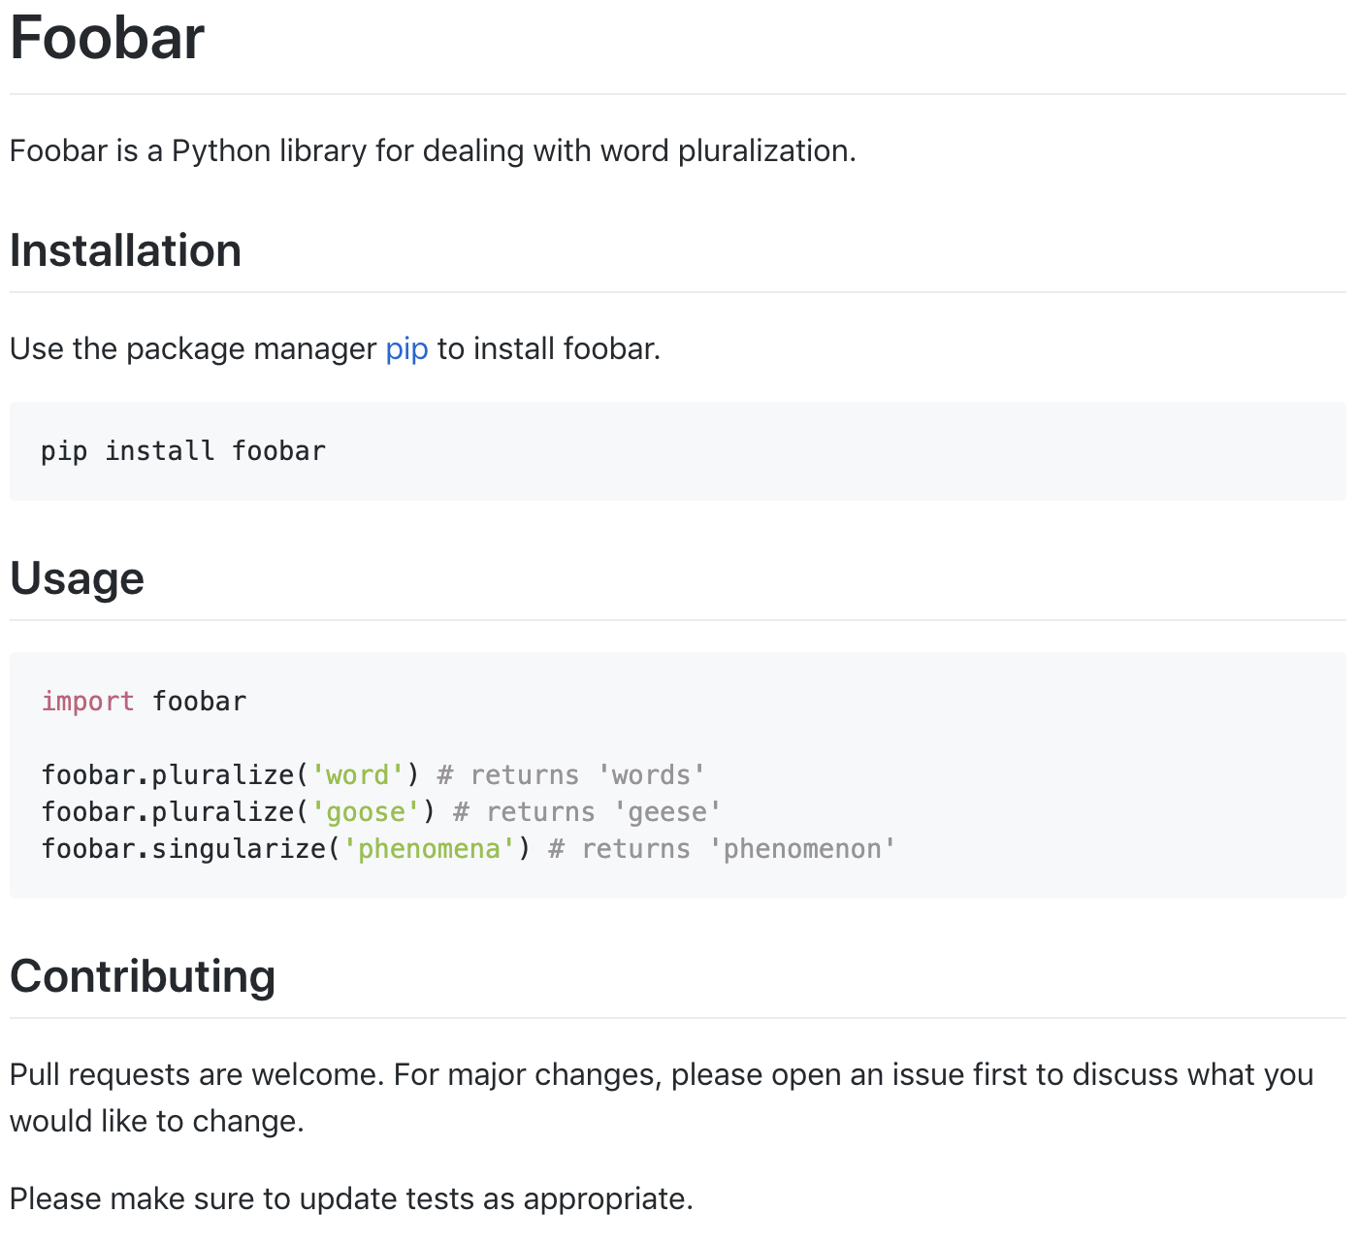
README
A README is a is a markdown .md file that introduces and explains a project
It should enable everyone joining the project to run the tool in one hour: it should explain how to install and use your project
It should be in the root directory of the project and contain the following sections

Slide 46
Sphinx
1
Tool that makes it easy to create intelligent and beautiful documentation
It has several advantages
Several output formats
Extensive cross-reference
Hierarchical structure
Automatic indices
Code handling
2
Launch in the terminal $ sphinx-quickstart
Reply to the questions to parameter it quickly (it can be changed later in conf.py)
Define the overall structure of your documentation in index.rst
In adjacent folders, reproduce your code main folders and define for each of them a .rst file
You can use the module autodoc to automatically load the docstring from your files
You can add additional text around them
3
4
5
6

Slide 47
Agenda
Design Pattern
Singleton
Factory
Abstract Classes
Code Improvement
Organize your code
Data Ingestion
Errors
Logging
Documenting
Formatting
Debugging
Package Design
Context Manager & Decorator (Reminder)
Deployment (Not covered along training sessions)
Docker
CI
Solution overview

Slide 48

PEP8
Main PEP8 rules
Spaces around operators
No space within brackets
One space after commas
Max. 79 characters per line
One module import per line
Indentation with 4 spaces (NOT tab)
Naming conventions :
Lower case letters + underscores for modules functions, variables and methods
Upper case letters + underscores for constants
Camel case for classes
PEP8 is a coding convention for Python
Pylint is a package that scans the code to check
PEP8 implementation
Ctrl + Alt + L PyCharm shortcut allowing automatic PEP8 implementation

Slide 49
Agenda
Design Pattern
Singleton
Factory
Abstract Classes
Code Improvement
Organize your code
Data Ingestion
Errors
Logging
Documenting
Formatting
Debugging
Package Design
Context Manager & Decorator (Reminder)
Deployment (Not covered along training sessions)
Docker
CI
Solution overview

Slide 50
Debugging
Use a scientific method to find the source of a bug in a systematic way
Find what changed since the last working state
Bugs commonly come from either the data, the configuration, the algorithm, the output processing or the infrastructure
Find the exact source of the bug
1
Reproduce the bug in a controlled environment
Formulate hypothesis on potential root causes
Change one thing at a time to prove or discard hypothesis
2
3
Repeat the steps until the scope of potential root causes is narrowed down to one
Prevent the issue from happening again

Slide 51
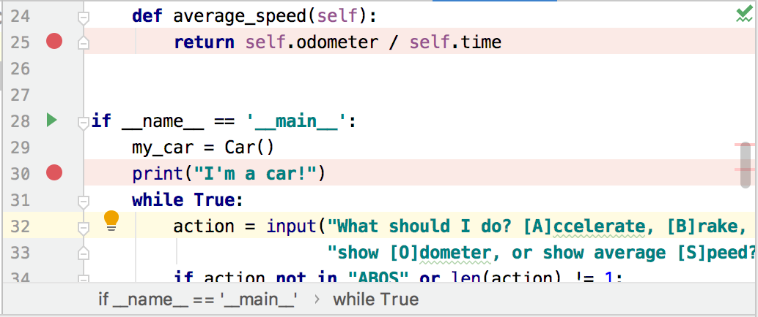



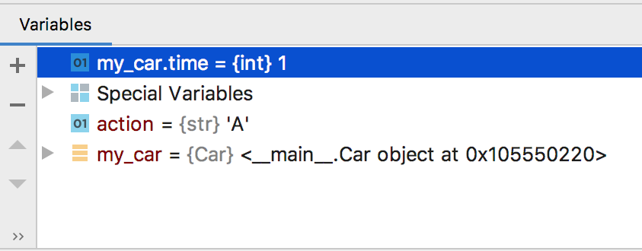
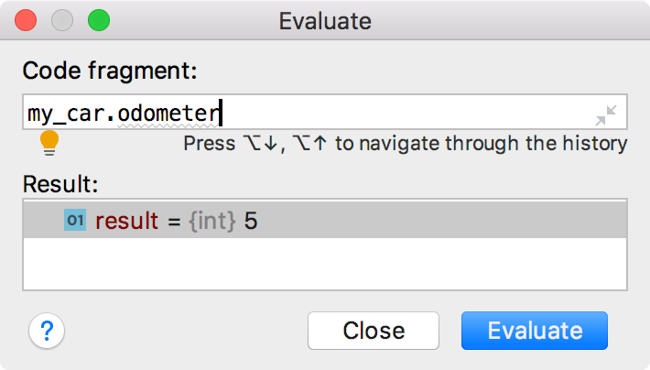
Debugging
Add breaking points
Resume program to go to the next breaking point
Step over to go line by line
Step into to go inside the function
Run the debugger
Example with Pycharm
Use keywords shortcuts!
Watch and evaluate variables

Slide 52
Agenda
Design Pattern
Singleton
Factory
Abstract Classes
Code Improvement
Organize your code
Data Ingestion
Errors
Logging
Documenting
Formatting
Debugging
Package Design
Context Manager & Decorator (Reminder)
Deployment (Not covered along training sessions)
Docker
CI
Solution overview

Slide 53
Package design
Approach
Pros and cons
No need to know each module names or remember where each function is
In the package's __init__.py
Method 1
The user gets access to everything in the module
from .foo import *
from .bar import *
from .baz import *
In the main script
Each function should have unique name.
If large package, it would add a lot to the namespace
Useful for general packages such as pandas or numpy
import example_pkg
example_pkg.foo_func()
example_pkg.bar_func()
example_pkg.baz_func()

Slide 54
Package design
Approach
Pros and cons
Easier to control what objects are available to user
In the package's __init__.py
Method 2
The user gets access to a subset of functionalities, defined in the __init__.py
from .foo import foo_func
from .bar import bar_func
from .baz import baz_func
In the main script
__init__.py can end up very large
Need to update __init__ every time we add a feature
Useful for modules made up of a single class
import example_pkg
example_pkg.foo_func()
example_pkg.bar_func()
example_pkg.baz_func()

Slide 55
Package design
Approach
Pros and cons
Simplifies the __init__ file
Flexible
Method 3
The user gets access to a subset of functionalities, defined in the __init__.py and is forced to give more details about where the method is nested
In the package's __init__.py
import example_pkg.foo
import example_pkg.bar
import example_pkg.baz
In the main script
Code can get longer
Useful if you have a complex series of module
import example_pkg
example_pkg.foo.foo_func()
example_pkg.bar.bar_func()
example_pkg.baz.baz_func()

Slide 56
Exercise 2.5
Build a Pipeline framework Branch origin/training/ex-pipeline-run
Exercise 2.6
Implement a model factory Branch origin/training/ex-model-factory

Slide 57
Agenda
Design Pattern
Singleton
Factory
Abstract Classes
Code Improvement
Organize your code
Data Ingestion
Errors
Logging
Documenting
Formatting
Debugging
Package Design
Context Manager & Decorator (Reminder)
Deployment (Not covered along training sessions)
Docker
CI
Solution overview

Slide 58
Context Manager & Decorator (Reminder)
Context Manager
Decorator
Python class allowing to open and close processes by "cleaning up" effectively
Mandatory to call it with with which triggers
__enter__() when entering the instruction block __exit__() when exiting the instruction block
Allows to add a new functionality to an existing function without modifying its structure
def check_path(function):
def wrapper(path, *args, **kwargs):
if not os.path.isfile(path):
raise ValueError(f"Path {path} does not exist")
else:
print(f"{path} checked ! ")
return function(path, *args, **kwargs)
return wrapper
@check_path
def load_data(path):
return pd.read_csv(path)
load_data('path_error.csv')
# ValueError(path_error.csv does not exist)
load_data('path_right.csv')
# pd.DataFrame
import datetime
class TimeIt(ContextDecorator):
def __enter__(self):
self.start = datetime.datetime.now()
print(self.start)
def __exit__(self, type, value, traceback):
print(datetime.datetime.now()-self.start).total_seconds()
if __name__=='__main__':
def foo(a):
return a + 1
with TimeIt():
foo(1)

Slide 59
Exercise 2.7 Create a time profiler Branch origin/training/ex-context-manager
Exercise 2.8
Add a decorator Branch origin/training/ex-decorator

Slide 60
Agenda
Design Pattern
Singleton
Factory
Abstract Classes
Code Improvement
Organize your code
Data Ingestion
Errors
Logging
Documenting
Formatting
Debugging
Package Design
Context Manager & Decorator (Reminder)
Deployment (Not covered along training sessions)
Docker
CI
Solution overview

Slide 61
Agenda
Design Pattern
Singleton
Factory
Abstract Classes
Code Improvement
Organize your code
Data Ingestion
Errors
Logging
Documenting
Formatting
Debugging
Package Design
Context Manager & Decorator (Reminder)
Deployment (Not covered along training sessions)
Docker
CI
Solution overview

Slide 62
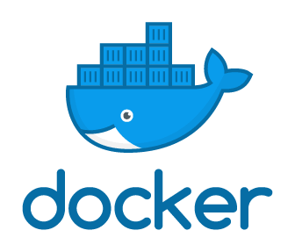
Why using Docker ?
Docker vs VM
Advantages
Instead of using a VM, which requires a full OS, significant space and a lot of memory, Docker uses lightweight images (up to 1 GB)
It is possible to share resources between containers
It is fast and starts in seconds (against minutes for VMs)
Reliable
Your application will run exactly the same wherever you run it
Quality deliverable
Packaged deliverable that the client can run on any system
Structure
APP A
APP B
APP C
APP D
APP E
Easy to integrate
Abstracts away the complicated setup of add and environment
Host OS
Versatile
Can be used for testing, as a backup, as a client deliverable or to deploy to production
Bare metal

Slide 63
Docker vocabulary
Image
Container
Volume
Network
Lightweight, standalone, executable package of software that includes everything needed to run an application: code, runtime, system tools, system libraries and settings.
Two options to create it:
build from scratch (see next slide for details)
use existing one (from Docker Hub Registry)
~ Similar to a class (in OOP)
Instantiation of a Docker Image which isolate software from its environment and ensure that it works uniformly despite differences for instance between development and staging
To create it:
docker run -it image_ID
~ Similar to an instantiated object (in OOP)
Area to store data on the host filesystem which is created and managed by Docker, ensuring data persistence (even after a container stops) and enabling to share it between several containers
Two options to create it:
docker volume create
(not very commun)
while creating a container or a service
Support for networking containers through the use of network drivers
3 are systematically created :
bridge corresponds to docker0 network present in all Docker installation
none adds a container to a container-specific network stack
host adds a container on the host's network stack
Possible to customize the Bridge one and to create other user-defined bridge networks

Slide 64
How do you create a customized Docker image?
From scratch
Create a file named Dockerfile
Write instructions using Dockerfile commands (details next slide)
The following example tells Docker to:
- Build an image starting with the Python 3.6 image
- Create code directory
- Set environment variables
- Copy the requirements
- Install the Python dependencies
- Copy the current local folder in the image
- Set the default command for the container to python3 ./run.py
Build docker image using
docker image build –t new_image_name:tag .
From an existing container
Assume you performed some changes on a container and you want to save it for further use
Build docker image using
docker commit current_container_name new_image_name:tag
FROM python:3.6
WORKDIR /code
ENV PATH=$PATH:/code
ENV PYTHONPATH /code
ENV MPLBACKEND agg
# install python requirements
COPY requirements.txt ./
RUN pip install --no-cache-dir -r requirements.txt
COPY . .
CMD ["python", "./run.py"]
1
2
3
You can check your image has been successfully created by calling: docker image ls
To make sure your Dockerfile is well structured and optimised, you can use https://github.com/hadolint/hadolint
1

Slide 65
Useful Docker commands to create a Dockerfile
Instruction | Usage | Explanation
FROM | FROM <image> | Create a base from the specified Docker image (Mandatory to start a Dockerfile with this instruction)
RUN | RUN <command> RUN ["<executable>", "<param1>", "<param2>"] | Execute any commands in a new layer on top of the current image and commit the results
ENV | ENV <key> <value> | Set the environment variable <key> to the value <value> for all subsequent instructions in the build stage
WORKDIR | WORKDIR </path/to/workdir> | Set the working directory for any instruction following
ADD | ADD <src> [<src> ...] <dest> | Copy new files, directories or remote file URLs from <src> and add them at the path <dest>in the image
COPY | COPY <src> [<src> ...] <dest> | Copy new files or directories from <src> and adds them to the filesystem of the container at the path <dest>
CMD | CMD ["<executable>","<param1>","<param2>"] | Specify which command to run within the container
EXPOSE | EXPOSE <port> [<port> ...] | Inform Docker that the container listens on the specified network ports at runtime
LABEL | LABEL <key>=<value> [<key>=<value> ...] | Add metadata to an image
ENTRYPOINT | ENTRYPOINT ["<executable>", "<param1>", "<param2>"] | Configure a container that will run as an executable
VOLUME | VOLUME ["<path>", ...] | Create a mount point and marks it as holding externally mounted volumes from native host or other containers
USER | USER <username | UID> | Set the user name (or UID) to use when running the image and for any instruction following
ARG | ARG <name>[=<default value>] | Define a variable that users can pass at build-time to the builder with the Docker build command
ONBUILD | ONBUILD <Dockerfile INSTRUCTION> | Add to the image a trigger instruction to be executed at a later time, when the image is used as the base for another build
1. Source: https://docs.docker.com/engine/reference/builder/

Slide 66

What happens if your project is made up of multiple apps conflicting with each other?
Model App
Web App
Must connect to each other over network
Must run everything at the same time to do e2e tests
Result DB
Each app might have dependency conflicts
Docker-compose enables you to easily orchestrate many containers side by side on a virtual network: dependencies are separated, conflicts avoided and each container can be scale separately

Slide 67
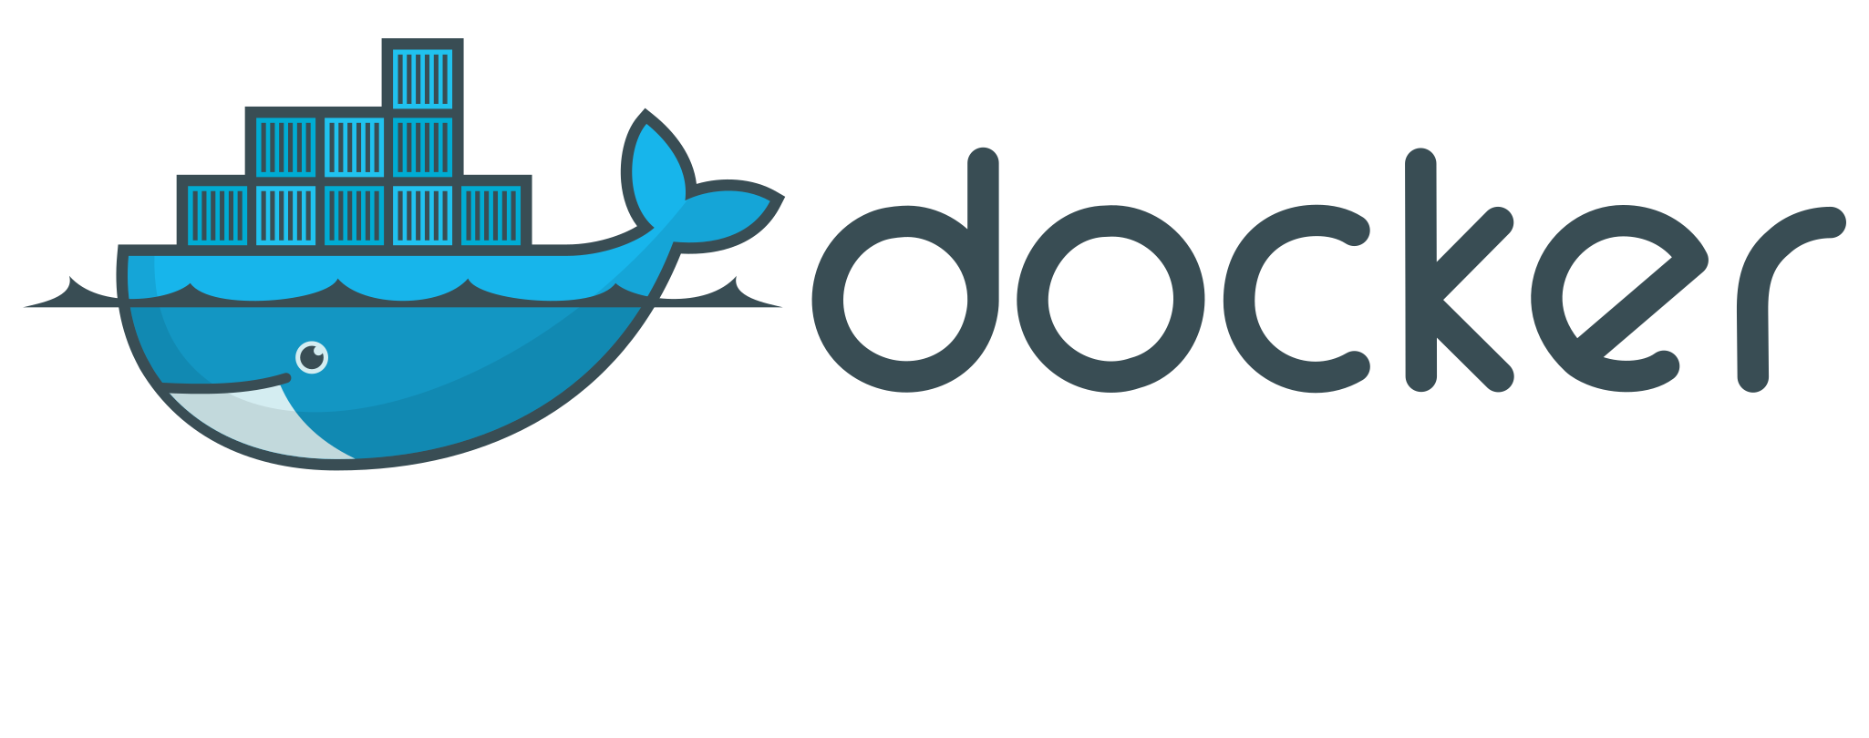
Tool architecture using docker networks/ports
Services within the same network can communicate with each other
Mapping of ports in `docker-compose.yml` is needed to access a service from outside
local (network)
app (network)
default
(network)
services:
data_warehouse:
image: postgres
restart: always
container_name: data_warehouse_service
environment:
POSTGRES_USER: gamma
POSTGRES_PASSWORD: example
POSTGRES_DB: data_warehouse
ports: # database exposed on port 5432
- "5432:5432"
networks:
- local
app:
build: app
ports:
- "5000:5000"
volumes:
- ./app:/app
networks:
- app
networks:
local:
app:
Data
Warehouse
Web App
Sphinx (doc)
pgAdmin
Model App
" local_port : docker_port "
Container belongs to "local" network
5050
5432
5000
8000
5050
5432
5000
8000
https://localhost:5050
https://localhost:5000
https://localhost:8000
Web browser
localhost (e.g. your laptop or AWS machine)
Container belongs to "app" network
local address -> docker address

Slide 68
Exercise 2.9 Build a Docker image Branch origin/training/ex-docker-image

Slide 69
Agenda
Design Pattern
Singleton
Factory
Abstract Classes
Code Improvement
Organize your code
Data Ingestion
Errors
Logging
Documenting
Formatting
Debugging
Package Design
Context Manager & Decorator (Reminder)
Deployment (Not covered along training sessions)
Docker
CI
Solution overview

Slide 70
"CI is a software development practice where members of a team integrate their work frequently, usually each person integrates at least daily - leading to multiple integrations per day. Each integration is verified by an automated build (including test) to detect integration errors as quickly as possible" – Martin FOWLER

Slide 71
What are the advantages of CI ?
Ensure code quality
Reduce the size of code changes making them easier to handle
Provide immediate feedbacks on the local changes
Reduce integration risk
Ease code deployment
Ensure the code runs anywhere (every machine, operating system, browser…)
Reduce time deploying
Constant availability of a
“current” build for testing, demo, or release purposes
Improve team work
Spend less time on fixing conflicts and bugs
Give confidence on the code being build
Increase transparency

Slide 72
7 core concepts of CI
1
Maintain a single source repository
Use Git and a robust Git flow¹ , for e.g.
master branch – reflect a production ready state
develop branch – reflect a state with the latest delivered development changes for the next release
Several feature branches – use for developing new features for the upcoming or distance future release
Several release branches – support preparation of a new production release
Several Hotfixes - act immediately upon an undesired state of a main branch
Commit frequently to the mainline
Divide your code in independent modules and commit one small change at a time Ensure your commit messages are clear, concise, well-written and focused on explaining the what and why rather than the how²
Integrate your work frequently by doing Pull Requests and always ask for code reviews
Automate the build
Test compilation (if needed by the language) as well as execution (e.g. check all requirements are well specified)
4
Build quickly
Avoid long build otherwise commits will occur less often and it would be harder to spot problems
Automate testing
Write tests along with your code ensuring each function is covered by an unit test Do not neglect integration & end2end tests neither (a recommended balance³ is 70% unit tests, 20% integration and 10% end-to-end tests)
Test in a clone of the production environment
Verify that software performs as expected in its intended environment (Docker can help you make sure your local environment will be similar to the production one)
Fix broken builds immediately
Do not wait to fix a bug: it will avoid it to move downstream and will ease everyone works
5
2
6
7
3
More details here: https://nvie.com/posts/a-successful-git-branching-model/
See here for best practices: https://chris.beams.io/posts/git-commit/
Source: https://testing.googleblog.com/2015/04/just-say-no-to-more-end-to-end-tests.html

Slide 73


External CI Services
Overall approach
Example of tools
Git Master branch
Trigger CI build
Jenkins¹ (recommended for big projects)
Free and open source
Support most types of projects
Customizable
Dedicated servers required
Development branch to merge
CI Server
Build
Allow the merge
Run tests
Success ?
yes
deploy
Circle CI²
Cloud-based system
Easy to start (only one .yaml configuration file needed)
Fast to build
Not easily customizable
Such services enable to build code and run tests in a different environment than your local one.
They act as monitors of the repository and stop anyone from merging to the master branch if their changes break the build.
Technical details for Jenkins here: https://confluence.sourceai.io/pages/viewpage.action?spaceKey=GP&title=Jenkins
Technical details for Circle CI here: https://confluence.sourceai.io/display/HWW/Linking+CircleCI+to+your+BCG+Github+repository+to+run+unit+tests

Slide 74
Exercise 2.10 Add CI Branch origin/training/ex-ci-conf

Slide 75
Agenda
Design Pattern
Singleton
Factory
Abstract Classes
Code Improvement
Organize your code
Data Ingestion
Errors
Logging
Documenting
Formatting
Debugging
Package Design
Context Manager & Decorator (Reminder)
Deployment (Not covered along training sessions)
Docker
CI
Solution overview

Slide 76
Solution overview
Not structured
Oriented-Object Programming (OOP)
Pipeline – sequentiality & loose coupling
Model Factory – homogeneity between ML models
Not flexible
Not robust
Config – immutable parameters
ConfigHandler – unicity of key objects (singleton)
Tests
Continuous Integration (CI)
Not easily reproducible
Scenarios – code versioning (commit hash is kept…)
Decorators – reproducible actions all along the code
Context manager – guarantee enter() and exit() for specific objects
Not easily deployable
Docker, Sphinx documentation

Slide 77
Questions or feedbacks ?
Warning
This module is NOT a starting framework for a case but more a tool box from which you can pick and choose some parts to add to your own code

Slide 80
Unused Slides

