Slide 1
Quandl
Wikipedia
SP500 index prices
SP500 stock prices
SP500 stock fundamentals
Stock Short Sell Volumes
Market sentiment
SP500 stocks and indexes
Calculation of Features & Labels
Momentum: 1,5,20 days
Alpha & Beta, Delta to Industry
Simple Moving Average 30 days
Bollinger Bands®
Returns 1,5,20 days
Price direction 1,5,20 days
% short sell
Change to Low/ High on the following day
Bull-Bear Spread
Change to Min/Max last 30 days
Local HDF storage. One Xy_all h5 file per stock

Slide 2
Xy_all_<ticker>
Features
Labels
HDF Storage
PCA
kMeans
cluster.csv
Features
Labels
GridSearch
Ada-Boost
Naïve Bayes
SVM
Random Forrest
Decision Trees
kNeighbors
HDF Storage of the models, csv storage of best parameters and of model accuracy

Slide 3
Select SP500 Index
Xy_all_<symbol>,
ML model, Accuracy stats
Q-Table
Price change clusters
Select Stocks
Predict Labels
Use Softmax to chose action
Calculate the best transaction price for Selling
Issue Selling Orders
Market executes acceptable orders
Issue buying orders, aligned with index composition and available funds
Calculate the best transaction price for Buying
Market executes acceptable orders
Calculate Rewards
Update Q-table and move to the next day
Calculate Rewards

Slide 4
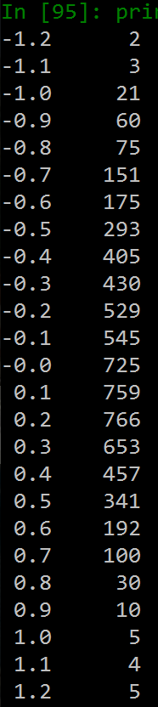
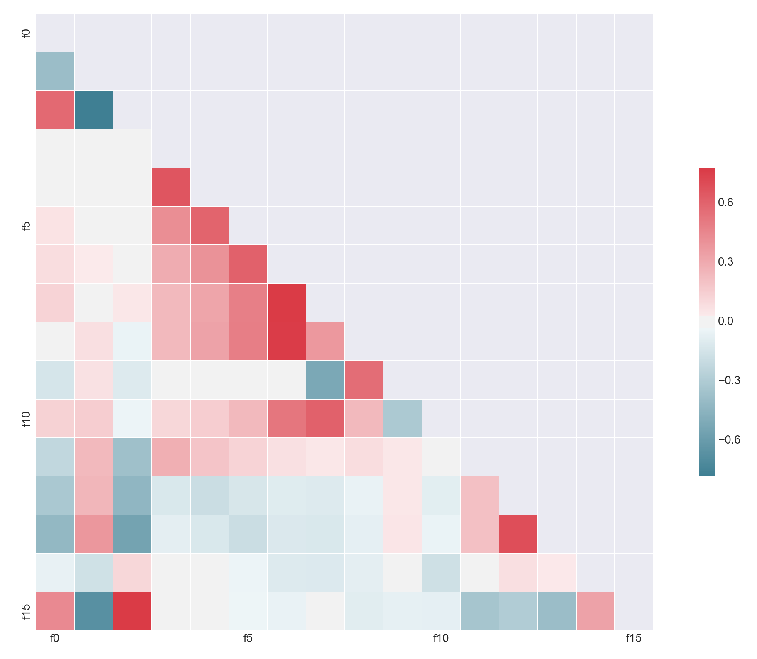
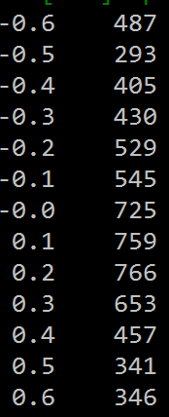
f0: Bull Bear Spread
f1: Price Book Ratio
f2: Price Earnings Share
f3: 1 day Momentum
f4: 2 days Momentum
f5: 5 days Momentum
f6: 30 days Standard Moving Avg
f7: 30 days max
f8: 30 days min
f9: 5 days Volatility
f10: Bollinger Bands®
f11: 1 day Delta to Expectation
f12: 2 days Delta to Expectation
f13: 5 days Delta to Expectation
f14: Nasdaq Short Sells
f15: NYSE Short Sells

