Slide 1
Quantifying and Predicting
Flight Delay Propagation
Using Statistical Learning Methods
Spencer Andries | Niaz Azeez | Kylie Breeding
STAT 654 — Texas A&M University — Spring 2026

Slide 2
Presentation Roadmap
Problem and Motivation
Why flight delay propagation matters
Data and Feature Engineering
Dataset, cleaning, and derived features
Exploratory Data Analysis
Key patterns and visual insights
Statistical Modeling
Classification & regression approaches
Results and Conclusions
Findings, limitations, and future work

Slide 3
The Problem
Research Question
To what extent do delays propagate between sequential flights of the same aircraft, and which factors best predict downstream delay?
When an aircraft arrives late, the next flight it operates is often delayed too — a cascading effect.
Airlines, airports, and passengers bear the cost. Understanding which factors drive propagation could help mitigate it.
We use statistical learning methods from STAT 654 to quantify and predict this phenomenon.

Slide 4
Data Overview
5.8M
14
322
~500K
Total Flights
Airlines
Airports
Modeled Flights
U.S. domestic, 2015
Major U.S. carriers
Origin airports
After cleaning & linking
Source: Kaggle — 2015 U.S. Flight Delays and Cancellations
Key Steps:
Tracked aircraft by tail number to link sequential flights
Converted HHMM times to datetime for accurate turnaround calculations
Filtered invalid sequences (negative turnaround, mismatched airports)
Capped extreme delays at 600 minutes to reduce distortion

Slide 5
Feature Engineering
Feature | Description | Category
prev_arrival_delay | Minutes late the previous flight arrived | Propagation
turnaround_time | Time between arrival and next departure (minutes) | Propagation
airport_congestion | Average delay at that airport/hour combination | Environment
hour | Hour of scheduled departure (0–23) | Temporal
DAY_OF_WEEK | Day of the week (1=Mon – 7=Sun) | Temporal
AIRLINE | Carrier code (14 airlines, one-hot encoded) | Operational
Response variable: delay_indicator (1 if departure delay > 15 min, else 0) and DEPARTURE_DELAY (minutes)

Slide 6
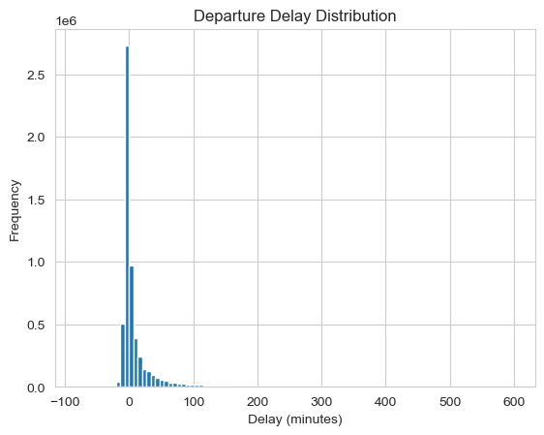
Departure Delay Distribution
Key Takeaways
Heavily right-skewed: most flights depart on time or early
82.3% of flights are not delayed (delay ≤ 15 min)
Only 17.7% classified as delayed
Class imbalance must be considered in modeling

Slide 7
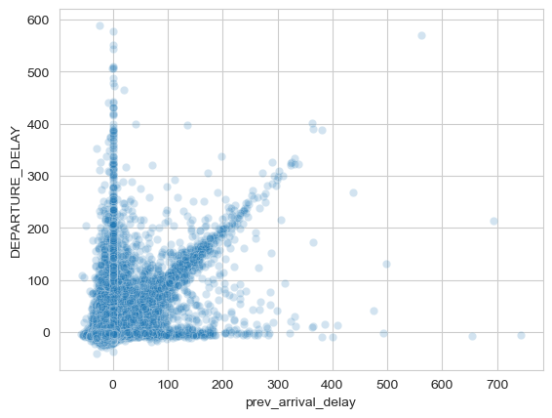
Delay Propagation Is Real
70%
chance of outbound delay
when inbound is delayed (>15 min)
vs. only 10% when inbound is on time
r = 0.469
Correlation between
inbound & outbound delay
Moderate correlation suggests a nonlinear relationship — other factors at play

Slide 8
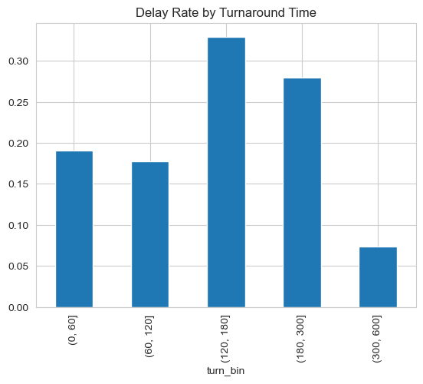
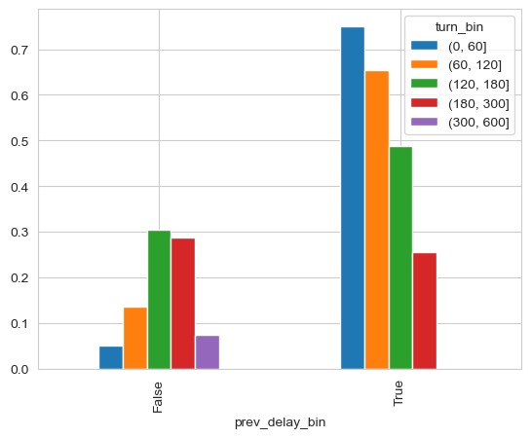
Turnaround Time and Delay Interaction
Moderate turnaround windows (120–300 min) show the highest delay rate. Very long turnarounds (300–600 min) allow recovery. When the inbound flight is delayed, short turnarounds amplify risk the most.

Slide 9
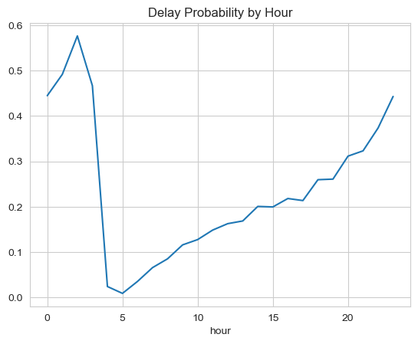
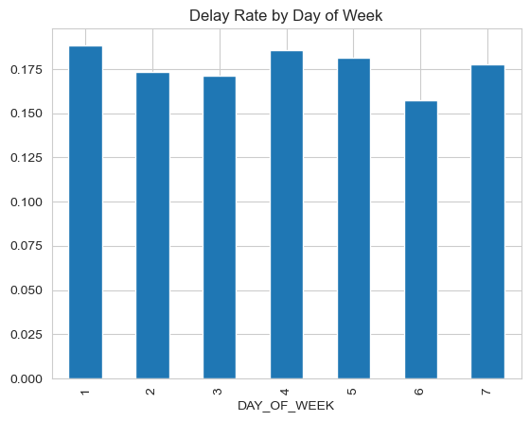
Temporal Patterns in Delays
Delays build throughout the day, peaking in late evening. Early-morning flights have the lowest delay risk. Day-of-week differences are minor (~15–18%), with Saturday slightly lower.

Slide 10
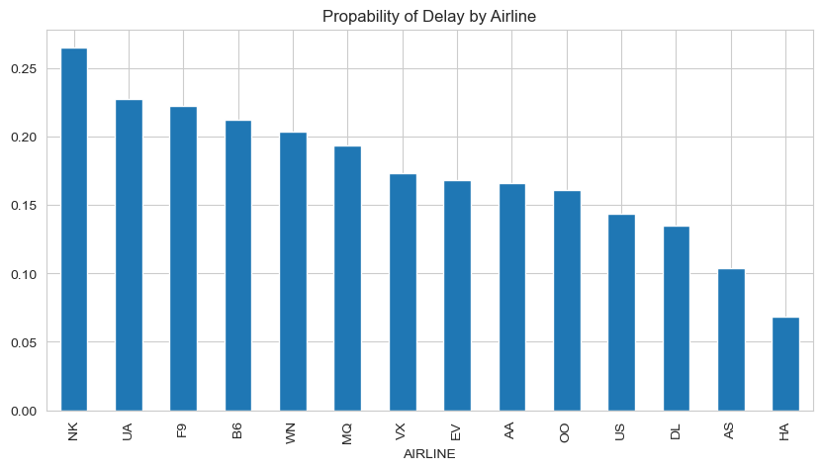
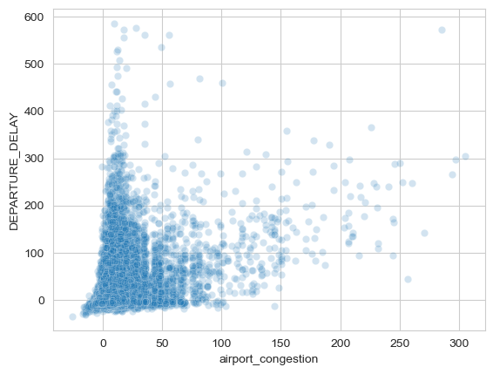
Airline and Airport Congestion Effects
Delay probability varies widely by airline (7% for HA to 27% for NK). Airport congestion shows a positive relationship with departure delay, motivating its inclusion as a feature.

Slide 11
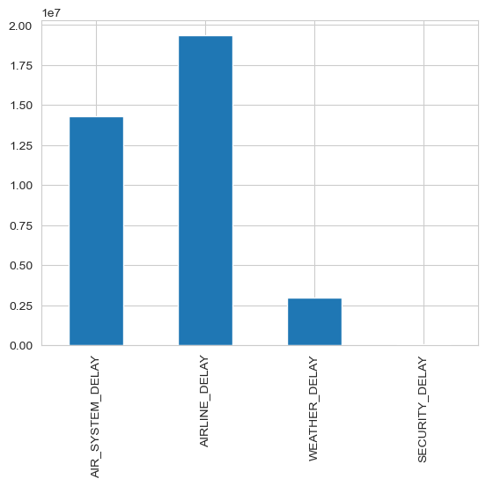
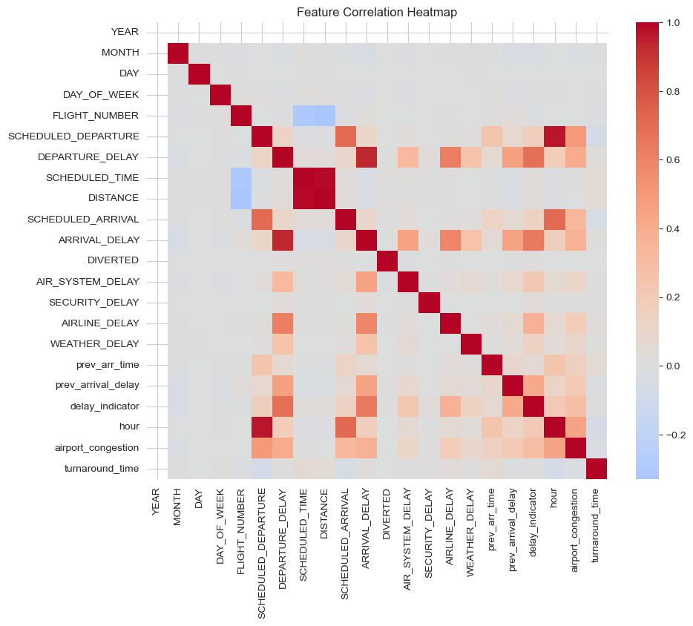
Delay Causes and Feature Correlations
Airline-related and air-system delays dominate; weather and security are minimal. The heatmap confirms prev_arrival_delay and airport_congestion as strong correlates of departure delay.

Slide 12
Modeling Strategy
Classification
Regression
Will this flight be delayed (>15 min)?
How many minutes will it be delayed?
Baseline: prev_arrival_delay only
Baseline+1: + turnaround_time
Full Model: all 6 predictors + airline dummies
Lasso Logistic: L1 regularization for variable selection
OLS Linear Regression with all predictors
Lasso Linear: L1 regularization to check for overfitting
Metrics: RMSE, R²
80/20 train-test split throughout

Slide 13

Classification: Building Up the Model
Baseline
Baseline + 1
Full Model
0.777
0.785
0.828
AUC
AUC
AUC
86.3% accuracy
86.3% accuracy
86.9% accuracy
log(p/(1-p)) = -1.78 + 0.048 × prev_delay
+ turnaround_time
+ congestion, hour, day, airline
Catches only 28% of delays
Slight AUC improvement
Catches 35% of delays

Slide 14
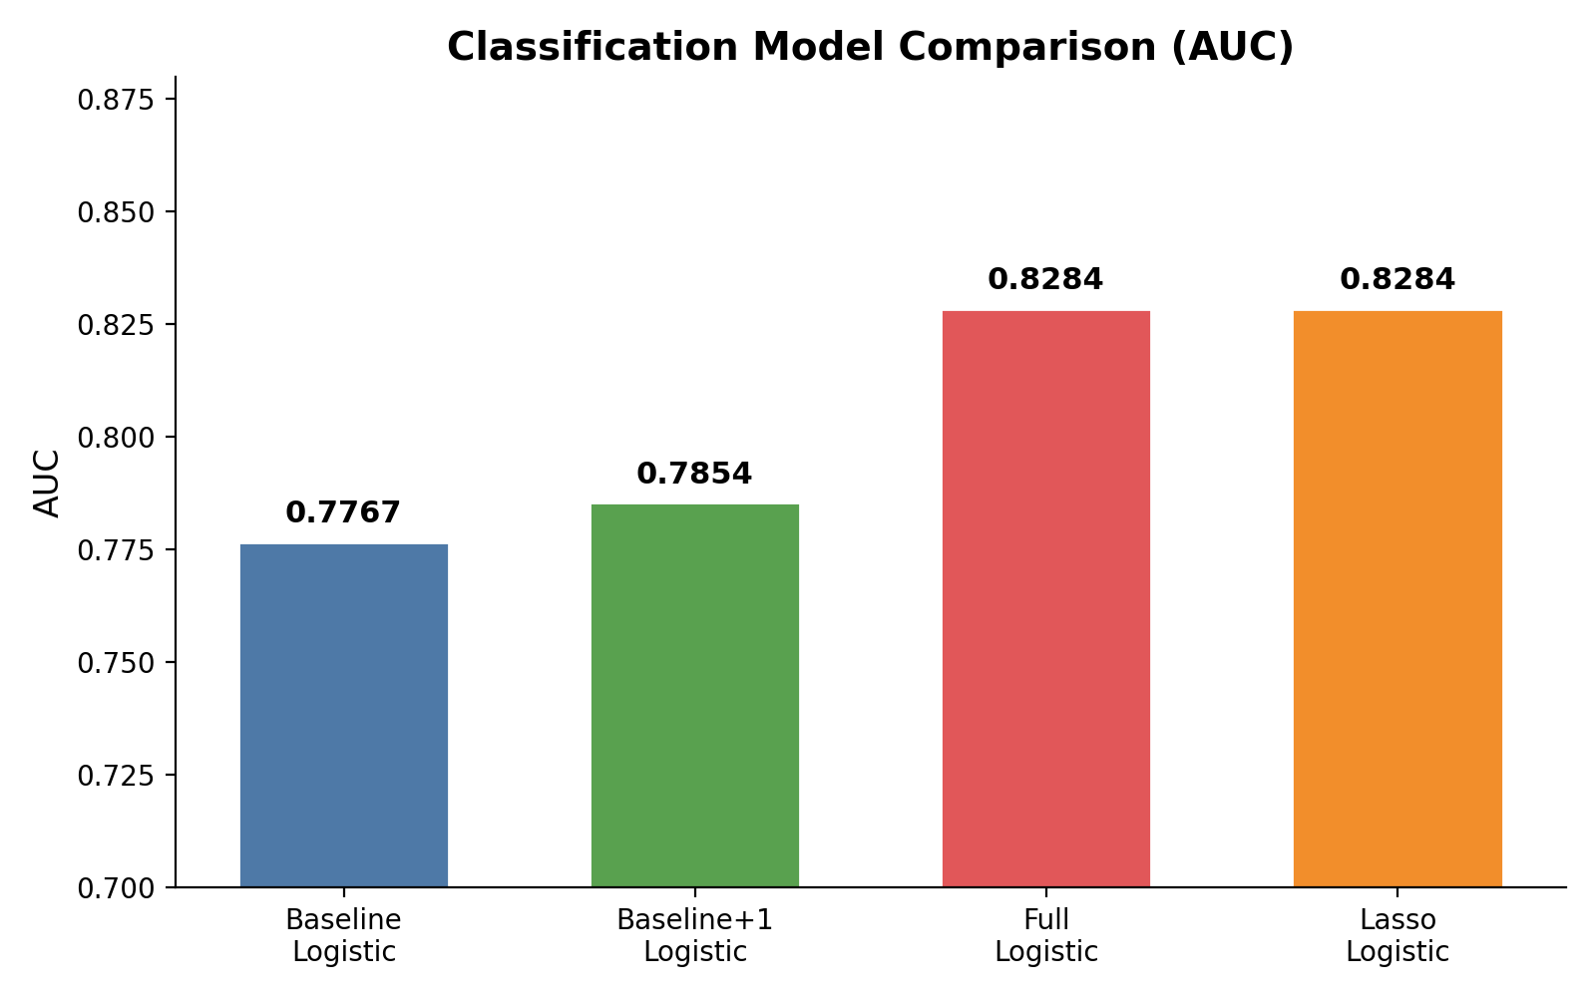
Classification Model Comparison
Interpretation
AUC jumped from 0.777 → 0.828 as more predictors were added
Lasso confirmed no overfitting (identical AUC to full model)
Biggest gain came from adding congestion, hour, and airline
All predictors significant at p < 0.05

Slide 15
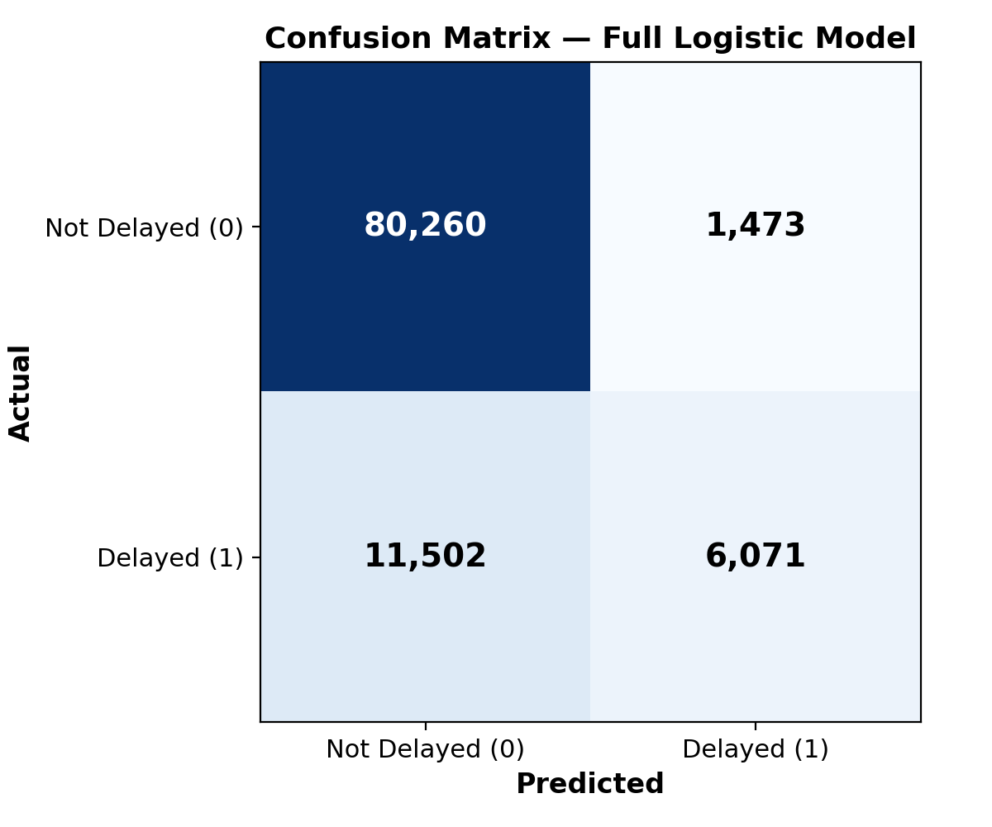
Confusion Matrix — Full Logistic Model
Key Metrics
Accuracy: 86.9%
Sensitivity (recall): 34.5% — catches about 1 in 3 actual delays
Specificity: 98.2% — excellent at identifying on-time flights
The model is conservative: it rarely falsely predicts a delay, but misses many actual delays due to class imbalance (82% vs 18%)

Slide 16
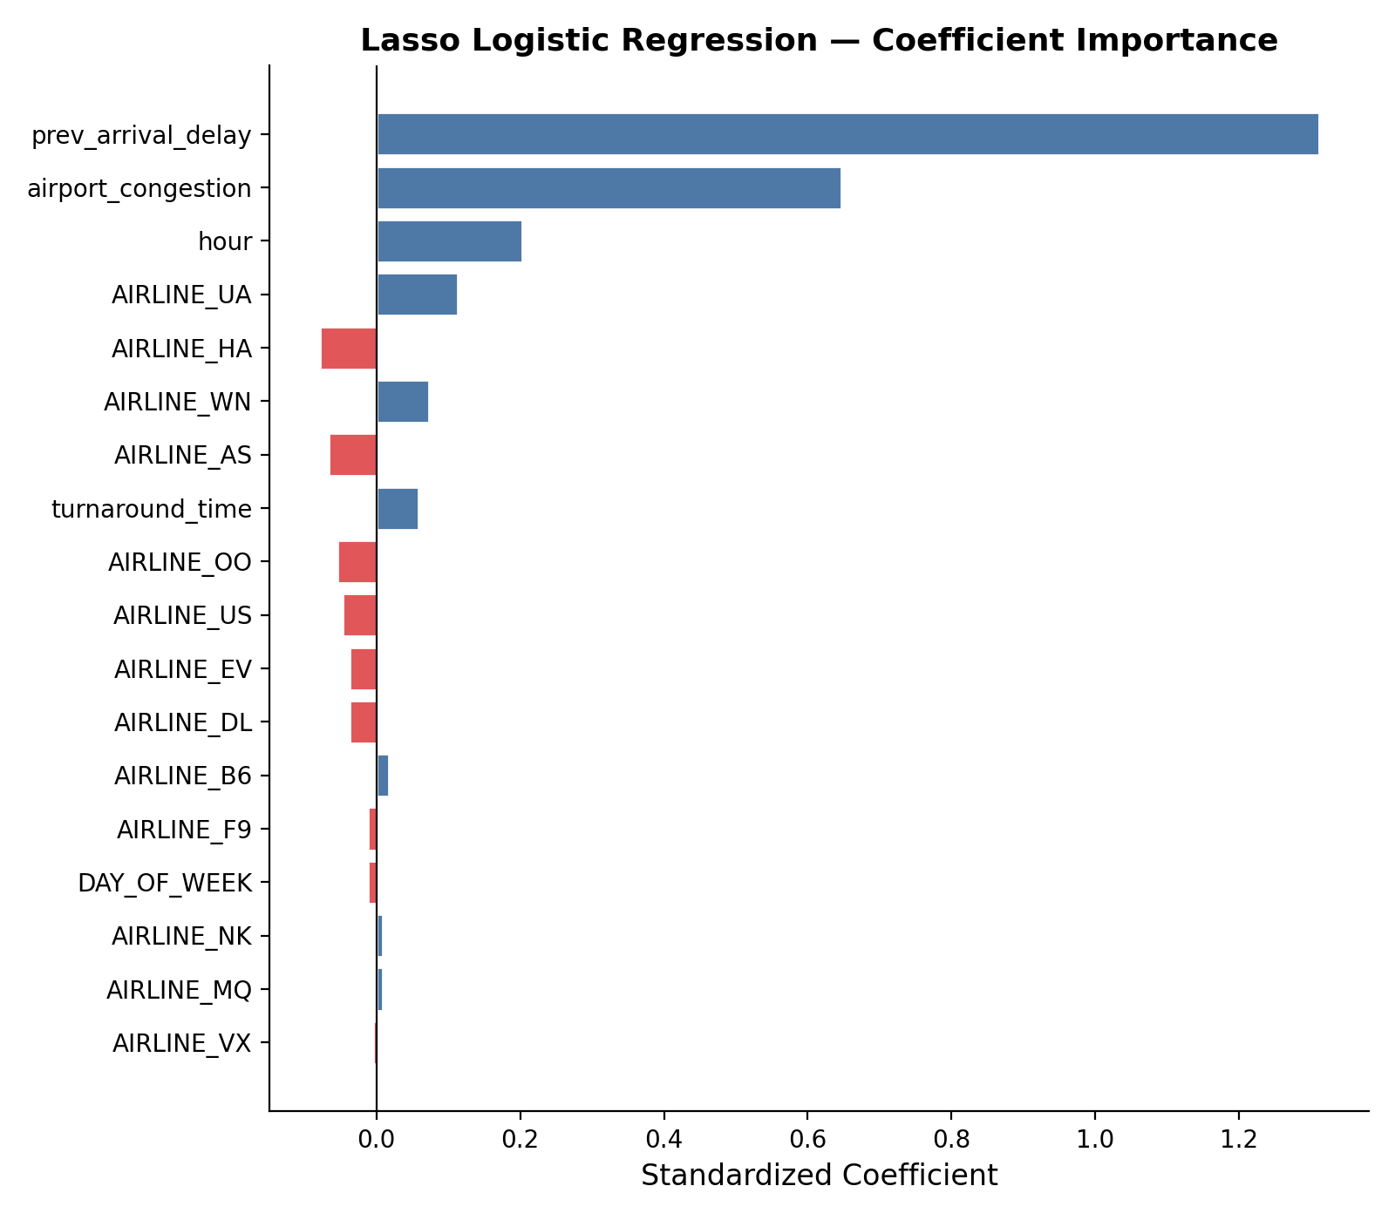
Which Predictors Matter Most?
Lasso Results
prev_arrival_delay is the dominant predictor by far
airport_congestion and hour are the next most important
No coefficients zeroed out — all features contribute
DAY_OF_WEEK near zero (-0.011), least important
United Airlines (UA) most delay-prone; Hawaiian (HA) least

Slide 17
Regression: Predicting Delay Minutes
OLS Coefficients
R² = 0.319
Linear regression explains ~32% of variation in delay minutes
Remaining 68% of variation reflects unmeasured factors (weather details, mechanical issues, crew scheduling)
RMSE = 28.1 min
Predictions are off by about half an hour on average
Predictor | Coefficient | p-value
prev_arrival_delay | 0.466 | <0.001
airport_congestion | 0.779 | <0.001
AIRLINE_UA | 4.385 | <0.001
hour | -0.030 | 0.004
turnaround_time | 0.001 | <0.001
Lasso zeroed out airlines B6, MQ, and VX
no additional explanatory power

Slide 18
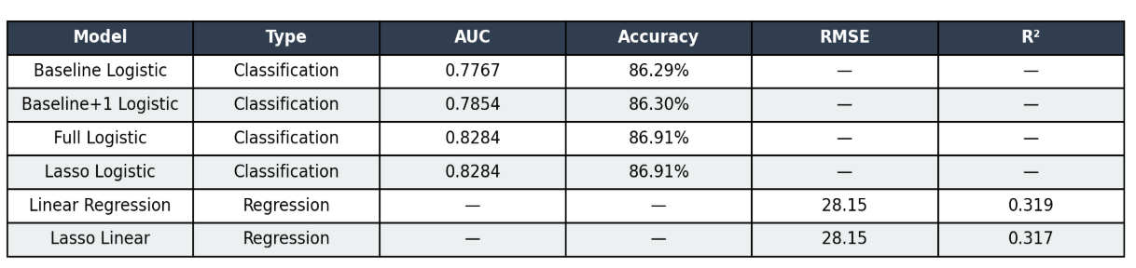
Model Performance Summary

Slide 19
Conclusions
Propagation is real and measurable
Flights following a delayed inbound aircraft have a 7× higher chance of being delayed themselves.
prev_arrival_delay is the strongest predictor
Both classification and regression models show it dominates all other features by a wide margin.
Full model achieves AUC of 0.830
Adding congestion, time-of-day, and airline significantly improved predictions over the baseline.
Challenges remain
32% R² in regression means most delay variation is still unexplained — better data (weather, crew, mechanical) could help.

Slide 20
Future Work
Incorporate granular weather data (METAR/ASOS) as additional features
Explore nonlinear methods (Random Forest, Gradient Boosting) to improve R²
Address class imbalance with SMOTE or adjusted thresholds
Extend to multi-hop propagation (3+ sequential flights)
Test on more recent data (post-COVID) to assess generalizability
Thank you!
Spencer Andries | Niaz Azeez | Kylie Breeding

