Slide 1

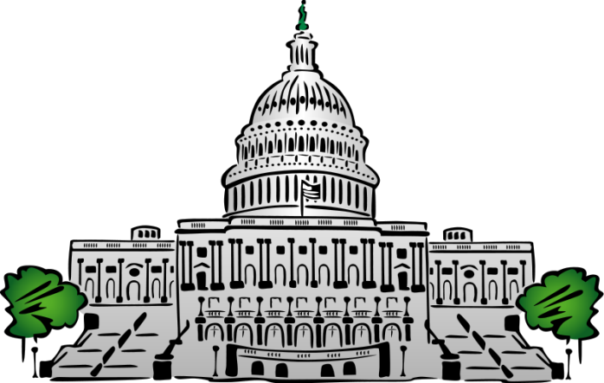
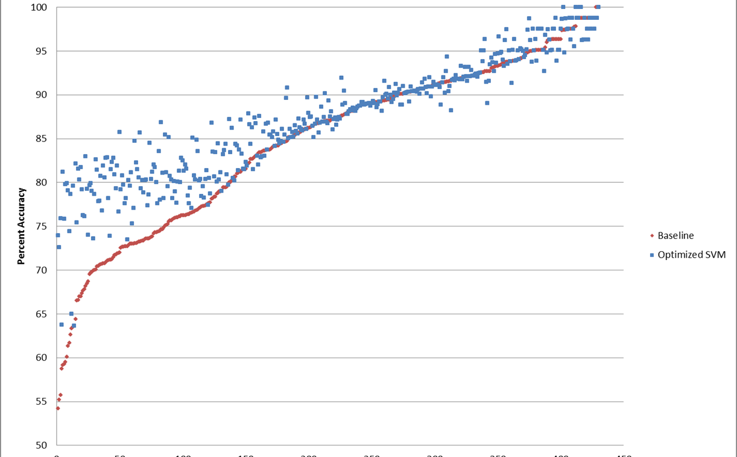
Vote Prediction in the House of Representatives
Jisha Kambo, John Oliver, Benjamin Shulman
Department of Computer Science, Cornell University
Introduction
Data Collection
Results
Conclusions
Bills passed by Congress may have huge effects on corporations and citizens.
Being able to predict outcome of votes could give corporations and citizens advanced warning.
Representative vote prediction could give insight into representatives’ actual beliefs and platforms.
It’s cool to predict political actions.
Previous work by Gerrish and Blei focused upon bill text.
Previous work extended the ideal point model from political science.
Limited scope to House of Representatives
Data was taken from www.govtrack.us
Pulled all current members of the House of Representatives
Pulled all votes made by each current member (200-3,500)
Pulled information for each bill
Features of SVM:
Party of bill sponsor
Name of bill sponsor
District of bill sponsor
Gender of bill sponsor
Date bill sponsor joined House of Representatives
Whether bill sponsor has Twitter
Whether bill sponsor has a website
Whether sponsor has a nickname
Length of time bill has been alive
Congressional Session
Year the bill was introduced
Day the bill was voted on
Month the bill was voted on
Year the bill was voted on
Year the bill was voted on mod 2
Year the bill was voted on mod 4
Year the bill was voted on mod 6
Name of sponsor feature was numerous features, each a binary feature corresponding to one bill sponsor in the task.
District of sponsor feature was numerous features, each a binary feature corresponding to one bill sponsor in the task.
Average test accuracy over all representatives for baseline: 80.80%
Average test accuracy over all representatives for optimized SVM: 84.62%
Range of test accuracies for baseline: [54.22%,100%]
Range of test accuracies for optimized SVM: [63.64%,100%]
Generally Optimized SVM performed better than baseline on a per representative basis.
Optimized SVM C values were predominantly C=0.1. A few instances of C=0.01 and C=0.05.
Representatives with lower baseline accuracy tended to have much higher accuracies with the optimized SVM.
When party sponsor is not a predominant factor for a representative, our optimized SVM captures other factors and performs well.
Each section represents the number of representatives satisfying the category label on the test set.
Future Work
Predict bill passage using sum of predicted votes, weighted by test set accuracy.
Run McNemar’s test on each representative’s optimized SVM against the baseline for each representative.
Consolidate McNemar’s tests to determine if optimized SVMs are likely better than baseline hypothesis.
Separate bills into categories using clustering on bill summaries.
Consider bill summary and bill categories as further features.
Consider bill summary and bill categories as isolated feature sets.
Accuracy of baseline compared to optimized SVM. Reps are sorted by increasing baseline accuracy.
A histogram of our data sets, showing distribution of size of sets.
Objectives
Methodology
Can we predict with high accuracy (above a baseline prediction) how a representative will vote on a given bill in Congress?
What feature of a bill is most important to a representative when deciding how to vote on a bill?
Can we predict whether a bill will pass using individual representatives’ predictions?
Individual prediction task for each representative
One SVM per representative
Each SVM trained and tested on its representative’s votes
SVM Optimization
Split train set into train and validate
Trained 5 different SVMs, C values of [0.0001, 0.001, 0.01, 0.05, 0.1]
Picked SVM with best validation accuracy
Compared each SVM against the baseline hypothesis.
Baseline Hypothesis: representative will vote along party lines
Vote yes (1) if party of rep = party of sponsor
Vote no (0) otherwise
References
Gerrish, S. M., & Blei, D. M. (2011). Predicting legislative roll calls from text. International Conference on Machine Learning
Acknowledgements
Cornell University
Thorsten Joachims
Igor Labutov
Govtrack.us
CS4780 Teaching Assistants and Consultants
Histogram showing frequency of representative accuracies in 2.5% bins.
Contact
Group ID: 12
Jisha Kambo: jk2228@cornell.edu
John Oliver: jro67@cornell.edu
Benjamin Shulman: bgs53@cornell.edu

