Slide 1

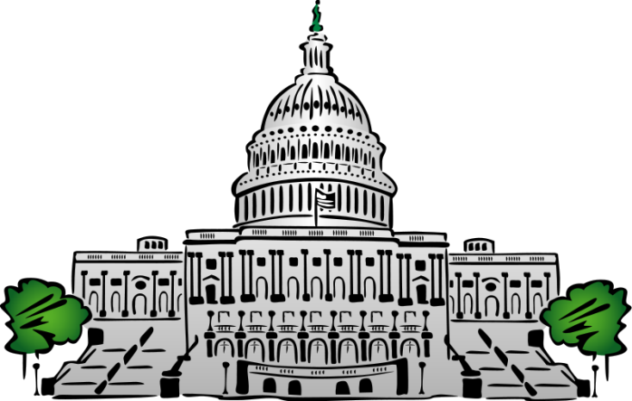
Vote Prediction in the House of Representatives
Jisha Kambo, John Oliver, Benjamin Shulman
Department of Computer Science, Cornell University
Introduction
Methodology and Data Collection
Results
Conclusion and Future Work
Bills passed by Congress may have huge effects on corporations and citizens.
Being able to predict outcome of votes could give corporations and citizens advanced warning.
Representative vote prediction could give insight into representatives’ actual beliefs and platforms.
Previous work by Gerrish and Blei focused upon bill text.
Previous work extended the ideal point model from political science.
Limited scope to House of Representatives
Data was taken from www.govtrack.us
Pulled all current members of the House of Representatives
Pulled all votes made by each current member (200-3,500)
Pulled information for each bill
Each representative wsa an individual prediction task
One SVM per representative
Each SVM trained and tested on it’s representative votes
Features of SVM:
Party of bill sponsor
Name of bill sponsor
District of bill sponsor
Gender of bill sponsor
Date bill sponsor joined House of Representatives
Whether bill sponsor has Twitter
Whether bill sponsor has a website
Whether sponsor has a nickname
Length of time bill has been alive
Congressional Session
Year the bill was introduced
Day the bill was voted on
Month the bill was voted on
Year the bill was voted on
Year the bill was voted on mod 2
Year the bill was voted on mod 4
Year the bill was voted on mod 6
Optimized each SVM from XXXXXXXXXXXXXX options.
Compared each SVM against the baseline hypothesis.
Baseline Hypothesis: representative will vote along party lines
Vote yes (1) if party of rep = party of sponsor
Vote no (0) otherwise
List of best SVMs. Graph of compared accuracies. Average accuracies
Run McNemar’s test on each representative’s optimized SVM against the baseline for each representative.
Consider bill summary and bill category as further features.
Objectives
References
Can we predict with high accuracy (above a baseline prediction) how a representative will vote on a given item in Congress?
What feature of a bill is most important to a representative when deciding how to vote on a bill?
Can we predict whether a bill will pass using individual representatives’ predictions?
PUT A GRAPHIC IN THIS COLUMN
Acknowledgements
PUT A GRAPHIC HERE
Cornell University
Thorsten Joachims
Igor Labutov
Govtrack.us
CS4780 Teaching Assistants and Consultants
Contact
Jisha Kambo: jk2228@cornell.edu
John Oliver: jro67@cornell.edu
Benjamin Shulman: bgs53@cornell.edu

