Slide 1
Reminders + Electromagnetic oscillations + Electromagnetic waves

Slide 2


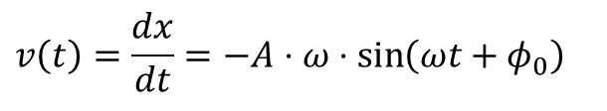




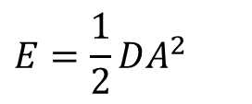

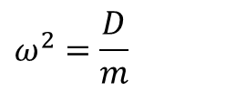
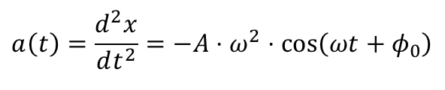
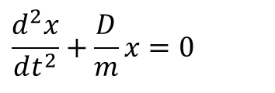
Reminder
Oscillation:
$$\underline{r}\left(t\right)=\underline{r}\left(t+T\right)$$
Simple Harmonic Oscillation:
$$x\left(t\right)=A\cos\left(ωt+φ_{0}\right)$$
or
$$x\left(t\right)=\operatorname{Re}\left[\hat{A}⋅e^{jωt}\right]$$
$$\hat{A}=A⋅e^{jφ_{0}}$$
$$v\left(t\right)=\frac{dx}{dt}=−A⋅ω⋅\sin\left(ωt+φ_{0}\right)$$
or
$$v\left(t\right)=\operatorname{Re}\left[jω⋅\hat{A}⋅e^{jωt}\right]$$
$$a\left(t\right)=\frac{d^{2}x}{dt^{2}}=−A⋅ω^{2}⋅\cos\left(ωt+φ_{0}\right)$$
or
$$a\left(t\right)=\operatorname{Re}\left[−ω^{2}⋅\hat{A}⋅e^{jωt}\right]$$
$$a\left(t\right)=−ω^{2}⋅x\left(t\right)$$
$$\frac{d^{2}x}{dt^{2}}+\frac{D}{m}x=0$$
$$ω^{2}=\frac{D}{m}$$
$$E=\frac{1}{2}DA^{2}$$

Slide 3
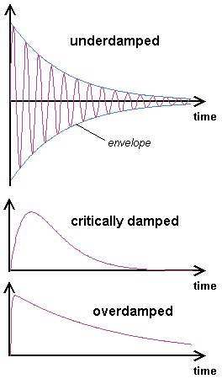


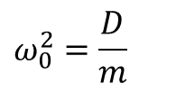

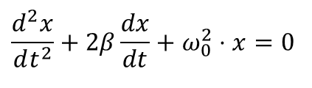


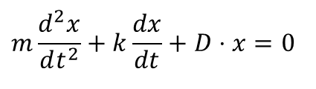

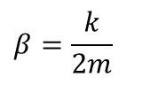

Damping:
$$m\frac{d^{2}x}{dt^{2}}+k\frac{dx}{dt}+D⋅x=0$$
$$ω_{0}^{2}=\frac{D}{m}$$
$$β=\frac{k}{2m}$$
$$\frac{d^{2}x}{dt^{2}}+2β\frac{dx}{dt}+ω_{0}^{2}⋅x=0$$
$$x=e^{λt}$$
$$λ_{1,2}=−β±j\sqrt{ω_{0}^{2}−β^{2}}$$
Solutions for the three cases:
$$x_{u}=A⋅e^{−βt}\cos\left(ωt\right)$$
$$ω=\sqrt{ω_{0}^{2}−β^{2}}$$
$$x_{c}=\left(A⋅t+B\right)⋅e^{−βt}$$
+ Ansatz:
$$x′=t⋅e^{λt}$$
$$x_{o}=A_{+}⋅e^{λ_{+}t}+A_{−}⋅e^{λ_{−}t}$$
Source of figures: http://www.elmer.unibas.ch/

Slide 4
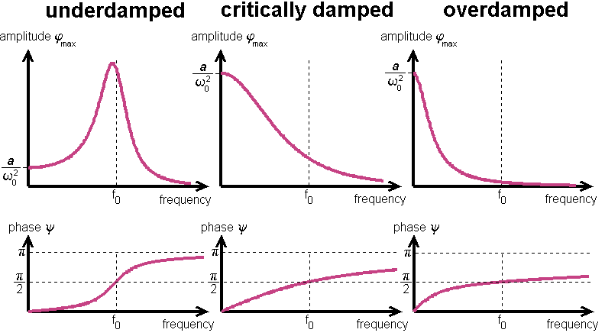

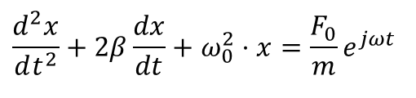
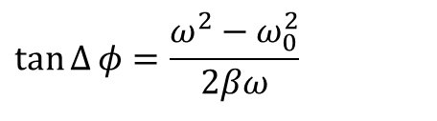
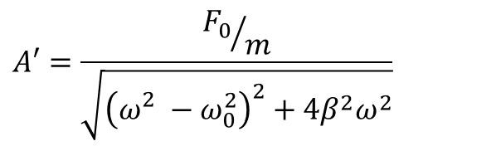
Reminder
Forced oscillacion:
$$A′=\frac{{F_{0}}/m}{\sqrt{{\left(ω_{}^{2}−ω_{0}^{2}\right)}^{2}+4β^{2}ω^{2}}}$$
$$\frac{d^{2}x}{dt^{2}}+2β\frac{dx}{dt}+ω_{0}^{2}⋅x=\frac{F_{0}}{m}e^{jωt}$$
$$x=A′⋅\cos\left(ωt−Δφ\right)$$
$$\tan{Δ}φ=\frac{ω^{2}−ω_{0}^{2}}{2βω}$$
Source of figures: http://www.elmer.unibas.ch/

Slide 5
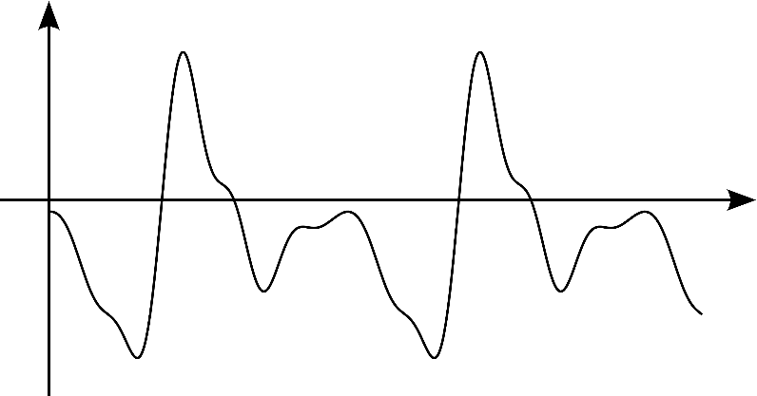
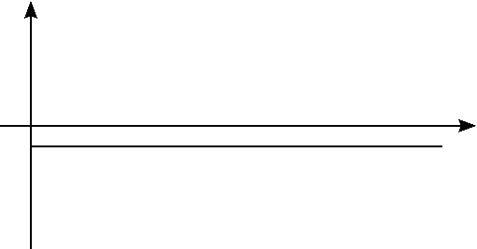
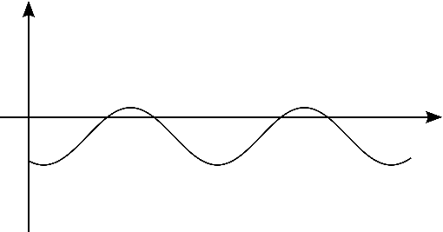
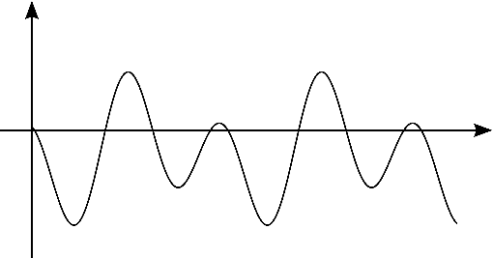
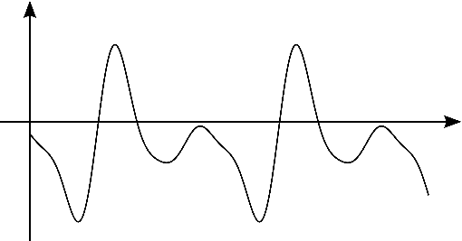
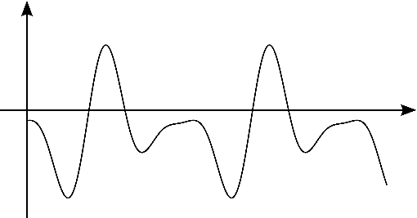
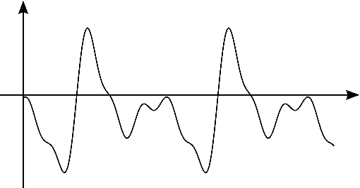
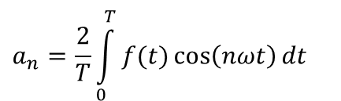
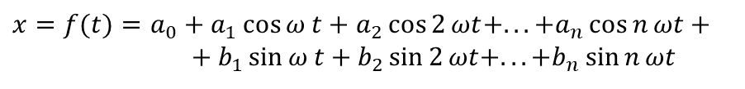
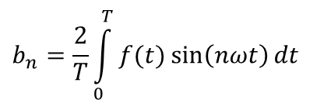
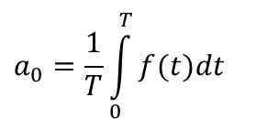
Reminder
$$x=f(t)=a_{0}+a_{1}\cos{ω}t+a_{2}\cos{2}ωt+...+a_{n}\cos{n}ωt+ \\ +b_{1}\sin{ω}t+b_{2}\sin{2}ωt+...+b_{n}\sin{n}ωt$$
$$a_{0}=\frac{1}{T}\int_{0}^{T}{f(t)dt}$$
$$a_{n}=\frac{2}{T}\int_{0}^{T}{f(t)\cos\left(nωt\right)dt}$$
$$b_{n}=\frac{2}{T}\int_{0}^{T}{f(t)\sin\left(nωt\right)dt}$$

Slide 6
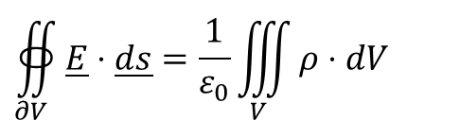
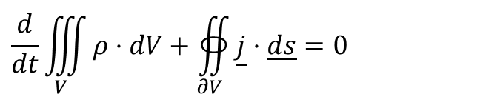
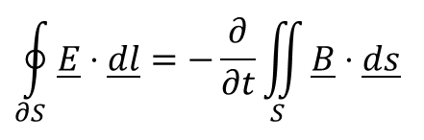
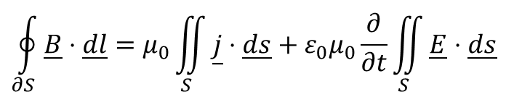

Reminder
$$∯_{∂V}{\underline{E}⋅\underline{ds}}=\frac{1}{ε_{0}}\iiint_{V}{ρ⋅dV}$$
Maxwell equations:
Continuity:
$$∯_{∂V}{\underline{B}⋅\underline{ds}}=0$$
$$\oint_{∂S}{\underline{E}⋅\underline{dl}}=−\frac{∂}{∂t}\iint_{S}{\underline{B}⋅\underline{ds}}$$
$$\oint_{∂S}{\underline{B}⋅\underline{dl}}=μ_{0}\iint_{S}{\underline{j}⋅\underline{ds}}+ε_{0}μ_{0}\frac{∂}{∂t}\iint_{S}{\underline{E}⋅\underline{ds}}$$
$$\frac{d}{dt}\iiint_{V}{ρ⋅dV}+∯_{∂V}{\underline{j}⋅\underline{ds}}=0$$

Slide 7
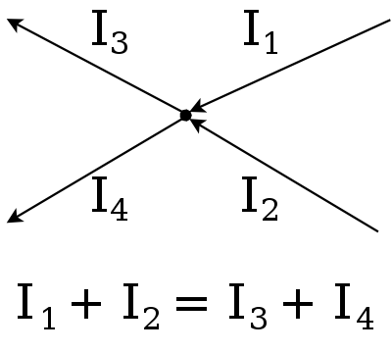
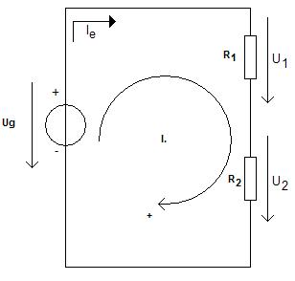


Reminder
Kirchoff I (from continuity):
Kirchoff II (from Maxwell III):
$$\frac{d}{dt}\int{ρ⋅dV}+∯_{S}{\underline{j}⋅\underline{ds}}=0 \\ \underset{0}{\underbrace{\frac{dQ}{dt}}}+\sum{i}=0 \\ \sum{i}=0$$
$$\oint{\underline{E}⋅\underline{dl}}=−\frac{d}{dt}\iint_{S}{\underline{B}⋅\underline{ds}}=0 \\ \oint{\underline{E}⋅\underline{dl}}=\sum{u_{i}}=0$$
Source of figures: http://www.wikipedia.org/

Slide 8
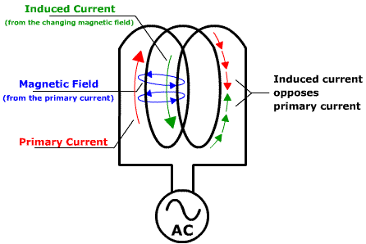

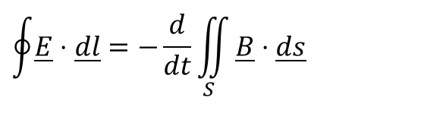

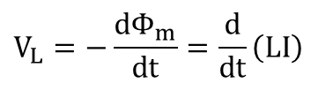
Reminder
Self-inductance:
$$\oint{\underline{E}⋅\underline{dl}}=−\frac{d}{dt}\iint_{S}{\underline{B}⋅\underline{ds}}$$
$$\oint{\underline{E}⋅\underline{\text{dl}}}=V_{L}$$
$$\iint_{S}{\underline{B}⋅\underline{\text{ds}}}=Φ_{m}=−\text{LI}$$
$$V_{L}=−\frac{\text{d}{\text{Φ}}_{m}}{\text{dt}}=\frac{d}{\text{dt}}\left(\text{LI}\right)$$
$$V_{L}=L\frac{\text{dI}}{\text{dt}}$$
Source of figure: http://www.ndt-ed.org/EducationResources/CommunityCollege/EddyCurrents/Physics/selfinductance.htm

Slide 9
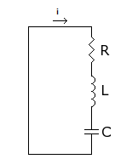
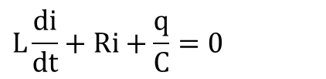

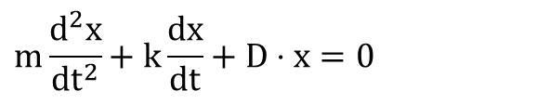
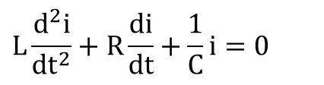
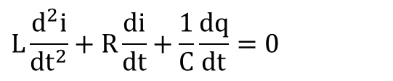
RLC circuit
$$V_{L}+V_{R}+V_{C}=0$$
$$L\frac{\text{di}}{\text{dt}}+\text{Ri}+\frac{q}{C}=0$$
$$L\frac{d^{2}i}{dt^{2}}+R\frac{di}{dt}+\frac{1}{C}\frac{dq}{dt}=0$$
$$L\frac{d^{2}i}{dt^{2}}+R\frac{di}{dt}+\frac{1}{C}i=0$$
$$m\frac{d^{2}x}{dt^{2}}+k\frac{dx}{dt}+D⋅x=0$$
L ↔ m
R ↔ k
1/C ↔ D
Source of figure: http://www.wikipedia.org/

Slide 10
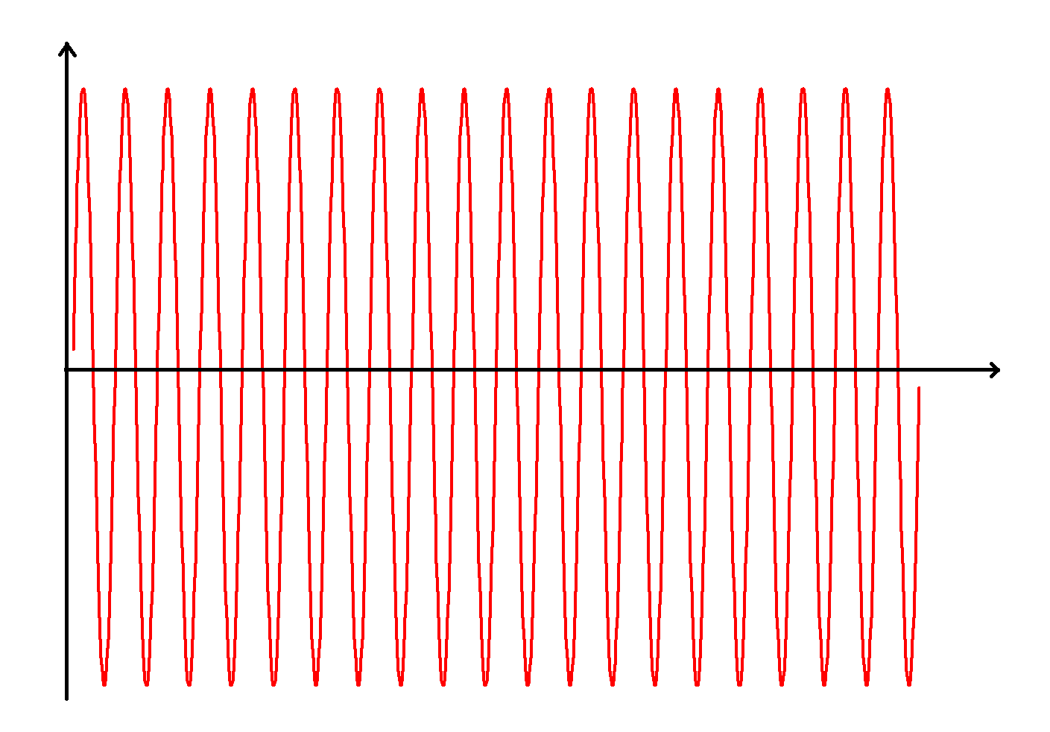
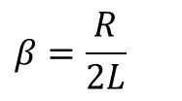

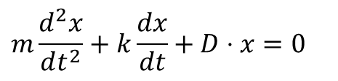
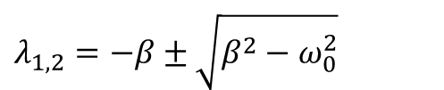
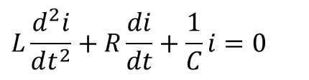

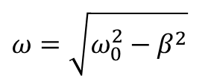


RLC circuit
$$L\frac{d^{2}i}{dt^{2}}+R\frac{di}{dt}+\frac{1}{C}i=0$$
$$m\frac{d^{2}x}{dt^{2}}+k\frac{dx}{dt}+D⋅x=0$$
L ↔ m
R ↔ k
1/C ↔ D
$$ω_{0}=\sqrt{\frac{1}{LC}}$$
$$i(t)=i_{0}\cos\left(ω_{0}t+φ\right)$$
$$i(t)=i_{0}⋅e^{−βt}⋅\cos\left(ωt+φ\right)$$
$$ω=\sqrt{ω_{0}^{2}−β^{2}}$$
$$β=\frac{R}{2L}$$
$$i(t)=i_{1}e^{λ_{1}t}+i_{2}e^{λ_{2}t}$$
$$λ_{1,2}=−β±\sqrt{β^{2}−ω_{0}^{2}}$$
Source of figures: http://www.wikipedia.org/
http://www.elmer.unibas.ch/

Slide 11





Forced oscillation
$$iR+L\frac{di}{dt}+\frac{Q}{C}=U_{0}\sin{ω}t$$
$$\dot{Q}\frac{R}{L}+\ddot{Q}+\frac{Q}{LC}=\frac{U_{0}}{L}\sin{ω}t$$
Inhomogeneous linear ordinary differential equation
Solution: general solution of the hom. eq. (damped oscillator)
+ 1 particular solution of the inhom. eq.
$$Q_{0}=\frac{{U_{0}}/L}{\sqrt{{\left(ω_{0}^{2}−ω^{2}\right)}^{2}+4β^{2}ω^{2}}}$$
$$tgφ=\frac{ωR/L}{ω_{0}^{2}−ω^{2}}$$
$$Q=Q_{0}e^{j\left(ωt+ρ\right)}$$

Slide 12


Resonance
Charge or voltage resonance
(Similar to the amplitude resonance of mechanical oscillators)
Current resonance
(Similar to the velocity resonance of mechanical oscillators)
$$ω_{qres}=\sqrt{ω_{0}^{2}−2β^{2}}$$
$$i=\dot{Q}=A⋅jω⋅e^{\left(jωt+φ\right)} \\ i=ωQe^{j\frac{π}{2}} \\ ω_{cres}=ω_{0}$$

Slide 13








$$v_{R}\left(t\right)=i_{R}\left(t\right)R ⟹ Z_{R}=\frac{v_{R}\left(t\right)}{i_{R}\left(t\right)}=R$$
$$q_{C}\left(t\right)=v_{C}\left(t\right)C$$
$$i_{C}\left(t\right)=\frac{{dq}_{C}\left(t\right)}{dt}=C\frac{dv_{C}\left(t\right)}{dt}$$
$$v_{C}\left(t\right)={\hat{v}}_{C} e^{jωt} ⟹ i_{C}\left(t\right)=C\frac{d{\hat{v}}_{C} e^{jωt}}{dt}=C{\hat{v}}_{C} \frac{de^{jωt}}{dt}=jωC{\hat{v}}_{C}e^{jωt}$$
$$Z_{C}=\frac{v_{c}\left(t\right)}{i_{c}\left(t\right)}=\frac{{\hat{v}}_{C} e^{jωt}}{jωC{\hat{v}}_{C}e^{jωt}}=\frac{1}{jωC}$$
$${\hat{v}}_{C}=v_{0}e^{jφ_{0}}$$
$$v_{L}\left(t\right)=L\frac{{di}_{L}\left(t\right)}{dt}$$
$$i_{L}\left(t\right)={\hat{i}}_{L} e^{jωt} ⟹ u_{L}\left(t\right)=L\frac{d{\hat{i}}_{L} e^{jωt}}{dt}=L{\hat{i}}_{L} \frac{de^{jωt}}{dt}=jωL{\hat{i}}_{L}e^{jωt}$$
$$Z_{L}=\frac{v_{L}\left(t\right)}{i_{L}\left(t\right)}=\frac{jωL{\hat{i}}_{L}e^{jωt}}{{\hat{i}}_{L} e^{jωt}}=jωL$$
$${\hat{i}}_{L}=i_{0}e^{jφ_{0}}$$

Slide 14










$$Im$$
$$Z_{L}=jωL$$
$$Z_{R}=R$$
$$Re$$
$$Im$$
$$Z_{R}=R$$
$$Re$$
$$Z_{C}=\frac{1}{jωC}$$

Slide 15





R
v_{in}
v_{out}
C
$$v_{out}=\frac{Z_{C}}{Z_{C}+Z_{R}}v_{in}=\frac{\frac{1}{jωC}}{\frac{1}{jωC}+R}v_{in}$$
$$v_{out}=\frac{1}{1+jωRC}v_{in}$$
$$f_{c}=\frac{1}{2πRC}$$

Slide 16



Waves
Bad definition: A transport of disturbance in space whithout the motion of the medium as a whole
What about standing waves?
What about electromagnetic waves in vacuum?
It transports energy and momentum without the transport of mass
Transverse and longitudinal waves
Periodic waves and shock waves
In general:
Folow a point of the wave:
$$y(x,t)=f(x±vt)$$
$$x−vt=const \\ \frac{dx}{dt}=v$$
Source of figure: Hudson-Nelson: Útban a modern fizikához

Slide 17






Sine Wave
$$y(x,t)=A⋅\sin{k}\left(x−vt\right)$$
Wavenumber:
$$k=\frac{2π}{λ}$$
$$y(x,t)=A⋅\sin\left(kx−\frac{2π}{λ}vt\right)$$
$$\frac{v}{λ}=\frac{1}{T}⇒\frac{2π}{λ}v=\frac{2π}{T}=ω$$
$$y(x,t)=A⋅\sin\left(kx−ωt\right)$$
Source of figures: www.wikipedia.org

Slide 18









Sine Wave
$$y(x,t)=A⋅\sin\left(kx−ωt\right)$$
$$\frac{∂y}{∂t}=−ωA⋅\cos\left(kx−ωt\right)$$
$$\frac{∂y}{∂x}=kA⋅\cos\left(kx−ωt\right)$$
$$\frac{∂^{2}y}{∂t^{2}}=−ω^{2}A⋅\sin\left(kx−ωt\right)$$
$$\frac{∂^{2}y}{∂x^{2}}=−k^{2}A⋅\sin\left(kx−ωt\right)$$
$$\frac{∂^{2}y}{∂t^{2}}={\left(\frac{ω}{k}\right)}^{2}\frac{∂^{2}y}{∂x^{2}}$$
$$\frac{ω}{k}=\frac{{2π}/T}{{2π}/λ}=\frac{λ}{T}=v$$
$$\frac{∂^{2}y}{∂t^{2}}=v^{2}\frac{∂^{2}y}{∂x^{2}}$$
$$\frac{∂^{2}y}{∂t^{2}}=\left(\frac{F}{μ}\right)\frac{∂^{2}y}{∂x^{2}}$$
Transverse wave on a string:

Slide 19
Reminder
$$∯_{∂V}{\underline{E}⋅\underline{ds}}=\frac{1}{ε_{0}}\iiint_{V}{ρ⋅dV}$$
Maxwell equations:
Continuity:
$$∯_{∂V}{\underline{B}⋅\underline{ds}}=0$$
$$\oint_{∂S}{\underline{E}⋅\underline{dl}}=−\frac{∂}{∂t}\iint_{S}{\underline{B}⋅\underline{ds}}$$
$$\oint_{∂S}{\underline{B}⋅\underline{dl}}=μ_{0}\iint_{S}{\underline{j}⋅\underline{ds}}+ε_{0}μ_{0}\frac{∂}{∂t}\iint_{S}{\underline{E}⋅\underline{ds}}$$
$$\frac{d}{dt}\iiint_{V}{ρ⋅dV}+∯_{∂V}{\underline{j}⋅\underline{ds}}=0$$

Slide 20







$$∇ =\left(\frac{∂}{∂x},\frac{∂}{∂y},\frac{∂}{∂z}\right)$$
$$gard a=∇a=\left(\frac{∂}{∂x},\frac{∂}{∂y},\frac{∂}{∂z}\right)a=\left(\frac{∂a}{∂x},\frac{∂a}{∂y},\frac{∂a}{∂z}\right)$$
$$div \underline{v}=∇·\underline{v}=\left(\frac{∂}{∂x},\frac{∂}{∂y},\frac{∂}{∂z}\right)·\left(v_{x},v_{z},v_{z}\right)=\frac{∂v_{x}}{∂x}+\frac{∂v_{y}}{∂y}+\frac{∂v_{z}}{∂z}$$
$$rot \underline{v}=∇×\underline{v}=\left(\frac{∂}{∂x},\frac{∂}{∂y},\frac{∂}{∂z}\right)×\left(v_{x},v_{z},v_{z}\right)=\left|\begin{matrix}\underline{i} & \underline{j} & \underline{k} \\ \frac{∂}{∂x} & \frac{∂}{∂y} & \frac{∂}{∂z} \\ v_{x} & v_{y} & v_{z}\end{matrix}\right|=$$
$$=\left(\frac{∂v_{z}}{∂y}−\frac{∂v_{y}}{∂z},\frac{∂v_{x}}{∂z}−\frac{∂v_{z}}{∂x},\frac{∂v_{y}}{∂x}−\frac{∂v_{x}}{∂y}\right)$$
$$∆ =∇·∇ =\frac{∂^{2}}{∂x^{2}}+\frac{∂^{2}}{∂y^{2}}+\frac{∂^{2}}{∂z^{2}}$$
$$rot\left(rot \underline{v}\right) =grad\left(div \underline{v}\right) − ∆ \underline{v}$$

Slide 21

Source of figure: wikipedia https://en.wikipedia.org/wiki/File:Gradient2.svg

Slide 22
$$∇ =\left(\frac{∂}{∂x},\frac{∂}{∂y},\frac{∂}{∂z}\right)$$
$$gard a=∇a=\left(\frac{∂}{∂x},\frac{∂}{∂y},\frac{∂}{∂z}\right)a=\left(\frac{∂a}{∂x},\frac{∂a}{∂y},\frac{∂a}{∂z}\right)$$
$$div \underline{v}=∇·\underline{v}=\left(\frac{∂}{∂x},\frac{∂}{∂y},\frac{∂}{∂z}\right)·\left(v_{x},v_{z},v_{z}\right)=\frac{∂v_{x}}{∂x}+\frac{∂v_{y}}{∂y}+\frac{∂v_{z}}{∂z}$$
$$rot \underline{v}=∇×\underline{v}=\left(\frac{∂}{∂x},\frac{∂}{∂y},\frac{∂}{∂z}\right)×\left(v_{x},v_{z},v_{z}\right)=\left|\begin{matrix}\underline{i} & \underline{j} & \underline{k} \\ \frac{∂}{∂x} & \frac{∂}{∂y} & \frac{∂}{∂z} \\ v_{x} & v_{y} & v_{z}\end{matrix}\right|=$$
$$=\left(\frac{∂v_{z}}{∂y}−\frac{∂v_{y}}{∂z},\frac{∂v_{x}}{∂z}−\frac{∂v_{z}}{∂x},\frac{∂v_{y}}{∂x}−\frac{∂v_{x}}{∂y}\right)$$
$$∆ =∇·∇ =\frac{∂^{2}}{∂x^{2}}+\frac{∂^{2}}{∂y^{2}}+\frac{∂^{2}}{∂z^{2}}$$
$$rot\left(rot \underline{v}\right) =grad\left(div \underline{v}\right) − ∆ \underline{v}$$

Slide 23

+
-
Source of figure: wikipedia https://en.wikipedia.org/wiki/File:Divergence_(captions).svg

Slide 24
$$∇ =\left(\frac{∂}{∂x},\frac{∂}{∂y},\frac{∂}{∂z}\right)$$
$$gard a=∇a=\left(\frac{∂}{∂x},\frac{∂}{∂y},\frac{∂}{∂z}\right)a=\left(\frac{∂a}{∂x},\frac{∂a}{∂y},\frac{∂a}{∂z}\right)$$
$$div \underline{v}=∇·\underline{v}=\left(\frac{∂}{∂x},\frac{∂}{∂y},\frac{∂}{∂z}\right)·\left(v_{x},v_{z},v_{z}\right)=\frac{∂v_{x}}{∂x}+\frac{∂v_{y}}{∂y}+\frac{∂v_{z}}{∂z}$$
$$rot \underline{v}=∇×\underline{v}=\left(\frac{∂}{∂x},\frac{∂}{∂y},\frac{∂}{∂z}\right)×\left(v_{x},v_{z},v_{z}\right)=\left|\begin{matrix}\underline{i} & \underline{j} & \underline{k} \\ \frac{∂}{∂x} & \frac{∂}{∂y} & \frac{∂}{∂z} \\ v_{x} & v_{y} & v_{z}\end{matrix}\right|=$$
$$=\left(\frac{∂v_{z}}{∂y}−\frac{∂v_{y}}{∂z},\frac{∂v_{x}}{∂z}−\frac{∂v_{z}}{∂x},\frac{∂v_{y}}{∂x}−\frac{∂v_{x}}{∂y}\right)$$
$$∆ =∇·∇ =\frac{∂^{2}}{∂x^{2}}+\frac{∂^{2}}{∂y^{2}}+\frac{∂^{2}}{∂z^{2}}$$
$$rot\left(rot \underline{v}\right) =grad\left(div \underline{v}\right) − ∆ \underline{v}$$

Slide 25

Source of figure: wikipedia https://en.wikipedia.org/wiki/File:Uniform_curl.svg

Slide 26

Source of figure: High order gradient, curl and divergence conforming spaces, with an application to NURBS-based IsoGeometric Analysis
R. Hiemstra, R. Huijsmans, M. Gerritsma, Published 9 September 2012, Mathematics, arXiv: Numerical Analysis https://arxiv.org/pdf/1209.1793.pdf

Slide 27






The differential form of Maxwell Equations
$$∯_{S}{\underline{E}⋅\underline{ds}}=\frac{1}{ε_{0}}\int{ρ⋅dV}$$
$$div\underline{E}=\frac{1}{ε_{0}}ρ$$
$$∯_{S}{\underline{E}⋅\underline{ds}}=\int{div\underline{E}⋅dV}$$
$$∯_{S}{\underline{B}⋅\underline{ds}}=0$$
$$div\underline{B}=0$$
$$∯_{S}{\underline{B}⋅\underline{ds}}=\int{div\underline{B}⋅dV}$$

Slide 28






The differential form of Maxwell Equations
$$\oint{\underline{B}⋅\underline{dl}}=μ_{0}\iint_{S}{\underline{j}⋅\underline{ds}}+μ_{0}ε_{0}\frac{d}{dt}\iint_{S}{\underline{E}⋅\underline{ds}}$$
$$rot\underline{B}=μ_{0}\underline{j}+μ_{0}ε_{0}\frac{∂\underline{E}}{∂t}$$
$$\oint{\underline{B}⋅\underline{dl}}=\iint_{S}{rot\underline{B}⋅\underline{ds}}$$
$$\oint{\underline{E}⋅\underline{dl}}=−\frac{d}{dt}\iint_{S}{\underline{B}⋅\underline{ds}}$$
$$rot\underline{E}=−\frac{∂\underline{B}}{∂t}$$
$$\oint{\underline{E}⋅\underline{dl}}=\iint_{S}{rot\underline{E}⋅\underline{ds}}$$

Slide 29








The differential form of Maxwell Equations
$$∯_{∂V}{\underline{E}⋅\underline{ds}}=\frac{1}{ε_{0}}\iiint_{V}{ρ⋅dV}$$
$$div\underline{E}=\frac{1}{ε_{0}}ρ$$
$$∯_{∂V}{\underline{B}⋅\underline{ds}}=0$$
$$div\underline{B}=0$$
$$\oint_{∂S}{\underline{E}⋅\underline{dl}}=−\frac{∂}{∂t}\iint_{S}{\underline{B}⋅\underline{ds}}$$
$$rot\underline{E}=−\frac{∂\underline{B}}{∂t}$$
$$\oint_{∂S}{\underline{B}⋅\underline{dl}}=μ_{0}\iint_{S}{\underline{j}⋅\underline{ds}}+ε_{0}μ_{0}\frac{∂}{∂t}\iint_{S}{\underline{E}⋅\underline{ds}}$$
$$rot\underline{B}=μ_{0}\underline{j}+ε_{0}μ_{0}\frac{∂\underline{E}}{∂t}$$

Slide 30





Electromagnetic Waves
$$rot\underline{E}=−\frac{∂\underline{B}}{∂t}$$
$$rot\underline{B}=ε_{0}μ_{0}\frac{∂\underline{E}}{∂t}$$
$$\text{rot}\left(\text{rot}\left(\underline{E}\right)\right)=\text{rot}\left(−\frac{∂\underline{B}}{∂t}\right)=−\frac{∂}{∂t}\left(\text{rot}\left(\underline{B}\right)\right)=−ε_{0}μ_{0}\frac{∂^{2}\underline{E}}{∂t^{2}}$$
$$rot\left(rot\left(\underline{E}\right)\right)=grad\left(div\left(\underline{E}\right)\right)−Δ\underline{E}$$
$$grad\left(div\left(\underline{E}\right)\right)−Δ\underline{E}=−ε_{0}μ_{0}\frac{∂^{2}\underline{E}}{∂t^{2}}$$
$$Δ\underline{E}=με\frac{∂^{2}\underline{E}}{∂t^{2}}$$

Slide 31
Reminder
$$∯_{∂V}{\underline{E}⋅\underline{ds}}=\frac{1}{ε_{0}}\iiint_{V}{ρ⋅dV}$$
Maxwell equations:
Continuity:
$$∯_{∂V}{\underline{B}⋅\underline{ds}}=0$$
$$\oint_{∂S}{\underline{E}⋅\underline{dl}}=−\frac{∂}{∂t}\iint_{S}{\underline{B}⋅\underline{ds}}$$
$$\oint_{∂S}{\underline{B}⋅\underline{dl}}=μ_{0}\iint_{S}{\underline{j}⋅\underline{ds}}+ε_{0}μ_{0}\frac{∂}{∂t}\iint_{S}{\underline{E}⋅\underline{ds}}$$
$$\frac{d}{dt}\iiint_{V}{ρ⋅dV}+∯_{∂V}{\underline{j}⋅\underline{ds}}=0$$

Slide 32








Electromagnetic Waves
$$\oint{B⋅\underline{dl}}=B_{z}\left(x\right)L+0−B_{z}\left(x+Δx\right)L+0$$
$$\oint{B⋅\underline{dl}}=μ_{0}ε_{0}\frac{d}{dt}\iint_{S}{\underline{E}⋅\underline{ds}}$$
$$μ_{0}ε_{0}\frac{∂}{∂t}\iint_{S}{\underline{E}⋅\underline{ds}}=μ_{0}ε_{0}\frac{∂\left(AE_{y}\right)}{∂t}=μ_{0}ε_{0}LΔx\frac{∂E_{y}}{∂t}$$
$$B_{z}\left(x\right)L−B_{z}\left(x+Δx\right)L=μ_{0}ε_{0}LΔx\frac{∂E_{y}}{∂t}$$
$$\lim{\frac{B_{z}\left(x+Δx\right)−B_{z}\left(x\right)}{Δx}}=−μ_{0}ε_{0}\frac{∂E_{y}}{∂t}$$
$$\frac{∂B_{z}}{∂x}=−μ_{0}ε_{0}\frac{∂E_{y}}{∂t}$$
Source of figures: Hudson-Nelson: Útban a modern fizikához

Slide 33








Electromagnetic Waves
$$\oint{B⋅\underline{dl}}=μ_{0}ε_{0}\frac{d}{dt}\iint_{S}{\underline{E}⋅\underline{ds}}$$
$$\oint{E⋅\underline{dl}}=−\frac{d}{dt}\iint_{S}{\underline{B}⋅\underline{ds}}$$
$$\frac{∂B_{z}}{∂x}=−μ_{0}ε_{0}\frac{∂E_{y}}{∂t}$$
$$\frac{∂E_{y}}{∂x}=−\frac{∂B_{z}}{∂t}$$
$$\frac{∂^{2}B_{z}}{∂x^{2}}=−μ_{0}ε_{0}\frac{∂^{2}E_{y}}{∂t∂x}$$
$$\frac{∂^{2}E_{y}}{∂t∂x}=−\frac{∂^{2}B_{z}}{∂t^{2}}$$
$$\frac{∂^{2}B_{z}}{∂x^{2}}=μ_{0}ε_{0}\frac{∂^{2}B_{z}}{∂t^{2}}$$
$$\frac{∂^{2}E_{y}}{∂x^{2}}=μ_{0}ε_{0}\frac{∂^{2}E_{y}}{∂t^{2}}$$

Slide 34










Electromagnetic Waves
$$\frac{∂^{2}B_{z}}{∂x^{2}}=μ_{0}ε_{0}\frac{∂^{2}B_{z}}{∂t^{2}}$$
$$B_{z}=B_{0}\text{sin}\left(\text{kx}−\text{ωt}\right)$$
$$k=\frac{2π}{λ}$$
$$ω=\frac{2π}{T}$$
$$v=\frac{λ}{T}=\frac{λ}{2π}⋅\frac{2π}{T}=\frac{ω}{k}$$
$$\frac{∂^{2}B_{z}}{∂x^{2}}=−k^{2}B_{0}\sin\left(kx−ωt\right)$$
$$k^{2}B_{0}\sin\left(kx−ωt\right)=μ_{0}ε_{0}ω^{2}B_{0}\sin\left(kx−ωt\right)$$
$$\frac{∂^{2}B_{z}}{∂t^{2}}=−ω^{2}B_{0}\sin\left(kx−ωt\right)$$
$$\frac{ω^{2}}{k^{2}}=\frac{1}{μ_{0}ε_{0}}$$
$$v=\frac{ω}{k}=\frac{1}{\sqrt{μ_{0}ε_{0}}}$$
Source of figure: http://www.phys.ttu.edu/~huang24/Teaching/Phys2401/

Slide 35



Electromagnetic Waves
Source of figures: Hudson-Nelson: Útban a modern fizikához

Slide 36

The electromagnetic spectrum
Source of figure: http://www.phys.ttu.edu/~huang24/Teaching/Phys2401/

Slide 37











Direction of E and B
$$\underline{E}={\underline{E}}_{0}e^{j\left(\underline{k}⋅\underline{r}−ωt\right)}$$
$$\underline{B}={\underline{B}}_{0}e^{j\left(\underline{k}⋅\underline{r}−ωt\right)}$$
$$rot\underline{E}=∇×\underline{E}=−\frac{∂\underline{B}}{∂t}$$
$$rot\underline{B}=∇×\underline{B}=μ_{0}ε_{0}\frac{∂\underline{E}}{∂t}$$
$$j\underline{k}×\underline{E}=jω\underline{B}$$
$$j\underline{k}×\underline{B}=μ_{0}ε_{0}jω\underline{E}$$
$$\underline{B}=\frac{1}{ω}\underline{k}×\underline{E}$$
$$\underline{E}=\frac{1}{μ_{0}ε_{0}}\frac{1}{ω}\underline{k}×\underline{B}$$
$$\left|\frac{1}{ω}\underline{k}\right|=\frac{1}{c}$$
$$\frac{1}{μ_{0}ε_{0}} \left|\frac{1}{ω}\underline{k}\right|=c^{2}\frac{1}{c}=c$$
Only in free space and isotropic medium
Source of figure: http://www.wepapers.com/Papers/9867/10-_Polarization%3B_Energy%2FPoynting%27s_Vector%3 B_Reflection_and_Refraction_at_a_Dielectric_Interface

Slide 38






Superposition of two SHM Different direction: Lissajous figures
$$x(t)=A⋅\cos\left(ω_{1}t+φ_{1}\right)$$
$$y(t)=B⋅\cos\left(ω_{2}t+φ_{2}\right)$$
Same frequency, Δφ=0
$$y(t)=\frac{B}{A}x(t)$$
Same frequency, Δφ=π
$$y(t)=−\frac{B}{A}x(t)$$
Same frequency, Δφ=±π/2
$$\frac{x^{2}\left(t\right)}{A^{2}}+\frac{y^{2}\left(t\right)}{B^{2}}=1$$
Source of figure: Alonso-Finn:Fundamental University Physics

Slide 39



Polarization
Linear
Circular
Elliptical
Source of figures: www.wikipedia.org

Slide 40
Poynting vector
$$u_{E}=\frac{1}{2}ε_{0}E^{2}$$
$$u_{B}=\frac{1}{2μ_{0}}B^{2}$$
$$ΔU=ΔU_{E}+ΔU_{B}$$
$$ΔU=\frac{1}{2}L^{2}Δx\left(ε_{0}E_{y}^{2}+\frac{1}{μ_{0}}B_{z}^{2}\right)$$
$$E_{y}=cB_{z}$$
$$ΔU=\frac{1}{2}L^{2}Δx\left(ε_{0}cE_{y}B_{z}+\frac{1}{μ_{0}c}E_{y}B_{z}\right)=\frac{1}{2}L^{2}\frac{Δx}{c}E_{y}B_{z}\left(ε_{0}c^{2}+\frac{1}{μ_{0}}\right)$$
$$ΔU=L^{2}\frac{Δx}{c}E_{y}B_{z}\left(\frac{1}{μ_{0}}\right)$$
$$S=\frac{ΔU}{L^{2}Δt}=\frac{1}{μ_{0}}E_{y}B_{z}$$
$$\underline{S}=\frac{1}{μ_{0}}\underline{E}×\underline{B}$$
Source of figure: Hudson-Nelson: Útban a modern fizikához

Slide 41
Pressure
$$\underline{E}=\left[E_{0}\sin\left(ωt\right)\right]{\underline{u}}_{y}$$
$$\underline{B}=\left[B_{0}\sin\left(ωt\right)\right]{\underline{u}}_{z}$$
$${\underline{F}}_{E}=\left[−eE_{0}\sin\left(ωt\right)\right]{\underline{u}}_{y}$$
$${\underline{v}}_{d}=−\left[\frac{eE_{0}}{b}\sin\left(ωt\right)\right]{\underline{u}}_{y}$$
$${\underline{F}}_{E}=b{\underline{v}}_{d}$$
$${\underline{F}}_{B}=−e\left({\underline{v}}_{d}×\underline{B}\right)=−e\left[−\frac{eE_{0}}{b}\sin\left(ωt\right)\right]{\underline{u}}_{y}×\left[B_{0}\sin\left(ωt\right)\right]{\underline{u}}_{z}$$
$${\underline{F}}_{B}=\left[\frac{e^{2}E_{0}B_{0}}{b}\sin^{2}\left(ωt\right)\right]{\underline{u}}_{x}$$

Slide 42
Pressure
$${\underline{v}}_{d}=−\left[\frac{eE_{0}}{b}\sin\left(ωt\right)\right]{\underline{u}}_{y}$$
$${\underline{F}}_{E}=\left[−eE_{0}\sin\left(ωt\right)\right]{\underline{u}}_{y}$$
$$\frac{dU}{dt}={\underline{F}}_{E}⋅{\underline{v}}_{d}$$
$$\frac{dU}{dt}=\left[−eE_{0}\sin\left(ωt\right)\right]{\underline{u}}_{y}⋅\left[−\frac{eE_{0}}{b}\sin\left(ωt\right)\right]{\underline{u}}_{y}=\frac{e^{2}E_{0}^{2}}{b}\sin^{2}\left(ωt\right)$$
$$\frac{\text{dU}}{\text{dt}}=c\frac{e^{2}E_{0}B_{0}}{b}\text{si}{\text{n}}^{2}\left(\text{ωt}\right)=\text{c}{\text{F}}_{B}=c\frac{\text{dp}}{\text{dt}}$$
$$\int_{0}^{U}{\frac{dU}{dt}}=c\int_{0}^{p}{\frac{dp}{dt}}$$
$$U=cp$$
$$F=\frac{1}{c}\frac{dU}{dt}$$
$$P_{abs}=\frac{S}{c}$$
$$P_{refl}=\frac{2S}{c}$$

Slide 43
Crookes radiometer
It is NOT rotated by light pressure!!!

